Slide 1
Preparing for destiny - Angelic
It is time to pray that the lid comes off and to call forth my angels who are waiting to start gathering and removing stumbling blocks both within and without
Call forth the gathering angels. The lids are coming off the sewers, the secret and hidden things of the heart are about to be exposed. All I ask is for the willingness to submit to the fire that will refine, purify and prepare you for true holiness

Slide 2
Preparing for destiny - Angelic
This is the year for the angels and the angelic realm to be revealed to you as a church
The seraphim are coming in force the Cashmalim are already released and the breakthrough angels have their assignments
You must embrace the angels that gather and the hunter angels you must send out to accompany you into the highways and byways

Slide 3
Preparing for destiny - Angelic
741 AD judgment church no names angels mention other than Michael & Gabriel – fear still operating
Psa 8:⁴ What is man that You take thought of him, And the son of man that You care for him? ⁵ Yet You have made him a little lower than God, And You crown him with glory and majesty! ⁶ You make him to rule over the works of Your hands; You have put all things under his feet
Heb 2:7 “ YOU HAVE MADE HIM FOR A LITTLE WHILE LOWER THAN THE ANGELS;
Angels higher than unregenerate man
Angels lower than original creation & recreation

Slide 4
Preparing for destiny - Angelic
Fallen Angels Gen 6, Jude Ezek 28
Col 1:16 For by Him all things were created, both in the heavens and on earth, visible and invisible, whether thrones or dominions or rulers or authorities - all things have been created through Him and for Him.
Eph 6:12 For our struggle is not against flesh and blood, but against the rulers, against the powers, against the world forces of this darkness, against the spiritual forces of wickedness in the heavenly places.

Slide 5
Preparing for destiny - Angelic
283 references 107 Old 176 New
1000+ references include names etc.
The term “angel” is derived from the Greek word angelos which means “messenger.” Angelos and the Hebrew equivalent, malak (which also means “messenger”), are the two most common terms used to describe this class of beings in the Bible. Another term Elohim - the strong one is a name of God that can also be translated angels
In general, in texts where an angel appears, the task is to convey the message or do the will of the God who sent him. Since the focus of the text is on the message, the messenger is rarely described in detail.

Slide 6
Preparing for destiny - Angelic
Another set of terms used to describe angels focuses not on angels as mediators between God and people, but on God’s heavenly entourage. Terms such as “sons of God,” “holy ones,” and “heavenly host” seem to focus on angels as celestial beings.
As such, these variously worship God, attend God’s throne, or comprise God’s army. These terms are used typically in contexts emphasizing the grandeur, power, and/or acts of God.

Slide 27
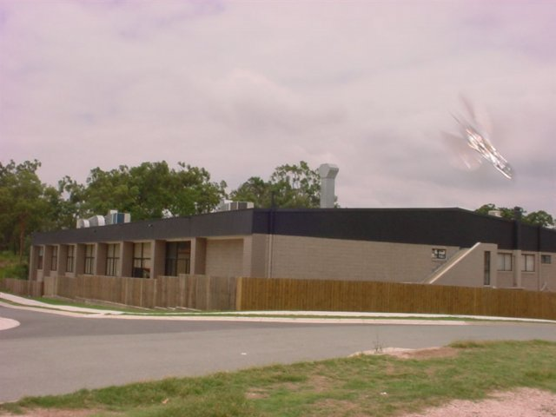

Slide 30
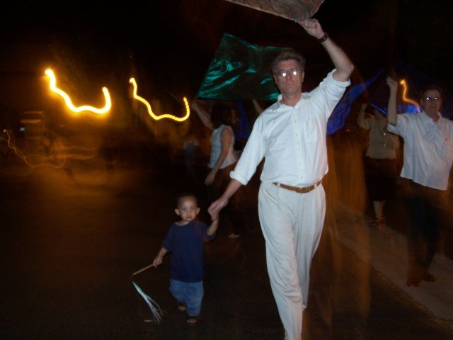
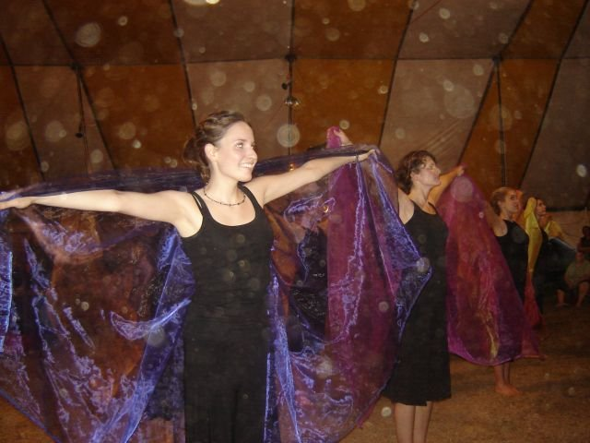

Slide 31
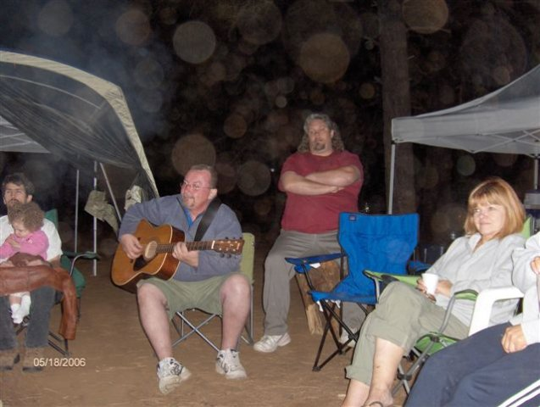
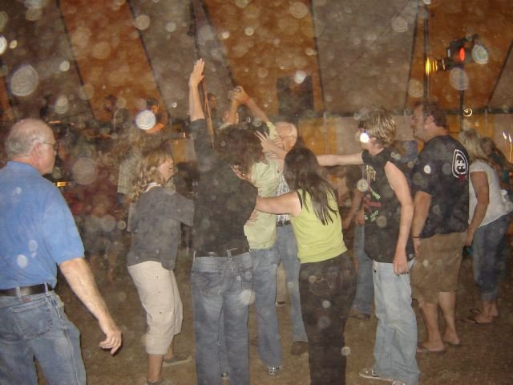

Slide 32
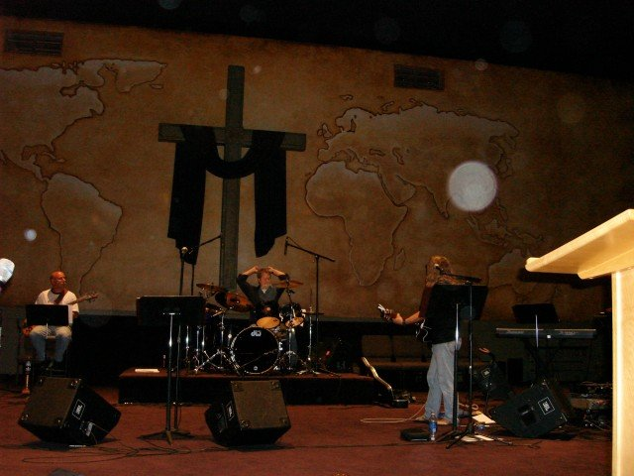

Slide 36
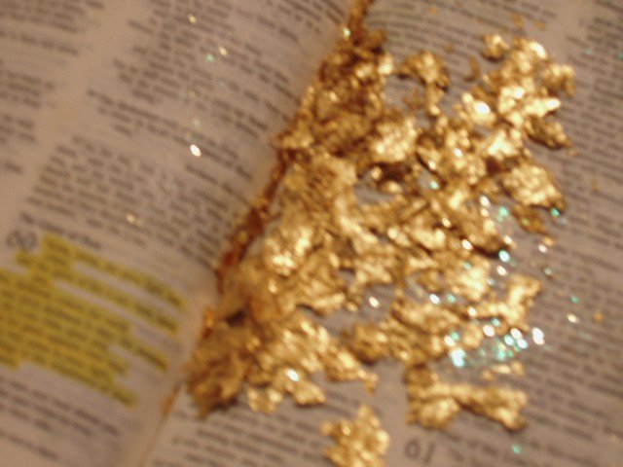
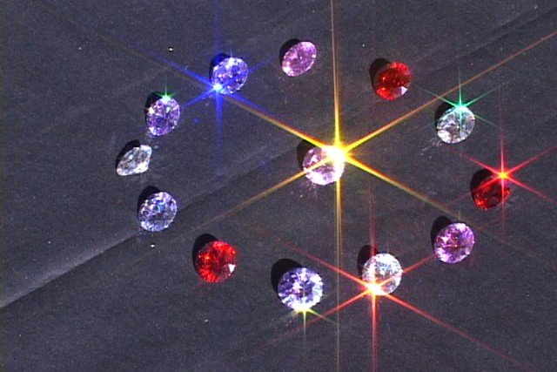

Slide 37
Preparing for destiny - Angelic
Another context is where a personal attribute is mention
The Angels being the executors of God's actions and the means of the revelation of His personal being to man, it is not surprising that God's eyes, hand, arm and other parts of His body (remember that God is corporeal) are phrases used to describe the Angels.
The hand of the Lord
Dan 10:10 Then behold, a hand touched me and set me trembling on my hands and knees. 11 He said to me, "O Daniel, man of high esteem, understand the words that I am about to tell you and stand upright, for I have now been sent to you." And when he had spoken this word to me, I stood up trembling.

Slide 38
Preparing for destiny - Angelic
The eyes of the Lord
2 Chron 16:9 "For the eyes of the LORD move to and fro throughout the earth that He may strongly support those whose heart is completely His.
The presence of God
Isa 63:9 In all their affliction He was afflicted, And the angel of His presence saved them; In His love and in His mercy He redeemed them, And He lifted them and carried them all the days of old.

Slide 39
Preparing for destiny - Angelic
The Fear of the Lord
Exod 23:23 "For My angel will go before you and bring you in to the land 27 "I will send My terror ahead of you, and throw into confusion all the people among whom you come, and I will make all your enemies turn their backs to you.

Slide 40
Preparing for destiny - Angelic
Word of the Lord
Zech 1:7 the word of the LORD came to Zechariah the prophet, ⁸ I saw at night, and behold, a man was riding on a red horse, and he was standing among the myrtle trees which were in the ravine, with red, sorrel and white horses behind him. ⁹ Then I said, “My lord, what are these?” And the angel who was speaking with me said to me, “I will show you what these are.”

Slide 41
Preparing for destiny - Angelic
Zech 1:¹⁰ And the man who was standing among the myrtle trees answered and said, “These are those whom the LORD has sent to patrol the earth.” ¹¹ So they answered the angel of the LORD who was standing among the myrtle trees and said, “We have patrolled the earth, and behold, all the earth is peaceful and quiet.” ¹² Then the angel of the LORD said, “O LORD of hosts, how long will You have no compassion …

Slide 42
Preparing for destiny - Angelic
Zech 1:¹³ The LORD answered the angel who was speaking with me with gracious words, comforting words. ¹⁴ So the angel who was speaking with me said to me, “Proclaim, saying, ‘Thus says the LORD of hosts,

Slide 43
Preparing for destiny - Angelic
Dan 7:¹⁰A stream of fire came forth from before Him; a thousand thousands ministered to Him and ten thousand times ten thousand rose up and stood before Him; the Judge was seated [the court was in session] and the books were opened.
Rev 5:¹¹Then I looked, and I heard the voices of many angels on every side of the throne and of the living creatures and the elders [of the heavenly Sanhedrin], and they numbered ten thousand times ten thousand and thousands of thousands,

Slide 44
Preparing for destiny - Angelic
Heb 12:²²But rather, you have come to Mount Zion, even to the city of the living God, the heavenly Jerusalem, and to countless multitudes of angels in festal gathering
Matt 26:⁵³Do you suppose that I cannot appeal to My Father, and He will immediately provide Me with more than twelve legions [more than 80,000] of angels?

Slide 45
Preparing for destiny - Angelic
Rev 4:² Immediately I was in the Spirit; and behold, a throne was standing in heaven, and One sitting on the throne. ⁴ Around the throne were twenty-four thrones; and upon the thrones I saw twenty-four elders sitting, clothed in white garments, and golden crowns on their heads. ⁵ .. And there were seven lamps of fire burning before the throne, which are the seven Spirits of God

Slide 46
Preparing for destiny - Angelic
Rev ⁶ and in the centre and around the throne, four living creatures full of eyes in front and behind. ⁷ The first creature was like a lion, and the second creature like a calf, and the third creature had a face like that of a man, and the fourth creature was like a flying eagle. ⁸ And the four living creatures, each one of them having six wings, are full of eyes around and within

Slide 47
Preparing for destiny - Angelic
Heb 12: ¹ Therefore, since we have so great a cloud of witnesses surrounding us
Forerunners from Old & New Testament period – last runner best
Men in white linen
Gen 18:1-3, Ezek 10:2-3,7, Dan 12:4-6, 9-13, Zech 1:10, Matt 17:3, Matt 27:52, Mark 16:5, Luke 24:4, Acts 1:9-10
Jacob, Adam, Enoch

Slide 48
Preparing for destiny - Angelic
Isa 11:2
7 spirits of God – tutors to teach & train us in the revelation of God
Meet, talk engage in heaven & then in your garden
Spirit of Lord, fear of Lord, knowledge, wisdom, council, understanding, strength

Slide 49
Preparing for destiny - Angelic
Intelligent & Wise - 2 Sam 14:20, 19:27, MATT 24:3
Patient - Numbers 11:22-35
Meek - 2 Peter 2:11
Joyful - Luke 15:1-10
Modest - 1 Cor 11:10
Holy - Mark 8:38
Glorious - Luke 9:26
Immortal - Luke 20:36
Mighty, Powerful - 1 Thes 1:7-10, Rev 18:1
Obedient - Psa 103:20, Matt 6:10

Slide 50
Preparing for destiny - Angelic
They have wills - Isa 14:12-14
Created spirit beings – Ezek 28:14-15
Spirit Bodies - Heb 13:2, Judges 13:6
They need no rest - Rev 4:8
They can appear selectively – Num 22:31
Can ascend and descend - Gen 28:12, John 1:51
They can speak languages - 1 Cor 13:1
Limited Knowledge - Gen. 18:21

Slide 51
Preparing for destiny - Angelic
Angels are a company Luke 22:33-34 Matt 22:30 no marriage & reproduction
Angels sin as individuals choice
Angels had power of moral choice 2 Peter 2:4 Jude 6

Slide 52
Preparing for destiny - Angelic
Servants involved in worship - obedience
Psa 103:20 Bless the LORD, you His angels, Mighty in strength, who perform His word, Obeying the voice of His word!
Guardians
Matt 18:10 "See that you do not despise one of these little ones, for I say to you that their angels in heaven continually see the face of My Father who is in heaven.
Heb 1:14 Are they not all ministering spirits, sent out to render service for the sake of those who will inherit salvation?

Slide 53
Preparing for destiny - Angelic
Ministers
Heb 1:7 And of the angels He says, "WHO MAKES HIS ANGELS WINDS, AND HIS MINISTERS A FLAME OF FIRE.“
Heb 1:14 Are they not all ministering spirits, sent out to render service for the sake of those who will inherit salvation?

Slide 54
Preparing for destiny - Angelic
Messengers
Rev 1:1 The Revelation of Jesus Christ, which God gave Him to show to His bond-servants, the things which must soon take place; and He sent and communicated it by His angel
Territorial Geographical assignments & limitations
Rev. 9:14 commands: “Loose the four angels which are bound at the great river Euphrates”
Dan 10:13 "But the prince of the kingdom of Persia was withstanding me for twenty-one days; then behold, Michael, one of the chief princes, came to help me, for I had been left there with the kings of Persia.

Slide 55
Preparing for destiny - Angelic
Terminators
Rev 20:1 Then I saw an angel coming down from heaven, holding the key of the abyss and a great chain in his hand. 10 And the devil who deceived them was thrown into the lake of fire and brimstone,
Engage in warfare on earth -Terminators
2 Kings 19:35: And it came to pass that night, that the angel of the Lord went out, and smote in the camp of the Assyrians an hundred eighty five thousand:
Engage in warfare in the heavenlies
Rev 12:7 And there was war in heaven, Michael and his angels waging war with the dragon. The dragon and his angels waged war,

Slide 56
Preparing for destiny - Angelic
Protectors
Psa 91:1 He who dwells in the shelter of the Most High Will abide in the shadow of the Almighty. 2 I will say to the LORD, "My refuge and my fortress, My God, in whom I trust!" 4 He will cover you with his feathers, and under his wings you will find refuge; his faithfulness will be your shield and rampart. 11 For He will give His angels charge concerning you, To guard you in all your ways.
Psa 34:7 The angel of the LORD camps round about them that fear him, and delivers them.

Slide 57
Preparing for destiny - Angelic
Angels interacted with man in the Old & New testament
Exod 3:2 The angel of the LORD appeared to him in a blazing fire from the midst of a bush; and he looked, and behold, the bush was burning with fire, yet the bush was not consumed
Gen 32:1 Now as Jacob went on his way, the angels of God met him.
Gen 24:40 "He said to me, 'The LORD, before whom I have walked, will send His angel with you to make your journey successful, and you will take a wife for my son from my relatives and from my father's house;

Slide 58
Preparing for destiny - Angelic
Exod 14:19 The angel of God, who had been going before the camp of Israel, moved and went behind them; and the pillar of cloud moved from before them and stood behind them.
Dan 4:13 'I was looking in the visions in my mind as I lay on my bed, and behold, an angelic watcher, a holy one, descended from heaven
Dan 9:21 while I was still speaking in prayer, then the man Gabriel, whom I had seen in the vision previously, came to me in my extreme weariness about the time of the evening offering. 22 He gave me instruction and talked with me and said, "O Daniel, I have now come forth to give you insight with understanding.

Slide 59
Preparing for destiny - Angelic
The Court of Heaven
Psa 82:1 GOD STANDS in the assembly [of the representatives] of God; in the midst of the magistrates or judges He gives judgment [as] among the angels.
Psa 89:6 For who in the heavens can be compared to the Lord? Who among the mighty [heavenly beings] can be likened to the Lord, 7 A God greatly feared and revered in the council of the holy (angelic) ones, and to be feared and worshipfully revered above all those who are round about Him?

Slide 60
Preparing for destiny - Angelic
1 Kings 22:19 Micaiah said, "Therefore, hear the word of the LORD. I saw the LORD sitting on His throne, and all the host of heaven standing by Him on His right and on His left. 20 "The LORD said, 'Who will entice Ahab to go up and fall at Ramoth-gilead?' And one said this while another said that.
Job 1:6 Now there was a day when the sons of God came to present themselves before the LORD, and Satan also came among them. 7 The LORD said to Satan, "From where do you come?" Then Satan answered the LORD and said, "From roaming about on the earth and walking around on it."

Slide 61
Preparing for destiny - Angelic
Watch over & interact with churches
Rev 1:20 the seven stars are the angels of the seven churches
Rev 2:1 "To the angel of the church in Ephesus write:
Affect the affairs of nations
Dan 10:13 "But the prince of the kingdom of Persia was withstanding me for twenty-one days; then behold, Michael, one of the chief princes, came to help me, for I had been left there with the kings of Persia.

Slide 62
Preparing for destiny - Angelic
Angels and prayer
Rev 5:8 When He had taken the book, the four living creatures and the twenty-four elders fell down before the Lamb, each one holding a harp and golden bowls full of incense, which are the prayers of the saints.
Rev 8:3 Another angel came and stood at the altar, holding a golden censer; and much incense was given to him, so that he might add it to the prayers of all the saints on the golden altar which was before the throne.

Slide 63
Preparing for destiny - Angelic
Dan 9:21 while I was still speaking in prayer, then the man Gabriel, whom I had seen in the vision previously, came to me in my extreme weariness about the time of the evening offering. 22 He gave me instruction and talked with me and said, "O Daniel, I have now come forth to give you insight with understanding.

Slide 64
Preparing for destiny - Angelic
New Testament times
Ministry Jesus - Ministry church - Our ministry?
Luke 1:19 The angel answered and said to him, "I am Gabriel, who stands in the presence of God, and I have been sent to speak to you and to bring you this good news.
Matt 4:11 Then the devil left Him; and behold, angels came and began to minister to Him.
Luke 22:43 Now an angel from heaven appeared to Him, strengthening Him.

Slide 65
Preparing for destiny - Angelic
Matt 28:2 And behold, a severe earthquake had occurred, for an angel of the Lord descended from heaven and came and rolled away the stone and sat upon it.
John 1:51 And He said to him, "Truly, truly, I say to you, you will see the heavens opened and the angels of God ascending and descending on the Son of Man."
Matt 13:39 .. the harvest is the end of the age; and the reapers are angels.
Matt 13:49 "So it will be at the end of the age; the angels will come forth and take out the wicked from among the righteous,

Slide 66
Preparing for destiny - Angelic
Luke 16:22 "Now the poor man died and was carried away by the angels to Abraham's bosom; and the rich man also died and was buried.
Acts 5:19 But during the night an angel of the Lord opened the gates of the prison, and taking them out he said,

Slide 67
Preparing for destiny - Angelic
Lead sinners to gospel workers
Acts 10:3 About the ninth hour of the day he clearly saw in a vision an angel of God who had just come in and said to him, "Cornelius!"
Act 11:13 "And he reported to us how he had seen the angel standing in his house, and saying, 'Send to Joppa and have Simon, who is also called Peter, brought here;

Slide 68
Preparing for destiny - Angelic
Direct God's ministers
Acts 8:26 But an angel of the Lord spoke to Philip saying, "Get up and go south to the road that descends from Jerusalem to Gaza.“
Act 12:8 And the angel said to him, "Gird yourself and put on your sandals." And he did so. And he said to him, "Wrap your cloak around you and follow me." 9 And he went out and continued to follow, and he did not know that what was being done by the angel was real, but thought he was seeing a vision.

Slide 69
Preparing for destiny - Angelic
Act 12:15 They said to her, "You are out of your mind!" But she kept insisting that it was so. They kept saying, "It is his angel."
Act 12:23 And immediately an angel of the Lord struck him because he did not give God the glory, and he was eaten by worms and died.
Heb 13:2 Do not neglect to show hospitality to strangers, for by this some have entertained angels without knowing it.
1 Cor 6:3 Do you not know that we will judge angels? How much more matters of this life?

Slide 70
Preparing for destiny - Angelic
Angelic manifestations
Fire, Lights & colours
Feathers
Power orbs
Fragrances
Winds, breezes
Dreams & Visions

Slide 71
Angelic Canopy
CHAYOTH
OFANIM
ER’ELIM
METATRON
CHASHMALIM
Creatures
RAZIEL
Spheres
TZAPHKIEL
SERAPHIM
TZADKIEL
MALACHIM
Mighty ones
GABRIEL
ELOHIM
Shining ones
Burning ones
URIEL
B’NAI-ELOHIM
Messengers
HANIEL
CHERUBIM
Judges
MICHAEL
ISHIM
Sons of God
RAPHAEL
Covering ones
Mountain Throne of God
Our Lives
SANDELPHON
Warring ones

Slide 72
Preparing for destiny - Angelic
Chayoth Creatures Ezek 1:5 fiery chariots, horses, swords, whirlwinds
Ofanim Spheres Ezek 1:16 2 Kings 2
Erelim Mighty ones Isa 33:7
Chashmalim Shining ones Ezek 1:4
Seraphim Burning ones Isa 6:6
Malachim Messengers Gen 19:1

Slide 73
Preparing for destiny - Angelic
Elohim Judges
B’nai-Elohim Sons of God Job 38:7
Cherubim Covering ones Ezek 10:1
Ishim Warring ones Dan 10:5
Rev 5:11 100 million

Slide 74
Preparing for destiny - Angelic
Judgment, Watcher, Salvation, Glory
Guard, Scroll, Lions, Seal, Mandate
Assignment, Art, Grace, Holiness
Healing, Gathering, Anointing, Provision
Mantle, Worship, Treasury, Finance
Fragrance, Revival, Portal, Deliverance
Warring, Wisdom, Pillars, Commanded
Hunter angels, Reaping angels

Slide 75
Preparing for destiny - Angelic
Job 38:⁴ “Where were you when I laid the foundation of the earth? ⁷ When the morning stars sang together And all the sons of God shouted for joy?
Recognize us when we engage in our eternal destiny
Administer kingdom around our lives
Release provision, protection,

Slide 76
Preparing for destiny - Angelic
Everything they did for Prophets, Jesus or the disciples they can do for us
Feed us
Strengthen us
Protect us
Direct us
Form a canopy over us

Slide 77
Preparing for destiny - Angelic
Welcome their involvement
Be in faith and pursue relationship
Engage with them speak to them
Who are they, what is their name, what is their function & mandate
Church has Urandiel 50 feet tall face of eagle and lion
Breakthrough angel, healing pool angel

Slide 78
Preparing for destiny - Angelic
2 personal named angels that minister for, to and with me
Angels surround our praise
Colour movement flags open portals for angelic manifestation

Slide 79
Preparing for destiny - Angelic
Angels can come through portals
Angels can come in power orbs
Angels can appear human
Angels can bring revelation
Angelic activity is activated by heavenly realm mandates

Slide 80
Preparing for destiny - Angelic
Angels manifest in the natural realm to be seen or heard through the natural senses.
The voice of angels can be heard internally by the human spirit or the human mind as a thought.
Angels can be seen and heard in a dream while sleeping.
Angels can be seen and heard in a spiritual vision either closed or open.

Slide 81
Manifestation Type | Being Sent/Reason | Appeared To | Bible Reference
Physical Presence on the Earth | Angel sent from God with a message to | Hagar | Genesis 16
Physical Presence on the Earth | Two Angels sent to Sodom to deliver Lot’s Family but not recognized as angels | Lot, his family and the city | Genesis 19
Dream | Angels appear to | Jacob | Genesis 28:12
Dream | Angel appears to | Jacob | Genesis 31:11
Physical Presence on the Earth | Angels seen by | Jacob | Genesis 32:1
Physical Presence on the Earth | Angel appears as a flame of fire | Moses | Exo 3:2
Vision | Angel sent to stop Balaam | Balaam | Num 22:31
Physical Presence on the Earth | Angel seen by | David | 2 Samuel 24:17
Physical Presence on the Earth | Angel brings food to the prophet touching him to awaken | Elijah | 1 Kings 19:5-7
Physical Presence on the Earth | Angel catches away the physical man Elijah observed by | Elijah and Elisha | 2 Kings 2:11
Vision | Chariots and horses of fire seen by | Elisha and the servant | 2 Kings 6:17
Physical Presence on the Earth | Angel sent with message from God to | Israel | Judge 2:1

Slide 82
Manifestation Type | Being Sent/Reason | Appeared To | Bible Reference
Physical Presence on the Earth | Angel with a message from God appears face to face to | Gideon | Judge 6:11-22
Physical Presence on the Earth | Angel appears to | Barren Woman | Judge 13:3
Physical Presence on the Earth | Angel appears but is not recognized to be an angel | Manoah | Judges 13:16
Vision | Angel appears to | Daniel | Daniel 12:7
Dream | Angel appears to | Joseph | Mat 1:20
Dream | Angel appears to | Joseph | Mat 2:13-19
Physical Presence on the Earth | Angel appears sitting in the tomb of Jesus to | Mary and Mary Magdalene | Mark 16:5
Vision | Angel Gabriel appears to | Zacharias | Luke 1:11
Physical Presence on the Earth | Angel Gabriel appears to | Mary | Luke 1:26-28
Physical Presence on the Earth | Angel appears to strengthen | Jesus | Luke 22:43
Vision | Angel appears in a vision to | Cornelius | Acts 10:1-3
Physical Presence on the Earth | Angel delivers Peter from prison physically touching | Peter | Acts 12:7

Slide 83
Preparing for destiny - Angelic
Angels drawn to God or what looks like God – reflections of His glory
Where God is displayed - lives, meetings etc.
Angels are drawn by the atmosphere around us, colour, fragrance, sound frequency

Slide 84
Preparing for destiny - Angelic
Atmosphere of faith, love, mercy, grace, hope, peace, joy, praise, thanksgiving, humility
1 Thes 5:¹⁶ Rejoice always; ¹⁷ pray without ceasing; ¹⁸ in everything give thanks; for this is God’s will for you in Christ Jesus.
Phil 2:⁵ Have this attitude in yourselves which was also in Christ Jesus

Slide 85
Preparing for destiny - Angelic
Phil 4 :4 Rejoice in the Lord always; again I will say, rejoice! 5 Let your gentle spirit be known to all men. The Lord is near. 6 Be anxious for nothing, but in everything by prayer and supplication with thanksgiving let your requests be made known to God. 7 And the peace of God, which surpasses all comprehension, will guard your hearts and your minds in Christ Jesus. 8 Finally, brethren, whatever is true, whatever is honourable, whatever is right, whatever is pure, whatever is lovely, whatever is of good repute, if there is any excellence and if anything worthy of praise, dwell on these things. 9 The things you have learned and received and heard and seen in me, practice these things, and the God of peace will be with you.

Slide 86
Heavenly Realms
Heb 1:14 Angels, Are they not all ministering spirits, sent out to render service for the sake of those who will inherit salvation?
Ministering = attendance as a servant to aid or offer official service
Gen 24:40 "He said to me, 'The LORD, before whom I have walked, will send His angel with you to make your journey successful, and you will take a wife for my son from my relatives and from my father's house;

Slide 87
Heavenly Realms
How does Abraham know this?
Reading this chapter I did not see Abraham pray to God and ask for an angel.
Did God tell Him that an angel would go with his servant? I couldn’t find that in the passage either.
Abraham declared a faith statement based on covenant – God would send an angel
Declared what his angel was going to do and thus he put his angel to work for him by faith.

Slide 88
Heavenly Realms
What happened?
As you continue to read in this chapter you find that a woman appears at the well. How is it that just the right woman comes to the exact well that the servant is sitting by at just the right time and no others come first? Have you ever thought about that?
Psa 103:²⁰ Bless the LORD, you His angels, Mighty in strength, who perform His word, Obeying the voice of His word!

Slide 89
Heavenly Realms
Angels were sent from God because of the words of men and women on the earth
Angels are not our personal servants
Angels are the servants of God who do things for us when we speak the right faith words.
Joshua 1:⁷ Only be strong and very courageous; be careful to do according to all the law which Moses My servant commanded you; do not turn from it to the right or to the left, so that you may have success wherever you go.

Slide 90
Heavenly Realms
Joshua 1:⁸ This book of the law shall not depart from your mouth, but you shall meditate on it day and night, so that you may be careful to do according to all that is written in it; for then you will make your way prosperous, and then you will have success.
I believe that you become the “voice” of His word when you say what He says. If you say what God says, I believe that allows angels to do what God said to do for you

Slide 91
Preparing for destiny - Angelic
Josh 5:¹³ Now it came about when Joshua was by Jericho, that he lifted up his eyes and looked, and behold, a man was standing opposite him with his sword drawn in his hand, and Joshua went to him and said to him, “Are you for us or for our adversaries?” ¹⁴ He said, “No; rather I indeed come now as captain of the host of the LORD.”

Slide 92
Preparing for destiny - Angelic
Dan 10:¹²Then he said to me, Fear not, Daniel, for from the first day that you set your mind and heart to understand and to humble yourself before your God, your words were heard, and I have come as a consequence of [and in response to] your words.

Slide 93
Preparing for destiny - Angelic
We can see angels
We can talk to angels
We can receive direction from angels
We can receive ministry from angels
We can have angels minister with us
We can ask God to release the angels
Angels are directed by God on our behalf

Slide 94
Preparing for destiny - Angelic
Angels can talk to God on our behalf
Angels respond to our words
Angels can answer our prayers
We can cooperate with angelic assignments
Angels cooperate with our assignments

Slide 95
Preparing for destiny - Angelic
We don’t worship angels
We don’t pray to angels
We don’t direct angels according to our will only as mature sons of God
Lords, kings and sons – angels facilitate the kingdom around us

Slide 96
Preparing for destiny - Angelic
Gathering angels
Matt 13:⁴¹ The Son of Man will send forth His angels, and they will gather out of His kingdom all stumbling blocks, and those who commit lawlessness,
Seraphim angels
Isa 6:⁶ Then one of the seraphim flew to me with a burning coal in his hand, which he had taken from the altar with tongs. ⁷ He touched my mouth with it and said, “Behold, this has touched your lips; and your iniquity is taken away and your sin is forgiven.”

Slide 97
Preparing for destiny - Angelic
Healing angels
John 5:4 for an angel of the Lord went down at certain seasons into the pool and stirred up the water; whoever then first, after the stirring up of the water, stepped in was made well from whatever disease with which he was afflicted.]

Slide 98
Preparing for destiny - Angelic
Chasmalim angels
Ezek 1:⁴As I looked, behold, a stormy wind came out of the north, and a great cloud with a fire enveloping it and flashing continually; a brightness was about it and out of the midst of it there seemed to glow amber metal, out of the midst of the fire

Slide 99
Preparing for destiny - Angelic
Hunter angels
Matt 22:⁸ Then he *said to his servants, ‘The wedding is ready, but those who were invited were not worthy. ⁹ Go therefore to the main highways, and as many as you find there, invite to the wedding feast.’ ¹⁰ Those slaves went out into the streets and gathered together all they found
Matt 13:39 … and the reapers are angels.

