Slide 1
Spirit Foundations notes
Spirit Light, Love - Wave Particle
Eternal essence Life = spirit
Spirit separated from eternal source creator, spirit realm heavenlies
Dead dormant disconnected – God, heaven, kingdom identity

Slide 2
Spirit Foundations
Born again – life, spirit activated connected – identity, destiny, purpose
Connected to Source creator - Holy Spirit, Father, Son, kingdom, heaven
Habitation glory, divine nature & capacity – Omnipresence, Omnipotence, Omniscience

Slide 3
Spirit Foundations
Newly born again spirit – baby, weak, undeveloped
Connection relationship creator
1 Cor 6:17 joined and one spirit
Spirit restored, spiritual gates, senses, attributes
Fear of God, Reverence, Prayer, Hope, Faith, Revelation, Intuition, Worship

Slide 4
Spirit Foundations
Spirit rise up, come forth, take dominion – fruitful, multiply, subdue, rule
Seat government, mountain, kingdom

Slide 5
Spirit Foundations
Soul needs – love acceptance, affirmation, approval, value, esteem, worth, dignity, protection, provision, purpose, destiny
Brokenness, Wounds, Pain
Soul – independent, disconnected from source draws from new source world
Who am I, What am I, Why am I

Slide 6
Spirit Foundations
Fractured, Fragmented, Broken, Wounded by sin and iniquity
Restored, wholeness, peace

Slide 7
Spirit Foundations
Building the spirit
Fellowship, communion, intimacy, relationship
First love, establish priority
Matt 6:33
Time priority rest, relate, restore

Slide 8
Spirit Foundations
Spirit Building exercises

Slide 9
Spirit Foundations
Give God first love, place, priority
Pray & sing in tongues
Meditate on word of God – Prov 4:20-23
Wait on the Lord – Be still
Praise & adoration
Fellowship
Pray & Ask
Confess & Declare the truth, call things
Persevere
Desire – Discipline - Delight

Slide 10
Building a strong spirit Eyes of our Heart - Imagination
Eph 1:17 that the God of our Lord Jesus Christ, the Father of glory, may give to you a spirit of wisdom and of revelation in the knowledge of Him. 18 I pray that the eyes of your heart may be enlightened, so that you will know what is the hope of His calling, what are the riches of the glory of His inheritance in the saints, 19 and what is the surpassing greatness of His power toward us who believe. These are in accordance with the working of the strength of His might

Slide 11
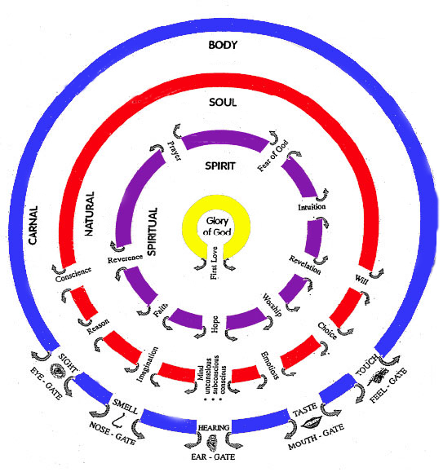
Gateways – Spirit – Soul - Body

Slide 12
Spirit Foundations
I am’s John connection spirit to spirit

Slide 13
Spirit Foundations
1 Cor 2:9 but just as it is written, "THINGS WHICH EYE HAS NOT SEEN AND EAR HAS NOT HEARD, AND which HAVE NOT ENTERED THE HEART OF MAN, ALL THAT GOD HAS PREPARED FOR THOSE WHO LOVE HIM." 10 For to us God revealed them through the Spirit; for the Spirit searches all things, even the depths of God. 11 For who among men knows the thoughts of a man except the spirit of the man which is in him? Even so the thoughts of God no one knows except the Spirit of God. 12 Now we have received, not the spirit of the world, but the Spirit who is from God, so that we may know the things freely given to us by God,

Slide 14
Spirit Foundations
Resonance, Frequency, Harmony
Eternal spirit – scroll destiny etc
Psa 139
Redemptive gifts destiny
Rom 12:

Slide 15
Spirit Foundations
Rom 12:2 …so that you may prove what the will of God is, that which is good and acceptable and perfect. 3… but to think so as to have sound judgment, as God has allotted to each a measure of faith.

Slide 16
Spirit Foundations
Rom 12:4 For just as we have many members in one body and all the members do not have the same function, 5 so we, who are many, are one body in Christ, and individually members one of another. 6 Since we have gifts that differ according to the grace given to us, each of us is to exercise them accordingly: if prophecy, according to the proportion of his faith; 7 if service, in his serving; or he who teaches, in his teaching; 8 or he who exhorts, in his exhortation; he who gives, with liberality; he who leads, with diligence; he who shows mercy, with cheerfulness.

Slide 17
Spirit Foundations
Rom 12:6 Having gifts (faculties, talents, qualities) that differ according to the grace given us, let us use them: [He whose gift is] prophecy, [let him prophesy] according to the proportion of his faith; 7 [He whose gift is] practical service, let him give himself to serving; he who teaches, to his teaching; 8 He who exhorts (encourages), to his exhortation; he who contributes, let him do it in simplicity and liberality; he who gives aid and superintends, with zeal and singleness of mind; he who does acts of mercy, with genuine cheerfulness and joyful eagerness.

Slide 18
Spirit Foundations
Birth right
Anointing
Character
Sacrifice
Redemptive gifts unlocked
Skill sets of the spirit
7 principles

Slide 19
Spirit Foundations
Prophet
Servant
Teacher
Exhorter
Giver
Ruler
Mercy

Slide 20
Spirit Foundations
Prophet Design
Servant Authority
Teacher Responsibility
Exhorter Sowing & Reaping
Giver Stewardship
Ruler Freedom
Mercy Fulfilment

Slide 21
Spirit Foundations
Prophet
Servant
Teacher
Exhorter
Giver
Ruler
Mercy

Slide 22
Spirit Foundations
1 gift defining template for our souls
Blend of 7 in light of God that is our spirit
Gifting shaped and coloured by birth order
1 st born prophet turbo charges eg Pter
2nd born mercies amplified by characteristics eg Aaron

Slide 23
Spirit Foundations
3 born exhorter
Miriam Aaron Moses
Parentage
Hard wired by God but social pressures nature family gifts etc. shape and mould blunting or enhancing e.g. Amos
Generation influences

Slide 24
Spirit Foundations
Strengths stronger weaknesses weaker
What is it? Causes pliable and imprint from culture
Childhood before school
Muted or exaggerated by forces of culture
OEM software key to who you are

Slide 25
Spirit Foundations
Use key God will unpack it
Understand yourself and your wife, neighbour identity by product not primary objective
Become world changer by knowing God first all will be added
Establish divine order love God first
Pain drives us to neighbour first
Be strategic thinker

Slide 26
Spirit Foundations
First bleeds into the 2nd
First be first know God in our own key of music

Slide 27
Spirit Foundations
Use analogies as bible study tool
Biblical DNA
List of 7 parallels redemptive gifts
7 days creation, Moses 7 responses burning bush, 7 furniture items tabernacle, 7 compound names Jehovah, 7 spirits God, 7 miracles John, 7 last words Christ on cross

Slide 28
Spirit Foundations
2nd item Bronze laver for cleansing
Core gifting's 2nd gift servant is bring cleansing
2nd position = cleansing over and over again.
Horizontal to vertical earth to heaven
2nd thing in heavenly tabernacle

Slide 29
Spirit Foundations
7 templates or software applies to land, areas, cities, regions etc.
Redemptive gifts for areas
Gifts in areas so people can find him and be drawn to himself.
Gifts draw people to the redeemer
7 ways present God in key music people are listening to

Slide 30
Spirit Foundations
Template on how we see and hear God and present God to others.
Spirit can’t respond to have its own voice unless it matures
Spirit Functions in 7 principles
Peace in confidence, trust God
Spiritual power blessing of presence produces change e.g. Peter shadow

Slide 31
Spirit Foundations
Access to volcano in you, deposit of can your soul cannot express
Music, art, business, teaching etc there is more
Community releasing spirits into market place not just in worship services
To unleash transformation into the world

Slide 32
Spirit Foundations
Know gift know key communicate with God know deposit before foundation of world
Access to apps of God waiting to be opened.

Slide 33
Spirit Foundations
Servant

Slide 34
Spirit Foundations
I call your spirit to attention
Listen with your spirit to the words that God your heavenly Father has for you

Slide 35
Spirit Foundations
Rom 8:14 For all who are being led by the Spirit of God, these are sons of God. 15 For you have not received a spirit of slavery leading to fear again, but you have received a spirit of adoption as sons by which we cry out, “Abba! Father!” 16 The Spirit Himself testifies with our spirit that we are children of God, 17 and if children, heirs also, heirs of God and fellow heirs with Christ, if indeed we suffer with Him so that we may also be glorified with

Slide 36
Spirit Foundations
Rom 8:18 For I consider that the sufferings of this present time are not worthy to be compared with the glory that is to be revealed to us. 19 For the anxious longing of the creation waits eagerly for the revealing of the sons of God.

Slide 37
Spirit Foundations
I call your spirit to attention
Listen with your spirit to the words that God your heavenly Father has for you

Slide 38
Spirit Foundations
The Spirit of your Father gives witness that you are His son
I bless your spirit with the Spirit of sonship and the mindset of sonship
I bless you with deep heart identity as God’s very own child, securely loved in His family

Slide 39
Spirit Foundations
I bless you with the settled assurance that He has a future and hope for you and has written your days in His book with love for your best interests and His ultimate glory
I bless you with the deep knowledge that God knows what you need and has all the resources of the universe to meet that need

Slide 40
Spirit Foundations
Listen with your spirit to God’s word for you
The Spirit testifies to your spirit that you are God’s child
I bless you with the ears to hear the testimony of the Spirit of the Lord, the Spirit of knowledge, wisdom & understanding, the Spirit of counsel, power and fear of the Lord

Slide 41
Spirit Foundations
I bless you with being tuned into God with eyes for seeing, ears for hearing and a mind for understanding according to the Spirit
I bless you with being led by the fullness of the Spirit of truth to see things as He sees them in the spirit realm

Slide 42
Spirit Foundations
Listen with your spirit to God’s word for you
I bless you with the deep knowledge that you are an heir with your brother Jesus to all the treasuries of your father
I bless you with the confidence that you lack for nothing that you need, spiritually, emotionally, mentally, physically practically

Slide 43
Spirit Foundations
Listen with your spirit to God’s word for you
I bless you with the sure understanding that His ways are not our ways and He wants to have His way for your blessings and His glory
I bless you with pressing forward to see His glory that He is revealing

Slide 44
Spirit Foundations
I bless you with a heart that does not rebel or shrink back from the opportunities He puts before you daily
I bless you with a hunger for the manifestation of His glory day by day in you and through your life

Slide 45
Spirit Foundations
I call your spirit to attention Isa 26:3 “The steadfast of mind You will keep in perfect peace, Because he trusts in You. 4 “Trust in the Lord forever, For in God the Lord, we have an everlasting Rock.
Since this is God’s will, and since this is your birthright, I bless you with having perfect peace that comes from trusting in the Lord

Slide 46
Spirit Foundations
I bless you with experiencing your Father’s faithfulness, His faithful love towards you, even when others do not love you. I bless you with experiencing His love, for your emotions to be aware, to know, to savour, to feel, to relish the love that your Father expresses toward you.

Slide 47
Spirit Foundations
I bless you with experiencing that so often that you never doubt your Father’s love.
I bless you with experiencing your Father’s faithfulness in providing for you. Your needs change, and your provision will come from many different sources.

Slide 48
Spirit Foundations
I bless you with seeing your Father provide again and again, so that you can have complete emotional confidence that He will provide for your daily bread
I bless you with having perfect peace about your Father’s communication with you. He will speak at times through His word very clearly and personally to you

Slide 49
Spirit Foundations
At times He will be silent, and even His word will seem closed and dry, but I bless you with perfect confidence and perfect peace during the silences of God as you stand in the things He has spoken to you in the past.
I bless you with

Slide 50
Spirit Foundations
I bless you with feeling the perfect peace of God in all things. I bless you with experiencing God’s supernatural timing over and over, for you to savour, deep in your spirit, His faithfulness in being, providing, arriving, communicating, and changing things at exactly the right time

Slide 51
Spirit Foundations
I bless you with having your fixed firmly on the memories of God’s faithfulness, so that when you come up against what appears to be a crisis situation where He has not moved yet, you will have perfect peace that He will move at exactly the right time because you have experienced His timely faithfulness in the past.

Slide 52
Spirit Foundations
I bless you with seeing your Father has protected you. I bless you with perfect peace because you trust in your Father’s protection of you.
I bless you with experiencing His protection when danger comes near but does not touch you. I bless you with first hand knowledge of your Father's infinite creativity in rescuing you from harm

Slide 53
Spirit Foundations
I bless you with having your eyes opened to see the circumstances and situations where the enemy has set a trap that you didn’t see, and your Father in His infinite power and wisdom removed the trap before you were aware of it.
I bless you with growing experiences of His protecting your spirit, soul and body and the call upon your life.

Slide 54
Spirit Foundations
I bless you with seeing so much of His protection that you that you will trust Him implicitly
I bless you with having a mind that is set on Christ, who offers this perfect peace to you.

Slide 55
Spirit Foundations
Psa 139:Your eyes have seen my unformed substance; And in Your book were all written The days that were ordained for me, When as yet there was not one of them. 17 How precious also are Your thoughts to me, O God! How vast is the sum of them!

Slide 56
Spirit Foundations
Jer 1:5 Before I formed you in the womb I knew you, And before you were born I consecrated you; I have appointed you

Slide 57
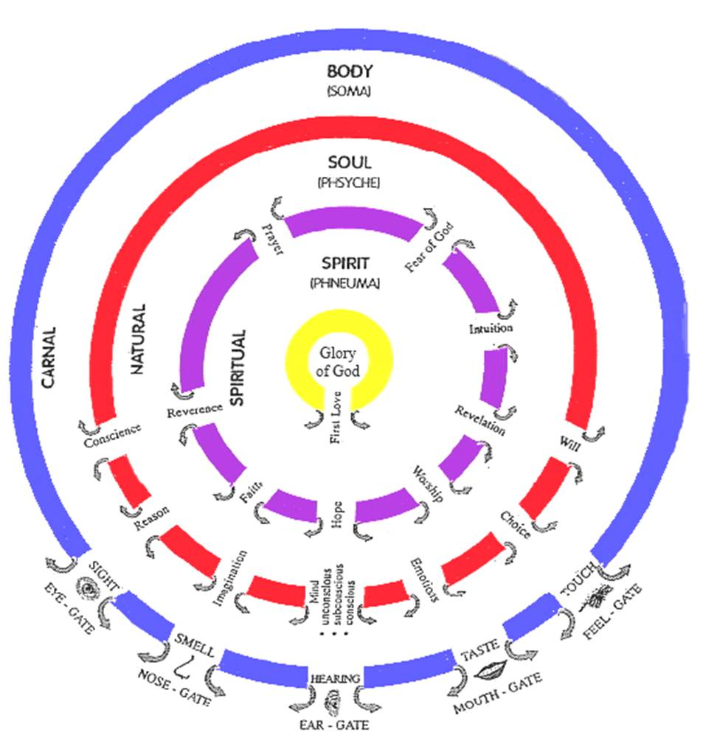

Slide 58
Spirit Foundations

Slide 59
Spirit Foundations

