Slide 1
Pathway of Responsibility
Pathway of responsibility is where engage the heavenly realms from the intimacy and relationship of first love within our lives
It follows from the Pathway of relationship where we establish our identity as a house, mountain and gateway and expand our boundaries

Slide 2
Pathway of Responsibility
Zech 3: 7 “Thus says the Lord of hosts, ‘If you will walk in My ways and if you will perform My service, then you will also govern My house and also have charge of My courts, and I will grant you free access among these who are standing here.

Slide 3
Pathway of Responsibility
We have heavenly and earthly spheres of authority and government.
Matt 6:10 Your kingdom come. Your will be done, On earth as it is in heaven.
It is our responsibility to learn how to establish the “as it is” of the kingdom in heaven so it can manifest on earth

Slide 4
Pathway of Responsibility
Growing in maturity as a son of God by accessing our heavenly positions of authority
Maturing in our positions of lordship, kingship and sonship
Learning how to rule the house and have charge of the courts
Ruling and legislating from our position where we are seated in the heavens

Slide 5
Pathway of Responsibility
Gen 1:28 God blessed them; and God said to them, “Be fruitful and multiply, and fill the earth, and subdue it; and rule over … it
As God’s children His sons and heirs we have been given this mandate or authority to rule

Slide 6
Pathway of Responsibility
Pathway of Responsibility is where we can walk under an open heaven on earth with access to enter into heaven
Ultimately to learn to live in dual realms
Our spirit in heaven continually “seeing” what the Father is doing and administrating what flows through the gateways of our soul and body into the world

Slide 7
Pathway of Responsibility
An open heaven and angelic support enables us walk with God
This reality is seen right through the bible and in history
Enoch, Noah, Jacob, Moses, 70 Elders, Joshua, Isaiah, Ezekiel, Joshua, Jesus, Paul and John are examples we have same invitation to come up here

Slide 8
Pathway of Responsibility
John 1:51 “Truly, truly, I say to you, you will see the heavens opened and the angels of God ascending and descending on the Son of Man.”
An open heaven gives us access to the angelic realm - they are our ministering spirits

Slide 9
Pathway of Responsibility
Paul
2 Cor 12:2 I know a man in Christ who fourteen years ago—whether in the body I do not know, or out of the body I do not know, God knows—such a man was caught up to the third heaven
Paul engaged heaven and received revelation some of he released

Slide 10
Pathway of Responsibility
John saw into heaven
Rev 4:1 After these things I looked, and behold, a door standing open in heaven, and the first voice which I had heard, like the sound of a trumpet speaking with me, said, “Come up here, and I will show you what must take place after these things.” 2 Immediately I was in the Spirit; and behold, a throne was standing in heaven, and One sitting on the throne.

Slide 11
Pathway of Responsibility
John 10:7 So Jesus said to them again, “Truly, truly, I say to you, I am the door of the sheep. .. 9 I am the door; if anyone enters through Me, he will be saved, and will go in and out and find pasture. 10 The thief comes only to steal and kill and destroy; I came that they may have life, and have it abundantly.

Slide 12
Pathway of Responsibility
That door or torn veil gives us access to follow Him
Pathway of responsibility is walked beyond the veil so that our expanding spheres of authority can be established and administered
So we can manifest the Kingdom on earth as we establish it in heaven.

Slide 13
Pathway of Responsibility
Heb 6:19 This hope we have as an anchor of the soul, a hope both sure and steadfast and one which enters within the veil, 20 where Jesus has entered as a forerunner for us, having become a high priest forever according to the order of Melchizedek.

Slide 14
Pathway of Responsibility
Heb 9:11 But when Christ appeared as a high priest of the good things to come, He entered through the greater and more perfect tabernacle, not made with hands, that is to say, not of this creation;
He entered so we can enter now

Slide 15
Pathway of Responsibility
Heb 9:24 For Christ did not enter a holy place made with hands, a mere copy of the true one, but into heaven itself, now to appear in the presence of God for us;
Jesus is our guarantee of access to the heavenly tabernacle

Slide 16
Pathway of Responsibility
Heb 10:11 Every priest stands daily ministering and offering time after time the same sacrifices, which can never take away sins; 12 but He, having offered one sacrifice for sins for all time, sat down at the right hand of God, 13 waiting from that time onward until His enemies be made a footstool for His feet.

Slide 17
Pathway of Responsibility
Heb 10:19 Therefore, brethren, since we have confidence to enter the holy place by the blood of Jesus, 20 by a new and living way which He inaugurated for us through the veil, that is, His flesh,

Slide 18
Pathway of Responsibility
Heb 10:21 and since we have a great priest over the house of God, 22 let us draw near with a sincere heart in full assurance of faith, having our hearts sprinkled clean from an evil conscience and our bodies washed with pure water.

Slide 19
Pathway of Responsibility
1 Cor 15:24 then comes the end, when He hands over the kingdom to the God and Father, when He has abolished all rule and all authority and power. 25 For He must reign until He has put all His enemies under His feet.

Slide 20
Pathway of Responsibility
2 Peter 3:9 The Lord is not slow about His promise, as some count slowness, but is patient toward you, not wishing for any to perish but for all to come to repentance.
1 Tim 2:4 who desires all men to be saved and to come to the knowledge of the truth.

Slide 21
Pathway of Responsibility
Who is His body therefore His feet?
God’s government will continue to increase in its present form until we are in our positions of authority and creation is restored
In the ages to come this government will continue to increase but in different ways and dimensions

Slide 22
Pathway of Responsibility
Psalm 24:7 Lift up your heads, O gates, And be lifted up, O ancient doors, That the King of glory may come in!
We must be lifted up to higher levels of authority to become gates of heaven and administer the everlasting doors
We must rule from above

Slide 23
Pathway of Responsibility
Zech 3: 7 “Thus says the Lord of hosts, ‘If you will walk in My ways and if you will perform My service, then you will also govern My house and also have charge of My courts, and I will grant you free access among these who are standing here.

Slide 24
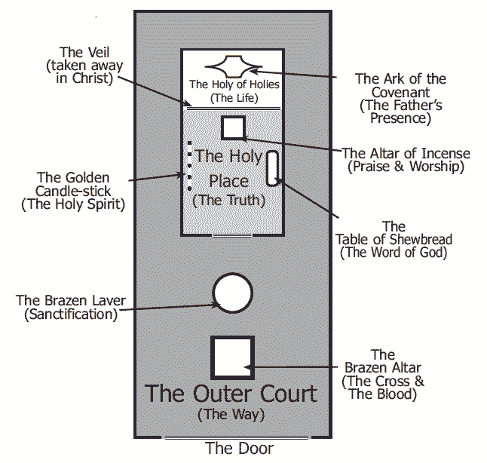
Heaven of Heavens
Free Access to stand in God’s presence
Son
Zechariah 3:7
Heaven
Charge of My Courts
Holy of Holies
---------------------
Veil -Life
Son
King
Kingdom of Heaven
Charge of My Courts
Inner Court
---------------------
Veil -Truth
King
Kingdom of God
Govern or Rule My House
Perform My service
Keep My laws (charge)
Outer Court
---------------------
Veil -Way- Cross
Lord
Servant – Steward - Friend
Kingdom of Earth
Walk in His ways

Slide 25


Deep Calls to Deep
Jesus is Lord
Training
You
Trials
Tribulations
Abdicate
Friend
Relationship
Steward
Resources
Responsibility
Seat of Rest
Government
Seat of Rest
Government
Servant
Works of God
Ways of God
Jesus is Lord
Jesus is King
God is Father
I am Lord
I am King
I am a Son
Holy Spirit
Jesus
Father
Seat of Rest
Government
Seat of Rest
Government
Seat of Rest
Government
Rule House
Administer Principles of Kingdom
Judge Courts
Access to Stand

Slide 26
Pathway of Responsibility
There are may different positions we can occupy as sons within heaven’s governmental structure
Government has structure, protocols and positions of authority all as sons
Lords, Kings, Priests, Oracles, Legislators, Scribes, Chancellors, Judges, Magistrates, Council members

Slide 27
Pathway of Responsibility
Eternity
Perfection
Heaven of Heavens
SONS
Heaven
Kingdom Heaven
KINGS
Kingdom God
LORDS
Principalities Powers
Everlasting Doors
Atmosphere Earth
Rulers/Darkness
Kingdom Earth
Spiritual Hosts of wickedness
Under the Earth

Slide 28


Place of His Presence
Eternity
Place of His Government
Perfection
Heaven of Heavens
Place of His Domain
2 Cherubim
Fiery Sword
Realm of His Abode
Heaven
Holy Holies
Holy Place
Inner
Court
Outer
Court
Kingdom of Heaven
Realm of His Domain
Walk in the light
LIGHT
Kingdom of God
Realm of His Government
See the light
LIGHT & DARK
Kingdom of Earth
Realm of His Presence
Time & Space
Born in darkness

Slide 30
Pathway of Responsibility
The heavens are a multiverse environment
Heavenly realms have some fixed dimensions that can be engaged in unique ways designed for us specifically
There are also interactive and creative environments
Heavenly encounters may be symbolic

Slide 31
Pathway of Responsibility
The heavenly realms operate in creative light this operates at a faster speed than created light
Creative light means time operates differently relative to created light
Eternity operate in pure light and has no linear time

Slide 32
Pathway of Responsibility
We see the light
We engage the light
We walk in the light
We reflect the light
We radiate the light
We become the light
We restore the light

Slide 33
Pathway of Responsibility
We must establish our own pathways by continually engaging until they are part of us
Learn the protocols of kingdom for rulership
We take our responsibility for each of our individual pathways our destiny
As Lords, Kings, Sons etc.

Slide 34
Pathway of Responsibility
The position of authority is different from the level of authority
The authority that we will be given is proportionate to the level of holiness that we operate in linked to the motives of our hearts
God gives us authority for our positions in the heavenly realms as we mature

Slide 35
Pathway of Responsibility
We all have positions but we have different levels of responsibility depending on our maturity
Many “great” people have fallen because they were not accountable for those inner motives (getting affirmation etc. from outside)
We must have our motives right if we are to carry authority correctly

Slide 36
Pathway of Responsibility
When we learn to serve like a king we will be operating in true sonship
When we rule with a servant heart it demonstrates our relationship of with the Father
We only desire to do what we see the Father doing
True rulership requires true intimacy

Slide 37
Pathway of Responsibility
We have a lot of maturing to do but fortunately we have a transformation process to follow
The more we live in creative light, in our position of righteousness, the more we begin to resonate and become holy as the Father is holy
Our spirit, soul and body become whole in oneness

Slide 38
Pathway of Responsibility
2 Cor 3:18 But we all, with unveiled face, beholding as in a mirror the glory of the Lord, are being transformed into the same image from glory to glory, just as from the Lord, the Spirit.
We are changed from glory to glory as we engage with God in creative light

Slide 39
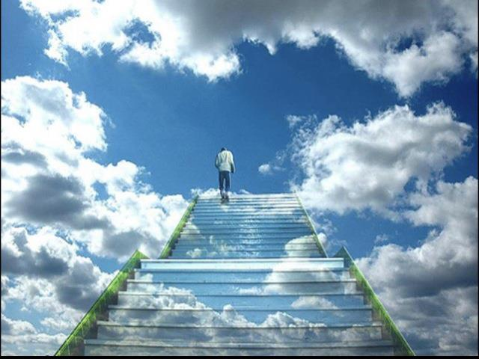
Pathway of Responsibility
Come up here
Rev 4:1

Slide 40

Steps like Jacob’s ladder leading up to heaven
There is a door standing open in heaven
Hear the invitation to come up here
Walk up those steps to the door
Now step through the veil into the kingdom realm

Slide 41
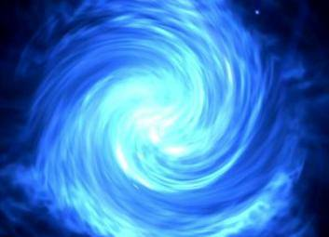
Let your mind and heart go to rise above this earthly realm.
Stepping into heavenly realms your spirit is free from earthly constraints physical laws etc.
Breathe in the atmosphere of heaven it is not oxygen that sustains you there but love, joy peace – glory
Breathe it in

Slide 42
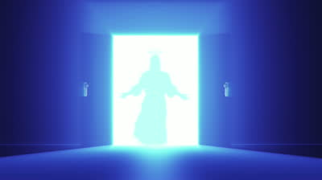
Jesus is standing in the doorway
Present yourself to Jesus your High Priest as a living sacrifice
Surrender your agenda
Let Him take you by the hand
Be open to go wherever He takes you and engage whatever He shows you

Slide 43
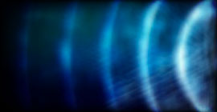
Let Jesus reveal a deeper revelation of your identity in sonship
Let Jesus lead you into a fresh revelation of your position of authority
Let Jesus lead you to engage your heavenly Father
Let your heavenly Father affirm your sonship

Slide 46
Pathway of Responsibility

Slide 47
Pathway of Responsibility
Rom 12:1-2 Therefore I urge you, brethren, by the mercies of God, to present your bodies a living and holy sacrifice, acceptable to God, which is your spiritual service of worship. 2 And do not be conformed to this world, but be transformed by the renewing of your mind, so that you may prove what the will of God is, that which is good and acceptable and perfect.

Slide 48
Pathway of Responsibility
Being a living sacrifice will test the motives of our heart
Helps us develop a servant heart for God's glory
To be a living sacrifice we need an altar, fire and an offering and a High Priest

Slide 49
Pathway of Responsibility
Ps 139:23 Search me, O God, and know my heart; Try me and know my anxious thoughts; 24 And see if there be any hurtful way in me, And lead me in the everlasting way.

Slide 50
Pathway of Responsibility
Heb 4:12 For the word of God is living and active and sharper than any two-edged sword, and piercing as far as the division of soul and spirit, of both joints and marrow, and able to judge the thoughts and intentions of the heart
3 levels of transformation

Slide 51
Pathway of Responsibility
To rule as LORDS in the kingdom of God we need to deal with the surface level of the transformation process,
Separation of soul and spirit our behaviours (coping and defence mechanisms etc.)
Transparency openness willingness to have our blind-self revealed

Slide 52
Pathway of Responsibility
To rule as KINGS in the kingdom of Heaven we need to deal with the deeper level
Our thoughts as well as the motives and intentions of the heart
Trading floors pathway of the knowledge of good and evil

Slide 53
Pathway of Responsibility
To rule as SONS in heaven we need to go to the deepest levels of transformation even to a genetic level
Rom 8:29 For those whom He foreknew, He also predestined to become conformed to the image of His Son, so that He would be the firstborn among many brethren;

Slide 54
Pathway of Responsibility
Heb 4:14 Therefore, since we have a great high priest who has passed through the heavens, Jesus the Son of God, let us hold fast our confession. 15 For we do not have a high priest who cannot sympathize with our weaknesses, but One who has been tempted in all things as we are, yet without sin.

Slide 55
Pathway of Responsibility
Heb 4:16 Therefore let us draw near with confidence to the throne of grace, so that we may receive mercy and find grace to help in time of need.
We will continually need to draw near in relationship and intimacy
Intimacy releases identity
Identity releases responsibility
Responsibility releases transformation

Slide 56
Pathway of Responsibility
In the introduction I will cover some topics at a introductory level that will be either become future modules or sections within modules covered in more detail
New verses old earthly verses heavenly ways
Navigating the heavenly realms and structures
Living sacrifices, Transformation, Worship

Slide 57
Pathway of Responsibility
Tabernacle, Holy of Holies and arc
Eternity and time
Courts councils and assemblies
Legislation, scrolls, mandates, laws, blueprints
Mountains and thrones,
Heavenly authority roles positions

Slide 58
Pathway of Responsibility
Order of Melchizedek
4 faces of God
Angelic canopy
7 spirits of God
Cloud of witnesses
Wisdom
Ancient or hooded ones

Slide 59
Pathway of Responsibility
Heavenly and earthly kingdom government
Reflection of the governmental pattern of heaven - Benches 3, 7 and 12
Culture of honour relational openness, honesty and mutual submission

Slide 60
Pathway of Responsibility
Reclaiming the atmosphere of the earth
Demonic bench of 3
Darkness and light in the kingdom
Relationship between earth, the atmosphere of the earth and kingdom of God realm
Dealing with dragons, giants, false kings

Slide 61
Pathway of Responsibility
Engaging the 12 High Chancellors Houses
Alignment of the Circle of the deep
Administrating the times and seasons to release the ordinances, mantles, scrolls from the eternal precepts of God
Establishing new order Ekklesia and Embassies of heaven on earth from heavenly blueprints

Slide 62
Pathway of Responsibility
We are responsible as sons to rule the created universe
Physical created realm
Spiritual unseen created realm
Are we willing to take that responsibility and be accountable as sons of God?

Slide 63
Pathway of Responsibility

Slide 64
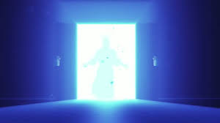
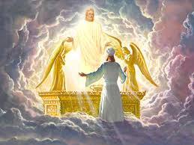

WAY
TRUTH
LIFE
CROSS
THOUGHTS & INTENTIONS
MOTIVES
BONE & MARROW
DNA
SOUL/SPIRIT
SKINS
LIVING
SACRIFICES
LAVER
LIGHT
ALTAR
Pattern of the true tabernacle
Pathway of Responsibility

Slide 65
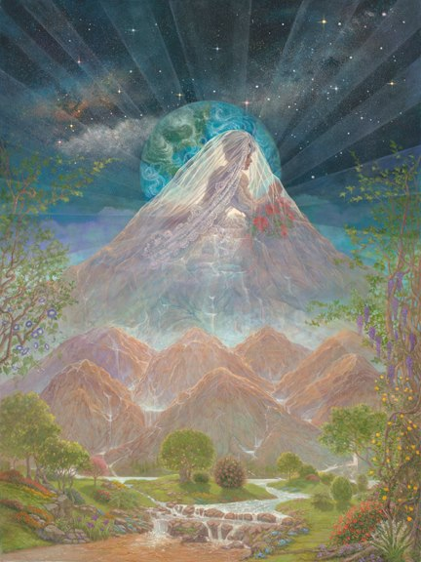

KINGDOM OF GOD
COURT ACCUSATION
COURT OF WAR/STRATEGY
COURT OF ANGELS
RULING LORDSHIP
WAY
TRUTH
CROSS
EVERLASTING DOORS

Slide 66
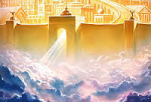
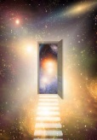
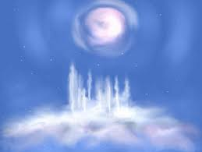
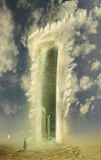
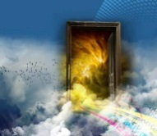

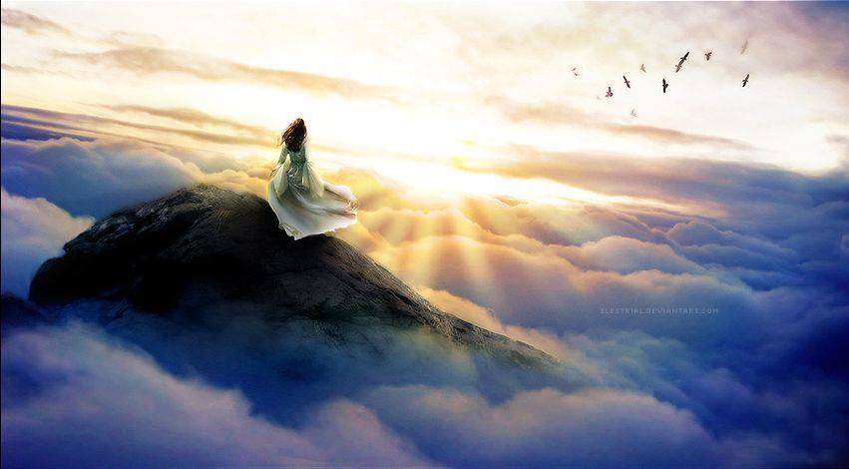
KINGDOM OF HEAVEN
Stars
TRUTH
LIFE
WISDOMS HEIGHTS
Under
Earth
Atmosphere
Earth
COURT OF CHANCELLORS
COURT OF SCRIBES
RULING KINGSHIP

Slide 67
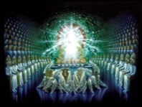
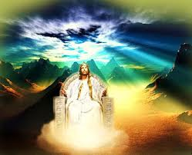
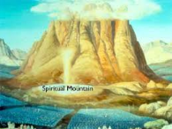
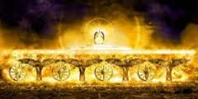
HEAVEN
Mountain or House of God
LIFE
COURT OF
KINGS
COURT OF
COUNCILS
COURT OF
THE UPRIGHT
Throne Room
RULING
SONS
Temple
Fire Stones
River of Life
River of Fire
Holy of Holies

Slide 68
HEAVEN
Mountain or House of God
LIFE
RULING
SONS
TRAINING HALL
7 SPIRITS of GOD
Trading Floors
12 Chancellors Houses
Treasury Room - Mantle Room - Scroll Room - Affairs of Nations Room - Weapons Room - Culture Room - Discovery Room - Commissioning Room - Law Room - Precepts Room - Ordinance Room - Statutes Room
Book Room
Wine Room
Oil Room
Dialogue Room
Wardrobe Room
Class Rooms
Quest Room
Body Parts Room
Record Room
Infinite Resources Room

Slide 69
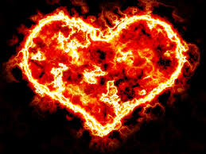
Heaven of Heavens
Perfection
Eternity
Dark Cloud
Person of God
COURT OF
JUDGES
COURT OF
THE LORD
COURT OF
70

Slide 70
Living Sacrifices
Understanding
Responsibility
Pathway of Responsibility

Slide 71
Base Camp 2
Stepping into heavenly realms your spirit is free from earthly constraints physical laws etc. - multiversed
Let your mind and heart go to rise above this earthly realm.
Breathe in the atmosphere of heaven it is not oxygen that sustains you there but love joy peace - glory

Slide 72
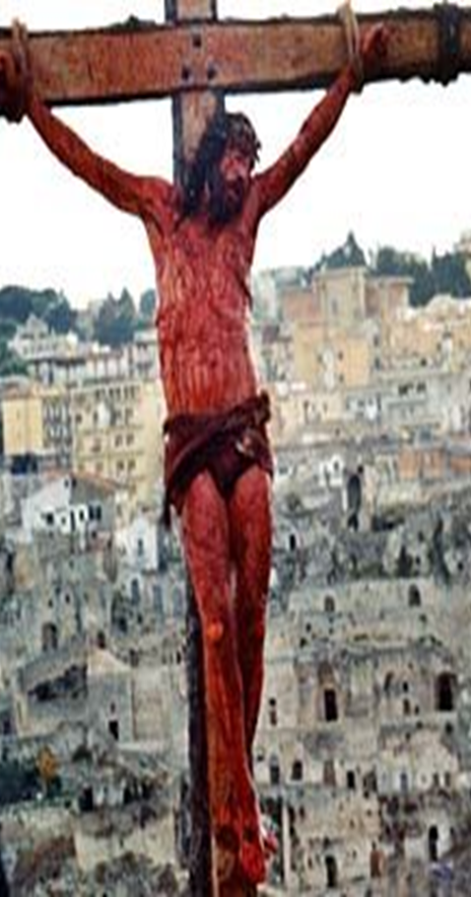
1 Cor 5:21 He made Him who knew no sin to be sin on our behalf, so that we might become the righteousness of God in Him.

Slide 73
Base Camp 2
1 Cor 5:21 He made Him who knew no sin to be sin on our behalf, so that we might become the righteousness of God in Him.
Gal 2:20 I have been crucified with Christ; and it is no longer I who live, but Christ lives in me; and the life which I now live in the flesh I live by faith in the Son of God, who loved me and gave Himself up for me.
Engage the Fathers great love for us

Slide 74
Pathway of Responsibility
Come up here
Rev 4:1

Slide 76
Base Camp 2
Breathe deeply let your capacity increase as Love flows as you enter into a deeper level of peace wholeness and rest.
Let heavens joy fill you and sense your strength and supernatural abilities increase.
Just stepping in and stepping out practice acclimatising. Let the freedom of heavens expansiveness expand the realm of your possibilities.

Slide 77
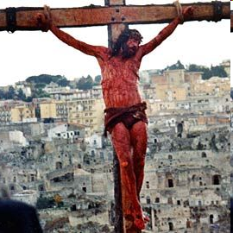
The Covenant Exchange at the Cross
OLD LIFE
DEATH
SIN & SICKNESS
BONDAGE TO SIN
OLD NATURE
GUILTY
CONDEMNED
SINFUL
JUDGMENT
SLAVES TO SIN
NEW LIFE
LIFE
FORGIVENESS & HEALTH
FREEDOM FROM SIN
NEW NATURE
INNOCENT
AQUITTED
RIGHTEOUS
JUSTIFICATION
SLAVES OF RIGHTEOUSNESS
1 Cor 5:21 He made Him who knew no sin to be sin on our behalf, so that we might become the righteousness of God in Him.

Slide 78
Pathway of Responsibility

Slide 79
Pathway of Responsibility

Slide 80
Pathway of Responsibility
Preparation 7 spirits and wisdom
Temple preparation fire fire stones preparation
Mandates Scrolls blueprints laws and legislation
Alignments of the heavens and the earth
Heavenly and earthly roles and mantles of authority.

Slide 81
Pathway of Responsibility

Slide 82
Pathway of Responsibility
Gen 1:28 God blessed them; and God said to them, “Be fruitful and multiply, and fill the earth, and subdue it; and rule over … it
That would have been just the start – whole creation awaits

Slide 83
Pathway of Responsibility
Rom 8:16 The Spirit Himself testifies with our spirit that we are children of God, 17 and if children, heirs also, heirs of God and fellow (joint) heirs with Christ, if indeed we suffer with Him so that we may also be glorified with Him.

Slide 84
Pathway of Responsibility
Rom 8:19 For the anxious longing of the creation waits eagerly for the revealing of the sons of God. 21 that the creation itself also will be set free from its slavery to corruption into the freedom of the glory of the children of God

Slide 85
Pathway of Responsibility
Cleansing gateways behavioural blockages and hindrances to intimacy in relationship
Sin, familiar spirits, habitual patterns of behaviour, guilt shame condemnation etc
Being a living sacrifice goes deeper to deal with motives of our hearts and genetic issues

Slide 86
Pathway of Responsibility
There are different levels. Most inner healing and deliverance dealt with the behavioural level. Now we look to engage in a deeper level in the realms of the kingdom we also need to go to a deeper level in those things.

Slide 87
Pathway of Responsibility
If you dealt with the surface level – the skins of behaviour (coping and defence mechanism) that will get you as far as the kingdom of God, you are dealing with some dragons and giants.
But if you want to engage in kingship you need to go deeper and deal with the thoughts, motives & intentions of the heart,
The trading!!.

Slide 88
Pathway of Responsibility

Slide 89
Pathway of Responsibility
Come up here
Rev 4:1

Slide 93
Base Camp 2
Stepping into heavenly realms your spirit is free from earthly constraints physical laws etc. - multiversed
Let your mind and heart go to rise above this earthly realm.
Breathe in the atmosphere of heaven it is not oxygen that sustains you there but love joy peace - glory

Slide 94
1 Cor 5:21 He made Him who knew no sin to be sin on our behalf, so that we might become the righteousness of God in Him.

Slide 95
Base Camp 2
1 Cor 5:21 He made Him who knew no sin to be sin on our behalf, so that we might become the righteousness of God in Him.
Gal 2:20 I have been crucified with Christ; and it is no longer I who live, but Christ lives in me; and the life which I now live in the flesh I live by faith in the Son of God, who loved me and gave Himself up for me.
Engage the Fathers great love for us

Slide 96
Pathway of Responsibility
Come up here
Rev 4:1

Slide 98
Base Camp 2
Breathe deeply let your capacity increase as Love flows as you enter into a deeper level of peace wholeness and rest.
Let heavens joy fill you and sense your strength and supernatural abilities increase.
Just stepping in and stepping out practice acclimatising. Let the freedom of heavens expansiveness expand the realm of your possibilities.

Slide 99
The Covenant Exchange at the Cross
OLD LIFE
DEATH
SIN & SICKNESS
BONDAGE TO SIN
OLD NATURE
GUILTY
CONDEMNED
SINFUL
JUDGMENT
SLAVES TO SIN
NEW LIFE
LIFE
FORGIVENESS & HEALTH
FREEDOM FROM SIN
NEW NATURE
INNOCENT
AQUITTED
RIGHTEOUS
JUSTIFICATION
SLAVES OF RIGHTEOUSNESS
1 Cor 5:21 He made Him who knew no sin to be sin on our behalf, so that we might become the righteousness of God in Him.

