Slide 1
Preparing for Destiny
Intimacy relationship – knowing God
Restored Identity gives authority to fulfil destiny
Destiny is Revelation of your Rulership mandate
Destiny is Manifesting the kingdom of God on earth as it is in heaven
Frequency vibration sound is being released from heaven
Resonate with the frequency come into harmony
Calling us back to our heavenly destiny

Slide 2
Preparing for Destiny
Scroll or book our lives - out of Eternity
Letter of decree or commission
Carries our Purpose, Provision for our Destiny
Accessed in heavenlies & in our hearts
Matt 6:10 ‘Your kingdom come. Your will be done, On earth as it is in heaven

Slide 3
Preparing for Destiny
Jer 1:5 “Before I formed you in the womb I knew you, And before you were born I consecrated you; I have appointed you a prophet to the nations.”
Psa 139:16 Your eyes have seen my unformed substance; And in Your book (scroll) were all written The days that were ordained for me, When as yet there was not one of them. 17 How precious also are Your thoughts to me, O God! How vast is the sum of them!

Slide 4
Preparing for Destiny
Your destiny is to rule – Plan A
Gen 1:28 God blessed them; and God said to them, “Be fruitful and multiply, and fill the earth, and subdue it; and rule
Church Destiny to rule – Plan A
Isa 2:2 Mountain of house of the Lord raised up above all other mountains
1 Peter 2:9 But you are A CHOSEN RACE, A royal PRIESTHOOD

Slide 5
Preparing for Destiny
Psa 24:7 Lift up your heads, O you gates! And be lifted up, you everlasting doors! And the King of glory shall come in 8 Who is this King of glory? The LORD strong and mighty,
Zech 3:6 And the angel of the LORD admonished Joshua, saying, 7 “Thus says the LORD of hosts, ‘If you will walk in My ways and if you will perform My laws, then you will also govern My house and also have charge of My courts, and I will grant you free access among these who are standing here.

Slide 6
Preparing for Destiny
Eternity
Perfection
Heaven of Heavens
Access & Stand - SONS
Heaven God’s Abode
Time Line
Judge Courts – KINGS
Kingdom Heaven God’s Domain
Rule House – LORDS
Principalities Powers
Kingdom God God’s Government
Keep my laws
Rulers/Darkness
Everlasting Doors
Atmosphere Earth
Spiritual Hosts of wickedness
Kingdom Earth God’s Presence
Walk in my ways
Luke 17:21
Kingdom of God is within

Slide 7
Increasing shaking of world systems
LAST DAY
Day of Resurrection & Judgment
John 6:40 John:12:48
Increasing world darkness but Church light
Increasing manifestations of glory, signs & wonders
Persecution
Mountain of the House of the Lord
Raised up Isa 2:2
Wealth transfer
Raising a Joshua Generation
The Call
to
Intimacy
& Love
Song of Solomon 8:6-7
Gathering
of
Stumbling
Blocks
Refiners
Fire
Matt 13:41
Isa 6:1-8
Judgment
of the household of God
Separation
of wheat & tares
Matt 13:40
1 Peter 4:17
Harvest of Harvesters
Years of blessing
Gen 41:47-49
Storm Judgment on the World systems
Heb 12:25-29
Final Harvest
Final Separation
Wheat & Tares
Gen 41:57
Age to come
New Heavens & New Earth Eternity
2 Peter 3:10-13 1 Cor 15:23-28
Isa 60:1-22, Numbers 14:21
Acts 3:21 Restoration of all
Increasing no’s regional apostolic centres
JESUS RETURNS
1 Cor 15:51-54, 1 Thes 4:14-17
Increasing releasing of 5 fold ministry & gifts
Increasing manifestation of Matt 6:33 people
Prophetic Timetable

Slide 8
Preparing for Destiny
Building up of the spirit
Restoring & refining of the soul
Spirit - Soul - Body
Glory of God manifested on earth & beyond through sons of light

Slide 9
Preparing for destiny
Give God first love, place, priority
Pray & sing in tongues
Wait on the Lord – Be still
Meditate on word of God – Prov 4:20-23

Slide 10
Preparing for destiny
3 stages of experiences
Visions – snap shot pictures or moving pictures in the 3rd person
Visitations – 1st person may involve trances or even translations
Habitations living in the dual realms of heaven & earth simultaneously
John 3:¹³ No one has ascended to heaven but He who came down from heaven, that is, the Son of Man who is in heaven. (dwells has His home)

Slide 11
Preparing for Destiny
Dethronement of self, soul, old life
Strongholds, mind-sets, false belief systems
Familiar spirits - Generational Spirits
Nature - DNA programming
Nurture - environmental programming
Trauma - experiential programming

Slide 12
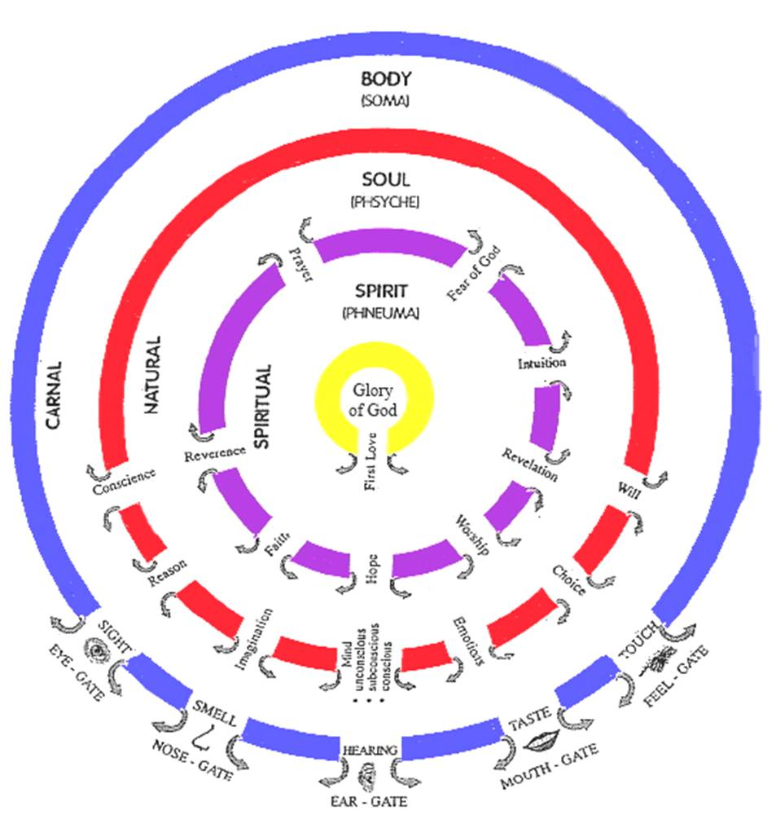

Slide 13
Spirit Gates
Training our Senses by Practice
Fear of God
F E L L O W S I P
Awestruck All Knowing, All Seeing, All Powerful, Almighty, Consuming Fire
Reverence
Honour Respect
Worship
Obeisance, Obedience Surrender, Submission
S O U L G A T E S
Prayer
Constant 2 Way Communication Flow
Hope
R E V E L A T O R Y
Visions, Dreams, Seeing Opportunities
Faith
Harmony, Concord, Understanding, Knowing
Revelation
Inspiration, Light, Counsel, Wisdom
Intuition
Knowledge, Gut feelings Instinct
Heavenly
Spiritual Consciousness Heavenly Access

Slide 14
Preparing for Destiny – Open Gates
Gifts & callings
Prophetic – revelation gate, hope gate
Spiritual gifts flow - Intuition gate - Words knowledge, wisdom, distinguishing spirits
Healing, miracles – Faith Gate
We all need reverence, fear of God, prayer gates open for intimate relationship
Will we be worshippers – obedient?

Slide 15
Soul Gates
Desire - Discipline - Delight Refine - Renew - Restore Harmony Spirit, Soul & Body
Ears
Conscience
Protector Director
Guard Guide
Voice
Reason
Translator Interpreter
Understand Explain
Eyes
Imagination
Receiver Transmitter
Screen Projector
Conscious Mind
Choice
Mind
Do What Jesus Would Do
H E A R T
Subconscious Mind
Storage Programmes Memories
Hard drive Motives
Beliefs Values
Emotions
Responses Feelings
Guts Moved
Will
Persistence Courage
Boldness Endurance

Slide 16
Preparing for Destiny – Open Gates
Soul – Flesh, Mind, Heart – self awareness
Gal 5:16 But I say, walk by the Spirit, and you will not carry out the desire of the flesh.
Gal 5:17 For the flesh sets its desire against the spirit, and the spirit against the flesh; for these are in opposition to one another, so that you may not do the things that you please.

Slide 17
Preparing for Destiny – Open gates
Die to self - self-centredness, selfishness
Self-importance, Self-promotion, Self-control
Self-respect, Self-esteem, Self-worth, Self-image
Self-reliance, Self-sufficiency, Self-belief
Self-righteousness, Self-help, Self-expression
Self-gratification, Self-indulgence

Slide 19
Preparing for destiny – Open Gates
What blocks & closes souls gates
Sin – Unforgiveness, Rebellion, independence, self-centredness
Strongholds, Mind-sets, Beliefs, Lies
Negative Emotions - Fear, Doubt, Unbelief
Demonic – Familiar spirits, Generational spirits
Deception, Confusion, Control

Slide 20
Preparing for Destiny – Open Gates
Worked through all 53 years - past
Unmet needs affect our Souls desires & motives
Unhealed hurts affect our emotional desires & motives
Unresolved issues affect our Trust - Doubt

Slide 21
Preparing for Destiny - Open Gates
Acceptance Love
Security Safety
Approval Significance
Affirmation Identity, Purpose
Affection Value, worth
God desires and is able to meet all our needs
Who I am, Why I am Here, What my purpose is

Slide 22
Preparing for Destiny – Open Gates
Conscience – Sin, rebellion - dull
Weaknesses, patterns of sin, “normal acceptable” behaviours
Own it, Confess it, Repent, Renounce it
Apply blood of Jesus
Receive Forgiveness & Cleansing
No guilt, shame or condemnation
Righteousness
Reverence flowing through it

Slide 23
Opening our gates
Step 1 Rev 3:20 Jesus is knocking and the door handle is on our side we have to open it..
Give God First Love – place, priority
Open the gate of first love. This gate is often most damaged by our natural experiences of hurt, pain and rejection. Renouncing inner vows, repenting of fear and forgiving hurts and then inviting Him into your spirit and out through your soul and body by deliberately opening the door.

Slide 24
Opening our gates
Step 2 opening my spirit gates.
By acting in faith & meditating on the gates
By a relationship of intimacy with God
By surrendering my spirit to God
Pray in tongues see yourself standing in the gateway and opening the door and welcoming in the glory & fire of God’s presence to come through.

Slide 25
Opening our gates
Sample prayer
Father, I choose to open the gate of “Revelation” in my spirit. I open it and yield it to Your glory. I receive and release the power of God through this gate, that I begin to receive revelation of Your kingdom so that it will change my soul into the image of the Son of God who abides in me.
Pray and persist until you start to see the results and then keep going. You can work on all the gates, one at a time or in groups but be persistent and diligent.

Slide 26
Opening our gates
Step 3 opening my soul gates.
By acting in faith & speaking to my soul yielding control to the direction of my spirit
Take God’s word as a sword to separate your spirit from the control and dominion of the soul. - Heb 4:12
Declaring soul you will not be motive or control me or block the flow of the spirit

Slide 27
Opening our gates
Soul rules draws life from spirit
Soul draws from world through body
Soul seeks control, it blocks the spirit
Break soul ties to your spirit
Break independence by surrendering control

Slide 28
Opening our gates
As gateways begin to open expect warfare from your soul as the kingdom influence begins to exert itself.
We have to take back possession of our souls and dispossess anything residing there, demonic spirits, blockages, strongholds, controls etc.
The soul gates are usually influenced by demonic familiar spirits and our sin nature (this must be crucified with Christ and reckoned dead daily)

Slide 29
Opening our gates
Step 4 Take possession of the gateway and place Christ at the centre of it. Yield the souls gateways to the dictates of the spirit by allowing the life and glory of God to flow through them to dictate the bodies actions. Cleaning the gateways by the blood of Jesus is key to fully opening the flow. The imagination from negative images it has seen etc. wipe them out using the blood of Jesus.

Slide 30
Opening our gates
Step 5 Repent of allowing any demonic spirits access through the individual gateways of our souls. Acknowledging our sin and taking responsibility for not guarding the gates. Take the blood of Jesus by faith and wipe the gateway clean and redeem it.

Slide 31
Opening our gates
Example prayer for conscience gateway
Today I bring my conscience into submission to my spirit. I release the life of God to flow from my spirit, through the gateways of reverence and of the fear of God to a consciousness of God’s righteousness and truth. Where my soul has been seared by sin. I now take the sword of the spirit and cleave the gateway open to allow the flow of God through it, to dictate my actions. Father, make me aware of my actions that I may submit to Your authority in my spirit.

Slide 32
Opening our gates
Today in Jesus name I take authority over the spiritual force or condition that is resistant to the flow of God in me. I loose it and cast it out of this gateway in Jesus name. I make and place Jesus as Lord over this gateway today.

Slide 33
Opening our gates
Father I thank You that my conscience gateway is full of Your glory. I thank You that my conscience receives and releases the flow of Godliness and holiness through it in Jesus name. My conscience will now dictate my bodies actions in the world.
This type of praying needs to be persistent to maintain victory and widen the gateways flow.

Slide 34
Opening our gates
Imagination gateway
A key area because it feeds and stores everything we see, do, feel and hear. God gives us most image revelation on the screen of our imaginations and once clean, revelation and the ability to see into the realms of the kingdom are heightened considerably.
2 Cor 10:5 bring every thought captive and obedient to Christ

Slide 35
Opening our gates
Imagination gateway
Dealing with the images from our pasts.
Acknowledge their presence in your life.
Own the sin and bring the image into the light.
Take the blood of Jesus and apply to the image like a paintbrush obliterating the image.

Slide 36
Opening our gates
Subconsious Mind gateway – Heart soil - hard, stones, weeds
Example prayer. – Strongholds, Mind-sets, beliefs
Father today I release the glory of the kingdom of heaven into my unconscious, subconscious and conscious mind and into my memories to purge and clean them so that I may receive supernatural revelation from Your word to change my life.

Slide 37
Opening our gates
I release the life of God through the gateway of revelation in my spirit like a river to flush and wash and restore my mind so that I may have the Mind of Christ operating in me. So that the actions of my body reflect the kingdom of God and its outworking in my behaviour and to those around me.

Slide 38
Opening our gates
Body Gateways - Example Prayer for eye gateway
Father today in the name of Jesus I release the flow of the glory of God through the gateway of first love and the gateway of revelation, into the gateway of my imagination and out through the gateway of my eyes, that I might see into the kingdom of heaven with renewed spiritual sight. May my eyes become like a flame of fire to the demonic world as I reflect the glory of God from inside me.

Slide 39
Opening our gates
Body Gateways
We need to relearn to see from the inside out, hear from the inside out etc.
The body must become a slave and servant of the soul. The soul must become a slave and servant of the spirit. The spirit must become a bond servant of Jesus Christ in the centre of our being.

Slide 40
Opening our gates
How to keep a gateway flowing.
Keep short accounts, by confession and repentance as soon as the conscience picks up sin.
Be sensitive to the Holy Spirit, through conviction and being sensitive to warnings, intuitions etc.
Spend as much time as possible strongly praying in tongues inside & out, to keep the spirit flowing.

Slide 41
Opening our gates
Summary keys of possession of all the gates of body, soul, spirit.
Lay hold of the gates by faith as my inheritance, so that I exercise my God given right to exercise dominion and authority in the gates of my life.
Cast out any spirit that exercises its authority in those gates. Jesus is lord of the gates only as He is given the right to flow through them. In the spirit by faith raise the banner of victory over each gate as a declaration that Jesus resides there.
Begin to enforce the kingdom of God from the point of authority in the spirit, into the soul, and then into the body and out into the world.

Slide 42
Preparing for Destiny- Practice
Heb 5:14 But solid food is for the mature, who because of practice have their senses trained to discern good and evil. (spirit & soul)
Perseverance in dealing with soul blockages
Practice Daily - Flowing from inside out so the Kingdom manifests through & around us

Slide 43
Preparing for Destiny – Practice
Father by faith I choose to step into Your heavenly presence
I receive Your acceptance, love, mercy and grace
I stand in the victory of the cross forgiven, justified and cleansed
I thank you that clothe me in white robes of righteousness
I am the righteousness of God in Christ

Slide 44
Preparing for Destiny – Soul
Father I choose to deny myself & surrender control of my life to you
I give you my conscience
I repent and renounce everything that has damaged my conscience
I ask you to purify & restore my conscience
Direct & Protect me through conscience by reverence & fear of the Lord

Slide 45
Preparing for Destiny – Practice
Father I choose to deny myself & surrender control of my life to you
I give you my reason centre
I repent and renounce doubt, unbelief, rationalism, scepticism, cynicism, denial
I ask you cleanse me of all false doctrine, philosophies & ideas
I ask you to renew & restore my reason
Use my reason to interpret your thoughts & understand your ways

Slide 46
Preparing for Destiny – Practice
Father I choose to deny myself & surrender control of my life to you
I give you my imagination
I repent and renounce of viewing any image that has polluted me
I ask you to blot out every image with the blood of Jesus
Purify & restore my imagination
Restore my screen, vision & revelation

Slide 47
Preparing for Destiny – Practice
Father I choose to deny myself & surrender control of my life to you
I give you my heart my sub-conscious mind
I repent and renounce all strongholds, negative belief & value systems, vows, words, curses, doctrines, triggers, coping & defence mechanisms
I ask you to cleanse every negative memory
Purify, restore & reprogram my heart with your truth, values & my destiny

Slide 48
Preparing for Destiny – Practice
Father I choose to deny myself & surrender control of my life to you
I give you my emotions
I repent and renounce all unforgiveness, bitterness, anger & self-pity
I ask you purify & restore my emotions
Use my emotions to feel your heart & guide me through intuition.

Slide 49
Preparing for Destiny – Practice
Father I choose to deny myself & surrender control of my life to you
I give you my will
I repent and renounce all Sin, Rebellion, Stubbornness, Wilfulness, Control, Fear, Doubt, Unbelief, Indecision
I ask you to Purify & restore my will & Restore courage, perseverance
Use my will to enable me to do your will through obedience & true worship

Slide 50
Preparing for Destiny – Practice
Father I surrender my spirit, soul and body to You
I declare that Jesus is Lord of the gates of my life
I step back into this realm readily available to do Your will & purposes
Manifest Your glory & presence in & through my life
Manifest Your Kingdom authority and power through me and around me

