Slide 1
Preparing for Destiny
Building up of the spirit
Restoring & refining of the soul
Spirit - Soul - Body
Glory of God manifested on earth & beyond through sons of light

Slide 2
Preparing for destiny - spirit building
Give God first love, place, priority
Pray & sing in tongues
Wait on the Lord – Be still
Meditate on word of God – Prov 4:20-23

Slide 3
Preparing for destiny - Meditation
Heb 4:12 For the word of God is living and active
Meditate on it in 2D to experience it in 3D. A picture paints a 1000 words
Experiences, visions, pictures, revelation
Write, Review & revisit – value it
Consumer of the word to a producer of the word
Tomato from supermarket
Grow tomatoes – soil, seed, support, flowers, prune, feed, water, sun, shelter

Slide 4
Preparing for destiny - Meditation
Some experiences heaven not in word ( greater works of Jesus)
Use word to plumb line experience to the principles of God’s nature & character
Word then becomes a starting point for future experience
Word is a doorway to heavenly encounters
Word is an anchor & platform for more heavenly experiences

Slide 5
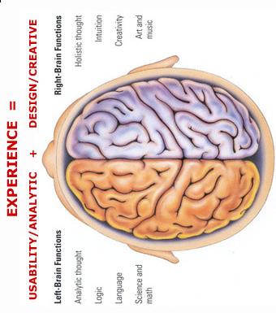
MIND
Hippocampus is a shredding machine for irrelevant information 100 billion instructions /sec
Use visions, dreams, Imagination, meditation, words call things that aren’t as if they are
Experiences are forgotten if the are not used Use it or lose it
Natural
TONGUES
H I P P O C A M P U S
M E M O R Y
B A NK S
Write
Review
Revisit
H E A R T
See
Smell
Hear
Taste
Touch
R E P E T I T I O N
V A L U E
V A L U E
Word Meditation Doors Visions Experience
Meditate
Synapses Close & Form Neural Pathways
Links to Memories
Confession
Repetition
Pictures Visions Encounters Word Anchor
Agreement
S P I R I T
Trauma forms instant neural pathways
Or forms pathways around the memories to block them
Spiritual
We all see spiritual realms most have no reference points or anchor so all info gets shredded
Words become doorways to spiritual experiences Words become anchors of experiences to keep doors open

Slide 6
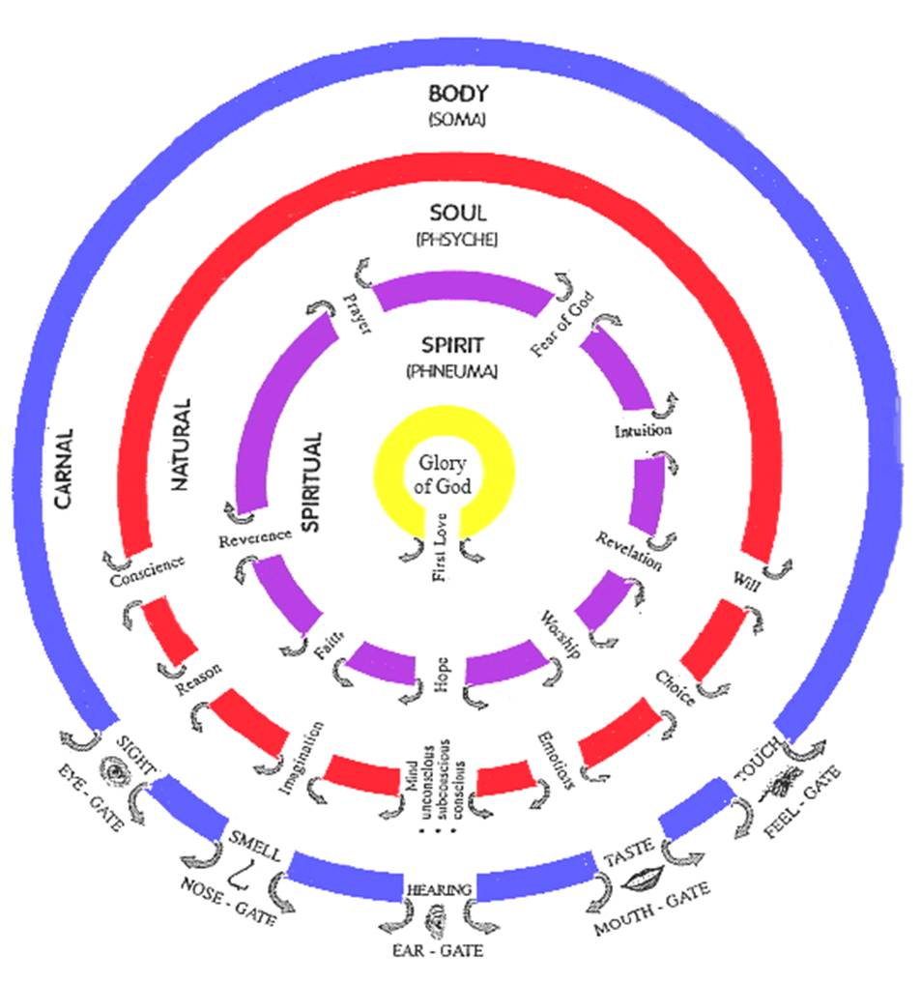

Slide 7
Preparing for Destiny - Meditation
Joshua 1:8 This book of the law shall not depart from your mouth, but you shall meditate on it day and night, so that you may be careful to do according to all that is written in it; for then you will make your way prosperous, and then you will have success.
Prov 4:20 My son, give attention to my words; Incline your ear to my sayings. 21 Do not let them depart from your sight; Keep them in the midst of your heart. 22 For they are life to those who find them And health to all their body 23 Watch over your heart with all diligence, For from it flow the springs of life.

Slide 8
Preparing for Destiny - Meditation
Psa 119:11 Your word I have treasured in my heart, That I may not sin against You.
15 I will meditate on Your precepts
23 Your servant meditates on Your statutes
27 So I will meditate on Your wonders
99 For Your testimonies are my meditation
148 I may meditate on Your word

Slide 9
Preparing for Destiny - Meditation
Meditation means “the act of focusing one’s thoughts: to ponder, think on, muse.” reflect, contemplate, babble, mutter, imagine
Some synonyms would be contemplation, reflection, rumination, deep thinking, or remembering in the sense of keeping or calling something to mind for the purpose of consideration, reflection, or meditation.

Slide 10
Preparing for Destiny - Meditation
To murmur; to converse with oneself, and hence aloud; speak; talk; communication; mutter; babbling; pray; musical notation; imagine.
Turns logos written word into the Rhema spoken word
Head knowledge to personal experience

Slide 11
Preparing for Destiny - Meditation
Psalm 63:6 When I remember Thee on my bed, I meditate on Thee in the night watches,
Psalm 77:11 I shall remember the deeds of the LORD; Surely I will remember Thy wonders of old.
Psalm 143:5 I remember the days of old; I meditate on all Thy doings; I muse on the work of Thy hands.

Slide 12
Study
vs.
Meditation

Slide 13
Preparing for Destiny - Meditation
Lord cleanse & prepare my heart
Lord give me a teachable attitude
Lord I surrender my senses to You
Lord open the eyes of my heart
Lord I present my abilities to reason & imagine to You to fill & flow through
Lord I focus my attention on what you show me
Lord I thank you for what you have revealed to me

Slide 14
Preparing for Destiny - Meditation
Logos word of God reveals His nature, character, safeguard truth, standard or plumb line
Psa 119:1-40 word, ways, testimonies, judgments, law, precepts, statutes, ordinances, commandments, wonders
Beholding & becoming
2 Cor 3:18 beholding as in a mirror the glory of the Lord, are being transformed into the same image from glory to glory

Slide 15
Preparing for Destiny - Meditation
Rhema word of God speaks truth into our spirits, hearts
Psa 119:1-40 walk, observe, seek, look, treasure, tell, rejoice, meditate, establish, delight, live, long for, cling, run, incline, reverence, give thanks
Psa 119:1-40 bless, ordain, teach, open eyes, rebuke, take away reproach, revive, answer, strengthen, grant, enlarge heart, give understanding, deal bountifully

Slide 16
Preparing for Destiny - Meditation
Prov 4:20 My son, give attention to my words; Incline your ear to my sayings. 21 Do not let them depart from your sight; Keep them in the midst of your heart. 22 For they are life to those who find them And health to all their body. 23 Watch over your heart with all diligence, For from it flow the springs of life.

Slide 17
Preparing for Destiny – Soul
Give control of your soul to your spirit
Take authority over the soul
Separate soul from spirit
Heb 4:12 For the word of God is living and active and sharper than any two-edged sword, and piercing as far as the division of soul and spirit, of both joints and marrow, and able to judge the thoughts and intentions of the heart.

Slide 18
Preparing for Destiny – Soul
Soul rules draws life from spirit
Soul draws from world through body
Soul seeks to control the spirit
Break soul ties to your spirit
Use word to separate Soul/Spirit

Slide 19
Preparing for Destiny – Soul
Like a wedge, divide & separate
Break control of soul over spirit
Change from inside out
Reflect your spirit man
Become one “living being”

Slide 20
Preparing for Destiny- Practice
Heb 5:14 But solid food is for the mature, who because of practice have their senses trained to discern good and evil. (spirit & soul)
Step in & Step out
Tabernacle holy place

