Slide 1
Preparing for Destiny
Building up of the spirit
Restoring & refining of the soul
Spirit - Soul - Body
Glory of God manifested on earth & beyond through sons of light

Slide 2
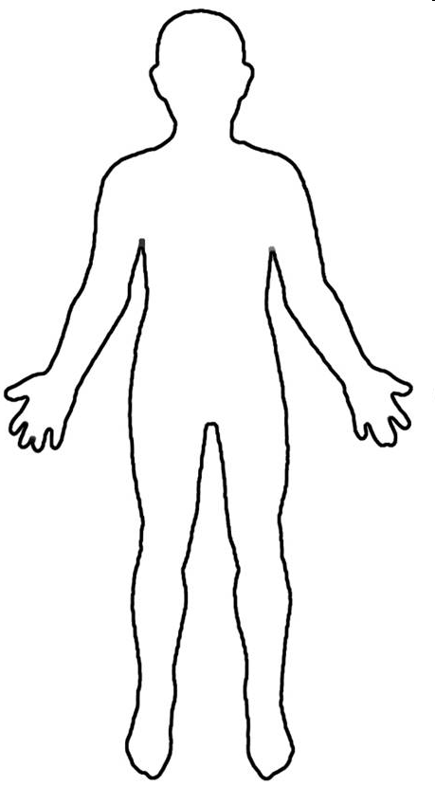
Conscious Mind
Spirit Father Son Holy Spirit
Heart Subconscious Mind Garden Scroll
Kingdom Heaven
Rivers Power Anointing
Rule House – LORDS
Kingdom within us Seat of Government
Keep my laws
Walk in my ways

Slide 3
Spirit – Father/Son/Spirit
Kingdom of Heaven
9 Spiritual Senses 7 Soul senses & 5 Body Senses
Tabernacle Holy Place Altar Incense
Present yourself as a Living Sacrifice
Throat Cut Total Surrender
Head cut off Government removed
Skin coverings removed Naked
Body Split Open Exposed
Legs Cut Off Walk
Denial of self Take up Cross Follow Him
Not my will but Yours be done
Seek First the kingdom & righteousness
I am crucified with Christ He lives in me
Choice I only do what Father is doing
Tabernacle Holy of Holies Mercy Seat

Slide 4
Familiar Spirit Remind Affirm Agreement
Confrontation
Criticised
Rejected
Injustice
Insecure
Event - Reactions
Intimidated
Sin
Mind is Replaying
Angry
Defensive
Aggressive
Passive
Imagination
Loving
Emotions
Reason
Forgive & Release
Mindsets Behaviours Mechanisms Emotions
Repetition
Seek God’s Counsel to Evaluate Patterns of Thinking & Behaviour
Truth of Motives Mind, Heart & Will of God
Revelation about
Reactions or Actions
Heart Sub-Conscious
Hard Weeds
Stones
Memories Motives
Not my Issue
Courts
My issue Own it Deal with it
Weakness Unmet Need Unhealed Hurt Unresolved Issue
Pray Intercede Confront in love?
Weakness Sin or Character Repent Renounce Find Word Meditate
Weakness Gift, skills Empower Support Learn
Weakness Gift, skills Discipled Learn Strong
DNA Nature Generational? Curse?
Nurture Upbringing Trauma Experiences
Renewed Mind & Restored Soul

Slide 5
Preparing for destiny – Seat of Rest
Seat Rest – live in the eye of the storm
Jesus our example asleep in the boat
Peace & Joy – relationship not circumstances
Attitude of gratitude & thanksgiving - choice
Praise - Rejoicing always - choice
Living giving a sacrifice of praise - choice
Treating trials & tribulations as joy & an opportunity for growth & transformation - choice

Slide 6
Preparing for destiny – Seat of Rest
Seat Rest – Eye of storm – Jesus says peace be still and rebuked the storm
Seat of Rest is the Kingdom of God within; it is the manifestation of the fullness of the government of God with us to bring revelation to the world around us.
Seat of rest is the place of your government to bring kingdom authority into life and command everything to be subject to realm of God’s kingdom

Slide 7
Preparing for destiny -Training
Jesus is Lord
Training
You
Trials Tribulations
Abdicate
Friend
Relationship
Steward
Resources Responsibility
Seat of Rest
Government
Seat of Rest
Government
Servant
Works of God
Ways of God
Jesus is King
God is Father
I am a Son
I am Lord
I am King
Holy Spirit
Jesus
Father
Seat of Rest
Government
Seat of Rest
Government
Seat of Rest
Government
Administer Principles of Kingdom
Rule House
Judge Courts

Slide 8
Preparing for destiny - spirit building
Give God first love, place, priority
Pray & sing in tongues
Wait on the Lord – Be still
Meditate on word of God – Prov 4:20-23

Slide 9
Preparing for destiny - Meditation
Heb 4:12 For the word of God is living and active
Meditate on it in 2D to experience it in 3D. A picture paints a 1000 words
Experiences, visions, pictures, revelation
Write, Review & revisit – value it
Consumer of the word to a producer of the word
Tomato from supermarket
Grow tomatoes – soil, seed, support, flowers, prune, feed, water, sun, shelter

Slide 10
Preparing for destiny - Meditation
Some experiences heaven not in word ( greater works of Jesus)
Use word to plumb line experience to the principles of God’s nature & character
Word then becomes a starting point for future experience
Word is a doorway to heavenly encounters
Word is an anchor & platform for more heavenly experiences

Slide 11
Preparing for destiny - Meditation
3 memory storage systems – neurones
Brain in our skull conscious memory
Heart – Sub-conscious memory
Gut – Instinctive memory
Nervous system connects our body
Brain Left & Right
Right side is intuitive, creative, visionary

Slide 12
Preparing for destiny - Meditation
Imagination can play back our external experiences
Imagination is the Screen where God can project vision & is our spiritual perception
Imagination can receive images from your soul – subconscious on one side and from you spirit on the other side
Learn to let spirit projections rule over soul projections to get a flow of revelation from God that we can follow

Slide 13
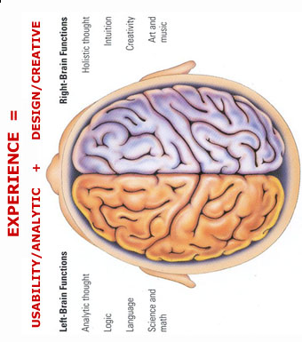
MIND
Hippocampus is a shredding machine for irrelevant information 100 billion instructions /sec
Use visions, dreams, Imagination, meditation, words call things that aren’t as if they are
Experiences are forgotten if the are not used Use it or lose it
Natural
TONGUES
H I P P O C A M P U S
M E M O R Y
B A NK S
Write
Review
Revisit
H E A R T
See
Smell
Hear
Taste
Touch
R E P E T I T I O N
V A L U E
V A L U E
Word Meditation Doors Visions Experience
Meditate
Synapses Close & Form Neural Pathways
Links to Memories
Confession
Repetition
Pictures Visions Encounters Word Anchor
Agreement
S P I R I T
Trauma forms instant neural pathways
Or forms pathways around the memories to block them
Spiritual
We all see spiritual realms most have no reference points or anchor so all info gets shredded
Words become doorways to spiritual experiences Words become anchors of experiences to keep doors open

Slide 14
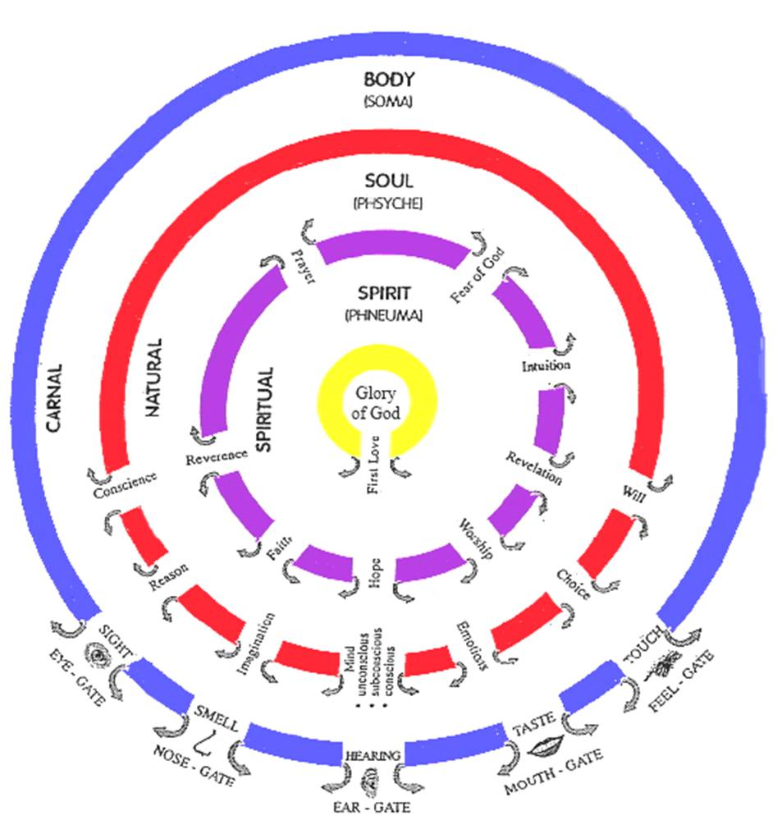

Slide 15
Spirit Gates
Training our Senses by Practice
Fear of God
F E L L O W S I P
Awestruck All Knowing, All Seeing, All Powerful, Almighty, Consuming Fire
Reverence
Honour Respect
Worship
Obeisance, Obedience Surrender, Submission
S O U L G A T E S
Prayer
Constant 2 Way Communication Flow
Hope
R E V E L A T O R Y
Visions, Dreams, Seeing Opportunities
Faith
Harmony, Concord, Understanding, Knowing
Revelation
Inspiration, Light, Counsel, Wisdom
Intuition
Knowledge, Gut feelings Instinct
Heavenly
Spiritual Consciousness Heavenly Access

Slide 16
Soul Gates
Desire - Discipline - Delight Refine - Renew - Restore Harmony Spirit, Soul & Body
Ears
Conscience
Protector Director
Guard Guide
Voice
Reason
Translator Interpreter
Understand Explain
Eyes
Imagination
Receiver Transmitter
Screen Projector
Conscious Mind
Choice
Mind
Do What Jesus Would Do
H E A R T
Subconscious Mind
Storage Programmes Memories
Hard drive Motives
Beliefs Values
Emotions
Responses Feelings
Guts Moved
Will
Persistence Courage
Boldness Endurance

Slide 18
Preparing for Destiny – Open Gates
Soul rules draws life from spirit
Soul draws from world through body
Soul seeks control it blocks the spirit
Break soul ties to your spirit
Break independence
Surrender control

Slide 19
Preparing for Destiny – Open gates
Die to self - self-centredness, selfishness
Self-importance, Self-promotion, Self-control
Self-respect, Self-esteem, Self-worth, Self-image
Self-reliance, Self-sufficiency, Self-belief
Self-righteousness, Self-help, Self-expression
Self-gratification, Self-indulgence

Slide 20
Preparing for destiny – Open Gates
Sin – Unforgiveness, Rebellion
Strongholds, Mind-sets, Beliefs, Lies
Demonic – Familiar spirits, Generational spirits
Deception, Confusion
Fear
Doubt
Unbelief

Slide 21
Opening our gates
Step 1 Rev 3:20 He is knocking and the door handle is outside we have to open it..
Give God First Love – place, priority
Open the gate of first love. This gate is often most damaged by our natural experiences of hurt, pain and rejection. Renouncing inner vows, repenting of fear and forgiving hurts and then inviting Him into your spirit and out through your soul and body by deliberately opening the door.

Slide 22
Opening our gates
Step 2 opening my spirit gates.
By acting in faith & meditating on the gates
By relationship & intimacy with God
By surrendering my spirit to God
Pray in tongues see yourself standing in the gateway and opening the door and welcoming in the glory & fire of God’s presence to come through.

Slide 23
Opening our gates
Step 2 opening my spirit gates.
By acting in faith & speaking to my soul yielding control to the direction of my spirit
Take God’s word as a sword to separate your spirit from the control and dominion of the soul. Heb 4:12
Declaring soul you will not be motive or control me or block the flow of the spirit

Slide 24
Opening our gates
Sample prayer
Father, I choose to open the gate of “Revelation” in my spirit. I open it and yield it to Your glory. I receive and release the power of God through this gate, that I begin to receive revelation of Your kingdom so that it will change my soul into the image of the Son of God who abides in me.
Pray and persist until you start to see the results and then keep going. You can work on all the gates, one at a time or in groups but be persistent and diligent.

Slide 25
Opening our gates
As gateways begin to open expect warfare from your soul as the kingdom influence begins to exert itself.
We have to take back possession of our souls and dispossess anything residing there, demonic spirits, blockages, strongholds, controls etc.
The soul gates are usually influenced by demonic familiar spirits and our sin nature (this must be crucified with Christ and reckoned dead daily)

Slide 26
Opening our gates
Step 3 Take possession of the gateway and place Christ at the centre of it. Yield the souls gateways to the dictates of the spirit by allowing the life and glory of God to flow through them to dictate the bodies actions. Cleaning the gateways by the blood of Jesus is key to fully opening the flow. The imagination from images it has seen etc. wipe them out using the blood of Jesus.

Slide 27
Opening our gates
Step 4 Repent of allowing any demonic spirits access through the individual gateways of my soul. Acknowledging your sin and taking responsibility for not guarding the gates. Take the blood of Jesus by faith and wipe the gateway clean and redeem it.

Slide 28
Opening our gates
Example prayer for conscience gateway
Today I bring my conscience into submission to my spirit. I release the life of God to flow from my spirit, through the gateways of reverence and of the fear of God to a consciousness of God’s righteousness and truth. Where my soul has been seared by sin. I now take the sword of the spirit and cleave the gateway open to allow the flow of God through it, to dictate my actions. Father, make me aware of my actions that I may submit to Your authority in my spirit.

Slide 29
Opening our gates
Today in Jesus name I take authority over the spiritual force or condition that is resistant to the flow of God in me. I loose it and cast it out of this gateway in Jesus name. I make and place Jesus as Lord over this gateway today.

Slide 30
Opening our gates
Father I thank You that my conscience gateway is full of Your glory. I thank You that my conscience receives and releases the flow of Godliness and holiness through it in Jesus name. My conscience will now dictate my bodies actions in the world.
This type of praying needs to be persistent to maintain victory and widen the gateways flow.

Slide 31
Opening our gates
Imagination gateway
A key area because it feeds and stores everything we see, do, feel and hear. God gives us most image revelation on the screen of our imaginations and once clean, revelation and the ability to see into the realms of the kingdom are heightened considerably.
2 Cor 10:5 bring every thought captive and obedient to Christ

Slide 32
Opening our gates
Imagination gateway
Dealing with the images from our pasts.
Acknowledge their presence in your life.
Own the sin and bring the image into the light.
Take the blood of Jesus and apply to the image like a paintbrush obliterating the image.

Slide 33
Opening our gates
Mind gateway – Heart soil - hard, stones, weeds
Example prayer. – Strongholds, Mind-sets, beliefs
Father today I release the glory of the kingdom of heaven into my unconscious, subconscious and conscious mind and into my memories to purge and clean them so that I may receive supernatural revelation from Your word to change my life.

Slide 34
Opening our gates
I release the life of God through the gateway of revelation in my spirit like a river to flush and wash and restore my mind so that I may have the Mind Of Christ operating in me. So that the actions of my body reflect the kingdom of God and its outworking in my behaviour and to those around me.

Slide 35
Opening our gates
Body Gateways
Example Prayer for eye gateway
Father today in the name of Jesus I release the flow of the glory of God through the gateway of first love and the gateway of revelation, into the gateway of my imagination and out through the gateway of my eyes, that I might see into the kingdom of heaven with renewed spiritual sight. May my eyes become like a flame of fire to the demonic world as I reflect the glory of God from inside me.

Slide 36
Opening our gates
Body Gateways
We need to relearn to see from the inside out, hear from the inside out etc.
The body is slave and servant of the soul. The soul is the slave and servant of the spirit. The spirit is the slave and servant of Jesus Christ in the centre of our being.

Slide 37
Opening our gates
How to keep a gateway flowing.
Keep short accounts, by confession and repentance as soon as the conscience picks up sin.
Be sensitive to the Holy Spirit, through conviction and being sensitive to warnings, intuitions etc.
Spend as much time as possible strongly praying in tongues, to keep the spirit flowing.

Slide 38
Opening our gates
Summary keys of possession of all the gates of body, soul, spirit.
Lay hold of the gates by faith as my inheritance, so that I exercise my God given right to exercise dominion and authority in the gates of my life.
Cast out any spirit that exercises its authority in those gates. Jesus is lord of the gates only as He is given the right to flow through them. In the spirit by faith raise the banner of victory over each gate as a declaration that Jesus resides there.
Begin to enforce the kingdom of God from the point of authority in the spirit, into the soul, and then into the body and out into the world.

Slide 39
Preparing for Destiny- Practice
Heb 5:14 But solid food is for the mature, who because of practice have their senses trained to discern good and evil. (spirit & soul)
Perseverance in dealing with soul blockages
Daily practice
Flowing from inside out
Kingdom manifests through & around us

Slide 40
Preparing for Destiny- Practice
Isa 10:²⁷ It shall come to pass in that day, That his burden will be taken away from your shoulder, And his yoke from your neck, And the yoke will be destroyed because of the anointing.
Matt 11:²⁹ Take My yoke upon you and learn from Me, for I am gentle and humble in heart, and YOU WILL FIND REST FOR YOUR SOULS.

