Slide 1
Preparing for Destiny
Building up of the spirit
Restoring & refining of the soul
Spirit - Soul - Body
Glory of God manifested on earth & beyond through sons of light

Slide 2
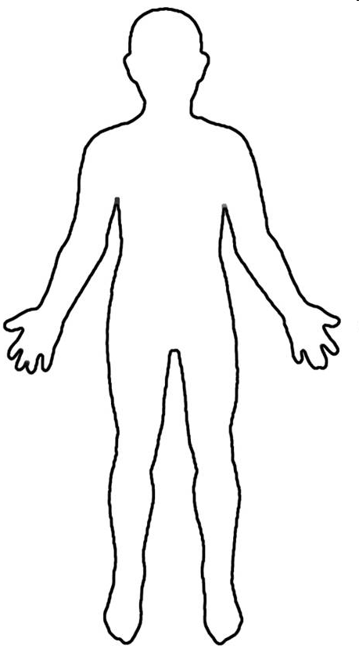
Conscious Mind
Spirit Father Son Holy Spirit
Heart Subconscious Mind Garden Scroll
Kingdom Heaven
Rivers Power Anointing
Rule House – LORDS
Kingdom within us Seat of Government
Keep my laws
Walk in my ways

Slide 3
Spirit – Father/Son/Spirit
Kingdom of Heaven
9 Spiritual Senses 7 Soul senses & 5 Body Senses
Tabernacle Holy Place Altar Incense
Present yourself as a Living Sacrifice
Throat Cut Total Surrender
Head cut off Government removed
Skin coverings removed Naked
Body Split Open Exposed
Legs Cut Off Walk
Denial of self Take up Cross Follow Him
Not my will but Yours be done
Seek First the kingdom & righteousness
I am crucified with Christ He lives in me
Choice I only do what Father is doing
Tabernacle Holy of Holies Mercy Seat

Slide 4
Familiar Spirit Remind Affirm Agreement
Confrontation
Criticised
Rejected
Injustice
Insecure
Event - Reactions
Intimidated
Sin
Mind is Replaying
Angry
Defensive
Aggressive
Passive
Imagination
Loving
Emotions
Reason
Forgive & Release
Mindsets Behaviours Mechanisms Emotions
Repetition
Seek God’s Counsel to Evaluate Patterns of Thinking & Behaviour
Truth of Motives Mind, Heart & Will of God
Revelation about
Reactions or Actions
Heart Sub-Conscious
Hard Weeds
Stones
Memories Motives
Not my Issue
Courts
My issue Own it Deal with it
Weakness Unmet Need Unhealed Hurt Unresolved Issue
Pray Intercede Confront in love?
Weakness Sin or Character Repent Renounce Find Word Meditate
Weakness Gift, skills Empower Support Learn
Weakness Gift, skills Discipled Learn Strong
DNA Nature Generational? Curse?
Nurture Upbringing Trauma Experiences
Renewed Mind & Restored Soul

Slide 5
Preparing for destiny – Seat of Rest
Seat Rest – live in the eye of the storm
Jesus our example asleep in the boat
Peace & Joy – relationship not circumstances
Attitude of gratitude & thanksgiving - choice
Praise - Rejoicing always - choice
Living giving a sacrifice of praise - choice
Treating trials & tribulations as joy & an opportunity for growth & transformation - choice

Slide 6
Preparing for destiny – Seat of Rest
Seat Rest – Eye of storm – Jesus says peace be still and rebuked the storm
Seat of Rest is the Kingdom of God within; it is the manifestation of the fullness of the government of God with us to bring revelation to the world around us.
Seat of rest is the place of your government to bring kingdom authority into life and command everything to be subject to realm of God’s kingdom

Slide 7
Preparing for destiny -Training
Jesus is Lord
Training
You
Trials Tribulations
Abdicate
Friend
Relationship
Steward
Resources Responsibility
Seat of Rest
Government
Seat of Rest
Government
Servant
Works of God
Ways of God
Jesus is King
God is Father
I am a Son
I am Lord
I am King
Holy Spirit
Jesus
Father
Seat of Rest
Government
Seat of Rest
Government
Seat of Rest
Government
Administer Principles of Kingdom
Rule House
Judge Courts

Slide 8
Preparing for destiny - spirit building
Give God first love, place, priority
Pray & sing in tongues
Wait on the Lord – Be still
Meditate on word of God – Prov 4:20-23

Slide 9
Preparing for destiny - Meditation
Heb 4:12 For the word of God is living and active
Meditate on it in 2D to experience it in 3D. A picture paints a 1000 words
Experiences, visions, pictures, revelation
Write, Review & revisit – value it
Consumer of the word to a producer of the word
Tomato from supermarket
Grow tomatoes – soil, seed, support, flowers, prune, feed, water, sun, shelter

Slide 10
Preparing for destiny - Meditation
Some experiences heaven not in word ( greater works of Jesus)
Use word to plumb line experience to the principles of God’s nature & character
Word then becomes a starting point for future experience
Word is a doorway to heavenly encounters
Word is an anchor & platform for more heavenly experiences

Slide 11
Preparing for destiny - Meditation
3 memory storage systems – neurones
Brain in our skull conscious memory
Heart – Sub-conscious memory
Gut – Instinctive memory
Nervous system connects our body
Brain Left & Right
Right side is intuitive, creative, visionary

Slide 12
Preparing for destiny - Meditation
Imagination can play back our external experiences
Imagination is the Screen where God can project vision & is our spiritual perception
Imagination can receive images from your soul – subconscious on one side and from you spirit on the other side
Learn to let spirit projections rule over soul projections to get a flow of revelation from God that we can follow

Slide 13
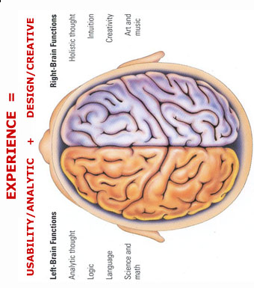
MIND
Hippocampus is a shredding machine for irrelevant information 100 billion instructions /sec
Use visions, dreams, Imagination, meditation, words call things that aren’t as if they are
Experiences are forgotten if the are not used Use it or lose it
Natural
TONGUES
H I P P O C A M P U S
M E M O R Y
B A NK S
Write
Review
Revisit
H E A R T
See
Smell
Hear
Taste
Touch
R E P E T I T I O N
V A L U E
V A L U E
Word Meditation Doors Visions Experience
Meditate
Synapses Close & Form Neural Pathways
Links to Memories
Confession
Repetition
Pictures Visions Encounters Word Anchor
Agreement
S P I R I T
Trauma forms instant neural pathways
Or forms pathways around the memories to block them
Spiritual
We all see spiritual realms most have no reference points or anchor so all info gets shredded
Words become doorways to spiritual experiences Words become anchors of experiences to keep doors open

Slide 14
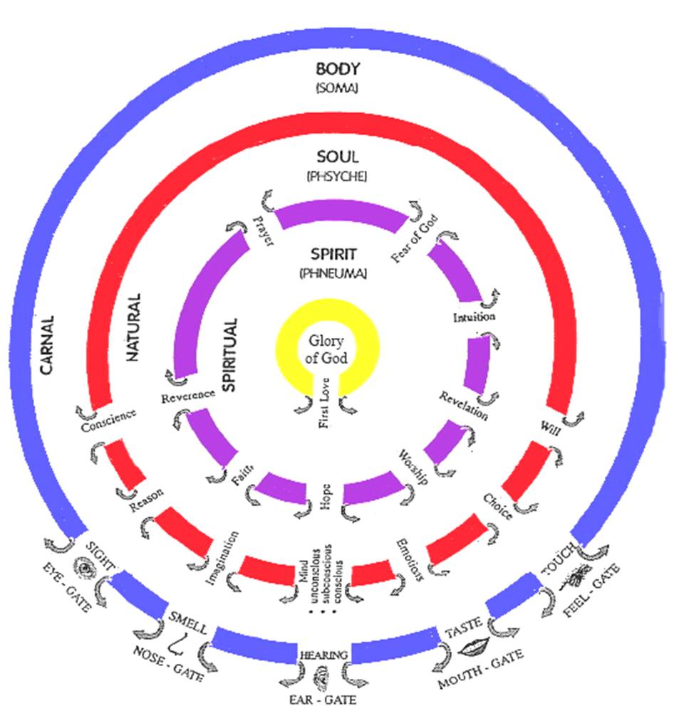

Slide 15
Preparing for Destiny- Practice
Heb 5:14 But solid food is for the mature, who because of practice have their senses trained to discern good and evil. (spirit & soul)
Perseverance in dealing with soul blockages
Daily practice
Flowing from inside out
Kingdom manifests through & around us

Slide 16
Preparing for Destiny- Practice
Isa 10:²⁷ It shall come to pass in that day, That his burden will be taken away from your shoulder, And his yoke from your neck, And the yoke will be destroyed because of the anointing.
Matt 11:²⁹ Take My yoke upon you and learn from Me, for I am gentle and humble in heart, and YOU WILL FIND REST FOR YOUR SOULS.

