Slide 1
Prophetic Timetable
LAST DAY
FINAL HARVEST
Heb 12:27 SHAKING OF WORLD SYSTEMS
A G E
T O
C O M E
WIND
Gen 41 HARVEST OF LABOURERS
ISA 2:2
Here
1 Peter 4:17 JUDGMENT OF GOD’S HOUSEHOLD
FIRE
Matt 13 GATHERING & REMOVING STUMBLING BLOCKS Releasing Joshua Generation
` ``
Fatherhood, Sonship, Royal Identity A CALL TO INTIMACY Habitation of God Song Solomon 8:6
WINE
DAY OF RESURRECTION & JUDGMENT

Slide 2
Increasing shaking of world systems
LAST DAY
Day of Resurrection & Judgment
John 6:40 John:12:48
Increasing world darkness but Church light
Increasing manifestations of glory, signs & wonders
Persecution
Mountain of the House of the Lord
Raised up Isa 2:2
Wealth transfer
Raising a Joshua Generation
The Call
to
Intimacy
& Love
Song of Solomon 8:6-7
Gathering
of
Stumbling
Blocks
Refiners
Fire
Matt 13:41
Isa 6:1-8
Judgment
of the household of God
Separation
of wheat & tares
Matt 13:40
1 Peter 4:17
Harvest of Harvesters
Years of blessing
Gen 41:47-49
Storm Judgment on the World systems
Heb 12:25-29
Final Harvest
Final Separation
Wheat & Tares
Gen 41:57
Age to come
New Heavens & New Earth Eternity
2 Peter 3:10-13 1 Cor 15:23-28
Isa 60:1-22, Numbers 14:21
Acts 3:21 Restoration of all
Increasing no’s regional apostolic centres
JESUS RETURNS
1 Cor 15:51-54, 1 Thes 4:14-17
Increasing releasing of 5 fold ministry & gifts
Increasing manifestation of Matt 6:33 people
Prophetic Timetable

Slide 3
Vision 2012
Let go of our negative pasts
Let go of the sin that entangles & hinders us
Let go of our own desires & directions in the flesh that weigh us down
Grab hold of our destinies in God
Run the race ahead with perseverance
Press on towards our destinies

Slide 4
Preparing for Destiny
Building up of the spirit
Restoring & refining of the soul
Spirit - Soul - Body
Glory of God manifested on earth & beyond through sons of light

Slide 5
Preparing for Destiny - Succession
Dethronement of self, soul, me, myself & I - ABDICATION
Nature - DNA programming
Nurture - environmental programming
Trauma - experiential programming
Restored to original eternal condition

Slide 6
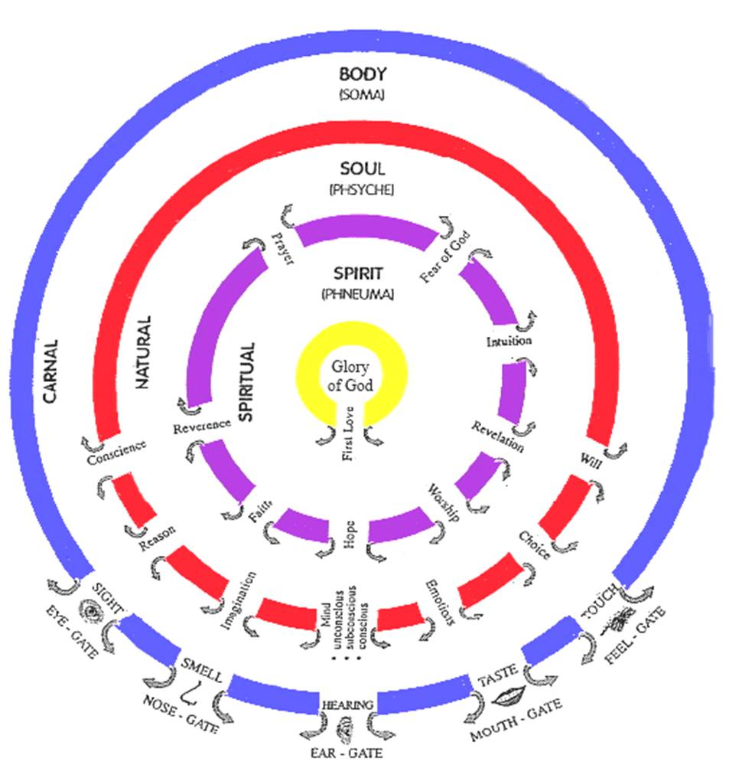

Slide 7
Spirit – Father/Son/Spirit
Kingdom of Heaven
9 Spiritual Senses 7 Soul senses & 5 Body Senses
Tabernacle Holy Place Altar Incense
Present yourself as a Living Sacrifice
Throat Cut Total Surrender
Head cut off Government removed
Skin coverings removed Naked
Body Split Open Exposed
Legs Cut Off Walk
Denial of self Take up Cross Follow Him
Not my will but Yours be done
Seek First the kingdom & righteousness
I am crucified with Christ He lives in me
Choice I only do what Father is doing
Tabernacle Holy of Holies Mercy Seat

Slide 8
Familiar Spirit Remind Affirm Agreement
Confrontation
Criticised
Rejected
Injustice
Insecure
Event - Reactions
Intimidated
Sin
Mind is Replaying
Angry
Defensive
Aggressive
Passive
Imagination
Loving
Emotions
Reason
Forgive & Release
Mindsets Behaviours Mechanisms Emotions
Repetition
Seek God’s Counsel to Evaluate Patterns of Thinking & Behaviour
Truth of Motives Mind, Heart & Will of God
Revelation about
Reactions or Actions
Heart Sub-Conscious
Hard Weeds
Stones
Memories Motives
Not my Issue
Courts
My issue Own it Deal with it
Weakness Unmet Need Unhealed Hurt Unresolved Issue
Pray Intercede Confront in love?
Weakness Sin or Character Repent Renounce Find Word Meditate
Weakness Gift, skills Empower Support Learn
Weakness Gift, skills Discipled Learn Strong
DNA Nature Generational? Curse?
Nurture Upbringing Trauma Experiences
Renewed Mind & Restored Soul

Slide 9
Preparing for destiny - spirit building
Give God first love, place, priority
Pray & sing in tongues
Wait on the Lord – Be still
Meditate on word of God – Prov 4:20-23
Praise & adoration - soak
Pray & Ask
Confess & Declare the truth, call things
Persevere
Desire – Discipline - Delight

Slide 10
Preparing for destiny - spirit building
Soaking
Quieten your mind
Focus attention on Jesus
Worship & adore Him
Wait in a position to listen & to receive revelation

Slide 11
Preparing for destiny - Seat of Rest
Matt 11:28 Come to Me, all you who are weary and are heavy-laden and overburdened, and I will cause you to rest. [I will ease and relieve and refresh your souls.] 29 Take My yoke upon you and learn of Me, for I am gentle and humble in heart, and you will find rest (relief and ease and refreshment and recreation and blessed quiet) for your souls.

Slide 12
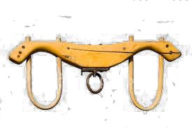
Preparing for destiny - Seat of Rest
Take my Yoke be joined to Jesus
Jesus sets our field of service
Jesus sets our path or direction
Jesus will carry the weight
Learn from Jesus – training discipleship
Gentle in heart – strength surrendered
Humble in heart – identity surrendered

Slide 13
Preparing for destiny – Seat of Rest
Why weary & heavy laden (burdened) ?
Am I tired trying to survive & cope with life myself?
Am I heavy carrying responsibilities that are not mine?
We are all called to live in a state of rest regardless of what is going on around our lives.

Slide 14
Preparing for destiny – Seat of Rest
Seat Rest – live in the eye of the storm
Jesus our example asleep in the boat
Peace & Joy – relationship not circumstances
Attitude of gratitude & thanksgiving - choice
Praise - Rejoicing always - choice
Living giving a sacrifice of praise - choice
Treating trials & tribulations as joy & an opportunity for growth & transformation - choice

Slide 15
Preparing for destiny – Seat of Rest
Seat Rest – Eye of storm – Jesus says peace be still and rebuked the storm
Seat of Rest is the Kingdom of God within it is the manifestation of the fullness of the government of God with us to bring revelation to the world around us.
Seat of rest is the place of your government to bring kingdom authority into life and command everything to be subject to realm of God’s kingdom

Slide 16
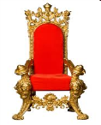
Preparing for destiny -Training
Ways of God
Jesus is Lord
You
Training
Trials Tribulations Troubles
Friend
Relationship
Abdicate
Resources Responsibility
Steward
NO Seat of Rest
Government
Seat of Rest
Government
Servant
Works of God

Slide 17
Preparing for destiny – Seat of Rest
Abdicate throne of my life to the Lordship of Jesus
Training for reigning process
Rom 5:17 those who receive the abundance of grace and of the gift of righteousness will reign in life through the One, Jesus Christ.
Rev 5:10 “You have made them to be a kingdom and priests to our God; and they will reign upon the earth.”

Slide 18
Preparing for destiny – Seat of Rest
Servant – Jesus our example
Matt 20:26 It is not this way among you, but whoever wishes to become great among you shall be your servant,
Mark 10:45 For even the Son of Man did not come to be served, but to serve, and to give His life a ransom for many.”
John 12:26 If anyone serves Me, he must follow Me; and where I am, there My servant will be also; if anyone serves Me, the Father will honour him.

Slide 19
Preparing for destiny – Seat of Rest
Servant – Jesus our example
Obedience to do the works that God directs
Heb 5:8 Although He was a Son, He learned obedience from the things which He suffered

Slide 20
Preparing for destiny - Seat of Rest
Servant – Jesus our example obedience
John 5:¹⁹ Therefore Jesus answered and was saying to them, “Truly, truly, I say to you, the Son can do nothing of Himself, unless it is something He sees the Father doing; for whatever the Father does, these things the Son also does in like manner.
John 14:¹⁰ Do you not believe that I am in the Father, and the Father is in Me? The words that I say to you I do not speak on My own initiative, but the Father abiding in Me does His works.
John 14:¹² Truly, truly, I say to you, he who believes in Me, the works that I do, he will do also; and greater works than these he will do; because I go to the Father.

Slide 21
Preparing for destiny - Seat of Rest
Servant – Jesus
2 Cor 4:5 For we do not preach ourselves but Christ Jesus as Lord, and ourselves as your bond-servants for Jesus’ sake.
Phil 2:5 who, although He existed in the form of God, did not regard equality with God a thing to be grasped, ⁷ but emptied Himself, taking the form of a bond-servant, and being made in the likeness of men. ⁸ Being found in appearance as a man, He humbled Himself by becoming obedient to the point of death, even death on a cross.

Slide 22
Preparing for destiny - Seat of Rest
Stewards – Responsibilities & Resources
Matt 25:¹ Then the kingdom of heaven will be comparable to ten virgins, who took their lamps and went out to meet the bridegroom. ² Five of them were foolish, and five were prudent. ³ For when the foolish took their lamps, they took no oil with them ¹² I do not know you
Matt 25:¹⁴ For it is just like a man about to go on a journey, who called his own servants and entrusted his possessions to them. ¹⁵ To one he gave five talents, to another, two, and to another, one, each according to his own ability

Slide 23
Preparing for destiny - Seat of Rest
Stewards – Resources & Responsibilities
Matt 25:¹⁶ Immediately the one who had received the five talents went and traded with them, and gained five more talents. ¹⁷ In the same manner the one who had received the two talents gained two more. ¹⁸ But he who received the one talent went away, and dug a hole in the ground and hid his master’s money.

Slide 24
Preparing for destiny - Seat of Rest
Stewards – Resources & Responsibilities
Matt 25:¹⁹ “Now after a long time the master of those servants came and settled accounts with them. ²⁰ The one who had received the five talents came up and brought five more talents, saying, ‘Master, you entrusted five talents to me. See, I have gained five more talents.’ ²¹ His master said to him, ‘Well done, good and faithful servant. You were faithful with a few things, I will put you in charge of many things; enter into the joy of your master.’

Slide 25
Preparing for destiny - Seat of Rest
Matt 25:²⁶ “But his master answered and said to him, ‘You wicked, lazy servant …²⁷.. you ought to have put my money in the bank, and on my arrival I would have received my money back with interest. ²⁸ Therefore take away the talent from him, and give it to the one who has the ten talents.’ ²⁹ “For to everyone who has, more shall be given, and he will have an abundance; but from the one who does not have, even what he does have shall be taken away. ³⁰ Throw out the worthless servant into the outer darkness; in that place there will be weeping and gnashing of teeth.

Slide 26
Preparing for destiny - Seat of Rest
Stewards – Resources & Responsibilities
Luke 16:10 He who is faithful in a very little thing is faithful also in much; and he who is unrighteous in a very little thing is unrighteous also in much.
Luke 19:17 And he said to him, ‘Well done, good servant, because you have been faithful in a very little thing, you are to be in authority over ten cities.

Slide 27
Preparing for destiny - Seat of Rest
Stewards – Resources & Responsibilities
1 Cor 4:¹ Let a man regard us in this manner, as servants of Christ and stewards of the mysteries of God. ² In this case, moreover, it is required of stewards that one be found trustworthy.
1 Peter 4:¹⁰ As each one has received a special gift, employ it in serving one another as good stewards of the manifold grace of God.

Slide 28
Preparing for destiny - Seat of Rest
Stewards – Responsibilities & Resources
Finances – tithes, offerings, everything
Resources, homes, cars & possessions
Gifts – spiritual, natural
Abilities – spiritual, natural
Covenant Relationships
It all belongs to him - attitude

Slide 29
Preparing for destiny - Seat of Rest
Friends – Relationship & Revelation
John 15:13 Greater love has no one than this, that one lay down his life for his friends. 14 You are My friends if you do what I command you.
John 15:15 No longer do I call you servants, for the servant does not know what his master is doing; but I have called you friends, for all things that I have heard from My Father I have made known to you.
Entrusted with insider knowledge & revelation

Slide 30
Preparing for destiny -Training
Jesus is Lord
Ways of God
Servant
Steward
Friend
Works of God
Resources Responsibility
Relationship
Seat of Rest
Government
Jesus is King
God is Father
I am a Son
I am Lord
I am King
Holy Spirit
Jesus
Father
Seat of Rest
Government
Seat of Rest
Government
Seat of Rest
Government
Administer Principles of Kingdom
Rule House
Judge Courts

Slide 31
Preparing for destiny - Seat of Rest
Alignment into the desire of God
Engagement into purpose of God
Setting ourselves apart to yield to His Lordship
Surrender to His government in our lives
Internally equipping us to engage external things so they change to take on the reflection of the internal authority
Walk into chaos to transform it

Slide 32
Preparing for Destiny- Practice
Heb 5:14 But solid food is for the mature, who because of practice have their senses trained to discern good and evil. (spirit & soul)
Stepping in Stepping out of His presence

Slide 33
Preparing for destiny - Seat of Rest
Father I thank you that You have made a way for me to come into your presence
By faith I step into the realm of your presence & ask you to forgive me for not fully surrendering to the absolute government of Your kingdom in my life
Today Jesus I wilfully with desire abdicate the throne of my heart so that you would come & seat yourself as Lord & King; as Lord of lords & King of kings over my life

Slide 34
Preparing for destiny – Seat of Rest
I surrender my seat of rest mountain throne with its domain & government into Your hands
I give You the keys of my heart. I give You the keys to every doorway of my spirit, soul & body.
Today by faith I thank you that You are seated on the throne of my life as Lord

Slide 35
Preparing for destiny – Seat of Rest
Train me Jesus to surrender to Your Lordship & to come to that place of maturity to assume responsibility for the seat of government in my life as a lord
Now Lord I step back into this earthly dimension bringing You to this realm to teach me how to administer your kingdom government to the world around me.

Slide 36
Preparing for destiny -Training
Jesus is Lord
Training
You
Trials Tribulations
Abdicate
Friend
Relationship
Steward
Resources Responsibility
Seat of Rest
Government
Seat of Rest
Government
Servant
Works of God
Ways of God
Jesus is King
God is Father
I am a Son
I am Lord
I am King
Holy Spirit
Jesus
Father
Seat of Rest
Government
Seat of Rest
Government
Seat of Rest
Government
Administer Principles of Kingdom
Rule House
Judge Courts

