Slide 1
Preparing for Destiny
Your eternal destiny is to rule – Plan A
Gen 1:28 God blessed them; and God said to them, “Be fruitful and multiply, and fill the earth, and subdue it; and rule
Will of God (His kingdom) from heaven to Earth
Church Destiny to rule – Plan A
Isa 2:2 Mountain of house of the Lord raised up above all other mountains
1 Peter 2:9 But you are A CHOSEN RACE, A royal PRIESTHOOD
Destiny to rule is through relationship and based in love

Slide 2
Preparing for Destiny
Destiny flows through a strong spirit
Destiny is blocked by a dominant soul
Soul restored & refined the restore order
Spirit - Soul - Body
Destiny - Glory of God to be manifested on earth & beyond through sons of light
1 Cor 6:¹⁷ But the person who is united to the Lord becomes one spirit with Him.

Slide 3
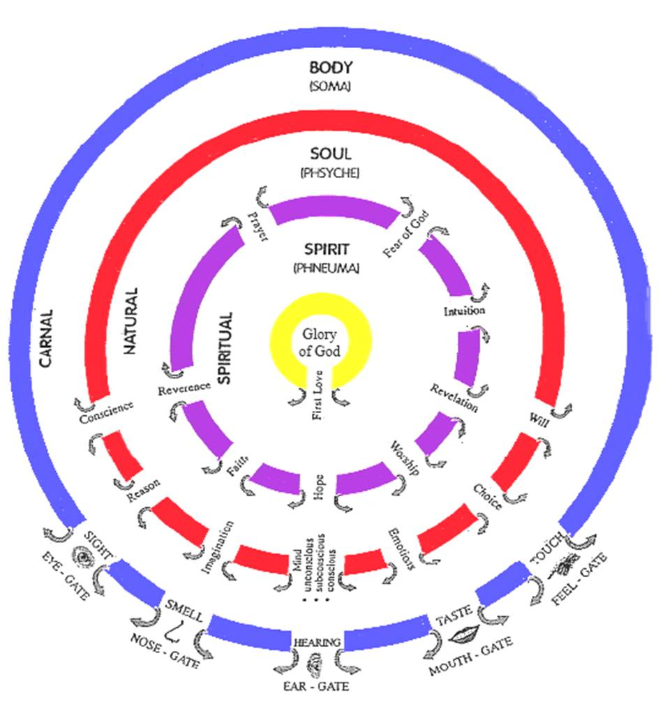
Sight
Hearing
Smell
Taste
Touch

Slide 5
Sight
Hearing
Smell
Taste
Touch
7 spirits of God Isa 11:2
Fear of God
Spirit of Fear of God
Reverence
Worship
Spirit of the Lord
Prayer
Spirit of Council
Hope
Spirit of Knowledge
Faith
Spirit of Wisdom
Revelation
Intuition
Spirit of Understanding
Heavenly
Spirit of Might

Slide 6
Preparing for Destiny – Open Gates
Each of us has a kingdom sphere of influence where we have authority to rule
Home, workplace, Street, Church, Ministry
Authority in your circle of influence or circumstances
Change the atmosphere, situation
Will of God on heaven and bring that will to earth as a manifestation of kingdom

Slide 7
Preparing for Destiny
Nature - DNA programming
Nurture - environmental programming
Trauma - experiential programming
Soul used to drawing outside in
Soul blocks flow of the spirit
Dethronement of self, soul, old life

Slide 8
Preparing for Destiny - Open Gates
Acceptance Love
Security Safety
Approval Significance
Affirmation Identity, Purpose
Affection Value, worth
God desires and is able to meet all our needs
Who I am, Why I am Here, What my purpose is

Slide 9
Jer 2:13"For My people have committed two evils: They have forsaken Me The fountain of living waters, To hew for themselves cisterns, Broken cisterns That can hold no water.
SECURITY
ACCEPTANCE
SIGNIFICANCE
Manifest Presence of God GLORY
LOVE
WORLD
PURPOSE
Hurt Pain Rejection Insecurity Fear Disappointment Guilt Shame
Body Flesh
Transfigured
Soul Heart Natural Needs
Damage
Transformation Restored, Renewed to the orginal
PURPOSE
Spirit Fountain Living Water
Spirit DEAD TO GOD
ACCEPTANCE
Born Again Resurrected
SECURITY
LOVE
SIGNIFICANCE

Slide 10
Sight
Hearing
Smell
Taste
Touch
Conscience
Protector Director
Reason
Translator Interpreter
Imagination
Screen Projector
Conscious Mind
Choice
Subconscious Mind
Storage Programmes Memories
Responses Feelings
Emotions
Persistence Rebellion
Will

Slide 11
Preparing for Destiny – Open Gates
Soul – Flesh, Mind, Heart – self awareness
Gal 5:16 But I say, walk by the Spirit, and you will not carry out the desire of the flesh.
Gal 5:17 For the flesh sets its desire against the spirit, and the spirit against the flesh; for these are in opposition to one another, so that you may not do the things that you please.

Slide 12
Preparing for Destiny – Open gates
Independence, Humanism
Die to self, self-centredness, selfishness
Self-importance, Self-promotion, Self-control
Self-respect, Self-esteem, Self-worth, Self-image, Self-denial, Self-improvement
Self-reliance, Self-sufficiency, Self-belief
Self-righteousness, Self-help, Self-expression
Self-gratification, Self-indulgence
Me myself & I have got to die

Slide 13
Preparing for destiny – Open Gates
What blocks & closes souls gates
Sin – Unforgiveness, Rebellion, independence, self-centredness
Strongholds, Mind-sets, Beliefs, Lies
Negative Emotions - Fear, Doubt, Unbelief
Demonic – Familiar spirits, Generational spirits
Deception, Confusion, Control

Slide 14
Preparing for destiny – Open Gates
Mind
Strongholds, Words spoken, Words received, Curses, Fear, False doctrines
Imagination
Images, TV, Films, Books, Fantasy, Games, Internet

Slide 15
Preparing for destiny – Open Gates
Emotions
Rejection, Disappointments, Unforgivenness, Betrayal
Conscience
Sin, Deception, Pride, Independence, Judgment, Criticism, Defensiveness
Unmet needs affect our Souls desires & motives
Unhealed hurts affect our emotional desires & motives
Unresolved issues affect our Trust - Doubt

Slide 16
Sight
Hearing
Smell
Taste
Touch
Fear of God
Conscience
Reverence
Reason
Worship
Imagination
Prayer
Choice
Hope
Faith
Subconscious Mind
Revelation
Emotions
Intuition
Will
Heavenly

Slide 17
Preparing for Destiny – Open Gates
Conscience – Sin, rebellion - dull
Weaknesses, patterns of sin, “normal acceptable” behaviours
Own it, Confess it, Repent, Renounce it
Apply blood of Jesus
Receive Forgiveness & Cleansing
No guilt, shame or condemnation
Righteousness
Reverence flowing through it

Slide 18
Opening our gates
Step 1 Rev 3:20 Jesus is knocking and the door handle is on our side we have to open it..
Give God First Love – place, priority
Open the gate of first love. This gate is often most damaged by our natural experiences of hurt, pain and rejection. Renouncing inner vows, repenting of fear and forgiving hurts and then inviting Him into your spirit and out through your soul and body by deliberately opening the door.

Slide 19
Opening our gates
Step 2 opening my spirit gates.
By acting in faith & meditating on the gates
By a relationship of intimacy with God
By surrendering my spirit to God
Pray in tongues see yourself standing in the gateway and opening the door and welcoming in the glory & fire of God’s presence to come through.

Slide 20
Opening our gates
Sample prayer
Father, I choose to open the gate of “Revelation” in my spirit. I open it and yield it to Your glory. I receive and release the power of God through this gate, that I begin to receive revelation of Your kingdom so that it will change my soul into the image of the Son of God who abides in me.
Pray and persist until you start to see the results and then keep going. You can work on all the gates, one at a time or in groups but be persistent and diligent.

Slide 21
Opening our gates
Step 3 opening my soul gates.
By acting in faith & speaking to my soul yielding control to the direction of my spirit
Take God’s word as a sword to separate your spirit from the control and dominion of the soul. - Heb 4:12
Declaring soul you will not motivate me or control me or block the flow of the spirit

Slide 22
Opening our gates
Soul rules draws life from spirit
Soul draws from world through body
Soul seeks control, it blocks the spirit
Break soul ties to your spirit
Break independence by surrendering control

Slide 23
Opening our gates
Example prayer for conscience gateway
Today I bring my conscience into submission to my spirit. I release the life of God to flow from my spirit, through the gateways of reverence and of the fear of God to a consciousness of God’s righteousness and truth. Where my soul has been seared by sin. I now take the sword of the spirit and cleave the gateway open to allow the flow of God through it, to dictate my actions. Father, make me aware of my actions that I may submit to Your authority in my spirit.

Slide 24
Opening our gates
Step 4 Take possession of the gateway and place Christ at the centre of it. Yield the souls gateways to the dictates of the spirit by allowing the life and glory of God to flow through them to dictate the bodies actions. Cleaning the gateways by the blood of Jesus is key to fully opening the flow. E.g. Cleansing the imagination from negative images it has seen etc. wipe them out using the blood of Jesus.

Slide 25
Opening our gates
Step 5 Repent of allowing any demonic spirits access through the individual gateways of our souls. Acknowledging our sin and taking responsibility for not guarding the gates. Take the blood of Jesus by faith and wipe the gateway clean and redeem it.

Slide 26
Opening our gates
As gateways begin to open expect warfare from your soul as the kingdom influence begins to exert itself.
We have to take back possession of our souls and dispossess anything residing there, demonic spirits, blockages, strongholds, controls etc.
The soul gates are usually influenced by demonic familiar spirits and our sin nature (this must be crucified with Christ and reckoned dead daily)

Slide 27
Opening our gates
Today in Jesus name I take authority over the spiritual force or condition that is resistant to the flow of God in me. I loose it and cast it out of this gateway in Jesus name. I make and place Jesus as Lord over this gateway today.

Slide 28
Opening our gates
Father I thank You that my conscience gateway is full of Your glory. I thank You that my conscience receives and releases the flow of Godliness and holiness through it in Jesus name. My conscience will now dictate my bodies actions in the world.
This type of praying needs to be persistent to maintain victory and widen the gateways flow.

Slide 29
Opening our gates
Summary keys of possession of all the gates of body, soul, spirit.
Lay hold of the gates by faith as my inheritance, so that I exercise my God given right to exercise dominion and authority in the gates of my life.
Cast out any spirit that exercises its authority in those gates. Jesus is lord of the gates only as He is given the right to flow through them. In the spirit by faith raise the banner of victory over each gate as a declaration that Jesus resides there.
Begin to enforce the kingdom of God from the point of authority in the spirit, into the soul, and then into the body and out into the world.

Slide 30
Opening our gates
How to keep a gateway flowing.
Keep short accounts, by confession and repentance as soon as the conscience picks up sin.
Be sensitive to the Holy Spirit, through conviction and being sensitive to warnings, intuitions etc.
Spend as much time as possible strongly praying in tongues inside & out, to keep the spirit flowing.

Slide 31
Preparing for Destiny – Soul
Father I choose to deny myself & surrender control of my life to you
I give you my conscience
I repent and renounce everything that has damaged my conscience
I ask you to purify & restore my conscience
Direct & Protect me through conscience by reverence & fear of the Lord

Slide 33
Preparing for Destiny – Open Gates

Slide 34
Opening our gates
Imagination gateway
A key area because it feeds and stores everything we see, do, feel and hear. God gives us most image revelation on the screen of our imaginations and once clean, revelation and the ability to see into the realms of the kingdom are heightened considerably.
2 Cor 10:5 bring every thought captive and obedient to Christ

Slide 35
Opening our gates
Imagination gateway
Dealing with the images from our pasts.
Acknowledge their presence in your life.
Own the sin and bring the image into the light.
Take the blood of Jesus and apply to the image like a paintbrush obliterating the image.

Slide 36
Opening our gates
Subconsious Mind gateway – Heart soil - hard, stones, weeds
Example prayer. – Strongholds, Mind-sets, beliefs
Father today I release the glory of the kingdom of heaven into my unconscious, subconscious and conscious mind and into my memories to purge and clean them so that I may receive supernatural revelation from Your word to change my life.

Slide 37
Opening our gates
I release the life of God through the gateway of revelation in my spirit like a river to flush and wash and restore my mind so that I may have the Mind of Christ operating in me. So that the actions of my body reflect the kingdom of God and its outworking in my behaviour and to those around me.

Slide 38
Opening our gates
Body Gateways - Example Prayer for eye gateway
Father today in the name of Jesus I release the flow of the glory of God through the gateway of first love and the gateway of revelation, into the gateway of my imagination and out through the gateway of my eyes, that I might see into the kingdom of heaven with renewed spiritual sight. May my eyes become like a flame of fire to the demonic world as I reflect the glory of God from inside me.

Slide 39
Opening our gates
Body Gateways
We need to relearn to see from the inside out, hear from the inside out etc.
The body must become a slave and servant of the soul. The soul must become a slave and servant of the spirit. The spirit must become a bond servant of Jesus Christ in the centre of our being.

Slide 40
Preparing for Destiny- Practice
Heb 5:14 But solid food is for the mature, who because of practice have their senses trained to discern good and evil. (spirit & soul)
Perseverance in dealing with soul blockages
Practice Daily - Flowing from inside out so the Kingdom manifests through & around us

Slide 41
Preparing for Destiny – Practice
Father by faith I choose to step into Your heavenly presence
I receive Your acceptance, love, mercy and grace
I stand in the victory of the cross forgiven, justified and cleansed
I thank you that clothe me in white robes of righteousness
I am the righteousness of God in Christ

Slide 42
Preparing for Destiny – Practice
Father I choose to deny myself & surrender control of my life to you
I give you my reason centre
I repent and renounce doubt, unbelief, rationalism, scepticism, cynicism, denial
I ask you cleanse me of all false doctrine, philosophies & ideas
I ask you to renew & restore my reason
Use my reason to interpret your thoughts & understand your ways

Slide 43
Preparing for Destiny – Practice
Father I choose to deny myself & surrender control of my life to you
I give you my imagination
I repent and renounce of viewing any image that has polluted me
I ask you to blot out every image with the blood of Jesus
Purify & restore my imagination
Restore my screen, vision & revelation

Slide 44
Preparing for Destiny – Practice
Father I choose to deny myself & surrender control of my life to you
I give you my heart my sub-conscious mind
I repent and renounce all strongholds, negative belief & value systems, vows, words, curses, doctrines, triggers, coping & defence mechanisms
I ask you to cleanse every negative memory
Purify, restore & reprogram my heart with your truth, values & my destiny

Slide 45
Preparing for Destiny – Practice
Father I choose to deny myself & surrender control of my life to you
I give you my emotions
I repent and renounce all unforgiveness, bitterness, anger & self-pity
I ask you purify & restore my emotions
Use my emotions to feel your heart & guide me through intuition.

Slide 46
Preparing for Destiny – Practice
Father I choose to deny myself & surrender control of my life to you
I give you my will
I repent and renounce all Sin, Rebellion, Stubbornness, Wilfulness, Control, Fear, Doubt, Unbelief, Indecision
I ask you to Purify & restore my will & Restore courage, perseverance
Use my will to enable me to do your will through obedience & true worship

Slide 47
Preparing for Destiny – Practice
Father I surrender my spirit, soul and body to You
I declare that Jesus is Lord of the gates of my life
I step back into this realm readily available to do Your will & purposes
Manifest Your glory & presence in & through my life
Manifest Your Kingdom authority and power through me and around me

Slide 48
Spirit Gates
Training our Senses by Practice
Fear of God
F E L L O W S I P
Awestruck All Knowing, All Seeing, All Powerful, Almighty, Consuming Fire
Reverence
Honour Respect
Worship
Obeisance, Obedience Surrender, Submission
S O U L G A T E S
Prayer
Constant 2 Way Communication Flow
Hope
R E V E L A T O R Y
Visions, Dreams, Seeing Opportunities
Faith
Harmony, Concord, Understanding, Knowing
Revelation
Inspiration, Light, Counsel, Wisdom
Intuition
Knowledge, Gut feelings Instinct
Heavenly
Spiritual Consciousness Heavenly Access

Slide 49
Soul Gates
Desire - Discipline - Delight Refine - Renew - Restore Harmony Spirit, Soul & Body
Ears
Conscience
Protector Director
Guard Guide
Voice
Reason
Translator Interpreter
Understand Explain
Eyes
Imagination
Receiver Transmitter
Screen Projector
Conscious Mind
Choice
Mind
Do What Jesus Would Do
H E A R T
Subconscious Mind
Storage Programmes Memories
Hard drive Motives
Beliefs Values
Emotions
Responses Feelings
Guts Moved
Will
Persistence Courage
Boldness Endurance

Slide 50
Our Being
Acts 17:28 For in Him we live, and move, and have our being
Gen 1:26 Then God said, “Let Us make man in Our image, according to Our likeness;
Conscious Mind
Will
Emotions
Sub Conscious Mind
BODY SOUL SPIRIT
H/S
G

Slide 51
Our Spirit
Expressed through Soul & Body
Gifts
Glory
Fear of God
Prayer
Reverence
Intuition
Revelation
Hope
Faith
Worship
Fruit
HOLY SPIRIT
Mind of Christ
Glory of God
Heart of Father

Slide 52
Strongholds
SOUL
Subconscious Mind
Heart
Conscious Mind
Ideas
Strongholds
Suggestion
Nature DNA
Nurture Trauma
Behaviour Patterns
Fear
Worry
Memories
Knower
Body
Beliefs
Revelation
Responses
Spirit
GOD
Subconscious
Values
Familiar spirits
Reactions
Lies
Truth
Heart
Mindsets
Familiar spirits
Thoughts
Coping Mechanisms
Attitudes
Defence Mechanisms
Doubt & Unbelief

Slide 53
Conscious Mind
SOUL
Emotions
Strongholds
Unmet needs
Low self-esteem
Co-dependency
Body
Unforgiveness
Esteem
Nature DNA
Nurture Trauma
Worth
Guilt
Heart
Disappointment
Dependency
S
Emotions
Love
Anger
Shame
Security
Value
Acceptance
Bitterness
Resentment
Insecurity
Rejection
Pain
Unhealed hurts

Slide 54
Conscious Mind
SOUL
Will
Humility
Confidence
Endurance
Stubbornness
Body
Patience
Boldness
Rebellion
Nature DNA
Nurture Trauma
Doubt
Sub Mind
Courage
SIN
E
S
Will
Unbelief
Indecision
Fear
CONTROL
Determination
Perseverance
Self-control

Slide 55
Preparing for Destiny – Open Gates

Slide 56
Preparing for Destiny – Open Gates

Slide 57
Preparing for Destiny – Open Gates

