Slide 1
Preparing for Destiny
Your eternal destiny is to rule – Plan A
Gen 1:28 God blessed them; and God said to them, “Be fruitful and multiply, and fill the earth, and subdue it; and rule
Will of God (His kingdom) from heaven to Earth
Church Destiny to rule – Plan A
Isa 2:2 Mountain of house of the Lord raised up above all other mountains
1 Peter 2:9 But you are A CHOSEN RACE, A royal PRIESTHOOD
Destiny to rule is through relationship and based in love

Slide 2
Preparing for Destiny
Destiny flows through a strong spirit
Destiny is blocked by a dominant soul
Soul restored & refined the restore order
Spirit - Soul - Body
Destiny - Glory of God to be manifested on earth & beyond through sons of light
1 Cor 6:¹⁷ But the person who is united to the Lord becomes one spirit with Him.

Slide 3
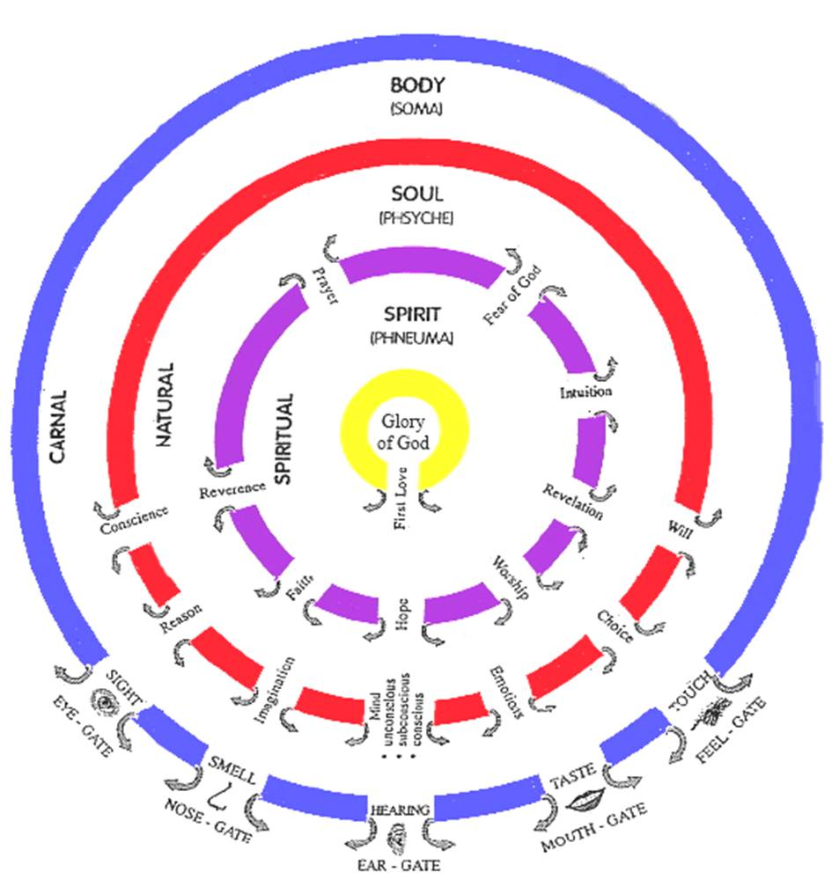

Slide 4
Preparing for Destiny – Open Gates
We all have a Body, Soul & Spirit
Body enables us to relate to world
Soul enables to relate to our selves
Spirit enables us to relate to God
All start out Messed up divided, separated, dead
In the beginning Adam was spirit, soul & body in perfect harmony & joined with God
No self awareness independent of God

Slide 6
Preparing for Destiny – Open Gates
Purpose – revelation of identity & authority
You are a dwelling of God’s presence
You are connected to heaven through God
You have a flow of abundant life flowing like a river from heaven (spiritual realm)
River flows from heaven through God to our spirit, soul, body to world around us
God’s will (kingdom rule) in heaven will operate in us, through us & around us

Slide 7
Preparing for Destiny – Open Gates
Eph 1:³ Blessed be the God .., who has blessed us with every spiritual blessing in the heavenly places in Christ
Eph 2:6 and raised us up with Him, and seated us with Him in the heavenly places in Christ Jesus,
Flow revelation, resources, authority, light, glory, God’s presence & power from the unseen spiritual heavenly dimension into the physical realm through the gateway of our lives

Slide 8
Preparing for Destiny – Open Gates
John 4:¹⁴ ..the water that I will give him shall become a spring of water welling up (flowing, bubbling) [continually] within him unto (into, from, for) eternal life.
John 7:³⁸ He who believes in Me [who cleaves to and trusts in and relies on Me] as the Scripture has said, From his innermost being shall flow [continuously] springs and rivers of living water.

Slide 9
Preparing for Destiny – Open Gates
Col 1:16 For by Him all things were created, both in the heavens and on earth, visible and invisible, whether thrones or dominions or rulers or authorities—all things have been created through Him and for Him. 17 He is before all things, and in Him all things hold together.
Spiritual or heavenly realm authority & power higher than & rules over the physical realm
Spiritual Laws or principles supersede natural laws and principles - miracles

Slide 10
Preparing for Destiny – Open Gates
Healing overrules sickness & disease
Freedom overrules captivity & bondage
Jesus is our example of heaven ruling earth through his life
Changed & transformed things
Healing is a speeding up of natural realm
Miracles spiritual realm overrules physical laws

Slide 11
Preparing for Destiny – Open Gates
Walked on water
Turned water into wine & multiplied food
Passed through people
Disappeared from natural sight
Controlled weather
Healed the sick & cast out demons
Restored things & Raised the dead
Made money appear in fishes mouth

Slide 12
Sight
Hearing
Smell
Taste
Touch

Slide 13
Preparing for Destiny – Open Gates
Everything flows from the outside in
Learn to relate to world around us through our 5 physical senses
Interpret the world through electrical impulses in the brain
See – interpret spatial awareness
Hear – interpret waves pressure
Smell - interpret chemical particles

Slide 14
Preparing for Destiny – Open Gates
Taste – sweet, sour, salty, bitter, savoury
Touch – hot, cold, soft, hard
Memories of experiences stored & reused
Learned through practice to train our senses
Soul also has senses that have been trained, from the outside in by nature, nurture & trauma
Spirit has to be trained from inside out

Slide 15
Sight
Hearing
Smell
Taste
Touch

Slide 16
Preparing for Destiny – Open Gates
Spiritual senses – are trained through our relationship with God
All knowing , All powerful, All present
Spontaneous flow of revelation knowledge
Thoughts of God dance in our mind
Feelings of God move our emotions
Impressions of God motivate our wills
Visions & Pictures form in our imagination

Slide 17
Preparing for Destiny – Open Gates
Learn to tune into hear God’s voice inside
Learn to see from the inside
Learn to hear from the inside
Learn to feel from the inside
Learn to be guided from the inside
Learn to smell from inside
Learn to touch from inside

Slide 18
Sight
Hearing
Smell
Taste
Touch
Fear of God
Awestruck All Knowing, All Seeing, All Powerful, Almighty, Consuming Fire
Reverence
Honour Respect
Worship
Obeisance, Obedience Surrender, Submission
Prayer
Constant 2 Way Communication Flow
Hope
Visions, Dreams, Seeing Opportunities
Faith
Harmony, Concord, Understanding, Knowing
Revelation
Inspiration, Light, Counsel, Wisdom
Intuition
Knowledge, Gut feelings Instinct
Heavenly
Spiritual Consciousness Heavenly Access

Slide 19
Preparing for Destiny – Open Gates
Gifts & callings
Prophetic – revelation gate, hope gate
Spiritual gifts flow - Intuition gate - Words knowledge, wisdom, distinguishing spirits
Healing, miracles – Faith Gate
We all need reverence, fear of God, prayer gates open for intimate relationship
Will we be worshippers – obedient?

Slide 20
Preparing for Destiny – Open Gates
John 14: ¹⁰ Do you not believe that I am in the Father, and the Father is in Me? The words that I say to you I do not speak on My own initiative, but the Father abiding in Me does His works.
John 16:⁷ I will send Him (the helper - Holy Spirit) to you. ⁸ And He, when He comes, will convict the world concerning sin and righteousness and judgment;

Slide 21
Preparing for Destiny – Open Gates
Luke 17:21 Nor will people say, Look! Here [it is]! or, See, [it is] there! For behold, the kingdom of God is within you [in your hearts] and among you [surrounding you].
Luke 6:19 And all the people were trying to touch Him, for power was coming from Him and healing them all.
Luke 8:46 But Jesus said, “Someone did touch Me, for I was aware that power had gone out of Me.”

Slide 22
Preparing for Destiny – Open Gates
Kingdom - Basileia “a supreme sovereign’s rule and reign.”
Gen 1:²⁸ God blessed them; and God said to them, “Be fruitful and multiply, and fill the earth, and subdue it; and rule
Matt 6:10 ‘Your kingdom come. Your will be done, On earth as it is in heaven.
We are channels, gateways for the kingdom to operate on earth

Slide 23
Preparing for Destiny – Open Gates
Each of us has a kingdom sphere of influence where we have authority to rule
Home, Workplace, Street, Church, Ministry
Authority in your circle of influence or circumstances
We can change the atmosphere, situation
Will of God inn heaven and bring that will to earth as a manifestation of the kingdom

Slide 24
Preparing for Destiny – Open Gates
Job 22:²¹ “Yield now and be at peace with Him; Thereby good will come to you. ²² “Please receive instruction from His mouth And establish His words in your heart.
Job 22:²⁸ “You will also decree a thing, and it will be established for you; And light will shine on your ways.

Slide 25
Preparing for Destiny – Open Gates
Use keys of kingdom
Matt 16:19 I will give you the keys of the kingdom of heaven; and whatever you bind on earth shall have been bound in heaven, and whatever you loose on earth shall have been loosed in heaven.”
Bind to the will of God, truth etc.
Loose from restrictions, chains of enemy
In heaven first

Slide 27
Preparing for Destiny – Open Gates
God I thank you for your presence in my life
I open the gate of first love and invite you into my spirit
I invite you to activate my spiritual senses and flow through me
Jesus I surrender control of my life to your lordship. You are Lord of my spirit
Transform me into the image of Jesus from the inside out

Slide 28
Preparing for Destiny – Open Gates
Renew my mind, heal my emotions, restore my conscience, cleanse my imagination
Train my senses to hear your voice, know your heart, see your vision, be directed by your peace
Manifest your kingdom rule through me to the world around me
Your destiny is to be a world changer

Slide 29
Preparing for Destiny
I saw God on His throne with a large can labelled accelerant
Zech 2:⁵ For I,’ says the Lord, ‘will be a wall of fire all around you, and I will be the glory in your midst.’
Isa 10:27 It shall come to pass in that day That his burden will be taken away from your shoulder, And his yoke from your neck, And the yoke will be destroyed because of the anointing oil.
Increase fire, glory & anointing coming
A new mantle of authority has been released

Slide 30
Preparing for Destiny
Increase prayer ministry focus
More prayer ministry during meetings
Raise expectancy for power encounters
Release Isa 61, Luke 4:18 anointing
Isa 61:¹ The Spirit of the Lord GOD is upon me, Because the LORD has anointed me To bring good news to the afflicted; He has sent me to bind up the broken-hearted, To proclaim liberty to captives And freedom to prisoners; ² To proclaim the favourable year of the LORD And the day of vengeance of our God;

Slide 31
Preparing for Destiny – Open Gates

Slide 32
Preparing for Destiny – Open Gates

Slide 33
Preparing for Destiny- Heart
I have seen a new mantle of authority
I am called to identify and raise up a Joshua generation to equip in supernatural ministry
I am called to identify ministers for our 7 ministry mandates
Release ministries to the church and then through the church
I am called to minister to a wider area locally, regionally and nationally

Slide 34
Sight
Hearing
Smell
Taste
Touch
Fear of God
Conscience
Reverence
Reason
Worship
Imagination
Prayer
Choice
Hope
Faith
Subconscious Mind
Revelation
Emotions
Intuition
Will
Heavenly

Slide 35
Sight
Hearing
Smell
Taste
Touch
Fear of God
Conscience
Reverence
Reason
Worship
Imagination
Prayer
Choice
Hope
Faith
Subconscious Mind
Revelation
Emotions
Intuition
Will
Heavenly

Slide 36
Preparing for Destiny – Open Gates

Slide 37
Preparing for Destiny – Open Gates
Soul – Flesh, Mind, Heart – self awareness
Gal 5:16 But I say, walk by the Spirit, and you will not carry out the desire of the flesh.
Gal 5:17 For the flesh sets its desire against the spirit, and the spirit against the flesh; for these are in opposition to one another, so that you may not do the things that you please.

Slide 38
Preparing for Destiny – Open gates
Die to self - self-centredness, selfishness
Self-importance, Self-promotion, Self-control
Self-respect, Self-esteem, Self-worth, Self-image
Self-reliance, Self-sufficiency, Self-belief
Self-righteousness, Self-help, Self-expression
Self-gratification, Self-indulgence

Slide 39
Preparing for destiny – Open Gates
What blocks & closes souls gates
Sin – Unforgiveness, Rebellion, independence, self-centredness
Strongholds, Mind-sets, Beliefs, Lies
Negative Emotions - Fear, Doubt, Unbelief
Demonic – Familiar spirits, Generational spirits
Deception, Confusion, Control

Slide 40
Preparing for destiny – Open Gates
Mind Strongholds, Words spoken Words received, Curses Fear, False doctrines
Imagination Images, TV, Films, Books Fantasy, Games, Internet

Slide 41
Preparing for destiny – Open Gates
Emotions Rejection, Disappointments Unforgivenness, Betrayal
Conscience Sin, Deception, Pride, Independence, Judgment Criticism, Defensiveness
Unmet needs affect our Souls desires & motives
Unhealed hurts affect our emotional desires & motives
Unresolved issues affect our Trust - Doubt

Slide 42
Preparing for Destiny – Open Gates
Conscience – Sin, rebellion - dull
Weaknesses, patterns of sin, “normal acceptable” behaviours
Own it, Confess it, Repent, Renounce it
Apply blood of Jesus
Receive Forgiveness & Cleansing
No guilt, shame or condemnation
Righteousness
Reverence flowing through it

Slide 43
Preparing for Destiny - Open Gates
Acceptance Love
Security Safety
Approval Significance
Affirmation Identity, Purpose
Affection Value, worth
God desires and is able to meet all our needs
Who I am, Why I am Here, What my purpose is

Slide 45
Preparing for Destiny – Open Gates

Slide 46
Opening our gates
Step 1 Rev 3:20 Jesus is knocking and the door handle is on our side we have to open it..
Give God First Love – place, priority
Open the gate of first love. This gate is often most damaged by our natural experiences of hurt, pain and rejection. Renouncing inner vows, repenting of fear and forgiving hurts and then inviting Him into your spirit and out through your soul and body by deliberately opening the door.

Slide 47
Opening our gates
Step 2 opening my spirit gates.
By acting in faith & meditating on the gates
By a relationship of intimacy with God
By surrendering my spirit to God
Pray in tongues see yourself standing in the gateway and opening the door and welcoming in the glory & fire of God’s presence to come through.

Slide 48
Opening our gates
Sample prayer
Father, I choose to open the gate of “Revelation” in my spirit. I open it and yield it to Your glory. I receive and release the power of God through this gate, that I begin to receive revelation of Your kingdom so that it will change my soul into the image of the Son of God who abides in me.
Pray and persist until you start to see the results and then keep going. You can work on all the gates, one at a time or in groups but be persistent and diligent.

Slide 49
Opening our gates
Step 3 opening my soul gates.
By acting in faith & speaking to my soul yielding control to the direction of my spirit
Take God’s word as a sword to separate your spirit from the control and dominion of the soul. - Heb 4:12
Declaring soul you will not motivate me or control me or block the flow of the spirit

Slide 50
Opening our gates
Soul rules draws life from spirit
Soul draws from world through body
Soul seeks control, it blocks the spirit
Break soul ties to your spirit
Break independence by surrendering control

Slide 51
Opening our gates
Example prayer for conscience gateway
Today I bring my conscience into submission to my spirit. I release the life of God to flow from my spirit, through the gateways of reverence and of the fear of God to a consciousness of God’s righteousness and truth. Where my soul has been seared by sin. I now take the sword of the spirit and cleave the gateway open to allow the flow of God through it, to dictate my actions. Father, make me aware of my actions that I may submit to Your authority in my spirit.

Slide 52
Opening our gates
Summary keys of possession of all the gates of body, soul, spirit.
Lay hold of the gates by faith as my inheritance, so that I exercise my God given right to exercise dominion and authority in the gates of my life.
Cast out any spirit that exercises its authority in those gates. Jesus is lord of the gates only as He is given the right to flow through them. In the spirit by faith raise the banner of victory over each gate as a declaration that Jesus resides there.
Begin to enforce the kingdom of God from the point of authority in the spirit, into the soul, and then into the body and out into the world.

Slide 53
Opening our gates
As gateways begin to open expect warfare from your soul as the kingdom influence begins to exert itself.
We have to take back possession of our souls and dispossess anything residing there, demonic spirits, blockages, strongholds, controls etc.
The soul gates are usually influenced by demonic familiar spirits and our sin nature (this must be crucified with Christ and reckoned dead daily)

Slide 54
Opening our gates
Step 4 Take possession of the gateway and place Christ at the centre of it. Yield the souls gateways to the dictates of the spirit by allowing the life and glory of God to flow through them to dictate the bodies actions. Cleaning the gateways by the blood of Jesus is key to fully opening the flow. The imagination from negative images it has seen etc. wipe them out using the blood of Jesus.

Slide 55
Opening our gates
Step 5 Repent of allowing any demonic spirits access through the individual gateways of our souls. Acknowledging our sin and taking responsibility for not guarding the gates. Take the blood of Jesus by faith and wipe the gateway clean and redeem it.

Slide 56
Opening our gates
Today in Jesus name I take authority over the spiritual force or condition that is resistant to the flow of God in me. I loose it and cast it out of this gateway in Jesus name. I make and place Jesus as Lord over this gateway today.

Slide 57
Opening our gates
Father I thank You that my conscience gateway is full of Your glory. I thank You that my conscience receives and releases the flow of Godliness and holiness through it in Jesus name. My conscience will now dictate my bodies actions in the world.
This type of praying needs to be persistent to maintain victory and widen the gateways flow.

Slide 58
Opening our gates
Imagination gateway
A key area because it feeds and stores everything we see, do, feel and hear. God gives us most image revelation on the screen of our imaginations and once clean, revelation and the ability to see into the realms of the kingdom are heightened considerably.
2 Cor 10:5 bring every thought captive and obedient to Christ

Slide 59
Opening our gates
Imagination gateway
Dealing with the images from our pasts.
Acknowledge their presence in your life.
Own the sin and bring the image into the light.
Take the blood of Jesus and apply to the image like a paintbrush obliterating the image.

Slide 60
Opening our gates
Subconsious Mind gateway – Heart soil - hard, stones, weeds
Example prayer. – Strongholds, Mind-sets, beliefs
Father today I release the glory of the kingdom of heaven into my unconscious, subconscious and conscious mind and into my memories to purge and clean them so that I may receive supernatural revelation from Your word to change my life.

Slide 61
Opening our gates
I release the life of God through the gateway of revelation in my spirit like a river to flush and wash and restore my mind so that I may have the Mind of Christ operating in me. So that the actions of my body reflect the kingdom of God and its outworking in my behaviour and to those around me.

Slide 62
Opening our gates
Body Gateways - Example Prayer for eye gateway
Father today in the name of Jesus I release the flow of the glory of God through the gateway of first love and the gateway of revelation, into the gateway of my imagination and out through the gateway of my eyes, that I might see into the kingdom of heaven with renewed spiritual sight. May my eyes become like a flame of fire to the demonic world as I reflect the glory of God from inside me.

Slide 63
Opening our gates
Body Gateways
We need to relearn to see from the inside out, hear from the inside out etc.
The body must become a slave and servant of the soul. The soul must become a slave and servant of the spirit. The spirit must become a bond servant of Jesus Christ in the centre of our being.

Slide 64
Opening our gates
How to keep a gateway flowing.
Keep short accounts, by confession and repentance as soon as the conscience picks up sin.
Be sensitive to the Holy Spirit, through conviction and being sensitive to warnings, intuitions etc.
Spend as much time as possible strongly praying in tongues inside & out, to keep the spirit flowing.

Slide 65
Preparing for Destiny- Practice
Heb 5:14 But solid food is for the mature, who because of practice have their senses trained to discern good and evil. (spirit & soul)
Perseverance in dealing with soul blockages
Practice Daily - Flowing from inside out so the Kingdom manifests through & around us

Slide 66
Preparing for Destiny – Practice
Father by faith I choose to step into Your heavenly presence
I receive Your acceptance, love, mercy and grace
I stand in the victory of the cross forgiven, justified and cleansed
I thank you that clothe me in white robes of righteousness
I am the righteousness of God in Christ

Slide 67
Preparing for Destiny – Soul
Father I choose to deny myself & surrender control of my life to you
I give you my conscience
I repent and renounce everything that has damaged my conscience
I ask you to purify & restore my conscience
Direct & Protect me through conscience by reverence & fear of the Lord

Slide 68
Preparing for Destiny – Practice
Father I choose to deny myself & surrender control of my life to you
I give you my reason centre
I repent and renounce doubt, unbelief, rationalism, scepticism, cynicism, denial
I ask you cleanse me of all false doctrine, philosophies & ideas
I ask you to renew & restore my reason
Use my reason to interpret your thoughts & understand your ways

Slide 69
Preparing for Destiny – Practice
Father I choose to deny myself & surrender control of my life to you
I give you my imagination
I repent and renounce of viewing any image that has polluted me
I ask you to blot out every image with the blood of Jesus
Purify & restore my imagination
Restore my screen, vision & revelation

Slide 70
Preparing for Destiny – Practice
Father I choose to deny myself & surrender control of my life to you
I give you my heart my sub-conscious mind
I repent and renounce all strongholds, negative belief & value systems, vows, words, curses, doctrines, triggers, coping & defence mechanisms
I ask you to cleanse every negative memory
Purify, restore & reprogram my heart with your truth, values & my destiny

Slide 71
Preparing for Destiny – Practice
Father I choose to deny myself & surrender control of my life to you
I give you my emotions
I repent and renounce all unforgiveness, bitterness, anger & self-pity
I ask you purify & restore my emotions
Use my emotions to feel your heart & guide me through intuition.

Slide 72
Preparing for Destiny – Practice
Father I choose to deny myself & surrender control of my life to you
I give you my will
I repent and renounce all Sin, Rebellion, Stubbornness, Wilfulness, Control, Fear, Doubt, Unbelief, Indecision
I ask you to Purify & restore my will & Restore courage, perseverance
Use my will to enable me to do your will through obedience & true worship

Slide 73
Preparing for Destiny – Practice
Father I surrender my spirit, soul and body to You
I declare that Jesus is Lord of the gates of my life
I step back into this realm readily available to do Your will & purposes
Manifest Your glory & presence in & through my life
Manifest Your Kingdom authority and power through me and around me

Slide 74
Spirit Gates
Training our Senses by Practice
Fear of God
F E L L O W S I P
Awestruck All Knowing, All Seeing, All Powerful, Almighty, Consuming Fire
Reverence
Honour Respect
Worship
Obeisance, Obedience Surrender, Submission
S O U L G A T E S
Prayer
Constant 2 Way Communication Flow
Hope
R E V E L A T O R Y
Visions, Dreams, Seeing Opportunities
Faith
Harmony, Concord, Understanding, Knowing
Revelation
Inspiration, Light, Counsel, Wisdom
Intuition
Knowledge, Gut feelings Instinct
Heavenly
Spiritual Consciousness Heavenly Access

Slide 75
Soul Gates
Desire - Discipline - Delight Refine - Renew - Restore Harmony Spirit, Soul & Body
Ears
Conscience
Protector Director
Guard Guide
Voice
Reason
Translator Interpreter
Understand Explain
Eyes
Imagination
Receiver Transmitter
Screen Projector
Conscious Mind
Choice
Mind
Do What Jesus Would Do
H E A R T
Subconscious Mind
Storage Programmes Memories
Hard drive Motives
Beliefs Values
Emotions
Responses Feelings
Guts Moved
Will
Persistence Courage
Boldness Endurance

