Slide 1
Preparing for Destiny
Your eternal destiny is to rule – Plan A
Gen 1:28 God blessed them; and God said to them, “Be fruitful and multiply, and fill the earth, and subdue it; and rule
Will of God (His kingdom) from heaven to Earth
Church Destiny to rule – Plan A
Isa 2:2 Mountain of house of the Lord raised up above all other mountains
1 Peter 2:9 But you are A CHOSEN RACE, A royal PRIESTHOOD
Destiny to rule is through relationship and based in love

Slide 2
Preparing for Destiny
Destiny flows through a strong spirit
Destiny is blocked by a dominant soul
Soul restored & refined the restore order
Spirit - Soul - Body
Destiny - Glory of God to be manifested on earth & beyond through sons of light
1 Cor 6:¹⁷ But the person who is united to the Lord becomes one spirit with Him.

Slide 3
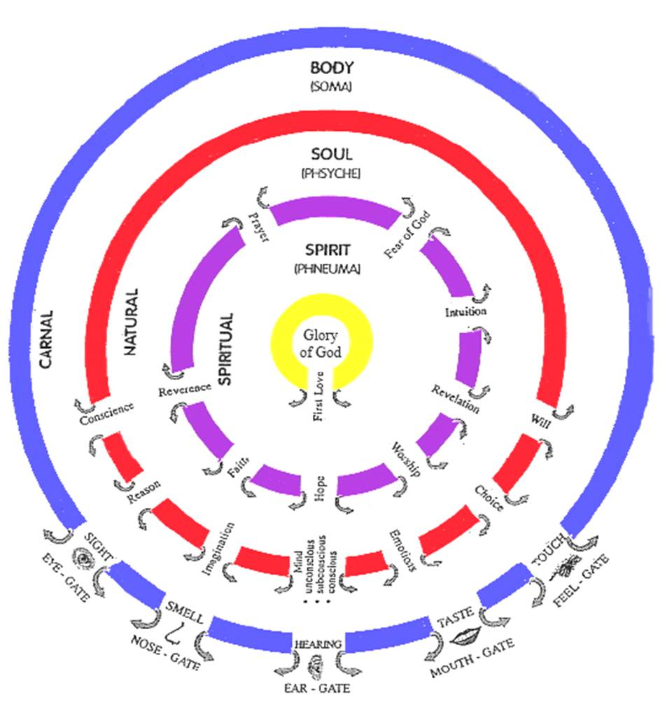

Slide 4
Preparing for Destiny – Open Gates
We all have a Body, Soul & Spirit
Body enables us to relate to world
Soul enables to relate to our selves
Spirit enables us to relate to God
All start out Messed up divided, separated, dead
In the beginning Adam was spirit, soul & body in perfect harmony & joined with God
No self awareness independent of God

Slide 6
Preparing for Destiny – Open Gates
Purpose – revelation of identity & authority
You are a dwelling of God’s presence
You are connected to heaven through God
You have a flow of abundant life flowing like a river from heaven (spiritual realm)
River flows from heaven through God to our spirit, soul, body to world around us
God’s will (kingdom rule) in heaven will operate in us, through us & around us

Slide 7
Preparing for Destiny – Open Gates
Eph 1:³ Blessed be the God .., who has blessed us with every spiritual blessing in the heavenly places in Christ
Eph 2:6 and raised us up with Him, and seated us with Him in the heavenly places in Christ Jesus,
Flow revelation, resources, authority, light, glory, God’s presence & power from the unseen spiritual heavenly dimension into the physical realm through the gateway of our lives

Slide 8
Preparing for Destiny – Open Gates
John 4:¹⁴ ..the water that I will give him shall become a spring of water welling up (flowing, bubbling) [continually] within him unto (into, from, for) eternal life.
John 7:³⁸ He who believes in Me [who cleaves to and trusts in and relies on Me] as the Scripture has said, From his innermost being shall flow [continuously] springs and rivers of living water.

Slide 9
Preparing for Destiny – Open Gates
Col 1:16 For by Him all things were created, both in the heavens and on earth, visible and invisible, whether thrones or dominions or rulers or authorities—all things have been created through Him and for Him. 17 He is before all things, and in Him all things hold together.
Spiritual or heavenly realm authority & power higher than & rules over the physical realm
Spiritual Laws or principles supersede natural laws and principles - miracles

Slide 10
Preparing for Destiny – Open Gates
Healing overrules sickness & disease
Freedom overrules captivity & bondage
Jesus is our example of heaven ruling earth through his life
Changed & transformed things
Healing is a speeding up of natural realm
Miracles spiritual realm overrules physical laws

Slide 11
Preparing for Destiny – Open Gates
Walked on water
Turned water into wine & multiplied food
Passed through people
Disappeared from natural sight
Controlled weather
Healed the sick & cast out demons
Restored things & Raised the dead
Made money appear in fishes mouth

Slide 12
Sight
Hearing
Smell
Taste
Touch

Slide 13
Preparing for Destiny – Open Gates
Everything flows from the outside in
Learn to relate to world around us through our 5 physical senses
Interpret the world through electrical impulses in the brain
See – interpret spatial awareness
Hear – interpret waves pressure
Smell - interpret chemical particles

Slide 14
Preparing for Destiny – Open Gates
Taste – sweet, sour, salty, bitter, savoury
Touch – hot, cold, soft, hard
Memories of experiences stored & reused
Learned through practice to train our senses
Soul also has senses that have been trained, from the outside in by nature, nurture & trauma
Spirit has to be trained from inside out

Slide 15
Sight
Hearing
Smell
Taste
Touch

Slide 16
Preparing for Destiny – Open Gates
Spiritual senses – are trained through our relationship with God
All knowing , All powerful, All present
Spontaneous flow of revelation knowledge
Thoughts of God dance in our mind
Feelings of God move our emotions
Impressions of God motivate our wills
Visions & Pictures form in our imagination

Slide 17
Preparing for Destiny – Open Gates
Learn to tune into hear God’s voice inside
Learn to see from the inside
Learn to hear from the inside
Learn to feel from the inside
Learn to be guided from the inside
Learn to smell from inside
Learn to touch from inside

Slide 18
Sight
Hearing
Smell
Taste
Touch
Fear of God
Awestruck All Knowing, All Seeing, All Powerful, Almighty, Consuming Fire
Reverence
Honour Respect
Worship
Obeisance, Obedience Surrender, Submission
Prayer
Constant 2 Way Communication Flow
Hope
Visions, Dreams, Seeing Opportunities
Faith
Harmony, Concord, Understanding, Knowing
Revelation
Inspiration, Light, Counsel, Wisdom
Intuition
Knowledge, Gut feelings Instinct
Heavenly
Spiritual Consciousness Heavenly Access

Slide 19
Preparing for Destiny – Open Gates
Gifts & callings
Prophetic – revelation gate, hope gate
Spiritual gifts flow - Intuition gate - Words knowledge, wisdom, distinguishing spirits
Healing, miracles – Faith Gate
We all need reverence, fear of God, prayer gates open for intimate relationship
Will we be worshippers – obedient?

Slide 20
Preparing for Destiny – Open Gates
John 14: ¹⁰ Do you not believe that I am in the Father, and the Father is in Me? The words that I say to you I do not speak on My own initiative, but the Father abiding in Me does His works.
John 16:⁷ I will send Him (the helper - Holy Spirit) to you. ⁸ And He, when He comes, will convict the world concerning sin and righteousness and judgment;

Slide 21
Preparing for Destiny – Open Gates
Luke 17:21 Nor will people say, Look! Here [it is]! or, See, [it is] there! For behold, the kingdom of God is within you [in your hearts] and among you [surrounding you].
Luke 6:19 And all the people were trying to touch Him, for power was coming from Him and healing them all.
Luke 8:46 But Jesus said, “Someone did touch Me, for I was aware that power had gone out of Me.”

Slide 22
Preparing for Destiny – Open Gates
Kingdom - Basileia “a supreme sovereign’s rule and reign.”
Gen 1:²⁸ God blessed them; and God said to them, “Be fruitful and multiply, and fill the earth, and subdue it; and rule
Matt 6:10 ‘Your kingdom come. Your will be done, On earth as it is in heaven.
We are channels, gateways for the kingdom to operate on earth

Slide 23
Preparing for Destiny – Open Gates
Each of us has a kingdom sphere of influence where we have authority to rule
Home, Workplace, Street, Church, Ministry
Authority in your circle of influence or circumstances
We can change the atmosphere, situation
Will of God inn heaven and bring that will to earth as a manifestation of the kingdom

Slide 24
Preparing for Destiny – Open Gates
Job 22:²¹ “Yield now and be at peace with Him; Thereby good will come to you. ²² “Please receive instruction from His mouth And establish His words in your heart.
Job 22:²⁸ “You will also decree a thing, and it will be established for you; And light will shine on your ways.

Slide 25
Preparing for Destiny – Open Gates
Use keys of kingdom
Matt 16:19 I will give you the keys of the kingdom of heaven; and whatever you bind on earth shall have been bound in heaven, and whatever you loose on earth shall have been loosed in heaven.”
Bind to the will of God, truth etc.
Loose from restrictions, chains of enemy
In heaven first

Slide 27
Preparing for Destiny – Open Gates
God I thank you for your presence in my life
I open the gate of first love and invite you into my spirit
I invite you to activate my spiritual senses and flow through me
Jesus I surrender control of my life to your lordship. You are Lord of my spirit
Transform me into the image of Jesus from the inside out

Slide 28
Preparing for Destiny – Open Gates
Renew my mind, heal my emotions, restore my conscience, cleanse my imagination
Train my senses to hear your voice, know your heart, see your vision, be directed by your peace
Manifest your kingdom rule through me to the world around me
Your destiny is to be a world changer

