Slide 1
Prophetic Timetable
LAST DAY
FINAL HARVEST
Heb 12:27 SHAKING OF WORLD SYSTEMS
A G E
T O
C O M E
WIND
Gen 41 HARVEST OF LABOURERS
ISA 2:2
Here
1 Peter 4:17 JUDGMENT OF GOD’S HOUSEHOLD
FIRE
Matt 13 GATHERING & REMOVING STUMBLING BLOCKS Releasing Joshua Generation
` ``
Fatherhood, Sonship, Royal Identity A CALL TO INTIMACY Habitation of God Song Solomon 8:6
WINE
DAY OF RESURRECTION & JUDGMENT

Slide 2
Preparing for Destiny - Investiture
Jer 1:5 Before I formed you in the womb I knew you, And before you were born I consecrated you; I have appointed you
Psa 139:16 Your eyes have seen my unformed substance; And in Your book (scroll) were all written The days that were ordained for me,
Your destiny to rule – bring heaven to earth
Gen 1:28 God blessed them; and God said to them, “Be fruitful and multiply, and fill the earth, and subdue it; and rule

Slide 3
Preparing for Destiny - Investiture
Psa 24:7 Lift up your heads, O you gates! And be lifted up, you everlasting doors! And the King of glory shall come in 8 Who is this King of glory? The LORD strong and mighty,
Zech 3:6 And the angel of the LORD admonished Joshua, saying, 7 “Thus says the LORD of hosts, ‘If you will walk in My ways and if you will perform My laws, then you will also govern My house and also have charge of My courts, and I will grant you free access among these who are standing here.

Slide 4
Preparing for Destiny - Investiture
Eternity
Perfection
Heaven of Heavens
Access & Stand
Heaven
Time Line
Judge Courts
Kingdom Heaven
Rule House
Kingdom God
Keep my laws
SONS KINGS LORDS
Principalities Powers
Ruling in Light
Everlasting Doors
Atmosphere Earth
Ruling in Love
Rulers/Darkness
Kingdom Earth
Spiritual Hosts of wickedness
Ruling Righteous Power
Walk in my ways
Luke 17:21
Kingdom of God is within us
Kingdom of God on Earth

Slide 5
Preparing for Destiny - Succession
Dethronement of self, soul, me, myself & I
Nature - DNA programming
Nurture - environmental programming
Trauma - experiential programming
Restored to original eternal condition

Slide 6
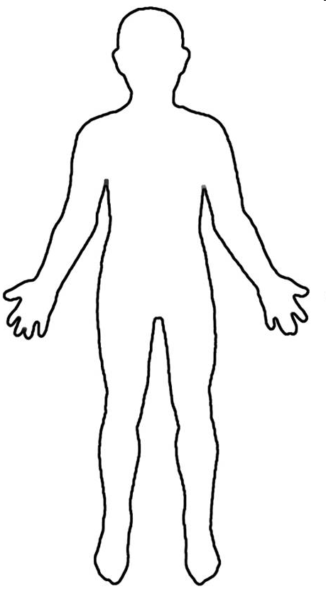
Conscious Mind
Spirit Father Son Holy Spirit
Heart Subconscious Mind Garden Scroll
Kingdom Heaven
Rivers Power Anointing
Rule House – LORDS
Kingdom within us Seat of Government
Keep my laws
Walk in my ways

Slide 7
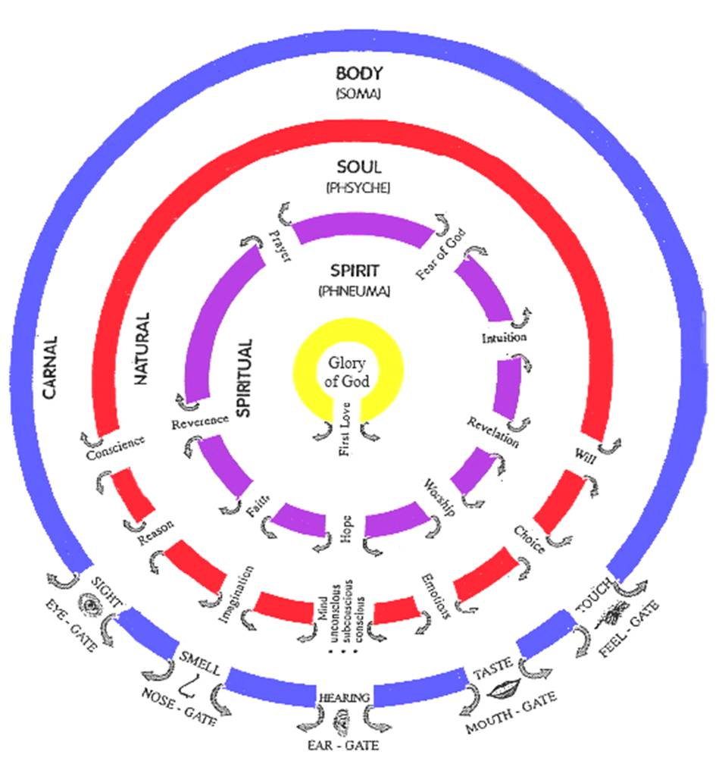

Slide 8
Spirit – Father/Son/Spirit
Kingdom of Heaven
9 Spiritual Senses 7 Soul senses & 5 Body Senses
Tabernacle Holy Place Altar Incense
Present yourself as a Living Sacrifice
Throat Cut Total Surrender
Head cut off Government removed
Skin coverings removed Naked
Body Split Open Exposed
Legs Cut Off Walk
Denial of self Take up Cross Follow Him
Not my will but Yours be done
Seek First the kingdom & righteousness
I am crucified with Christ He lives in me
Choice I only do what Father is doing
Tabernacle Holy of Holies Mercy Seat

Slide 9
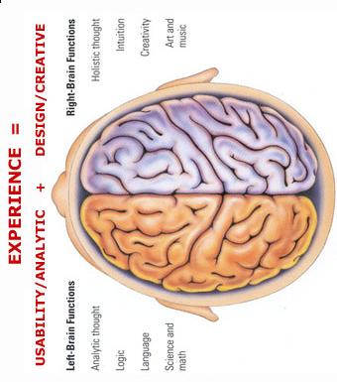
MIND
Hippocampus is a shredding machine for irrelevant information 100 billion instructions /sec
Trauma forms instant neural pathways
Or forms pathways around the memories to block them
Experiences are forgotten if the are not used Use it or lose it
Natural
H I P P O C A M P U S
M E M O R Y
B A NK S
Write
Review
Revisit
See
Smell
Hear
Taste
Touch
R E P E T I T I O N
V A L U E
V A L U E
Words Thoughts Doors Visions Anchors
Meditate
Synapses Close & Form Neural Pathways
Links to Memories
H E A R T
Anchor Pictures Meditations Imaginations Words
Repetition
Spiritual
TONGUES
Use visions, dreams, Imagination, meditation, words call things that aren’t as if they are
We all see spiritual realms most have no reference points or anchor so all info gets shredded
Words become doorways to spiritual experiences Words become anchors of experiences to keep doors open

Slide 10
Hippocampus is a Storage machine & shreds irrelevant information 100 billion instructions /sec
MIND
Prayer Ministry Deliverance Blood of Jesus
Trauma forms instant neural pathways
Natural
H I P P O C A M P U S
AUTOMAT I C RESPONSES
D E FE NSE MECHAN I SMS
B E V A V I O U R P A T T E R N S
R E P E T I T I O N
Form new neural pathways
M E M O R Y
B A NK S
REJECT ION
See
Smell
Hear
Taste
Touch
F I L T E R S
Synapses Close & Form Neural Pathways
Links to Memories
Confession
DEMONS
Agreement
Repetition
Spiritual
Break old neural pathways
Or Trauma forms pathways around the memories to block them
Forgiveness Repentance Renunciation

Slide 11
Hippocampus is a Storage machine & shreds irrelevant information 100 billion instructions /sec
MIND
Truth Meditation Truth Visualisation
ACCEPTED LOVED AFF I RMED
Natural
H I P P O C A M P U S
LED BY THE SP I R I T
WALK I K I NG I N L I GHT
R E P E T I T I O N
Form new neural pathways
C ON SC I E N C E
M E M O R Y
B A NK S
A C CE P T A N C E
See
Smell
Hear
Taste
Touch
Synapses Close & Form Neural Pathways
Links to Memories
Confession
Agreement
Repetition
Spiritual
Truth Confessions Tongues

Slide 12
Preparing for destiny - spirit building
Give God first love, place, priority
Pray & sing in tongues
Wait on the Lord – Be still
Meditate on word of God – Prov 4:20-23
Praise & adoration - soak
Pray & Ask
Confess & Declare the truth, call things
Persevere
Desire – Discipline - Delight

Slide 13
Word – Doorway & Anchor
Heb 4:12 For the word of God is living and active
Meditate on it in 2D to experience it in 3D. A picture paints a 1000 words
Experiences, visions, pictures, revelation
Write, Review & revisit - value
Some experiences heaven not in word ( greater works of Jesus)
Use word to plumb line experience to the principles of God’s nature & character
Word then becomes a starting point

Slide 14
Meditation
Joshua 1:8 This book of the law shall not depart from your mouth, but you shall meditate on it day and night, so that you may be careful to do according to all that is written in it; for then you will make your way prosperous, and then you will have success.
Prov 4:20 My son, give attention to my words; Incline your ear to my sayings. 21 Do not let them depart from your sight; Keep them in the midst of your heart. 22 For they are life to those who find them And health to all their body 23 Watch over your heart with all diligence, For from it flow the springs of life.

Slide 15
Meditation
Psa 119:11 Your word I have treasured in my heart, That I may not sin against You.
15 I will meditate on Your precepts
23 Your servant meditates on Your statutes
27 So I will meditate on Your wonders
99 For Your testimonies are my meditation
148 I may meditate on Your word

Slide 16
Meditation
Meditation means “the act of focusing one’s thoughts: to ponder, think on, muse.” reflect, contemplate, babble, mutter, imagine
Some synonyms would be contemplation, reflection, rumination, deep thinking, or remembering in the sense of keeping or calling something to mind for the purpose of consideration, reflection, or meditation.

Slide 17
Meditation
To murmur; to converse with oneself, and hence aloud; speak; talk; communication; mutter; babbling; pray; musical notation; imagine.
Turns logos written word into the Rhema spoken word
Head knowledge to personal experience

Slide 18
Meditation
Psalm 63:6 When I remember Thee on my bed, I meditate on Thee in the night watches,
Psalm 77:11 I shall remember the deeds of the LORD; Surely I will remember Thy wonders of old.
Psalm 143:5 I remember the days of old; I meditate on all Thy doings; I muse on the work of Thy hands.

Slide 19
Study
vs.
Meditation

Slide 20
7 Steps to Meditation
Lord cleanse & prepare my heart
Lord give me a teachable attitude
Lord I surrender my senses to You
Lord open the eyes of my heart
Lord I present my abilities to reason & imagine to You to fill & flow through
Lord I focus my attention on what you show me
Lord I thank you for what you have revealed to me

Slide 21
Word in Meditation
Logos word of God reveals His nature, character, safeguard truth, standard or plumb line
Psa 119:1-40 word, ways, testimonies, judgments, law, precepts, statutes, ordinances, commandments, wonders
Beholding & becoming
2 Cor 3:18 beholding as in a mirror the glory of the Lord, are being transformed into the same image from glory to glory

Slide 22
Word in Meditation
Rhema word of God speaks truth into our spirits, hearts
Psa 119:1-40 walk, observe, seek, look, treasure, tell, rejoice, meditate, establish, delight, live, long for, cling, run, incline, reverence, give thanks
Psa 119:1-40 bless, ordain, teach, open eyes, rebuke, take away reproach, revive, answer, strengthen, grant, enlarge heart, give understanding, deal bountifully

Slide 23
Word in Meditation
Prov 4:20 My son, give attention to my words; Incline your ear to my sayings. 21 Do not let them depart from your sight; Keep them in the midst of your heart. 22 For they are life to those who find them And health to all their body. 23 Watch over your heart with all diligence, For from it flow the springs of life.

Slide 24
Preparing for Destiny – Soul
Soul – Flesh, Mind, Heart – self awareness
Gal 5:16 But I say, walk by the Spirit, and you will not carry out the desire of the flesh.
Gal 5:17 For the flesh sets its desire against the spirit, and the spirit against the flesh; for these are in opposition to one another, so that you may not do the things that you please.

Slide 25
Preparing for Destiny- Practice
Heb 5:14 But solid food is for the mature, who because of practice have their senses trained to discern good and evil. (spirit & soul)
Step in & Step out
Tabernacle holy place

Slide 26
Preparing for Destiny – Soul
Give control of your soul to your spirit
Take authority over the soul
Separate soul from spirit
Heb 4:12 For the word of God is living and active and sharper than any two-edged sword, and piercing as far as the division of soul and spirit, of both joints and marrow, and able to judge the thoughts and intentions of the heart.

Slide 27
Preparing for Destiny – Soul
Soul rules draws life from spirit
Soul draws from world through body
Soul seeks to control the spirit
Break soul ties to your spirit
Use word to separate Soul/Spirit

Slide 28
Preparing for Destiny – Soul
Like a wedge, divide & separate
Break control of soul over spirit
Change from inside out
Reflect your spirit man
Become one “living being”

