Slide 1
Freedom
Blessing
Good News
Health
Media
Enterprise
Harmony

Slide 2
Freedom Media Mountain

Slide 6
by whatever means
revelation
testimony

Slide 7
Rule enables action
responsibility
influence

Slide 11
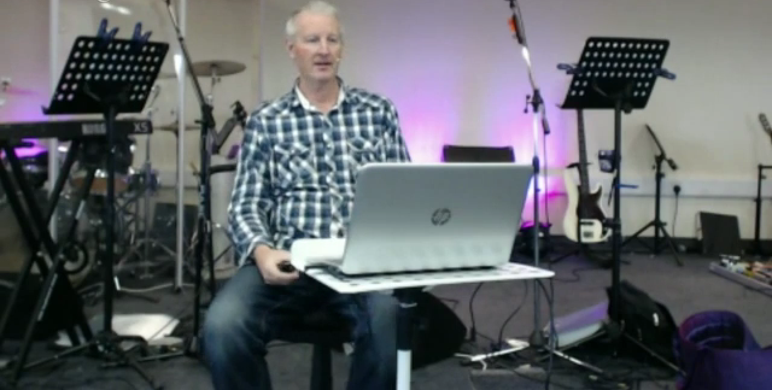

Slide 12
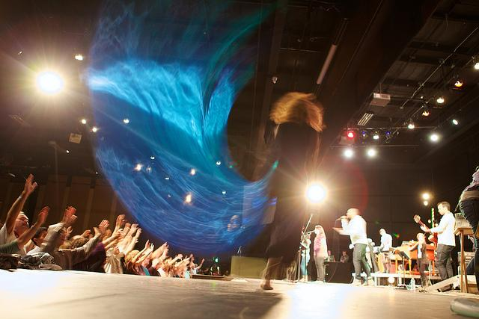

Slide 14
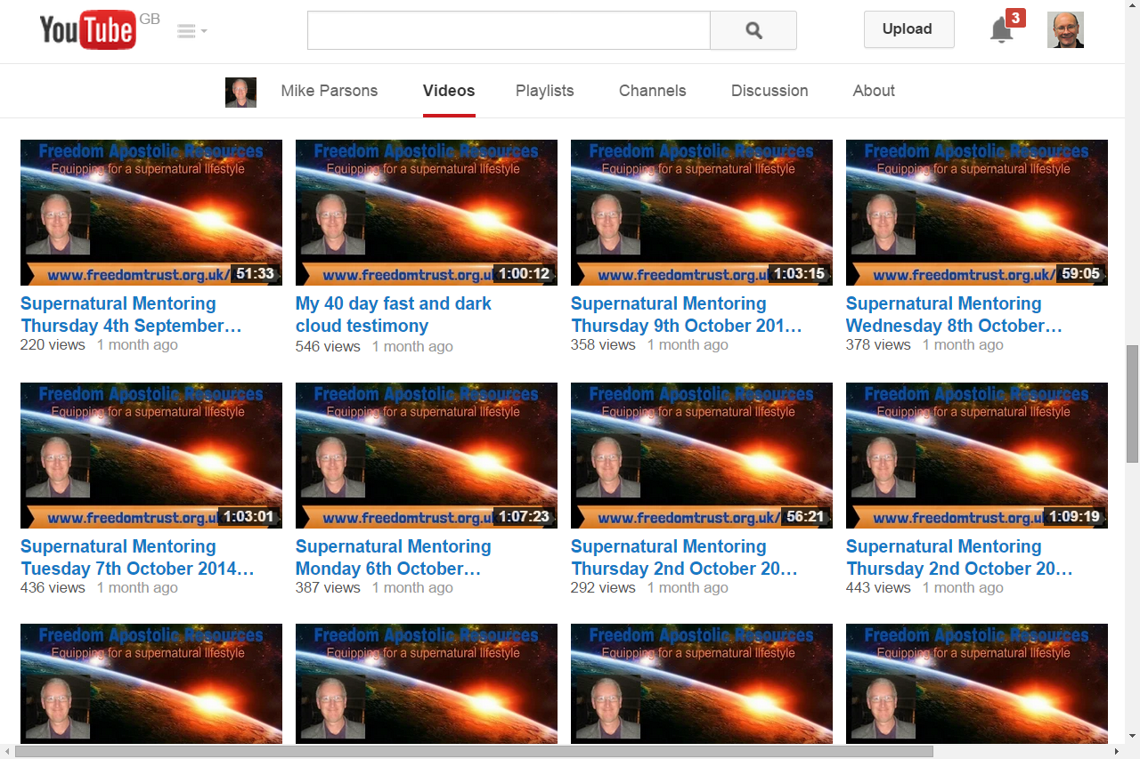

Slide 15
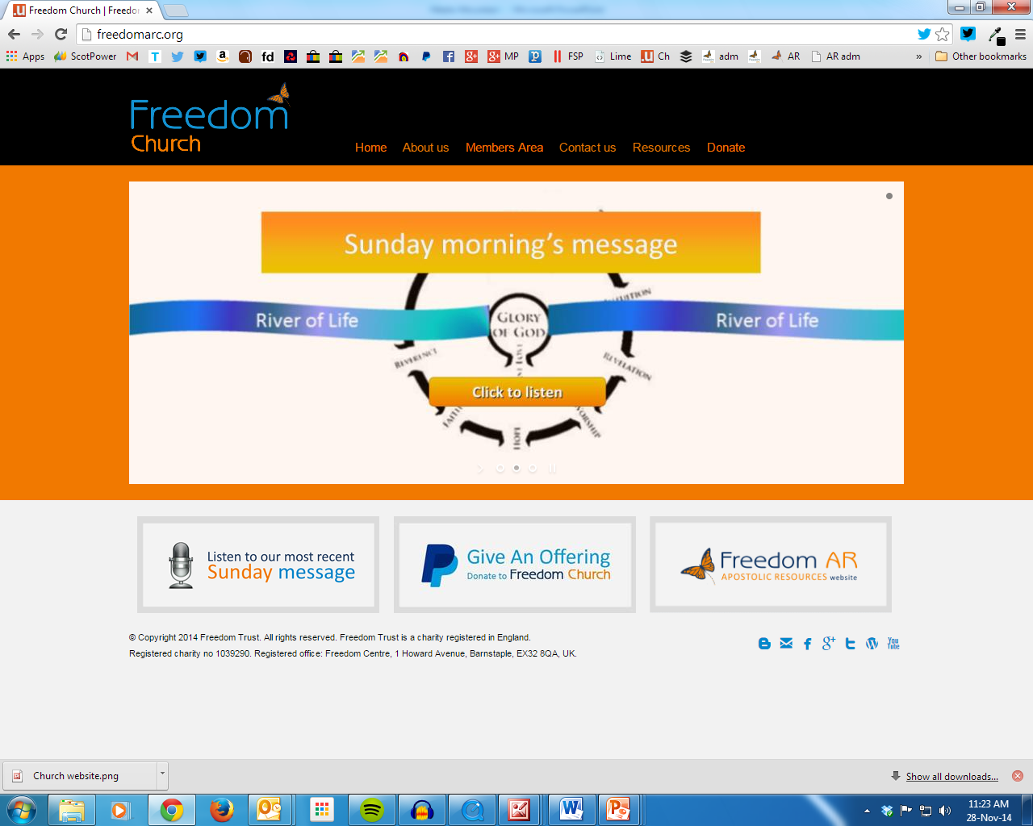

Slide 17
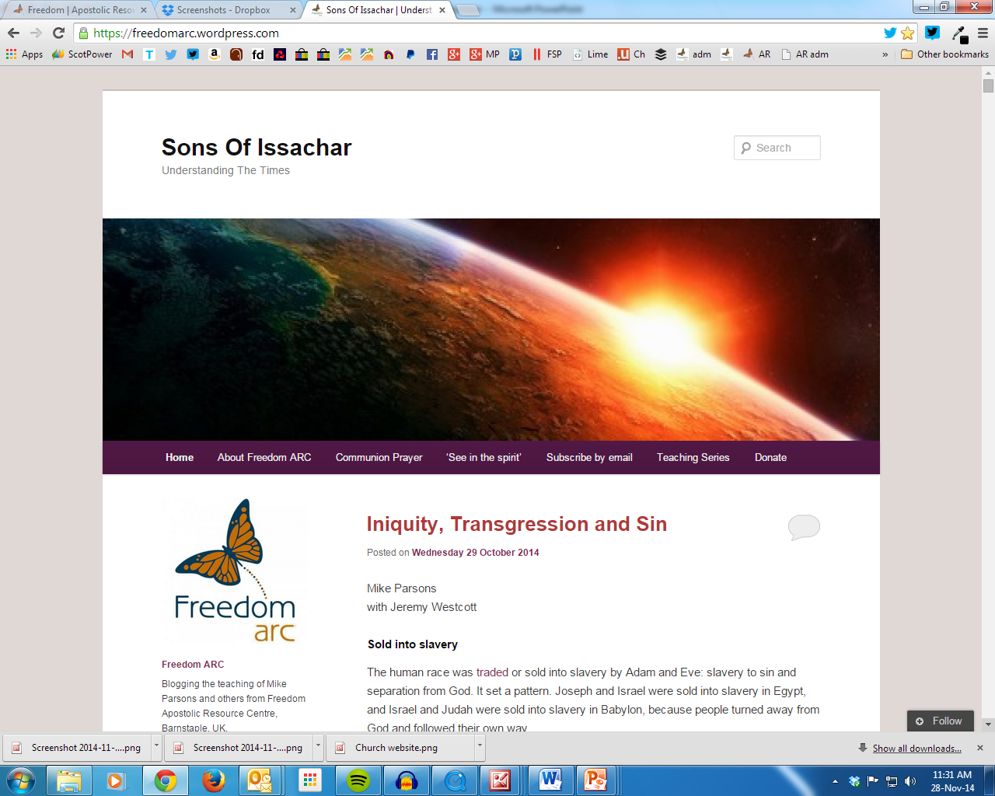

Slide 18
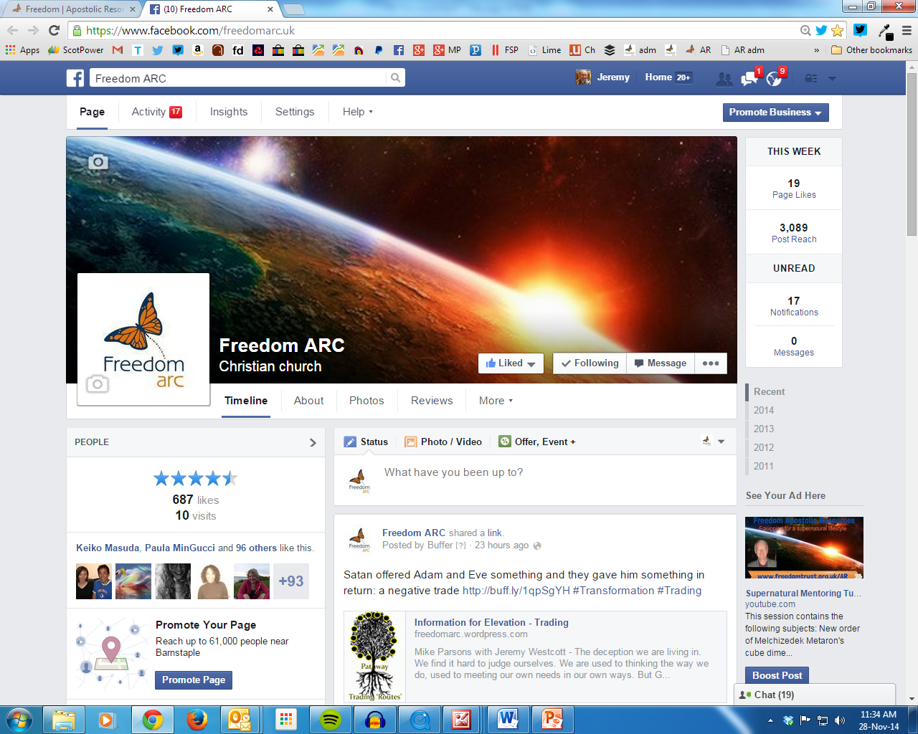

Slide 19
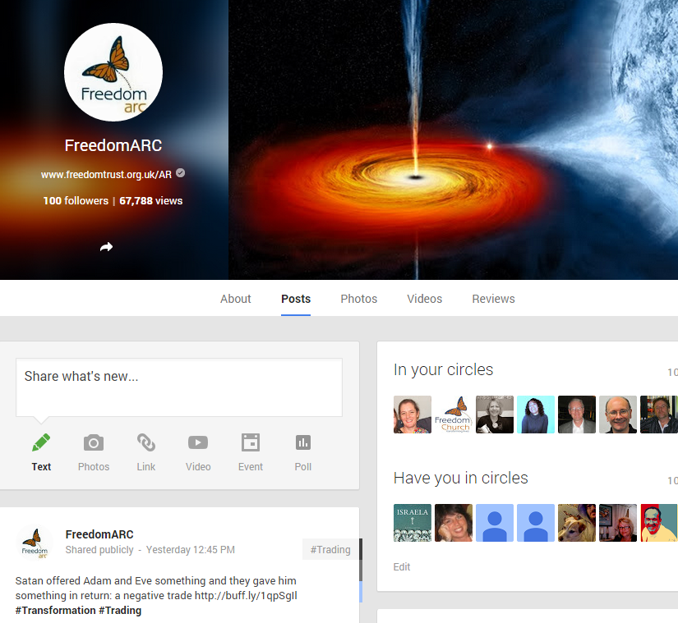

Slide 21
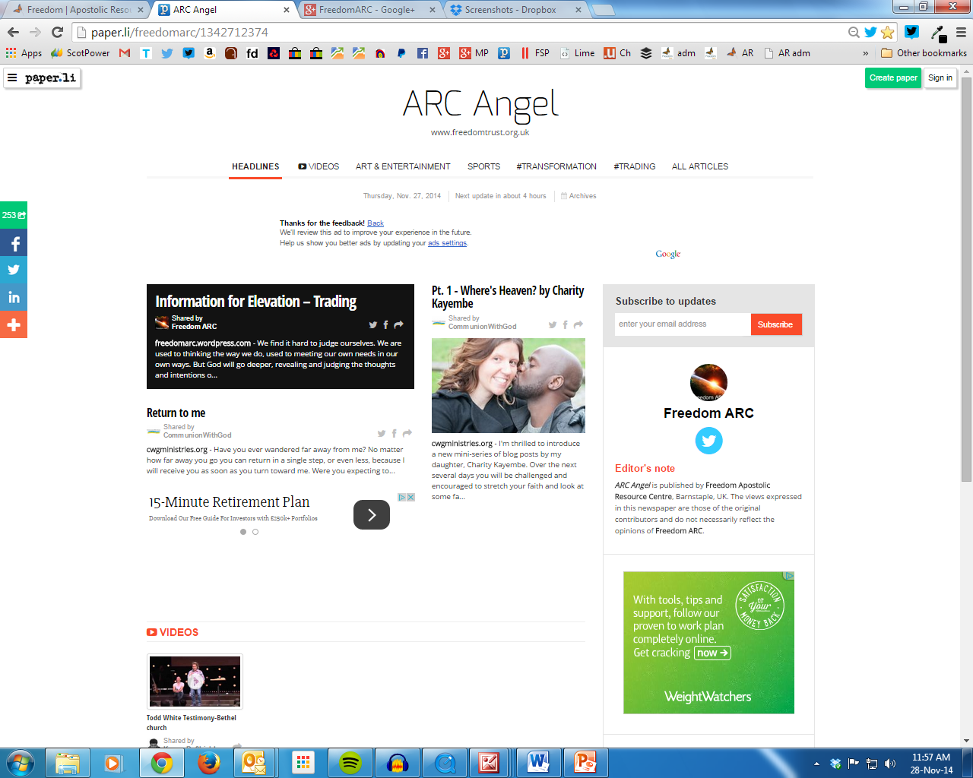

Slide 23
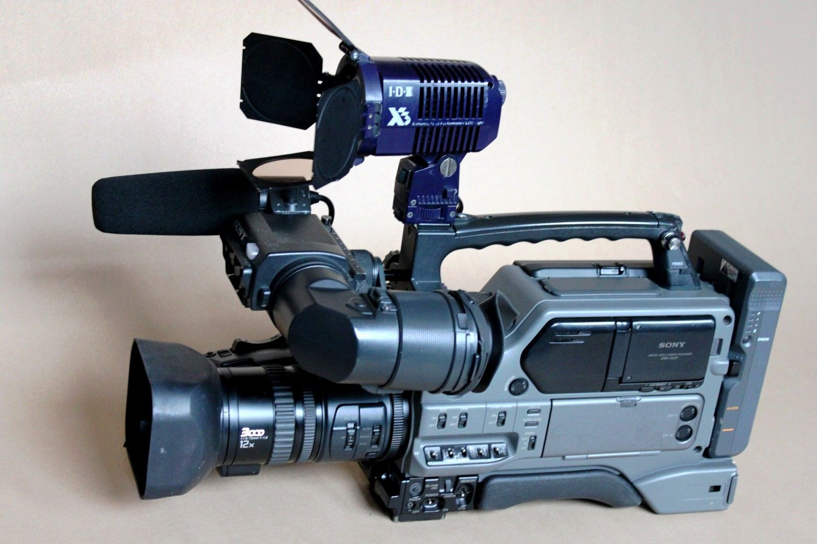

Slide 24
?
?
?

Slide 25
Media
Written
Music
Audio-visual
Angels
Evangelism
Pioneering
Networking

Slide 26
Media
Written
Music
Audio-visual
Angels
Evangelism
Pioneering
Networking

