Slide 1
Deep Calls to Deep
Freedom Apostolic Resources
www.freedomtrust.org.uk/AR
www.freedomarc.wordpress.com
mike@freedomarc.org

Slide 2
Deep Calls to Deep
God is raising up a new order in the kingdom
Order of Melchizedec – no genealogy
Old order 5 fold ministries is coming to an end
Transition from the Moses generation to the Joshua generation
Joshua generation are to be forerunners who mentored the next generation into their inheritance

Slide 3
Deep Calls to Deep
We are called to be part of, raise up and release a Joshua Generation
We are called to be forerunners
We are called to embrace progressive revelation of God’s kingdom
We are called to leave the old religious institutional ways and embrace new kingdom ways

Slide 4
Deep Calls to Deep
What sort of people do we need to be to fulfil our destiny?
Joshua Generation people those with a different spirit – 40 characteristics
Apostolic people willing to go first
Jesus Centred, Creation lovers
Pioneers, Adventurers, Leaders Disciplers etc

Slide 5
Deep Calls to Deep
It is about getting alongside people to equip and mentor them in a supernatural lifestyle
Willing to be got alongside of
Willing to go deeper with God
Willing to experience new things
Willing to understand new truth
Willing to pursue new ways
Willing to pass that on to others

Slide 6
Deep Calls to Deep
What is a supernatural lifestyle
Being like Jesus and more
John 14:12 Truly, truly, I say to you, he who believes in Me, the works that I do, he will do also; and greater works than these he will do; because I go to the Father.
John 3:13 And yet no one has ever gone up to heaven, but there is One Who has come down from heaven—the Son of Man [Himself], Who is (dwells, has His home) in heaven.

Slide 7
Deep Calls to Deep
A supernatural lifestyle
Doing the earthly and heavenly works of Jesus
The way Jesus did it in a full intimate love relationship with the Father being able to see, hear, know and do His will.

Slide 8
Deep Calls to Deep
John 5:19 Therefore Jesus answered and was saying to them, “Truly, truly, I say to you, the Son can do nothing of Himself, unless it is something He sees the Father doing; for whatever the Father does, these things the Son also does in like manner.
John 3:13 And yet no one has ever gone up to heaven, but there is One Who has come down from heaven—the Son of Man [Himself], Who is (dwells, has His home) in heaven.

Slide 9
Deep Calls to Deep
Living in heaven and earth simultaneously
Being a home for God and a gateway of heaven on earth
That is the only way it can be done legitimately
God is looking for those who want to be on this adventure of discovery

Slide 10
Deep Calls to Deep
Colossians 3:1-2 Therefore if you have been raised up with Christ, keep seeking the things above, where Christ is, seated at the right hand of God. Set your mind on the things above, not on the things that are on earth.
This represents the key revelatory principle in the NEW ways

Slide 11
Deep Calls to Deep
What are the new things?
New governmental structure patterned after heaven
Both for the corporate and the individual
Body, Soul and Spirit in wholeness connected to heaven flowing from inside out
New revelations and understanding of how to expand kingdom, subdue and rule

Slide 12
Deep Calls to Deep
New ways of ministry - experiential
New ways of teaching - experiential
New ways of prayer - experiential
New ways of interceding - experiential
New more effective ways of kingdom administration
New ways of partnering with the angelic realm – ministering servants

Slide 13
Deep Calls to Deep
New ways are about maturity
Moses did miracles, parted red sea, food just appeared, clothes never wore out, pillar cloud & fire - children
Joshua - people miracles, parted Jordan, Jericho fall, sow & reap
Jesus disciples – multiply food, do miracles, produce provision etc.

Slide 14
Deep Calls to Deep
New ways of being salt and light
New ways of being agents of change in history, society and culture
Are we influenced or influencers?
New ways to bring transformation to our communities
Establishing all things in heaven first so they can be manifested on earth

Slide 15
Deep Calls to Deep
Compare the old and new
Prayer from earth asking for God's help from heaven - God hears us from a distance.
Isaiah 64:1 Oh, that You would rend the heavens and come down,
Isaiah 64:4 For from days of old they have not heard or perceived by ear, Nor has the eye seen a God besides You, Who acts in behalf of the one who waits for Him.

Slide 16
Deep Calls to Deep
God has come down and He has rent the heavens
He has gone back up into heavens and opened up the veil for us to come.
Rev 4:1 After these things I looked, and behold, a door standing open in heaven, and the first voice which I had heard, like the sound of a trumpet speaking with me, said, “Come up here, and I will show you what must take place after these things.”

Slide 17
Deep Calls to Deep
Old - access to holy places and holy things of God is limited to only some special people – mediator priest
New access open to all of us
Old way of seeking God’s help pray from earth and hope He hears you
New way come to meet Him face to face

Slide 18
Deep Calls to Deep
Heb 4:14 Therefore, since we have a great high priest who has passed through the heavens, Jesus the Son of God..16 Therefore let us draw near with confidence to the throne of grace, so that we may receive mercy and find grace to help in time of need.

Slide 19
Deep Calls to Deep
Old ways like the wilderness expecting God to do it for us from heaven
New ways God has given us responsibility to be coheirs, partners in heaven operating as lords, kings and sons.
Your Kingdom come on earth as it is in heaven old way thinking God administers from His throne we just obey here
New way thinking we are given thrones to administer from in heaven.

Slide 20
Deep Calls to Deep
Old ways like being children where the parent does many things for and on behalf of the child
But there comes a time when children become responsible adults
God is withdrawing His support for old
As this happens if we don't embrace the new the old will slowly stop being effective.

Slide 21
Deep Calls to Deep
God wants us to grow up to become mature
He is starting to withdraw from doing everything for us to enable us to become adults
He wants to manifest His mature sons on the earth
To fulfil their destinies

Slide 22
Deep Calls to Deep
Why can’t I keep the old ways?
2.5 tribes did but there is no record of them and no evidence that the old ways continued to work for them
We can all desire the simplicity of childhood with few responsibilities
We are called to grow up we can’t just keep drinking milk if we want to be true sons

Slide 23
Deep Calls to Deep
There is coming another sound of a mighty rushing wind that will be a sound that is on a higher frequency.
This sound will be like when I hovered and vibrated over the matter and space and caused cohesion to take place.

Slide 24
Deep Calls to Deep
This sound will be vibrating at a frequency that will shake the very particles of your beings.
You will be shaken from the central core of your physical and spiritual structure and you will be transformed by this new and infinitely more powerful Pentecost.

Slide 25
Deep Calls to Deep
There will be a new order of being established restored to My original specification. Living beings containing the very essence of I am will take transformational order.
Creation itself will be shaken violently as I come closer and the spiritual and the natural orders once again overlap.

Slide 26
Deep Calls to Deep
I am releasing the sound frequency that is calling deep to deep and many are being drawn into position being made ready for the great vibrational wind that is coming.
For the new order to be established the old order must fall away and die. Those who cling to the old will die along with it just as Moses and his disobedient faithless generation died in the wilderness.

Slide 27
Deep Calls to Deep
Son I am giving this warning again because many are not heeding My wooing.
I am releasing the harbingers I will remove the stumbling blocks and obstacles.
Lawlessness will be removed from My kingdom there is no room for discord.

Slide 28
Deep Calls to Deep
You must prepare and be ready as the sound of the mighty rushing wind that will shake the created order will destroy as well as transform. The frequency of the created order itself will be changed by the power of My voice.
Use this warning to shake people out of their complacency and call for a heavenly and earthy alignment.

Slide 29
Deep Calls to Deep
Embassies of heaven on earth
Apostolic Resource Centres
Cities of refuge
Gardens of God subdue and establish dominion, rule, government
Operating with heavenly government
Not subject to the physical laws of this realm but the higher spiritual laws

Slide 30
MAN
LION
I
G
EAGLE
OX

Slide 31
I
MAN
LION
G
EAGLE
OX

Slide 32
Bench of 3
Father Son Spirit
North Gate Man Priestly
East Gate Lion Kingly
Heavenlies
Earth
West Gate Eagle Apostolic
South Gate Ox Prophetic
Bench of 3
Spirit Soul Body
Church, City, Region, Nation

Slide 33
Legend
3G = Heavenly Bench
Father, Son, Holy Spirit
3 AC = Apostolic Council
7 =Elders
---- = 4 Apostolic visionary principles
----- = 7 redemptive gifts
----- = 4 ministry areas
= 7 mountains
= Church
= ARC
FT = Freedom Trust
FSP = Freedom Social Projects
FC = Freedom Communities
FSE = Freedom Social Enterprises
S = Spiritual Social Supernatural
H = Health Holistic Hope
A = Accommodation Administration
L = Lifestyle Learning Liberty Love
O = Occupation Opportunities
M = Mentoring Mediation Ministry Media
FT
Good News
FSP
Media
S
7 Elders
Ruler
Health
M
Teacher
Servant
3 AC
3 G
H
Enterprise
Prophet
Giver
O
Exhorter
Freedom
FSE
Mercy
A
Blessing
L
FC
Harmony

Slide 34
?
ARC
?
FAMILY LIFE
S
M
HEALTH
BENCH 7
Bench 3
3 GOD
H
EDUCATION
O
FINANCE
?
A
POLITICS
L
?
PROPHETIC VOICE

Slide 35
Deep Calls to Deep
I call your spirit to attention
Spirit listen as a true son
I call forth your identity as the Joshua generation
I call forth your destiny to manifest God’s kingdom on earth as it is in heaven
I call forth your destiny to fill the earth with God’s glory

Slide 36
Deep Calls to Deep
I call forth your identity, destiny & authority as Lords to administer God’s rule on earth as it is in heaven
I call forth your identity, destiny & authority as Kings to have charge over God’s heavenly courts
I call forth your identity, destiny & authority as Sons to stand in God’s presence & be displayed on the earth

Slide 37
Deep Calls to Deep
I call forth your identity, destiny & authority as Sons of God to answer the groan of creation and restore to it to original condition & purpose
I call forth the Joshua generation to rise up & take possession of their inheritance

Slide 38
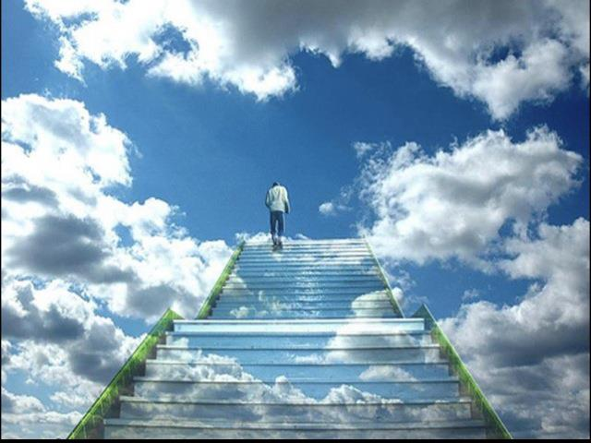

Slide 39
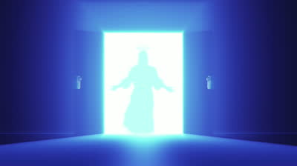

Slide 40
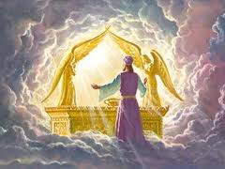

Slide 41
Deep Calls to Deep
Freedom Apostolic Resources
www.freedomtrust.org.uk/AR
www.freedomarc.wordpress.com
mike@freedomarc.org

