Slide 1
Engaging God
We are on a journey or an adventure together discovering how to engage the spiritual realms
Discovering those realms within us around us & the heavenly realms
On this journey we are going to follow the pathway of relationship and responsibility
Notes:
0

Slide 2
House of God
First Love
JOURNEY MAPS
First Love
Engaging our spirit
River of Life
Seat of Government
Yoke of Jesus

Slide 3
Seat of Rest
Lordship
Seat of Government Kingship
Engaging The Father Sonship
Seat of Rest and Government

Slide 4
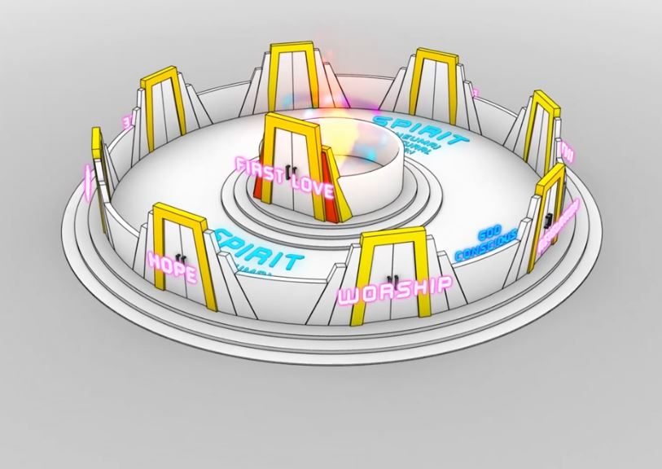
River of Life
River of Life
River of Life
River of Life
River of Life
River of Life

Slide 5
Engaging God the Father
Engage the Holy Spirit as living water in the River of life
Engaged Jesus as we take His yoke upon us
We engage the Father at the seat of rest and government
Matt 11:28 “Come to Me, all who are weary and heavy-laden, and I will give you rest.

Slide 6
Engaging God the Father
Our spirit is a mountain a place of spiritual authority
There are thrones on the mountain
Throne represents the authority to rule and government of our lives
Depending on who is on the throne we will be at rest or seeking to meet our own needs in our own strength

Slide 7
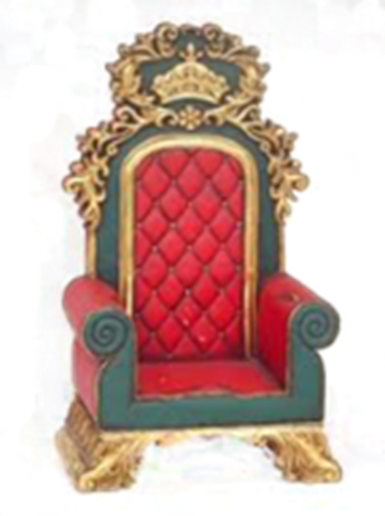
Engaging God the Father
Who is on the throne of your life
Who is in charge of your life

Slide 8
Engaging God the Father
If God is on the throne of our lives on the seat of Rest and government we can live our lives in the eye of the storm
Jesus was our example, asleep in the boat when all the disciples were fearful and panic stricken in the storm
When our peace & joy come from our relationship with God as His children they do not need to be affected by the circumstances around us

Slide 9
Engaging God the Father
Only when we know God’s Fatherhood can we truly know our sonship
When our lives are established on the solid rock of our Father and son relationship
The whole perspective of life will change
We can live our lives in rest and peace
We can treat trials & tribulations as joy and an opportunity for growth & transformation not something run from and avoid

Slide 10
Engaging God the Father
Gen 3:7 they sewed fig leaves together and made themselves loin coverings. 8 They heard the sound of the Lord God walking in the garden in the cool of the day, and the man and his wife hid themselves from the presence of the Lord God among the trees of the garden. 9 Then the Lord God called to the man, and said to him, “Where are you?” 10 He said, “I heard the sound of You in the garden, and I was afraid

Slide 11
Engaging God the Father
This fear of God and covering up was mistake then and it is a mistake now
If they had only run to God and not from Him everything would have been different
They would have discovered the full nature of Father God
A loving forgiving Father

Slide 12
Engaging God the Father
This wrong image of God has been propagated by religion through history
This wrong image of God has restricted our experience of true fatherhood
This wrong image of God has negatively affected every earthly father and all their children

Slide 13
Engaging God the Father
Rom 8:¹⁹ For the anxious longing of the creation waits eagerly for the revealing of the sons of God. ²¹ that the creation itself also will be set free from its slavery to corruption into the freedom of the glory of the children of God.

Slide 14
Engaging God the Father
We can’t be revealed as sons if we don’t have a father
God wants us to know Him as our heavenly Father
Will we surrender the throne of our lives to Father God?
Enemy can stop our sonship if He can stop our father relationship

Slide 15
Engaging God the Father
Father what does that word evoke?
Depending on our earthly experience that word will have a positive or negative or absent association
Our earthly parents are not perfect so there is a likelihood that we may have some issues in relating to God as our father

Slide 16
Engaging God the Father
What is our image of Father God based on?
Devil and religion have done a powerful P.R. job misrepresenting God
Presenting God as a harsh disapproving taskmaster waiting to punish us if we get anything wrong
It could not be further from the truth

Slide 17
Engaging God the Father
Father - my creator, my sustainer, my essence, my rest, my shalom, my affirmer, my accepter, my peace, my love, my provider, my protector, my healer, my sanctifier, my righteousness my banner, my victory, my security, my identity, my anchor, my hope, my delight, my purpose, my glorifier, my rock, my restorer

Slide 18
Engaging God the Father
FATHER - my reconciler, my transformer, my transfigurer, my renewer, my conformer, my forgiver my strength, my authority, my power, my eternal destination, my eternal home, my reference point.
My Father but it was not always my experience

Slide 19
Engaging God the Father
Num 6:24 The Lord bless you, and keep you; 25 The Lord make His face shine on you, And be gracious to you; 26 The Lord lift up His countenance on you, And give you peace.’
This is the loving God that gave Himself up for us

Slide 20
Engaging God the Father
Mal 4:5 “Behold, I am going to send you Elijah the prophet before the coming of the great and terrible day of the Lord. 6 He will restore the hearts of the fathers to their children and the hearts of the children to their fathers,

Slide 21
Engaging God the Father
Court of Kings took the orb of authority and made a new decree that will establish a new season.
I decree in the court the law of fatherhood and sonship.
l call forth the spirit that turns the hearts of the children back to their Father.

Slide 22
Engaging God the Father
I call forth a new dimension in intimacy and relationship in sonship.
I call forth the alignment in the spirit with the 4 faces of God.
I call forth a new dimension in revelation of ministry in this alignment.

Slide 23
Engaging God the Father

Slide 24
Engaging God the Father
Testimony of knowing the Father heart of God by experience
Natural Dad – no love, no affection, no affirmation, no approval, no encouragement, no fathering - abuse
No relationship with God as Father
Baptised in the Spirit – liquid love – called to a purpose

Slide 25
Engaging God the Father
First hug in worship – intimacy
Revelation of the truth that God was not like my earthly father - Hannah
Ministry – posed sham picture – chose to forgive and release – hugged him
Release of pain and emotion
My first heavenly encounter fun on His knee

Slide 26
Engaging God the Father
Heavenly encounter where my Father wound was removed
True intimacy restored
Healed wounds from -100 to 0
What about the + 100
Fathering revealed – free to be me
Discovered the love of my Father was unique designed for me

Slide 27
Engaging God the Father
Fathering intimacy = Languages of love
Gift-giving.
Quality time.
Words of affirmation.
Physical affection.
Acts of service.
Languages may correspond to different redemptive gift types

Slide 28
Engaging God the Father
Quality time the Father sharing revelation with me is my heavenly love language
Speaking to me does it for me, revealing things to me makes me feel special and loved
Books, films, word, visions, impressions, concepts, ideas
He speaks to me directly when He answers my questions always His way

Slide 29
Engaging God the Father
Revelation of His heart, mind, purpose and word makes me feel loved, valued appreciated, Fathered
He relates to me according to my gift
I am unique, special and He Fathers me according to my destiny uniquely
He will do that for you if you let Him

Slide 30
Engaging God the Father
Do we have the desire for an intimate relationship with God where trust can develop?
Or are we still holding back because of our past experiences of being hurt, wounded and being in pain?
You will know Him and feel His great love for you if you are willing to let it go

Slide 31
Engaging God the Father
Knowing our identity is key to knowing and fulfilling our destiny
Experientially knowing who we are
If you don’t know who you are how can you know what belongs to you and what you are called to do
Example in the children of Israel

Slide 32
Engaging God the Father
They came out of Egypt after 400 years as slaves
Egypt did not necessarily come out of them
Lost their identity as sons of Abraham, Isaac and Jacob
Lost their inheritance and birth-right
Mind were programmed by their conditions and generational experience

Slide 33
Engaging God the Father
Mind-set of slavery slaves not sonship
Matt 5:45 so that you may be sons of your Father who is in heaven
Who am I?
What is my identity?
Where does my identity come from?

Slide 34
Engaging God the Father
Do You feel like you don’t belong?
Do You feel like you don’t fit anywhere?
Do You still feel like an orphan?
Do You feel like no one loves you?
Do You still feel rejected?
Father God wants you to feel His love & acceptance today

Slide 35
Engaging God the Father
Journey is from a slavery mentality to a mentality of royalty with identity as sons of the King
Slaves own nothing
Slaves live in survival mode
Slaves have no hope
Slaves have no expectations
Slaves have a poverty mentality

Slide 36
Engaging God the Father
Rom 8:29 For those God foreknew he also predestined to be conformed to the likeness of his Son, that he might be the firstborn among many brothers.
It is our destiny to be His son
Do I feel, think, act like a son?

Slide 37
Engaging God the Father
Do I think like a son or a slave?
Do I act like a son or a slave?
Do I identify with slavery or sonship?
Do I know my identity as a son?
Do I know my royal identity as a son of the King?
Do I have the spirit of sonship?

Slide 38
Engaging God the Father
Slavery breeds a poverty spirit, fear & lack of identity
Sonship breeds faith, identity, resources and responsibility
Empowering slaves leads to rebellion and betrayal and treason – no ownership or loyalty
Restricting sons stops creativity

Slide 39
Engaging God the Father
We are all affected in some way by our upbringing
We are all influenced by the parenting of those who brought us up
This can be severely affecting how we view and live life
There is a process that has affected all of us to one degree or another

Slide 40
Engaging God the Father
We are affected by faults in parental authority
We receive parental faults as disappointments, discouragement, grief, rejection or insecurity
We lose basic trust in parental authority
We move into fear of receiving love, comfort and admonition from others
We develop a closed spirit
We take on an independent, self-reliant attitude

Slide 41
Engaging God the Father
We start controlling our relationships
Our relationships become superficial
We develop an ungodly belief that says no one will be there to meet our need
We begin to live life like a spiritual orphan
We begin chasing after counterfeit affections
We begin to daily battle a stronghold of oppression

Slide 42
Engaging God the Father
Counterfeit affections
Passion – substitutes
Possessions - materialism
Performance - perfectionism
People – pleasers - praise affirmation
Places – homes safe places
Position – strive for status
Power – safety, security, control

Slide 43
Engaging God the Father
Passions - addictions food, alcohol, drugs, sex, pornography, escapism comforts for the needy heart
Possessions – Security in materialism
Position - Praise of man, - striving for acceptance, approval especially of significant others
Performance - perfectionism, doing something to feel better about ourselves

Slide 44
Engaging God the Father
People meeting our needs as substitutes for God
Places - needing somewhere safe better to be happy - wandering
Power - controlling life try to control emotions, people, circumstances to never be hurt or disappointed

Slide 45
Category | A Slave | A Son
The Response to Pain | - Runs from pain - Seeks to avoid problems - Sees the cost of failure | - Embraces pain strategically - Sees opportunities in problems - Sees the benefit of failure
The Perspective on Work | - Obeys orders - Looks at the right way to do a job - Consider consequences | - Solves problems - Looks for a better way to do a job - Sees possibilities
The Use of Resource | - Sees cost - Wants to receive from those who have - Cares for himself | - Sees value - Wants to know how they got there - Understands social responsibility
The Nature of Their Relationships | - Talks about self - Expects more from others than from self - Extends honour upwards | - Talks about his team - Personally raises the bar - Extends honour downward
The View of the Future | - Looks for immediate gain - Seeks comfort - Wants to be liked now | - Sows into the future - Seeks fulfilment - Will let history be his judge
The Exercise of Power | - Is disloyal when he succeeds - Gives favours - Seeks supernatural for self | - Initiates sharing success - Shows favour - Use the supernatural for others

Slide 46
Engaging God the Father
Luke 15:11 And He said, “A man had two sons. 12 The younger of them said to his father, ‘Father, give me the share of the estate that falls to me.’ So he divided his wealth between them. 13 And not many days later, the younger son gathered everything together and went on a journey into a distant country, and there he squandered his estate with loose living. 14 Now when he had spent everything, a severe famine occurred in that country, and he began to be impoverished. 15 So he went and hired himself out to one of the citizens of that country, and he sent him into his fields to feed swine. 16 And he would have gladly filled his stomach with the pods that the swine were eating, and no one was giving anything to him.

Slide 47
Engaging God the Father
Luke 15:17 But when he came to his senses, he said, ‘How many of my father’s hired men have more than enough bread, but I am dying here with hunger! 18 I will get up and go to my father, and will say to him, “Father, I have sinned against heaven, and in your sight; 19 I am no longer worthy to be called your son; make me as one of your hired men.”’ 20 So he got up and came to his father. But while he was still a long way off, his father saw him and felt compassion for him, and ran and embraced him and kissed him.

Slide 48
Engaging God the Father
Luke 15:21 And the son said to him, ‘Father, I have sinned against heaven and in your sight; I am no longer worthy to be called your son.’ 22 But the father said to his slaves, ‘Quickly bring out the best robe and put it on him, and put a ring on his hand and sandals on his feet; 23 and bring the fattened calf, kill it, and let us eat and celebrate; 24 for this son of mine was dead and has come to life again; he was lost and has been found.’ And they began to celebrate.

Slide 49
Engaging God the Father
Luke 15:11-12 Then he said, “There was once a man who had two sons. The younger said to his father, ‘Father, I want right now what’s coming to me.’ 12-16 “So the father divided the property between them. It wasn’t long before the younger son packed his bags and left for a distant country. There, undisciplined and dissipated, he wasted everything he had. After he had gone through all his money, there was a bad famine all through that country and he began to hurt. He signed on with a citizen there who assigned him to his fields to slop the pigs. He was so hungry he would have eaten the corncobs in the pig slop, but no one would give him any.

Slide 50
Engaging God the Father
Luke 15:17-20 “That brought him to his senses. He said, ‘All those farmhands working for my father sit down to three meals a day, and here I am starving to death. I’m going back to my father. I’ll say to him, Father, I’ve sinned against God, I’ve sinned before you; I don’t deserve to be called your son. Take me on as a hired hand.’ He got right up and went home to his father. 20-21 “When he was still a long way off, his father saw him. His heart pounding, he ran out, embraced him, and kissed him. The son started his speech: ‘Father, I’ve sinned against God, I’ve sinned before you; I don’t deserve to be called your son ever again.’

Slide 51
Engaging God the Father
Luke 15:22-24 “But the father wasn’t listening. He was calling to the servants, ‘Quick. Bring a clean set of clothes and dress him. Put the family ring on his finger and sandals on his feet. Then get a grain-fed heifer and roast it. We’re going to feast! We’re going to have a wonderful time! My son is here—given up for dead and now alive! Given up for lost and now found!’ And they began to have a wonderful time.

Slide 52
Engaging God the Father
Intimacy with a loving Father God
Prodigal son & loving Father is a story of reconciliation & restoration of relationship
Not a slave or servant but a son - full sonship rights and responsibility restored.
Love of the Father can meet you today in a hug

Slide 53
Engaging God the Father

Slide 54
Engaging God the Father
Do I have an orphan spirit?
Orphans have no parents
Orphans have no inheritance
Orphans have no home
Orphans have no connection to heritage
Orphans think like slaves

Slide 55
Engaging God the Father
Do I think like a son or a slave?
Do I act like a son or a slave?
Do I identify with slavery or sonship?
Do I know my identity as a son?
Do I know my royal identity as a son of the King?

Slide 56
Engaging God the Father
God wants to heal your father and mother wounds
God wants you to have a home in Him
God wants you to know you are adopted, accepted, loved
God wants you to know & fulfil your destiny

Slide 57
Engaging God the Father
Will you allow God to be your Father?
Will you trust Him with your heart?
Will you allow him to deliver you from an orphan spirit?
Will you lay down your old natural slave and orphan identity?
Will you embrace your new supernatural identity as a royal son?

Slide 58
Engaging God the Father
I choose to lay down my old identity as an orphan and slave
I choose to turn away from my past
I choose to forgive and release my earthly father for not fully representing true fatherhood to me
I choose to forgive and release anyone who has wounded me and created a fear and mistrust of authority figures

Slide 59
Engaging God the Father
I choose to look to my heavenly Father for my acceptance
I choose not to be bound by my past
I choose not to be restricted and limited by my past experiences
I choose to face my fears, my feelings, my hurt, my pain and I choose to let them go

Slide 60
Engaging God the Father
I choose to let go of rejection & insecurity
I choose to give my heart to You Father afresh today
I choose to allow you to heal, deliver & restore me
I choose to embrace my destiny

Slide 61
Engaging God the Father
I loose each person from an orphan spirit and a spirit of slavery and a spirit of rejection
I bind each person to their full destinies in heaven & on earth as sons of God
I speak the blessing of God over each person

Slide 62
Engaging God the Father
Num 6:24 The Lord bless you, and keep you; 25 The Lord make His face shine on you, And be gracious to you; 26 The Lord lift up His countenance on you, And give you peace.’
It is time to come home and meet with Father God
Think of the prodigal son or better the loving Father story

Slide 63
Engaging God the Father

Slide 64
Engaging God the Father
Picture the Father kneeling before you now
Open your heart to Him and give Him your wounded heart
See the father/mother wounds and the scars over your heart
Surrender your wounds to Him

Slide 65
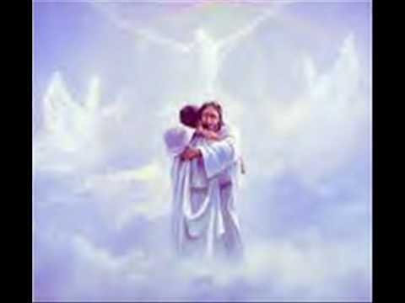
Engaging God the Father
Listen to His words of affirmation
Here the voice of Father God - I love you my child - I love, I love, I love you
Feel the healing restoring power of those words removing your scars and healing your wounds

Slide 66
Engaging God the Father
I accept you as my child
I affirm who you truly are
I receive you and adopt you into My family
I give you My love, My time, My affirmation, My approval
I give Myself to you

Slide 67
Engaging God the Father
Picture yourself walking up to God as your Father carrying any guilt, shame or condemnation you feel
Picture the Father with love and longing in His eyes waiting for you
Picture the Father with arms open and a loving smile on His face
Drop everything you are carrying
Picture the Father embracing you

Slide 68
Engaging God the Father
Feel the pleasure of the Father’s heart as He embraces you
He removes all your guilt, shame and condemnation
He forgives all your sin and cleanses your life from all your past
Choose to forgive and release yourself
He gives you new white robes of righteousness

Slide 69
Engaging God the Father
He gives you a ring of sonship and seals you with His love and affirmation
The angels celebrate and rejoice around you
Let Him minister to your heart and mind
Let Him speak the truth into your heart
Let Him renew your mind with that truth

Slide 70
Engaging God the Father
I call out your spiritual identity as my child
I call you my child and I restore your eternal identity
I invest you with the authority as princes and princesses to subdue, rule and manifest My kingdom on earth as it is in heaven

Slide 71
Engaging God the Father

Slide 73
Engaging God the Father

Slide 74
Engaging God the Father
Judgment – verdicts of the judge passed in our favour
Releases Provision Protection Direction
Justice -
Holiness -

Slide 75
Engaging God the Father
Adoption
Restoration to the Father’s heart
Fathers heart in eternity

Slide 76
Engaging God the Father

Slide 77
Engaging God the Father
Names of God reveal his character nature
El-shaddai – the almighty Gen 17:1-2
Jehovah-Jireh Lord our provider Gen22:14
Jehovah-Rapha healer
Jehovah-Tsisqenu righteousness
Jehovah-Nissi banner
Jehovah-shalom peace
Jehovah-shammah is there

Slide 78
Engaging God the Father
Jehovah M’kedesh Lord my sanctifier
Jehovah-sabaoth Lord of hosts
Meditate on God’s acts –testimony
Rev 19:10
Heb 13:8
Psa 77:10-12
Psa 143:5

Slide 79
Engaging God the Father
Sonship
Adoption
God is our Father
Can we embrace our sonship

Slide 80
Engaging God the Father
Salvation does not make us slaves (i.e., servile followers of a tyrannical God). Rather, this great salvation makes us sons (i.e. grateful followers of a loving Father)
The source of our redemption and adoption originated in the loving, sovereign plan of God the Father.

Slide 81
Engaging God the Father
To be liberated as a slave is great! But then to be adopted as a son and made a co-heir of the Father’s entire estate is astounding!
The shift from slave to son language is remarkable
By virtue of our adoption our whole relationship to God has radically changed.

Slide 82
Engaging God the Father
By virtue of our adoption, we have been given:
A new name (son no longer slave)
A new legal standing/status (accepted no longer alienated or condemned)
A new family-relationship (Father no longer Judge)
A new image, the image of Christ,

Slide 83
Engaging God the Father
Jesus life an example of sonship and His relationship with the Father reveals true Fatherhood

Slide 84
Engaging God the Father
John 14:18 “I will not leave you as orphans; I will come to you. 20 In that day you will know that I am in My Father, and you in Me, and I in you.
John 14:23 Jesus answered and said to him, “If anyone loves Me, he will keep My word; and My Father will love him, and We will come to him and make Our abode with him.

Slide 85
Engaging God the Father
Jesus said I am in My Father
Jesus said He is in you and you are in Him
The Father is in you and you are in the Father
Intimacy, relationship, oneness, wholeness
You are My beloved son in you I am well pleased.

Slide 86
Engaging God the Father
John 6:27 Do not work for the food which perishes, but for the food which endures to eternal life, which the Son of Man will give to you, for on Him the Father, God, has set His seal.”
John 13:3 Jesus, knowing that the Father had given all things into His hands, and that He had come forth from God and was going back to God,

Slide 87
Engaging God the Father
John 1:18 No one has seen God at any time; the only begotten God who is in the bosom of the Father, He has explained Him.
Matt 3:17 and behold, a voice out of the heavens said, “This is My beloved Son, in whom I am well-pleased.”

Slide 88
Engaging God the Father
1 Cor 15:24 then comes the end, when He hands over the kingdom to the God and Father, when He has abolished all rule and all authority and power.

Slide 89
Engaging God the Father
John 5:19 Therefore Jesus answered and was saying to them, “Truly, truly, I say to you, the Son can do nothing of Himself, unless it is something He sees the Father doing; for whatever the Father does, these things the Son also does in like manner.

Slide 90
Engaging God the Father
John 5:20 For the Father loves the Son, and shows Him all things that He Himself is doing; and the Father will show Him greater works than these, so that you will marvel.
John 10:30 I and the Father are one.
John 10:38 but if I do them, though you do not believe Me, believe the works, so that you may know and understand that the Father is in Me, and I in the Father.”

Slide 91
Engaging God the Father
John 12:49 For I did not speak on My own initiative, but the Father Himself who sent Me has given Me a commandment as to what to say and what to speak.
John 14:2 In My Father’s house are many dwelling places; if it were not so, I would have told you; for I go to prepare a place for you.

Slide 92
Engaging God the Father
John 14:10 Do you not believe that I am in the Father, and the Father is in Me? The words that I say to you I do not speak on My own initiative, but the Father abiding in Me does His works.
John 14:20 In that day you will know that I am in My Father, and you in Me, and I in you.

Slide 93
Engaging God the Father
John 14:23 Jesus answered and said to him, “If anyone loves Me, he will keep My word; and My Father will love him, and We will come to him and make Our abode with him.
John 15:9 Just as the Father has loved Me, I have also loved you; abide in My love.

Slide 94
Engaging God the Father
John 15:10 If you keep My commandments, you will abide in My love; just as I have kept My Father’s commandments and abide in His love.
John 15:26 “When the Helper comes, whom I will send to you from the Father, that is the Spirit of truth who proceeds from the Father, He will testify about Me,

Slide 95
Engaging God the Father
John 16:15 All things that the Father has are Mine; therefore I said that He takes of Mine and will disclose it to you.
John 16:23 Truly, truly, I say to you, if you ask the Father for anything in My name, He will give it to you.

Slide 96
Engaging God the Father
John 16:26 In that day you will ask in My name, and I do not say to you that I will request of the Father on your behalf;
John 16:27 for the Father Himself loves you, because you have loved Me and have believed that I came forth from the Father.

Slide 97
Engaging God the Father
John 17:21 that they may all be one; even as You, Father, are in Me and I in You, that they also may be in Us, so that the world may believe that You sent Me.
John 17:24 Father, I desire that they also, whom You have given Me, be with Me where I am, so that they may see My glory which You have given Me, for You loved Me before the foundation of the world.

Slide 98
Engaging God the Father
John 20:17 .. for I have not yet ascended to the Father; but go to My brethren and say to them, ‘I ascend to My Father and your Father, and My God and your God.’”
John 20:21 So Jesus said to them again, “Peace be with you; as the Father has sent Me, I also send you.”

Slide 99
Engaging God the Father
1 John 3:1 See how great a love the Father has bestowed on us, that we would be called children of God;
1 John 4:16 We have come to know and have believed the love which God has for us. God is love, and the one who abides in love abides in God, and God abides in him.

Slide 100
Engaging God the Father
John 1:12 But to all who believed him and accepted him, he gave the right to become children of God.
Rom 8:14 For all who are led by the Spirit of God are children of God. So you have not received a spirit that makes you fearful slaves. Instead, you received God's Spirit when he adopted you as his own children.

Slide 101
Engaging God the Father
1 John 3:1 See how great a love the Father has bestowed on us, that we would be called children of God
1 John 3:1 See what great love the Father has lavished on us, that we should be called children of God!

Slide 102
Engaging God the Father
Redeemed from slavery by Jesus.
Bought back from slavery given a new home and a family.
We are adopted as sons into the family of the King
We are royalty – princess & princesses
Regardless of history or background

Slide 103
Engaging God the Father
Born again into a new family with a new identity
We have a new heavenly home & are a home of God
New heavenly citizenship
New yet eternal identity & purpose
Sonship with a relationship with the Father

Slide 104
Engaging God the Father
Every blessing of the new covenant comes through our union with Jesus
Our adoption,
In Christ, we become His sons and daughters & God becomes our Father.
Gal 3:26 For you are all sons of God through faith in Christ Jesus.
Everything comes through faith by grace

Slide 105
Engaging God the Father
Gal 4:6 Because you are sons, God has sent forth the Spirit of His Son into our hearts, crying, “Abba! Father!”
Rom 8:15 For you have not received a spirit of slavery leading to fear again, but you have received a spirit of adoption as sons by which we cry out, “Abba! Father!”

Slide 106
Engaging God the Father
Eph 1:4 just as He chose us in Him before the foundation of the world, that we would be holy and blameless before Him. In love 5 He predestined us to adoption as sons through Jesus Christ to Himself, according to the kind intention of His will,
Matt 5:45 so that you may be sons of your Father who is in heaven

Slide 107
Engaging God the Father
Rom 8:16 The Spirit Himself testifies with our spirit that we are children of God, 17 and if children, heirs also, heirs of God and fellow heirs with Christ, if indeed we suffer with Him so that we may also be glorified with Him.

Slide 108
Engaging God the Father
Psa 139:1 O Lord, You have searched me and known me. 2 You know when I sit down and when I rise up; You understand my thought from afar. 3 You scrutinize my path and my lying down, And are intimately acquainted with all my ways.

Slide 109
Engaging God the Father
Psa 139:13 For You formed my inward parts; You wove me in my mother’s womb. 14 I will give thanks to You, for I am fearfully and wonderfully made; Wonderful are Your works, And my soul knows it very well. 15 My frame was not hidden from You, When I was made in secret, And skilfully wrought in the depths of the earth;

Slide 110
Engaging God the Father
Psa 139:16 Your eyes have seen my unformed substance; And in Your book were all written The days that were ordained for me, When as yet there was not one of them. 17 How precious also are Your thoughts to me, O God! How vast is the sum of them! 18 If I should count them, they would outnumber the sand. When I awake, I am still with You.

Slide 111
Engaging God the Father
1 Cor 8:6 yet for us there is but one God, the Father, from whom are all things and we exist for Him; and one Lord, Jesus Christ, by whom are all things, and we exist through Him.

Slide 112
Engaging God the Father

Slide 113
Engaging God the Father

Slide 114
Engaging God the Father
John 14:18 “I will not leave you as orphans; I will come to you. 20 In that day you will know that I am in My Father, and you in Me, and I in you.
John 14:23 Jesus answered and said to him, “If anyone loves Me, he will keep My word; and My Father will love him, and We will come to him and make Our abode with him.

Slide 115
Engaging God the Father
Jesus said I am in My Father
Jesus said He is in you and you are in Him
The Father is in you and you are in the Father
Intimacy, relationship, oneness, wholeness
You are My beloved son in you I am well pleased.

Slide 116
Engaging God the Father

Slide 117
Engaging God the Father
Rom 8:29 For those God foreknew he also predestined to be conformed to the likeness of his Son, that he might be the firstborn among many brothers.
It is my destiny to be His son
Do I feel, think, act like a son?

Slide 118
Engaging God the Father
Do I think like a son or a slave?
Do I act like a son or a slave?
Do I identify with slavery or sonship?
Do I know my identity as a son?
Do I know my royal identity as a son of the King?
Do I have the spirit of sonship?

Slide 119
Inheritance – Destiny 4
Slavery breeds a poverty spirit, fear & lack of identity
Sonship breeds Faith, identity resources, responsibility
Empowering slaves leads to rebellion and betrayal and treason – no ownership or loyalty
Restricting sons stops creativity

Slide 120
Engaging God the Father

Slide 121
Engaging God the Father

Slide 122
Engaging God the Father
Do I have an orphan spirit?
Orphans have no parents
Orphans have no inheritance
Orphans have no home
Orphans have no connection to heritage
Orphans think like slaves

Slide 123
Engaging God the Father
Do I think like a son or a slave?
Do I act like a son or a slave?
Do I identify with slavery or sonship?
Do I know my identity as a son?
Do I know my royal identity as a son of the King?

Slide 124
Engaging God the Father
God wants to heal your father mother wounds
God wants you to have a home in Him
God wants you to know you are adopted, accepted, loved
God wants you to know & fulfil your destiny

Slide 125
Engaging God the Father
Will you allow God to be your Father?
Will you trust Him with your heart?
Will you allow him to deliver you from an orphan spirit?
Will you lay down your old natural identity?
Will you pick up your new supernatural identity?

Slide 126
Engaging God the Father
I choose to lay down my old identity as an orphan and slave
I choose to turn away from my past
I choose to forgive and release my earthly father for not representing true fatherhood to me
I choose to look to my heavenly Father for my acceptance

Slide 127
Engaging God the Father
I choose to let go of rejection, fear & insecurity
I choose to embrace my destiny
I choose to give my heart to You Father afresh today
I choose to allow you to heal, deliver & restore me

Slide 128
Engaging God the Father
In authority I loose them from an orphan spirit and a spirit of slavery and a spirit of rejection
I bind them to their full destinies in heaven & on earth as sons of God
See with the eyes of your heart, father/mother wounds scars
Here the voice of Father God - I love you my child - I love, I love

Slide 129
Engaging God the Father
I accept you as my child
I affirm who you truly are
I call out your spiritual identity as my sons
I invest you with the authority as princes and princesses to subdue, rule and manifest My kingdom on earth as it is in heaven

Slide 130
Engaging God the Father

Slide 131
Engaging God Seat of Government

Slide 132
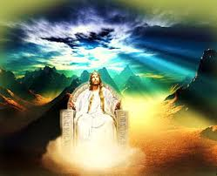

Slide 133
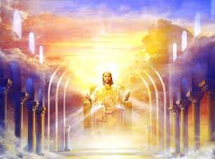

Slide 135
Engaging God Seat of Government
Prov 3:5 Trust in the LORD with all your heart And do not lean on your own understanding

Slide 136
Engaging God Seat of Government

Slide 137
Engaging God the Father
Father my creator my sustainer my essence my rest my shalom my affirmer my accepter My peace My love My provider my protector my healer my sanctifier my righteousness my banner My victory my security my identity my anchor my hope my delight my purpose my glorifier my rock my restorer my reconciler my transformer my transfigurer My renewer my conformer my forgiver my strength my authority my power my eternal destination my eternal home my reference point. My Father

Slide 138
Engaging God the Father
God My Consuming fire My frequency My harmony My resonance My Manifold grace my Manifold wisdom My Melody My Rhythm My metronome My conductor My author My producer My composer Yod Hei Vav Hei My Lion My Ox My Eagle My Man My King my Prophet My Apostle My Priest My Home My dwelling place My covenant My all in all

Slide 139
Engaging God the Father
Sonship
Adoption
God is our Father
Prodigal son
Embrace of sonship

Slide 140
Engaging God the Father
Names of God reveal his character nature
El-shaddai – the almighty Gen 17:1-2
Jehovah-Jireh Lord our provider Gen22:14
Jehovah-Rapha healer
Jehovah-Tsisqenu righteousness
Jehovah-Nissi banner
Jehovah-shalom peace
Jehovah-shammah is there

Slide 141
Engaging God the Father
Jehovah M’kedesh Lord my sanctifier
Jehovah-sabaoth Lord of hosts
Meditate on God’s acts –testimony
Rev 19:10
Heb 13:8
Psa 77:10-12
Psa 143:5

Slide 142
Engaging God the Father
Came out of Egypt after 400 years as slaves
Lost their identity as sons of Abraham Isaac and Jacob
Lost their inheritance and birth-right
Slaves, servants, stewards, friends or sons
Slaves to the illusion

Slide 143
Engaging God the Father
Mind-set of slavery
Slaves not sons
Matt 5:45 so that you may be sons of your Father who is in heaven

Slide 144
Engaging God the Father
Rom 5:17 For if by the transgression of the one, death reigned through the one, much more those who receive the abundance of grace and of the gift of righteousness will reign in life through the One, Jesus Christ.

Slide 145
Engaging God Seat of Government
Who is on the throne of your life
Who is in charge of your life

Slide 146
Engaging God Seat of Government
Not my will but yours be done
Heb 4: 9 So there remains a Sabbath rest for the people of God. 10 For the one who has entered His rest has himself also rested from his works, as God did from His. 11 Therefore let us be diligent to enter that rest,

Slide 147
Engaging God Seat of Rest
Trust in God as provider protector
Names of YHVH
Lord

Slide 148
Engaging God Seat of Rest
Lordship
Abdication
Training for reigning

Slide 149
Engaging God Seat of Rest
Rest engages the motivations and desires of hearts purify
Desire of soul is for things
Desire from rest is to bring order into things
Responsible to operate in righteousness by grace that will release mercy

Slide 150
Engaging God Seat of Rest
Place of true rest is being I the womb of His heart where my destiny is contained within His thoughts about me
Engage my future when my past has been brought into rest forgib=vem
Engage the future outside of the consequences of our past (in what was where Christ was already slain)

Slide 151
Engaging God Seat of Rest
What you are today out of what you were in eternity sets the course for what will be tomorrow
Rest of in us and through us and around us and be able to rule in Him and from my mountain position of government.
Realm of government in heavens from the seat of rest within.

Slide 152
Engaging God Seat of Rest
Abdicate and rule
Father today by faith we enter into the realm of your presence through the veil
Jesus as my saviour I surrender to you as the Lord of my life
Today by faith I abdicate the throne of my life and I ask that you take your place on the throne the seat of rest and government in my spirit

Slide 153
Engaging God Seat of Rest
I abdicate and step away from that throne and observe you sitting on that throne and I step into you
Help me stay in this place as I learn of your lordship and am trained to become a lord
Mandated a son to become a king to rule with a river flowing through me

Slide 154
Engaging God Seat of Rest
Changing the world around me and bringing your dominion into the earth

Slide 155
Engaging God Seat of Rest
Now, being seated is a picture of rest. In the Old Testament, the priests never sat down. There were no chairs in the tabernacle of Moses or in the temple of God because their work was never finished. But Jesus sat down because His work is finished. (John 19:30, Hebrews 10:11–13) And God said to me, “Son, tell My people to have a throne attitude.” So what does it mean to have a “throne attitude”?

Slide 156
Engaging God Seat of Rest
Psalm 110:1–2 The LORD said to my Lord, “Sit at My right hand, till I make Your enemies Your footstool.” The LORD shall send the rod of Your strength out of Zion. Rule in the midst of Your enemies!

Slide 157
Engaging God Seat of Rest
This means that what the physical land was to the children of Israel in the Old Testament, God’s grace and rest are to the believer under the new covenant. That is your inheritance today. God wants to bring you out of lack and into the land of abundance! He wants to bring you out of sickness into robust health! And this promised land is the place of His rest.

Slide 158
Engaging God Seat of Rest
Be Rest-Conscious, Not Giant-Conscious
Today, some of us still have this slave mentality. We are so focused on our “Anakim”—our problems and symptoms—instead of Jesus’ finished work on the cross, that we cannot enter our promised land of rest.

Slide 159
Engaging God Seat of Rest
John 5:8–9
Jesus said to him, “Rise, take up your bed and walk.” And immediately the man was made well, took up his bed, and walked. And that day was the Sabbath.
I asked the Lord why He asked the man to take up his bed. Why not just ask him to rise and walk? And He showed me that the bed is a picture of rest. So what Jesus was actually saying to the man was, “Rise, take up your rest and walk!”
Notice that that day was the Sabbath, the day of rest. Therefore, what God is saying is that when you rest, He works! Isn’t this amazing?

Slide 160
Engaging God Seat of Rest
Be still and know
Wait on the lord and renew your strength

Slide 161
Engaging God Seat of Rest
The reason we can rest and rejoice in the midst of our enemies is because Jesus defeated them when He took our place and bore our sins on the cross. He has done it all and the work is finished. (Hebrews 10:12–14) We only need to take up a throne attitude and rest in Him.

Slide 162
Engaging God Seat of Rest
Psa 23 Table = supply in the presence of our enemies
Enemy lack fear poverty insecurity

Slide 163
Engaging God Seat of Rest

Slide 164
Preparing for destiny – Seat of Rest
Why weary & heavy laden (burdened) ?
Am I tired trying to survive & cope with life myself?
Am I heavy carrying responsibilities that are not mine?
We are all called to live in a state of rest regardless of what is going on around our lives.

Slide 165
Engaging God First Love
Father my creator my sustainer my essence my rest my shalom my affirmer my accepter My peace My love My provider my protector my healer my sanctifier my righteousness my banner My victory my security my identity my anchor my hope my delight my purpose my glorifier my rock my restorer my reconciler my transformer my transfigurer My renewer my conformer my forgiver my strength my authority my power my eternal destination my eternal home my reference point. My Father

Slide 166
Engaging God First Love
God My Consuming fire My frequency My harmony My resonance My Manifold grace my Manifold wisdom My Melody My Rhythm My metronome My conductor My author My producer My composer Yod Hei Vav Hei My Lion My Ox My Eagle My Man My King my Prophet My Apostle My Priest My Home My dwelling place My covenant My all in all

Slide 167
Engaging God First Love
Matthew 6:25, 32-33 "For this reason I say to you, do not be worried about your life, as to what you will eat or what you will drink; nor for your body, as to what you will put on. Is not life more than food, and the body more than clothing? For the Gentiles eagerly seek all these things; for your heavenly Father knows that you need all these things. But seek first His kingdom and His righteousness, and all these things will be added to you.

Slide 168
Engaging God Seat of Rest

Slide 169
Engaging God Seat of Rest

Slide 170
Engage Jesus the Truth

Slide 171
Engage Jesus the Truth

Slide 172
Engaging God Yoke of Jesus 1
Close your eyes
Begin to think about that door
Activate your imagination as the doorway to encounter
Picture the door reach out and open the door
The river is flowing God starts to envelope you

Slide 174
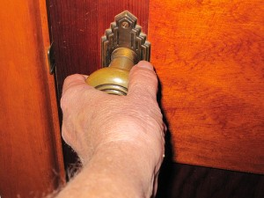
First Love House of God 1

Slide 175
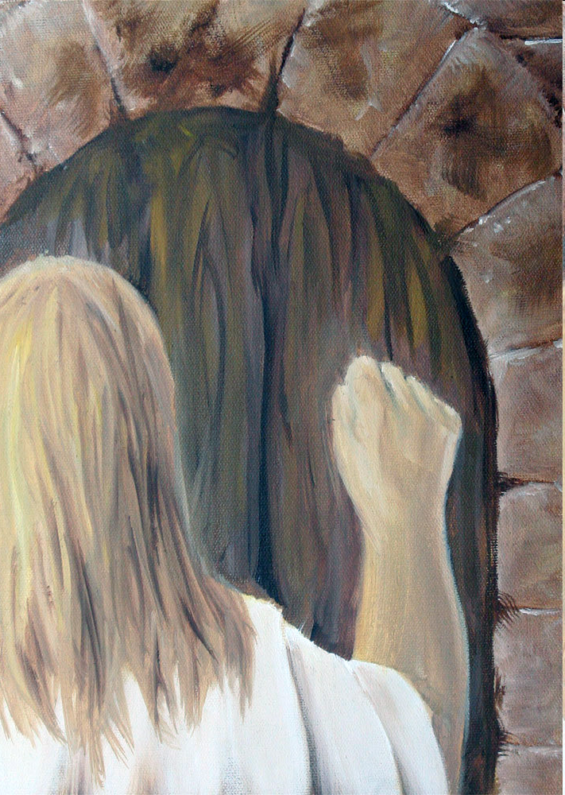

Slide 176
Engaging God Yoke of Jesus 1
Invite Jesus to embrace you
Let Him reveal himself to you
Let Him surround you and join with you
Feel the light energy His vibrational frequency energising you.
Feel Him touch your whole being feel restoration and renewal

Slide 178
Engaging God River of Life 3
See Jesus with the yoke of discipleship
Are you willing to know the Truth
Are you willing to let Jesus put His yoke on your shoulders
Are willing to take the burden of your governmental responsibility as a son

Slide 179
Engaging God Yoke of Jesus 1

Slide 180
Engaging God Yoke of Jesus 2
Let Him Unplug you from the limited constructs of your mind
Let Him expand your reality
Let Him expand your conscious awareness of who you are
Let the Truth free you To know true reality

Slide 181
Engaging God Yoke of Jesus 2
Let Him free you to know Him
Let Him free you to see your scroll
Let Him free you to be
Let Him free you to do
Let Him free you to go beyond

Slide 183
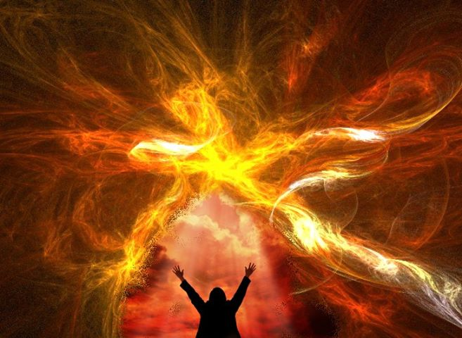

Slide 184
Engaging God River of Life 3
Let Him take you flying beyond your limits
Let Him take you outside your limits
Let Him show you eternal reality
Let Him reveal your true reality

Slide 185
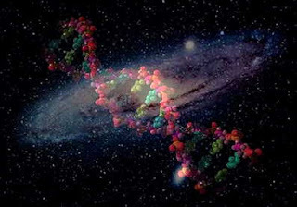

Slide 186
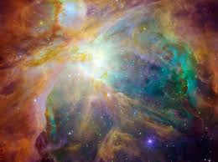

Slide 187
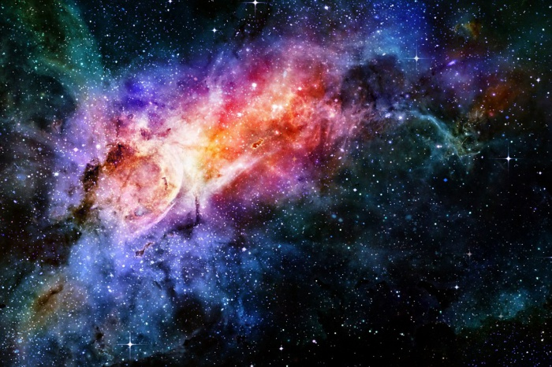

Slide 188
Engaging God Yoke of Jesus 1
Follow learn conditions of discipleship ox rabi
Results carrying own burdens yoke of world etc
Follow Him as forerunner Order Melchizedek Priest and king heavenly access though veil to Holy Holies
Yoke joined entwined connected 1 Cor 6:17
Yoke of relationship intimacy draw from the source love joy peace John 14 - 16 Gentle humble heart Stewardship to friendship key disclose reveal unveil

Slide 189
Engaging God Yoke of Jesus 1
High priest advocate in all court cases prepares me to serve when I surrender as a living sacrifice burden responsibility of sonship being a joint heir inheritance the nations kingdom priests
Jesus way truth life way of cross sacrifice and surrender deny self -own way follow His way I am's 7 statements Bread of life Resurrection
I am what was what is what will beTruth Who I am who l was eternal covenant slain before sin messed it up

Slide 190
Engaging God Yoke of Jesus 1
way of the cross Gal 2:20 dead to old yoked joined to new a follower of the way path method
Jesus prophet priest king and the apostle
heavenly seated with Him and in His name carry His authority. John 14:12 works and greater wants
Truth of living word of God creator and sustainer image of God predestined to be conformed Rom.8

Slide 191
Engaging God First Love
Jesus Lord and king steward resources ministry trusted most often biggest test will I get my ldentity from what I do or from who I am in relationship will I get caught up in working for l lose my first love and enter duty cycle fear cycle
Friendship joint heir reveals ways heart revelation invested heavenly authority.

Slide 192
Engaging God First Love
Luke 10:And he answered, “You shall love the Lord your God with all your heart, and with all your soul, and with all your strength, and with all your mind; and your neighbour as yourself.”
1 Cor 6:17 But the one who joins himself to the Lord is one spirit with Him.

Slide 193
Engaging God First Love
Our spirit encompasses our soul and creates an atmosphere that manifests the kingdom of God around us
John 14:12
Works of Jesus – healing, miracles, authority over nature, supernatural provision and protection

Slide 194
Engaging God First Love
What does it feel like to embrace God?
What does it feel like to be embraced by God?
Embracing God's presence is holistic – spirit, soul and body need to be involved

Slide 195
Engaging God First Love
Engaging in the physical or natural realm can activate spiritual
Physical actions can be faith steps faith without works is dead
Hugging or embracing ourselves is faith step
Raise our hands, kneel or lie down physical expression of spiritual reality

Slide 196
Engaging God Yoke of Jesus 1
John 1:14 And the Word became flesh, and dwelt among us, and we saw His glory, glory as of the only begotten from the Father, full of grace and truth.

Slide 197
Engaging God Yoke of Jesus 3

Slide 198
Engaging God Yoke of Jesus 3
Sonship
Adoption

Slide 199
Engaging God Yoke of Jesus 2
Came out of Egypt after 400 years as slaves
Lost their identity as sons of Abraham Isaac and Jacob
Lost their inheritance and birth-right
Slaves, servants, stewards, friends or sons
Slaves to the illusion

Slide 200
Engaging God Yoke of Jesus 2
Mind-set of slavery
Slaves not sons
Matt 5:45 so that you may be sons of your Father who is in heaven

Slide 201
Engaging God Yoke of Jesus 3

Slide 202
Engaging God Yoke of Jesus 3

Slide 203
Engaging God Yoke of Jesus 2

Slide 204
Engaging God Yoke of Jesus 2
Living sacrifice

Slide 205
Engaging God Yoke of Jesus 1

Slide 206
Engaging God Yoke of Jesus 1
Matt 11:28 Come to Me, all you who are weary and are heavy-laden and overburdened, and I will cause you to rest. [I will ease and relieve and refresh your souls.] 29 Take My yoke upon you and learn of Me, for I am gentle and humble in heart, and you will find rest (relief and ease and refreshment and recreation and blessed quiet) for your souls.

Slide 207
Preparing for destiny – Seat of Rest
Why weary & heavy laden (burdened) ?
Am I tired trying to survive & cope with life myself?
Am I heavy carrying responsibilities that are not mine?
We are all called to live in a state of rest regardless of what is going on around our lives.

Slide 208
Preparing for destiny – Seat of Rest
Seat Rest – live in the eye of the storm
Jesus our example asleep in the boat
Peace & Joy – relationship not circumstances
Attitude of gratitude & thanksgiving - choice
Praise - Rejoicing always - choice
Living giving a sacrifice of praise - choice
Treating trials & tribulations as joy & an opportunity for growth & transformation - choice

Slide 209
Preparing for destiny – Seat of Rest
Seat Rest – Eye of storm – Jesus says peace be still and rebuked the storm
Seat of Rest is the Kingdom of God within it is the manifestation of the fullness of the government of God with us to bring revelation to the world around us.
Seat of rest is the place of your government to bring kingdom authority into life and command everything to be subject to realm of God’s kingdom

Slide 210
Engaging God Yoke of Jesus 1

Slide 211
Engaging God First Love
Introduction I am a mountain l am a dwelling I am a channel Spirit - soul Body temple tabernacle patterned after the heavenly in the image of the heavenly Rom 8 predestined to be conformed to the image of
Exercise Embracing God's presence engaging body soul spirit physical actions faith steps faith without works is dead l Cor 16:17 joined or spirit
0mnipresent Omnipotent Omniscient in Him Him in us we have access to know anything do anything be anywhere
Rev 3:20 Behold look see engage I knock if choice any man can make I will promise guaranteed Come into him and we will Purpose dine together joining relationship fellowship 2 in same ship I am in Him and He is in me.

Slide 212
Engaging God First Love
Luke 17:21 Nor will people say, Look! Here it is! or, See, it is there! For behold, the kingdom of God is within you, in your hearts and among you, surrounding you.
Spirit realm is connected to you because heaven or God's kingdom is in you
Therefore you have access to God the heavenly spiritual realm and God has access to you.
You are a gate of that spiritual heavenly realm and a God Channel

Slide 213
Engaging God First Love
Revelation 3:20 Behold, I stand at the door and knock; if anyone hears My voice and opens the door, I will come in to him and will dine with him, and he with Me.
You must give a daily invitation to fill you and flow through you
This is the access point to the Pathway of relationship

Slide 215
Engaging God First Love
Revelation 4:1-2 After these things I looked, and behold, a door standing open in heaven, and the first voice which I had heard, like the sound of a trumpet speaking with me, said, "Come up here, and I will show you what must take place after these things."
You have to accept the invitation
This begins the pathway of responsibility

Slide 216
Engaging God First Love
Born into darkness
To see the light
To reflect the light
To walk in the light
To become a light beings
Matt 5:16 Let your light shine before men in such a way that they may see your good works, and glorify your Father who is in heaven.

Slide 217
Engaging God First Love
What is our spirit?
Where does our spirit come from?
What is our spirit made of?
Where is our spirit?
What does our spirit do?
How do we engage our spirit?

Slide 218
Engaging God First Love
1 John 5:5 This is the message we have heard from Him and announce to you, that God is Light,
John 4:24 God is spirit, and those who worship Him must worship in spirit and truth.”
God is spirit God is light
We are spirit and our spirit is light

Slide 219
Engaging God First Love
We pre-existed in eternity as thoughts within the heart or mind of God
Psa 139:13 For You formed my inward parts; You wove me in my mother’s womb.
16 Your eyes have seen my unformed substance And in Your book were all written The days that were ordained for me, When as yet there was not one of them.

Slide 220
Engaging God First Love
Our spirit is our eternal essence it came from eternity and will return to it
Pneuma, Ruach spirit (Spirit), wind, or breath Our spirit entered our cells at conception
Our spirit is the centre of our being - our inner most being
Our spirit is the purest representation of our true self
Our spirit is not limited by time and space TARDIS

Slide 221
Engaging God First Love
Where is our spirit?
Our spirit dwells in the brain and spinal column cavity and is separated from our blood
Our spirit engages our soul/heart & body via the nervous system
As a man thinks in his heart so is he
Heart programmes our blood which forms in our marrow that is cleansed by the words of faith engaged in communion

Slide 222
Engaging God First Love
Red blood cells contain no DNA no nucleus carry oxygen breath to the brain
The life is in the blood, red cells breath This can be programmed by the spirit
White blood cells contain record of 22 + 22 autosomes generational genetic programming & 1+1 chromosomes
Our DNA can be epigenetically re-sequenced by frequency, light, sound also by trauma and nurture

Slide 223
Engaging God First Love
Our spirit is a dimensional place that God dwells in and can dwell in God
John 14:16 I will ask the Father, and He will give you another Helper,… 17 that is the Spirit of truth, .. He abides with you and will be in you.
John 14:20 In that day you will know that I am in My Father, and you in Me, and I in you. 23 … We will come to him and make Our abode with him.

Slide 224
Engaging God First Love
We are a spirit we have a soul that lives in a body (an earth suit)
We are spirit the eternal essence of God within that receives spiritual revelation.
We are a spirit being that is God conscious
We have a soul that is self conscious and makes us a human being
Our spirit and soul makes us a living being

Slide 225
Engaging God First Love
In Adam the spirit was outside the body and as a light being he could travel in the spiritual realms
Psa 8:4 What is man that You take thought of him, And the son of man that You care for him? 5 Yet You have made him a little lower than God, And You crown him with glory and majesty! 6 You make him to rule over the works of Your hands; You have put all things under his feet

Slide 226
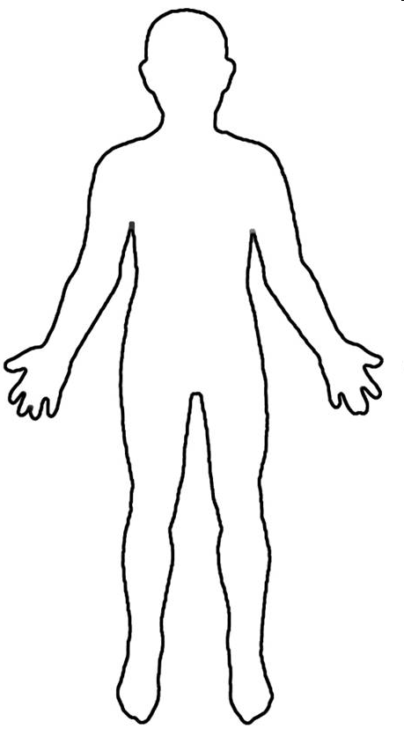
Conscious Mind
Spirit Father Son Holy Spirit
Heart Subconscious Mind Garden Scroll
Kingdom within us
First Love Gate
Rivers Power Anointing
Seat of Government

Slide 227
Engaging God First Love
Why is the spirit so important?
Proverbs 20:27 The spirit of man is the lamp of the LORD, searching all the innermost parts of his being.
1 Cor 2:14 But a natural man does not accept the things of the Spirit of God, for they are foolishness to him; and he cannot understand them, because they are spiritually appraised. 15 But he who is spiritual appraises all things,

Slide 228
Engaging God First Love
1 Cor 2:9 but just as it is written, “Things which eye has not seen and ear has not heard, And which have not entered the heart of man, All that God has prepared for those who love Him.”10 For to us God revealed them through the Spirit; for the Spirit searches all things, even the depths of God.

Slide 229
Engaging God First Love
1 Cor 2:11 For who among men knows the thoughts of a man except the spirit of the man which is in him? Even so the thoughts of God no one knows except the Spirit of God. 12 Now we have received, not the spirit of the world, but the Spirit who is from God, so that we may know the things freely given to us by God,

Slide 230
Engaging God First Love
Connection to heaven and river of life transcendence Immanence. John 4:13 source of living water
Gen 28 house of God gateway of heaven
John 14 house dwelling place of God
Temple of Holy Spirit within body
Spirit soul body gateways diagram
Understanding gateways

Slide 231
Engaging God First Love
Spirit Ps 139 eternal soul forms union spirit and body
Spirit and Babel access to heaven
Spirit mountain authority
River whose streams make glad
Flow of river living water of fire of glory
Thrones seat rest and government Lordship kingship Fatherhood
Matt 11:28 yoked to Jesus surrendered yielded cease striving
enter Rest

Slide 232
Engaging God First Love
Separate First Love module
Relationship with SSF distinct personalities
River of life engagement
Sonship Fatherhood
Baptised into spirit Jesus Father (Burning ones exercise) clothed with SSF deeper
waterfall river pool

Slide 233
Engaging God First Love
Our Spirit is given life by God’s spirit the breath of life
Our spirit receives God’s light and becomes light
Light of truth eyes are opened
Drink Living water and receive a fountain
Our spirit becomes a House for God’s presence

Slide 234
Engaging God First Love
The Centre of Our Being - the residing place of the promise of God, centred inside our spirit.
The Human Spirit
The Human Soul
The Human Body

Slide 235
Engaging God First Love
You are a house of God therefore God lives in you
John 14:23
Gen 28:12, 17 And he dreamed that there was a ladder set up on the earth, and the top of it reached to heaven; and the angels of God were ascending and descending on it! He was afraid and said, How to be feared and reverenced is this place! This is none other than the house of God, and this is the gateway to heaven

Slide 236
Engaging God First Love
You are a house of God lives in you
John 14:20, 23 In that day you will know that I am in My Father, and you in Me, and I in you. Jesus answered and said to him, "If anyone loves Me, he will keep My word; and My Father will love him, and We will come to him and make Our abode with him.

Slide 237
Engaging God First Love
You are a house of God lives in you
Gen 28:12, 17 And he dreamed that there was a ladder set up on the earth, and the top of it reached to heaven; and the angels of God were ascending and descending on it! He was afraid and said, How to be feared and reverenced is this place! This is none other than the house of God, and this is the gateway to heaven

Slide 238
Engaging God First Love
1 Corinthians 3:16 Do you not know that you are a temple of God and that the Spirit of God dwells in you?
1 Corinthians 6:19 Or do you not know that your body is a temple of the Holy Spirit who is in you, whom you have from God, and that you are not your own?

Slide 239
Engaging God First Love
Luke 17:21 Nor will people say, Look! Here [it is]! or, See, [it is] there! For behold, the kingdom of God is within you [in your hearts] and among you [surrounding you].
Spirit realm is connected to you because heaven or God's kingdom is in you
Therefore you have access to God heavenly spiritual realm and God has access to you. You are a gate of the spiritual realm heaven and God Channel

Slide 240
Engaging God First Love
Psalms 46:4 There is a river whose streams make glad the city of God, The holy dwelling places of the Most High.5 God is in the midst of her, she will not be moved; God will help her when morning dawns. 6 The nations made an uproar, the kingdoms tottered; He raised His voice, the earth melted. 7 The Lord of hosts is with us; The God of Jacob is our stronghold.

Slide 241
Engaging God First Love
River of life living water life of the Holy Spirit Drink it step into it Ezek 47 flow deeper ankle knee waste out of depth. walking in the Spirit led by Spirit filled with the Spirit. Spirit flowing like rivers of living water. 1 Cor 6:17 joined to Lord intimate yoked become or spirit. 1 Cor 2 revelation from the Spirit. Open channel to the Increasing flow produce life around us.
Experience Righteousness Peace and Joy in the Spirit.

Slide 242
Engaging God First Love
Romans 14:17 for the kingdom of God is not eating and drinking, but righteousness and peace and joy in the Holy Spirit.
John 4 John 7 Source joy strength peace help parakletos John 15 16 Power Acts 1:8 clothed with power. 1 Cor 12 and 14 gifts charismata. Hovering vibrating energy vibrancy abundance of life. Creativity inspiration revelation
Psalm 23 surely goodness and lovingkindness mercy follow me.

Slide 243
Engaging God First Love
Flow In us and through us come upon us to anoint us equip us for service to engage us in relationship John reveals Jesus who reveals Father to us.
River is swirling with grace and faith when Mixed in the word hope expectation produces the charge of anointing words vibrating with power. heat vibration electricity light oil fragrance. laughter joy drunkenness intoxication. Peace shalom wholeness rest trance ecstacy baptised immersed and filled.

Slide 244
Engaging God First Love
River of living water drink it wash in it be clothed by it channel it focus flow like hydroelectric power. why water 68% body cells die without it quickly flows washes cleanses passes vibrations frequencies focused power. Flowed from heaven Genesis water garden to water world.

Slide 245
Engaging God First Love
Door gate portal entrance access opening. Closed or locked it is a barrier a blockage stops access stops flow stops Connection etc. Gates transactions commerce decisions post slaves chose bond servants elders met defended guarded protected exchange East gate Source Northgate trouble.
Yoked joined become one flowing together in resonant harmony.

Slide 246
Engaging God First Love
You are a mountain
You are a place of authority
God dwells in a mountain Ezek 28
Pillar engages heaven

Slide 247
Engaging God First Love
Rev 2:19 But I have this against you, that you have left your first love
Rev 3: 20 Behold, I stand at the door and knock; if anyone hears My voice and opens the door, I will come in to him and will dine with him, and he with Me.

Slide 248
Engaging God First Love
We can embrace and experience God within – Holy Spirit, Jesus & Father as distinct personalities
We can choose to do that as we have a promise if you draw near

Slide 249
Engaging God First Love
The altar experience alters us
It must be a proactive response a choice to surrender
A choice to present ourselves as an offering

Slide 250
Engaging God First Love

Slide 251
Engaging God First Love

Slide 252
Engaging God First Love
Luke 17:21For behold, the kingdom of God is within you [in your hearts] and among you [surrounding you].

Slide 253
Engaging God First Love
kingdom is within me and Isa 9 there is no end to the increase of His government (kingdom) and peace shalom, wholeness it must Increase expand grow in me and through me and around me.
Isaiah 9:7 There will be no end to the increase of His government or of peace, On the throne of David and over his kingdom, To establish it and to uphold it with justice and righteousness From then on and forevermore. The zeal of the Lord of hosts will accomplish this.

Slide 254
Engaging God First Love
Liquid light- interspatial matrix interface my spirit

Slide 255
Engaging God First Love
Holy spirit Living water my source My well My fountain My spring My stream my river my insight my revelation My direction my guidance my abundant life my heavenly flow my heavenly Connection my filling my Overflowing my creativity my zero point energy my joy my Extravagance my exuberance my effulgence my eternal life source.

Slide 256
Engaging God First Love
Jesus my friend my brother my lover my Lord my king my model my example my Rabi my master my disciples my Word my Way my Truth my Life my door my Shepherd my Resurrection my light my Saviour my High Priest my advocate my interceder my yoke my song my Jesus

Slide 257
Engaging God First Love
John 14:16-17 I will ask the Father, and He will give you another Helper, that He may be with you forever; that is the Spirit of truth, whom the world cannot receive, because it does not see Him or know Him, but you know Him because He abides with you and will be in you.

Slide 258
Engaging God First Love
John 14:20, 23, 25-26 In that day you will know that I am in My Father, and you in Me, and I in you. Jesus answered and said to him, "If anyone loves Me, he will keep My word; and My Father will love him, and We will come to him and make Our abode with him. "These things I have spoken to you while abiding with you. But the Helper, the Holy Spirit, whom the Father will send in My name, He will teach you all things, and bring to your remembrance all that I said to you.

Slide 259
Engaging God First Love
John 15:26 "When the Helper comes, whom I will send to you from the Father, that is the Spirit of truth who proceeds from the Father, He will testify about Me,
John 16:7-15 But I tell you the truth, it is to your advantage that I go away; for if I do not go away, the Helper will not come to you; but if I go, I will send Him to you. And He, when He comes, will convict the world concerning sin and righteousness and judgment; concerning sin, because they do not believe in Me; and concerning righteousness, because I go to the Father and you no longer see Me; and concerning judgment, because the ruler of this world has been judged. "I have many more things to say to you, but you cannot bear them now. But when He, the Spirit of truth, comes, He will guide you into all the truth; for He will not speak on His own initiative, but whatever He hears, He will speak; and He will disclose to you what is to come. He will glorify Me, for He will take of Mine and will disclose it to you. All things that the Father has are Mine; therefore I said that He takes of Mine and will disclose it to you.

Slide 260
Engaging God First Love
John 12:26 If anyone serves Me, he must follow Me; and where I am, there My servant will be also; if anyone serves Me, the Father will honour him.
John 13:34-35 A new commandment I give to you, that you love one another, even as I have loved you, that you also love one another. By this all men will know that you are My disciples, if you have love for one another."

Slide 261
Engaging God First Love
John 14:3, 6, 27 If I go and prepare a place for you, I will come again and receive you to Myself, that where I am, there you may be also. Jesus said to him, "I am the way, and the truth, and the life; no one comes to the Father but through Me. Peace I leave with you; My peace I give to you; not as the world gives do I give to you. Do not let your heart be troubled, nor let it be fearful.

Slide 262
Engaging God First Love
John 15:10-12, 14-15 If you keep My commandments, you will abide in My love; just as I have kept My Father's commandments and abide in His love. These things I have spoken to you so that My joy may be in you, and that your joy may be made full. "This is My commandment, that you love one another, just as I have loved you. You are My friends if you do what I command you. No longer do I call you slaves, for the slave does not know what his master is doing; but I have called you friends, for all things that I have heard from My Father I have made known to you.

Slide 263
Engaging God First Love
John 16:28, 33 I came forth from the Father and have come into the world; I am leaving the world again and going to the Father." These things I have spoken to you, so that in Me you may have peace. In the world you have tribulation, but take courage; I have overcome the world."

Slide 264
Engaging God First Love
John 17:13, 16-18, 20-21, 26 But now I come to You; and these things I speak in the world so that they may have My joy made full in themselves. They are not of the world, even as I am not of the world. Sanctify them in the truth; Your word is truth. As You sent Me into the world, I also have sent them into the world. "I do not ask on behalf of these alone, but for those also who believe in Me through their word; that they may all be one; even as You, Father, are in Me and I in You, that they also may be in Us, so that the world may believe that You sent Me. and I have made Your name known to them, and will make it known, so that the love with which You loved Me may be in them, and I in them."

Slide 265
Engaging God First Love
Source of life John 4:13 living water connection to heaven. Fountain Spring eternal life connection to eternity quality of heavens Source. Drink walk wade Swim baptised filled Spirit. John 7 rivers of living water Flow streams make glad. Ezek 47 flows from kingdom first love gate trickles flows deeper and deeper to engage the garden of our hearts Ps 23 quiet waters
life to the world turns death into rife. Resurrection life power Rom 6 baptised into the river.

Slide 266
Engaging God First Love
Matthew 11:27, 29-30 All things have been handed over to Me by My Father; and no one knows the Son except the Father; nor does anyone know the Father except the Son, and anyone to whom the Son wills to reveal Him. Take My yoke upon you and learn from Me, for I am gentle and humble in heart, and you will find rest for your souls . For My yoke is easy and My burden is light."

Slide 267
Engaging God First Love
John 4:10, 13-14 Jesus answered and said to her, "If you knew the gift of God, and who it is who says to you, 'Give Me a drink,' you would have asked Him, and He would have given you living water." Jesus answered and said to her, "Everyone who drinks of this water will thirst again; but whoever drinks of the water that I will give him shall never thirst; but the water that I will give him will become in him a well of water springing up to eternal life."

Slide 268
Engaging God First Love
John 7:37-39 Now on the last day, the great day of the feast, Jesus stood and cried out, saying, "If anyone is thirsty, let him come to Me and drink. He who believes in Me, as the Scripture said, 'From his innermost being will flow rivers of living water.'" But this He spoke of the Spirit, whom those who believed in Him were to receive; for the Spirit was not yet given, because Jesus was not yet glorified.

Slide 269
Engaging God First Love
Ezekiel 47:1 Then he brought me back to the door of the house; and behold, water was flowing from under the threshold of the house toward the east, for the house faced east. And the water was flowing down from under, from the right side of the house, from south of the altar.

Slide 270
Engaging God First Love
Ezekiel 47:7-9, 12
Now when I had returned, behold, on the bank of the river there were very many trees on the one side and on the other. Then he said to me, "These waters go out toward the eastern region and go down into the Arabah; then they go toward the sea, being made to flow into the sea, and the waters of the sea become fresh. It will come about that every living creature which swarms in every place where the river goes, will live. And there will be very many fish, for these waters go there and the others become fresh; so everything will live where the river goes. By the river on its bank, on one side and on the other, will grow all kinds of trees for food. Their leaves will not wither and their fruit will not fail. They will bear every month because their water flows from the sanctuary, and their fruit will be for food and their leaves for healing."

Slide 271
Engaging God First Love
Revelation 22:1-2 Then he showed me a river of the water of life, clear as crystal, coming from the throne of God and of the Lamb, in the middle of its street. On either side of the river was the tree of life, bearing twelve kinds of fruit, yielding its fruit every month; and the leaves of the tree were for the healing of the nations.

Slide 272
Engaging God First Love
John 11:25 Jesus said to her, "I am the resurrection and the life; he who believes in Me will live even if he dies,
Romans 6:5 For if we have become united with Him in the likeness of His death, certainly we shall also be in the likeness of His resurrection,
Philippians 3:10 that I may know Him and the power of His resurrection and the fellowship of His sufferings, being conformed to His death;

Slide 273
Engaging God First Love
1 Corinthians 15:42-49 So also is the resurrection of the dead. It is sown a perishable body, it is raised an imperishable body; it is sown in dishonor, it is raised in glory; it is sown in weakness, it is raised in power; it is sown a natural body, it is raised a spiritual body. If there is a natural body, there is also a spiritual body. So also it is written, "The first man , Adam, became a living soul ." The last Adam became a life-giving spirit. However, the spiritual is not first, but the natural; then the spiritual. The first man is from the earth, earthy; the second man is from heaven. As is the earthy, so also are those who are earthy; and as is the heavenly, so also are those who are heavenly. Just as we have borne the image of the earthy, we will also bear the image of the heavenly.

Slide 274
Engaging God First Love
Psalms 46:4 There is a river whose streams make glad the city of God, The holy dwelling places of the Most High.
Psalms 1:3 He will be like a tree firmly planted by streams of water, Which yields its fruit in its season And its leaf does not wither; And in whatever he does, he prospers.

Slide 275
Engaging God First Love
Song of Solomon 4:15-16 " You are a garden spring, A well of fresh water, And streams flowing from Lebanon." " Awake, O north wind, And come, wind of the south; Make my garden breathe out fragrance, Let its spices be wafted abroad. May my beloved come into his garden And eat its choice fruits!
Amos 5:24 "But let justice roll down like waters And righteousness like an ever-flowing stream.
Jeremiah 17:7-8 "Blessed is the man who trusts in the Lord And whose trust is the Lord . "For he will be like a tree planted by the water, That extends its roots by a stream And will not fear when the heat comes; But its leaves will be green, And it will not be anxious in a year of drought Nor cease to yield fruit.

Slide 276
Engaging God First Love
Isaiah 30:25-26 On every lofty mountain and on every high hill there will be streams running with water on the day of the great slaughter, when the towers fall. The light of the moon will be as the light of the sun, and the light of the sun will be seven times brighter, like the light of seven days, on the day the L ord binds up the fracture of His people and heals the bruise He has inflicted.
Isaiah 44:3 'For I will pour out water on the thirsty land And streams on the dry ground; I will pour out My Spirit on your offspring And My blessing on your descendants;

Slide 277
Engaging God First Love

Slide 278
Engaging God First Love

Slide 279
Engaging God First Love
River of life engagIng Source crystal from the tree of life pathway from eternity throne grace river flowing with grace and faith. Parakletos
Yoke of Jesus engaging rest friend joint heirs
Seat of rest and government Fathers tutoring 7 spirits God wisdom cloud of witnesses Gal 4 family
Kingdom within never end to the increase of His government
our Spirit holy holies 4 faces God FSS our spirit agreement window doorway heaven.

Slide 280
Engaging God First Love
I am that I am Ex
There is no flow without drinking priming the more you drink the greater the flew until you can walk in it. Draw from the well and release it to flow from our innermost being. The river is in you and you can be in the river
I am is in me I am way truth life I am the resurrection and the life I am the good shepherd I am the light of the world I am the door I am the bread of life
I am in My Father
Jesus is in you and you are in Him
The Father is in you and you in the Father
You are My beloved son I am well pleased.

Slide 281
Engaging God First Love
Holy Spirit Joy abundance joire de vie exuberance vitality
Jesus peace shalom wholeness
Father love acceptance affirmation approval

Slide 282
Engaging God First Love
Holy spirit Living water my source My well My fountain My spring My stream my river my insight my revelation My direction my guidance my abundant life my heavenly flow my heavenly Connection my filling my Overflowing my creativity my zero point energy my joy my Extravagance my exuberance my effulgence my eternal life source

Slide 283
Engaging God First Love
Jesus my friend my brother my lover my Lord my king my model my example my Rabi my master my disciples my Word my Way my Truth my Life my door my Shepherd my Resurrection my light my Saviour my High Priest my advocate my interceder my yoke my song my Jesus

Slide 284
Engaging God First Love
Father my creator my sustainer my essence my rest my shalom my affirmer my accepter My peace My love My provider my protector my healer my sanctifier my righteousness my banner My victory my security my identity my anchor my hope my delight my purpose my glorifier my rock my restorer my reconciler my transformer my transfigurer My renewer my conformer my forgiver my strength my authority my power my eternal destination my eternal home my reference point. My Father

Slide 285
Engaging God First Love
God My Consuming fire My frequency My harmony My resonance My Manifold grace my Manifold wisdom My Melody My Rhythm My metronome My conductor My author My producer My composer Yod Hei Vav Hei My Lion My Ox My Eagle My Man My King my Prophet My Apostle My Priest My Home My dwelling place My covenant My all in all

Slide 286
Engaging God First Love

Slide 287
Engaging God First Love
seat rest and government yielded abdicated to Father Lordship kingship Rest Provision Blessing Protection. Matt 6:33 Seek first kingdom and His righteousness and everything added. Trust Him be at rest in peace living in the eye of the storm.
yoked to Jesus learn from Him discipleship to the master Rabi guidance and direction for the path today. Heart attitude gentle and humble in heart. Rest for the soul Searching for direction identity purpose significance meaning Matt 11:28
Source of life John 4:13 living water connection to heaven. Fountain Spring eternal life connection to eternity quality of heavens Source. Drink walk wade Swim baptised filled Spirit. John 7 rivers of living water Flow streams make glad. Ezek 47 flows from kingdom first love gate trickles flows deeper and deeper to engage the garden of our hearts Ps 23 quiet waters
life to the world turns death into rife. Resurrection life power Rom 6 baptised into the river.

Slide 288
Engaging God First Love

Slide 289
Engaging God First Love

Slide 290
Pathway of Relationship
Flow from heaven inside out
Plant Seeds of Testimony
Enlarge Spirit Flowing
Experience River of life
Tongues Development
Matt 13
Matt 11
Cultivate good soil
Yoked to Jesus
Ps 23
Opening gateways
Rev 3:20
Preparation Spirit Building
Garden of Heart
Opening First Love Gate
Deal with stones, weeds hardness
Jesus is Lord
Invite Jesus to walk through
Experience God’s Presence
Meditation Thoughts Of God Visualization
Cultivate & Tend

Slide 291
Gateways Spirit Body Soul
Experience God’s Presence
Experience the River of life
Rev 3:20
Opening First Love Gate
Surrender
Yoke Yourself
Experience God’s Passion

Slide 293
Experience the River of life
House of God
JOURNEY MAPS
First Love
Engaging our spirit
Experience God’s Presence
Experience God’s Passion

Slide 294
God
within
Kingdom God Within
Gate of heaven
Further Info 1
House of God
Further Info 2

Slide 295
Engaging Holy Spirit
Drinking living Water
Engaging The river
Further Info 1
Further Info 2
River of life

Slide 296
Lordship
Kingship
Sonship
Further Info 1
Seat of Government
Further Info 2

Slide 297
Rest
Identity
Surrender
Further Info 1
Further Info 2
Yoke of Jesus

Slide 298
Drink Living Water
Engage Source Life
Get in the river
Feel His Love
Feel His Joy
Feel His Peace
Gateways Spirit Body Soul
Experience God’s Presence
Experience the River of life
Rev 3:20
Opening First Love Gate
Surrender
Yoke Yourself
Experience God’s Passion
Matt 11
Yoked to Jesus
Feel His Affirming
Feel His Acceptance
Feel His Approval
Jesus is Lord
3rd DNA
Light

Slide 301
Tongues Word
Tongues 3 ways
Tongues
Vision
Be still
Psa 46:10
Relax
Hearing God’s voice
Journaling
Tongues Development
Meditation Word Flow God’s thoughts
Base Camp
Spirit Building
Eyes of Spirit Activation
Eyes of heart Activating Imagination
Black Veil
Spirit perception
3 levels of spirit realm
Picture Objects
Picture Word
Picture Doorways

Slide 302
Spiritual Perception
Torn Veil
3 levels of spirit realm
Further Info 1
Eyes of spirit Activating Black Veil
Further Info 2

