Slide 1
Engaging God
We are on a journey or an adventure together discovering how to engage the spiritual realms
Discovering the realms within us, around us and the heavenly realms
We are going to follow the pathway of relationship and responsibility

Slide 2
House of God
First Love
JOURNEY MAPS
First Love
Engaging God in our spirit
River of Life
Seat of Government
Yoke of Jesus

Slide 3
Engaging Holy Spirit
Living Water
Engaging the rivers
River of life

Slide 4
Engaging God River of Life 3
River of the Holy Spirit is our source of eternal everlasting life, love, peace, joy, grace, mercy, faith, power, gifts and guidance
All these things can be accessed by our desire for intimacy and destiny

Slide 5
Engaging God River of Life 3
Baptisms - Holy Spirit Jesus Father
Holy Spirit - Righteousness Peace Joy
Jesus - Way Truth Life
Father - Judgement Justice Holiness
Clothed or skinned with armour
Rom 13:12 put on the armour of light
2 Cor 6:7 amour of righteousness
Eph 6:11 Put on the full armour of God

Slide 6
Engaging God River of Life 3
Isa 12:2 “Behold, God is my salvation, I will trust and not be afraid; For the Lord God is my strength and song, And He has become my salvation.” 3 Therefore you will joyously draw water from the springs of salvation.

Slide 7
Engaging God River of Life 3
First Love is about an up close and personal relational encounter with God
With the Holy Spirit, Jesus and the Father to get to know them intimately and personally
Know their frequencies, fragrances, characters, personalities

Slide 8
Engaging God River of Life 3
John 7:38 38 He who believes in Me, as the Scripture said, ‘From his innermost being will flow rivers of living water.’” 39 But this He spoke of the Spirit,
God the Spirit is the river and we can encounter Him in the river
He can flow through us to the world

Slide 9
Engaging God River of Life 3
We need to get to know Him
We need to ask Him to reveal Himself to us
We need to know Him by daily personal intimate encounters
Many symbols that represent the Holy Spirit’s presence

Slide 10
Engaging God River of Life 3
Water River living eternal water
Dove Peace comforter
Wind Breath of life
Wine Joy of the Lord our strength
Oil Anointing healer
Fire Purifying righteousness
Light Revelation teacher
Cloud Guidance

Slide 11
Engaging God River of Life 3
He expresses supernatural abilities and character in the gifts and fruit.
He is a revealer of the true awe and wonder of creation and life itself
He is the unveiler of the mysteries of God.
He is the breath of life, the wind of heaven and our spiritual oxygen

Slide 12
Engaging God River of Life 3
We engage the Holy Spirit as a person not a force or cosmic consciousness
Holy Spirit is not simply an "influence" or "impersonal force“ that emanates from God?
We can know Him, feel Him, sense His character the essence of who He is.

Slide 13
Engaging God River of Life 3
The Holy Spirit is a person with personal characteristics
THE HOLY SPIRIT SPEAKS...
The Spirit spoke and gave directions to Philip - Acts 8:29
THE HOLY SPIRIT TEACHES...
He was to teach the apostles all things - John 14:26

Slide 14
Engaging God River of Life 3
THE HOLY SPIRIT BEARS WITNESS...
He was to testify of Jesus - John 15:26-27
THE HOLY SPIRIT GUIDES, HEARS, SPEAKS, TELLS...
He would carry on and complete the work started by Jesus – John 16:12-13

Slide 15
Engaging God River of Life 3
THE HOLY SPIRIT FORBIDS...
He prevented Paul and his companions from going into certain areas of Asia - Acts 16:6-7
THE HOLY SPIRIT INTERCEDES...
The Spirit Himself makes intercession for us" - Rom 8:26

Slide 16
Engaging God River of Life 3
THE HOLY SPIRIT HAS A MIND...
"the mind of the Spirit" - Rom 8:27
HE HAS KNOWLEDGE...
He "knows the things of God" - 1 Cor 2:11
HE POSSESSES AFFECTION...
"the love of the Spirit" - Rom 15:30

Slide 17
Engaging God River of Life 3
THE HOLY SPIRIT HAS A WILL...
"the same Spirit works all these things, distributing to each one individually as He wills" – 1 Cor 12:11
HE CAN BE GRIEVED...
"do not grieve the Holy Spirit of God" - Eph 4:30

Slide 18
Engaging God River of Life 3
THE HOLY SPIRIT CAN BE INSULTED...
"insulted the Spirit of grace" - Heb 10:29 This is done by sinning "wilfully" - Heb 10:26
HE CAN BE LIED TO...
As Ananias and his wife Sapphira were guilty of doing "...why has Satan filled your heart to lie to the Holy Spirit...?" - Acts 5:3

Slide 19
Engaging God River of Life 3
THE HOLY SPIRIT CAN BE RESISTED...
This they did by resisting the message and persecuting the messengers who were inspired by the Holy Spirit - Acts 7: 52-53
The Holy Spirit gives testimony.
John 15:26 When the Counsellor comes, whom I will send to you from the Father, the Spirit of truth who goes out from the Father, he will testify about me.

Slide 20
Engaging God River of Life 3
Counsellor or Helper Greek Parakletos
Definition - Summoned, called to one's side, called to one's aid
One who pleads another's cause before a judge, a pleader, counsel for defence, legal assistant, an advocate, an intercessor

Slide 21
Engaging God River of Life 3
Counsellor or Helper
A helper, aider, assistant
Counsellor, Comforter or Helper
God sends His Spirit to us to help equip, teach and guide us

Slide 22
Engaging God River of Life 3
John 14:16-17 I will ask the Father, and He will give you another Helper, that He may be with you forever; that is the Spirit of truth, whom the world cannot receive, because it does not see Him or know Him, but you know Him because He abides with you and will be in you.

Slide 23
Engaging God River of Life 3
John 14:26 But the Counsellor, the Holy Spirit, whom the Father will send in my name, will teach you all things and will remind you of everything I have said to you

Slide 24
Engaging God River of Life 3
John 16:13 But when he, the Spirit of truth, comes, he will guide you into all truth. He will not speak on his own; he will speak only what he hears, and he will tell you what is yet to come. 14 He will bring glory to me by taking from what is mine and making it known to you.

Slide 25
Engaging God River of Life 3
The Holy Spirit reveals
1 Corinthians 2:10 but God has revealed it to us by his Spirit. The Spirit searches all things, even the deep things of God.
The Holy Spirit leads us and directs us where to go and shows us what to do.

Slide 26
Engaging God River of Life 3
Romans 8:14 because those who are led by the Spirit of God are sons of God.
Gal 5:25 If we live by the Spirit, let us also walk by the Spirit.
Walk in the fruit of character –righteousness, peace and joy
Walk in supernatural power

Slide 27
Engaging God River of Life 3
John 15:10-12, No longer do I call you slaves, for the slave does not know what his master is doing; but I have called you friends, for all things that I have heard from My Father I have made known to you.
This is what the Holy Spirit does friendship, intimacy and revelation

Slide 28
Engaging God River of Life 3
Baptised in the river of the Spirit
Luke 24:49 And behold, I am sending forth the promise of My Father upon you; but you are to stay in the city until you are clothed with power from on high.”
Clothed with, empowered, gifted and equipped by the Holy Spirit

Slide 29
Engaging God River of Life 3
Equipping of sons by the Spirit
Fruit of the Spirit Gal 5:22-23
Gifts of the Spirit 1 Cor 12
Ministries of the Spirit 1 Cor 14
Redemptive gifts Rom 12
5 Fold Ministry gifts Eph 4
7 spirits of God Isa 11

Slide 30
FRUIT
GIFTS
MINISTRIES
REDEMPTIVE GIFTS
7 SPIRITS
OFFICES
OLD ORDER
OFFICES
NEW ORDER
LOVE
WISDOM
APOSTLES
JOY
KNOWLEDGE
SPIRIT OF THE LORD
APOSTLES
PROPHETS
PROPHET
KING
PEACE
FAITH
SPIRIT WISDOM
TEACHERS
SERVANT
PROPHETS
PATIENCE
HEALING
PRIEST
TEACHER
SPIRIT
UNDERSTANDING
MIRACLES
KINDNESS
MIRACLES
EVANGELISTS
HEALINGS
EXHORTER
SPIRIT
COUNSEL
ORACLE
GOODNESS
PROPHECY
GIVER
HELPS
SPIRIT
STRENGTH
SHEPHERDS
FAITHFULNESS
DISTINGUISHING SPIRITS
RULER
SCRIBE
ADMINISTRATIONS
SPIRIT
KNOWLEDGE
MERCY
HUMILITY
TEACHERS
TONGUES
TONGUES
SPIRIT
FEAR OF LORD
LEGISLATOR
SELF-CONTROL
INTERPRETATION

Slide 31
Engaging God River of Life 3
John 14:10 Do you not believe that I am in the Father, and the Father is in Me? The words that I say to you I do not speak on My own initiative, but the Father abiding in Me does His works. 11 Believe Me that I am in the Father and the Father is in Me; otherwise believe because of the works themselves.

Slide 32
Engaging God River of Life 3
John 14:12 Truly, truly, I say to you, he who believes in Me, the works that I do, he will do also; and greater works than these he will do; because I go to the Father.
The Holy Spirit will equip us and enable us to do the supernatural works of Jesus and even greater

Slide 33
Engaging God River of Life 3
Miracles, healings, deliverance and raising the dead
Transforming matter & multiply matter
Authority over the weather and natural world, water walking & levitation
Invisibility and passing through matter
Knowing peoples thoughts and intentions
Living in dual realms of heaven & earth

Slide 34
Engaging God River of Life 3
Follow the journey Jesus had with the Holy Spirit
Luke 1:35 The angel answered and said to her, “The Holy Spirit will come upon you, and the power of the Most High will overshadow you;

Slide 35
Engaging God River of Life 3
Luke 3:21 Now when all the people were baptized, Jesus was also baptized, and while He was praying, heaven was opened, 22 and the Holy Spirit descended upon Him in bodily form like a dove, and a voice came out of heaven, “You are My beloved Son, in You I am well-pleased.”

Slide 36
Engaging God River of Life 3
Luke 4:1 Jesus, full of the Holy Spirit, returned from the Jordan and was led around by the Spirit in the wilderness
Luke 4:14 And Jesus returned to Galilee in the power of the Spirit, and news about Him spread through all the surrounding district.

Slide 37
Engaging God River of Life 3
Luke 5:17 and the power of the Lord was present for Him to perform healing.
Luke 6:19 And all the people were trying to touch Him, for power was coming from Him and healing them all.

Slide 38
Engaging God River of Life 3
Luke 8:46 But Jesus said, “Someone did touch Me, for I was aware that power had gone out of Me.”
Luke 9:1 And He called the twelve together, and gave them power and authority over all the demons and to heal diseases.

Slide 39
Engaging God River of Life 3
Luke 10:19 Behold, I have given you authority to tread on serpents and scorpions, and over all the power of the enemy, and nothing will injure you.

Slide 40
Engaging God River of Life 3
Luke 21:27 Then they will see the Son of Man coming in a cloud with power and great glory.
Luke 22:69 But from now on the Son of Man will be seated at the right hand of the power of God.”

Slide 41
Engaging God River of Life 3
Luke 24:49 And behold, I am sending forth the promise of My Father upon you; but you are to stay in the city until you are clothed with power from on high.”

Slide 42
Engaging God River of Life 3
Daniel 7:9 “I kept looking until thrones were set up, And the Ancient of Days took His seat; His vesture was like white snow And the hair of His head like pure wool. His throne was ablaze with flames, Its wheels were a burning fire.

Slide 43
Engaging God River of Life 3
Daniel 7:13 “I kept looking in the night visions, And behold, with the clouds of heaven One like a Son of Man was coming, And He came up to the Ancient of Days And was presented before Him.

Slide 44
Engaging God River of Life 3
Daniel 7:14 “And to Him was given dominion, Glory and a kingdom, That all the peoples, nations and men of every language Might serve Him. His dominion is an everlasting dominion which will not pass away; And His kingdom is one which will not be destroyed.

Slide 45
Engaging God River of Life 3
Daniel 7:22 until the Ancient of Days came and judgment was passed in favour of the saints of the Highest One, and the time arrived when the saints took possession of the kingdom.

Slide 46
Engaging God River of Life 3
Daniel 11:32 the people who know their God will display strength and do great exploits
The people who know God are sons of God
Romans 8:14 For all who are being led by the Spirit of God, these are sons of God.

Slide 47
Engaging God River of Life 3
Dan 12:3 Those who have insight will shine brightly like the brightness of the expanse of heaven, and those who lead the many to righteousness, like the stars forever and ever. 4 But as for you, Daniel, conceal these words and seal up the book until the end of time; many will go back and forth, and knowledge will increase.”

Slide 48
Engaging God River of Life 3
Rom 8:11 But if the Spirit of Him who raised Jesus from the dead dwells in you, He who raised Christ Jesus from the dead will also give life to your mortal bodies through His Spirit who dwells in you.
Power of resurrection life is found in the Holy Spirit

Slide 49
Engaging God River of Life 3
Rom 8:15 For you have not received a spirit of slavery leading to fear again, but you have received a spirit of adoption as sons by which we cry out, “Abba! Father!” 16 The Spirit Himself testifies with our spirit that we are children of God,

Slide 50
Engaging God River of Life 3
Rom 8:17 and if children, heirs also, heirs of God and fellow heirs with Christ, if indeed we suffer with Him so that we may also be glorified with Him.
Rom 8:19 For the anxious longing of the creation waits eagerly for the revealing of the sons of God.

Slide 51
Engaging God River of Life 3
Rom 8:20 For the creation was subjected to futility, not willingly, but because of Him who subjected it, in hope 21 that the creation itself also will be set free from its slavery to corruption into the freedom of the glory of the children of God.

Slide 52
Engaging God River of Life 3
The Holy Spirit enthroned in our spirit will lead and direct us to walk in His ways
Holy Spirit gives us direction, guidance and resources
Holy Spirit empowers us to be sons and equips us as overcomers for dominion

Slide 53
Engaging God River of Life 3
1 Cor 6:17 But the one who joins himself to the Lord is one spirit with Him.
We need to be joined in intimacy to be in relational oneness
Oneness can flow through our spirit gates to our soul gates through our body gates
A focus of power - vibrational energy though our words and our touch

Slide 54
Engaging God River of Life 3
We need to behold and become like Him through close spirit contact
We need to be transformed and restored through heart to heart cardiogenesis
My spirit must be connected to and flowing from heaven
So my heart can be subdued and tended and cultivated to be like Eden

Slide 55
Engaging God River of Life 3
Everything starts with first love.
In relationship I can be the representation of the 4 faces of God on earth as it is in heaven.
I need to Embrace 1st love
I need to Embrace Holy Spirit
I need to Embrace Jesus
I need to Embrace the Father

Slide 56
Engaging God River of Life 3
We are in Him, He is in us, we are joined and one yet still individual
Just as the sponge lies in the water, and the water fills the sponge, but the water is not the sponge and the sponge is not the water, they ever remain different things, so children abide in Me and I in them.

Slide 57
Engaging God River of Life 3
Engage the river of life
Be connected through our spirit to that flow of heavenly life
Be joined and one spirit
Let’s get up close and personal with the Holy Spirit today

Slide 58
Engaging God River of Life 3
He will untether you from being earthbound
He will release you to be unlimited
He will take you out into the creativity of the universe
He will take you flying into new realms of creativity experience
He will equip and empower you

Slide 60
Engaging God River of Life

Slide 61
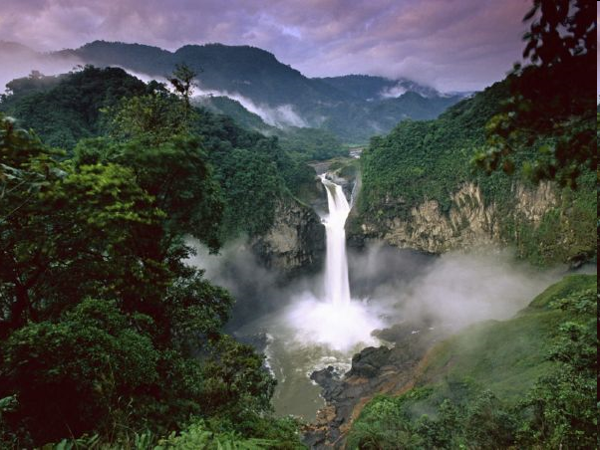

Slide 63
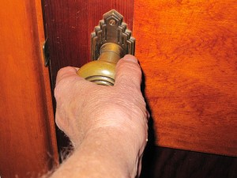
First Love House of God 1

Slide 64
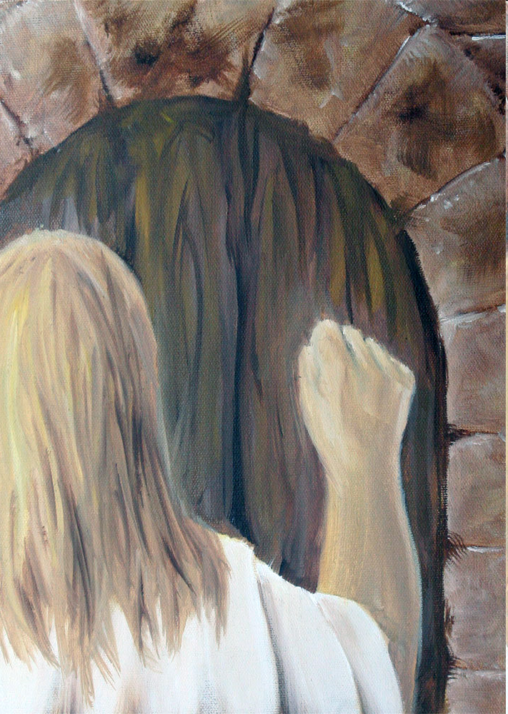

Slide 65
Engaging God River of Life 3
Close your eyes
Begin to think about that door
Activate your imagination as the doorway to encounter
Picture the door reach out and open the door
The river is flowing God starts to envelope you

Slide 66
Engaging God River of Life 3
Invite the Holy Spirit to embrace you
Let Him reveal himself to you
Let Him surround you and join with you
Feel the light energy His vibrational frequency energising you.
Feel Him touch your whole being feel restoration and renewal

Slide 67
Engaging God River of Life 3
Feel the presence of peace let that peace rest on you and fill you
Feel His joy fill you let that joy bubble up in you like a fountain springing up to effervescent abundant overflowing wellbeing
Let Him reveal Himself to your spirit
Let Him reveal His amazing thoughts about you

Slide 68
Engaging God River of Life 3
Let Him fill you with His wisdom
Let Him remind your of God’s words about you
Let Him empower you
Let Him release His supernatural gifts and abilities to come upon on you
Feel His equipping and empowerment

Slide 69
Engaging God River of Life

Slide 70
Engaging God River of Life

Slide 71
Engaging God River of Life 2
Let Him release you from the limits of your own mind and past experience
Let Him untether you from being earthbound
He will take you out into the creativity of the universe
He will take you flying free into new realms of creativity experience

Slide 72
Engaging God River of Life 2
A heavenly portal is opening to a new dimension of experience
Activate your imagination as a doorway to a new creative encounter with God
Let Him lead you through that portal untethered free to fly

Slide 73
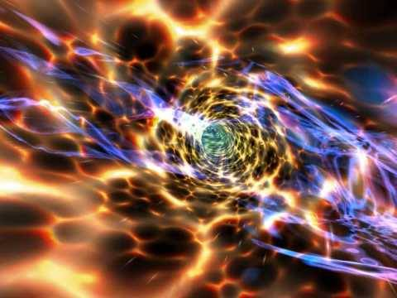

Slide 74
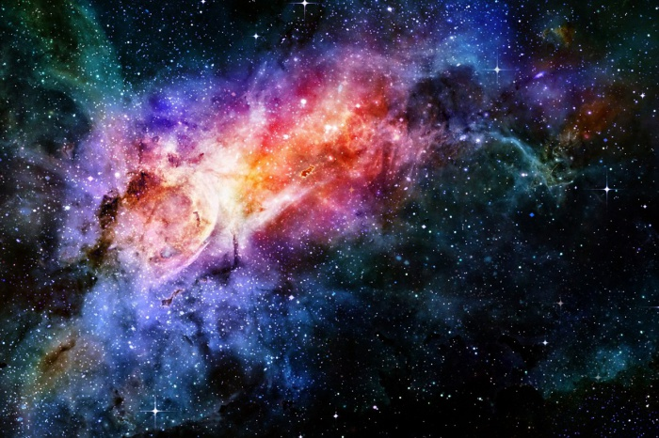

Slide 77
Engaging God River of Life 3

Slide 78
Engaging God River of Life 3

Slide 79
Engaging God River of Life 3

Slide 80
Engaging God River of Life 3

Slide 81
Engaging God River of Life 3
Let it energise you
Let it cleanse you and wash you from the inside out

Slide 84
Engaging God River of Life 2
Begin to open that door
Let God’s presence embrace you
Feel His love joy and peace
The river of life is flowing from that first love gate

Slide 85
Engaging God River of Life 2
Begin to picture that fountain of living water flow in your spirit
Engage the river ankle deep lie in it drink from it
Feel the light energy the vibrational frequency energising you.
Feel your cells being restored, renewed repaired

Slide 86
Engaging God River of Life

Slide 87
Engaging God River of Life

Slide 88
Engaging God River of Life 2
Invite the river of His presence into the garden of your heart
Let Him take you by the hand and walk with you into the garden of your heart
Lie down in the green pasture
Relax and talk with the Lord as your shepherd

Slide 89
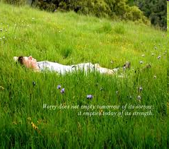

Slide 90
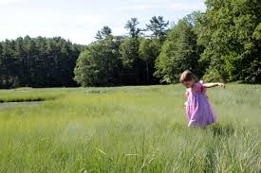

Slide 91
Engaging God River of Life 2
Explore your garden
Walk with Him
Feel the freedom the joy of walking with Him
Start to think of how you want your garden to be
Let the creative thoughts of tending and cultivating your garden dance in your mind

Slide 92
Engaging God River of Life 2
Release your creativity to create and plant your garden
Create a secret special place for intimacy with Him
Take a special testimony and plant it as a seed and water it and command it to grow
Take and eat the fruit

Slide 93
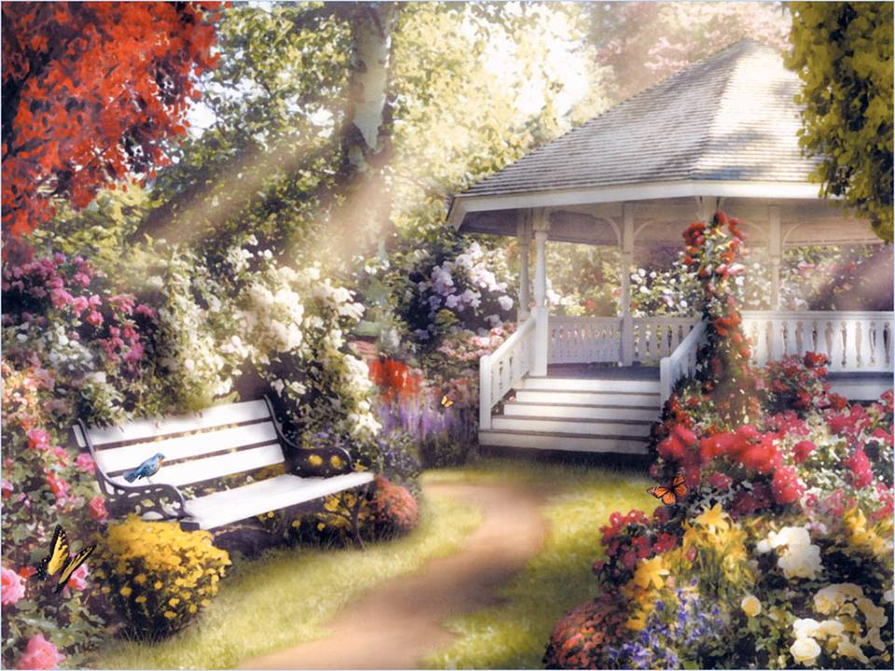

Slide 94
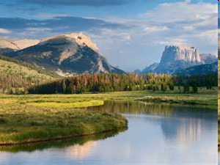

Slide 95
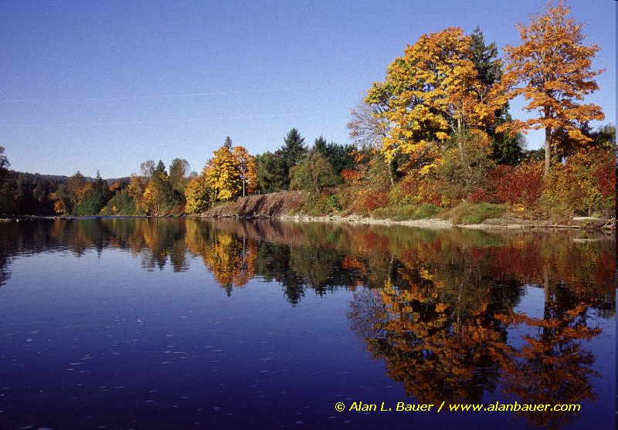

Slide 96
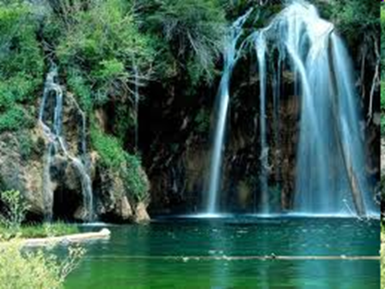

Slide 97
Engaging God River of Life 2
Follow the river go back into the heavenly garden of Eden
Walk back through the gate
Engage the river dive down see what is on the bottom, scrolls, gems
See the waterfall and stand under it feel it’s call deep to deep

Slide 99
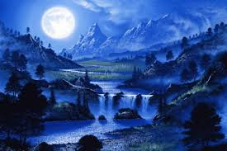

Slide 102
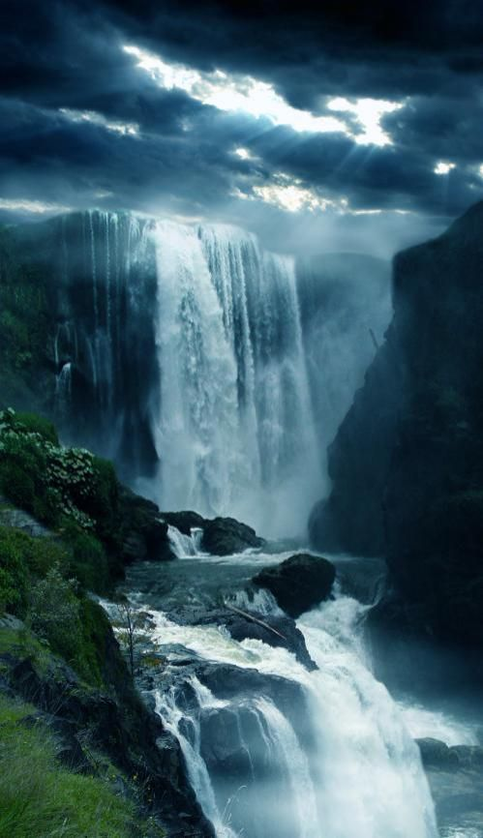

Slide 103
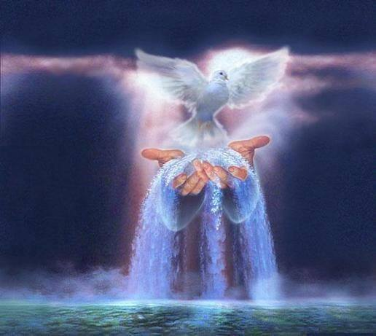

Slide 104
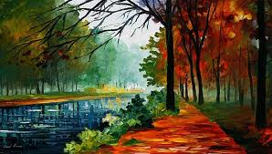

Slide 106
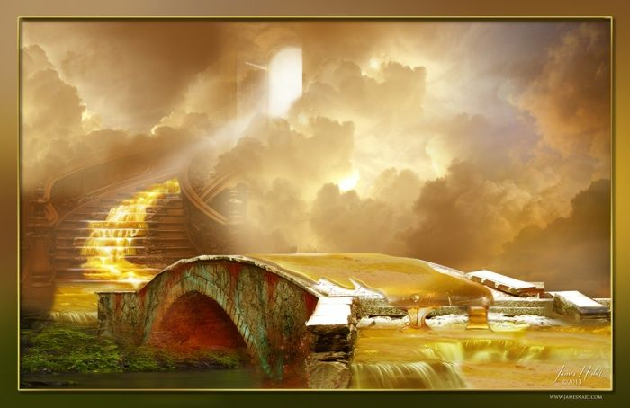

Slide 107
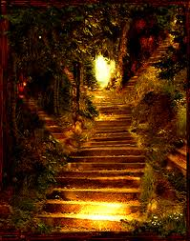

Slide 108
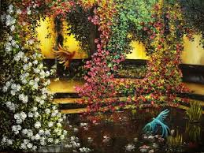

Slide 109
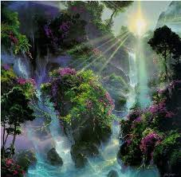

Slide 110
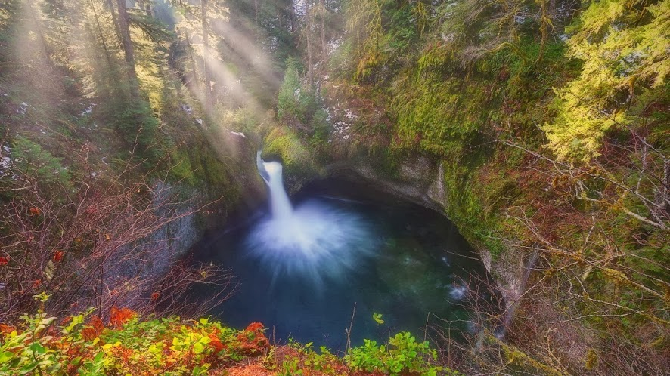

Slide 111
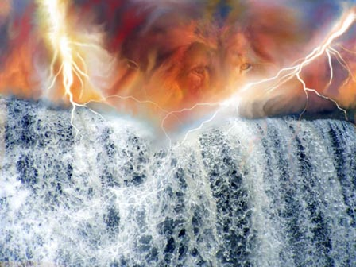

Slide 113
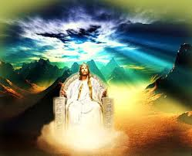

Slide 114
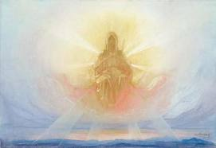

Slide 115
Engaging God River of Life

Slide 116
Engaging God River of Life

Slide 117
Whoever is thirsty come to Jesus & drink
Who wants to be filled with the joy come & receive
Who is eager for gifts come & receive
Who wants to speak in tongues come & receive a river flowing from within
Open your heart and receive all He has for you
Experience the power of baptism in the Spirit at a new level

Slide 118
The river of life is here jump in immerse yourselves, be forgiven & cleansed,
Drink the water of life until it becomes a well spring bubbling up in you
Become a dwelling place for the Father and Jesus

Slide 120
River of Life – New birth
River of death – Water Baptism
River of the Spirit – Baptism in Spirit
River of Fire – Consuming Fire
River of Glory – Heavenly presence
Immersed – Saturated – Filled - Experience

Slide 121
Rivers are flowing in Heaven
Rivers can be flowing in our spirits
Rivers are flowing in this Room
Immersed – Saturated – Filled
Experience God’s presence at a new level

Slide 122
The river of death & resurrection is present
Plunge in immerse yourselves – inside & out - SURRENDER
Be Washed & Cleansed from your past
Have the power of sin broken over your life
Exchange all the old for the new
Exchange struggles, sickness, guilt, shame, old identity
Stop to trying to meet your own needs
Allow God to meet your needs
Walk in resurrection power

Slide 123
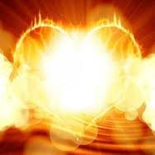

Slide 124
Engaging God First Love
Holy spirit Living water my source My well My fountain My spring My stream my river my insight my revelation My direction my guidance my abundant life my heavenly flow my heavenly Connection my filling my Overflowing my creativity my zero point energy my joy my Extravagance my exuberance my effulgence my eternal life source.

Slide 125
Engaging God River of Life
Door gate portal entrance access opening. Closed or locked it is a barrier a blockage stops access stops flow stops Connection etc. Gates transactions commerce decisions post slaves chose bond servants elders met defended guarded protected exchange East gate Source Northgate trouble.
Yoked joined become one flowing together in resonant harmony.

Slide 126
Engaging God River of Life
Matthew 6:25, 32-33 "For this reason I say to you, do not be worried about your life, as to what you will eat or what you will drink; nor for your body, as to what you will put on. Is not life more than food, and the body more than clothing? For the Gentiles eagerly seek all these things; for your heavenly Father knows that you need all these things. But seek first His kingdom and His righteousness, and all these things will be added to you.

Slide 127
Engaging God River of Life
John 4:10, 13-14 Jesus answered and said to her, "If you knew the gift of God, and who it is who says to you, 'Give Me a drink,' you would have asked Him, and He would have given you living water." Jesus answered and said to her, "Everyone who drinks of this water will thirst again; but whoever drinks of the water that I will give him shall never thirst; but the water that I will give him will become in him a well of water springing up to eternal life."

Slide 128
Engaging God River of Life
Ezekiel 47:7-9, 12
Now when I had returned, behold, on the bank of the river there were very many trees on the one side and on the other. Then he said to me, "These waters go out toward the eastern region and go down into the Arabah; then they go toward the sea, being made to flow into the sea, and the waters of the sea become fresh. It will come about that every living creature which swarms in every place where the river goes, will live. And there will be very many fish, for these waters go there and the others become fresh; so everything will live where the river goes. By the river on its bank, on one side and on the other, will grow all kinds of trees for food. Their leaves will not wither and their fruit will not fail. They will bear every month because their water flows from the sanctuary, and their fruit will be for food and their leaves for healing."

Slide 129
Engaging God River of Life
Revelation 22:1-2 Then he showed me a river of the water of life, clear as crystal, coming from the throne of God and of the Lamb, in the middle of its street. On either side of the river was the tree of life, bearing twelve kinds of fruit, yielding its fruit every month; and the leaves of the tree were for the healing of the nations.

Slide 130
Engaging God River of Life

Slide 131
Engaging God River of Life
1 Cor 12:4 Now there are varieties of gifts, but the same Spirit. 5 And there are varieties of ministries, and the same Lord. 6 There are varieties of effects, but the same God who works all things in all persons. 7 But to each one is given the manifestation of the Spirit for the common good. 8 For to one is given the word of wisdom through the Spirit, and to another the word of knowledge according to the same Spirit; 9 to another faith by the same Spirit, and to another gifts of healing by the one Spirit, 10 and to another the effecting of miracles, and to another prophecy, and to another the distinguishing of spirits, to another various kinds of tongues, and to another the interpretation of tongues. 11 But one and the same Spirit works all these things, distributing to each one individually just as He wills.

Slide 132
Engaging God River of Life
Gal 5:22 But the fruit of the Spirit is love, joy, peace, patience, kindness, goodness, faithfulness, 23 gentleness, self-control;
Gal 5:25 If we live by the Spirit, let us also walk by the Spirit.

Slide 133
Engaging God River of Life

Slide 134
Engaging God River of Life

Slide 135
Engaging God River of Life
Holy spirit Living water my source My well My fountain My spring My stream my river my insight my revelation My direction my guidance my abundant life my heavenly flow my heavenly Connection my filling my Overflowing my creativity my zero point energy my joy my Extravagance my exuberance my effulgence my eternal life source

Slide 136
Engaging God River of Life
Holy Spirit enthroned lead direct to walk in His ways direction and resources Lordship led by spirit Servant gratitude for amazing salvation but also by choice bond servant

Slide 137
Engaging God River of Life
Separate First Love module
Relationship with SSF distinct personalities
River of life engagement
Sonship Fatherhood
Baptised into spirit Jesus Father (Burning ones exercise) clothed with SSF deeper
waterfall river pool

Slide 138
Engaging God River of Life
Psalms 46:4 There is a river whose streams make glad the city of God, The holy dwelling places of the Most High.5 God is in the midst of her, she will not be moved; God will help her when morning dawns. 6 The nations made an uproar, the kingdoms tottered; He raised His voice, the earth melted. 7 The Lord of hosts is with us; The God of Jacob is our stronghold.

Slide 139
Engaging God River of Life
Romans 14:17 for the kingdom of God is not eating and drinking, but righteousness and peace and joy in the Holy Spirit.
John 4 John 7 Source joy strength peace help parakletos John 15 16 Power Acts 1:8 clothed with power. 1 Cor 12 and 14 gifts charismata. Hovering vibrating energy vibrancy abundance of life. Creativity inspiration revelation
Psalm 23 surely goodness and lovingkindness mercy follow me.

Slide 140
Engaging God River of Life
John 14:16-17 I will ask the Father, and He will give you another Helper, that He may be with you forever; that is the Spirit of truth, whom the world cannot receive, because it does not see Him or know Him, but you know Him because He abides with you and will be in you.

Slide 141
Engaging God River of Life

Slide 142
Engaging God River of Life
John 14:20, 23, 25-26 In that day you will know that I am in My Father, and you in Me, and I in you. Jesus answered and said to him, "If anyone loves Me, he will keep My word; and My Father will love him, and We will come to him and make Our abode with him. "These things I have spoken to you while abiding with you. But the Helper, the Holy Spirit, whom the Father will send in My name, He will teach you all things, and bring to your remembrance all that I said to you.

Slide 143
Engaging God River of Life
John 15:26 "When the Helper comes, whom I will send to you from the Father, that is the Spirit of truth who proceeds from the Father, He will testify about Me,
John 16:7-15 But I tell you the truth, it is to your advantage that I go away; for if I do not go away, the Helper will not come to you; but if I go, I will send Him to you. And He, when He comes, will convict the world concerning sin and righteousness and judgment; concerning sin, because they do not believe in Me; and concerning righteousness, because I go to the Father and you no longer see Me; and concerning judgment, because the ruler of this world has been judged. "I have many more things to say to you, but you cannot bear them now. But when He, the Spirit of truth, comes, He will guide you into all the truth; for He will not speak on His own initiative, but whatever He hears, He will speak; and He will disclose to you what is to come. He will glorify Me, for He will take of Mine and will disclose it to you. All things that the Father has are Mine; therefore I said that He takes of Mine and will disclose it to you.

Slide 144
Engaging God River of Life
John 12:26 If anyone serves Me, he must follow Me; and where I am, there My servant will be also; if anyone serves Me, the Father will honour him.
John 13:34-35 A new commandment I give to you, that you love one another, even as I have loved you, that you also love one another. By this all men will know that you are My disciples, if you have love for one another."

Slide 145
Engaging God River of Life
John 14:3, 6, 27 If I go and prepare a place for you, I will come again and receive you to Myself, that where I am, there you may be also. Jesus said to him, "I am the way, and the truth, and the life; no one comes to the Father but through Me. Peace I leave with you; My peace I give to you; not as the world gives do I give to you. Do not let your heart be troubled, nor let it be fearful.

Slide 146
Engaging God River of Life
John 15:10-12, 14-15 If you keep My commandments, you will abide in My love; just as I have kept My Father's commandments and abide in His love. These things I have spoken to you so that My joy may be in you, and that your joy may be made full. "This is My commandment, that you love one another, just as I have loved you. You are My friends if you do what I command you. No longer do I call you slaves, for the slave does not know what his master is doing; but I have called you friends, for all things that I have heard from My Father I have made known to you.

Slide 147
Engaging God River of Life
John 16:28, 33 I came forth from the Father and have come into the world; I am leaving the world again and going to the Father." These things I have spoken to you, so that in Me you may have peace. In the world you have tribulation, but take courage; I have overcome the world."

Slide 148
Engaging God River of Life
John 17:13, 16-18, 20-21, 26 But now I come to You; and these things I speak in the world so that they may have My joy made full in themselves. They are not of the world, even as I am not of the world. Sanctify them in the truth; Your word is truth. As You sent Me into the world, I also have sent them into the world. "I do not ask on behalf of these alone, but for those also who believe in Me through their word; that they may all be one; even as You, Father, are in Me and I in You, that they also may be in Us, so that the world may believe that You sent Me. and I have made Your name known to them, and will make it known, so that the love with which You loved Me may be in them, and I in them."

Slide 149
Engaging God River of Life
John 11:25 Jesus said to her, "I am the resurrection and the life; he who believes in Me will live even if he dies,
Romans 6:5 For if we have become united with Him in the likeness of His death, certainly we shall also be in the likeness of His resurrection,
Philippians 3:10 that I may know Him and the power of His resurrection and the fellowship of His sufferings, being conformed to His death;

Slide 150
Engaging God River of Life
Yoke of Jesus way discipleship oxen rabbi not my will path Surrender to destiny before foundation of the world
Baptism into his death and resurrection life
TRUTH my identify as a son gentle and humble in heart
The Life works miracles destroy enemy
Seat of rest and government
Responsibility zechariah 3:6-7
Process walk in His ways spirit stewardship to friendship
Laws or principles of the Kingdom lordship
Charge of the house and of courts kingship
Stand in the assembly as a mature son
Fatherhood bringing us to maturity

Slide 151
Engaging God River of Life
1 Corinthians 15:42-49 So also is the resurrection of the dead. It is sown a perishable body, it is raised an imperishable body; it is sown in dishonor, it is raised in glory; it is sown in weakness, it is raised in power; it is sown a natural body, it is raised a spiritual body. If there is a natural body, there is also a spiritual body. So also it is written, "The first man , Adam, became a living soul ." The last Adam became a life-giving spirit. However, the spiritual is not first, but the natural; then the spiritual. The first man is from the earth, earthy; the second man is from heaven. As is the earthy, so also are those who are earthy; and as is the heavenly, so also are those who are heavenly. Just as we have borne the image of the earthy, we will also bear the image of the heavenly.

Slide 152
Engaging God River of Life
Psalms 46:4 There is a river whose streams make glad the city of God, The holy dwelling places of the Most High.
Psalms 1:3 He will be like a tree firmly planted by streams of water, Which yields its fruit in its season And its leaf does not wither; And in whatever he does, he prospers.

Slide 153
Engaging God River of Life
Song of Solomon 4:15-16 " You are a garden spring, A well of fresh water, And streams flowing from Lebanon." " Awake, O north wind, And come, wind of the south; Make my garden breathe out fragrance, Let its spices be wafted abroad. May my beloved come into his garden And eat its choice fruits!
Amos 5:24 "But let justice roll down like waters And righteousness like an ever-flowing stream.
Jeremiah 17:7-8 "Blessed is the man who trusts in the Lord And whose trust is the Lord . "For he will be like a tree planted by the water, That extends its roots by a stream And will not fear when the heat comes; But its leaves will be green, And it will not be anxious in a year of drought Nor cease to yield fruit.

Slide 154
Engaging God River of Life
Isaiah 30:25-26 On every lofty mountain and on every high hill there will be streams running with water on the day of the great slaughter, when the towers fall. The light of the moon will be as the light of the sun, and the light of the sun will be seven times brighter, like the light of seven days, on the day the Lord binds up the fracture of His people and heals the bruise He has inflicted.
Isaiah 44:3 'For I will pour out water on the thirsty land And streams on the dry ground; I will pour out My Spirit on your offspring And My blessing on your descendants;

Slide 155
Engaging God River of Life
River of life engaging Source crystal from the tree of life pathway from eternity throne grace river flowing with grace and faith. Parakletos
Yoke of Jesus engaging rest friend joint heirs
Seat of rest and government Fathers tutoring 7 spirits God wisdom cloud of witnesses Gal 4 family
Kingdom within never end to the increase of His government
our Spirit holy holies 4 faces God FSS our spirit agreement window doorway heaven.

Slide 156
Engaging God River of Life
Holy Spirit Joy abundance joire de vie exuberance vitality
Jesus peace shalom wholeness
Father love acceptance affirmation approval

Slide 157
Engaging God River of Life
Yoke of Jesus way discipleship
oxen rabbi not my will path
Surrender to destiny before foundation of the world
Baptism into his death and resurrection life
TRUTH my identify as a son gentle and humble in heart
The Life works miracles destroy enemy

Slide 158
Engaging God River of Life
Seat of rest and government
Responsibility zechariah 3:6-7
Process walk in His ways spirit stewardship to friendship
Laws or principles of the Kingdom lordship
Charge of the house and of courts kingship
Stand in the assembly as a mature son
Fatherhood bringing us to maturity

Slide 159
Engaging God River of Life

Slide 160
Engaging God River of Life

Slide 161
Engaging God River of Life
Revelation 22: 1 Then a he showed me a river of the water of life, clear as crystal, coming from the throne of God and of the Lamb, 2 in the middle of its street. On either side of the river was the tree of life, bearing twelve kinds of fruit, yielding its fruit every month; and the leaves of the tree were for the healing of the nations.

Slide 162
Engaging God River of Life
Heb 4:16 Therefore let us draw near with confidence to the throne of grace, so that we may receive mercy and find grace to help in time of need.

Slide 163
Engaging God River of Life
Engage the river of life
Be connected through your spirit to that flow of heavenly life
5 Rivers are cascading like waterfalls out of heaven today

Slide 164
River of Life – New birth
River of death – Water Baptism
River of the Spirit – Baptism in Spirit
River of Fire – Consuming Fire
River of Glory – Heavenly presence
Immersed – Saturated – Filled - Experience

Slide 165
Rivers are flowing in Heaven
Rivers can be flowing in our spirits
Rivers are flowing in this Room
Immersed – Saturated – Filled
Experience God’s presence at a new level

Slide 166
The river of life is here jump in immerse yourselves, be forgiven & cleansed,
Drink the water of life until it becomes a well spring bubbling up in you
Become a dwelling place for the Father and Jesus

Slide 167
The river of death & resurrection is present
Plunge in immerse yourselves – inside & out - SURRENDER
Be Washed & Cleansed from your past
Have the power of sin broken over your life
Exchange all the old for the new
Exchange struggles, sickness, guilt, shame, old identity
Stop to trying to meet your own needs
Allow God to meet your needs
Walk in resurrection power

Slide 168
Whoever is thirsty come to Jesus & drink
Who wants to be filled with the joy come & receive
Who is eager for Gifts come & receive
Who wants to speak in tongues come & receive a river flowing from within
Open your heart and receive all He has for you
Experience the power of baptism in the Spirit at a new level
Give it away let it flow from you

Slide 172
First Love House of God 1

Slide 175
Engaging God First Love
Receive Him as love personified
Feel the security, power and strength of His love
Feel His unconditional love for you
Feel the fire of His love burn in you
Feel His love embrace you hold you safe in His arms of love
Feel your heart melt in His embrace

Slide 176
Engaging God First Love
Express your love for Him
Yield surrender open up your heart to embrace Him
Let Him fill you with His presence
Ask Him to take you back to before conception when you were created as a spirit in His heart

Slide 177
Engaging God First Love
Rest allow His thought to envelope you in the womb of His hearts
Feel His frequency of love vibrating in your spirit
Let Him reveal His heart to your spirit once again
Let Him reveal His amazing thoughts about you

Slide 178
Engaging God First Love
Listen to Him as He unveils the hidden mysteries of your destiny
Let Him reveal how special you are to Him
Let Him show you your true identity
Let Him show you your true purpose
Let what was transform what is to release what will be
Begin to resonate with your scroll

Slide 179
Engaging God First Love
Scrolls of revelation
Scrolls revealing who we were
Scrolls revealing our redemptive gift and purpose
Scrolls revealing our true identity
Scrolls revealing our true destiny
Scrolls revealing what we will be
Scrolls revealing what we will do

Slide 180
Engaging God First Love
Blockages
Hurt pain rejection fear mistrust
Past
Projections chains brambles nailed shut
Souls protection mechanism is projection creates fear, aprehension

Slide 181
Transformation 7
I stand in the light of your truth
Show me the seeds of offense & sin that have taken root in my heart
I commit myself to forgiving & release all offenses in my life & my generational line

Slide 182
Transformation 7
Show me all roots of bitterness that have grown in my heart
I commit myself to a lifestyle of repentance against all negative roots
I repent of all negative emotions and attitudes rooted in my heart

Slide 183
Transformation 7
Show me all fruits of resentment that have developed in my behaviour
I commit myself to a lifestyle of renunciation against all negative behaviours
I renounce all my defence & coping mechanisms
I renounce my sin as a way of life

Slide 184
Transformation 7
Give me revelation of my true identity as a son of God
Give me a heart secure in its identity
Renew my mind to the mind of Christ
Meet all my unmet needs in yourself
Heal all my unhealed hurts
Restore my soul

Slide 185
Transformation 7
I receive your unconditional love, acceptance, affirmation, approval
I stand transparent naked and unafraid before you
I hear you say I see you and I love you
I receive your value, esteem and worth

Slide 186
Transformation 7
I choose to live a lifestyle of forgiveness, repentance & renunciation
I step back into this realm to walk in the ways of your kingdom
Manifest your glory through me on earth as it is in heaven so I will fulfil my eternal destiny

Slide 187
Engaging God First Love
What does it feel like to loved unconditionally

Slide 188
Engaging God First Love
Arc agreement of 2 produces manifest presence and anointing agreement 3 produces government Matt 18
Interaction Holy Spirit and Father Holy Spirit and Jesus Jesus and the Father
Yoke Jesus why heavy laden weary ox and Rabi walk like Him 1 John 4

Slide 189
Engaging God First Love
seat of Government and rest Trust for provision protection purpose acceptance affirmation approval affection appreciation. Zech 3:6 7 government

Slide 190
Engaging God First Love
Arc agreement of 2 produces manifest presence and anointing agreement 3 produces government Matt 18
Interaction Holy Spirit and Father Holy Spirit and Jesus Jesus and the Father
Yoke Jesus why heavy laden weary ox and Rabi walk like Him 1 John 4

Slide 191
Engaging God First Love
seat of Government and rest Trust for provision protection purpose acceptance affirmation approval affection appreciation. Zech 3:6 7 government

Slide 192
Engaging God First Love
Holy Spirit enthroned lead direct to walk in His ways direction and resources Lordship led by spirit Servant gratitude for amazing salvation but also by choice bond servant

Slide 193
Engaging God First Love
Jesus Lord and king steward resources ministry trusted most often biggest test will I get my identity from what I do or from who I am in relationship will I get caught up in working for l lose my first love and enter duty cycle fear cycle
Friendship joint heir reveals ways heart revelation invested heavenly authority.

Slide 194
Engaging God First Love
Bench of 3 in us government kingdom of God Must reflect and come from heaven Matt 5 your kingdom Come on earth as it is in heaven. My agreement within 3+1=4 opens window doorway to responsibility Lord king Son heavenly order Melchizedek.

Slide 195
Engaging God First Love
Matthew 18:3-4 and said, "Truly I say to you, unless you are converted and become like children, you will not enter the kingdom of heaven. Whoever then humbles himself as this child, he is the greatest in the kingdom of heaven.
Matthew 18:19-20 "Again I say to you, that if two of you agree on earth about anything that they may ask, it shall be done for them by My Father who is in heaven. For where two or three have gathered together in My name, I am there in their midst."

Slide 196
Engaging God First Love
First love what we freely receive we freely give
God is first love that is His person His purpose His plan His priority and His methodology and motivation
God is love and every thing He does is both fully loving and fully expresses Himself
Love is the highest frequency of vibrating energy that exists. Love is the fastest speed of light Love is the greatest source of potential energy
Have we experienced and encountered God is love
Do we know love
Do we resonate with Ioves frequency

Slide 197
Engaging God First Love
Have we been transformed and realigned by love
Are we filled with love
Is everything we think say and do motivated by love?
Does love flow in us and through us and around us
Are we receivers and channels of love therefore of God?
Love is the manifold wisdom and grace of God personified in Jesus and fully expressed on the cross

Slide 198
Engaging God First Love
This is first love that He loves us with all His heart mind strength and being
This is our first love that we love Him with all our spirit soul body
This is first love that He loves us with all His heart mind strength and being Sacrifice Once for all time He embraced cross once
This is our first love that we love Him with all our spirit soul body living sacrifice daily we pickup the cross daily denying ourselves.

Slide 199
Engaging God First Love
Holy Spirit enthroned lead direct to walk in His ways direction and resources Lordship led by spirit Servant gratitude for amazing salvation but also by choice bond servant

Slide 200
Engaging God First Love
Jesus Lord and king steward resources ministry trusted most often biggest test will I get my identity from what I do or from who I am in relationship will I get caught up in working for l lose my first love and enter duty cycle fear cycle
Friendship joint heir reveals ways heart revelation invested heavenly authority.

Slide 201
Engaging God First Love
Bench of 3 in us government kingdom of God Must reflect and come from heaven Matt 5 your kingdom Come on earth as it is in heaven. My agreement within 3+1=4 opens window doorway to responsibility Lord king Son heavenly order Melchizedek.

Slide 202
Engaging God First Love
Matthew 18:3-4 and said, "Truly I say to you, unless you are converted and become like children, you will not enter the kingdom of heaven. Whoever then humbles himself as this child, he is the greatest in the kingdom of heaven.
Matthew 18:19-20 "Again I say to you, that if two of you agree on earth about anything that they may ask, it shall be done for them by My Father who is in heaven. For where two or three have gathered together in My name, I am there in their midst."

Slide 203
Engaging God First Love
First love what we freely receive we freely give
God is first love that is His person His purpose His plan His priority and His methodology and motivation
God is love and every thing He does is both fully loving and fully expresses Himself
Love is the highest frequency of vibrating energy that exists. Love is the fastest speed of light Love is the greatest source of potential energy
Have we experienced and encountered God is love
Do we know love
Do we resonate with Ioves frequency

Slide 204
Engaging God First Love 2
Rev 3:19 Those whom I love, I reprove and discipline; therefore be zealous and repent. 20 Behold, I stand at the door and knock; if anyone hears My voice and opens the door, I will come in to him and will dine with him, and he with Me. 21 He who overcomes, I will grant to him to sit down with Me on My throne, as I also overcame and sat down with My Father on His throne.

Slide 205
Engaging God First Love 2
Love = reproof and discipline – oh no
Don’t equate discipline with punishment
Passionate to turn and follow Him into relationship and transformation into His image
Preparation for intimacy
Desire for intimacy
Reward of intimacy rulership

Slide 206
Engaging God First Love
Have we been transformed and realigned by love
Are we filled with love
Is everything we think say and do motivated by love?
Does love flow in us and through us and around us
Are we receivers and channels of love therefore of God?
Love is the manifold wisdom and grace of God personified in Jesus and fully expressed on the cross

Slide 207
Engaging God First Love
This is first love that He loves us with all His heart mind strength and being
This is our first love that we love Him with all our spirit soul body
This is first love that He loves us with all His heart mind strength and being Sacrifice Once for all time He embraced cross once
This is our first love that we love Him with all our spirit soul body living sacrifice daily we pickup the cross daily denying ourselves.

Slide 208
Engaging God First Love
Luke 10:And he answered, “You shall love the Lord your God with all your heart, and with all your soul, and with all your strength, and with all your mind; and your neighbour as yourself.”
1 Cor 6:17 But the one who joins himself to the Lord is one spirit with Him.

Slide 209
Engaging God First Love
Behold and become close contact heart to heart cardio genesis transformed reordered. My spirit must be like heaven So My heart can be subdued and tended and cultivated to be like Eden. All starts with first love. I can be the representation of the 4 faces of God on earth as it is in heaven. Embrace 1st love.

Slide 210
Engaging God First Love
Psa 139:16 Your eyes have seen my unformed substance; And in Your book were all written The days that were ordained for me, When as yet there was not one of them.17 How precious also are Your thoughts to me, O God! How vast is the sum of them!

Slide 211
Engaging God First Love
2 Cor 3:18 But we all, with unveiled face, beholding as in a mirror the glory of the Lord, are being transformed into the same image from glory to glory, just as from the Lord, the Spirit.
Heb 12:2 fixing our eyes on Jesus, the author and perfecter of our faith

Slide 212
Engaging God First Love
God is letting us experience who He is intrinsically
Father Son Spirit and their wonderful interaction

Slide 213
Engaging God First Love

Slide 214
Engaging God First Love
Revelation 3:20 Behold, I stand at the door and knock; if anyone hears My voice and opens the door, I will come in to him and will dine with him, and he with Me.
You must give a daily invitation to fill you and flow through you
This is the access point to the Pathway of relationship

Slide 216
Engaging God First Love
Revelation 4:1-2 After these things I looked, and behold, a door standing open in heaven, and the first voice which I had heard, like the sound of a trumpet speaking with me, said, "Come up here, and I will show you what must take place after these things."
You have to accept the invitation
This begins the pathway of responsibility

Slide 217
Engaging God First Love
What is our spirit?
Where does our spirit come from?
What is our spirit made of?
Where is our spirit?
What does our spirit do?
How do we engage our spirit?

Slide 218
Engaging God First Love
1 John 5:5 This is the message we have heard from Him and announce to you, that God is Light,
John 4:24 God is spirit, and those who worship Him must worship in spirit and truth.”
God is spirit God is light
We are spirit and our spirit is light

Slide 219
Engaging God First Love
We pre-existed in eternity as thoughts within the heart or mind of God
Psa 139:13 For You formed my inward parts; You wove me in my mother’s womb.
16 Your eyes have seen my unformed substance And in Your book were all written The days that were ordained for me, When as yet there was not one of them.

Slide 220
Engaging God First Love
Our spirit is our eternal essence it came from eternity and will return to it
Pneuma, Ruach spirit (Spirit), wind, or breath Our spirit entered our cells at conception
Our spirit is the centre of our being - our inner most being
Our spirit is the purest representation of our true self
Our spirit is not limited by time and space TARDIS

Slide 221
Engaging God First Love
Red blood cells contain no DNA no nucleus carry oxygen breath to the brain
The life is in the blood, red cells breath This can be programmed by the spirit
White blood cells contain record of 22 + 22 autosomes generational genetic programming & 1+1 chromosomes
Our DNA can be epigenetically re-sequenced by frequency, light, sound also by trauma and nurture

Slide 222
Engaging God First Love
Our spirit is a dimensional place that God dwells in and can dwell in God
John 14:16 I will ask the Father, and He will give you another Helper,… 17 that is the Spirit of truth, .. He abides with you and will be in you.
John 14:20 In that day you will know that I am in My Father, and you in Me, and I in you. 23 … We will come to him and make Our abode with him.

Slide 223
Engaging God First Love
We are a spirit we have a soul that lives in a body (an earth suit)
We are spirit the eternal essence of God within that receives spiritual revelation.
We are a spirit being that is God conscious
We have a soul that is self conscious and makes us a human being
Our spirit and soul makes us a living being

Slide 224
Engaging God First Love
In Adam the spirit was outside the body and as a light being he could travel in the spiritual realms
Psa 8:4 What is man that You take thought of him, And the son of man that You care for him? 5 Yet You have made him a little lower than God, And You crown him with glory and majesty! 6 You make him to rule over the works of Your hands; You have put all things under his feet

Slide 225
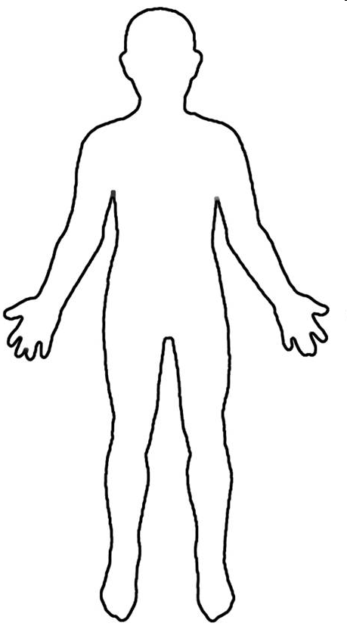
Conscious Mind
Spirit Father Son Holy Spirit
Heart Subconscious Mind Garden Scroll
Kingdom within us
First Love Gate
Rivers Power Anointing
Seat of Government

Slide 226
Source
Blockages
Intimacy
Further Info 1
Further Info 2
River of Life

Slide 227
Source
Blockages
Intimacy
Further Info 1
Further Info 2
Yoke of Jesus

Slide 228
Source
Blockages
Intimacy
Further Info 1
Further Info 2
Seat of rest and government

Slide 232
First Love House of God 1

Slide 235
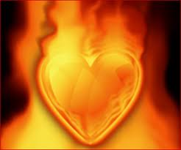

Slide 236
Engaging God First Love
Feel the power and strength of His love
Feel His fire burn in you
Express your love to Him
Express your love for Him

Slide 237
Engaging God First Love
The Centre of Our Being - the residing place of the promise of God, centred inside our spirit.
The Human Spirit
The Human Soul
The Human Body

Slide 238
Engaging God First Love
Luke 17:21 Nor will people say, Look! Here [it is]! or, See, [it is] there! For behold, the kingdom of God is within you [in your hearts] and among you [surrounding you].
Spirit realm is connected to you because heaven or God's kingdom is in you
Therefore you have access to God heavenly spiritual realm and God has access to you. You are a gate of the spiritual realm heaven and God Channel

Slide 239
Engaging God First Love
You are a mountain
You are a place of authority
God dwells in a mountain Ezek 28
Pillar engages heaven

Slide 240
Engaging God First Love
Rev 2:19 But I have this against you, that you have left your first love
Rev 3: 20 Behold, I stand at the door and knock; if anyone hears My voice and opens the door, I will come in to him and will dine with him, and he with Me.

Slide 241
Engaging God First Love
We can embrace and experience God within – Holy Spirit, Jesus & Father as distinct personalities
We can choose to do that as we have a promise if you draw near

Slide 242
Engaging God First Love
The altar experience alters us
It must be a proactive response a choice to surrender
A choice to present ourselves as an offering

Slide 243
Engaging God First Love

Slide 244
Engaging God First Love

Slide 245
Engaging God First Love
Luke 17:21For behold, the kingdom of God is within you [in your hearts] and among you [surrounding you].

Slide 246
Engaging God First Love
kingdom is within me and Isa 9 there is no end to the increase of His government (kingdom) and peace shalom, wholeness it must Increase expand grow in me and through me and around me.
Isaiah 9:7 There will be no end to the increase of His government or of peace, On the throne of David and over his kingdom, To establish it and to uphold it with justice and righteousness From then on and forevermore. The zeal of the Lord of hosts will accomplish this.

Slide 247
Engaging God First Love
Liquid light- interspatial matrix interface my spirit

Slide 248
Engaging God First Love
Jesus my friend my brother my lover my Lord my king my model my example my Rabi my master my disciples my Word my Way my Truth my Life my door my Shepherd my Resurrection my light my Saviour my High Priest my advocate my interceder my yoke my song my Jesus

Slide 249
Engaging God First Love
Father my creator my sustainer my essence my rest my shalom my affirmer my accepter My peace My love My provider my protector my healer my sanctifier my righteousness my banner My victory my security my identity my anchor my hope my delight my purpose my glorifier my rock my restorer my reconciler my transformer my transfigurer My renewer my conformer my forgiver my strength my authority my power my eternal destination my eternal home my reference point. My Father

Slide 250
Engaging God First Love
God My Consuming fire My frequency My harmony My resonance My Manifold grace my Manifold wisdom My Melody My Rhythm My metronome My conductor My author My producer My composer Yod Hei Vav Hei My Lion My Ox My Eagle My Man My King my Prophet My Apostle My Priest My Home My dwelling place My covenant My all in all

Slide 251
Engaging Holy Spirit
Drinking living Water
Engaging The river
Further Info 1
Further Info 2
River of life

Slide 252
Engaging God First Love
Matthew 11:27, 29-30 All things have been handed over to Me by My Father; and no one knows the Son except the Father; nor does anyone know the Father except the Son, and anyone to whom the Son wills to reveal Him. Take My yoke upon you and learn from Me, for I am gentle and humble in heart, and you will find rest for your souls . For My yoke is easy and My burden is light."

Slide 253
Engaging God First Love

Slide 254
Engaging God First Love

Slide 255
Engaging God First Love
seat rest and government yielded abdicated to Father Lordship kingship Rest Provision Blessing Protection. Matt 6:33 Seek first kingdom and His righteousness and everything added. Trust Him be at rest in peace living in the eye of the storm.
yoked to Jesus learn from Him discipleship to the master Rabi guidance and direction for the path today. Heart attitude gentle and humble in heart. Rest for the soul Searching for direction identity purpose significance meaning Matt 11:28

Slide 256
Engaging God First Love
Jesus my friend my brother my lover my Lord my king my model my example my Rabi my master my disciples my Word my Way my Truth my Life my door my Shepherd my Resurrection my light my Saviour my High Priest my advocate my interceder my yoke my song my Jesus

Slide 257
Engaging God First Love
Father my creator my sustainer my essence my rest my shalom my affirmer my accepter My peace My love My provider my protector my healer my sanctifier my righteousness my banner My victory my security my identity my anchor my hope my delight my purpose my glorifier my rock my restorer my reconciler my transformer my transfigurer My renewer my conformer my forgiver my strength my authority my power my eternal destination my eternal home my reference point. My Father

Slide 258
Engaging God First Love
God My Consuming fire My frequency My harmony My resonance My Manifold grace my Manifold wisdom My Melody My Rhythm My metronome My conductor My author My producer My composer Yod Hei Vav Hei My Lion My Ox My Eagle My Man My King my Prophet My Apostle My Priest My Home My dwelling place My covenant My all in all

Slide 259
Engaging God First Love

Slide 260
Engaging God First Love
seat rest and government yielded abdicated to Father Lordship kingship Rest Provision Blessing Protection. Matt 6:33 Seek first kingdom and His righteousness and everything added. Trust Him be at rest in peace living in the eye of the storm.
yoked to Jesus learn from Him discipleship to the master Rabi guidance and direction for the path today. Heart attitude gentle and humble in heart. Rest for the soul Searching for direction identity purpose significance meaning Matt 11:28
Source of life John 4:13 living water connection to heaven. Fountain Spring eternal life connection to eternity quality of heavens Source. Drink walk wade Swim baptised filled Spirit. John 7 rivers of living water Flow streams make glad. Ezek 47 flows from kingdom first love gate trickles flows deeper and deeper to engage the garden of our hearts Ps 23 quiet waters
life to the world turns death into rife. Resurrection life power Rom 6 baptised into the river.

Slide 261
Engaging God First Love

Slide 262
Engaging God First Love

Slide 263
Pathway of Relationship
Flow from heaven inside out
Plant Seeds of Testimony
Enlarge Spirit Flowing
Experience River of life
Tongues Development
Matt 13
Matt 11
Cultivate good soil
Yoked to Jesus
Ps 23
Opening gateways
Rev 3:20
Preparation Spirit Building
Garden of Heart
Opening First Love Gate
Deal with stones, weeds hardness
Jesus is Lord
Invite Jesus to walk through
Experience God’s Presence
Meditation Thoughts Of God Visualization
Cultivate & Tend

Slide 264
Gateways Spirit Body Soul
Experience God’s Presence
Experience the River of life
Rev 3:20
Opening First Love Gate
Surrender
Yoke Yourself
Experience God’s Passion

Slide 266
Experience the River of life
House of God
JOURNEY MAPS
First Love
Engaging our spirit
Experience God’s Presence
Experience God’s Passion

Slide 267
God
within
Kingdom God Within
Gate of heaven
Further Info 1
House of God
Further Info 2

Slide 268
Lordship
Kingship
Sonship
Further Info 1
Seat of Government
Further Info 2

Slide 269
Rest
Identity
Surrender
Further Info 1
Further Info 2
Yoke of Jesus

Slide 270
Drink Living Water
Engage Source Life
Get in the river
Feel His Love
Feel His Joy
Feel His Peace
Gateways Spirit Body Soul
Experience God’s Presence
Experience the River of life
Rev 3:20
Opening First Love Gate
Surrender
Yoke Yourself
Experience God’s Passion
Matt 11
Yoked to Jesus
Feel His Affirming
Feel His Acceptance
Feel His Approval
Jesus is Lord
3rd DNA
Light

Slide 273
Tongues Word
Tongues 3 ways
Tongues
Vision
Be still
Psa 46:10
Relax
Hearing God’s voice
Journaling
Tongues Development
Meditation Word Flow God’s thoughts
Base Camp
Spirit Building
Eyes of Spirit Activation
Eyes of heart Activating Imagination
Black Veil
Spirit perception
3 levels of spirit realm
Picture Objects
Picture Word
Picture Doorways

Slide 274
Spiritual Perception
Torn Veil
3 levels of spirit realm
Further Info 1
Eyes of spirit Activating Black Veil
Further Info 2

