Slide 1
Engaging God
Pathway of relationship that leads to deeper intimacy with God
Flowing from inside out - heaven to our gateways of spirit, soul, body to the world around us
Pathway of responsibility that leads to greater kingdom rulership
Flowing from outside in from earth to heaven as living sacrifices to rule.

Slide 2
Base Camp
Journey Preparation
Unseen Realms
spirit, soul, angelic
Heavenly Realms
River of Life
River of Life
Pathway of Relationship

Slide 3
House of God
First Love
JOURNEY MAPS
First Love
Engaging our spirit
River of Life
Seat of Government
Yoke of Jesus

Slide 4
I am a Dwelling
I am a Mountain
I am a gateway
House of God

Slide 5
First Love House of God 3
We are made in the image of God and patterned after the heavenly blueprint the tabernacle – a dwelling place
Ex 25:40 See that you make them after the pattern for them, which was shown to you on the mountain.
Outer & Inner courts, Holy of Holies cf Body – Soul – Spirit
Our body is a dwelling place
The kingdom is in us we are a mountain

Slide 6
First Love House of God 3
Gen 28:12, 17 And he dreamed that there was a ladder set up on the earth, and the top of it reached to heaven; and the angels of God were ascending and descending on it! He was afraid and said, How to be feared and reverenced is this place! This is none other than the house of God, and this is the gateway to heaven
You are a gateway to heaven and for heaven

Slide 8
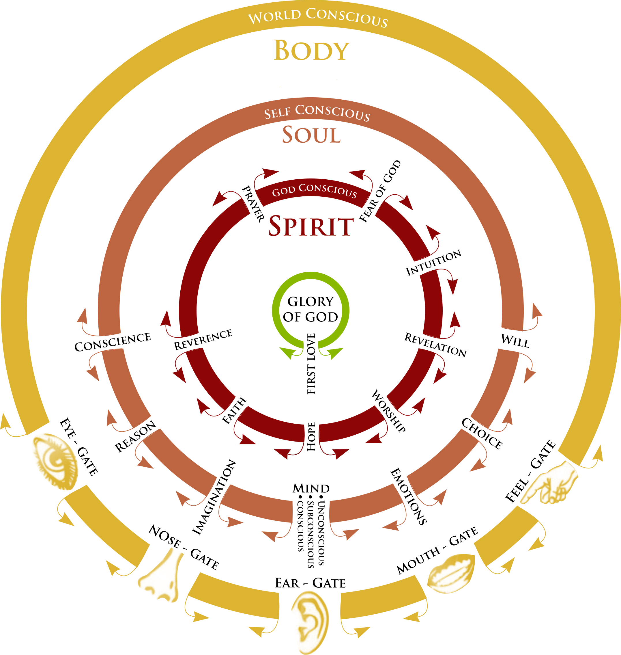

Slide 9
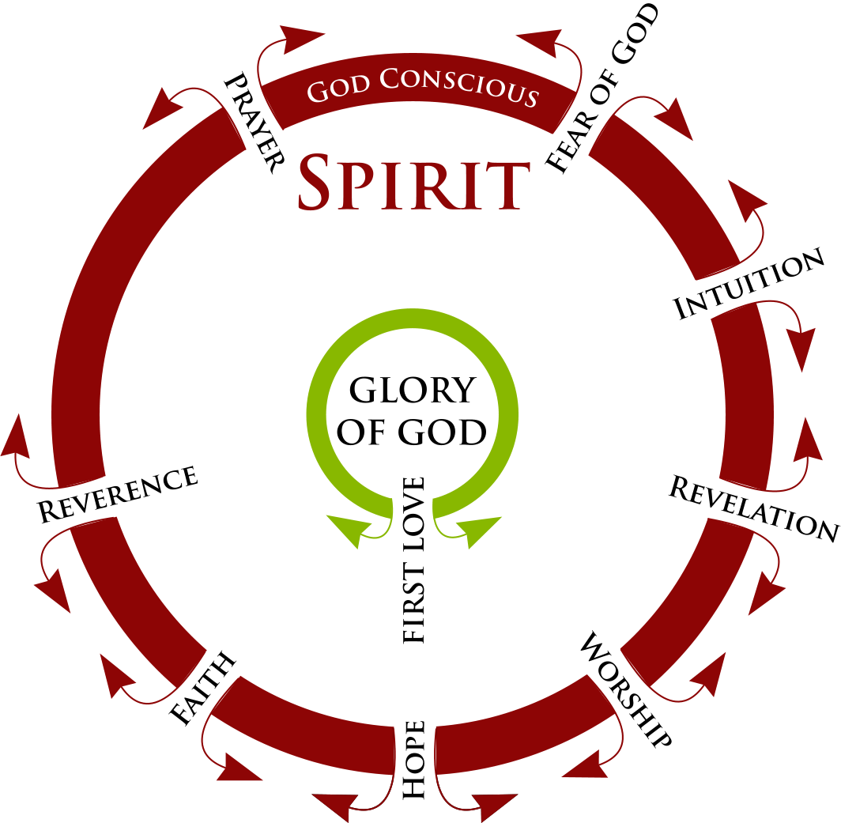

Slide 10
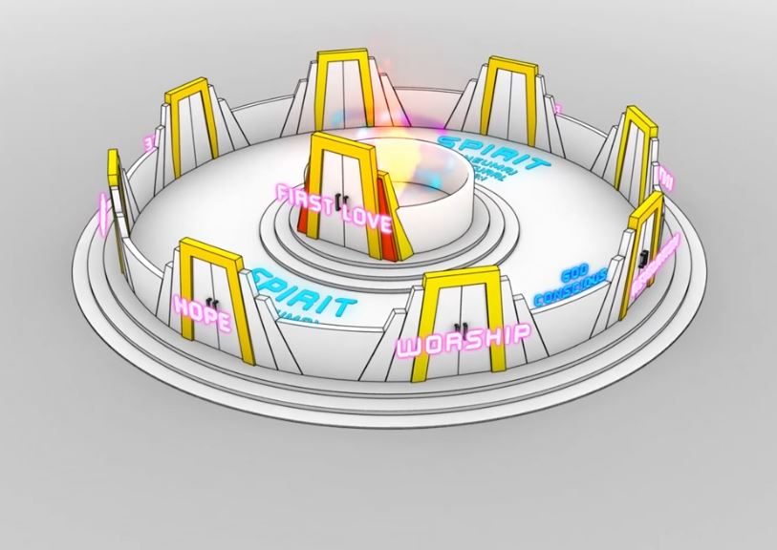
Gateway first love
Rev 3:20
River of Life

Slide 11
First Love House of God 3
John 10:7 So Jesus said to them again, “Truly, truly, I say to you, I am the door of the sheep.
John 10:9 I am the door; if anyone enters through Me, he will be saved, and will go in and out and find pasture.
Jesus is a door or gateway

Slide 12
First Love House of God 3
Rom 8:29 For those whom He foreknew, He also predestined to become conformed to the image of His Son,
We are to be conformed to His image
Therefore we are a door or gateway
A gateway to or for what?
What is the significance of gates and doors?

Slide 13
First Love House of God 3
Business Transactions 1 Kings 22:10
Legal Transactions Ruth 4:1-11
Criminal Cases Deut. 25:7-9
Disputes/Judgments Deut. 25:7-9
Proclamations Jer. 17:19-20
Festivities Ps 24:7
Protection 2 Sam 18:24-33
We have gates for various functions

Slide 14
First Love House of God 3
Our gates are our senses or abilities
Our spirit has 8 gateways, our soul has 7 and our body has 5
1 Thessalonians 5:23.. May your whole spirit, soul and body be kept blameless at the coming of our Lord Jesus Christ.
God’s desire is that we become a unified whole – reconciled & restored

Slide 15
First Love House of God 3
My SPIRIT
Fear of God
Prayer
Reverence
Hope
Faith
Revelation
Intuition
Worship
My SOUL
Conscience
Imagination
Reason
Mind – Heart Subconscious Conscious Unconscious Emotions
Will
Choice
My BODY
Eye - Sight
Ear - Hearing
Nose - Smell
Mouth -Taste
Hands -Touch

Slide 17
First Love House of God 3
A Gateway is a place of authority where dominion is exercised
Whoever controls your life’s different gateways exercises authority, dominion & control over you
Your gates are designed to be open and flowing from the inside out so that you become a gateway of heaven

Slide 18
First Love House of God 3
Our eyes and ears etc are windows or gates
Problem is that everything has flowed from the outside in and we are conformed to that pattern – worlds mould
For us to be conformed to the heavenly pattern everything must flow from inside out
Your gates must be open
Whoever sits in the gate controls it

Slide 19
First Love House of God 3
We may have inadvertently given demonic forces legal access and legal rights to sit in those gates to control, resist and block the flow
Our ancestors may have given a legal right to demons.
Those legal rights may still be there
We need to remove those legal rights, cleanse and purify and rule gates

Slide 20
First Love House of God 3
Familiars can counterfeit gate functions for illegitimate purposes
We must engage and know our gates
We must open our gates
We must cleanse and purify our gates
We must use our gates for their designed purpose and function
We must become a gateway for God

Slide 21
First Love House of God 3
Tabernacle had veils or gates
Your body soul spirit has gates
You are designed to be a gateway for heaven to rule the earth
You are a gateway for the kingdom to be at hand around you
John 14:12 .. he who believes in Me, the works that I do, he will do also; and greater works than these he will do;

Slide 22
First Love House of God 3
John 10:9 we can go in and out of the gate
Jesus as the door is a torn veil between heaven and earth
We live under an open gate to heaven
John 1:51 And He said to him, "Truly, truly, I say to you, you will see the heavens opened and the angels of God ascending and descending on the Son of Man.“

Slide 23
First Love House of God 3
Heb 10:19 Therefore, brethren, since we have confidence to enter the holy place by the blood of Jesus, 20 by a new and living way which He inaugurated for us through the veil, that is, His flesh, 21 and since we have a great priest over the house of God, 22 let us draw near

Slide 24
First Love House of God 3
Open heaven examples, Abraham, Jacob, Moses, 70 Elders, Joshua, Isaiah, Ezekiel, Zechariah, Jesus, Stephen, Paul, John & many mystics
Rev 4:1 door stands open in heaven
You live under that open heaven with an invitation to interact with the spiritual realms both the eternal heavenly and the unseen angelic realms

Slide 25
First Love House of God 3
Gate of First Love is our access to the source of living water to be filled and to overflow life
John 4:10, 13-14 Jesus answered and said to her, "If you knew the gift of God, … He would have given you living water." Jesus answered and said to her, "Everyone who drinks of this water will thirst again; but whoever drinks of the water that I will give him shall never thirst; but the water that I will give him will become in him a fountain of water springing up to eternal life."

Slide 26
First Love House of God 3
John 7:37-39 .. Jesus stood and cried out, saying, "If anyone is thirsty, let him come to Me and drink. He who believes in Me, as the Scripture said, 'From his innermost being will flow rivers of living water.'" But this He spoke of the Spirit, whom those who believed in Him were to receive;

Slide 27
First Love House of God 3
Ezekiel 47:1 Then he brought me back to the door of the house; and behold, water was flowing from under the threshold of the house toward the east,
Ezekiel 47:7-9, 12 Now when I had returned, behold, on the bank of the river there were very many trees on the one side and on the other. Then he said to me, "These waters go out toward the eastern region .. then they go toward the sea, being made to flow into the sea, and the waters of the sea become fresh

Slide 28
First Love House of God 3
Ezekiel 47:7-9, 12 It will come about that every living creature which swarms in every place where the river goes, will live. And there will be very many fish, for these waters go there and the others become fresh; so everything will live where the river goes. By the river on its bank, on one side and on the other, will grow all kinds of trees for food. Their leaves will not wither and their fruit will not fail. They will bear every month because their water flows from the sanctuary, and their fruit will be for food and their leaves for healing."

Slide 29
First Love House of God 3
I am a gateway for the river of life to flow from heaven through my spirit through my heart to the world just as the river that flowed from Eden the heavenly garden to Adam's garden at the east to become 4 rivers to water earth.
East gate where the river flowed

Slide 30
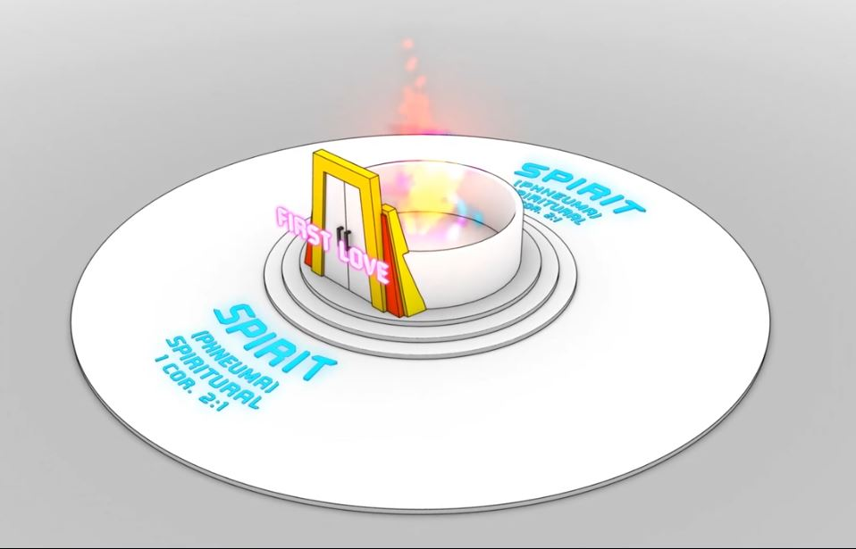
Living Water
John 4 & John 7
Gateway first love
Rev 3:20
Gateway first love
Rev 3:20
River of Life
River of Life

Slide 31
Living Water
John 4 & John 7
Gateway first love
Rev 3:20
River of Life
River of Life
River of Life
River of Life
River of Life
River of Life

Slide 32
First Love House of God 3
God is light, Jesus was the light of the world
We are to be the light of the world
The source of life and light is in us
Life must radiate out of us
Light must emanate from us
Kingdom is in us but must manifest through us

Slide 33
First Love House of God 3
Kingdom is within me and Isa 9 says there is no end to the increase of His government (kingdom) and peace shalom, wholeness
It must increase expand grow in me and through me and around me
Gifts and fruit of the spirit developing and growing in us - flowing through us
So we bring life wherever we go

Slide 34
First Love House of God 3
John 14:12 works of Jesus manifested through us, miracles, healings, nature
Everything created has a vibrating frequency – sound and image
When we resonate with God’s frequency of love, grace and mercy we have vibrating energy in us, through us and around us
So we bring life wherever we go

Slide 35
First Love House of God 3
I am a heavenly gate for my mountain authority
A channel for the kingdom within to become the kingdom around me as my spirit joined with Him in unity, oneness engages and brings dominion to the spiritual and physical realms within my sphere of influence into my circumstances.

Slide 36
First Love House of God 3
The kingdom is at hand wherever l stand, live, work go etc.
Energy field of vibrational frequency or the atmosphere around me.
Living in the atmosphere of heaven on earth.
Living under the authority, power of love
Establishing the rule of heaven as embassies on earth being ambassadors of reconciliation to bring restoration to the world.

Slide 37
First Love House of God 3
We become free flowing gateways so that the atmosphere of heaven the glory and expression of God as love radiates as light through us as transfigured spirit beings
Love, Joy, Peace Patience Goodness Kindness etc bringing life, peace and rest changing salt water to fresh

Slide 38
First Love House of God 3
Rom 8:19 For the anxious longing of the creation waits eagerly for the revealing of the sons of God. 21 that the creation itself also will be set free from its slavery to corruption into the freedom of the glory of the children of God. 22 For we know that the whole creation groans and suffers the pains of childbirth together until now.

Slide 39
First Love House of God 3
We become a resonant harmonic frequency as we become part of heavens symphony answering creations groan
A frequency or sound recognized and responded to by creation itself
We will raise creation’s frequency back to its original condition of harmony between heaven and earth.

Slide 40
First Love House of God 3
As we embrace our destiny as sons
God desires to reveal or manifest us as sons of God who live at a higher frequency
Restoring the frequency of the planet into alignment - resonating with heaven once again
Reconciling and restoring

Slide 41
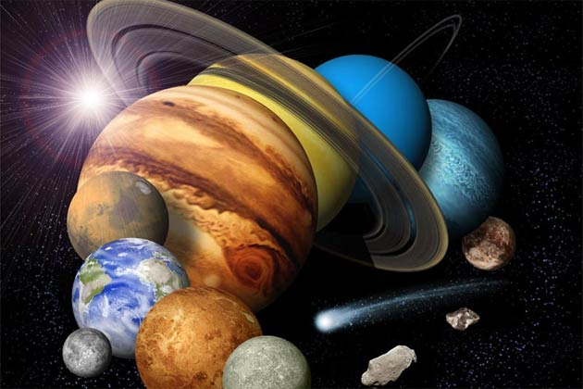

Slide 42
First Love House of God 3
Romans 5:10-11 For if while we were enemies we were reconciled to God through the death of His Son, much more, having been reconciled, we shall be saved by His life. And not only this, but we also exult in God through our Lord Jesus Christ, through whom we have now received the reconciliation.
Spirit soul body in harmony – saved sozo

Slide 43
First Love House of God 3
2 Corinthians 1:18-20 Now all these things are from God, who reconciled us to Himself through Christ and gave us the ministry of reconciliation, namely, that God was in Christ reconciling the world to Himself, not counting their trespasses against them, and He has committed to us the word of reconciliation. Therefore, we are ambassadors for Christ, as though God were making an appeal through us; we beg you on behalf of Christ, be reconciled to God.

Slide 44
First Love House of God 3
John 14:10 Do you not believe that I am in the Father, and the Father is in Me? The words that I say to you I do not speak on My own initiative, but the Father abiding in Me does His works.
We are a gateway – a God channel
For God to work through us as sons

Slide 45
First Love House of God 3
As my spirit grows, it enlarges its territory to encompass and be unified with my soul and in cooperation to flow out through my body to engage the world around me.
I am whole and bring that wholeness to a broken fractured world
For God so loved the world He gave His Son Jesus and He gives us as His sons

Slide 46
New Birth Spirit DNA of God
Access to our Destiny
Water of Life Fountain
Dwelling Place of the Father & Son
Relationship
SPIRIT Kingdom of God
Access to heavenly realms
Fruit of the Spirit
Gifts of the Spirit
Heart Soul Garden
Deliverance
Signs & Wonders
Body Kingdom Around us
Jesus Works
Greater Works
Healing
Miracles
Supernatural Works
Jesus Character

Slide 47
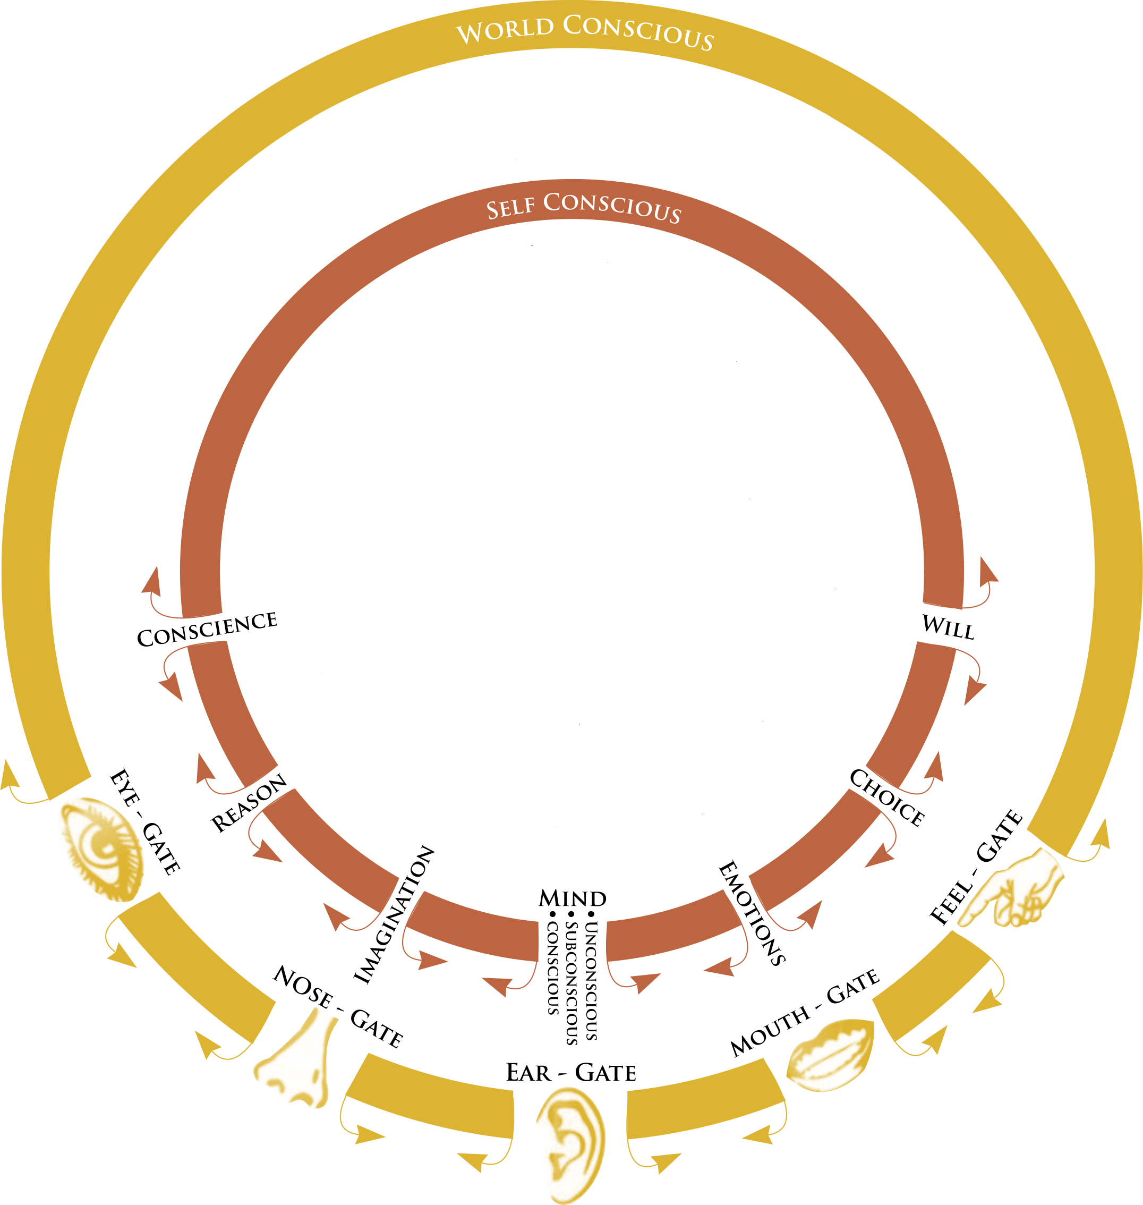
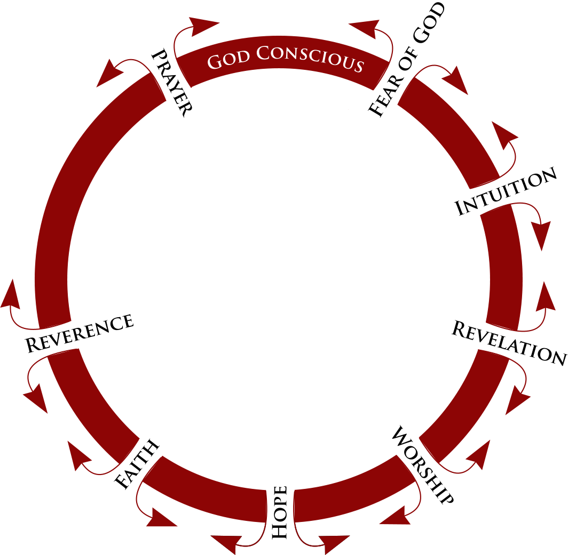

Slide 48
First Love House of God 3
As a Gateway of Love we can radiate the essence of love
Works of Jesus are love in action the essence of the Father through us and around us as an electro magnetic field of love
Atmosphere of the kingdom that rules and governs by love
Creating an atmosphere or field of love a vibrational frequency of love that creation the Spirit realm, angels and demons can detect

Slide 50
First Love House of God 3
Practical application
Draw from within us by choice
Draw the anointing from within us
Access the faith gate to potential possibilities
Truth - lay hands on the sick, cast out demons, raise the dead etc.
Faith mixed with the grace or divine ability vibrating energy in your hand or words = anointing a charge of power forms

Slide 51
First Love House of God 3
The gates of our spirit, soul and body must be open
Starting with the first love gate that is the source of heavens life
What is flowing through you as a gate?
What frequency are you vibrating at?
What colour is filling the atmosphere around your life?

Slide 52
First Love House of God 3
Revelation 3:20 Behold, I stand at the door and knock; if anyone hears My voice and opens the door, I will come in to him and will dine with him, and he with Me.
We invite Him to our mountain and throne so we can be a gateway

Slide 53
First Love House of God 3
1 Cor 6:17 But the one who joins himself to the Lord is one spirit with Him.
Become joined, entwined in oneness, spiritual union, resonating with His frequency
Flowing and radiating

Slide 54
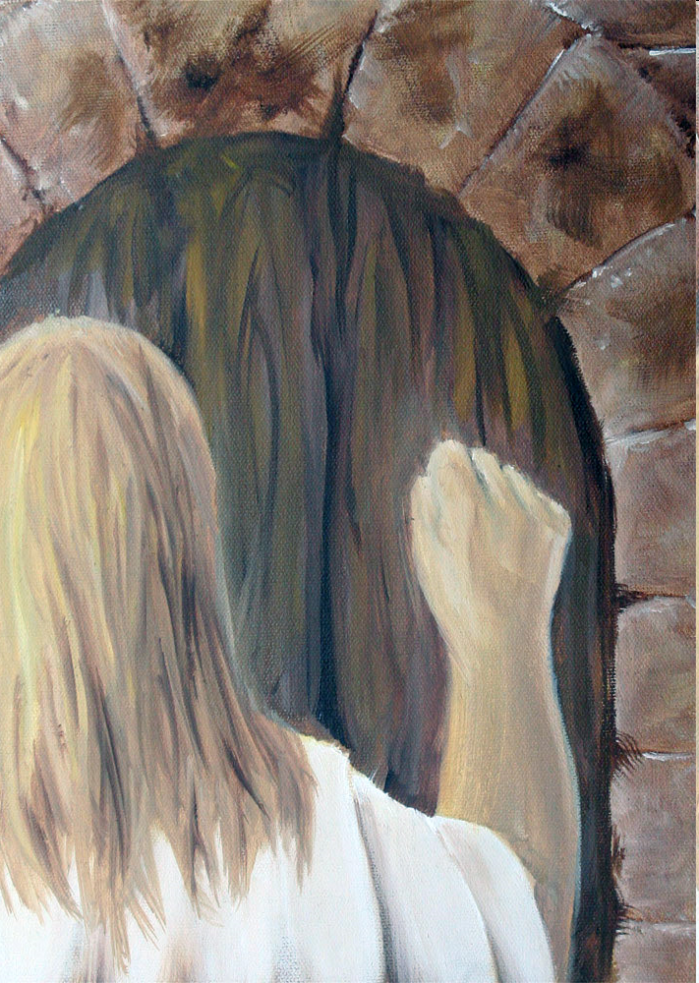

Slide 57
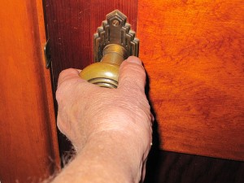
First Love House of God 1

Slide 59
First Love House of God 3
Close your eyes and relax
Starting focusing on the door in your spirit, think about that door with expectation
Start to picture that door using the imagination screen in your mind
Listen for God knocking, listen to what He is saying

Slide 60
First Love House of God 3
Reach out and open the door
Invite God in
Engage your body and your senses, feel His embrace, feel His presence, feel His acceptance and love
Feel yourself becoming joined, connected, vibrating intimate with Him
Feel your heart next to His heart

Slide 61
First Love House of God 3
See the living water flowing from the first love gate
Drink that living water deep and deeper
Let it become a river in you
Feel its vibrational energy resonating within you
Feel its flow

Slide 62
First Love House of God 3
Consciously choose to open your soul gates to the flow
Let it flow in you
Consciously choose to open your body gates
Let it flow out of you
Feel your spirit growing enlarging through your soul forming an atmosphere of love, joy peace around you

Slide 63
First Love House of God 3
Engage the spiritual atmosphere around you
Draw from the revelation gate to see into the atmosphere around you
Engage your angels
Draw through the faith gate for healing power to flow from you and send it out like Peters’ shadow

