Slide 1
Engaging God
Pathway of relationship that leads to deeper intimacy with God
Flowing from inside out - heaven to our gateways of spirit, soul, body to the world around us
Pathway of responsibility that leads to greater kingdom rulership
Flowing from outside in from earth to heaven as living sacrifices to rule.

Slide 2
Base Camp
Journey Preparation
Unseen Realms
spirit, soul, angelic
Heavenly Realms
River of Life
River of Life
Pathway of Relationship

Slide 3
House of God
First Love
JOURNEY MAPS
First Love
Engaging our spirit
River of Life
Seat of Government
Yoke of Jesus

Slide 4
I am a Dwelling
I am a Mountain
I am a gateway
House of God

Slide 5
First Love House of God 2
We are made in the image of God and patterned after the heavenly tabernacle – a dwelling place
Outer & Inner courts, Holy of Holies
Body – Soul – Spirit
Our body is a dwelling place
Our spirit is also a dwelling place

Slide 6
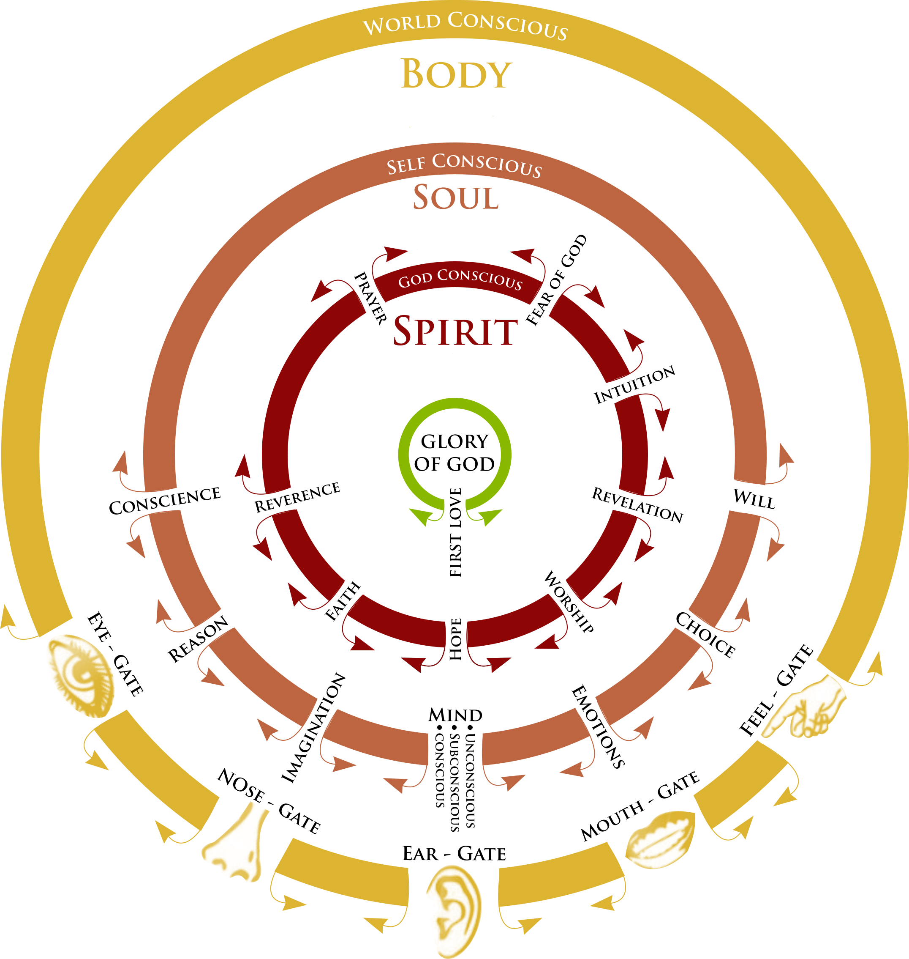

Slide 7
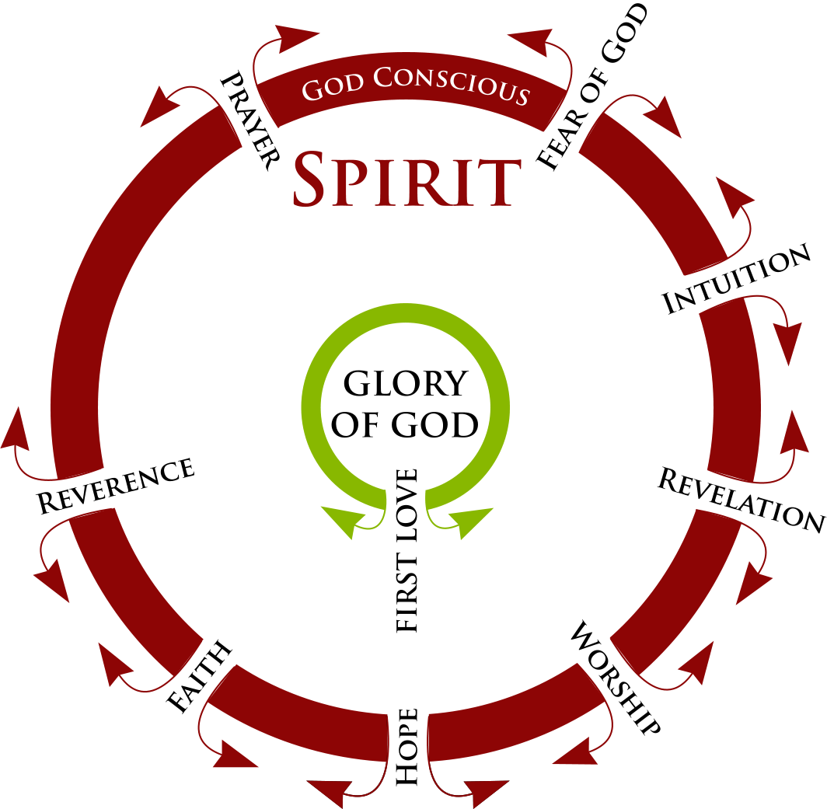

Slide 8
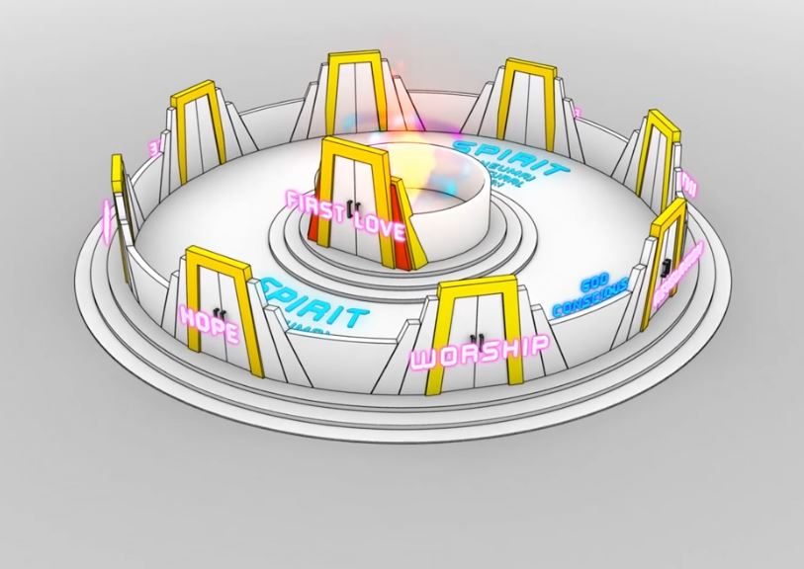
Gateway first love
Rev 3:20
River of Life

Slide 9
First Love House of God 2
You are a house of God, He lives in you
Gen 28:12, 17 And he dreamed that there was a ladder set up on the earth, and the top of it reached to heaven; and the angels of God were ascending and descending on it! He was afraid and said, How to be feared and reverenced is this place! This is none other than the house of God, and this is the gateway to heaven

Slide 10
First Love House of God 2
Gen 12:8 Then he proceeded from there to the mountain on the east of Bethel, and pitched his tent, with Bethel on the west and Ai on the east; and there he built an altar to the Lord and called upon the name of the Lord. I am

Slide 11
First Love House of God 2
Where does God dwell in heaven?
Where is God’s throne in heaven?
We are made in God’s image?
We are made to reflect heaven

Slide 12
First Love House of God 2
There will be a connection between where God dwells and rules in heaven and where He dwells and has His throne in us
We are His ambassadors living in heaven and on earth under heavens government
So we can be manifested as sons on earth as it is in heaven

Slide 13
First Love House of God 2
Ezek 28:13 “You were in Eden, the garden of God; 14 …You were on the holy mountain of God;
Psa 68:16 16 Why do you look with envy, O mountains with many peaks, At the mountain which God has desired for His abode? Surely the Lord will dwell there forever.
God dwells on a mountain

Slide 14
First Love House of God 2
When God started coming and appearing to man, it was unsurprisingly on mountain tops.
Gen 22:2 He said, “Take now your son, your only son, whom you love, Isaac, and go to the land of Moriah, and offer him there as a burnt offering on one of the mountains of which I will tell you. 14 Abraham called the name of that place The Lord Will Provide, as it is said to this day, “In the mount of the Lord it will be provided.”

Slide 15
First Love House of God 2
Ex 24:17 And to the eyes of the sons of Israel the appearance of the glory of the LORD was like a consuming fire on the mountain top.
Ps 48:1 Great is the Lord, and greatly to be praised, In the city of our God, His holy mountain.

Slide 16
First Love House of God 2
The city of God and the mountain of God are synonymous terms.
The bible uses lots of different terms to describe where God dwells, rules and where His throne is
Sometimes it will be like a temple, like a city, like a mountain, but they are all talking about the same thing

Slide 17
First Love House of God 2
Ex 3:1 Now Moses… led the flock to the west side of the wilderness and came to Horeb, the mountain of God.
Also know as Mount Sinai
God’s dwelling place on earth

Slide 18
First Love House of God 2
Ezek 20:40 For on My holy mountain, on the high mountain of Israel,”
Isa 66:20 Then they shall bring all your brethren from all the nations…., to My holy mountain Jerusalem,
There is a progression of deeper connection, intimacy and immanency

Slide 19
First Love House of God 2
John 4:21 Jesus said to her, “Woman, believe Me, an hour is coming when neither in this mountain nor in Jerusalem will you worship the Father. 23 But an hour is coming, and now is, when the true worshipers will worship the Father in spirit and truth; for such people the Father seeks to be His worshipers. 24 God is spirit, and those who worship Him must worship in spirit and truth.

Slide 20
First Love House of God 2
God did everything on mountains
Eden was a mountain
Mount Moriah – Jerusalem
Mount Horeb – Sinai God’s mountain
Israel described as God’s mountain
Jerusalem described as God’s mountain
We are now God’s mountain

Slide 21
First Love House of God 2
Ex 15:17“You will bring them and plant them in the mountain of Your inheritance, The place, O Lord, which You have made for Your dwelling, The sanctuary, O Lord, which Your hands have established.
Ps 2:6 “But as for Me, I have installed My King Upon Zion, My holy mountain.”
His throne is on the mountain

Slide 22
First Love House of God 2
Our spirit is a mountain, symbolic of authority and God’s throne and dwelling place
Our spirit is a place of governmental authority
God’s Kingdom resides within our spirit
God has called to rule as His sons

Slide 23
First Love House of God 2
You are a mountain
You are a place of authority
When God dwells on your mountain you reflect the heavenly realms
You also have mountain ranges in the heavenly realms
You have thrones on those mountains
You are and have a position of authority

Slide 24
First Love House of God 2
Matt 4:8 Again, the devil took Him to a very high mountain and showed Him all the kingdoms of the world and their glory
He was shown all the kingdom governmental spheres including yours and mine
We each have 7 mountains or governmental spheres under our position or seat of government in the heavenly kingdom of God
The mountain ranges in the heavenly realms are patterned after God’s mountain

Slide 25
First Love House of God 2
Mountains represent the 7 redemptive governmental aspects of your destiny
These spheres of authority are your destined role in the manifestation of sonship that will bring about creations restoration

Slide 26
First Love House of God 2
Hebrew language each letter is a picture
Each word is thereforea comic strip
Mountain הָ֫רַר harar means -
Behold the ruler of rulers
Mountains are places of authority, rulership and government

Slide 27
First Love House of God 2
Think Hebrew and not Greek. We need to think function, not form – but that is alien to the western mind-set
The function of a mountain is authority.
The function of a throne is rulership.
When we come across mountains in the bible, dreams, visions etc we can now stop thinking about them as big lumps of rock, things to climb and plant a flag on?

Slide 28
First Love House of God 2
Psa 2:6 “But as for Me, I have installed My King Upon Zion, My holy mountain.” 7 “I will surely tell of the decree of the Lord: He said to Me, ‘You are My Son, Today I have begotten You.
Kingdom – associated with mountains
Jesus is enthroned as King of Kings

Slide 29
First Love House of God 2
Isaiah 2:2-5, 12-14, 17-18 Now it will come about that In the last days The mountain of the house of the Lord Will be established as the chief of the mountains, And will be raised above the hills; And all the nations will stream to it.
The destiny of God’s people and the true Ecclesia of God, the true government of God

Slide 30
First Love House of God 2
Daniel 2:34-35, 43-45 You continued looking until a stone was cut out without hands, Inasmuch as you saw that a stone was cut out of the mountain without hands and it struck the statue...
But the stone that struck the statue became a great mountain and filled the whole earth.
In the days of those kings the God of heaven will set up a kingdom which will never be destroyed, and that kingdom will not be left for another people; it will crush and put an end to all these kingdoms,

Slide 31
First Love House of God 2
Daniel 7:9-10, 13-14, 18, 22, 26-27 "I kept looking Until thrones were set up, And the Ancient of Days took His seat; His vesture was like white snow And the hair of His head like pure wool. His throne was ablaze with flames, Its wheels were a burning fire. "A river of fire was flowing And coming out from before Him; Thousands upon thousands were attending Him, And myriads upon myriads were standing before Him;

Slide 32
First Love House of God 2
Daniel 7:9-10, 13-14, 18, 22, 26-27 "The court sat, And the books were opened. "I kept looking in the night visions, And behold, with the clouds of heaven One like a Son of Man was coming, And He came up to the Ancient of Days And was presented before Him. "And to Him was given dominion, Glory and a kingdom, That all the peoples, nations and men of every language Might serve Him. His dominion is an everlasting dominion which will not pass away; And His kingdom is one which will not be destroyed.

Slide 33
First Love House of God 2
Daniel 7:9-10, 13-14, 18, 22, 26-27 "But the saints of the Highest One will receive the kingdom and possess the kingdom forever, for all ages to come.' until the Ancient of Days came and judgment was passed in favour of the saints of the Highest One, and the time arrived when the saints took possession of the kingdom.

Slide 34
First Love House of God 2
Daniel 7:9-10, 13-14, 18, 22, 26-27 "But the court will sit for judgment, and his dominion will be taken away, annihilated and destroyed forever. Then the sovereignty, the dominion and the greatness of all the kingdoms under the whole heaven will be given to the people of the saints of the Highest One; His kingdom will be an everlasting kingdom, and all the dominions will serve and obey Him.‘

Slide 35
First Love House of God 2
Rev 1:6 and He has made us to be a kingdom, priests to His God and Father—to Him be the glory and the dominion forever and ever. Amen.
Rev 5:10 You have made them to be a kingdom and priests to our God; and they will reign upon the earth
Rev 11:15 The kingdom of the world has become the kingdom of our Lord and of His Christ; and He will reign forever and ever.

Slide 36
First Love House of God 2
Hebrews 12:18 For you have not come to a mountain that can be touched and to a blazing fire, and to darkness and gloom and whirlwind, 22 But you have come to Mount Zion and to the city of the living God, the heavenly Jerusalem, and to myriads of angels, 23 to the general assembly and church of the firstborn who are enrolled in heaven…

Slide 37
First Love House of God 2
Isaiah 9:7 There will be no end to the increase of His government or of peace, On the throne of David and over his kingdom, To establish it and to uphold it with justice and righteousness From then on and forevermore. The zeal of the Lord of hosts will accomplish this.

Slide 38
First Love House of God 2
The purpose of true government is to bring rest and peace
He must be on the seat of rest and government in me on my mountain and my throne until I am seated on my throne in heaven as a fully mandated and manifested son of God

Slide 39
First Love House of God 2
Kingdom is within us there is no end to the increase of His government (kingdom) and peace, shalom, wholeness
Therefore the kingdom must also increase, expand and grow in me and through me and around me.

Slide 40
First Love House of God 2
I have had many encounters with mountains
I am here because of a mountain vision 1993 as I climbed it and my spirit saw now
2006 I saw a vision of a mountain rising up out of a desert with the 4 faces of God the pattern of heavenly government

Slide 41
First Love House of God 2
God is looking for a reflection of heaven in us and on earth
God is looking for the government of His kingdom on earth as it is in heaven
Judgement is coming to the Church on the basis of what God sees
This is like Me and reflects heaven and I will inhabit this person or place

Slide 42
First Love House of God 2
Jesus talks about the authority figures on earth how they lord it over people (Mark 10:42)
Jesus says His kingdom is totally different. He didn’t come to be served, but to serve.
So everything about rulership in God’s kingdom is about serving, not dictatorship. The first will be last and the last first.

Slide 43
First Love House of God 2
That turns on its head the whole system of the world, in which people want to be more highly placed than others so use them to climb up and then they can stamp on them and keep them down.
In the kingdom of God, authority is all about raising people up.

Slide 44
First Love House of God 2
What is a reflection on earth of the heavenly mountain?

Slide 45
First Love House of God 2
So there is a place where you rule, and it is called a mountain and a throne,
The nature of the rulership we are called to is to raise people up into their own places of authority and power, not to keep them down and subservient
Joshua generation

Slide 46
First Love House of God 2
Revelation 3:20 Behold, I stand at the door and knock; if anyone hears My voice and opens the door, I will come in to him and will dine with him, and he with Me.
We give God this daily invitation to fill us and flow through us
We invite Him to our mountain and throne

Slide 47
First Love House of God 2
1 Cor 6:17 17 But the one who joins himself to the Lord is one spirit with Him.
Become joined, entwined in oneness, spiritual union
This will mostly be spirit to spirit communication but may engage your most developed soul area
Emotions, imagination, reason

Slide 48
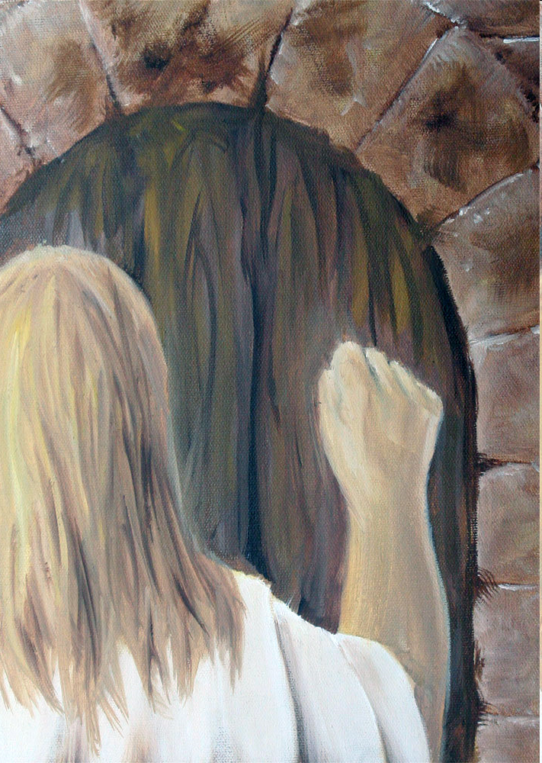

Slide 51
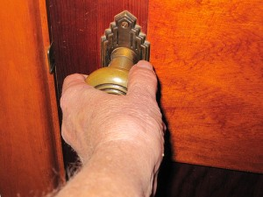
First Love House of God 1

Slide 53
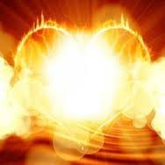

Slide 54
