Slide 1
Engaging God
We are going on a journey or an adventure together - systematic way
Journey of discovering how to engage the spiritual realms
Discovering the realms within us, around us and the heavenly realms
There are 2 main pathways that we are going to follow

Slide 2
Engaging God
Pathway of relationship that leads to deeper intimacy with God
Flowing from inside out - heaven to our gateways of spirit, soul, body to the world around us
Pathway of responsibility that leads to greater kingdom rulership
Flowing from outside in from earth to heaven as living sacrifices to rule.

Slide 3
Base Camp
Journey Preparation
Unseen Realms
Heavenly Realms
River of Life
River of Life
Pathway of Relationship

Slide 4
House of God
First Love
JOURNEY MAPS
First Love
Engaging our spirit
River of Life
Seat of Government
Yoke of Jesus

Slide 5
I am a Dwelling
I am a Mountain
I am a Gateway
House of God

Slide 6
First Love House of God 1
Dwelling places of God
Heaven is a house of God
Tabernacle is a house of God
Church is a house of God
We are a house of God
All spiritual dimensions

Slide 7
First Love House of God 1
Tabernacle means dwelling or residence
Earthly tabernacle is patterned after the heavenly tabernacle
Heavenly tabernacle is patterned after the heavenly realms
Kingdom of God, Kingdom of Heaven, Heaven
Outer court – Inner Court – Holy of Holies with veils or gateways

Slide 8
First Love House of God 1
We are made in the image of God and patterned after the tabernacle
Body – Soul – Spirit
Our body is a dwelling place
Our spirit is a dwelling place

Slide 9
First Love House of God 1
Our spirit is a gateway to God’s heavenly kingdom
Our spirit has gateways to our soul
Our soul has gateways to our body
Our body has gateways to the world

Slide 10
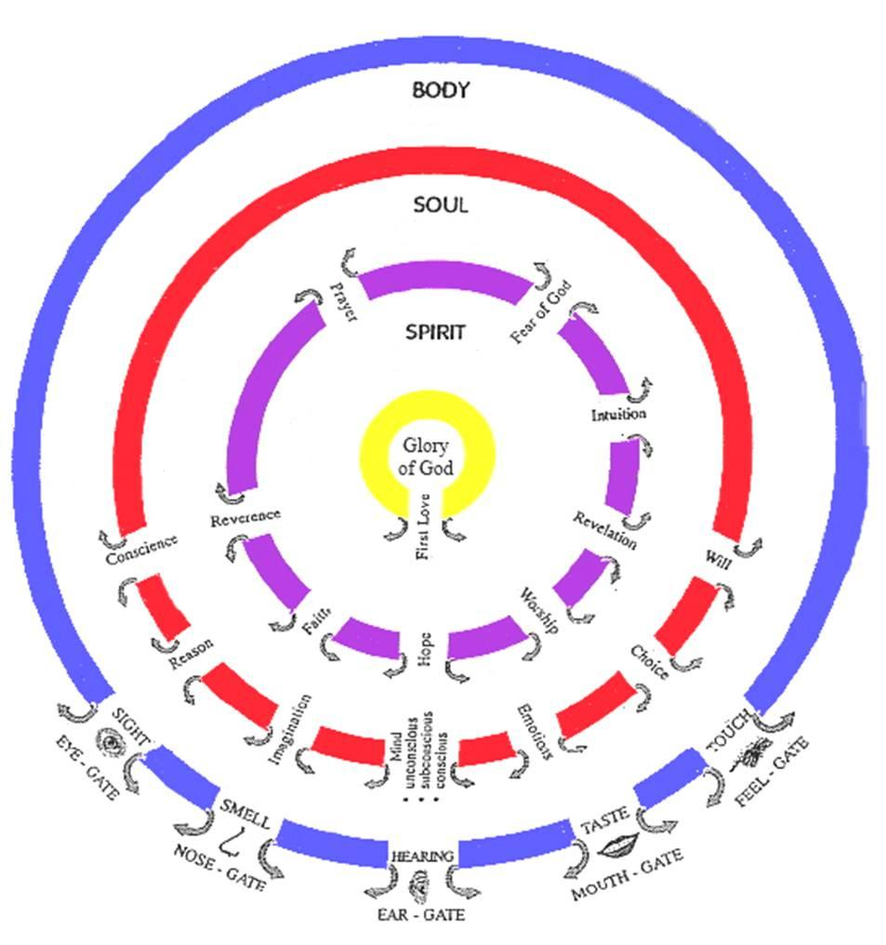

Slide 11
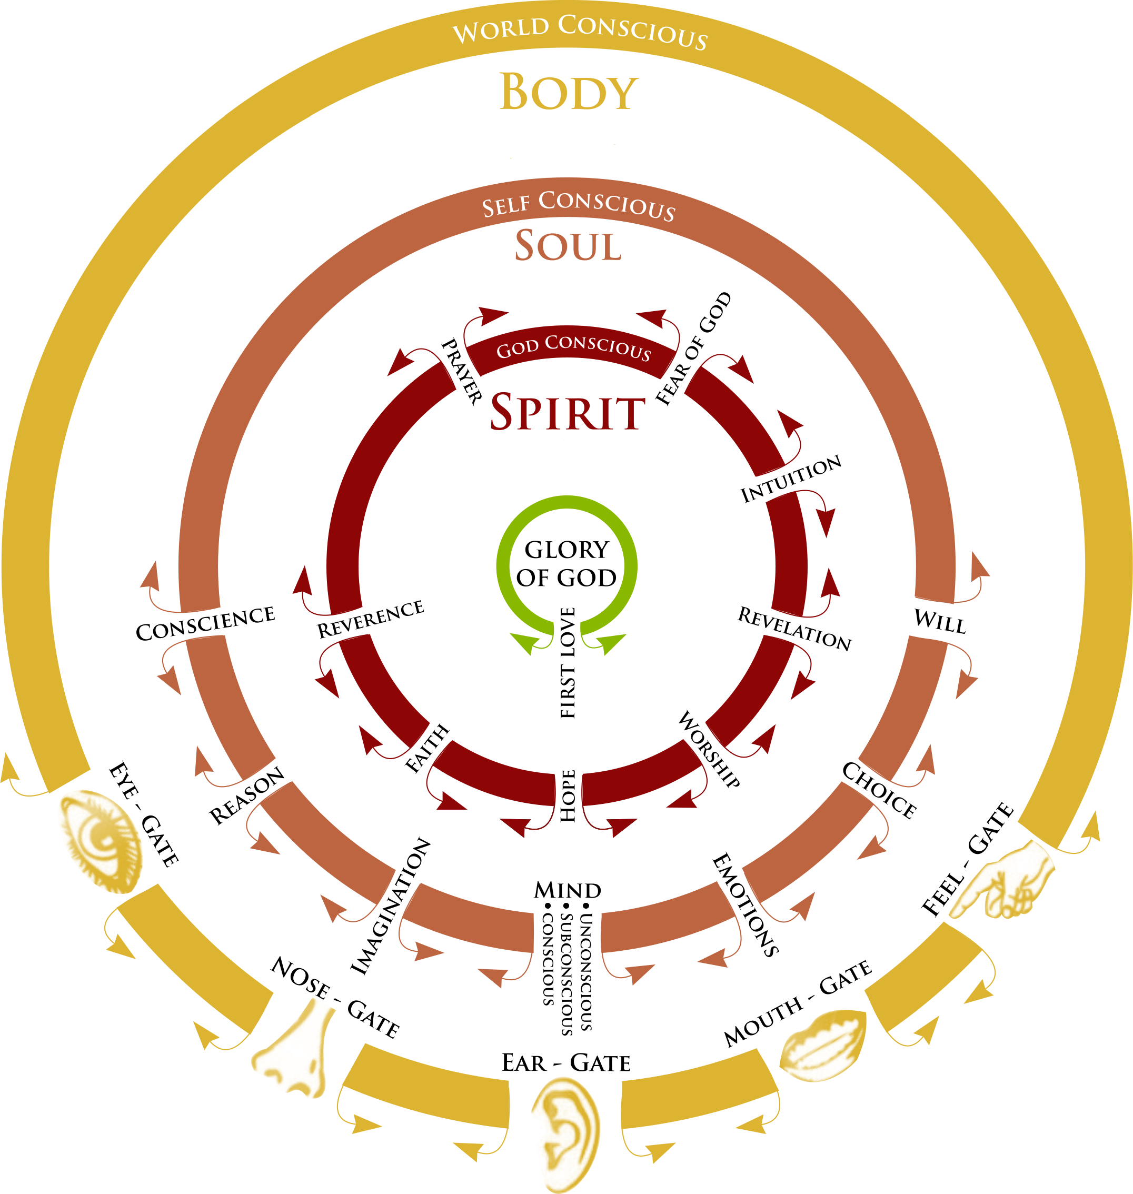

Slide 12
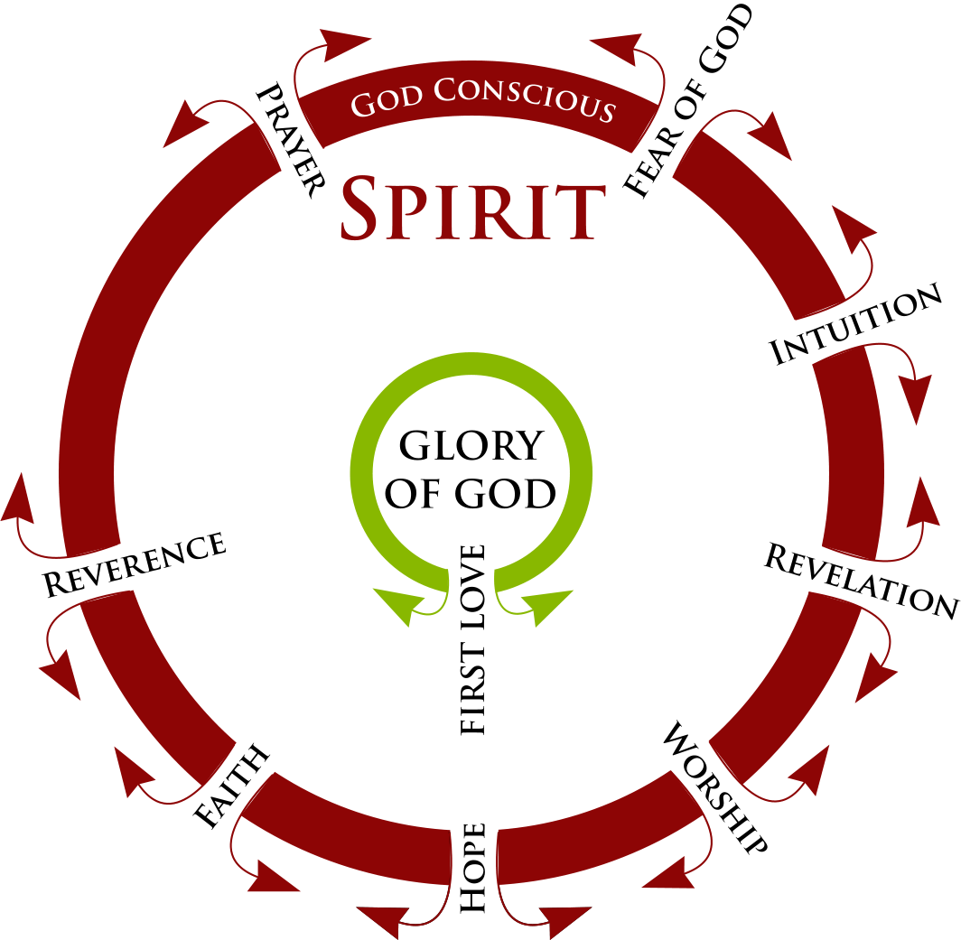

Slide 13
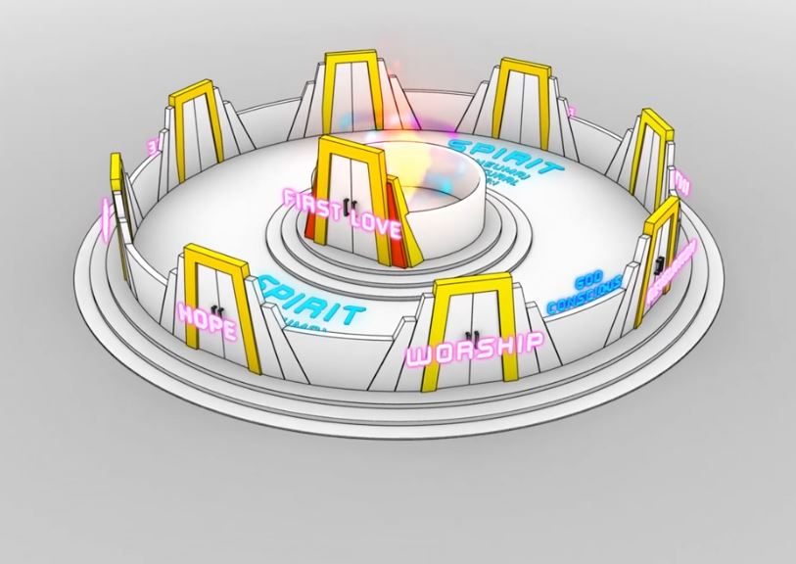
Gateway first love
Rev 3:20
River of Life

Slide 14
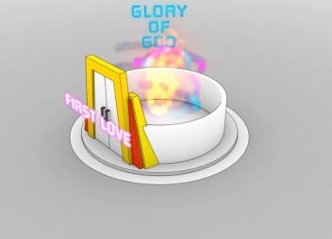
SPIRIT
Heaven
Gateway first love
Rev 3:20
Gateway first love Come up here
Rev 4:1
River of Life
River of Life
Pathway of Relationship

Slide 15
Jer 2:13"For My people have committed two evils: They have forsaken Me The fountain of living waters, To hew for themselves cisterns, Broken cisterns That can hold no water.
Deliverance
Signs & Wonders
SECURITY
MONEY
WORK
ACCEPTANCE
SIGNIFICANCE
Jesus Works
Greater Works
POWER
Manifest Presence of God GLORY
Relationships
LOVE
WORLD
PURPOSE
Miracles
Healing
THINGS
Supernatural Works
Hurt Pain Rejection Insecurity Fear Disappointment Guilt Shame
Body Flesh
Transfigured
Soul Heart Natural Needs
Damage
Transformation Restored, Renewed to the orginal
PURPOSE
Spirit DEAD TO GOD
Spirit Fountain Living Water
ACCEPTANCE
Born Again Resurrected
SECURITY
LOVE
SIGNIFICANCE

Slide 16
Heavenly Realm
Blockage
Spirit – Father/Son/Spirit
Glory of God is in us & through us
9 Spiritual Senses
Know God’s LOVE
Born Again Resurrected
Blockage
Feel God’s LOVE
Soul 7 Senses
Transformation Restored, Renewed to original state
Blockage
Deliverance
Signs & Wonders
Body - 5 Senses Manifest Presence of God
Jesus Works
Greater Works
Transfigured
Express God’s LOVE
Miracles
Healing
Supernatural Works

Slide 17
First Love House of God 1
First there must be reconciliation between our spirit and God
Then reconciliation between our spirit, soul and body and ultimately between us and creation
1 Cor 6:17 But the one who joins himself to the Lord is one spirit with Him.

Slide 18
First Love House of God 1
What is our spirit?
Where does our spirit come from?
What is our spirit made of?
Where is our spirit?
What does our spirit do?
How do we engage our spirit?

Slide 19
First Love House of God 1
1 John 5:5 This is the message we have heard from Him and announce to you, that God is Light,
John 4:24 God is spirit, and those who worship Him must worship in spirit and truth.”
God is spirit, God is light, God is love
We are spirit and our spirit is light – creative light

Slide 20
First Love House of God 1
Psa 139:13 For You formed my inward parts; You wove me in my mother’s womb. 16 Your eyes have seen my unformed substance And in Your book were all written The days that were ordained for me, When as yet there was not one of them. 17 How precious also are Your thoughts to me, O God! How vast is the sum of them!
We pre-existed in eternity as thoughts within the very heart or mind of God

Slide 21
First Love House of God 1
Our spirit is our eternal essence it came from eternity and will return to it
Pneuma, Ruach, spirit, wind, or breath
Our spirit entered our cells at conception
Our spirit is the centre of our being - our inner most being
Our spirit is the purest representation of our true self
Our spirit is not limited by time and space it is like the TARDIS bigger inside

Slide 22
First Love House of God 1
We are a spirit we have a soul that lives in a body (an earth suit)
We are a spirit being that is God and spirit realm conscious
We have a soul that is self conscious and that makes us a human being
Our spirit and soul together makes us a living being
We are in a process of restoration

Slide 23
First Love House of God 1
Adam’s spirit was on the outside of his body and as a light being he could travel in the spiritual realms
Psa 8:4 What is man that You take thought of him, And the son of man that You care for him? 5 Yet You have made him a little lower than God, And You crown him with glory and majesty! 6 You make him to rule over the works of Your hands; You have put all things under his feet

Slide 24
First Love House of God 1
I am a dwelling
What or who dwells in me?
Our spirit and soul dwell in our body
Our spirit is also a dwelling place
What dwells in our spirit?

Slide 25
First Love House of God 1
John 14:16 I will ask the Father, and He will give you another Helper,… 17 that is the Spirit of truth, .. He abides with you and will be in you.
John 14:20 In that day you will know that I am in My Father, and you in Me, and I in you. 23 … We will come to him and make Our home with him.
Our spirit is a dimensional place that God dwells in and can also dwell in God and the heavenly dimensions

Slide 26
First Love House of God 1
John 3:3 Jesus answered and said to him, “Truly, truly, I say to you, unless one is born again he cannot see the kingdom of God.”
Our spirit becomes alive to God and we our reconciled and reconnected to His presence
God then comes and dwells in us
Where does God dwell in our spirit?

Slide 27
First Love House of God 1
Luke 17:21 Nor will people say, Look! Here [it is]! or, See, [it is] there! For behold, the kingdom of God is within you [in your hearts] and among you [surrounding you].
Kingdom is the area where God dwells in us but He does not want to be imprisoned and limited there

Slide 28
First Love House of God 1
"The primary meaning of both the Hebrew word malkuth in the Old Testament and of the Greek word basileia in the New Testament is the rank, authority and sovereignty exercised by a king.
A basileia is a realm over which a sovereign exercises his authority

Slide 29
First Love House of God 1
Spirit realm is connected to you because heaven or God's kingdom is in you
Therefore you have access to God, to the heavenly spiritual realms and those realms have access to you and through you – if you allow
You are a gate to and of the heavenly spiritual realms and are a God channel

Slide 30
First Love House of God 1
You are a house of God who lives in you
Gen 28:12, 17 And he dreamed that there was a ladder set up on the earth, and the top of it reached to heaven; and the angels of God were ascending and descending on it! He was afraid and said, How to be feared and reverenced is this place! This is none other than the house of God, and this is the gateway to heaven

Slide 31
First Love House of God 1
John 14:2 In My Father’s house are many dwelling places; for I go to prepare you to be a dwelling place 3 If I go and prepare you to be a dwelling place, I will come again and receive you to Myself, that where I am, there you may be also.
My paraphrase

Slide 32
First Love House of God 1
John 14:10 Do you not believe that I am in the Father, and the Father is in Me? The words that I say to you I do not speak on My own initiative, but the Father abiding in Me does His works.

Slide 33
First Love House of God 1
John 14:20 In that day you will know that I am in My Father, and you in Me, and I in you. 23 Jesus answered and said to him, “If anyone loves Me, he will keep My word; and My Father will love him, and We will come to him and make Our home with him.

Slide 34
First Love House of God 1
1 Corinthians 3:16 Do you not know that you are a temple of God and that the Spirit of God dwells in you?
1 Corinthians 6:19 Or do you not know that your body is a temple of the Holy Spirit who is in you, whom you have from God, and that you are not your own?

Slide 35
First Love House of God 1
Ex 4:14 Now they may say to me, ‘What is His name?’ What shall I say to them?” 14 God said to Moses, “I AM WHO I AM”;
John 14:6 Jesus said to him, “I am the way, and the truth, and the life; no one comes to the Father but through Me.

Slide 36
First Love House of God 1
I am is in you
John 6:35, 48 I am the bread of life
John 8:12, 9:5 I am the light of the world
John 10:9 I am the door
John 10:11 I am the good shepherd

Slide 37
First Love House of God 1
John 11:25 I am the resurrection and the life
John 14:6 I am the way, the truth, and the life
John 15:1 I am the true vine
John 8:58 Before Abraham was, I am
Eternal I am is in our spirit

Slide 38
First Love House of God 1
0mnipresent, Omnipotent, Omniscient
All Present, All Powerful, All Knowing
We are in Him and He in us
Therefore we have access to:
Know anything
Do anything
Be anywhere in time and space and beyond

Slide 39
First Love House of God 1
Jesus said I am in My Father
Jesus is in you and you are in Him
The Father is in you and you are in the Father
Intimacy, relationship, oneness, wholeness
You are My beloved son in you I am well pleased.

Slide 40
First Love House of God 1
What does it feel like to embrace God?
What does it feel like to be embraced by God?
Embracing God's presence is holistic – our spirit, soul and body need to be involved

Slide 41
First Love House of God 1
Engaging in the physical or natural realm can activate the spiritual
Physical actions can be faith steps as faith without works is dead
Raise our hands, kneel or lie down physical expression of spiritual reality
Hugging or embracing ourselves is faith step

Slide 42
First Love House of God 1
Revelation 3:20 Behold, I stand at the door and knock; if anyone hears My voice and opens the door, I will come in to him and will dine with him, and he with Me.
This is the access point to the Pathway of relationship
We can give God this daily invitation to fill us and flow through us

Slide 43
First Love House of God 1
Psa 24:7 Lift up your heads, O gates, And be lifted up, O ancient doors, That the King of glory may come in!

Slide 44
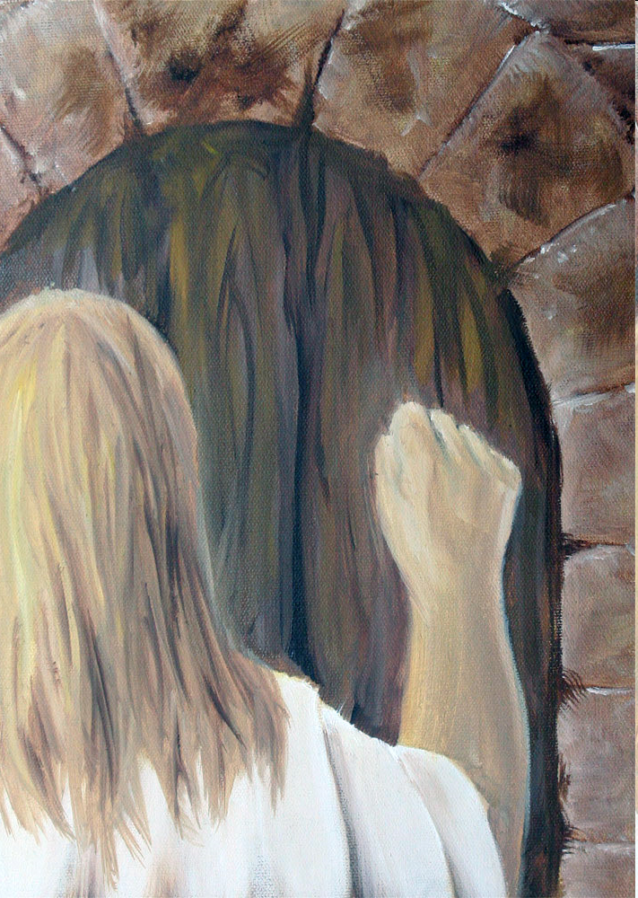

Slide 45
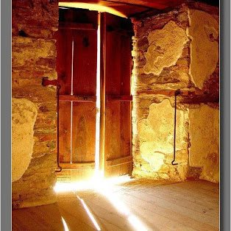

Slide 48
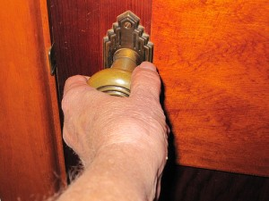
First Love House of God 1

Slide 50
