Slide 1
Engaging God
We are on a journey or an adventure together discovering how to engage the spiritual realms
Discovering the realms within us, around us and the heavenly realms
We are going to follow the pathway of relationship and responsibility

Slide 2
House of God
First Love
JOURNEY MAPS
First Love
Engaging our spirit
River of Life
Seat of
Government
Yoke of Jesus

Slide 3
Engaging God First Love 3
Why first love?
What is first love?
Why is first love so important?
Our eternal destiny and destination is at stake on the basis of experiencing the answer to those questions

Slide 4
First Love
Identity
Intimacy
Transformation
First Love

Slide 5
Engaging God First Love 3
The power of first love is God’s grace His supernatural ability to heal us, restore us, make us whole
The power to set us free from all bondages, blockages, prisons of our souls - minds, emotions and wills
The power to transform us into our true image - sonship

Slide 6
Engaging God First Love 3
True first love with Love Himself is where we find:
Who am I?
My identity is found in His love
Why am I here?
My Value, Worth, Esteem are found in His acceptance

Slide 7
Engaging God First Love 3
What is my purpose?
My significance, redemptive gift and restorative assignments are found in relationship with Him
Where do l come from?
My Eternal Destiny is found in Him
All found in an intimate love relationship with First Love

Slide 8
Engaging God First Love 3
God is love, God is spirit, God is light
Love carries a vibrational frequency of the spirit as wavelengths of light.
We can experience the presence or the frequency of love and become like it through resonance
We can be embraced by love and it can change and transform us

Slide 9
Engaging God First Love 3
We can then be a channel for that love frequency to vibrate and engage others
John 13:35 It is by your love for one another that others will know that you are My disciples
We can only radiate what we have received through our personal experience – get up close and intimate

Slide 10
Engaging God First Love 3
Cardiogenesis
Development of the embryonic heart formed from the genetic record of our earthly parents
We can undergo a new cardiogenesis with a new but eternal record from our heavenly Father
We need to get heart to heart deep to deep with Him

Slide 11
Engaging God First Love 3
Psa 84:5 How blessed is the man whose strength is in You, In whose heart are the highways to Zion!
Ancient paths of life flowing in and through us
Prov 23:7 as he thinks within himself (In His heart), so he is.

Slide 12
Engaging God First Love 3
Our heart radiates 10 x more powerful electromagnetic fields than our brain
Electromagnetic frequency can be detected 12 inches from our brain but 10 feet from our heart
What sort of atmosphere are we radiating?
We can engage God and embrace the transformational frequency His heart

Slide 13
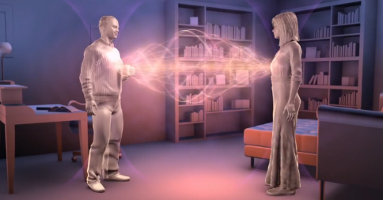
Engaging God First Love 3

Slide 14
Engaging God First Love 3
Emotional information is actually coded and modulated into these energy fields.
By learning to flow from our spirits, we can change the information coded in the magnetic fields that are radiated by our hearts, and that can impact those around us.

Slide 15
Engaging God First Love 3
We can be intimately connected to the heart and mind of God
From the vibrational frequency of God’s love we can vibrate love
We can be connected with each other and the planet itself because we are connected to God
We all are frequencies

Slide 16
Engaging God First Love 3
Rev 3:20 Behold, I stand at the door and knock; if anyone hears My voice and opens the door, I will come in to him and will dine with him, and he with Me.
Rev 3:19 Those whom I love, I reprove and discipline; therefore be zealous and repent.

Slide 17
Engaging God First Love 3
Rev 3:21 He who overcomes, I will grant to him to sit down with Me on My throne, as I also overcame and sat down with My Father on His throne.
Love = reproof and discipline – oh no
Don’t equate discipline with punishment
Discipline is training, conformation and transformation

Slide 18
Engaging God First Love 3
Repenting - negative or positive?
Zealous passionate about it how, why?
Repentance means to change our mind to turn
To turn and follow Him into relationship and transformation into His image that His love brings

Slide 19
Engaging God First Love 3
Embracing His loving discipline and correction because transformation is the preparation for deeper intimacy
It creates the desire for intimacy that helps us to choose to daily open the first love gate and engage First Love
Reward of intimacy is rulership we overcome and rule on thrones

Slide 20
Engaging God First Love 3
God’s first love is like nothing we have truly experienced in our human relationships.
In fact human first love probably caused us rejection, emotional damage, pain, created our insecurities, fears and our trust issues.

Slide 21
Engaging God First Love 3
Rom 8:35 Who will separate us from the love of Christ? Will tribulation, or distress, or persecution, or famine, or nakedness, or peril, or sword?
Rom 8:39 nor height, nor depth, nor any other created thing, will be able to separate us from the love of God, which is in Christ Jesus our Lord.

Slide 22
Engaging God First Love 3
Rom 8:37 But in all these things we overwhelmingly conquer through Him who loved us.
This is the truth but are we experiencing and living this truth?
Do we really know that we are more than conquerors because of His love?

Slide 23
Engaging God First Love 3
Are there things that have and still are continuing to separate us from experiencing who God always is – LOVE?
John 10:10 The thief comes only to steal and kill and destroy; I came that they may have life, and have it abundantly.

Slide 24
Engaging God First Love 3
First love releases destiny
Damaged love blocks destiny
When some people try to open their first love gates they can appear blocked
These blockages are projections of the soul because of fear of hurt, pain and rejection

Slide 25
Engaging God First Love 3
Door can appear to be locked shut,
Our souls try to block to protect us through because of it’s belief systems and behaviour patterns
Hurts, pains and rejection of parents, friends and first love relationships set up these defence mechanisms

Slide 26
Engaging God First Love 3
Blockages can be seen as images - nailed, barred, brambles over it that stop us opening our first love gate
Souls protection mechanism is a projection that creates fear, apprehension because of our:
Our past experiences of love
Hurt, pain, rejection, fear, mistrust

Slide 27
Jer 2:13 For My people have committed two evils: They have forsaken Me The fountain of living waters, To hew for themselves cisterns, Broken cisterns That can hold no water.
MONEY
WORK
SECURITY
ACCEPTANCE
SIGNIFICANCE
POWER
Relationships
Manifest
Presence of God
GLORY
LOVE
WORLD
PURPOSE
THINGS
Hurt Pain
Rejection
Insecurity
Fear
Disappointment
Guilt
Shame
Body
Flesh
Transfigured
Soul
Heart
Natural Needs
Damage
Transformation
Restored, Renewed
to the orginal
PURPOSE
Spirit
Fountain Living
Water
Spirit
DEAD TO GOD
ACCEPTANCE
Born Again
Resurrected
SECURITY
LOVE
SIGNIFICANCE

Slide 28

ADDICTION
REJECTION
DEPRESSION
ANGER
SICKNESS
FEAR
INSECURITY
LOW ESTEEM
ANXIETY
WORRY
?
?
?
?
?
?
?
?
?
?

Slide 29
Engaging God First Love 3
What are you still connected or chained to?
What experiences?
What memories?
What emotions?
What hurts, pains, rejections betrayals
Unforgiveness is a yoke that keeps us tied to our past

Slide 30
Engaging God First Love 3
Rejected, Abandoned, Betrayed, Disappointed, Hurt, Let down, Abused
All of us have had those experiences but are we still yoked to them?
Isa 58:6 Is this not the fast which I choose, To loosen the bonds of wickedness, To undo the bands of the yoke, And to let the oppressed go free And break every yoke?

Slide 31
Engaging God First Love 3
Isa 61:1 The Spirit of the Lord God is upon me, Because the Lord has anointed me To bring good news to the afflicted; He has sent me to bind up the brokenhearted, To proclaim liberty to captives And freedom to prisoners;2 To proclaim the favourable year of the Lord (cancelled debts)

Slide 32
Engaging God First Love 3
Isa 61:4 Then they will rebuild the ancient ruins, They will raise up the former devastations; And they will repair the ruined cities, The desolations of many generations.
How can our lives be restored?
By embracing the transforming power of First Love - forgiveness

Slide 33
Engaging God First Love 3
Forgive and release and be free
Wounds caused by fathers, mothers, friends, lovers can be healed
Heart of stone replaced and renewed
Heart can be restored made whole
Our hearts can receive forgiveness and then release forgiveness to be free

Slide 34
Heart
Heart
Soil of Insecurity
Resulting from lack of: love, acceptance, affirmation, appreciation, affection, encouragement – identity

Slide 35
Seed of offence
Emotions
Heart
Soil of Insecurity
Resulting from: what others said or didn’t say; what others did or didn’t do - sin

Slide 36

Seed of offence
Roots of Bitterness
Heart
Soil of Insecurity
Will
Sub-conscious
Mind
Resulting from your responses: what you think; what you feel – attitudes, emotions - Anger

Slide 37
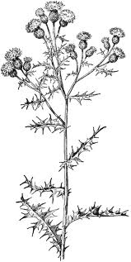
Seed of offence
Fruit of Resentment
Choices
Reason
Filters
Roots of Bitterness
Heart
Soil of Insecurity
Resulting from your behaviour: what you say; what you do

Slide 38
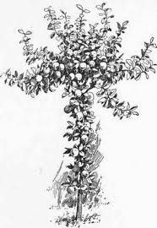
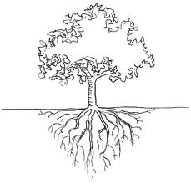
Fruit of Righteousness
Seed of offence
Fruit of Resentment
Forgive & Release
Renounce
Roots of Bitterness
Heart
Soil of Insecurity
Heart
Soil of Security
Repent
Revelation True Identity

Slide 39
Engaging God First Love 3
We are owed by those who have hurt us
There may be invoices outstanding
We must settle the accounts
What they did or did not do – choose to forgive them
How has it affected your life - how you think, feel and behave

Slide 40
Engaging God First Love 3
Make an invoice of those memories that come to mind
Remove the offense by choosing to forgive them
Cancel the debt by to choosing to release them
Then allow God’s love to heal you break your chains and remove the wounds and scars on your heart

Slide 41
Engaging God First Love 3
Forgive, release and be free
Break the chains to the person, memory or the to the pain
We then are no longer tied and chained to our past
The wounds can be healed
God’s love that vibrating frequency will bring us restoration as we resonate with it

Slide 42
Engaging God First Love 3
Psa 139:23 Search me thoroughly , O God, and know my heart; Try me and know my anxious thoughts; 24 And see if there be any hurtful way in me, And lead me in the everlasting way.
Heart, Thoughts, Ways

Slide 43
Engaging God First Love 3
Inviting God to access us
Every thought, every emotion every memory, every experience
To penetrate the deepest recesses of our lives
To engage every fibre of our being
Let the barriers down

Slide 44
Engaging God First Love 3
Choose open ourselves to God
Choose to embrace first love
Choose to give ourselves to Him
Choose to surrender the past
Choose to receive His healing love
Choose to forgive release and be made whole

Slide 45
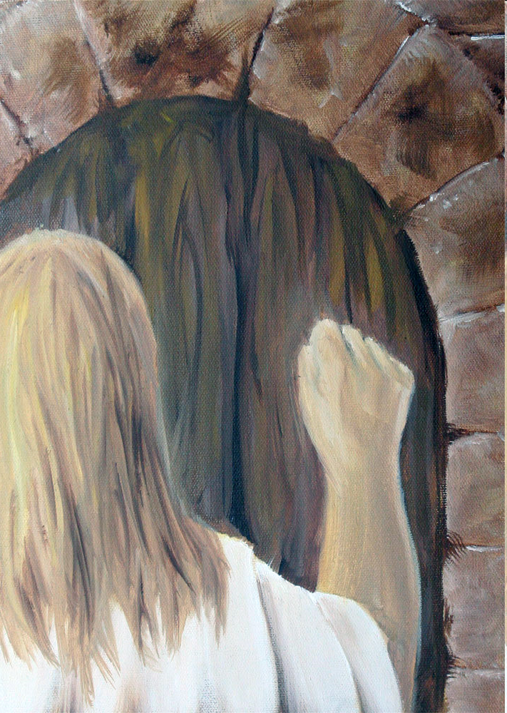

Slide 46



Slide 48
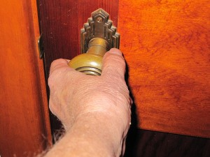
First Love House of God 1

Slide 49


Slide 50
Engaging God First Love 3
Receive Him as love personified
Feel the security, power and strength of His love
Feel His unconditional love for you
Feel the fire of His love burn in you
Feel His love embrace you hold you safe in His arms of love
Feel your heart melt in His embrace

Slide 51
Engaging God First Love 3
I stand in the light of your truth
Show me the seeds of offense & sin that have taken root in my heart
I commit myself to forgiving & release all offenses in my life & my generational line

Slide 52
Engaging God First Love 3
Choose to forgive each seed for each person or memory that comes to your mind
Choose to release the person for each debt outstanding and for each effect influencing your life
Choose to cancel each debt

Slide 53
Engaging God First Love 3
Show me all roots of bitterness that have grown in my heart
I commit myself to a lifestyle of repentance against all negative roots
I repent of all negative emotions and attitudes rooted in my heart

Slide 54
Engaging God First Love 3
Show me all fruits of resentment that have developed in my behaviour
I commit myself to a lifestyle of renunciation against all negative behaviours
I renounce all my defence & coping mechanisms
I renounce my sin as a way of life

Slide 55
Engaging God First Love 3
Give me revelation of my true identity as a son of God
Give me a heart secure in my identity
Renew my mind to the mind of Christ
Let all my unmet needs be met in Your love
Heal all my unhealed hurts
Restore my soul

Slide 56
Engaging God First Love 3
I receive your unconditional love, acceptance, affirmation, approval
I stand transparent naked and unafraid before you
I hear you say I see you and I love you
I receive your value, esteem and worth

Slide 57
Engaging God First Love 3
I choose to live a lifestyle of forgiveness, repentance & renunciation
I choose to walk in an intimate love relationship with You
Manifest your glory through me on earth as it is in heaven so I will fulfil my eternal destiny

Slide 58
Engaging God First Love 3
Listen to Him as He unveils the hidden mysteries of your destiny
Let Him reveal how special you are to Him
Let Him show you your true identity
Let Him show you your true purpose
Let what was transform what is to release what will be
Feel His love burning in your heart

Slide 59
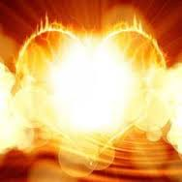

Slide 60
Engaging God First Love

Slide 61
Engaging God First Love

Slide 62
Engaging God First Love
Arc agreement of 2 produces manifest presence and anointing agreement 3 produces government Matt 18
Interaction Holy Spirit and Father Holy Spirit and Jesus Jesus and the Father
Yoke Jesus why heavy laden weary ox and Rabi walk like Him 1 John 4

Slide 63
Engaging God First Love
seat of Government and rest Trust for provision protection purpose acceptance affirmation approval affection appreciation. Zech 3:6 7 government

Slide 64
Engaging God First Love
Arc agreement of 2 produces manifest presence and anointing agreement 3 produces government Matt 18
Interaction Holy Spirit and Father Holy Spirit and Jesus Jesus and the Father
Yoke Jesus why heavy laden weary ox and Rabi walk like Him 1 John 4

Slide 65
Engaging God First Love
seat of Government and rest Trust for provision protection purpose acceptance affirmation approval affection appreciation. Zech 3:6 7 government

Slide 66
Engaging God First Love

Slide 67
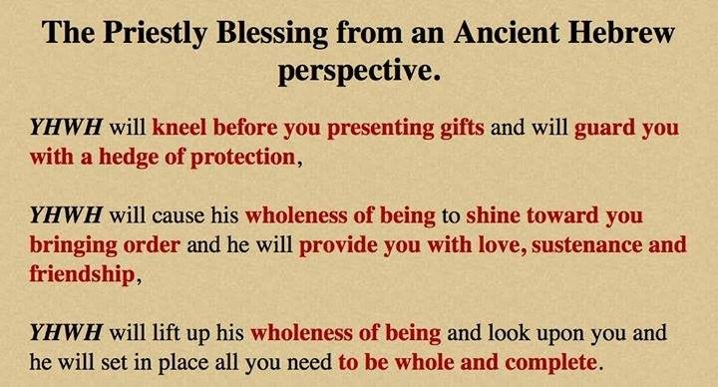
Engaging God First Love

Slide 68
Engaging God First Love
Holy Spirit enthroned lead direct to walk in His ways direction and resources Lordship led by spirit Servant gratitude for amazing salvation but also by choice bond servant

Slide 69
Engaging God First Love
Jesus Lord and king steward resources ministry trusted most often biggest test will I get my ientity from what I do or from who I am in relationship will I get caught up in working for l lose my first love and enter duty cycle fear cycle
Friendship joint heir reveals ways heart revelation invested heavenly authority.

Slide 70
Engaging God First Love
Bench of 3 in us government kingdom of God Must reflect and come from heaven Matt 5 your kingdom Come on earth as it is in heaven. My agreement within 3+1=4 opens window doorway to responsibility Lord king Son heavenly order Melchizedek.

Slide 71
Engaging God First Love
Matthew 18:3-4 and said, "Truly I say to you, unless you are converted and become like children, you will not enter the kingdom of heaven. Whoever then humbles himself as this child, he is the greatest in the kingdom of heaven.
Matthew 18:19-20 "Again I say to you, that if two of you agree on earth about anything that they may ask, it shall be done for them by My Father who is in heaven. For where two or three have gathered together in My name, I am there in their midst."

Slide 72
Engaging God First Love
First love what we freely receive we freely give
God is first love that is His person His purpose His plan His priority and His methodology and motivation
God is love and every thing He does is both fully loving and fully expresses Himself
Love is the highest frequency of vibrating energy that exists. Love is the fastest speed of light Love is the greatest source of potential energy
Have we experienced and encountered God is love
Do we know love
Do we resonate with Ioves frequency

Slide 73
Engaging God First Love
Have we been transformed and realigned by love
Are we filled with love
Is everything we think say and do motivated by love?
Does love flow in us and through us and around us
Are we receivers and channels of love therefore of God?
Love is the manifold wisdom and grace of God personified in Jesus and fully expressed on the cross

Slide 74
Engaging God First Love
This is first love that He loves us with all His heart mind strength and being
This is our first love that we love Him with all our spirit soul body
This is first love that He loves us with all His heart mind strength and being Sacrifice Once for all time He embraced cross once
This is our first love that we love Him with all our spirit soul body living sacrifice daily we pickup the cross daily denying ourselves.

Slide 75
Engaging God First Love
Holy Spirit enthroned lead direct to walk in His ways direction and resources Lordship led by spirit Servant gratitude for amazing salvation but also by choice bond servant

Slide 76
Engaging God First Love
Jesus Lord and king steward resources ministry trusted most often biggest test will I get my ldentity from what I do or from who I am in relationship will I get caught up in working for l lose my first love and enter duty cycle fear cycle
Friendship joint heir reveals ways heart revelation invested heavenly authority.

Slide 77
Engaging God First Love
Bench of 3 in us government kingdom of God Must reflect and come from heaven Matt 5 your kingdom Come on earth as it is in heaven. My agreement within 3+1=4 opens window doorway to responsibility Lord king Son heavenly order Melchizedek.

Slide 78
Engaging God First Love
Matthew 18:3-4 and said, "Truly I say to you, unless you are converted and become like children, you will not enter the kingdom of heaven. Whoever then humbles himself as this child, he is the greatest in the kingdom of heaven.
Matthew 18:19-20 "Again I say to you, that if two of you agree on earth about anything that they may ask, it shall be done for them by My Father who is in heaven. For where two or three have gathered together in My name, I am there in their midst."

Slide 79
Engaging God First Love
First love what we freely receive we freely give
God is first love that is His person His purpose His plan His priority and His methodology and motivation
God is love and every thing He does is both fully loving and fully expresses Himself
Love is the highest frequency of vibrating energy that exists. Love is the fastest speed of light Love is the greatest source of potential energy
Have we experienced and encountered God is love
Do we know love
Do we resonate with Ioves frequency

Slide 80
Engaging God First Love 2
Rev 3:19 Those whom I love, I reprove and discipline; therefore be zealous and repent. 20 Behold, I stand at the door and knock; if anyone hears My voice and opens the door, I will come in to him and will dine with him, and he with Me. 21 He who overcomes, I will grant to him to sit down with Me on My throne, as I also overcame and sat down with My Father on His throne.

Slide 81
Engaging God First Love 2
Love = reproof and discipline – oh no
Don’t equate discipline with punishment
Passionate to turn and follow Him into relationship and transformation into His image
Preparation for intimacy
Desire for intimacy
Reward of intimacy rulership

Slide 82
Engaging God First Love
Have we been transformed and realigned by love
Are we filled with love
Is everything we think say and do motivated by love?
Does love flow in us and through us and around us
Are we receivers and channels of love therefore of God?
Love is the manifold wisdom and grace of God personified in Jesus and fully expressed on the cross

Slide 83
Engaging God First Love
This is first love that He loves us with all His heart mind strength and being
This is our first love that we love Him with all our spirit soul body
This is first love that He loves us with all His heart mind strength and being Sacrifice Once for all time He embraced cross once
This is our first love that we love Him with all our spirit soul body living sacrifice daily we pickup the cross daily denying ourselves.

Slide 84
Engaging God First Love

Slide 85
Engaging God First Love
Luke 10:And he answered, “You shall love the Lord your God with all your heart, and with all your soul, and with all your strength, and with all your mind; and your neighbour as yourself.”
1 Cor 6:17 But the one who joins himself to the Lord is one spirit with Him.

Slide 86
Engaging God First Love
Behold and become close contact heart to heart cardio genesis transformed reordered. My spirit must be like heaven So My heart can be subdued and tended and cultivated to be like Eden. All starts with first love. I can be the representation of the 4 faces of God on earth as it is in heaven. Embrace 1st love.

Slide 87
Engaging God First Love
Psa 139:16 Your eyes have seen my unformed substance; And in Your book were all written The days that were ordained for me, When as yet there was not one of them.17 How precious also are Your thoughts to me, O God! How vast is the sum of them!

Slide 88
Engaging God First Love
2 Cor 3:18 But we all, with unveiled face, beholding as in a mirror the glory of the Lord, are being transformed into the same image from glory to glory, just as from the Lord, the Spirit.
Heb 12:2 fixing our eyes on Jesus, the author and perfecter of our faith

Slide 89
Engaging God First Love
God is letting us experience who He is intrinsically
Father Son Spirit and their wonderful interaction

Slide 90
Engaging God First Love

Slide 91
Engaging God First Love
Revelation 3:20 Behold, I stand at the door and knock; if anyone hears My voice and opens the door, I will come in to him and will dine with him, and he with Me.
You must give a daily invitation to fill you and flow through you
This is the access point to the Pathway of relationship

Slide 93
Engaging God First Love
Revelation 4:1-2 After these things I looked, and behold, a door standing open in heaven, and the first voice which I had heard, like the sound of a trumpet speaking with me, said, "Come up here, and I will show you what must take place after these things."
You have to accept the invitation
This begins the pathway of responsibility

Slide 94
Engaging God First Love
Born into darkness
To see the light
To reflect the light
To walk in the light
To become a light beings
Matt 5:16 Let your light shine before men in such a way that they may see your good works, and glorify your Father who is in heaven.

Slide 95
Engaging God First Love
What is our spirit?
Where does our spirit come from?
What is our spirit made of?
Where is our spirit?
What does our spirit do?
How do we engage our spirit?

Slide 96
Engaging God First Love
1 John 5:5 This is the message we have heard from Him and announce to you, that God is Light,
John 4:24 God is spirit, and those who worship Him must worship in spirit and truth.”
God is spirit God is light
We are spirit and our spirit is light

Slide 97
Engaging God First Love
We pre-existed in eternity as thoughts within the heart or mind of God
Psa 139:13 For You formed my inward parts; You wove me in my mother’s womb.
16 Your eyes have seen my unformed substance And in Your book were all written The days that were ordained for me, When as yet there was not one of them.

Slide 98
Engaging God First Love
Our spirit is our eternal essence it came from eternity and will return to it
Pneuma, Ruach spirit (Spirit), wind, or breath Our spirit entered our cells at conception
Our spirit is the centre of our being - our inner most being
Our spirit is the purest representation of our true self
Our spirit is not limited by time and space TARDIS

Slide 99
Engaging God First Love
Red blood cells contain no DNA no nucleus carry oxygen breath to the brain
The life is in the blood, red cells breath
This can be programmed by the spirit
White blood cells contain record of 22 + 22 autosomes generational genetic programming & 1+1 chromosomes
Our DNA can be epigenetically re-sequenced by frequency, light, sound also by trauma and nurture

Slide 100
Engaging God First Love
Our spirit is a dimensional place that God dwells in and can dwell in God
John 14:16 I will ask the Father, and He will give you another Helper,… 17 that is the Spirit of truth, .. He abides with you and will be in you.
John 14:20 In that day you will know that I am in My Father, and you in Me, and I in you. 23 … We will come to him and make Our abode with him.

Slide 101
Engaging God First Love
We are a spirit we have a soul that lives in a body (an earth suit)
We are spirit the eternal essence of God within that receives spiritual revelation.
We are a spirit being that is God conscious
We have a soul that is self conscious and makes us a human being
Our spirit and soul makes us a living being

Slide 102
Engaging God First Love
In Adam the spirit was outside the body and as a light being he could travel in the spiritual realms
Psa 8:4 What is man that You take thought of him, And the son of man that You care for him? 5 Yet You have made him a little lower than God, And You crown him with glory and majesty! 6 You make him to rule over the works of Your hands; You have put all things under his feet

Slide 103
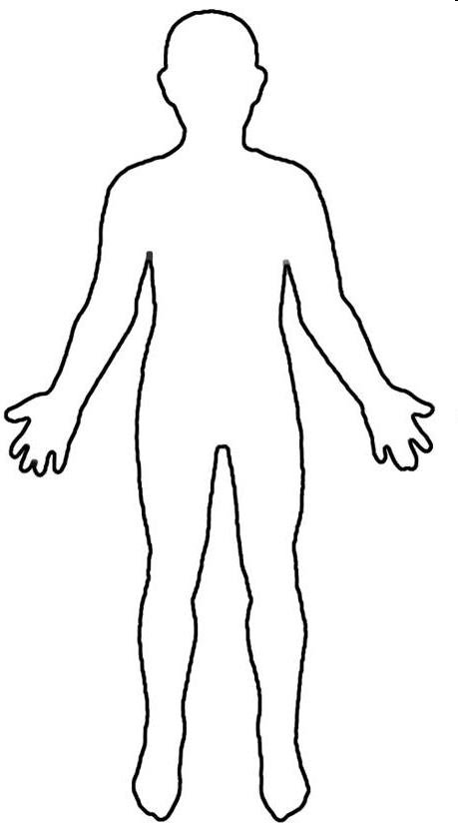

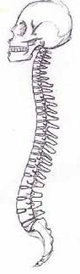


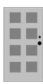
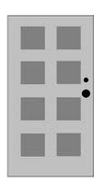

Conscious
Mind
Spirit
Father
Son
Holy
Spirit
Heart
Subconscious Mind
Garden
Scroll
Kingdom
within us
First Love Gate
Rivers
Power
Anointing
Seat of Government

Slide 104
Source
Blockages
Intimacy
Further Info 1
Further Info 2
River of Life

Slide 105
Source
Blockages
Intimacy
Further Info 1
Further Info 2
Yoke of Jesus

Slide 106
Source
Blockages
Intimacy
Further Info 1
Further Info 2
Seat of rest and government

Slide 107
Engaging God First Love
Separate First Love module
Relationship with SSF distinct personalities
River of life engagement
Sonship Fatherhood
Baptised into spirit Jesus Father (Burning ones exercise) clothed with SSF deeper
waterfall river pool

Slide 108
Engaging God First Love
Our Spirit is given life by God’s spirit the breath of life
Our spirit receives God’s light and becomes light
Light of truth eyes are opened
Drink Living water and receive a fountain
Our spirit becomes a House for God’s presence

Slide 112
First Love House of God 1

Slide 115
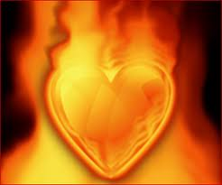

Slide 116
Engaging God First Love
Feel the power and strength of His love
Feel His fire burn in you
Express your love to Him
Express your love for Him

Slide 117
Engaging God First Love
The Centre of Our Being - the residing place of the promise of God, centred inside our spirit.
The Human Spirit
The Human Soul
The Human Body

Slide 118
Engaging God First Love
Luke 17:21 Nor will people say, Look! Here [it is]! or, See, [it is] there! For behold, the kingdom of God is within you [in your hearts] and among you [surrounding you].
Spirit realm is connected to you because heaven or God's kingdom is in you
Therefore you have access to God heavenly spiritual realm and God has access to you. You are a gate of the spiritual realm heaven and God Channel

Slide 119
Engaging God First Love
Psalms 46:4 There is a river whose streams make glad the city of God, The holy dwelling places of the Most High.5 God is in the midst of her, she will not be moved; God will help her when morning dawns. 6 The nations made an uproar, the kingdoms tottered; He raised His voice, the earth melted. 7 The Lord of hosts is with us; The God of Jacob is our stronghold.

Slide 120
Engaging God First Love
River of life living water life of the Holy Spirit Drink it step into it Ezek 47 flow deeper ankle knee waste out of depth. walking in the Spirit led by Spirit filled with the Spirit. Spirit flowing like rivers of living water. 1 Cor 6:17 joined to Lord intimate yoked become or spirit. 1 Cor 2 revelation from the Spirit. Open channel to the Increasing flow produce life around us.
Experience Righteousness Peace and Joy in the Spirit.

Slide 121
Engaging God First Love
Romans 14:17 for the kingdom of God is not eating and drinking, but righteousness and peace and joy in the Holy Spirit.
John 4 John 7 Source joy strength peace help parakletos John 15 16 Power Acts 1:8 clothed with power. 1 Cor 12 and 14 gifts charismata. Hovering vibrating energy vibrancy abundance of life. Creativity inspiration revelation
Psalm 23 surely goodness and lovingkindness mercy follow me.

Slide 122
Engaging God First Love
Flow In us and through us come upon us to anoint us equip us for service to engage us in relationship John reveals Jesus who reveals Father to us.
River is swirling with grace and faith when Mixed in the word hope expectation produces the charge of anointing words vibrating with power. heat vibration electricity light oil fragrance. laughter joy drunkenness intoxication. Peace shalom wholeness rest trance ecstacy baptised immersed and filled.

Slide 123
Engaging God First Love
River of living water drink it wash in it be clothed by it channel it focus flow like hydroelectric power. why water 68% body cells die without it quickly flows washes cleanses passes vibrations frequencies focused power. Flowed from heaven Genesis water garden to water world.

Slide 124
Engaging God First Love
Door gate portal entrance access opening. Closed or locked it is a barrier a blockage stops access stops flow stops Connection etc. Gates transactions commerce decisions post slaves chose bond servants elders met defended guarded protected exchange East gate Source Northgate trouble.
Yoked joined become one flowing together in resonant harmony.

Slide 125
Engaging God First Love
You are a mountain
You are a place of authority
God dwells in a mountain Ezek 28
Pillar engages heaven

Slide 126
Engaging God First Love
Rev 2:19 But I have this against you, that you have left your first love
Rev 3: 20 Behold, I stand at the door and knock; if anyone hears My voice and opens the door, I will come in to him and will dine with him, and he with Me.

Slide 127
Engaging God First Love
We can embrace and experience God within – Holy Spirit, Jesus & Father as distinct personalities
We can choose to do that as we have a promise if you draw near

Slide 128
Engaging God First Love
The altar experience alters us
It must be a proactive response a choice to surrender
A choice to present ourselves as an offering

Slide 129
Engaging God First Love

Slide 130
Engaging God First Love

Slide 131
Engaging God First Love
Luke 17:21For behold, the kingdom of God is within you [in your hearts] and among you [surrounding you].

Slide 132
Engaging God First Love
kingdom is within me and Isa 9 there is no end to the increase of His government (kingdom) and peace shalom, wholeness it must Increase expand grow in me and through me and around me.
Isaiah 9:7 There will be no end to the increase of His government or of peace, On the throne of David and over his kingdom, To establish it and to uphold it with justice and righteousness From then on and forevermore. The zeal of the Lord of hosts will accomplish this.

Slide 133
Engaging God First Love
Liquid light- interspatial matrix interface my spirit

Slide 134
Engaging God First Love
Holy spirit Living water my source My well My fountain My spring My stream my river my insight my revelation My direction my guidance my abundant life my heavenly flow my heavenly Connection my filling my Overflowing my creativity my zero point energy my joy my Extravagance my exuberance my effulgence my eternal life source.

Slide 135
Engaging God First Love
Jesus my friend my brother my lover my Lord my king my model my example my Rabi my master my disciples my Word my Way my Truth my Life my door my Shepherd my Resurrection my light my Saviour my High Priest my advocate my interceder my yoke my song my Jesus

Slide 136
Engaging God First Love
Father my creator my sustainer my essence my rest my shalom my affirmer my accepter My peace My love My provider my protector my healer my sanctifier my righteousness my banner My victory my security my identity my anchor my hope my delight my purpose my glorifier my rock my restorer my reconciler my transformer my transfigurer My renewer my conformer my forgiver my strength my authority my power my eternal destination my eternal home my reference point. My Father

Slide 137
Engaging God First Love
God My Consuming fire My frequency My harmony My resonance My Manifold grace my Manifold wisdom My Melody My Rhythm My metronome My conductor My author My producer My composer Yod Hei Vav Hei My Lion My Ox My Eagle My Man My King my Prophet My Apostle My Priest My Home My dwelling place My covenant My all in all

Slide 138
Engaging God First Love
John 14:16-17 I will ask the Father, and He will give you another Helper, that He may be with you forever; that is the Spirit of truth, whom the world cannot receive, because it does not see Him or know Him, but you know Him because He abides with you and will be in you.

Slide 139
Engaging God First Love
John 14:20, 23, 25-26 In that day you will know that I am in My Father, and you in Me, and I in you. Jesus answered and said to him, "If anyone loves Me, he will keep My word; and My Father will love him, and We will come to him and make Our abode with him. "These things I have spoken to you while abiding with you. But the Helper, the Holy Spirit, whom the Father will send in My name, He will teach you all things, and bring to your remembrance all that I said to you.

Slide 140
Engaging God First Love
John 15:26 "When the Helper comes, whom I will send to you from the Father, that is the Spirit of truth who proceeds from the Father, He will testify about Me,
John 16:7-15 But I tell you the truth, it is to your advantage that I go away; for if I do not go away, the Helper will not come to you; but if I go, I will send Him to you. And He, when He comes, will convict the world concerning sin and righteousness and judgment; concerning sin, because they do not believe in Me; and concerning righteousness, because I go to the Father and you no longer see Me; and concerning judgment, because the ruler of this world has been judged. "I have many more things to say to you, but you cannot bear them now. But when He, the Spirit of truth, comes, He will guide you into all the truth; for He will not speak on His own initiative, but whatever He hears, He will speak; and He will disclose to you what is to come. He will glorify Me, for He will take of Mine and will disclose it to you. All things that the Father has are Mine; therefore I said that He takes of Mine and will disclose it to you.

Slide 141
Engaging God First Love
John 12:26 If anyone serves Me, he must follow Me; and where I am, there My servant will be also; if anyone serves Me, the Father will honour him.
John 13:34-35 A new commandment I give to you, that you love one another, even as I have loved you, that you also love one another. By this all men will know that you are My disciples, if you have love for one another."

Slide 142
Engaging God First Love
John 14:3, 6, 27 If I go and prepare a place for you, I will come again and receive you to Myself, that where I am, there you may be also. Jesus said to him, "I am the way, and the truth, and the life; no one comes to the Father but through Me. Peace I leave with you; My peace I give to you; not as the world gives do I give to you. Do not let your heart be troubled, nor let it be fearful.

Slide 143
Engaging God First Love
John 15:10-12, 14-15 If you keep My commandments, you will abide in My love; just as I have kept My Father's commandments and abide in His love. These things I have spoken to you so that My joy may be in you, and that your joy may be made full. "This is My commandment, that you love one another, just as I have loved you. You are My friends if you do what I command you. No longer do I call you slaves, for the slave does not know what his master is doing; but I have called you friends, for all things that I have heard from My Father I have made known to you.

Slide 144
Engaging God First Love
John 16:28, 33 I came forth from the Father and have come into the world; I am leaving the world again and going to the Father." These things I have spoken to you, so that in Me you may have peace. In the world you have tribulation, but take courage; I have overcome the world."

Slide 145
Engaging God First Love
John 17:13, 16-18, 20-21, 26 But now I come to You; and these things I speak in the world so that they may have My joy made full in themselves. They are not of the world, even as I am not of the world. Sanctify them in the truth; Your word is truth. As You sent Me into the world, I also have sent them into the world. "I do not ask on behalf of these alone, but for those also who believe in Me through their word; that they may all be one; even as You, Father, are in Me and I in You, that they also may be in Us, so that the world may believe that You sent Me. and I have made Your name known to them, and will make it known, so that the love with which You loved Me may be in them, and I in them."

Slide 146
Engaging God First Love
Source of life John 4:13 living water connection to heaven. Fountain Spring eternal life connection to eternity quality of heavens Source. Drink walk wade Swim baptised filled Spirit. John 7 rivers of living water Flow streams make glad. Ezek 47 flows from kingdom first love gate trickles flows deeper and deeper to engage the garden of our hearts Ps 23 quiet waters
life to the world turns death into rife. Resurrection life power Rom 6 baptised into the river.

Slide 147
Engaging God First Love
Matthew 6:25, 32-33 "For this reason I say to you, do not be worried about your life, as to what you will eat or what you will drink; nor for your body, as to what you will put on. Is not life more than food, and the body more than clothing? For the Gentiles eagerly seek all these things; for your heavenly Father knows that you need all these things. But seek first His kingdom and His righteousness, and all these things will be added to you.

Slide 148
Engaging God First Love
Matthew 11:27, 29-30 All things have been handed over to Me by My Father; and no one knows the Son except the Father; nor does anyone know the Father except the Son, and anyone to whom the Son wills to reveal Him. Take My yoke upon you and learn from Me, for I am gentle and humble in heart, and you will find rest for your souls . For My yoke is easy and My burden is light."

Slide 149
Engaging God First Love
John 4:10, 13-14 Jesus answered and said to her, "If you knew the gift of God, and who it is who says to you, 'Give Me a drink,' you would have asked Him, and He would have given you living water." Jesus answered and said to her, "Everyone who drinks of this water will thirst again; but whoever drinks of the water that I will give him shall never thirst; but the water that I will give him will become in him a well of water springing up to eternal life."

Slide 150
Engaging God First Love
John 7:37-39 Now on the last day, the great day of the feast, Jesus stood and cried out, saying, "If anyone is thirsty, let him come to Me and drink. He who believes in Me, as the Scripture said, 'From his innermost being will flow rivers of living water.'" But this He spoke of the Spirit, whom those who believed in Him were to receive; for the Spirit was not yet given, because Jesus was not yet glorified.

Slide 151
Engaging God First Love
Ezekiel 47:1 Then he brought me back to the door of the house; and behold, water was flowing from under the threshold of the house toward the east, for the house faced east. And the water was flowing down from under, from the right side of the house, from south of the altar.

Slide 152
Engaging God First Love
Ezekiel 47:7-9, 12
Now when I had returned, behold, on the bank of the river there were very many trees on the one side and on the other. Then he said to me, "These waters go out toward the eastern region and go down into the Arabah; then they go toward the sea, being made to flow into the sea, and the waters of the sea become fresh. It will come about that every living creature which swarms in every place where the river goes, will live. And there will be very many fish, for these waters go there and the others become fresh; so everything will live where the river goes. By the river on its bank, on one side and on the other, will grow all kinds of trees for food. Their leaves will not wither and their fruit will not fail. They will bear every month because their water flows from the sanctuary, and their fruit will be for food and their leaves for healing."

Slide 153
Engaging God First Love
Revelation 22:1-2 Then he showed me a river of the water of life, clear as crystal, coming from the throne of God and of the Lamb, in the middle of its street. On either side of the river was the tree of life, bearing twelve kinds of fruit, yielding its fruit every month; and the leaves of the tree were for the healing of the nations.

Slide 154
Engaging God First Love
John 11:25 Jesus said to her, "I am the resurrection and the life; he who believes in Me will live even if he dies,
Romans 6:5 For if we have become united with Him in the likeness of His death, certainly we shall also be in the likeness of His resurrection,
Philippians 3:10 that I may know Him and the power of His resurrection and the fellowship of His sufferings, being conformed to His death;

Slide 155
Engaging God First Love
1 Corinthians 15:42-49 So also is the resurrection of the dead. It is sown a perishable body, it is raised an imperishable body; it is sown in dishonor, it is raised in glory; it is sown in weakness, it is raised in power; it is sown a natural body, it is raised a spiritual body. If there is a natural body, there is also a spiritual body. So also it is written, "The first man , Adam, became a living soul ." The last Adam became a life-giving spirit. However, the spiritual is not first, but the natural; then the spiritual. The first man is from the earth, earthy; the second man is from heaven. As is the earthy, so also are those who are earthy; and as is the heavenly, so also are those who are heavenly. Just as we have borne the image of the earthy, we will also bear the image of the heavenly.

Slide 156
Engaging God First Love
Psalms 46:4 There is a river whose streams make glad the city of God, The holy dwelling places of the Most High.
Psalms 1:3 He will be like a tree firmly planted by streams of water, Which yields its fruit in its season And its leaf does not wither; And in whatever he does, he prospers.

Slide 157
Engaging God First Love
Song of Solomon 4:15-16 " You are a garden spring, A well of fresh water, And streams flowing from Lebanon." " Awake, O north wind, And come, wind of the south; Make my garden breathe out fragrance, Let its spices be wafted abroad. May my beloved come into his garden And eat its choice fruits!
Amos 5:24 "But let justice roll down like waters And righteousness like an ever-flowing stream.
Jeremiah 17:7-8 "Blessed is the man who trusts in the Lord And whose trust is the Lord . "For he will be like a tree planted by the water, That extends its roots by a stream And will not fear when the heat comes; But its leaves will be green, And it will not be anxious in a year of drought Nor cease to yield fruit.

Slide 158
Engaging God First Love
Isaiah 30:25-26 On every lofty mountain and on every high hill there will be streams running with water on the day of the great slaughter, when the towers fall. The light of the moon will be as the light of the sun, and the light of the sun will be seven times brighter, like the light of seven days, on the day the Lord binds up the fracture of His people and heals the bruise He has inflicted.
Isaiah 44:3 'For I will pour out water on the thirsty land And streams on the dry ground; I will pour out My Spirit on your offspring And My blessing on your descendants;

Slide 159
Engaging God First Love

Slide 160
Engaging God First Love

Slide 161
Engaging God First Love
seat rest and government yielded abdicated to Father Lordship kingship Rest Provision Blessing Protection. Matt 6:33 Seek first kingdom and His righteousness and everything added. Trust Him be at rest in peace living in the eye of the storm.
yoked to Jesus learn from Him discipleship to the master Rabi guidance and direction for the path today. Heart attitude gentle and humble in heart. Rest for the soul Searching for direction identity purpose significance meaning Matt 11:28

Slide 162
Engaging God First Love
River of life engagIng Source crystal from the tree of life pathway from eternity throne grace river flowing with grace and faith. Parakletos
Yoke of Jesus engaging rest friend joint heirs
Seat of rest and government Fathers tutoring 7 spirits God wisdom cloud of witnesses Gal 4 family
Kingdom within never end to the increase of His government
our Spirit holy holies 4 faces God FSS our spirit agreement window doorway heaven.

Slide 163
Engaging God First Love
I am that I am Ex
There is no flow without drinking priming the more you drink the greater the flew until you can walk in it. Draw from the well and release it to flow from our innermost being. The river is in you and you can be in the river
I am is in me I am way truth life I am the resurrection and the life I am the good shepherd I am the light of the world I am the door I am the bread of life
I am in My Father
Jesus is in you and you are in Him
The Father is in you and you in the Father
You are My beloved son I am well pleased.

Slide 164
Engaging God First Love
Holy Spirit Joy abundance joire de vie exuberance vitality
Jesus peace shalom wholeness
Father love acceptance affirmation approval

Slide 165
Engaging God First Love
Holy spirit Living water my source My well My fountain My spring My stream my river my insight my revelation My direction my guidance my abundant life my heavenly flow my heavenly Connection my filling my Overflowing my creativity my zero point energy my joy my Extravagance my exuberance my effulgence my eternal life source

Slide 166
Engaging God First Love
Jesus my friend my brother my lover my Lord my king my model my example my Rabi my master my disciples my Word my Way my Truth my Life my door my Shepherd my Resurrection my light my Saviour my High Priest my advocate my interceder my yoke my song my Jesus

Slide 167
Engaging God First Love
Father my creator my sustainer my essence my rest my shalom my affirmer my accepter My peace My love My provider my protector my healer my sanctifier my righteousness my banner My victory my security my identity my anchor my hope my delight my purpose my glorifier my rock my restorer my reconciler my transformer my transfigurer My renewer my conformer my forgiver my strength my authority my power my eternal destination my eternal home my reference point. My Father

Slide 168
Engaging God First Love
God My Consuming fire My frequency My harmony My resonance My Manifold grace my Manifold wisdom My Melody My Rhythm My metronome My conductor My author My producer My composer Yod Hei Vav Hei My Lion My Ox My Eagle My Man My King my Prophet My Apostle My Priest My Home My dwelling place My covenant My all in all

Slide 169
Engaging God First Love

Slide 170
Engaging God First Love 3
Matt 11:28 “Come to Me, all who are weary and heavy-laden, and I will give you rest. 29 Take My yoke upon you and learn from Me, for I am gentle and humble in heart, and you will find rest for your souls. 30 For My yoke is easy and My burden is light.”

Slide 171
Engaging God First Love 3
Weary carrying my own burdens
Tired of doing things in my own strength in my own way
Tired of having to meet my own needs and my own or others expectations
Tired of self protection and coping mechanism

Slide 172
Engaging God First Love
seat rest and government yielded abdicated to Father Lordship kingship Rest Provision Blessing Protection. Matt 6:33 Seek first kingdom and His righteousness and everything added. Trust Him be at rest in peace living in the eye of the storm.
yoked to Jesus learn from Him discipleship to the master Rabi guidance and direction for the path today. Heart attitude gentle and humble in heart. Rest for the soul Searching for direction identity purpose significance meaning Matt 11:28
Source of life John 4:13 living water connection to heaven. Fountain Spring eternal life connection to eternity quality of heavens Source. Drink walk wade Swim baptised filled Spirit. John 7 rivers of living water Flow streams make glad. Ezek 47 flows from kingdom first love gate trickles flows deeper and deeper to engage the garden of our hearts Ps 23 quiet waters
life to the world turns death into rife. Resurrection life power Rom 6 baptised into the river.

Slide 173
Engaging God First Love

Slide 174
Engaging God First Love

Slide 175
Pathway of Relationship
Flow from heaven inside out
Plant Seeds of
Testimony
Enlarge Spirit
Flowing
Experience River of life
Tongues
Development
Matt 13
Matt 11
Cultivate
good soil
Yoked to Jesus
Ps 23
Opening gateways
Rev 3:20
Preparation
Spirit Building
Garden of Heart
Opening First Love Gate
Deal with stones,
weeds hardness
Jesus is
Lord
Invite Jesus to walk through
Experience God’s Presence
Meditation
Thoughts Of God
Visualization
Cultivate & Tend

Slide 176
Gateways
Spirit Body
Soul
Experience God’s Presence
Experience the River of life
Rev 3:20
Opening First Love Gate
Surrender
Yoke Yourself
Experience God’s
Passion

Slide 178
Experience the River of life
House of God
JOURNEY MAPS
First Love
Engaging our spirit
Experience God’s Presence
Experience God’s
Passion

Slide 179
God
within
Kingdom
God
Within
Gate of heaven
Further Info 1
House of God
Further Info 2

Slide 180
Engaging
Holy Spirit
Drinking
living
Water
Engaging
The river
Further Info 1
Further Info 2
River of life

Slide 181
Lordship
Kingship
Sonship
Further Info 1
Seat of Government
Further Info 2

Slide 182
Rest
Identity
Surrender
Further Info 1
Further Info 2
Yoke of Jesus

Slide 183
Drink
Living
Water
Engage
Source
Life
Get in
the river
Feel His Love
Feel His
Joy
Feel His
Peace
Gateways
Spirit Body
Soul
Experience God’s Presence
Experience the River of life
Rev 3:20
Opening First Love Gate
Surrender
Yoke Yourself
Experience God’s
Passion
Matt 11
Yoked to Jesus
Feel His Affirming
Feel His
Acceptance
Feel His
Approval
Jesus
is Lord
3rd DNA
Light

Slide 186
Tongues
Word
Tongues
3 ways
Tongues
Vision
Be still
Psa 46:10
Relax
Hearing God’s
voice
Journaling
Tongues
Development
Meditation Word
Flow God’s thoughts
Base Camp
Spirit Building
Eyes of Spirit Activation
Eyes of heart Activating Imagination
Black
Veil
Spirit
perception
3 levels
of spirit realm
Picture Objects
Picture
Word
Picture
Doorways

Slide 187
Spiritual
Perception
Torn
Veil
3 levels of spirit realm
Further Info 1
Eyes of spirit Activating
Black Veil
Further Info 2

