Slide 1
Engaging God
We are on a journey or an adventure together discovering how to engage the spiritual realms
Discovering the realms within us, around us and the heavenly realms
We are going to follow the pathway of relationship and responsibility

Slide 2
Engaging God
Pathway of relationship that leads to deeper intimacy with God
Flowing from inside out - heaven to our gateways of spirit, soul, body to the world around us
Pathway of responsibility that leads to greater kingdom rulership
Flowing from outside in from earth to heaven as living sacrifices to rule.

Slide 3
House of God
First Love
JOURNEY MAPS
First Love
Engaging our spirit
River of Life
Seat of Government
Yoke of Jesus

Slide 4
First Love
Identity
Intimacy
Blockages
First Love

Slide 5
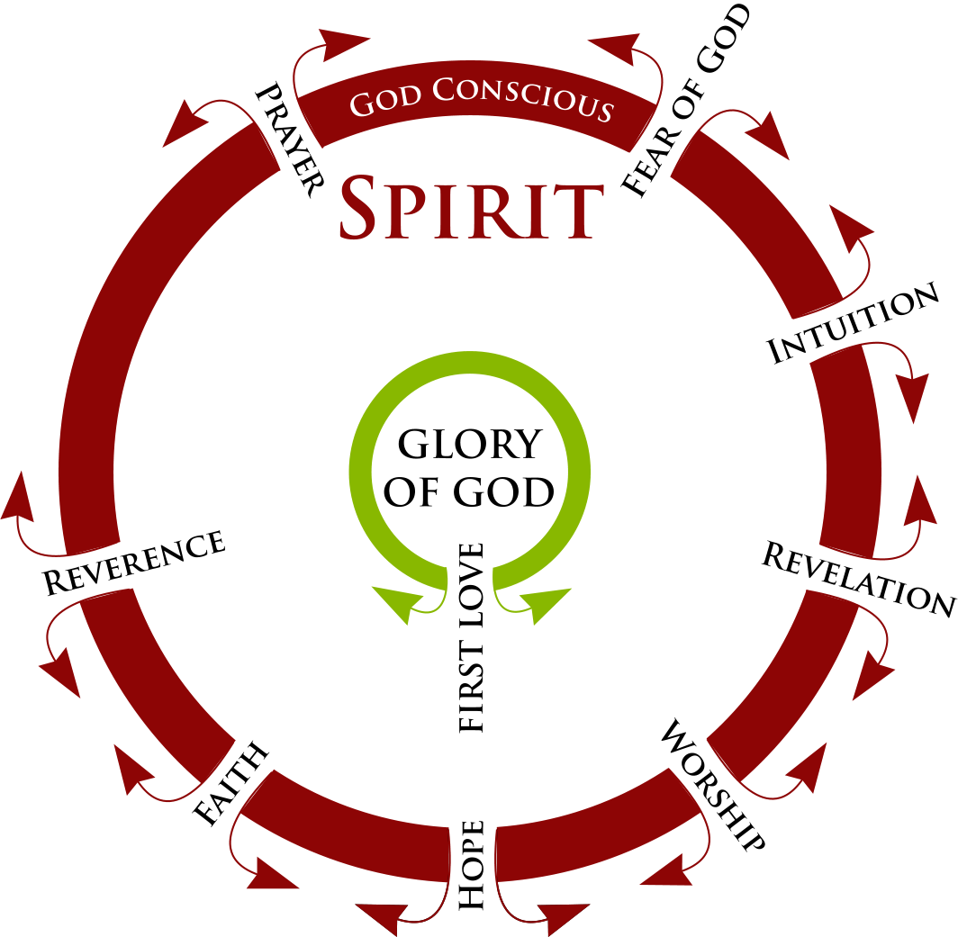

Slide 6
Engaging God First Love 2
Why first love?
What is first love?
Why is first love so important?
Our eternal destiny and destination is at stake on the basis of our experiencing and knowing First Love

Slide 7
Engaging God First Love 2
True first love is the primary and most important relational encounter and experience we can have
It is available to us daily through the opening of a door and the giving of an invitation.

Slide 8
Engaging God First Love 2
We have a tendency to believe that we are human beings that are having a spiritual experience.
When the truth is, we are spiritual beings having a human experience.
That means that we are eternal beings.

Slide 9
Engaging God First Love 2
We have to understand what our true identity is.
Our true identity is not our humanity.
Our true identity is the divine nature the image of God.

Slide 10
Engaging God First Love 2
When we begin to see our true image restored the divine nature functioning in us out of us
Then we can begin to function without earthly limitation
Then we can begin to fulfil our true destiny as sons of God
The works and greater works of Jesus

Slide 11
Engaging God First Love 2
Gen 22:2 He said, “Take now your son, your only son, whom you love, Isaac, and go to the land of Moriah, and offer him there as a burnt offering on one of the mountains of which I will tell you.”
First mention of love is in relation to the willingness to sacrifice

Slide 12
Engaging God First Love 2
1 John 3:16 We know love by this, that He laid down His life for us; and we ought to lay down our lives for the brethren.
1 John 3:1 See how great a love the Father has bestowed on us, that we would be called children of God;

Slide 13
Engaging God First Love 2
Gal 2:20 I have been crucified with Christ; and it is no longer I who live, but Christ lives in me; and the life which I now live in the flesh I live by faith in the Son of God, who loved me and gave Himself up for me.
I am willing to give myself up for Him?
I am willing to be who He created me to be?

Slide 14
Engaging God First Love 2
1 John 4:16 We have come to know and have believed the love which God has for us. God is love, and the one who abides in love abides in God, and God abides in him.
Intimacy is living and dwelling in a love relationship with our creator

Slide 15
Engaging God First Love 2
True first love with Love Himself is where we find ourselves
Identity, Value, Worth, Esteem and Significance are to be encountered and revealed in the first love relationship with our creator and the lover of our souls

Slide 16
Engaging God First Love 2
First love is where all the answers to our deepest questions are to be found.
Who am I?
Why am I here?
What is my purpose?
Where do l come from?

Slide 17
Engaging God First Love 2
Our eternal identity and destiny is completely connected to love
Our identity can only be revealed in a love relationship
Our destiny can only be outworked in a love relationship
To know who we are we must know who God is - love

Slide 18
Engaging God First Love 2
1 Cor 2:9 “Things which eye has not seen and ear has not heard, And which have not entered the heart of man, All that God has prepared for those who love Him.”
First love releases destiny
Our first love as a response to His

Slide 19
Engaging God First Love 2
We pre-existed in eternity as thoughts within the heart or mind of God
Psa 139:13 For You formed my inward parts; You wove me in my mother’s womb.
Psa 139:16 Your eyes have seen my unformed substance And in Your book were all written The days that were ordained for me, When as yet there was not one of them.

Slide 20
Engaging God First Love 2
Ps 139 v 16 Your eyes saw my unformed substance; in your book all my days were recorded, even those which were purposed before they had come into being 17 How precious also are Your thoughts to me, O God! How vast is the sum of them!
We are no random accident of nature

Slide 21
Engaging God First Love 2
Eph 2:10 For we are God’s masterpiece, created in the Messiah Jesus to perform good actions that God prepared long ago to be our way of life.
2 Cor 9:8 Besides, God is able to make every blessing of yours overflow for you, so that in every situation you will always have all you need for any good work

Slide 22
Engaging God First Love 2
Matthew 5:16 Let your light shine before men in such a way that they may see your good works, and glorify your Father who is in heaven
Expressing who we were created to be brings glory to God as we reveal Him in and through and around our lives

Slide 23
Engaging God First Love 2
2 Timothy 3:16-17 All Scripture is inspired by God and profitable for teaching, for reproof, for correction, for training in righteousness; so that the man of God may be adequate, equipped for every good work
God has given us His written and living word to equip us

Slide 24
Engaging God First Love 2
Ps 139 v23 Search me, O God, and know my heart; Try me and know my anxious thoughts; 24 And see if there be any hurtful way in me, And lead me in the everlasting way.
Transformation is being conformed to His image of me that will bring me to my everlasting way or destiny and destination

Slide 25
Engaging God First Love 2
Philippians 1:6 For I am confident of this very thing, that He who began a good work in you will perfect it until the day of Christ Jesus.
2 Timothy 2:21 Therefore, if anyone cleanses himself from these things, he will be a vessel for honour, sanctified, useful to the Master, prepared for every good work.

Slide 26
Engaging God First Love 2
Colossians 1:10 so that you will walk in a manner worthy of the Lord, to please Him in all respects, bearing fruit in every good work and increasing in the knowledge of God;
Philippians 2:13 for it is God who is at work in you, both to will and to work for His good pleasure.

Slide 27
Engaging God First Love 2
John 14:21 He who has My commandments and keeps them is the one who loves Me; and he who loves Me will be loved by My Father, and I will love him and will disclose Myself to him.”
John 14:23 Jesus answered and said to him, “If anyone loves Me, he will keep My word; and My Father will love him, and We will come to him and make Our home with him.

Slide 28
Engaging God First Love 2
The way to know that we love God is that we align ourselves with His thoughts, words and will of our eternal destiny
We are in relationship with the living word
This is not external code of practice (law) but an internal love relationship

Slide 29
Engaging God First Love 2
Love = obedience
Denying path of self knowledge of good and evil, to follow the true ancient path the eternal path revealed in God's heart and agreed by my spirit before foundation of the world.

Slide 30
Engaging God First Love 2
My heart formed from the genetic record of my parents generations but my spirit formed in the womb of Gods heart.
The vast some of His thoughts about me are written and recorded on my scroll of destiny.

Slide 31
Engaging God First Love 2
Mark 12:33 to love Him with all the heart and with all the understanding and with all the strength, and to love one’s neighbour as himself, is much more than all burnt offerings and sacrifices.”
First love loves with all, everything

Slide 32
Engaging God First Love 2
Hebrews 13:20-21 Now the God of peace, who brought up from the dead the great Shepherd of the sheep through the blood of the eternal covenant, even Jesus our Lord, equip you in every good thing to do His will, working in us that which is pleasing in His sight, through Jesus Christ, to whom be the glory forever and ever. Amen.

Slide 33
Engaging God First Love 2
First love is eternal
God is eternal love
John 17:24 Father, I desire that they also, whom You have given Me, be with Me where I am, so that they may see My glory which You have given Me, for You loved Me before the foundation of the world.

Slide 34
Engaging God First Love 2
Eph 1:4 just as He chose us in Him before the foundation of the world, that we would be holy and blameless before Him. In love
Rev 13:8 the Lamb that was slain [in sacrifice] from the foundation of the world.
The power and effect of the cross is not limited to time

Slide 35
Engaging God First Love 2
2 Tim 1:9 who has saved us and called us with a holy calling, not according to our works, but according to His own purpose and grace which was granted us in Christ Jesus from all eternity,

Slide 36
Engaging God First Love 2
1 Cor 6:15 Do you not know that your bodies are members of Christ? Shall I then take away the members of Christ and make them members of a prostitute? May it never be! 16 Or do you not know that the one who joins himself to a prostitute is one body with her? For He says, “The two shall become one flesh.” 17 But the one who joins himself to the Lord is one spirit with Him.

Slide 37
Engaging God First Love 2
1 Cor 6:15 Do you not know that your bodies are members of Christ? Shall I then take away the members of Christ and make them members of a prostitute? May it never be! 16 Or do you not know that the one who joins himself to a prostitute is one body with her? For He says, “The two shall become one flesh.”

Slide 38
Engaging God First Love 2
1 Cor 6:17 But the one who joins himself to the Lord is one spirit with Him.
Intimacy that is compared to giving our body in erotic love and being joined to the past of the person. Open ourselves up and become one flesh.

Slide 39
Engaging God First Love 2
When we join ourselves to God in first love we become joined entwined connected to Him and one spirit.
We become connected past, present and future
We can engage in what was eternally to transform what is to reveal what is meant to be

Slide 40
Engaging God First Love 2
We come home and know the heart of our creator once again connected to eternity.
Every part of us open to Him our very DNA and every encoded sequence of our genome exposed to the fire of His eyes

Slide 41
Engaging God First Love 2
Transparent, vulnerable, open and revealed before His eyes
All barriers protective coverings removed and abandoned to His love trusting Him implicitly.
This is our true love

Slide 42
Engaging God First Love 2
First love is inviting God to access us
Every thought, every emotion, every memory, every experience
To penetrate the deepest recesses of our lives
To engage every fibre of our being

Slide 43
Engaging God First Love 2
Mark 12:30 and you shall love the Lord your God with all your heart, and with all your soul, and with all your mind, and with all your strength.’
Love and vulnerability
Love and transparency
Love and trust

Slide 44
Engaging God First Love 2
I release loves sound, loves frequency loves light that will draw people’s hearts to come back to My heart.
A call to restoration of oneness, true spiritual intimacy.
I release the prophetic sound and symbol to engage the cross. Where what was meets what is to reveal and create what will be.

Slide 45
Engaging God First Love 2
Cross
What WAS
What will be
What IS

Slide 46
Engaging God First Love 2
True covenant exchange where the eternal changes the effects of my past to restore my future.
Lamb slain before the foundation of the world. This is loves true definition my saviour, healer, restorer exchanging His life for mine.

Slide 47
Engaging God First Love 2
The greatest exchange where eternities love took my Sin and gave me His righteousness and restored my eternal destiny.
Engage and experience true first love the most powerful love

Slide 48
Engaging God First Love 2
Rom 8:19 For the anxious longing of the creation waits eagerly for the revealing of the sons of God. 20 … in hope 21 that the creation itself also will be set free from its slavery to corruption into the freedom of the glory of the children of God.

Slide 49
Engaging God First Love 2
Rom 8:29 For those whom He foreknew, He also predestined to become conformed to the image of His Son, so that He would be the firstborn among many brethren;

Slide 50
Engaging God First Love 2
Rom 5:5 and hope does not disappoint, because the love of God has been poured out within our hearts through the Holy Spirit who was given to us.

Slide 51
Engaging God First Love 2
Rom 8:35 Who will separate us from the love of Christ? Will tribulation, or distress, or persecution, or famine, or nakedness, or peril, or sword?

Slide 52
Engaging God First Love 2
Rom 8:37 But in all these things we overwhelmingly conquer through Him who loved us.
Rom 8:39 nor height, nor depth, nor any other created thing, will be able to separate us from the love of God, which is in Christ Jesus our Lord.

Slide 53
Engaging God First Love 2
Wired to be made whole and complete by loves higher frequency
Abandoned to love
Overwhelmed by love
Intoxicated by love
Transformed and conformed by love
Our destiny is to be an expression of love

Slide 54
Engaging God First Love 2
Your love has ravished my heart
And taken me over, taken me over
And all I want is to be
With You forever, with You forever
Pull me a little closer
Take me a little deeper

Slide 55
Engaging God First Love 2
I want to know Your heart
I want to know Your heart
‘Cause Your love is so much sweeter
Than anything I’ve tasted
I want to know Your heart

Slide 56
Engaging God First Love 2
Ooh, Ooh how great your love is for me
Ooh, Ooh how great is your love
Pull me a little closer
Take me a little deeper
I want to know Your heart
‘Cause Your love is so much stronger
Than anything I’ve faced

Slide 57
Engaging God First Love 2
Words could never say the way He says my name
He calls me lovely
No one ever sees the way,
He looks at me He sees me holy
Words could never hold,
This love that burn my soul
Heaven holds me,

Slide 58
Engaging God First Love 2
I can't hold my love back from You
I can't hold my love back from You
I've gotta sing, I've gotta sing,
Sing my love

Slide 59
Engaging God First Love 2
You would not believe, The way He touches me
He burns right through me
And I could not forget, Every word He said
He always knew me
The earth could never hold,
This love that burns my soul
Heaven holds me

Slide 60
Engaging God First Love 2
You placed the stars into motion. You called to the Light and it came into place.
Every detail of our beings You created. Like a good Father you take care...You hold my being.
You wrap yourself around every detail of my life. You place everything into motion
And all I have to do is stand in the palm of your hand... cause I mean everything to You.

Slide 61
Engaging God First Love 2
Your love frees my soul
And fear has no hold
For You have broken the chains
Now joy fills my life Your Spirit, Your Light
I'm undone by the kindness of Christ

Slide 62
Engaging God First Love 2
Nothing can tear us from
The grip of His mighty love
We’ve only glimpsed, His vast affection
Heard whispers of, His heart and passion
It’s pouring out…

Slide 63
Engaging God First Love 2
His love is deep, His love is wide
And it covers us
His love is fierce, His love is strong
It is furious
His love is sweet, His love is wild
And it's waking hearts to life

Slide 64
Engaging God First Love 2
The Father loves and sends His son
The Son lays down His life for all
He lavishes His love upon us
He calls us now, His sons and daughters
He’s reaching out…
… and its waking hearts to life
He is waking hearts to life

Slide 65
Engaging God First Love 2
Your love it burns inside
Our hearts are satisfied by You
Your love is our reward
It’s why we ask for more of You
So let this love be like a fire Let our life be like a flame Fill our souls with Your desire Let our passion bring You fame

Slide 66
Engaging God First Love 2
Lord, I give You my heart
I give You my soul
I live for You alone
Every Breath that I take
Every moment I'm awake
Lord, have Your way in me

Slide 67
Engaging God First Love 2
My hearts aches for you my God
My soul waits for you my God
I've come far to find you here
In this place will I draw near
Your spirit inside me holds me close
In your wonderful presence I let go

Slide 68
Engaging God First Love 2
I cleanse my hands, You burn my heart
I cry out for love, You set me apart
And your spirit soars in me to the highest height
From where I'll not look back,
No I'll keep trusting you

Slide 69
Engaging God First Love
Open ourselves to God
Choose to embrace first love
Choose to give ourselves to Him
Choose to embrace our eternal destiny as sons
Choose to take the scroll and surrender to who we truly were to fully become history makers

Slide 70
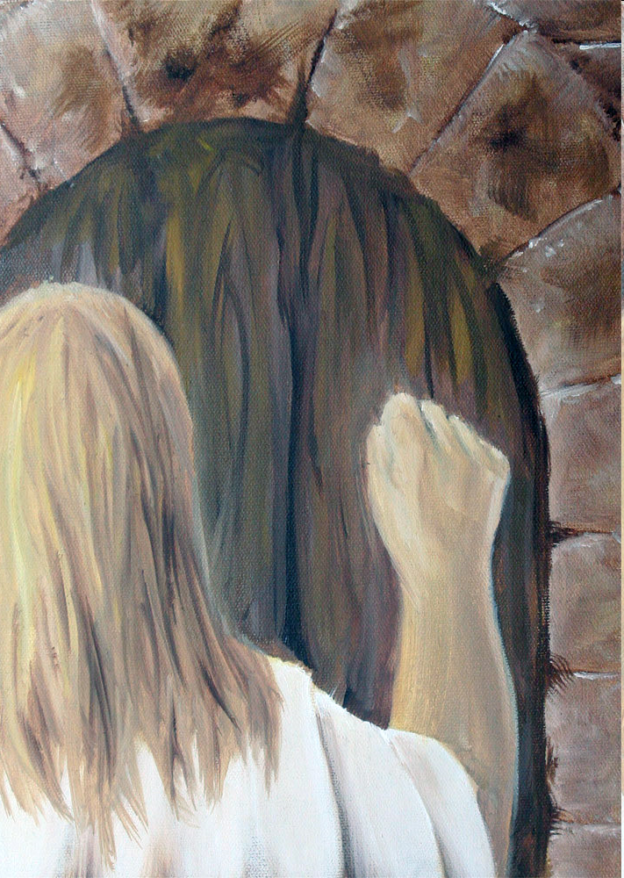

Slide 73
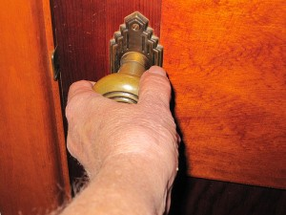
First Love House of God 1

Slide 75
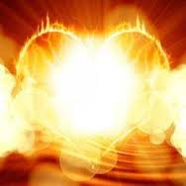

Slide 76
Engaging God First Love
Receive Him as love personified
Feel the security, power and strength of His love
Feel His unconditional love for you
Feel the fire of His love burn in you
Feel His love embrace you hold you safe in His arms of love
Feel your heart melt in His embrace

Slide 77
Engaging God First Love
Express your love for Him
Yield surrender open up your heart to embrace Him
Let Him fill you with His presence
Ask Him to take you back to before conception when you were created as a spirit in His heart

Slide 78
Engaging God First Love
Rest allow His thought to envelope you in the womb of His hearts
Feel His frequency of love vibrating in your spirit
Let Him reveal His heart to your spirit once again
Let Him reveal His amazing thoughts about you

Slide 79
Engaging God First Love
Listen to Him as He unveils the hidden mysteries of your destiny
Let Him reveal how special you are to Him
Let Him show you your true identity
Let Him show you your true purpose
Let what was transform what is to release what will be
Begin to resonate with your scroll

Slide 80
Engaging God First Love
Scrolls of revelation
Scrolls revealing who we were
Scrolls revealing our redemptive gift and purpose
Scrolls revealing our true identity
Scrolls revealing our true destiny
Scrolls revealing what we will be
Scrolls revealing what we will do

Slide 81
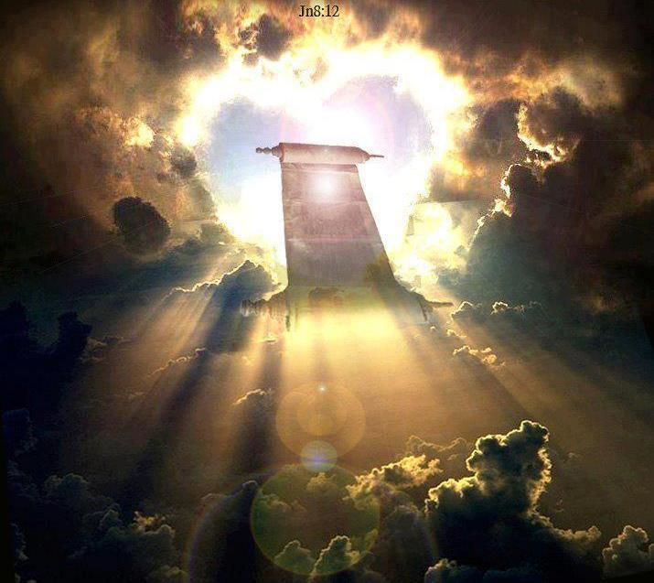

Slide 82
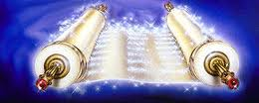

Slide 83
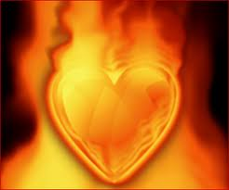

Slide 85
Engaging God First Love
What does it feel like to loved unconditionally

Slide 86
Engaging God First Love
Blockages
Hurt pain rejection fear mistrust
Past
Projections chains brambles nailed shut
Souls protection mechanism is projection creates fear, aprehension

Slide 87
Engaging God First Love
Arc agreement of 2 produces manifest presence and anointing agreement 3 produces government Matt 18
Interaction Holy Spirit and Father Holy Spirit and Jesus Jesus and the Father
Yoke Jesus why heavy laden weary ox and Rabi walk like Him 1 John 4

Slide 88
Engaging God First Love
seat of Government and rest Trust for provision protection purpose acceptance affirmation approval affection appreciation. Zech 3:6 7 government

Slide 89
Engaging God First Love
Holy Spirit enthroned lead direct to walk in His ways direction and resources Lordship led by spirit Servant gratitude for amazing salvation but also by choice bond servant

Slide 90
Engaging God First Love
Jesus Lord and king steward resources ministry trusted most often biggest test will I get my ldentity from what I do or from who I am in relationship will I get caught up in working for l lose my first love and enter duty cycle fear cycle
Friendship joint heir reveals ways heart revelation invested heavenly authority.

Slide 91
Engaging God First Love
Bench of 3 in us government kingdom of God Must reflect and come from heaven Matt 5 your kingdom Come on earth as it is in heaven. My agreement within 3+1=4 opens window doorway to responsibility Lord king Son heavenly order Melchizedek.

Slide 92
Engaging God First Love
Matthew 18:3-4 and said, "Truly I say to you, unless you are converted and become like children, you will not enter the kingdom of heaven. Whoever then humbles himself as this child, he is the greatest in the kingdom of heaven.
Matthew 18:19-20 "Again I say to you, that if two of you agree on earth about anything that they may ask, it shall be done for them by My Father who is in heaven. For where two or three have gathered together in My name, I am there in their midst."

Slide 93
Engaging God First Love
First love what we freely receive we freely give
God is first love that is His person His purpose His plan His priority and His methodology and motivation
God is love and every thing He does is both fully loving and fully expresses Himself
Love is the highest frequency of vibrating energy that exists. Love is the fastest speed of light Love is the greatest source of potential energy
Have we experienced and encountered God is love
Do we know love
Do we resonate with Ioves frequency

Slide 94
Engaging God First Love 2
Rev 3:19 Those whom I love, I reprove and discipline; therefore be zealous and repent. 20 Behold, I stand at the door and knock; if anyone hears My voice and opens the door, I will come in to him and will dine with him, and he with Me. 21 He who overcomes, I will grant to him to sit down with Me on My throne, as I also overcame and sat down with My Father on His throne.

Slide 95
Engaging God First Love 2
Love = reproof and discipline – oh no
Don’t equate discipline with punishment
Passionate to turn and follow Him into relationship and transformation into His image
Preparation for intimacy
Desire for intimacy
Reward of intimacy rulership

Slide 96
Engaging God First Love
Have we been transformed and realigned by love
Are we filled with love
Is everything we think say and do motivated by love?
Does love flow in us and through us and around us
Are we receivers and channels of love therefore of God?
Love is the manifold wisdom and grace of God personified in Jesus and fully expressed on the cross

Slide 97
Engaging God First Love
This is first love that He loves us with all His heart mind strength and being
This is our first love that we love Him with all our spirit soul body
This is first love that He loves us with all His heart mind strength and being Sacrifice Once for all time He embraced cross once
This is our first love that we love Him with all our spirit soul body living sacrifice daily we pickup the cross daily denying ourselves.

Slide 98
Engaging God First Love

Slide 99
Engaging God First Love
Luke 10:And he answered, “You shall love the Lord your God with all your heart, and with all your soul, and with all your strength, and with all your mind; and your neighbour as yourself.”
1 Cor 6:17 But the one who joins himself to the Lord is one spirit with Him.

Slide 100
Engaging God First Love
Behold and become close contact heart to heart cardio genesis transformed reordered. My spirit must be like heaven So My heart can be subdued and tended and cultivated to be like Eden. All starts with first love. I can be the representation of the 4 faces of God on earth as it is in heaven. Embrace 1st love.

Slide 101
Engaging God First Love
Psa 139:16 Your eyes have seen my unformed substance; And in Your book were all written The days that were ordained for me, When as yet there was not one of them.17 How precious also are Your thoughts to me, O God! How vast is the sum of them!

Slide 102
Engaging God First Love
2 Cor 3:18 But we all, with unveiled face, beholding as in a mirror the glory of the Lord, are being transformed into the same image from glory to glory, just as from the Lord, the Spirit.
Heb 12:2 fixing our eyes on Jesus, the author and perfecter of our faith

Slide 103
Engaging God First Love
God is letting us experience who He is intrinsically
Father Son Spirit and their wonderful interaction

Slide 104
Engaging God First Love
Matt 11:28 “Come to Me, all who are weary and heavy-laden, and I will give you rest. 29 Take My yoke upon you and learn from Me, for I am gentle and humble in heart, and you will find rest for your souls. 30 For My yoke is easy and My burden is light.”

Slide 105
Engaging God First Love
Love carries a vibrational frequency of the spirit as waves of light.
God is love, God is spirit, God is light
We can experience the presence or frequency of love and become like it
We can embraced by love and it change and transform us

Slide 106
Engaging God First Love
We can a be a channel for that frequency to vibrate and engage others
It is by your love for one another that others will know that you are My disciples

Slide 107
Engaging God First Love

Slide 108
Engaging God First Love
Cardiogenesis
Development of the embryonic heart
Psa 84:5 How blessed is the man whose strength is in You, In whose heart are the highways to Zion!

Slide 109
Engaging God First Love
“Emotional information is actually coded and modulated into these fields. By learning to shift our emotions, we are changing the information coded into the magnetic fields that are radiated by the heart, and that can impact those around us. We are fundamentally and deeply connected with each other and the planet itself.” -

Slide 110
Engaging God First Love
There are Christians who say they love God, but their lifestyle is contrary to the will of God. These people mistake their feeling of affection for God for true agape love. Jesus made this clear: “He who does not love me will not obey my teaching…” (John 14:24a).

Slide 111
Engaging God First Love
Acts 13:22 … David the son of Jesse, a man after My heart, who will do all My will.’ 36 36 For David, after he had served the purpose of God in his own generation,
A man after God’s heart
The heart of God
Place of our conception

Slide 112
Engaging God First Love
Aligned and transformed to that eternal image made possible by the sacrifice of the cross where He gave His body and shed His blood so my body and blood can be restored to oiginal blueprint the image recorded in His heart. Heart to Heart restoration of my eternal image cardio genesis. l present myself as a living sacrifice that the ancient ruins of my life my DNA will he restored Isa 61
Frequency vibrating in His heart beat causes resonance in me when I draw near come closer to know His heart To find my true identity destiny who I am truly am and why I am really here To discover sonship and my true creative purpose.
Embrace Him let true love transform us heart to heart. Power of true love who gave His life so I could experience acceptance affirmation Prodigal

Slide 113
Engaging God First Love

Slide 114
Engaging God First Love
David’s example is a great road map for how we are to live our life.
Repentant
Humble
Reverent
Respectful
Trusting
Loving
Devoted
Recognition
Faithful
Obedient

Slide 115
Engaging God First Love
I take manna hidden in the mysteries of the will of God vibrating with the motivating energy force of love. Activating all the grace mercy and help needed for the day to do all good deeds prepared for me to do
Eph 2:10 For we are God’s masterpiece, created in the Messiah Jesus to perform good actions that God prepared long ago to be our way of life.
2 Cor 9:8 Besides, God is able to make every blessing of yours overflow for you, so that in every situation you will always have all you need for any good work
2 Corinthians 9:8 And God is able to make all grace abound to you, so that always having all sufficiency in everything, you may have an abundance for every good deed;
Matthew 5:16 Let your light shine before men in such a way that they may see your good works, and glorify your Father who is in heaven
Ps 139 v 16 Your eyes saw my unformed substance; in your book all my days were recorded, even those which were purposed before they had come into being

Slide 116
Engaging God First Love

Slide 117
Engaging God First Love
Revelation 3:20 Behold, I stand at the door and knock; if anyone hears My voice and opens the door, I will come in to him and will dine with him, and he with Me.
You must give a daily invitation to fill you and flow through you
This is the access point to the Pathway of relationship

Slide 119
Engaging God First Love
Revelation 4:1-2 After these things I looked, and behold, a door standing open in heaven, and the first voice which I had heard, like the sound of a trumpet speaking with me, said, "Come up here, and I will show you what must take place after these things."
You have to accept the invitation
This begins the pathway of responsibility

Slide 120
Engaging God First Love
Born into darkness
To see the light
To reflect the light
To walk in the light
To become a light beings
Matt 5:16 Let your light shine before men in such a way that they may see your good works, and glorify your Father who is in heaven.

Slide 121
Engaging God First Love
What is our spirit?
Where does our spirit come from?
What is our spirit made of?
Where is our spirit?
What does our spirit do?
How do we engage our spirit?

Slide 122
Engaging God First Love
1 John 5:5 This is the message we have heard from Him and announce to you, that God is Light,
John 4:24 God is spirit, and those who worship Him must worship in spirit and truth.”
God is spirit God is light
We are spirit and our spirit is light

Slide 123
Engaging God First Love
We pre-existed in eternity as thoughts within the heart or mind of God
Psa 139:13 For You formed my inward parts; You wove me in my mother’s womb.
16 Your eyes have seen my unformed substance And in Your book were all written The days that were ordained for me, When as yet there was not one of them.

Slide 124
Engaging God First Love
Our spirit is our eternal essence it came from eternity and will return to it
Pneuma, Ruach spirit (Spirit), wind, or breath Our spirit entered our cells at conception
Our spirit is the centre of our being - our inner most being
Our spirit is the purest representation of our true self
Our spirit is not limited by time and space TARDIS

Slide 125
Engaging God First Love
Red blood cells contain no DNA no nucleus carry oxygen breath to the brain
The life is in the blood, red cells breath This can be programmed by the spirit
White blood cells contain record of 22 + 22 autosomes generational genetic programming & 1+1 chromosomes
Our DNA can be epigenetically re-sequenced by frequency, light, sound also by trauma and nurture

Slide 126
Engaging God First Love
Our spirit is a dimensional place that God dwells in and can dwell in God
John 14:16 I will ask the Father, and He will give you another Helper,… 17 that is the Spirit of truth, .. He abides with you and will be in you.
John 14:20 In that day you will know that I am in My Father, and you in Me, and I in you. 23 … We will come to him and make Our abode with him.

Slide 127
Engaging God First Love
We are a spirit we have a soul that lives in a body (an earth suit)
We are spirit the eternal essence of God within that receives spiritual revelation.
We are a spirit being that is God conscious
We have a soul that is self conscious and makes us a human being
Our spirit and soul makes us a living being

Slide 128
Engaging God First Love
In Adam the spirit was outside the body and as a light being he could travel in the spiritual realms
Psa 8:4 What is man that You take thought of him, And the son of man that You care for him? 5 Yet You have made him a little lower than God, And You crown him with glory and majesty! 6 You make him to rule over the works of Your hands; You have put all things under his feet

Slide 129
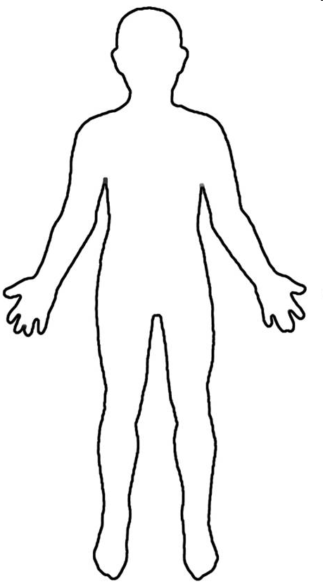
Conscious Mind
Spirit Father Son Holy Spirit
Heart Subconscious Mind Garden Scroll
Kingdom within us
First Love Gate
Rivers Power Anointing
Seat of Government

Slide 130
Source
Blockages
Intimacy
Further Info 1
Further Info 2
River of Life

Slide 131
Source
Blockages
Intimacy
Further Info 1
Further Info 2
Yoke of Jesus

Slide 132
Source
Blockages
Intimacy
Further Info 1
Further Info 2
Seat of rest and government

Slide 133
Engaging God First Love
Separate First Love module
Relationship with SSF distinct personalities
River of life engagement
Sonship Fatherhood
Baptised into spirit Jesus Father (Burning ones exercise) clothed with SSF deeper
waterfall river pool

Slide 134
Engaging God First Love
Our Spirit is given life by God’s spirit the breath of life
Our spirit receives God’s light and becomes light
Light of truth eyes are opened
Drink Living water and receive a fountain
Our spirit becomes a House for God’s presence

Slide 138
First Love House of God 1

Slide 142
Engaging God First Love
Feel the power and strength of His love
Feel His fire burn in you
Express your love to Him
Express your love for Him

Slide 143
Engaging God First Love
The Centre of Our Being - the residing place of the promise of God, centred inside our spirit.
The Human Spirit
The Human Soul
The Human Body

Slide 144
Engaging God First Love
Luke 17:21 Nor will people say, Look! Here [it is]! or, See, [it is] there! For behold, the kingdom of God is within you [in your hearts] and among you [surrounding you].
Spirit realm is connected to you because heaven or God's kingdom is in you
Therefore you have access to God heavenly spiritual realm and God has access to you. You are a gate of the spiritual realm heaven and God Channel

Slide 145
Engaging God First Love
Psalms 46:4 There is a river whose streams make glad the city of God, The holy dwelling places of the Most High.5 God is in the midst of her, she will not be moved; God will help her when morning dawns. 6 The nations made an uproar, the kingdoms tottered; He raised His voice, the earth melted. 7 The Lord of hosts is with us; The God of Jacob is our stronghold.

Slide 146
Engaging God First Love
River of life living water life of the Holy Spirit Drink it step into it Ezek 47 flow deeper ankle knee waste out of depth. walking in the Spirit led by Spirit filled with the Spirit. Spirit flowing like rivers of living water. 1 Cor 6:17 joined to Lord intimate yoked become or spirit. 1 Cor 2 revelation from the Spirit. Open channel to the Increasing flow produce life around us.
Experience Righteousness Peace and Joy in the Spirit.

Slide 147
Engaging God First Love
Romans 14:17 for the kingdom of God is not eating and drinking, but righteousness and peace and joy in the Holy Spirit.
John 4 John 7 Source joy strength peace help parakletos John 15 16 Power Acts 1:8 clothed with power. 1 Cor 12 and 14 gifts charismata. Hovering vibrating energy vibrancy abundance of life. Creativity inspiration revelation
Psalm 23 surely goodness and lovingkindness mercy follow me.

Slide 148
Engaging God First Love
Flow In us and through us come upon us to anoint us equip us for service to engage us in relationship John reveals Jesus who reveals Father to us.
River is swirling with grace and faith when Mixed in the word hope expectation produces the charge of anointing words vibrating with power. heat vibration electricity light oil fragrance. laughter joy drunkenness intoxication. Peace shalom wholeness rest trance ecstacy baptised immersed and filled.

Slide 149
Engaging God First Love
River of living water drink it wash in it be clothed by it channel it focus flow like hydroelectric power. why water 68% body cells die without it quickly flows washes cleanses passes vibrations frequencies focused power. Flowed from heaven Genesis water garden to water world.

Slide 150
Engaging God First Love
Door gate portal entrance access opening. Closed or locked it is a barrier a blockage stops access stops flow stops Connection etc. Gates transactions commerce decisions post slaves chose bond servants elders met defended guarded protected exchange East gate Source Northgate trouble.
Yoked joined become one flowing together in resonant harmony.

Slide 151
Engaging God First Love
You are a mountain
You are a place of authority
God dwells in a mountain Ezek 28
Pillar engages heaven

Slide 152
Engaging God First Love
Rev 2:19 But I have this against you, that you have left your first love
Rev 3: 20 Behold, I stand at the door and knock; if anyone hears My voice and opens the door, I will come in to him and will dine with him, and he with Me.

Slide 153
Engaging God First Love
We can embrace and experience God within – Holy Spirit, Jesus & Father as distinct personalities
We can choose to do that as we have a promise if you draw near

Slide 154
Engaging God First Love
The altar experience alters us
It must be a proactive response a choice to surrender
A choice to present ourselves as an offering

Slide 155
Engaging God First Love

Slide 156
Engaging God First Love

Slide 157
Engaging God First Love
Luke 17:21For behold, the kingdom of God is within you [in your hearts] and among you [surrounding you].

Slide 158
Engaging God First Love
kingdom is within me and Isa 9 there is no end to the increase of His government (kingdom) and peace shalom, wholeness it must Increase expand grow in me and through me and around me.
Isaiah 9:7 There will be no end to the increase of His government or of peace, On the throne of David and over his kingdom, To establish it and to uphold it with justice and righteousness From then on and forevermore. The zeal of the Lord of hosts will accomplish this.

Slide 159
Engaging God First Love
Liquid light- interspatial matrix interface my spirit

Slide 160
Engaging God First Love
Holy spirit Living water my source My well My fountain My spring My stream my river my insight my revelation My direction my guidance my abundant life my heavenly flow my heavenly Connection my filling my Overflowing my creativity my zero point energy my joy my Extravagance my exuberance my effulgence my eternal life source.

Slide 161
Engaging God First Love
Jesus my friend my brother my lover my Lord my king my model my example my Rabi my master my disciples my Word my Way my Truth my Life my door my Shepherd my Resurrection my light my Saviour my High Priest my advocate my interceder my yoke my song my Jesus

Slide 162
Engaging God First Love
Father my creator my sustainer my essence my rest my shalom my affirmer my accepter My peace My love My provider my protector my healer my sanctifier my righteousness my banner My victory my security my identity my anchor my hope my delight my purpose my glorifier my rock my restorer my reconciler my transformer my transfigurer My renewer my conformer my forgiver my strength my authority my power my eternal destination my eternal home my reference point. My Father

Slide 163
Engaging God First Love
God My Consuming fire My frequency My harmony My resonance My Manifold grace my Manifold wisdom My Melody My Rhythm My metronome My conductor My author My producer My composer Yod Hei Vav Hei My Lion My Ox My Eagle My Man My King my Prophet My Apostle My Priest My Home My dwelling place My covenant My all in all

Slide 164
Engaging God First Love
John 14:16-17 I will ask the Father, and He will give you another Helper, that He may be with you forever; that is the Spirit of truth, whom the world cannot receive, because it does not see Him or know Him, but you know Him because He abides with you and will be in you.

Slide 165
Engaging God First Love
John 14:20, 23, 25-26 In that day you will know that I am in My Father, and you in Me, and I in you. Jesus answered and said to him, "If anyone loves Me, he will keep My word; and My Father will love him, and We will come to him and make Our abode with him. "These things I have spoken to you while abiding with you. But the Helper, the Holy Spirit, whom the Father will send in My name, He will teach you all things, and bring to your remembrance all that I said to you.

Slide 166
Engaging God First Love
John 15:26 "When the Helper comes, whom I will send to you from the Father, that is the Spirit of truth who proceeds from the Father, He will testify about Me,
John 16:7-15 But I tell you the truth, it is to your advantage that I go away; for if I do not go away, the Helper will not come to you; but if I go, I will send Him to you. And He, when He comes, will convict the world concerning sin and righteousness and judgment; concerning sin, because they do not believe in Me; and concerning righteousness, because I go to the Father and you no longer see Me; and concerning judgment, because the ruler of this world has been judged. "I have many more things to say to you, but you cannot bear them now. But when He, the Spirit of truth, comes, He will guide you into all the truth; for He will not speak on His own initiative, but whatever He hears, He will speak; and He will disclose to you what is to come. He will glorify Me, for He will take of Mine and will disclose it to you. All things that the Father has are Mine; therefore I said that He takes of Mine and will disclose it to you.

Slide 167
Engaging God First Love
John 12:26 If anyone serves Me, he must follow Me; and where I am, there My servant will be also; if anyone serves Me, the Father will honour him.
John 13:34-35 A new commandment I give to you, that you love one another, even as I have loved you, that you also love one another. By this all men will know that you are My disciples, if you have love for one another."

Slide 168
Engaging God First Love
John 14:3, 6, 27 If I go and prepare a place for you, I will come again and receive you to Myself, that where I am, there you may be also. Jesus said to him, "I am the way, and the truth, and the life; no one comes to the Father but through Me. Peace I leave with you; My peace I give to you; not as the world gives do I give to you. Do not let your heart be troubled, nor let it be fearful.

Slide 169
Engaging God First Love
John 15:10-12, 14-15 If you keep My commandments, you will abide in My love; just as I have kept My Father's commandments and abide in His love. These things I have spoken to you so that My joy may be in you, and that your joy may be made full. "This is My commandment, that you love one another, just as I have loved you. You are My friends if you do what I command you. No longer do I call you slaves, for the slave does not know what his master is doing; but I have called you friends, for all things that I have heard from My Father I have made known to you.

Slide 170
Engaging God First Love
John 16:28, 33 I came forth from the Father and have come into the world; I am leaving the world again and going to the Father." These things I have spoken to you, so that in Me you may have peace. In the world you have tribulation, but take courage; I have overcome the world."

Slide 171
Engaging God First Love
John 17:13, 16-18, 20-21, 26 But now I come to You; and these things I speak in the world so that they may have My joy made full in themselves. They are not of the world, even as I am not of the world. Sanctify them in the truth; Your word is truth. As You sent Me into the world, I also have sent them into the world. "I do not ask on behalf of these alone, but for those also who believe in Me through their word; that they may all be one; even as You, Father, are in Me and I in You, that they also may be in Us, so that the world may believe that You sent Me. and I have made Your name known to them, and will make it known, so that the love with which You loved Me may be in them, and I in them."

Slide 172
Engaging God First Love
Source of life John 4:13 living water connection to heaven. Fountain Spring eternal life connection to eternity quality of heavens Source. Drink walk wade Swim baptised filled Spirit. John 7 rivers of living water Flow streams make glad. Ezek 47 flows from kingdom first love gate trickles flows deeper and deeper to engage the garden of our hearts Ps 23 quiet waters
life to the world turns death into rife. Resurrection life power Rom 6 baptised into the river.

Slide 173
Engaging God First Love
Matthew 6:25, 32-33 "For this reason I say to you, do not be worried about your life, as to what you will eat or what you will drink; nor for your body, as to what you will put on. Is not life more than food, and the body more than clothing? For the Gentiles eagerly seek all these things; for your heavenly Father knows that you need all these things. But seek first His kingdom and His righteousness, and all these things will be added to you.

Slide 174
Engaging God First Love
Matthew 11:27, 29-30 All things have been handed over to Me by My Father; and no one knows the Son except the Father; nor does anyone know the Father except the Son, and anyone to whom the Son wills to reveal Him. Take My yoke upon you and learn from Me, for I am gentle and humble in heart, and you will find rest for your souls . For My yoke is easy and My burden is light."

Slide 175
Engaging God First Love
John 4:10, 13-14 Jesus answered and said to her, "If you knew the gift of God, and who it is who says to you, 'Give Me a drink,' you would have asked Him, and He would have given you living water." Jesus answered and said to her, "Everyone who drinks of this water will thirst again; but whoever drinks of the water that I will give him shall never thirst; but the water that I will give him will become in him a well of water springing up to eternal life."

Slide 176
Engaging God First Love
John 7:37-39 Now on the last day, the great day of the feast, Jesus stood and cried out, saying, "If anyone is thirsty, let him come to Me and drink. He who believes in Me, as the Scripture said, 'From his innermost being will flow rivers of living water.'" But this He spoke of the Spirit, whom those who believed in Him were to receive; for the Spirit was not yet given, because Jesus was not yet glorified.

Slide 177
Engaging God First Love
Ezekiel 47:1 Then he brought me back to the door of the house; and behold, water was flowing from under the threshold of the house toward the east, for the house faced east. And the water was flowing down from under, from the right side of the house, from south of the altar.

Slide 178
Engaging God First Love
Ezekiel 47:7-9, 12
Now when I had returned, behold, on the bank of the river there were very many trees on the one side and on the other. Then he said to me, "These waters go out toward the eastern region and go down into the Arabah; then they go toward the sea, being made to flow into the sea, and the waters of the sea become fresh. It will come about that every living creature which swarms in every place where the river goes, will live. And there will be very many fish, for these waters go there and the others become fresh; so everything will live where the river goes. By the river on its bank, on one side and on the other, will grow all kinds of trees for food. Their leaves will not wither and their fruit will not fail. They will bear every month because their water flows from the sanctuary, and their fruit will be for food and their leaves for healing."

Slide 179
Engaging God First Love
Revelation 22:1-2 Then he showed me a river of the water of life, clear as crystal, coming from the throne of God and of the Lamb, in the middle of its street. On either side of the river was the tree of life, bearing twelve kinds of fruit, yielding its fruit every month; and the leaves of the tree were for the healing of the nations.

Slide 180
Engaging God First Love
John 11:25 Jesus said to her, "I am the resurrection and the life; he who believes in Me will live even if he dies,
Romans 6:5 For if we have become united with Him in the likeness of His death, certainly we shall also be in the likeness of His resurrection,
Philippians 3:10 that I may know Him and the power of His resurrection and the fellowship of His sufferings, being conformed to His death;

Slide 181
Engaging God First Love
1 Corinthians 15:42-49 So also is the resurrection of the dead. It is sown a perishable body, it is raised an imperishable body; it is sown in dishonor, it is raised in glory; it is sown in weakness, it is raised in power; it is sown a natural body, it is raised a spiritual body. If there is a natural body, there is also a spiritual body. So also it is written, "The first man , Adam, became a living soul ." The last Adam became a life-giving spirit. However, the spiritual is not first, but the natural; then the spiritual. The first man is from the earth, earthy; the second man is from heaven. As is the earthy, so also are those who are earthy; and as is the heavenly, so also are those who are heavenly. Just as we have borne the image of the earthy, we will also bear the image of the heavenly.

Slide 182
Engaging God First Love
Psalms 46:4 There is a river whose streams make glad the city of God, The holy dwelling places of the Most High.
Psalms 1:3 He will be like a tree firmly planted by streams of water, Which yields its fruit in its season And its leaf does not wither; And in whatever he does, he prospers.

Slide 183
Engaging God First Love
Song of Solomon 4:15-16 " You are a garden spring, A well of fresh water, And streams flowing from Lebanon." " Awake, O north wind, And come, wind of the south; Make my garden breathe out fragrance, Let its spices be wafted abroad. May my beloved come into his garden And eat its choice fruits!
Amos 5:24 "But let justice roll down like waters And righteousness like an ever-flowing stream.
Jeremiah 17:7-8 "Blessed is the man who trusts in the Lord And whose trust is the Lord . "For he will be like a tree planted by the water, That extends its roots by a stream And will not fear when the heat comes; But its leaves will be green, And it will not be anxious in a year of drought Nor cease to yield fruit.

Slide 184
Engaging God First Love
Isaiah 30:25-26 On every lofty mountain and on every high hill there will be streams running with water on the day of the great slaughter, when the towers fall. The light of the moon will be as the light of the sun, and the light of the sun will be seven times brighter, like the light of seven days, on the day the Lord binds up the fracture of His people and heals the bruise He has inflicted.
Isaiah 44:3 'For I will pour out water on the thirsty land And streams on the dry ground; I will pour out My Spirit on your offspring And My blessing on your descendants;

Slide 185
Engaging God First Love

Slide 186
Engaging God First Love

Slide 187
Engaging God First Love
seat rest and government yielded abdicated to Father Lordship kingship Rest Provision Blessing Protection. Matt 6:33 Seek first kingdom and His righteousness and everything added. Trust Him be at rest in peace living in the eye of the storm.
yoked to Jesus learn from Him discipleship to the master Rabi guidance and direction for the path today. Heart attitude gentle and humble in heart. Rest for the soul Searching for direction identity purpose significance meaning Matt 11:28

Slide 188
Engaging God First Love
River of life engagIng Source crystal from the tree of life pathway from eternity throne grace river flowing with grace and faith. Parakletos
Yoke of Jesus engaging rest friend joint heirs
Seat of rest and government Fathers tutoring 7 spirits God wisdom cloud of witnesses Gal 4 family
Kingdom within never end to the increase of His government
our Spirit holy holies 4 faces God FSS our spirit agreement window doorway heaven.

Slide 189
Engaging God First Love
I am that I am Ex
There is no flow without drinking priming the more you drink the greater the flew until you can walk in it. Draw from the well and release it to flow from our innermost being. The river is in you and you can be in the river
I am is in me I am way truth life I am the resurrection and the life I am the good shepherd I am the light of the world I am the door I am the bread of life
I am in My Father
Jesus is in you and you are in Him
The Father is in you and you in the Father
You are My beloved son I am well pleased.

Slide 190
Engaging God First Love
Holy Spirit Joy abundance joire de vie exuberance vitality
Jesus peace shalom wholeness
Father love acceptance affirmation approval

Slide 191
Engaging God First Love
Holy spirit Living water my source My well My fountain My spring My stream my river my insight my revelation My direction my guidance my abundant life my heavenly flow my heavenly Connection my filling my Overflowing my creativity my zero point energy my joy my Extravagance my exuberance my effulgence my eternal life source

Slide 192
Engaging God First Love
Jesus my friend my brother my lover my Lord my king my model my example my Rabi my master my disciples my Word my Way my Truth my Life my door my Shepherd my Resurrection my light my Saviour my High Priest my advocate my interceder my yoke my song my Jesus

Slide 193
Engaging God First Love
Father my creator my sustainer my essence my rest my shalom my affirmer my accepter My peace My love My provider my protector my healer my sanctifier my righteousness my banner My victory my security my identity my anchor my hope my delight my purpose my glorifier my rock my restorer my reconciler my transformer my transfigurer My renewer my conformer my forgiver my strength my authority my power my eternal destination my eternal home my reference point. My Father

Slide 194
Engaging God First Love
God My Consuming fire My frequency My harmony My resonance My Manifold grace my Manifold wisdom My Melody My Rhythm My metronome My conductor My author My producer My composer Yod Hei Vav Hei My Lion My Ox My Eagle My Man My King my Prophet My Apostle My Priest My Home My dwelling place My covenant My all in all

Slide 195
Engaging God First Love

Slide 196
Engaging God First Love
seat rest and government yielded abdicated to Father Lordship kingship Rest Provision Blessing Protection. Matt 6:33 Seek first kingdom and His righteousness and everything added. Trust Him be at rest in peace living in the eye of the storm.
yoked to Jesus learn from Him discipleship to the master Rabi guidance and direction for the path today. Heart attitude gentle and humble in heart. Rest for the soul Searching for direction identity purpose significance meaning Matt 11:28
Source of life John 4:13 living water connection to heaven. Fountain Spring eternal life connection to eternity quality of heavens Source. Drink walk wade Swim baptised filled Spirit. John 7 rivers of living water Flow streams make glad. Ezek 47 flows from kingdom first love gate trickles flows deeper and deeper to engage the garden of our hearts Ps 23 quiet waters
life to the world turns death into rife. Resurrection life power Rom 6 baptised into the river.

Slide 197
Engaging God First Love

Slide 198
Engaging God First Love

Slide 199
Pathway of Relationship
Flow from heaven inside out
Plant Seeds of Testimony
Enlarge Spirit Flowing
Experience River of life
Tongues Development
Matt 13
Matt 11
Cultivate good soil
Yoked to Jesus
Ps 23
Opening gateways
Rev 3:20
Preparation Spirit Building
Garden of Heart
Opening First Love Gate
Deal with stones, weeds hardness
Jesus is Lord
Invite Jesus to walk through
Experience God’s Presence
Meditation Thoughts Of God Visualization
Cultivate & Tend

Slide 200
Gateways Spirit Body Soul
Experience God’s Presence
Experience the River of life
Rev 3:20
Opening First Love Gate
Surrender
Yoke Yourself
Experience God’s Passion

Slide 202
Experience the River of life
House of God
JOURNEY MAPS
First Love
Engaging our spirit
Experience God’s Presence
Experience God’s Passion

Slide 203
God
within
Kingdom God Within
Gate of heaven
Further Info 1
House of God
Further Info 2

Slide 204
Engaging Holy Spirit
Drinking living Water
Engaging The river
Further Info 1
Further Info 2
River of life

Slide 205
Lordship
Kingship
Sonship
Further Info 1
Seat of Government
Further Info 2

Slide 206
Rest
Identity
Surrender
Further Info 1
Further Info 2
Yoke of Jesus

Slide 207
Drink Living Water
Engage Source Life
Get in the river
Feel His Love
Feel His Joy
Feel His Peace
Gateways Spirit Body Soul
Experience God’s Presence
Experience the River of life
Rev 3:20
Opening First Love Gate
Surrender
Yoke Yourself
Experience God’s Passion
Matt 11
Yoked to Jesus
Feel His Affirming
Feel His Acceptance
Feel His Approval
Jesus is Lord
3rd DNA
Light

Slide 210
Tongues Word
Tongues 3 ways
Tongues
Vision
Be still
Psa 46:10
Relax
Hearing God’s voice
Journaling
Tongues Development
Meditation Word Flow God’s thoughts
Base Camp
Spirit Building
Eyes of Spirit Activation
Eyes of heart Activating Imagination
Black Veil
Spirit perception
3 levels of spirit realm
Picture Objects
Picture Word
Picture Doorways

Slide 211
Spiritual Perception
Torn Veil
3 levels of spirit realm
Further Info 1
Eyes of spirit Activating Black Veil
Further Info 2

