Slide 1
Spirit Building Exercises Tongues
In my life tongues has been the number one spirit building exercise
While I am practicing engaging, my spirit is praying the heart of the Holy Spirit
Tongues enables us to pray without ceasing
Tongues is then part of all that I do
Start small and build up - like weights
Use the PDF or pause the recording before going on to the next part of the exercise

Slide 2
Spirit Building Exercises Tongues
2 minutes Praying in tongues out loud tune out Cast all your burdens thoughts onto Jesus.
2 minutes continuing to prayer in tongues out loud as you activate spiritual senses - a flow
Look at the picture to help focus on Jesus.
Start thinking about Jesus.

Slide 3
Spirit Building Exercises Tongues
2 minutes pray in tongues in your mind.
Let the words form in your mind but not come out of your mouth.
At first you may find your lips still try to move.
Continue to focus on Jesus it might be helpful to look at the picture of Jesus or close your eyes

Slide 4
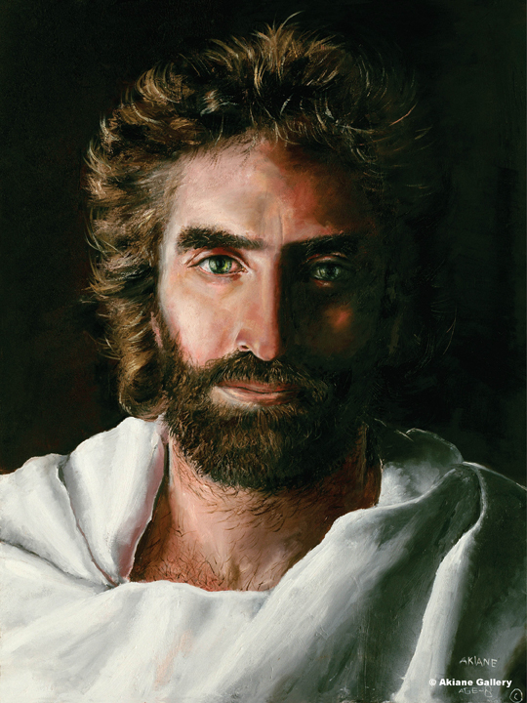

Slide 5
Spirit Building Exercises Tongues
2 minutes pray in tongues in your mind look at picture of Jesus then close your eyes think about and picture Jesus while continuing to pray in tongues
2 minutes Alternate praying in tongues out loud and in your mind.

Slide 6
Spirit Building Exercises Tongues
2 minutes pray in tongues in your mind.
Start to think about a fountain bubbling In your spirit now let tongues flow from spirit put your hand on your belly and feel the bubbling up.
Tongues continuously not in your mouth or your mind.
Look at Jesus and start thinking about him.

Slide 8
Spirit Building Exercises Tongues
Tongues and the word of God
2 minutes pray in tongues alternate out loud in your mind and from your spirit.
Listen to Psalm 23
Practice dual activities
2 minutes pray in tongues out loud start reading psalm 23 in your mind.
2 minutes read Ps 23 out loud and pray in tongues in your mind

Slide 9
Spirit Building Exercises Tongues
Psa23:1 The Lord is my shepherd, I shall not want. 2 He makes me lie down in green pastures; He leads me beside quiet waters. 3 He restores my soul; He guides me in the paths of righteousness For His name’s sake.4 Even though I walk through the valley of the shadow of death, I fear no evil, for You are with me; Your rod and Your staff, they comfort me. 5 You prepare a table before me in the presence of my enemies; You have anointed my head with oil; My cup overflows. 6 Surely goodness and lovingkindness will follow me all the days of my life, And I will dwell in the house of the Lord forever.

Slide 10
Spirit Building Exercises Tongues
2 minutes read Ps 23 your mind and alternate tongues out loud and in your spirit.
2 minutes Pray in tongues out loud or in your spirit read Ps 23 in your mind
Close your eyes and begin picturing Psalm 23 lying down in a green pasture with a gently flowing river.

Slide 11
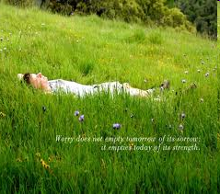

Slide 12
Spirit Building Exercises Tongues
2 minutes pray in tongues in your mind then in your spirit
Tune into what you are praying
Speak out loud the interpretation of what is flowing in your mother tongue English, German, Spanish etc

Slide 13
Spirit Building Exercises Tongues
You can begin to expand the time and focus of these exercises until they become a lifestyle where your spirit is praying or engaging without ceasing
Start with 2 minutes go to five minutes until you can do 10 minutes or more for each exercise
When you can do every thing whilst praying in tongues and feel constantly connected to God then use that in the next stages of meditation

Slide 14
Spirit Building Exercises Tongues
Spirit building exercises – practice
5 minutes tongues out loud thinking about or picturing Jesus
5 minutes tongues in your mind thinking about or picturing Jesus
5 minutes tongues anyway whilst reading any visual scripture
John 4:13 Drinking living water, Heb 4:16 coming to throne of grace

Slide 15
Spirit Building Exercises Tongues
5 minutes tongues anyway whilst visualising the scripture
Every day try to pray in tongues in your mind whilst doing everything
Every hour re-centre your thoughts by praying in tongues whilst think about or visualising for 1 minute
Digital watches set the hourly chime

Slide 16
Spirit Building Exercises Tongues
Remember that these training our spirit exercises are like the scaffolding used to erect a house. It is only needed during the building process
Once you have built the house then you have to live in it.
Tongues enables a lifestyle of constant communion and connection with God and the realms of heaven

