Slide 1
Prophetic Timetable
LAST DAY
FINAL HARVEST
Heb 12:27 SHAKING OF WORLD SYSTEMS
A G E
T O
C O M E
WIND
Gen 41 HARVEST OF LABOURERS
ISA 2:2
Here
1 Peter 4:17 JUDGMENT OF GOD’S HOUSEHOLD
FIRE
Matt 13 GATHERING & REMOVING STUMBLING BLOCKS Releasing Joshua Generation
` ``
Fatherhood, Sonship, Royal Identity A CALL TO INTIMACY Habitation of God Song Solomon 8:6
WINE
DAY OF RESURRECTION & JUDGMENT

Slide 2
Preparing for Destiny - Investiture
Jer 1:5 Before I formed you in the womb I knew you, And before you were born I consecrated you; I have appointed you
Psa 139:16 Your eyes have seen my unformed substance; And in Your book (scroll) were all written The days that were ordained for me,
Your destiny to rule – bring heaven to earth
Gen 1:28 God blessed them; and God said to them, “Be fruitful and multiply, and fill the earth, and subdue it; and rule

Slide 3
Preparing for Destiny - Succession
Dethronement of self, soul, me, myself & I - abdication
Nature - DNA programming
Nurture - environmental programming
Trauma - experiential programming
Restored to original eternal condition

Slide 4
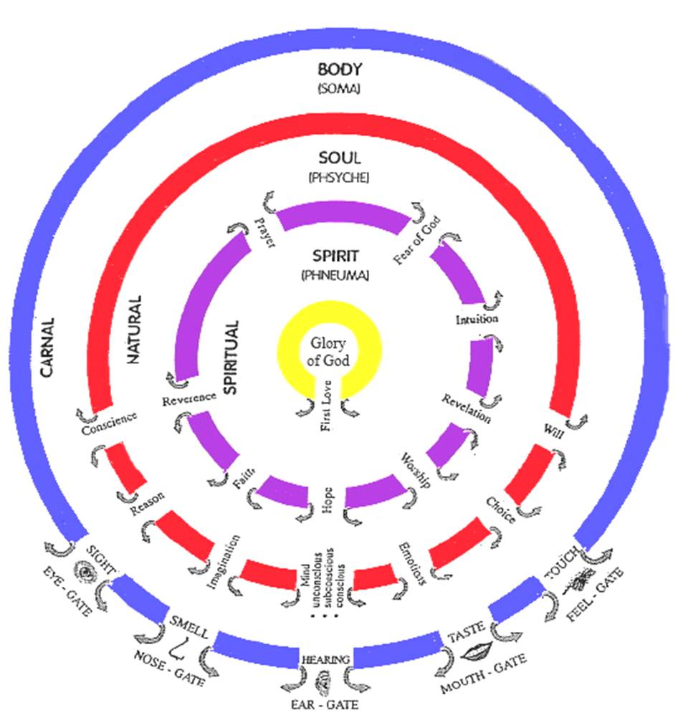

Slide 5
Spirit – Father/Son/Spirit
Kingdom of Heaven
9 Spiritual Senses 7 Soul senses & 5 Body Senses
Tabernacle Holy Place Altar Incense
Present yourself as a Living Sacrifice
Throat Cut Total Surrender
Head cut off Government removed
Skin coverings removed Naked
Body Split Open Exposed
Legs Cut Off Walk
Denial of self Take up Cross Follow Him
Not my will but Yours be done
Seek First the kingdom & righteousness
I am crucified with Christ He lives in me
Choice I only do what Father is doing
Tabernacle Holy of Holies Mercy Seat

Slide 6
Preparing for Destiny – Soul
Give control of your soul to your spirit
Take authority over the soul
Separate soul from spirit
Heb 4:12 For the word of God is living and active and sharper than any two-edged sword, and piercing as far as the division of soul and spirit, of both joints and marrow, and able to judge the thoughts and intentions of the heart.

Slide 7
Preparing for Destiny – Soul
Soul rules draws life from spirit
Soul draws from world through body
Soul seeks to control the spirit
Break soul ties to your spirit
Use word to separate Soul/Spirit

Slide 8
Preparing for Destiny – Soul
Like a wedge, divide & separate
Break control of soul over spirit
Change from inside out
Reflect your spirit man
Become one “living being”

Slide 9
Preparing for Destiny – Soul
Gal 2:20 I have been crucified with Christ; and it is no longer I who live, but Christ lives in me; and the life which (Christ) I now live in the flesh (Christ) I live by faith in the Son of God, who loved me and gave Himself up for me.

Slide 10
Preparing for destiny - Soul
Psa 139:23 Search me thoroughly , O God, and know my heart; Try me and know my anxious thoughts; 24 And see if there be any hurtful way in me, And lead me in the everlasting way.
1 Cor 10:28 examine yourselves
1 Cor 11:13 Judge for yourselves

Slide 11
Preparing for destiny - Soul
Matt 13:18 “Hear then the parable of the sower. 19 When anyone hears the word of the kingdom and does not understand it, the evil one comes and snatches away what has been sown in his heart. This is the one on whom seed was sown beside the road. 20 The one on whom seed was sown on the rocky places, this is the man who hears the word and immediately receives it with joy;

Slide 12
Preparing for destiny - Soul
Matt 13:21 yet he has no firm root in himself, but is only temporary, and when affliction or persecution arises because of the word, immediately he falls away. 22 And the one on whom seed was sown among the thorns, this is the man who hears the word, and the worry of the world and the deceitfulness of wealth choke the word, and it becomes unfruitful. 23 And the one on whom seed was sown on the good soil,

Slide 13
Preparing for destiny - Soul
James 1: 2 Consider it all joy, my brethren, when you encounter various trials, 3 knowing that the testing of your faith produces endurance. 4 And let endurance have its perfect result, so that you may be perfect and complete, lacking in nothing.
Act 14:22 strengthening the souls of the disciples, encouraging them to continue in the faith, and saying, “Through many tribulations we must enter the kingdom of God.”

Slide 14
Preparing for destiny - Soul
Rom 5:3 And not only this, but we also exult in our tribulations, knowing that tribulation brings about perseverance; 4 and perseverance, proven character; and proven character, hope; 5 and hope does not disappoint, because the love of God has been poured out within our hearts through the Holy Spirit who was given to us.

Slide 15
Familiar Spirit Remind Affirm Agreement
Confrontation
Criticised
Rejected
Injustice
Insecure
Event Reactions
Intimidated
Sin
Mind is Replaying
Loving
Angry
Defensive
Aggressive
Passive
Imagination
Forgive & Release
Emotions
Reason
Repetition
Seek God’s Counsel to Evaluate Patterns of Thinking & Behaviour
Truth of Motives Mind, Heart & Will of God
Revelation about
Reactions or Actions
Heart Sub-Conscious
Hard Weeds Memories Motives
Stones
Not my Issue
Courts
My issue Own it Deal with it
Weakness Unmet Need Unhealed Hurt Unresolved Issue
Pray Intercede Confront in love?
Weakness Sin or Character Repent Renounce Find Word Meditate
Weakness Gift, skills Empower Support Learn
Weakness Gift, skills Discipled Learn Strong
DNA Nature Generational? Curse?
Nurture Upbringing Trauma Experiences
Renewed Mind & Restored Soul

Slide 16
Familiar Spirit Remind Affirm Agreement
Confrontation
Criticised
Rejected
Injustice
Insecure
Event Reactions
Intimidated
Sin
Mind is Replaying
Loving
Angry
Defensive
Aggressive
Passive
Imagination
Forgive & Release
Emotions
Reason
Mindsets Behaviours Mechanisms
Repetition
Seek God’s Counsel to Evaluate Patterns of Thinking & Behaviour
Truth of Motives Mind, Heart & Will of God
Revelation about
Reactions or Actions
Heart Sub-conscious
Hard Weeds Memories Motives
Stones
Godly Righteous
Courts
Ungodly, Own it Deal with it
Weakness Unmet Need Unhealed Hurt Unresolved Issue
Display to world in love? Speak truth
Weakness Sin or Character Repent Renounce Find Word Meditate
Weakness in knowledge Seek truth revelation Word
Weakness Gift, skills Discipled Learn Strong
DNA Nature Generational? Curse?
Nurture Upbringing Trauma Experiences
Trauma

Slide 17
Familiar Spirit Remind Affirm Agreement
Forgive & Release
Own it
Confess it
Mindsets Behaviours Mechanisms
Renounce it
Heart Sub-Conscious
Repent
Hard Weeds Memories Motives
Stones
Meditate Truth
Hammer Familiars
Weakness Unmet Need Unhealed Hurt Unresolved Issue
Positive Confession
Deliverance
Healing
DNA Nature Generational? Curse?
Nurture Upbringing
Rejection
Insecurity
Anxiety Worry
Value Worth
Fear failure
Trauma Experiences
Fear Rejection
Abuse Trust Lust
Restoration

Slide 18
Preparing for Destiny – Soul
Heb 4:12 For the Word that God speaks is alive and full of power [making it active, operative, energizing, and effective]; it is sharper than any two-edged sword, penetrating to the dividing line of the breath of life (soul) and [the immortal] spirit, and of joints and marrow [of the deepest parts of our nature], exposing and sifting and analyzing and judging the very thoughts and purposes of the heart.

Slide 19
Preparing for Destiny – Soul
Gal 2:20 I have been crucified with Christ; and it is no longer I who live, but Christ lives in me; and the life which I now live in the flesh I live by faith in the Son of God, who loved me and gave Himself up for me.

Slide 20
Preparing for Destiny – Soul
Die to self - self-centredness, selfishness
Self-importance, Self-promotion, Self-control
Self-respect, Self-esteem, Self-worth, Self-image
Self-reliance, Self-sufficiency, Self-belief
Self-righteousness, Self-help, Self-expression
Self-gratification, Self-indulgence

Slide 21
Spirit – Father/Son/Spirit
Kingdom of Heaven
9 Spiritual Senses 7 Soul senses & 5 Body Senses
Tabernacle Holy Place Altar Incense
Present yourself as a Living Sacrifice
Throat Cut Total Surrender
Head cut off Government removed
Skin coverings removed Naked
Body Split Open Exposed
Legs Cut Off Walk
Denial of self Take up Cross Follow Him
Not my will but Yours be done
Seek First the kingdom & righteousness
I am crucified with Christ He lives in me
Choice I only do what Father is doing
Tabernacle Holy of Holies Mercy Seat

Slide 22
Spirit – Father/Son/Spirit
Kingdom of Heaven
9 Spiritual Senses 7 Soul senses & 5 Body Senses
Tabernacle Holy Place Altar Incense
Present yourself as a Living Sacrifice
Throat Cut Total Surrender
Head cut off Government removed
Skin coverings removed Naked
Body Split Open Exposed
Legs Cut Off Walk
Denial of self Take up Cross Follow Him
Not my will but Yours be done
Seek First the kingdom & righteousness
I am crucified with Christ He lives in me
Choice I only do what Father is doing
Tabernacle Holy of Holies Mercy Seat

Slide 23
Prophetic Timetable
LAST DAY
FINAL HARVEST
Heb 12:27 SHAKING OF WORLD SYSTEMS
A G E
T O
C O M E
WIND
Gen 41 HARVEST OF LABOURERS
ISA 2:2
1 Peter 4:17 JUDGMENT OF GOD’S HOUSEHOLD
FIRE
Matt 13 GATHERING & REMOVING STUMBLING BLOCKS Releasing Joshua Generation
Fatherhood, Sonship, Royal Identity A CALL TO INTIMACY Habitation of God Song Solomon 8:6
WINE
DAY OF RESURRECTION & JUDGMENT

Slide 24
Preparing for Destiny- Practice
Heb 5:14 But solid food is for the mature, who because of practice have their senses trained to discern good and evil. (spirit & soul)
Step in & Step out

