Slide 1
Prophetic Timetable
LAST DAY
FINAL HARVEST
Heb 12:27 SHAKING OF WORLD SYSTEMS
A G E
T O
C O M E
WIND
Gen 41 HARVEST OF LABOURERS
ISA 2:2
1 Peter 4:17 JUDGMENT OF GOD’S HOUSEHOLD
FIRE
Matt 13 GATHERING & REMOVING STUMBLING BLOCKS Releasing Joshua Generation
Fatherhood, Sonship, Royal Identity A CALL TO INTIMACY Habitation of God Song Solomon 8:6
WINE
DAY OF RESURRECTION & JUDGMENT

Slide 2
Transformation 7
2 Cor 3:¹⁸ .. are being transformed into the same image from one degree of glory to another
Process of change to display glory – the manifest presence of God on earth as it is in heaven
We can choose to embrace, pursue the process of change or maturity
Can’t stay babies, toddlers or infants

Slide 3
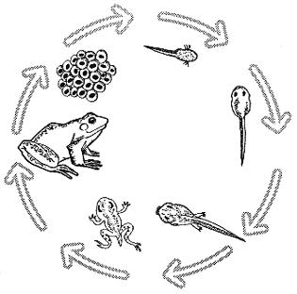
Transformation 7
Transformation = Metamorphosis
A complete change of form
Body Soul Spirit to Spirit Soul Body
Human being – spirit being – living being – godlike being

Slide 4
Transformation 7
Cocoon, Cloud, Wilderness
Crucible, Furnace, Fire,
Altar
Heat often comes through situations, circumstances & relationships
Sister rough & brother sandpaper
Things buried or covered up will come to the surface or into the light

Slide 5
Transformation 7
Rom 12:1 Therefore I urge you, brethren, by the mercies of God, to present your bodies a living and holy sacrifice, acceptable to God, which is your spiritual service of worship. ² And do not be conformed to this world, but be transformed by the renewing of your mind, so that you may prove what the will of God is, that which is good and acceptable and perfect.

Slide 6
Transformation 7
Sacrifice & Surrender on the heavenly altars
By faith enter into the heavenly tabernacle in surrender
Jesus is our High Priest - who prepares us as a sacrifice
Heb 10:19 Therefore, brethren, since we have confidence to enter the holy place by the blood of Jesus

Slide 7
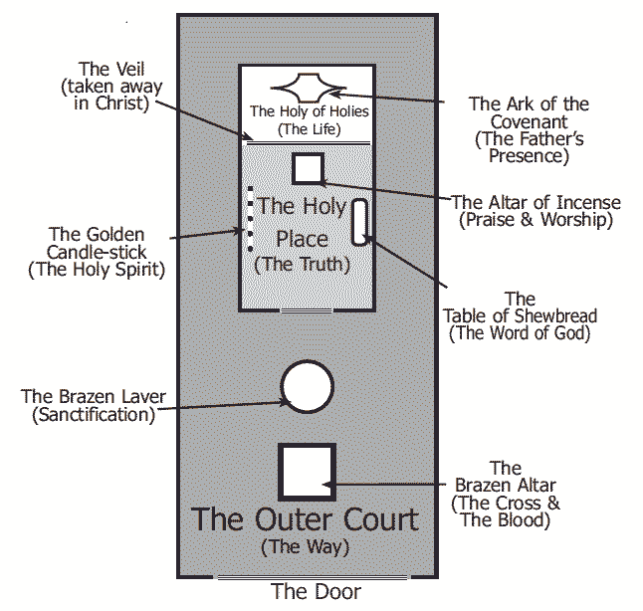
Transformation 7

Slide 8
Transformation 7
Sacrificial lamb was prepared by the high priest
Ex 29:16 And you shall kill the ram 17 And you shall cut the ram in pieces and wash its entrails and legs and put them with its pieces and its head,
Slit its throat (dead) drained blood
Skinned it
Split it open washed it’s inner organs
Split open backbone to reveal the marrow
Chopped off its head
Cut off its legs

Slide 9
Transformation 7
Altars are where we yield to God
Brazen altar in the court through the way of the cross
Altar of incense in the Holy Place through the veil of truth
Protocols of entry as living sacrifices
Denied self – lose our life
Presented ourselves for skinning

Slide 10
Place of His Presence
Eternity
Place of His Government
Perfection
Heaven of Heavens
Place of His Domain
2 Cherubim
Fiery Sword
Realm of His Abode
Heaven
Holy Holies
Holy Place
Inner Court
Outer Court
Kingdom of Heaven
Realm of His Domain
Walk in the light
LIGHT
Kingdom of God
Realm of His Government
See the light
LIGHT & DARK
Kingdom of Earth
Realm of His Presence
Time & Space
Born in darkness

Slide 11
Transformation 7
Skin me
Remove all behavioural layers
Built up through:
Trauma – experiential programming
Nurture – environmental programming
Nature – genetic DNA cell memory programming

Slide 12
Transformation 7
Psa 139:23 Search me thoroughly , O God, and know my heart; Try me and know my anxious thoughts; 24 And see if there be any hurtful way in me, And lead me in the everlasting way.
Heart, Thoughts, Ways

Slide 13
Transformation 7
Search – examine & show me
My sin & behaviours
Family sin & behaviours
Seed line sin & behaviours
My heart motives
What influences & directs my daily choices?

Slide 14
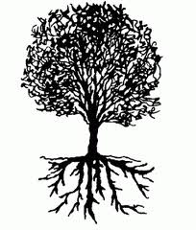
Transformation 7
Tree of the knowledge of good and evil
Pathway & source of all self
Roots sourced from satan's trading - I will ascend, I will be like God

Slide 15
Transformation 7
ADDICTION
REJECTION
DEPRESSION
ANGER
SICKNESS
FEAR
INSECURITY
LOW ESTEEM
ANXIETY
WORRY
?
?
?
?
?
?
?
?
?
?

Slide 16
Transformation 7
Heb 12:15 See to it that no one comes short of the grace of God; that no root of bitterness springing up causes trouble, and by it many be defiled;
Soil of insecurity
Seeds of offense
Roots of bitterness
Fruit of resentment

Slide 17
Transformation 7
Soil heart insecure lack of love, acceptance, affirmation, approval, encouragement
Seeds offenses things said or done or not said or done, sin
Roots Things you think or feel responses, emotions, attitudes
Fruit Things you say or do behaviour

Slide 18
Heart
Heart Soil of Insecurity
Resulting from lack of: love, acceptance, affirmation, appreciation, affection, encouragement – identity

Slide 19
Seed of offence
Emotions
Heart Soil of Insecurity
Resulting from: what others said or didn’t say; what others did or didn’t do - sin

Slide 20
Seed of offence
Roots of Bitterness
Heart Soil of Insecurity
Will
Sub-conscious Mind
Resulting from your responses: what you think; what you feel – attitudes, emotions - Anger

Slide 21
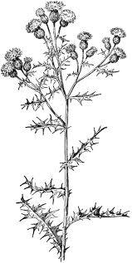
Seed of offence
Fruit of Resentment
Choices
Reason Filters
Roots of Bitterness
Heart Soil of Insecurity
Resulting from your behaviour: what you say; what you do

Slide 22
Fruit of Protection
Seed of offence
Rejection
Reject others first
Accommodating Compliant
Rejection Filters
Roots of Rejection
Heart Soil of Insecurity
Anger Hurt Pain

Slide 23
Fruit of Depression
Seed of offence
Injustice
Fruit of victim mentality
Roots of Self-pity
Heart Soil of Insecurity
Roots of Self -hatred
Roots of low Self-worth

Slide 24
Fruit of Self-sufficiency
Seed of offence
Lack, Poverty Deprivation
Fruit of stinginess
Fruit of failure
Roots of Independence
Heart Soil of Insecurity
Roots of hopelessness

Slide 25
Seed of offence
False Accusations
Fruit of Self-righteousness
Roots of Pride I’m right
Heart Soil of Insecurity

Slide 26
Seed of offence
Fruit of Resentment
Roots of Bitterness
Heart Soil of Insecurity

Slide 27
Seed of generational offence or sin
Fruit of generational behaviour patterns & Sin
Heart Record of Generational Sin
Roots of Iniquity
Passed to 4th generation

Slide 28
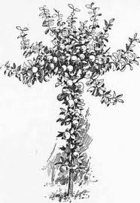
Fruit of Righteousness
Seed of offence
Fruit of Resentment
Forgive & Release
Renounce
Roots of Bitterness
Heart Soil of Insecurity
Heart Soil of Security
Repent
Revelation True Identity

Slide 29
Familiar Spirit Remind Affirm Agreement
Confrontation
Criticised
Rejected
Injustice
Insecure
Event - Reactions
Intimidated
Sin
Mind is Replaying
Angry
Defensive
Aggressive
Passive
Imagination
Loving
Emotions
Reason
Forgive & Release
Repetition
Seek God’s Counsel to Evaluate Patterns of Thinking & Behaviour
Truth of Motives Mind, Heart & Will of God
Revelation about
Reactions or Actions
Heart Sub-Conscious
Hard Weeds
Stones
Memories Motives
Not my Issue
My issue Own it Deal with it
Pray Intercede Confront in love?
Weakness Sin or Character Repent Renounce Find Word Meditate
Weakness Unmet Need Unhealed Hurt Unresolved Issue
DNA Nature Generational? Curse?
Nurture Upbringing Trauma Experiences
Courts
Renewed Mind & Restored Soul

Slide 30
Familiar Spirit Remind Affirm Agreement
Confrontation
Criticised
Rejected
Injustice
Insecure
Event Reactions
Intimidated
Sin
Mind is Replaying
Angry
Defensive
Aggressive
Passive
Imagination
Loving
Forgive & Release
Emotions
Reason
Mindsets Behaviours Mechanisms Emotions
Repetition
Seek God’s Counsel to Evaluate Patterns of Thinking & Behaviour
Truth of Motives Mind, Heart & Will of God
Revelation about
Reactions or Actions
Heart Sub-conscious
Hard Weeds Memories Motives
Stones
Godly Righteous
Ungodly, Own it Deal with it
Display to world in love? Speak truth
Weakness Sin or Character Repent Renounce Find Word Meditate
Weakness Unmet Need Unhealed Hurt Unresolved Issue
DNA Nature Generational? Curse?
Nurture Upbringing Trauma Experiences
Courts
Renewed Mind & Restored Soul

Slide 31
Familiar Spirit Remind Affirm Agreement
Forgive & Release
Go to Courts
Own it
Mindsets Behaviours Mechanisms
Confess it
Heart Sub-Conscious
Repent
Hard Weeds
Stones
Renounce it
Memories Motives
Meditate Truth
Truth Spirit led
Hammer Familiars
Weakness Unmet Need Unhealed Hurt Unresolved Issue
Positive Confession
Deliverance
Healing
DNA Nature Generational? Curse?
Nurture Upbringing
Rejection
Insecurity
Anxiety Worry
Value Worth
Fear failure
Trauma Experiences
Fear Rejection
Abuse Trust Lust
Restoration

Slide 32
Transformation 7
Father I thank you that You have made a way for me to access your heavenly presence
By faith I step in through the veil of Jesus through the way of the cross
I present myself to you Jesus my high priest in surrender as a living sacrifice

Slide 33
Transformation 7
I submit to the authority of the living word in my life
I step through the veil of truth into the Holy Place
I stand in the light of your truth
I ask you to search me
Reveal my blind self to me, show me the hidden motives of my heart

Slide 34
Transformation 7
I stand in the light of your truth
Show me the seeds of offense & sin that have taken root in my heart
I commit myself to forgiving & release all offenses in my life & my generational line

Slide 35
Transformation 7
Show me all roots of bitterness that have grown in my heart
I commit myself to a lifestyle of repentance against all negative roots
I repent of all negative emotions and attitudes rooted in my heart

Slide 36
Transformation 7
Show me all fruits of resentment that have developed in my behaviour
I commit myself to a lifestyle of renunciation against all negative behaviours
I renounce all my defence & coping mechanisms
I renounce my sin as a way of life

Slide 37
Transformation 7
Give me revelation of my true identity as a son of God
Give me a heart secure in its identity
Renew my mind to the mind of Christ
Meet all my unmet needs in yourself
Heal all my unhealed hurts
Restore my soul

Slide 38
Transformation 7
I receive your unconditional love, acceptance, affirmation, approval
I stand transparent naked and unafraid before you
I hear you say I see you and I love you
I receive your value, esteem and worth

Slide 39
Transformation 7
I choose to live a lifestyle of forgiveness, repentance & renunciation
I step back into this realm to walk in the ways of your kingdom
Manifest your glory through me on earth as it is in heaven so I will fulfil my eternal destiny

Slide 40
Transformation 7

