Slide 1
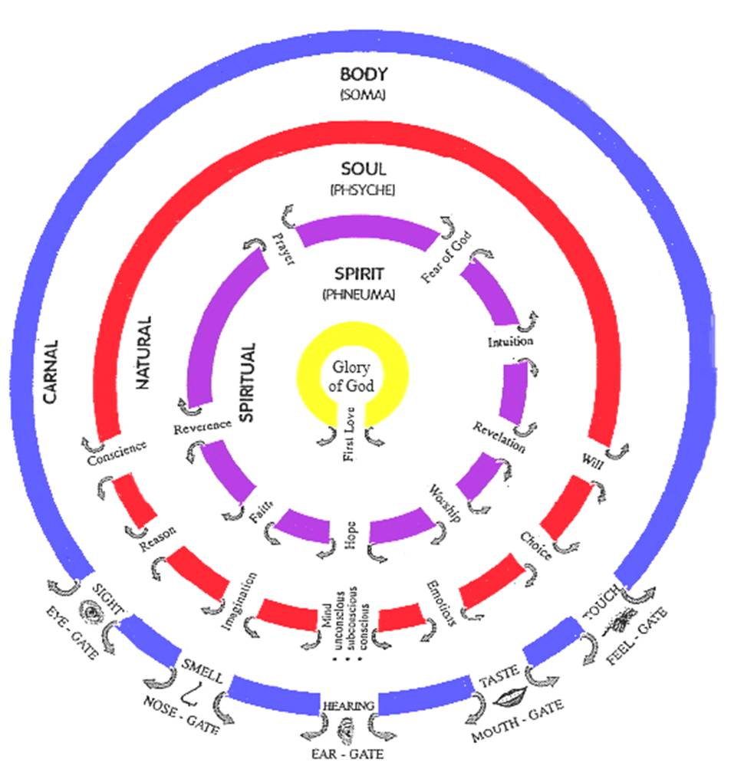

Slide 2
Soul Gates
Desire - Discipline - Delight Refine - Renew - Restore Harmony Spirit, Soul & Body
Ears
Conscience
Protector Director
Guard Guide
Voice
Reason
Translator Interpreter
Understand Explain
Eyes
Imagination
Receiver Transmitter
Screen Projector
Conscious Mind
Choice
Mind
Do What Jesus Would Do
H E A R T
Subconscious Mind
Storage Programmes Memories
Hard drive Motives
Beliefs Values
Emotions
Responses Feelings
Guts Moved
Will
Persistence Courage
Boldness Endurance

Slide 3
Cultivating Our Heart
You have a destiny in both time & eternity
Jer 1:5 “Before I formed you in the womb I knew you, And before you were born I consecrated you; I have appointed you a prophet to the nations.”
Psa 139:16 Your eyes have seen my unformed substance; And in Your book (scroll) were all written The days that were ordained for me, When as yet there was not one of them. 17 How precious also are Your thoughts to me, O God! How vast is the sum of them!

Slide 4
Cultivating Our Heart
Scroll or book of our lives
Out of Eternity -
Letter of decree or commission
Purpose, Provision for our Destiny
Accessed in heavenlies & your heart
Matt 6:10 ‘Your kingdom come. Your will be done, On earth as it is in heaven

Slide 5
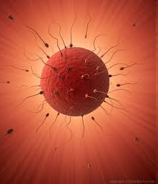
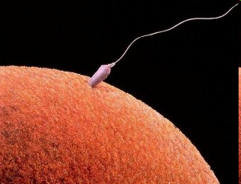
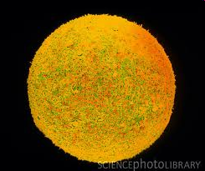
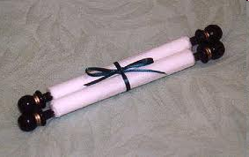
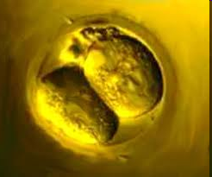
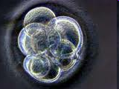
23 + 23 chromosomes DNA Record of parents history
Eternal Record of Destiny
Prov 23:7 For as he thinks in his heart, so he is

Slide 6
Heavenly Realms - Destiny
Scroll – record of your eternal destiny
Psa 40:7 Then I said, “Behold, I come; In the scroll of the book it is written of me. 8 I delight to do Your will, O my God; Your Law is within my heart.”
Frequency – vibration, Sound – song
Colour, Fragrance, Formula – encoded abilities
DNA song vibrates with record of the chaos it was created in (sin & iniquity)
Scroll vibrates with the record of your destiny
You choose which you resonate & come into harmony with

Slide 7
Heavenly Realms - Destiny
Conception our heart carries scroll record of 46 chromosomes + our scroll of destiny
Soul and body surround the scroll destiny
Flesh gets programmed by it’s environment
Ear is first nerve to form vibrates until death connected to all organs
Learn - Distance, Space, Time
Heart carries record of past generations
Prov 23:7 For as he thinks in his heart, so he is
Heart programs blood, blood goes to brain and programs your thinking

Slide 8
Heavenly Realms - Destiny
Born again spiritually
Flesh & spirit start wrestling for control
Resonating testimonies start to compete
Gal 5:17 For the flesh sets its desire against the Spirit, and the Spirit against the flesh; for these are in opposition to one another, so that you may not do the things that you please.

Slide 9
Heavenly Realms - Destiny
Rom 12: ¹ Therefore I urge you, brethren, by the mercies of God, to present your bodies a living and holy sacrifice, acceptable to God, which is your spiritual service of worship. ² And do not be conformed to this world, but be transformed by the renewing of your mind, so that you may prove what the will of God is, that which is good and acceptable and perfect.
2 Cor 4:¹⁶ .. our inner man is being renewed day by day.
Col 3:¹⁰ and have put on the new self who is being renewed to a true knowledge according to the image of the One who created him
Eph 4:²³ that you be renewed in the spirit of your mind

Slide 10
Cultivating Our Heart
Luke 17:²¹ the kingdom of God is within you
Spirit - Father, Son, Holy Spirit in you
Seat of rest or government
Heart – subconscious mind
Scroll destiny in our hearts
Garden in our heart
Rivers – heaven – spirit –garden heart- world

Slide 11
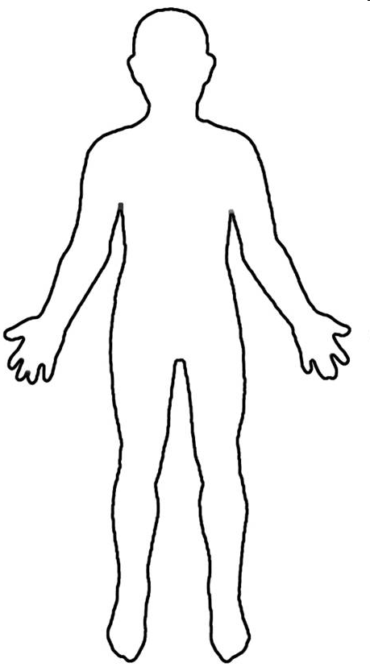
Conscious Mind
Spirit Father Son Holy Spirit
Heart Subconscious Mind Garden Scroll
Rivers Power Anointing
Kingdom within us Seat of Government
Heavenlies

Slide 12
Spirit
Bridal Chamber
Garden
Soaking Room
Dance Floor
Mind Body

Slide 13
Cultivating Our Heart
Manifest presence of God within - intimacy
4 chambers of the heart
Garden Fellowship, communion
Dance Floor Intimacy, identity, DNA
Soaking room Cocoon Preparation, DNA Oils, perfumes etc.
Bridal chamber Consummation marriage contract

Slide 14
Cultivating Our Heart
Turn your heart towards intimacy
Set your desire upon intimacy
Pursue your desire
Intimacy – hear, see, feel, experience
Hear the sound frequency of the song of heaven
Resonate
Harmony

Slide 15
Cultivating Our Heart
Heb 4:12 For the word of God is living and active – renew heart from the record of our DNA to the record of our destiny
Prov 4:20 My son, give attention to my words; Incline your ear to my sayings. 21 Do not let them depart from your sight; Keep them in the midst of your heart. 22 For they are life to those who find them And health to all their body 23 Watch over your heart with all diligence, For from it flow the springs of life.

Slide 16
Cultivating Our Heart
Matt 13:18 “Hear then the parable of the sower. 19 When anyone hears the word of the kingdom and does not understand it, the evil one comes and snatches away what has been sown in his heart. This is the one on whom seed was sown beside the road. 20 The one on whom seed was sown on the rocky places, this is the man who hears the word and immediately receives it with joy;

Slide 17
Cultivating Our Heart
Matt 13:21 yet he has no firm root in himself, but is only temporary, and when affliction or persecution arises because of the word, immediately he falls away. 22 And the one on whom seed was sown among the thorns, this is the man who hears the word, and the worry of the world and the deceitfulness of wealth choke the word, and it becomes unfruitful. 23 And the one on whom seed was sown on the good soil,

Slide 18
Cultivating Our Heart
James 1:2 Consider it all joy, my brethren, when you encounter various trials, 3 knowing that the testing of your faith produces endurance. 4 And let endurance have its perfect result, so that you may be perfect and complete, lacking in nothing.
Act 14:22 strengthening the souls of the disciples, encouraging them to continue in the faith, and saying, “Through many tribulations we must enter the kingdom of God.”

Slide 19
Cultivating Our Heart
Rom 5:3 And not only this, but we also exult in our tribulations, knowing that tribulation brings about perseverance; 4 and perseverance, proven character; and proven character, hope; 5 and hope does not disappoint, because the love of God has been poured out within our hearts through the Holy Spirit who was given to us.

Slide 20
Familiar Spirit Remind Affirm Agreement
Confrontation
Criticised
Rejected
Injustice
Insecure
Event - Reactions
Intimidated
Sin
Mind is Replaying
Angry
Defensive
Aggressive
Passive
Imagination
Loving
Emotions
Reason
Forgive & Release
Repetition
Seek God’s Counsel to Evaluate Patterns of Thinking & Behaviour
Truth of Motives Mind, Heart & Will of God
Revelation about
Reactions or Actions
Heart Sub-Conscious
Hard Weeds
Stones
Memories Motives
Not my Issue
Courts
My issue Own it Deal with it
Weakness Unmet Need Unhealed Hurt Unresolved Issue
Pray Intercede Confront in love?
Weakness Sin or Character Repent Renounce Find Word Meditate
Weakness Gift, skills Empower Support Learn
Weakness Gift, skills Discipled Learn Strong
DNA Nature Generational? Curse?
Nurture Upbringing Trauma Experiences
Renewed Mind & Restored Soul

Slide 21
Familiar Spirit Remind Affirm Agreement
Confrontation
Criticised
Rejected
Injustice
Insecure
Event Reactions
Intimidated
Sin
Mind is Replaying
Angry
Defensive
Aggressive
Passive
Imagination
Loving
Forgive & Release
Emotions
Reason
Mindsets Behaviours Mechanisms Emotions
Repetition
Seek God’s Counsel to Evaluate Patterns of Thinking & Behaviour
Truth of Motives Mind, Heart & Will of God
Revelation about
Reactions or Actions
Heart Sub-conscious
Hard Weeds Memories Motives
Stones
Godly Righteous
Courts
Ungodly, Own it Deal with it
Weakness Unmet Need Unhealed Hurt Unresolved Issue
Display to world in love? Speak truth
Weakness Sin or Character Repent Renounce Find Word Meditate
Weakness in knowledge Seek truth revelation Word
Weakness Gift, skills Discipled Learn Strong
DNA Nature Generational? Curse?
Nurture Upbringing Trauma Experiences
Renewed Mind & Restored Soul

Slide 22
Familiar Spirit Remind Affirm Agreement
Forgive & Release
Own it
Confess it
Mindsets Behaviours Mechanisms
Renounce it
Heart Sub-Conscious
Repent
Hard Weeds
Stones
Memories Motives
Meditate Truth
Truth Spirit led
Hammer Familiars
Weakness Unmet Need Unhealed Hurt Unresolved Issue
Positive Confession
Deliverance
Healing
DNA Nature Generational? Curse?
Nurture Upbringing
Rejection
Insecurity
Anxiety Worry
Value Worth
Fear failure
Trauma Experiences
Fear Rejection
Abuse Trust Lust
Restoration

Slide 23
Cultivating Our Heart
Gal 2:20 I have been crucified with Christ; and it is no longer I who live, but Christ lives in me; and the life which I now live in the flesh I live by faith of the Son of God, who loved me and gave Himself up for me.
I become a channel or gateway of God to the world

Slide 24
Cultivating Our Heart
Gen 2:⁸ The LORD God planted a garden toward the east, in Eden; and there He placed the man whom He had formed. ⁹ Out of the ground the LORD God caused to grow every tree that is pleasing to the sight and good for food; the tree of life also in the midst of the garden,
Gen 2:¹⁰ Now a river flowed out of Eden to water the garden; and from there it divided and became four rivers.

Slide 25
Cultivating Our Heart
Gen 2:¹⁵ Then the LORD God took the man and put him into the garden to cultivate it and tend it.
Gen 3:⁸ They heard the sound of the LORD God walking in the garden in the cool of the day

Slide 26
Cultivating Our Heart
Rev 22:1 Then he showed me a river of the water of life, clear as crystal, coming from the throne of God and of the Lamb, 2 in the middle of its street. On either side of the river was the tree of life, bearing twelve kinds of fruit, yielding its fruit every month; and the leaves of the tree were for the healing of the nations.

Slide 27
Cultivating Our Heart
Jer 2:13 I am the fountain of living waters
Psa 23:2 He makes me lie down in green pastures; He leads me beside quiet waters.
Isa 58:11 And you will be like a watered garden, And like a spring of water whose waters do not fail.

Slide 28
Cultivating Our Heart
John 4:¹⁴ but whoever drinks of the water that I will give him shall never thirst; but the water that I will give him will become in him a well of water springing up to eternal life.”
John 7:³⁸ He who believes in Me, as the Scripture said, ‘From his innermost being will flow rivers of living water.’

Slide 29
Cultivating Our Heart
Psa 1:² But his delight is in the law of the LORD, And in His law he meditates day and night. ³ He will be like a tree firmly planted by streams of water, Which yields its fruit in its season And its leaf does not wither; And in whatever he does, he prospers.

Slide 30
Cultivating Our Heart
You are a dwelling of God’s presence
You are connected to heaven through God
You have a flow of abundant life flowing like a river from heaven (spiritual realm)
River flows from heaven through God to our spirit, soul (heart), body to world around us
Your hearts are now the garden where you can walk with God in intimacy
Your hearts need tending & cultivating

Slide 31
Cultivating Our Heart
Focus on meeting with God who dwells within us & then in the heavenlies
Daily open the heavenly door into your spirit and invite God’s presence to come into your garden
Develop that secret place in our hearts like a garden Isa 51:3, Isa 58:11 watered by the well spring bubbling up John 4:14 and a river of living water flowing John 7:38
Tend & Cultivate your garden

Slide 32
Cultivating Our Heart
Tend the garden of our hearts
Store things given by God in encounters - eat them, scrolls, diamonds, sceptres etc.
Ezek 2:8 Open your mouth and eat what I am giving you.
Ezek 3:1 Then He said to me, “Son of man, eat what you find; eat this scroll,.. 2 So I opened my mouth, and He fed me this scroll. 3 He said to me, “Son of man, feed your stomach and fill your body with this scroll which I am giving you.” Then I ate it, and it was sweet as honey in my mouth.

Slide 33
Cultivating Our Heart
Cultivate the garden of our hearts
Plants & water seeds
1 Cor 3:8 Now he who plants and he who waters are one; but each will receive his own reward according to his own labour. 9 For we are God’s fellow workers; you are God’s field, God’s building.
Seeds - encounters, victories, visions, revelations, testimonies, truth etc.

Slide 34
Cultivating Our Heart
Seed of testimony – encounter, vision, victory, revelation, word
Plant it in the garden of your heart
Water it from the river of life
Speak life to it, command it to grow
Grows into a tree/plant with fruit
Eat the fruit to release the power of the testimony again & again

Slide 35
Cultivating Our Heart
Heb 5:14 But solid food is for the mature, who because of practice have their senses trained to discern good and evil. (spirit & soul)
Practice
Desire – Discipline – Delight
Activate our imaginations to see our encounters

Slide 36
Cultivating Our Heart
Imagination can play back our external experiences – needs cleansing
Imagination is the Screen where God can project vision & is our spiritual perception
Imagination can receive images from your soul – subconscious on one side and from you spirit on the other side
Learn to let spirit projections rule over soul projections to get a flow of revelation from God that we can follow

Slide 37
Cultivating Our Heart
3 stages of experiences
Visions – snap shot pictures or moving pictures in the 3rd person
Visitations – 1st person may involve trances or even translations
Habitations living in the dual realms of heaven & earth simultaneously
John 3:¹³ No one has ascended to heaven but He who came down from heaven, that is, the Son of Man who is in heaven. (dwells has His home)

Slide 38
Cultivating Our Heart

Slide 39
Cultivating Our Heart
Rev 3:20 'Behold, I stand at the door and knock; if anyone hears My voice and opens the door, I will come in to him and will dine with him, and he with Me.
Open the door to God’s glory dwelling place to let God flow out into our spirit
Surrender throne of our life to God
Open our heart’s garden to flow of God
Develop a relationship of intimacy

Slide 40
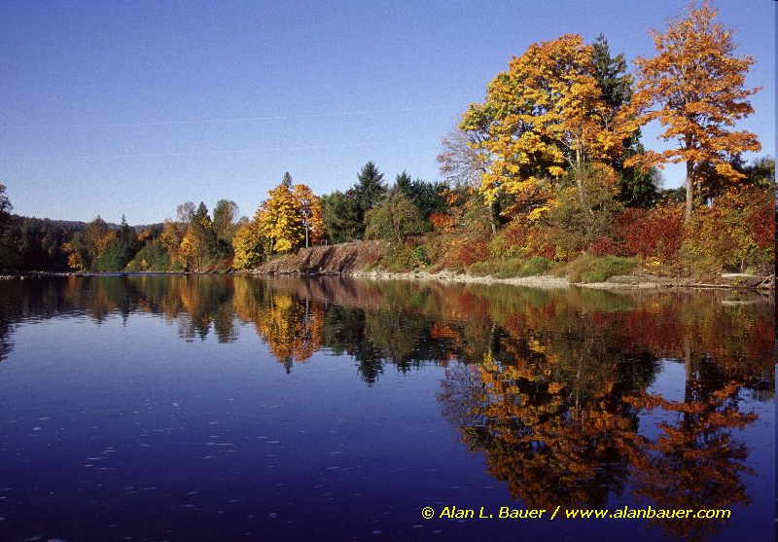

Slide 41
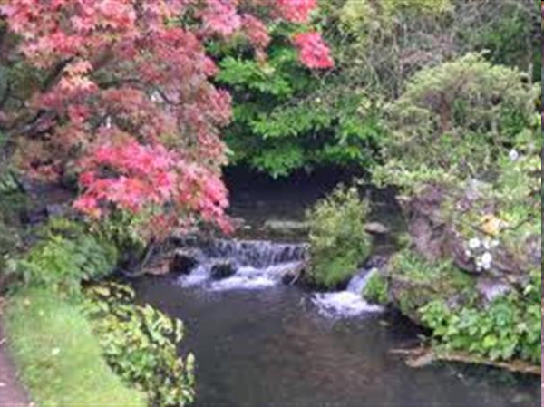

Slide 42
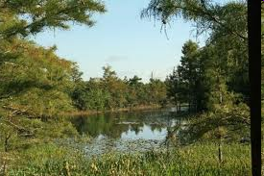

Slide 44
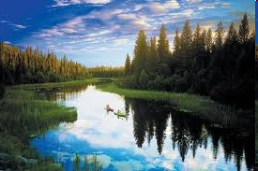

Slide 45
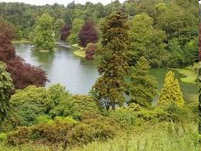

Slide 46
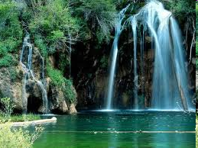

Slide 47
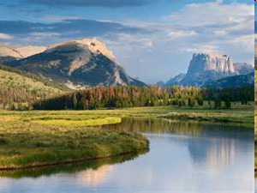

Slide 51
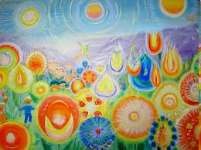

Slide 52
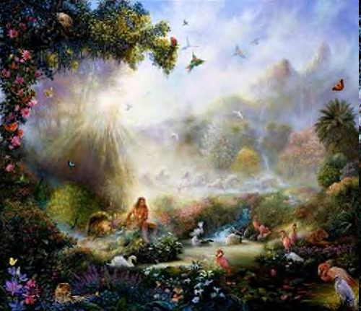

Slide 53
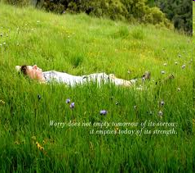

Slide 55
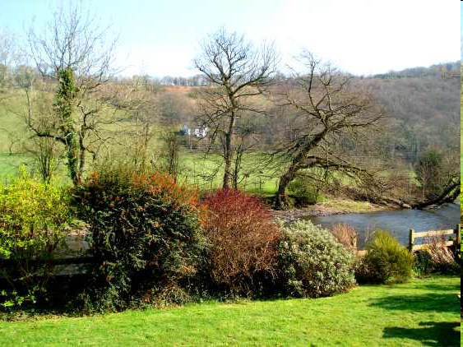

Slide 64
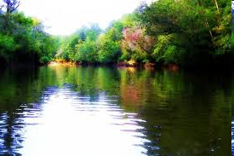

Slide 70
Cultivating Our Heart

