Slide 1
Vision Destiny 2015 2
Share revelation from 2014/15
What has God said? - Words
What has God show? - Visions
What does God mean?
What is the application for you?
What is the application for the church here?
What is the application for the wider church?

Slide 2
Vision Destiny 2015 2
Scales - justice
Lion - Kingly order - Legislation
New sounds and frequencies
Judgment – verdict and separation
End of a 40 year generation in August 2015
Beginning of a new order
Joshua Generation and the order of Melchizedek

Slide 3
Vision Destiny 2015 2
The overlapping place
A vision that Nancy Coen had in 1995 where God caught her up in the spirit and He showed her the earth realm and spirit realm and they were very far apart and there was a separation in between them and there wasn’t even an access place from one to the other. And suddenly the Hand of the Lord took these two realms and He began to push these two worlds together until they became overlapping.

Slide 4
Vision Destiny 2015 2
He said “ I’m going to raise up a troop of over-comers who are going to stand in an overlapping place and they are going to stand between the earthly realm and the spiritual realm and they are going to go up in to the spiritual realm and they are going to grab what they see and manifest it in the earth”.

Slide 5
Vision Destiny 2015 2
The Incubation in January and the Birthing in September
The Lord spoke to me and said that this will be a year that the seers are coming into their multi-dimensional sight. A new realm of the prophetic will be birthed this year. In January, many prophetic people will enter into a season of incubation for greater manifestation.

Slide 6
Vision Destiny 2015 2
The Lord showed me that from January to September will be a time of preparation for what is going to be birthed toward the end of September
This nine-month period will be a time for the conception and forming of a supernatural movement to be birthed into the earth. He said, "This will be the beginning of the overshadowing! Much like what Mary encountered.

Slide 7
Vision Destiny 2015 2
There will be a birthing of a greater glory at the end of September. A place of unusual power will begin to flow toward the end of 2015 like we have never seen before. Many will begin to taste of the age to come. There will be a prophetic people that will begin to emerge toward the end of next year that will speak a wisdom that is not of this world. They will manifest a message from an age to come. They will transcend the system of the world and operate from a higher order of the supernatural.

Slide 8
Vision Destiny 2015 2
A Daniel company is coming! This will be a company of prophets who can discern our times with pinpoint accuracy. Some will be given high places to speak into earthly governments around the world. They will have a mandate from the Lord to administer justice and solve complex situations that human intellect cannot understand.

Slide 9
Vision Destiny 2015 2
Ancient Paths
Shift in heavens - end of the old order
Mysteries - deep hidden things
New heavenly authority
12 High Chancellors Houses
12 Laws of Zion ( Heavenly Government )
Choice, Call, Beckoning, Wooing

Slide 10
Prophetic Timetable
Acts 2 Wine, Fire, Wind
Early Rain – Latter Rain
Former Glory – Latter Glory
LAST DAY
FINAL
HARVEST
Heb 12:27 SHAKING OF WORLD SYSTEMS
A
G
E
T
O
C
O
M
E
WIND
Gen 41 HARVEST OF LABOURERS
ISA 2:2
1 Peter 4:17 JUDGMENT OF GOD’S HOUSEHOLD
FIRE
Matt 13 GATHERING & REMOVING STUMBLING BLOCKS
Releasing Joshua Generation
Fatherhood, Sonship, Royal Identity A CALL TO INTIMACY Habitation of God
Song Solomon 8:6
WINE
DAY OF RESURRECTION
& JUDGMENT

Slide 11
Vision Destiny 2015 2
As a church with a wider apostolic ministry we are called to be part of the Joshua Generation
We are called to equip the Joshua Generation as mentors for that new order
We are called to receive our kingdom inheritance

Slide 12
Vision Destiny 2015 2
Understand Order of Melchizedek
Understand the nature of judgment - Scales of justice
Understand our Priestly & Kingly functions
Understand the year of the Lion
Engage the ancient paths

Slide 13
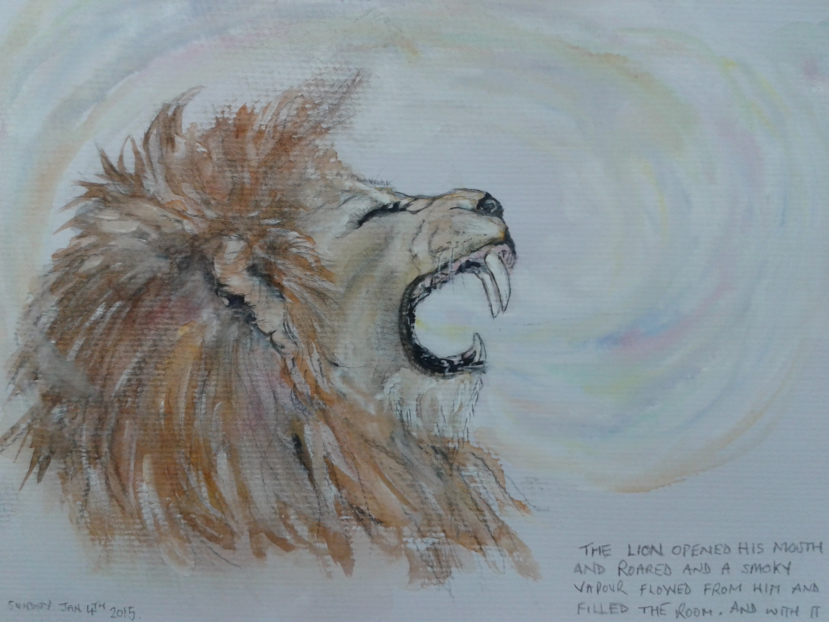

Slide 14
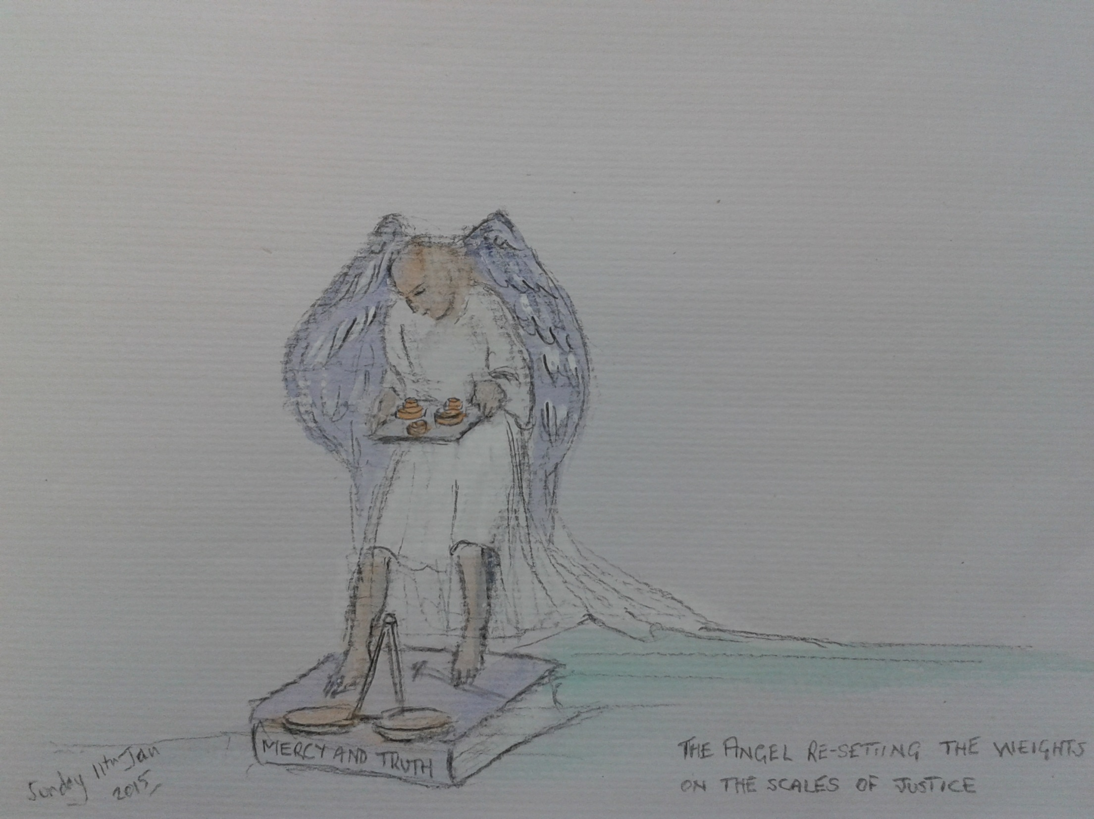

Slide 15
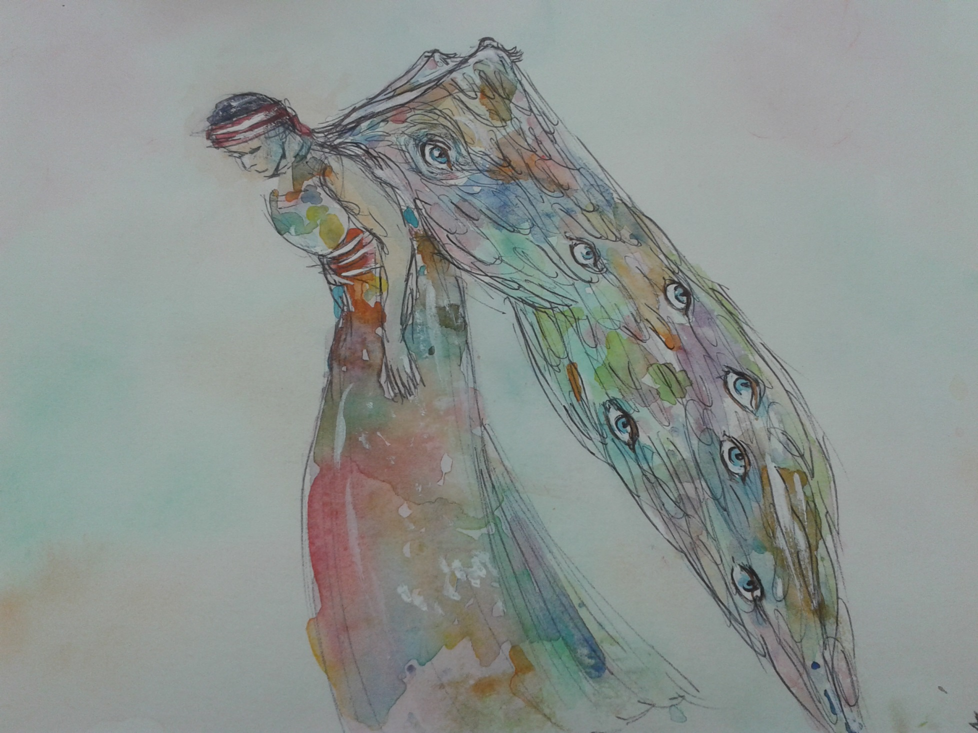

Slide 16
Vision Destiny 2015 2
Prov 8:12 “I, wisdom, dwell with prudence, And I find knowledge and discretion. 14 “Counsel is mine and sound wisdom; I am understanding, power is mine. 15 “By me kings reign, And rulers decree justice.16 “By me princes rule, and nobles, All who judge rightly.

Slide 17
Vision Destiny 2015 2
Proverbs 9:1-3 Wisdom has built her house, She has hewn out her seven pillars; She has prepared her food, she has mixed her wine; She has also set her table; She has sent out her maidens, she calls From the tops of the heights of the city:

Slide 18
Vision Destiny 2015 2
Engage Prudence and her gifts to open the revelation of the 12 houses.
The 7 gifts will enable you to navigate the dimensions that are to be opened.
Sextant, Compass, Log books, Map of territories, Instruments for measuring wind (Sound) and Waves (light) and the trumpet to herald the call.

Slide 19
Vision Destiny 2015 2
Son I am calling you to new level of governmental authority It is time to come near to Me and the heights of wisdom will be opened
l have given you the strategic instruments to plot the course ahead
My scroll has a large ship on it that was at anchor but is now moving

Slide 20
Vision Destiny 2015 2
Prudence will partner with you to discover the protocols that will open the doors and release My people into their positions of true heavenly authority.
A new quest is your reward for faithfulness. Engage the waterfall and your quest will be revealed.

Slide 21
Vision Destiny 2015 2
I give you this quest to unveil the depths of the fire stones and the sapphire cube.
The affairs of the nations must be brought to order and called into the alignment of eternity.
The house of scrolls will be opened once My precepts, statues and laws are in sequence and the ordinances of heaven have been set into motion.

Slide 22
Vision Destiny 2015 2
Your task is to unveil chancellors with the revelation of their true destiny.
Don't be overawed by this task it is your destiny. Yield and surrender and embrace the challenge.
Beware false covenants and alliances but actively pursue the relationships that I set before you.
Change the format and be proactive in legislative functions.

Slide 23
Vision Destiny 2015 2
I will set before you the opportunity to invest in many benches but you must now be proactive not reactive.
Call the benches to arise call the blueprints to be released and the shadows to form.

Slide 24
Vision Destiny 2015 2
You must focus on the governmental functions of Lordship and kingship
I have given you the swords of truth and judgement you must wield them with precision.

Slide 25
Vision Destiny 2015 2
Order - Order - Order the court is in session and the gavel is raised
Use this pause until September wisely to establish the order of the King as the Lion takes focus.

Slide 26
Vision Destiny 2015 2
The very stars are awaiting for their repositioning orders, as Sons accept their call to action from their mandated positions of true governmental authority.

Slide 27
Vision Destiny 2015 2
Everything is being prepared for the new order who will legislate statutes and ordinances because they know My ways and My testimonies and fully understand the council of my precepts.

Slide 28
Vision Destiny 2015 2
The ancient laws will be unveiled, the mysteries hidden in the dark cloud of My true person are being brought into the fullness of My light.
The books are being opened the ancient scrolls are once again being read. The creative force of my eternal desire for oneness is building, the pressure is increasing. The sound will be heard by true Sons.

Slide 29
Vision Destiny 2015 2
It is the time that I am about hold back the waters and the veil will be drawn.
Who will leave the old ways of the old order and cross over to the new dimensions of the royal priesthood of the Melchizedek order?

Slide 30
Vision Destiny 2015 2
Creation is waiting and will take a deep breath in anticipation of the revealing of true sons in their heavenly positions.
Who will cross over, who will embrace their destinies?

Slide 31
Vision Destiny 2015 2
The heavenly sound is intensifying and the winds of change are about to blow with great force.
Get ready. Be ready for the shift in dimensions is being prepared. Great shifts are going to be released in all spheres of authority as the mountain of the house of the Lord emerges from the wilderness to embrace it’s inheritance.

Slide 32
Vision Destiny 2015 2
The ground is about to break open and the landscape will be radically transformed. A voice is crying out from the wilderness prepare the way for My people to cross.
Let My forerunners cry out cross over, cross over. As they shift dimensions and open the portals into the realms of kingdom glory.

Slide 33
Vision Destiny 2015 2
Arise and shine with your glory as the glory of true sons is revealed.
Son prepare, prepare, prepare for the new depths of revelation that My people need in this hour.

Slide 34
Vision Destiny 2015 2
I will accelerate your ability and increase your capacity and give you the key to unlock those abilities and capacities in those who will follow you into the new order. A new order for a new spiritual landscape is about to arise.

Slide 35
Vision Destiny 2015 2
The 12 houses are about to release their mysteries and protocols to those who will follow the ancient paths to engage wisdom.
She calls to the sons of men to come and walk as Enoch on the ancient paths in the ancient knowledge and ways.

Slide 36
Vision Destiny 2015 2
Wisdom’s pillars are once again to be shadowed on earth as it is on her heights.
The 12 pillars, 12 stones, 12 foundations, 12 gates and 12 houses and their revelations are to come out of the darkness into the light.

Slide 37
Vision Destiny 2015 2
The mysteries hidden for so long in the shrouded mists are being readied to come forth from the myths and mythologies into revelation light. The ancient ways on the ancient paths brought out of darkness into the light of creativity.

Slide 38
Vision Destiny 2015 2
The power to create with conscious thought and the frequencies of sound and light will be restored to the true sons of God once again.

Slide 39
Vision Destiny 2015 2
Come back to creations womb, My heart to see what was and release what is to become what will be.
My heart is open to you, come and see. Come and see what you have always been. I call out to you come and see. Come to my heart and you will see once more what has always been.

Slide 40
Vision Destiny 2015 2
Progressive revelation
"The progressive character of divine revelation is recognized in relation to all the great doctrines of the Bible... What at first is only obscurely intimated is gradually unfolded in subsequent parts of the sacred volume, until the truth is revealed in its fullness."

Slide 41
Vision Destiny 2015 2
We recognize that God is continually restoring truths and light to His Church. We therefore place no limit on further revelation. However, each must be substantiated according to the Scriptures.
Mysteries, hidden truth, mystical truth revealed by the light of experience

Slide 42
Vision Destiny 2015 2
Dan 12:3 Those who have insight will shine brightly like the brightness of the expanse of heaven, and those who lead the many to righteousness, like the stars forever and ever. 4 But as for you, Daniel, conceal these words and seal up the book until the end of time; many will go back and forth, and knowledge will increase.”

Slide 43
Vision Destiny 2015 2
Rom 16:25 Now to Him who is able to establish you according to my gospel and the preaching of Jesus Christ, according to the revelation of the mystery which has been kept secret for long ages past,
Eph 3:4 By referring to this, when you read you can understand my insight into the mystery of Christ,

Slide 44
Vision Destiny 2015 2
Col 2:2 that their hearts may be encouraged, having been knit together in love, and attaining to all the wealth that comes from the full assurance of understanding, resulting in a true knowledge of God’s mystery, that is, Christ Himself,

Slide 45
Vision Destiny 2015 2
Col 1:27 to whom God willed to make known what is the riches of the glory of this mystery among the Gentiles, which is Christ in you, the hope of glory.
Experiential knowledge by encounter not intellectual information

Slide 46
Vision Destiny 2015 2
A way must be made for My new generation to find their destinies. The whole of the created orders are waiting longing for My sons to arise and restore them.
Ancient paths are opening once again. Where my people can walk with Me in the restored knowledge that was lost.

Slide 47
Vision Destiny 2015 2
Prov 8:2 paths meet, the way
Psa 23:3 paths of righteousness
Psa 139:24 the everlasting way
Isa 35:8 highway of holiness
Jer 6:16 ancient paths

Slide 48
Vision Destiny 2014 2
Jer 6:16 Thus says the Lord, “Stand by the ways and see and ask for the ancient paths, Where the good way is, and walk in it; And you will find rest for your souls. But they said, ‘We will not walk in it.’
People are still saying no

Slide 49
Vision Destiny 2014 2
Jer 18:15 ‘For My people have forgotten Me, They burn incense to worthless gods And they have stumbled from their ways, From the ancient paths, To walk in bypaths, Not on a highway,

Slide 50
Vision Destiny 2015 2
I am the God of the whirlwind and the fiery pillars and I am coming soon in judgment to My people to call them to decide who they will serve.
I am calling as multitudes stand in the valley of decision.
I call for judgment to new abundant overflowing life but the old orders must be left behind in the wilderness of indecision.

Slide 51
Vision Destiny 2015 2
Adam, Enoch, Noah and the ancient ones walked the ancient paths through the eternal dimensions. They walked on the circle of the deep. They walked amongst the stars they walked through the earth.
I am calling you to engage in the restoration of the ancient paths ways, and knowledge.

Slide 52
Vision Destiny 2015 2
Sons hear My cry, resonate with My call, align yourselves to My cause. I have shaken the old orders many times and once more the old order is about to be shaken and My true kingdom will begin to be manifested on earth as it is in heaven.

Slide 53
Vision Destiny 2015 2
My government will have its expressions on earth as Joshua’s and Caleb’s rise up and declare we will cross the line and we will take possession of our inheritance.

Slide 54
Vision Destiny 2015 2
This new order, this new breed has been promised for 40 years but only now will the force of My judgment by exerted. There will be no straddling the line there will be no foot allowed in both camps. I am issuing the call from My mountain
Choose you this day who you will serve

Slide 55
Vision Destiny 2015 2
There is fire in My eyes and a sword in My mouth and I am worthy to loose the seals. It is time to face the consuming fire of judgment who will bring Me their scrolls?
Who is prepared to come before Me?
Who is willing to stand before Him who knows all in all?

Slide 56
Vision Destiny 2015 2
Who will stand before Me and be undone, unravelled?
Who will embrace the fire from the altar?
Who will fly with the Seraphim?
Who will be My burning ones?
Who will be the fire starters?
Who, Who, Who?

Slide 57
Vision Destiny 2015 2
Judgement calls judgement beckons
Who will accept their destiny?
Who will Come to the Lion?
Who is worthy to open the scrolls?
Who will stand before the eyes of fire?

Slide 58
Vision Destiny 2015 2
Who will stand in the river of fire?
Who will ascend to the fire stones on My Holy Mountain?
Who will take their positions on the ancient path enthroned on My right hand?

Slide 59
Vision Destiny 2015 2
Those who will establish the pillars of fire on earth from heaven.
Those who will walk through the walls of fire and will burn as living flames.
Those who establish My storehouses, My Embassies, My habitations, My beachheads, My cities of refuge

Slide 60
Vision Destiny 2015 2
Heaven is looking to see its reflection on the earth and then the everlasting doors will be opened, then fire will purge the atmosphere as the canopy of fire spreads joining My pillars and becoming My covering once again.

Slide 61
Vision Destiny 2015 2
Son it is time. Listen carefully to everything I have to impart to you. You must rise up and take your place in government. I have assigned you the chancellors’ position and I have given you the seal.
It is time to begin to use it to engage the 12 houses to release understanding of the 12 heavenly laws of government.

Slide 62
Vision Destiny 2015 2
Go to each house in sequence and you will be able to receive the revelation you will need to authorise and release heavenly authority.
Release your frequency issue the call for the government to arise.
I am positioning those who will hear the call but you must be ready to invest them and seal their mandates.

Slide 63
Vision Destiny 2015 2
Son take your position and be ready for enthronements and coronations in the realms of heavenly government.
I know your heart and I know your struggles but don't be distracted from your heavenly assignment and quests.
The battles are for true government to reflect My house and My servant dominion.

Slide 64
Vision Destiny 2015 2
The release of angelic harbingers is near and those who refuse to embrace the new order will be given a choice until l will remove My approval and presence from their stewardship.

Slide 65
Vision Destiny 2015 2
Those who refuse sonship because they have ignored true friendship with Me will depart from Me because I don't know them.
Their destinies will pass to others who had been faithful to put relationship before ministry.

Slide 66
Vision Destiny 2015 2
There will be many successions that will take place as the old orders are removed and the new succeed them in heaven.
There will be many reassignments this coming year. Be ready to recognise and to authorise them.

Slide 67
Vision Destiny 2015 2
True government patterned after heaven will be established.
I am looking for the Sons who will take their heavenly positions and be who they always were.

Slide 68
Vision Destiny 2015 2
The pendulum is about to swing and momentum will increase as more and more enter the veils and experience My person. The dark cloud beckons and the eternal flame must be embraced.
The deeper experiences of My manifold, multi-faceted mysteries are to be encountered and then great shifts will take place.

Slide 69
Vision Destiny 2015 2
Don't be distracted by the esoteric Illusions that are being released that tickle the ears of the immature.
The mysteries hidden for so long are to be made plane for those willing to embrace their positions of responsibility.
Deep to deep beckons but the cost must be weighed. The mysteries hidden will be made plane for those who will pursue Me.

Slide 70
Vision Destiny 2015 2
The dimensions must be entered for the revelation of the mysteries to be opened up and governmental authority revealed.
The mysteries once hidden are awaiting those who will answer the call to take their places in heavenly government.

Slide 71
Vision Destiny 2015 2
I will issue the call to come once again. Be ready to make it simple.
The sapphire cube and the dimensions within dimensions have been mysteries but now will be experienced by those who are willing to come within.

Slide 72
Vision Destiny 2015 2
The 3, 4, 7, 12 dimensions of governmental orders will be revealed through personal encounter with these heavenly dimensional spheres not through the esoteric ramblings of the so called mystics who are placing veils of mystery over the eyes of those who look and listen but have not entered in and have not taken their positions as Lords.

Slide 73
Vision Destiny 2015 2
Metatron is my chosen vessel for this year. The keys to understanding the times will be given freely and the doors to the dimensional spheres of true governmental authority will be opened.
Metatron will give the keys and open the doors to those willing to let go of the old and fully embrace the new order.
Lengthening and shortening time for the resourcing of good deeds

Slide 74
Vision Destiny 2015 2
The order of Melchizedek will arise and be revealed when the last generation finally refuse to cross and the 40 years is complete.

Slide 75
Vision Destiny 2015 2
The Joshua generation will be given the mantle of government and investiture and succession will be over and enthronements will quickly take place.
The forerunners have gone before they are already in governmental heavenly positions but must be ready.

Slide 76
Vision Destiny 2015 2
When the 40 years has passed expect the light intensity to increase to such a level that the old orders will be exposed for what they are, man’s best efforts.
I will leave in ways that appear suddenly to take place but for many they have ignored the call to cross over for years.

Slide 77
Vision Destiny 2015 2
Suddenly will only be the appearance to those who have followed and have been submitted under the old mountains.
Long have I been calling to the sons of men to come but they would not.

Slide 78
Vision Destiny 2015 2
The call will continue for 8 months in 2015 and then I will finally begin to leave the old order.
Then the new sound of the new call to cross over and enter beyond the veil will go forth to those who have never imagined or thought.

Slide 79
Vision Destiny 2015 2
Make ready the Joshua Generation for they must be ready to guide those who will be early responders and will become lost without the forerunners.
The new landscape will be overwhelming without those who have spied out the land.

Slide 80
Vision Destiny 2015 2
Son your heavenly governmental position will increase next year so you must become more governmental in your engagements.
Son reorder everything to facilitate establishing government. In your heavenly chancellors role release and seal blueprints for government.

Slide 81
Vision Destiny 2015 2
The affairs of the nations will be a high priority so government must be established for cities, regions, parallels.
The map of the world will be rewritten and great shifts in the affairs of those new order governments will be the agenda of heaven.

Slide 82
Vision Destiny 2015 2
As the sword of judgment falls on the religious systems of man, I will reveal the pure golden bride from amongst the ore.
The seraphim are being prepared and the fiery swords already in place.

Slide 83
Vision Destiny 2015 2
From the fire of true judgment the true Ekklessia will rise. l will reveal by fire and those who are willing to leave the old Moses systems behind will be the Joshua foundations of the new order.

Slide 84
Vision Destiny 2015 2
The fire of My judgment will both remove the stumbling blocks and bring lawlessness into the light.
I will reveal that which does not reflect heavens government and new mountain foundations will rise from the desolation of My departing.

Slide 85
Vision Destiny 2015 2
Many cries of Ichabod, the glory has departed will go forth as I leave the old desolate just as I left the temple of old.
I am once again ready to overturn the money changers tables of those who have turn My house into self serving businesses.

Slide 86
Vision Destiny 2015 2
I have been preparing for 4O years as this generation has mostly ignored the call to prepare for the harvest.
Now the final calls are being released in preparation for My verdict. Those who leave the old with Me will go deeper into the revelation of the supernatural heavenly engagements that are hallmark of the new order.

Slide 87
Vision Destiny 2015 2
Those who do not embrace their heavenly positions of government beyond the veil of Jordan in their true inheritance will remain in the desolation of the wilderness.

Slide 88
Vision Destiny 2015 2
In August l will begin to leave the institutions of the old earthly religious systems.
My presence in the new order patterned after the blueprints of heavenly government will transition to glory.

Slide 89
Vision Destiny 2015 2
I am calling the Joshua generation to follow Me out of the wilderness of the old order into true destiny as sons, invested with heavenly authority and ready prepared for enthronement.

Slide 90
Vision Destiny 2015 2
For the new to be enthroned there must be a succession. The old must die for the new to be multiplied.
Don't let loyalty to the old hinder you.
Don't look back. You can not change the old from within it unless those who are leaders in the old are Joshua forerunners of the new.

Slide 91
Vision Destiny 2015 2
Only remain in what still appears to be old if there are visionary apostolic leaders who have tasted beyond the veil and who have My heavenly blueprints to transition into the new order.

Slide 92
Vision Destiny 2015 2
If there is no heavenly blueprint where you are then follow Me and I will lead you to the new orders that are being established those who are laying the foundations of the cities of refuge.

Slide 93
Vision Destiny 2015 2
Only those who are prepared to engage heaven and invert the mountains in humility and become reflections can truly transition from old to new.
Son you must focus on your role as heavenly chancellor to release the blueprints and support those in transition and open the revelation of the 12 laws and 12 chancellor’s houses of Zion.

Slide 94
Vision Destiny 2015 2
The mysteries so long hidden secrets are now being revealed. The myths so called will become true ancient pathways for My people to walk on again.
The patterns of heaven will be unveiled so that My true government can bring dominion to the whole created order.

Slide 95
Vision Destiny 2015 2
You have your sword, you will be one of My Instruments of judgement. The sword of truth will divide separate and call for decisions and choices to be made.

Slide 96
Vision Destiny 2015 2
Swing the sword with love, honour and respect for many who are still in the valley of decision in the wilderness and siding with the Moses generation are yet to decide. Issue a call. Send out a proclamation.

Slide 97
Vision Destiny 2015 2
Blow the silver trumpet and decree the new season. Consecrate yourselves for I am about to do great wonders in the heavenly realms and great shakings will take place in the atmosphere and on the earth.

Slide 98
Vision Destiny 2015 2
Many will call it this and many that, but it is the birth pangs of the new order and the death rattle of the old.
Creation itself will begin to shift in response to the revealing of heavenly government on the earth once again.

Slide 99
Vision Destiny 2015 2
There will be schisms and divides on the maps of men but on the maps of heaven there will be great movement towards oneness and harmony for the affairs of the nations.
Son your capacity will supernaturally increase as you fully embrace your role both in heaven and on earth.

Slide 100
Vision Destiny 2015 2
I went to the temple the seraphim were really attentive and I saw their eyes. I took a bow and fired arrows at a map. North West and South East of North America
Each arrow had a red cord attached to it formed a matrix of connections.
l saw it overlaid with a pyramid pattern NW to NE NW to SE to SW NE to SW

Slide 101
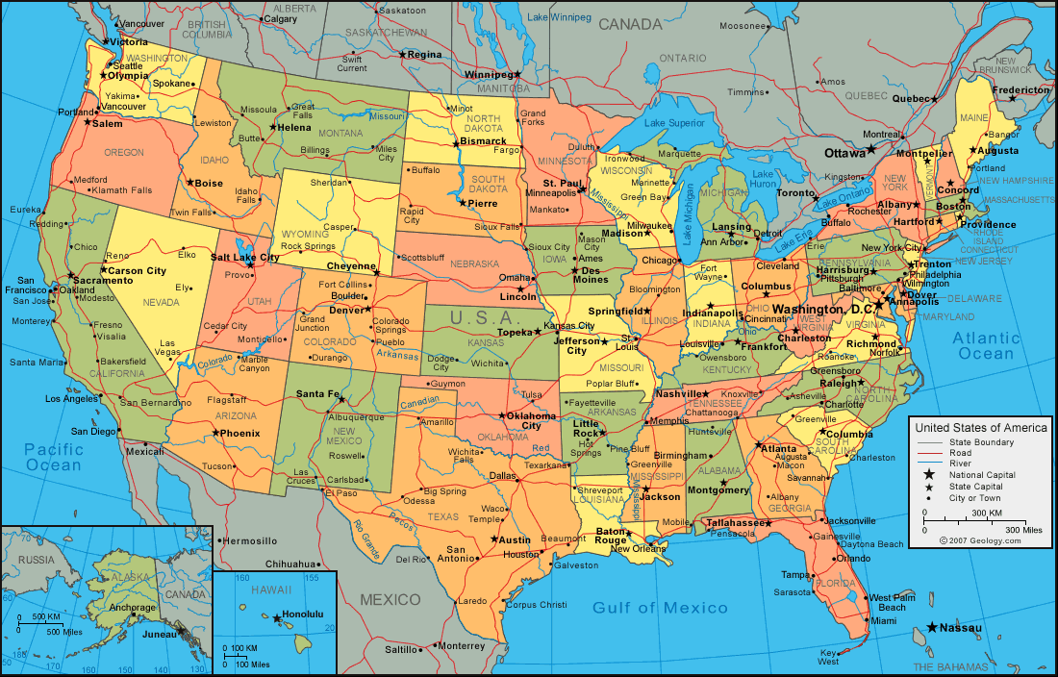

Slide 102
Vision Destiny 2015 2
Lion roared calling me to release a new sound a new call. The old order will end and the new order must be ready to take responsibly.
There are so many mountain ranges occupied by dragons and giants because of the failure of the Moses generation to cross into their heavenly authority. I saw ranges of mountains covering the globe.

Slide 103
Vision Destiny 2015 2
I saw so many Mountains with 3 thrones on them waiting for Benches of 3 to rise up and take their places.
So many who failed to answer the call of their destiny.
So many too busy with ministry to become friends who have been working for Me in long over mandates.

Slide 104
Vision Destiny 2015 2
I am releasing the call for Joshua's and Caleb's to arise and be the sound for the next generation to resonate with.
I am calling Fathers and mothers to align their hearts with mine so I can turn the hearts of the children back to their heavenly destinies
Son become the sound of the Lion roaring the new frequency that will cause a resonance to the place like never before.

Slide 105
Vision Destiny 2015 2
You have accepted responsibility for 2 scrolls but there are more coming. You must be ready.
The hills must be laid low and the valleys raised, the way must be made straight so there can be the highway of holiness that will lead to the ancient paths once again. The cherubim and the fiery swords must be embraced to access the way.

Slide 106
Vision Destiny 2015 2
Look to the constellations for the signs of impending upheaval as the affairs of the nations are administered by the sons of God once more.
The stars will release their light and glory to the sons of God once more. The resonance of their light and sound once again restored to divine order.

Slide 107
Vision Destiny 2015 2
Announce it, herald it, blow the silver trumpet Ekklesia arising Ekklesia arising.
Answering creations groan with the resonant frequencies of heaven on earth as sons arise to vibrate to the rhythm of the Fathers heart.

Slide 108

Vision Destiny 2015

Slide 109
Vision Destiny 2015

Slide 110
Vision Destiny 2015
Awareness of Times and Seasons
Greater Heights of Spiritual Vision
We have to be Released from Religious Traditions or Habits
To See and Hear into the Unseen Realm
5) Rhema Understanding of Your Spiritual Migration

Slide 111
Vision Destiny 2015
limitation. That means that we are standing at the most critical most important time of all human history. (She goes into the 3rd day of the church)…we’ve entered into 7th day of man’s communion of the divine nature Matt 17 …after 6 days Jesus was transfigured…7th day stands for transfiguration, perfection, and restoration. So here we are right now, this is where we are in times and seasons, We are standing right at the cross point between the 7th day transfiguration and the 3rd day of the resurrection., That means that the Church is coming in to the day of it’s greatest glory. The thing that we have not seen- that eyes have not seen nor ears heard., that is about to be unfolded in our eyesight.

Slide 112
Vision Destiny 2015
The overlapping place
A vision that she had in 1995 where God caught her up in the spirit and He showed her the earth realm and spirit realm and they were very far apart and there was a separation in between them and there wasn’t even an access place from one to the other. And suddenly the Hand of the Lord took these two realms and He began to push these two worlds together until they became overlapping.

Slide 113
Vision Destiny 2015
He said “ I’m going to raise up a troop of over-comers who are going to stand in an overlapping place and they are going to stand between the earthly realm and the spiritual realm and they are going to go up in to the spiritual realm and they are going to grab what they see and manifest it in the earth”.

Slide 114
Vision Destiny 2015 1
The Incubation in January and the Birthing in September
The Lord spoke to me and said that this will be a year that the seers are coming into their multi-dimensional sight. A new realm of the prophetic will be birthed this year. In January, many prophetic people will enter into a season of incubation for greater manifestation.

Slide 115
Vision Destiny 2015 1
The Lord showed me that from January to September will be a time of preparation for what is going to be birthed toward the end of September
This nine-month period will be a time for the conception and forming of a supernatural movement to be birthed into the earth. He said, "This will be the beginning of the overshadowing! Much like what Mary encountered.

Slide 116
Vision Destiny 2015 1
There will be a birthing of a greater glory at the end of September. A place of unusual power will begin to flow toward the end of 2015 like we have never seen before. Many will begin to taste of the age to come. There will be a prophetic people that will begin to emerge toward the end of next year that will speak a wisdom that is not of this world. They will manifest a message from an age to come. They will transcend the system of the world and operate from a higher order of the supernatural.

Slide 117
Vision Destiny 2015 1
A Daniel company is coming! This will be a company of prophets who can discern our times with pinpoint accuracy. Some will be given high places to speak into earthly governments around the world. They will have a mandate from the Lord to administer justice and solve complex situations that human intellect cannot understand.

