Slide 1
Engaging heaven on earth
Over the last 12 months we have begun to engage with God’s presence in the heavenly tabernacle
Yod Hei Vav Hei YHVH
There has been an increased engagement with flags, colours, prophetic acts etc.
We are engaging with the 4 faces of God
We are engaging with the 4 angels
We are engaging with the 7 spirits of God

Slide 2

East
Lion
King
YOD
Sound of many waters
Winds of Change
Heavenly
Tabernacle
Holy of Holies
Arc of God
South
Ox
Prophet
HEI
North
Man
Priest
HEI
Refining Fire
West
Eagle
Apostle
VAV
Transformation

Slide 3

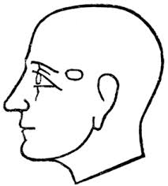

Engaging heaven on earth

Slide 4
Lion
King
YOD
Winds of Change
Transformation
Man
Priest
HEI
Ox
Prophet
HEI
Eagle
Apostle
VAV
Refiners
Fire
Sound of
many waters

Slide 5
Engaging heaven on earth

Slide 6
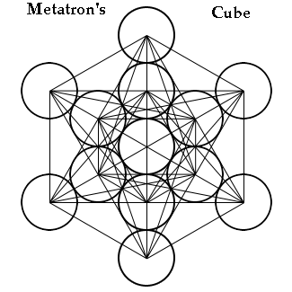

Slide 7
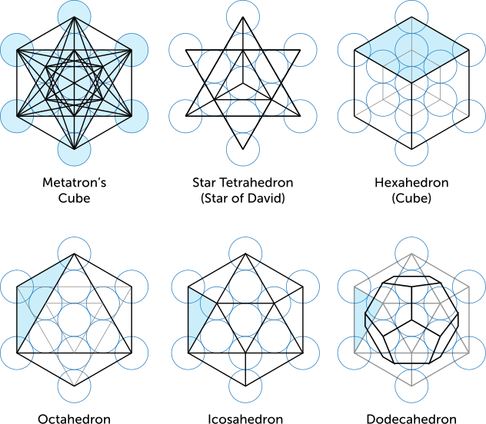

Slide 8
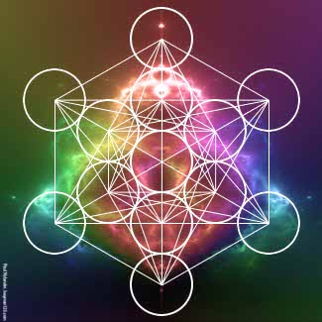

Slide 9
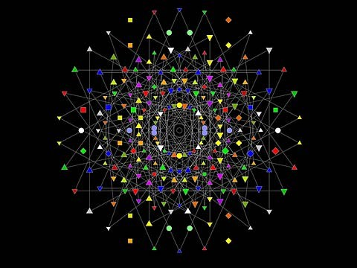

Slide 10
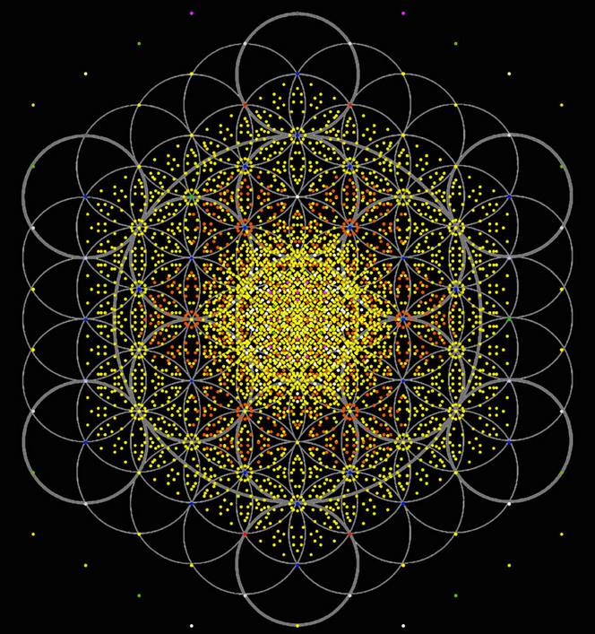

Slide 11
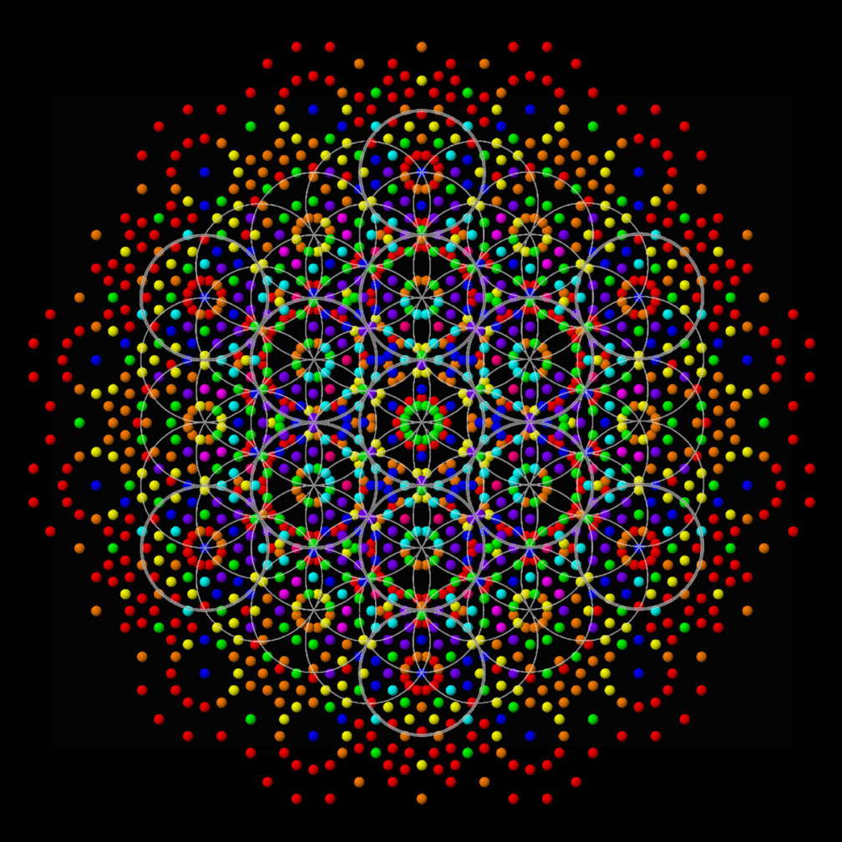

Slide 12


Slide 13


Slide 14


Slide 15
Engaging heaven on earth
What happened to herald Jesus arrival
There were signs in the heavens – stars
The mazzaroth or constellations were aligned in the heavens
Wise men or kings saw the signs
Angels before, during and after His birth

Slide 16
Engaging heaven on earth
Angelic activity, announcements, manifestations of glory, the opening of the heavens.
Wise men or Kings came from the east with gifts for the king
Who were these wise men and where did they come from?
Out of the east of Eden, east gate of the temple flowed the river of life

Slide 17
Engaging heaven on earth
7 spirits of God came to Jesus with gifts that were in recognition of His kingship His position and identity
Luke 2:52 And Jesus kept increasing in wisdom and stature, and in favour with God and men.
How?

Slide 18
Engaging heaven on earth
7 spirits of God trained Him
Isa 50:4 The Lord God has given Me the tongue of disciples, That I may know how to sustain the weary one with a word. He awakens Me morning by morning, He awakens My ear to listen as a disciple.
Train the heir in His sonship identity

Slide 19
Engaging heaven on earth
There is a great shift coming
Governors and tutors are being released to prepare for this shift into a new order
The cloud of witnesses and the 7 spirits are here to train and tutor us to take our positions as lords, kings and sons.
We must be willing to embrace and engage them if we are to fulfil our destiny to rule and bring dominion.

Slide 20
Engaging heaven on earth
Just as God releases the 7 spirits so does the enemy
Luke 11:26 Then it goes and takes along seven other spirits more evil than itself, and they go in and live there; and the last state of that man becomes worse than the first.”
The enemy seeks to counterfeit so he can rob, kill and destroy our destinies

Slide 21
Engaging heaven on earth
Rev 1:4 John to the seven churches that are in Asia: Grace to you and peace, from Him who is and who was and who is to come, and from the seven Spirits who are before His throne,
Greetings from beyond the veil
Indicate engagement and relationship

Slide 22
Engaging heaven on earth
Rev 4:5 And there were seven lamps of fire burning before the throne, which are the seven Spirits of God;
Rev 5:6 And I saw between the throne (with the four living creatures) and the elders a Lamb standing, as if slain, having seven horns and seven eyes, which are the seven Spirits of God, sent out into all the earth.

Slide 23
Engaging heaven on earth
Lamps = light or illumination
Fire = heat or refining
Throne = government
Lamb = sacrifice
Horns = authority
Eyes = revelation insight perception
Sent out with a purpose

Slide 24
Engaging heaven on earth
When something is sent out it is given a purpose, a mandate, authority to do a job.
The purpose of the 7 Spirits of God is to empower you and I to establish the Kingdom and to express it as heirs of God to the world around us that need Him.
Are we willing to say here am I send me?

Slide 25
Engaging heaven on earth
2 Chron 16:9 "For the eyes of the LORD move to and fro throughout the earth that He may strongly support those whose heart is completely His.
7 spirits will engage with those whose hearts are God’s and whose desire it is to operate as sons of God

Slide 26
Engaging heaven on earth
Isa 11:2 The Spirit of the Lord will rest on Him,
The spirit of wisdom and understanding,
The spirit of counsel and might (strength),
The spirit of knowledge and the fear of the Lord.
3 And He will delight in the fear of the Lord, And He will not judge by what His eyes see, Nor make a decision by what His ears hear;

Slide 27
Engaging heaven on earth
The 7 Spirits of God are not the Holy Spirit.
They are heavenly spiritual beings created to train us, mandate us and equip us to become sons of God
They are the testators to the covenant of adoption
They are our tutors

Slide 28
Engaging heaven on earth
Galatians 4:1-2 ‘An heir, though he be lord of all, is under tutors and governors until the appointed time.’
A tutor means someone who trains you
A governor means someone that teaches you how to rule or who rules over you until you can rule.

Slide 29
Engaging heaven on earth
Gal 3:29 we are heirs of the promise
Rom 8:16 joint heirs with Christ
If we are an heir to a promise then the heir needs to be trained to become a joint heir in Christ.
To be an heir of a promise doesn’t mean you are going to automatically inherit the promise,
There is a training process to go through to inherit the promise.

Slide 30
Engaging heaven on earth
As heirs we have huge potential to come to maturity, but we need to be trained
Isa 61:1 The Spirit of the Sovereign Lord is upon me, Because the Lord has anointed me To bring good news to the afflicted; He has sent me to bind up the brokenhearted, To proclaim liberty to captives And freedom to prisoners; 2 To proclaim the favourable year of the Lord

Slide 31
Engaging heaven on earth
1 John 1:15 .. God is Light, and in Him there is no darkness at all.
God is creative light at the ultimate speed that contains all wavelengths and bandwidths, electromagnetic frequencies
Prism is a pyramid or mountain shape that expresses white light as colours
Colour, wavelength of light, frequency of vibration, fragrance, shape

Slide 32
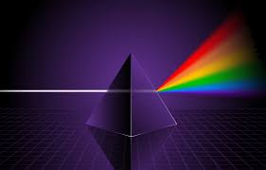
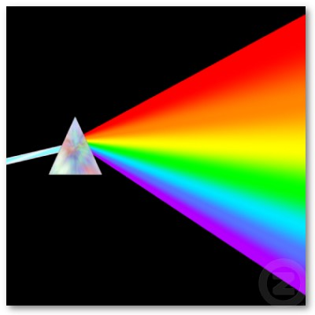
Engaging heaven on earth

Slide 33

Engaging heaven on earth

Slide 35
Engaging heaven on earth
We can engage with the colour that represents each of the 7 spirits
Spirit of the Lord is red
Spirit of Wisdom is orange
Spirit of Understanding is yellow
Spirit of Counsel is green
Spirit of Might is blue
Spirit of Knowledge is indigo
Spirit of the Fear of the Lord is violet or purple

Slide 36
7 spirits of God
SPIRIT OF COUNSEL
SPIRIT OF
UNDERSTANDING
SPIRIT OF MIGHT
Prepares us for Position
Authorizes us for Position
Reveals us for Position
SPIRIT
OF
WISDOM
SPIRIT OF KNOWLEDGE
Empowers
us for Position
Equips us for Position
SPIRIT OF THE
LORD
SPIRIT OF THE FEAR OF THE LORD
Mandates us for Position
Brings us into
Accountability
For Position

Slide 37
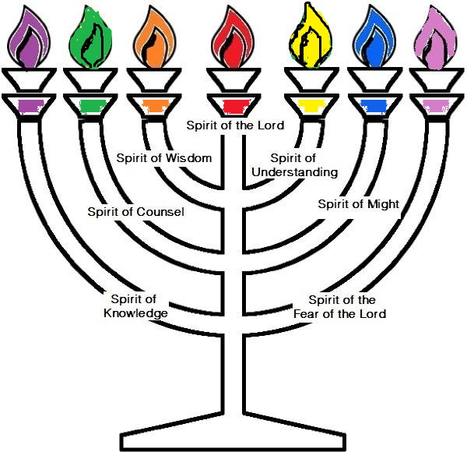

Slide 38
Engaging heaven on earth
Spirit of the Lord: mandates us for position.
Spirit of Wisdom: equips us for position.
Spirit of Understanding: authorises us for position.
Spirit of Counsel: prepares us for position.
Spirit of Might: reveals us for position.
Spirit of Knowledge: empowers us for position.
Spirit of the Fear of the Lord: brings accountability for position.

Slide 39
Engaging heaven on earth
What is a position?
The right or appropriate place
A strategic area occupied by members of a force
An advantageous place or location
Social standing or status; rank
A post of employment; a job.
The area for which a particular player is responsible.

Slide 40
Engaging heaven on earth
Position in government eg. prime minister chancellor exchequer, defence, education
Position in the team GK RB MF CF
Position in heavenly or earthly dimensions
Position charge of house & charge of courts Zech 3:6-7
Position of heavenly governmental kingdom authority
I am a dwelling, I am a mountain, I am a gateway

Slide 41
Engaging heaven on earth
An appointed position
A mandated position
A governmental position
A position of sonship
Our destiny has positions attached to it
We need to know our position our eternal identity

Slide 42
Engaging heaven on earth
Spirit of the Lord Mandates
Spirit of Wisdom Equips
Spirit of Understanding Authorises
Spirit of Counsel Prepares
Spirit of Might Reveals
Spirit of Knowledge Empowers
Spirit of the fear of Lord Accountable

Slide 43
Engaging heaven on earth
Spirit of the Lord Mandates
Mandate an official order or commission to do something.
Give (someone) authority to act in a certain way.
Instruction, directive, direction, decree, command, order, injunction, edict, charge, commission,

Slide 44
Engaging heaven on earth
Spirit of Wisdom Equips
Equips: supplies with the necessary items for a particular purpose.
To supply with necessities such as tools or provisions. To furnish with the qualities necessary for performance
To furnish or provide with whatever is needed for use or for any undertaking; fit out, as a ship or army:

Slide 45
Engaging heaven on earth
Spirit of Understanding Authorises
Authorize give official permission for or approval to (an undertaking or agent).
Permit, sanction, allow, agree to, approve, give one's consent/assent to, consent to,
To grant authority or power to.

Slide 46
Engaging heaven on earth
Spirit of Counsel Prepares
Prepares: make (someone) ready or able to do or deal with something.
To make ready beforehand for a specific purpose, as for an event or occasion
To put in proper condition or readiness

Slide 47
Engaging heaven on earth
Spirit of Might Reveals
Reveals: make (previously unknown or secret information) known to others.
To make known (something concealed or secret)
Unveil, publish, impart, tell, announce, proclaim.

Slide 48
Engaging heaven on earth
Spirit of Knowledge Empowers
Make (someone) stronger and more confident, especially in controlling their life and claiming their rights.
To invest with power, especially legal power or official authority

Slide 49
Engaging heaven on earth
Spirit of the fear of Lord Accountable
Accountable: required or expected to justify actions or decisions; responsible.
Responsible, liable, answerable
The obligation of an individual or organization to account for its activities, accept responsibility for them, and to disclose the results in ...

Slide 50
Engaging heaven on earth
Trained to have insight into the ways of the kingdom and it’s judicial protocols and functions of government
What Why How Where When
We become authorised and accountable

Slide 51
Engaging heaven on earth
Spirit of the Lord, is about positional dominion. The Spirit of the Lord mandates us for position.
It teaches us, it enables us to experience and see the reality of the dimensions of the Kingdom; about the throne room, about power, about authority, about dominion, about sonship, about rulership, about transfiguration, translation and trans-relocation.

Slide 52
Engaging heaven on earth
It teaches us about bringing divine order and divine government out of justice from Heaven; divine government and how to assert it on the earth as it is in heaven
Anything to do with the glory realm of God is about the Spirit of the Lord and how to exercise dominion on the earth.

Slide 53
Engaging heaven on earth
The Spirit of Wisdom:
The Spirit of Wisdom equips us for position.
The Spirit of Wisdom produces prosperity and delight towards God.
It teaches us how to judge and how to bring justice.
It teaches us how to exercise these as sons from the throne that we’ve been given to rule in.

Slide 54
Engaging heaven on earth
It teaches us how to bring divine order and authority into the spirit realm and how to bring divine justice out of it; it teaches us what to do in the realm of rulership as a son.
The Spirit of Wisdom releases contentment and joy in knowing we are fulfilling our destiny

Slide 55
Engaging heaven on earth
The Spirit of Understanding authorises us for position.
It teaches us where to and how to access the realm of God.
It teaches us how to use what we have at the right time.

Slide 56
Engaging heaven on earth
It helps us to decipher revelation and visions.
It teaches us how to perceive, how to teach and inform others about the realm of the Kingdom.
It teaches us how to rule in the realms of God as a son.

Slide 57
Engaging heaven on earth
The Spirit of Counsel prepares us for position.
The Spirit of Counsel teaches us which ways to rule as a son, teaches us how to access the counsels of God.
How to consult with them; it teaches us how to resolve issues and bring advice of God to those around you out of the realm of the spirit

Slide 58
Engaging heaven on earth
It teaches us how to commune with God and gain His advice.
It instructs us in the function of the different council chambers of God; about the role of the royal advisers to Him; about the Holy Spirit; and about the Son.
It teaches us about the triune of God and their role in our lives today.

Slide 59
Engaging heaven on earth
The Spirit of Knowledge empowers us for position.
It teaches us how to access the knowledge of God, how to apply that knowledge of God to the world around us.
It enables us to become aware of our place to rule as a son of God and what to do with what you know.
It enables us to gain access to knowledge about the supernatural realms of God, how they operate and how they function.

Slide 60
Engaging heaven on earth
Not only does the Spirit of Knowledge reveal but also teaches us how to retain what we see and to process and store the information until it becomes permanent in us.
It teaches us how to meditate and receive divine insight and revelation though visions, visitation and also through dreams; into circumstances and to bring God’s will on the earth.

Slide 61
Engaging heaven on earth
The Spirit of Might reveals us for position. It teaches us how to exercise the supernatural realm of God to reveal the power of God, the dominion of God and how to exercise it in the world and in the spirit realm around us.
It teaches us about the council chamber of war and the secrets of how to war in the spirit realm in the heavenlies.

Slide 62
Engaging heaven on earth
It teaches us about the heavenly places of God and how we are seated there.
It instructs us about our seats of rulership and the governmental arenas that we operate in as a king,
It instructs us how to do the works of the kingdom

Slide 63
Engaging heaven on earth
Spirit of the Fear of the Lord. is about and around the person of God.
It teaches us about the realms of holiness, intimacy, worship, reverence and righteousness.
It teaches us how to access and bring divine order and its application to the world around us.

Slide 64
Engaging heaven on earth
This fear is not as in being afraid but rather an understanding of the awe and wonder and majesty and might and dominion of the person of God.
The Spirit of the Fear of the Lord brings accountability for position.

Slide 65
Engaging heaven on earth
The spirit of the Lord - Let me show you how the Lord operates, he took me to a sort of giant screen where I saw the sun warming a garden and then the same sun producing a fierce heat in a burning desert.
He showed me a bubbling river and still waters and then I saw a raging torrent capable of incredible power and destruction.
He showed me a fire warming hands on a cold night and a raging inferno of a forest fire.

Slide 66
Engaging heaven on earth
He showed me a shepherds crook and a mighty sword.
He showed me righteousness and justice.
He showed me Jesus speaking words of pure love as He washed His disciples’ feet and the words of anger as He whipped and cleansed the temple.
He showed me the contrast of righteousness and justice, mercy and judgment.

Slide 67
Engaging heaven on earth
The Spirit of the Lord brings great separation and division in the hearts of men, spirit and soul dividing the thoughts and intentions, motives of the soul and spirit.
God is always good and He is always flowing from a gentleness and humility motivated by love, but when you see the righteousness and justice you will understand wisdom.

Slide 68
7 spirits of God
SPIRIT OF COUNSEL
SPIRIT OF
UNDERSTANDING
SPIRIT OF MIGHT
Prepares us for Position
Authorizes us for Position
Reveals us for Position
SPIRIT
OF
WISDOM
SPIRIT OF KNOWLEDGE
Empowers
us for Position
Equips us for Position
SPIRIT OF THE
LORD
SPIRIT OF THE FEAR OF THE LORD
Mandates us for Position
Brings us into
Accountability
For Position

Slide 69
Engaging heaven on earth
He took me to meet the spirit of understanding. I had a picture of a rainbow land; I went on a journey in the river of grace. There were rapids and white water and Jesus said that the river of grace was not always still and gentle. There were rapids of acceleration times of great understanding and growth and there were waterfalls of almost instant growth but then the river flowed gently to the still water and green pastures of my garden. The table cloth was set with wonderful truths to eat. I met understanding 6 arms each a different colour and a body of the 7th colour. I am connected to all the other 6 so that together we produce understanding. This when knowledge and wisdom, counsel, ways of the Lord, fear of God and strength all flow together and you know that you know that you know.

Slide 70
Engaging heaven on earth
I saw the awesome white gleaming light of these multi-colours flowing from understanding like an explosion of revelation but a stream of peace and love carried on the wave of grace. This is what you must find in meditation and prayer fellowship communion; this is what the Father is doing in each and every situation and circumstance. This insight and understanding my come as a blinding flash of light or as all the colours merge into one after quiet and careful prayer and reflection.

Slide 71
Engaging heaven on earth
This light of understanding requires obedience and submission and obedience harmonises and resonates through the spirit gates, soul gates and body gates and manifests as glory.
He then took me back to the tree of life and showed me another fruit this was the fruit of harmony (faith) it looked a swirl of colour and its shape was almost ethereal, shifting colours and shapes in front of me. He gave me one to eat and as I bit it there was an explosion of sight, smell, taste, sound and feel all flowing with the OOO in resonating waves and flowing frequencies of sounds and colours.

Slide 72
Engaging heaven on earth
This was amazing quite beyond anything, I could taste colours and sounds, see sound, hear colour, smell and feel colour and sound. This was a culmination of every spirit, soul and body sense flowing in time with the rhythm, dance and movement of creation. This fruit cannot be released until the others are eaten and lived but it is available and it is my desire that you live it.

Slide 73
Engaging heaven on earth
The Spirit led me to meet the spirit of strength, you have already met the fear of God he led you to the fire and smoke of judgment. Strength was not at all what I was expecting. He was kind of ordinary. You were expecting a warrior he said. I don’t bring you physical strength but I am the ability to say yes when you understand, I enable you to obey to say yes when everyone else says no. When there is opposition and fear is coming against you I enable you to say YES.

Slide 74
Engaging heaven on earth
True strength is in humility and submission to Him to the way, truth and life. True gentleness is having the ability to resist but choosing to surrender. I enable you to surrender to the Father’s will even when you find no sense. I am the ability to say yes and obey.

Slide 75
Engaging heaven on earth

Slide 76
Engaging heaven on earth
He took me to meet the 7 spirits of God before the throne. I asked to see the spirit of counsel. I imagined him to be old and wise but he was not like that at all. He was a creature of beauty and elegance, defined features of light. I told him that I did not know what his function was, what is a spirit of counsel? He pointed to a shape in the distance like a hill and then we were there, very strange; I was standing on a head attached to a heart and a mouth and eye. He said this is counsel it is the collective wisdom of the head, the purpose and reason behind it the heart that overflows through the mouth with the motive and the eye of the heart that would enable to see the outcomes of any choice on the screen of the imagination.

Slide 77
Engaging heaven on earth
These are the counsel of God that is available for any situation, circumstance and decision. The mind of Christ revealing the purpose, the heart of the Father revealing the motives, the eye of the Spirit revealing the consequences or future outcomes. This counsel is how we are to see what the Father is doing and why so faith can arise in our hearts as we see the outcome. The spirit of counsel is always available to enable us to have the mind of Christ, to know the heart of the Father and the revelation of the Spirit.

Slide 78
Engaging heaven on earth
In this pasture I saw a large picnic blanket spread out with many things on it to eat. This is where I set a table before your enemies, this is where you can talk to the spirits of God that I have sent out to reveal myself through. I thought they were before your throne I said. They are always connected to me but this heaven and different rules apply here. I know you wanted to speak to wisdom. I was aware that two creatures came, they always come together God said, you cannot have wisdom without knowledge and you cannot have knowledge without wisdom they are always joined.

Slide 79
Engaging heaven on earth
They looked different, knowledge had a large head and a small body and wisdom had a small head but a large body and hands. So I started talking to them, knowledge said I am the why and what and wisdom said I am the how and when. You cannot have the why and what without the how and when said wisdom and you can’t have the how and the when without the why and the what said knowledge. They were a double act and seemed to have a real flow between them. I am connected to the grace thoughts, the creativity of God and His eternal mind said knowledge and I am connected to the heart and hands the timing and purpose.

Slide 80
Engaging heaven on earth
We work together it is no good having one without the other they said. You need the why and the what and the when and the how and then you need to understand the 2 fold nature of God to know the heart righteousness and justice, mercy and judgment and you need the counsel that shows you head, heart and eye. We are all different and you will need to know all of us, we all place food on this table and you can come here whenever you want. Then God said this river and pasture are found in your garden you must spend time here, this is where you will learn to flow grace and faith power.

Slide 81
Engaging heaven on earth
The spirit of the fear of the Lord gave me the scroll of my life and took me to the judgement seat to give an account for the wood, hay and stubble and the gold silver and precious stones on the front and back
How does my scroll compare with my destiny scroll?

Slide 82
Engaging heaven on earth

Slide 83

Engaging heaven on earth
Open the eyes of your spirit
Engage unseen realm in the atmosphere of the room
Pictures, visions, thoughts, impressions, feelings in your mind
By faith engage one of the 4 angels

Slide 84
Engaging heaven on earth
They are blowing their trumpets heralding a new season for your life
Let the sound of their trumpets resonate over you bringing you into a new alignment with heaven and your eternal destiny
Let the frequency of the sound vibrate in every atom of your being transforming you

Slide 85
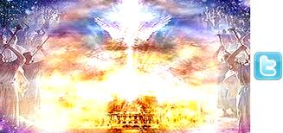

Slide 86
Engaging heaven on earth
Close your physical eyes relax
Fix your mind & thoughts on the unseen realms
See your spirit flowing through your gateways releasing a wave into the room
Open the eyes of your heart – engage your imagination screen
Now sense your guardian angels behind you let your spirit describe them

