Slide 1
Vision Destiny 2014
We are on a journey to the new land
Isa 2:5 Come, house of Jacob, and let us walk in the light of the Lord.
Isa 2:20 He, your Teacher will no longer hide Himself, but your eyes will behold your Teacher. 21 Your ears will hear a word behind you, “This is the way, walk in it,” whenever you turn to the right or to the left.

Slide 2
Vision Destiny 2014
Jer 6:16 Thus says the Lord, “Stand by the ways and see and ask for the ancient paths, Where the good way is, and walk in it; And you will find rest for your souls.
Isa 40:31 Yet those who wait for the Lord Will gain new strength; They will mount up with wings like eagles, They will run and not get tired, They will walk and not become weary.

Slide 3
Vision Destiny 2014
Isa 43:2 “When you pass through the waters, I will be with you; And through the rivers, they will not overflow you. When you walk through the fire, you will not be scorched, Nor will the flame burn you.

Slide 4
Vision Destiny 2014
Psa 23:4 Even though I walk through the valley of the shadow of death, I fear no evil, for You are with me; Your rod and Your staff, they comfort me.

Slide 5
Vision Destiny 2014
Isa 35:8 A highway will be there, a roadway, And it will be called the Highway of Holiness.
Isa 35:5 Then the eyes of the blind will be opened And the ears of the deaf will be unstopped. 6 Then the lame will leap like a deer, And the tongue of the mute will shout for joy.

Slide 6
Vision Destiny 2014
To Keep on the right path we need to know:
What God has said?
What God is saying?
What God is doing?
God has spoken through prophets
Now we can all hear His voice

Slide 7
Vision Destiny 2014
Amos 3:7 Surely the Lord God does nothing Unless He reveals His secret counsel To His servants the prophets. 8 A lion has roared! Who will not fear? The Lord God has spoken! Who can but prophesy?

Slide 8
Vision Destiny 2014
Luke 1:69 And has raised up a horn of salvation for us In the house of David His servant 70 As He spoke by the mouth of His holy prophets from of old
Isa 22:22 “Then I will set the key of the house of David on his shoulder, When he opens no one will shut, When he shuts no one will open.

Slide 9
Vision Destiny 2014
Act 15:15 With this the words of the Prophets agree, just as it is written, 16 ‘After these things I will return, And I will rebuild the tabernacle of David which has fallen, And I will rebuild its ruins, And I will restore it,

Slide 10
Vision Destiny 2014
Acts 3:21 whom heaven must receive until the period of restoration of all things about which God spoke by the mouth of His holy prophets from ancient time.
1 Peter 3:2 that you should remember the words spoken beforehand by the holy prophets and the commandment of the Lord and Saviour spoken by your apostles.

Slide 11
Vision Destiny 2014
John 5:19 Therefore Jesus answered and was saying to them, “Truly, truly, I say to you, the Son can do nothing of Himself, unless it is something He sees the Father doing; for whatever the Father does, these things the Son also does in like manner. 20 For the Father loves the Son, and shows Him all things that He Himself is doing; and the Father will show Him greater works than these, so that you will marvel.

Slide 12
Vision Destiny 2014
John 14:10 Do you not believe that I am in the Father, and the Father is in Me? The words that I say to you I do not speak on My own initiative, but the Father abiding in Me does His works. 11 Believe Me that I am in the Father and the Father is in Me;

Slide 13
Vision Destiny 2014
John 14:12 Truly, truly, I say to you, he who believes in Me, the works that I do, he will do also; and greater works than these he will do; because I go to the Father. 13 Whatever you ask in My name, that will I do, so that the Father may be glorified in the Son. 14 If you ask Me anything in My name, I will do it.

Slide 14
Vision Destiny 2014
John 14:20 In that day you will know that I am in My Father, and you in Me, and I in you. 23 Jesus answered and said to him, “If anyone loves Me, he will keep My word; and My Father will love him, and We will come to him and make Our abode (Home) with him.

Slide 15
Vision Destiny 2014
John 3:13 And yet no one has ever gone up to heaven, but there is One Who has come down from heaven—the Son of Man [Himself], Who is (dwells, has His home) in heaven.

Slide 16
Vision Destiny 2014
Rev 4:1 After these things I looked, and behold, a door standing open in heaven, and the first voice which I had heard, like the sound of a trumpet speaking with me, said, “Come up here, and I will show you what must take place after these things.”

Slide 17
Vision Destiny 2014
Heb 8:1 Now the main point in what has been said is this: we have such a high priest, who has taken His seat at the right hand of the throne of the Majesty in the heavens, 2 a minister in the sanctuary and in the true tabernacle,

Slide 18
Vision Destiny 2014
Eph 2:6 And He raised us up together with Him and made us sit down together [giving us joint seating with Him] in the heavenly sphere

Slide 19
Vision Destiny 2014
Heb 9:3 Behind the second veil there was a tabernacle which is called the Holy of Holies, 4 having a golden altar of incense and the ark of the covenant covered on all sides with gold, in which was a golden jar holding the manna, and Aaron’s rod which budded, and the tables of the covenant; 5 and above it were the cherubim of glory overshadowing the mercy seat;

Slide 20
Vision Destiny 2014
Heb 10:19 Therefore, brethren, since we have confidence to enter the holy place by the blood of Jesus, 20 by a new and living way which He inaugurated for us through the veil, that is, His flesh, 21 and since we have a great priest over the house of God, 22 let us draw near with a sincere heart in full assurance of faith,

Slide 21
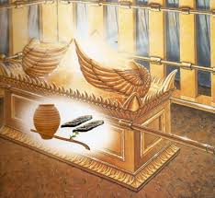
Vision Destiny 2014

Slide 22
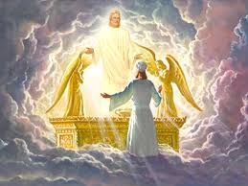
Vision Destiny 2014

Slide 23
Vision Destiny 2014
Come to the ark to look into what the Father is doing
Look into the 4 faces of God
Look into the name of God
Yod Hei Vav Hei
Lion Ox Eagle Man
Kingly Prophetic Apostolic Priestly

Slide 24
Vision Destiny 2014
Looking to see what Father is doing – mandate or authorisation
Manna Tablets Rod
John 4:34 Jesus said to them, “My food is to do the will of Him who sent Me and to accomplish His work.

Slide 25
Vision Destiny 2014
Heb 10:7 “Then I said, ‘Behold, I have come (In the scroll of the book it is written of Me) To do Your will, O God.’
Heb 10:16 “This is the covenant that I will make with them After those days, says the Lord: I will put My laws upon their heart, And on their mind I will write them,”

Slide 26
Vision Destiny 2014
Our destiny scroll gets revealed unveiled to our hearts
Desires of hearts get transformed
Rod – sceptre
Psa 45:6 Your throne, O God, is forever and ever; A sceptre of uprightness is the sceptre of Your kingdom.

Slide 27
Vision Destiny 2014
YHVH – יהוה
Jod - as a symbol of a hand denotes power and, figuratively, ownership it is representative of the Father.
Hei - represents gentleness and means behold, to show or to reveal representative of the Holy Spirit

Slide 28
Vision Destiny 2014
Vav - signifies a nail, peg, or hook. It also conveys the meaning of being nailed or bound together.
Hei - divine breath, revelation, light, represents God’s creative power the living word Jesus the Son

Slide 29
Vision Destiny 2014
In English right to left
"BEHOLD THE NAIL, BEHOLD THE HAND!“ Or, "Behold the nailed hand."

Slide 30
North
Man
Priest
HEI
Tabernacle
Holy of Holies
Arc of God
West
Eagle
Apostle
VAV
East
Lion
King
YOD
South
Ox
Prophet
HEI

Slide 31
New alignment with 4 faces of God symbol, sound, frequency and shape of heaven
Heaven
Priestly
Kingly
Reflection of heaven on earth
Apostolic
Prophetic
Earth

Slide 32
Vision Destiny 2014
We look into the manifest presence and glory of God
We see the will and purpose of God for our lives
We resonate or align ourselves to His will
Our hearts desires draw us towards His will and our destiny
We receive our mandate to rule

Slide 33
Vision Destiny 2014
We begin to frame our world from the mandate we receive
We become the representation of the 4 faces of God on earth
We act as kings and priests
We speak prophetically and administer apostolically

Slide 34
Vision Destiny 2014
Old order ended in Dec 2012 as a new government was established the order of Melchizedek
New for old New or Old
2013 battle to let go of the old
Old book was closed but the new book could not be opened because of old fruit

Slide 35
Vision Destiny 2014
Son Prophesy a new season call it forth declare it from the heights. Proclaim it blow the trumpet herald its coming.
The opening of a new book, new chapters and new pages.
A new level of government and a new fresh expression of kingdom.

Slide 36
Vision Destiny 2014
l saw the 4 living creatures standing in the E S W N of the room each had a trumpet and a standard they were here to herald a new season. In the centre was Urandial the church angel carrying standard of 4 faces and fire was coming off him releasing fresh passion for the new season.

Slide 37
Vision Destiny 2014
The I saw the 4 creatures move around the room creating like a vortex of colour, sound & energy that opened heavens.
In a new dimension and I saw new angels assigned. I saw the 7 spirits, l saw the cloud of witnesses with mantles coats of different colours.

Slide 38
Vision Destiny 2014
l saw it in the spiritual realm and I saw it also as a prophetic act using the flags and leaders who have to be in agreement and unity.
Wind of change an Angel was assigned to administer this process
A new dimension for a new season.

Slide 39
Vision Destiny 2014
2 angels released to herald a new season
Transformation
Winds of change
Fiery golden scroll – mandate for the billion fold harvest
2 more angels to be released
Sound of Many waters.
Refining Fire

Slide 40
Vision Destiny 2014
I have told you to prepare the house for glory all you have done up to now is to lay new foundations. Now you must build and have the blueprint revealed and on display on earth as it is in heaven.

Slide 41
Vision Destiny 2014
Sunday March 23rd
Calling solemn yet joyful assembly
Asking everyone who feels called to be part of Freedom Church and who wants to go on this journey of adventure with us to come and break bread together
Or if you can’t be there in person let us know
Open the new book release a new season

Slide 42
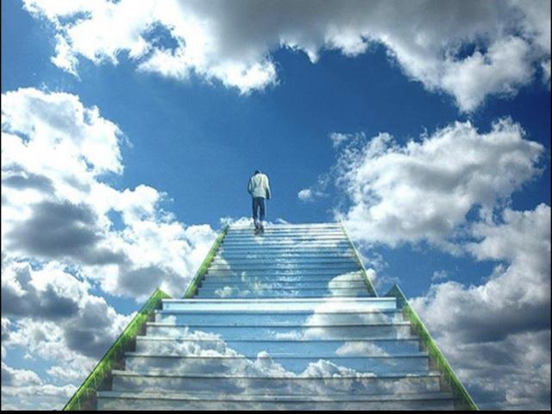

Slide 43
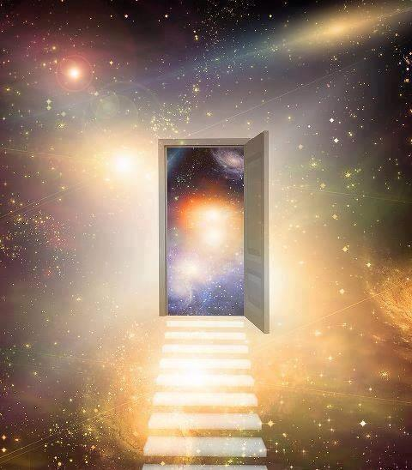

Slide 44
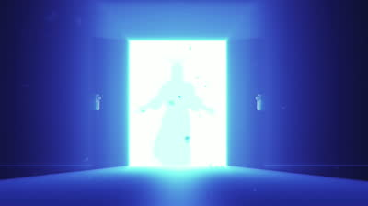

Slide 45
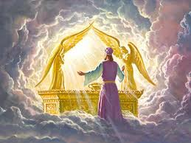

Slide 48
Vision Destiny 2014
God speaks of the great shakings – through Wind, Severe Rain and Storms in specific areas of the nations of the world – targeted by Heaven for a "massive movement" of the Spirit of God.
Watch in 2014 where the earth shakes and where unusual weather breaks out. For there, God is allowing a sign to show you where He is moving at this time – in the most unusual and "stormy" ways!

Slide 49
Vision Destiny 2014
Memo from heaven delivered byan angel
FIRE
WIND
SHAKING
TRANSFORMATION

Slide 50
Vision Destiny 2014
Fire
Heart of Fire and Passion, Every time I spoke or wrote the words of the memo, a revelatory meaning was etched by holy FIRE and burned into my heart. God revealed His motivation. He wants to share His first desire of His passionate love to all the people of the whole world that He sent His Son Jesus to transform.
The Lord told me, "The fire of My desire is to see My people restored to My heart.

Slide 51
Vision Destiny 2014
Wind
The vision of flowing letters in the word WIND on the memo is forever etched in my heart. Each letter blew as if by a strong wind released from the Holy Spirit during the Angel of Transformation's visitation. God highlighted wind to me as "Ruach (Breath of His Spirit) wanting again to 'breathe His refreshing Spirit and new life into all lost or discouraged hearts.'"

Slide 52
Vision Destiny 2014
Genesis 2:7 (NASB) "Then the Lord God formed man of dust from the ground, and breathed into his nostrils the breath of life; and man became a living being."
Winds of His Glory, The Lord emphasized to me that His breath of Holy Spirit is more than enough wind of transformation to turn this nation back to His heart now.

Slide 53
Vision Destiny 2014
We must experience and activate the Holy Spirit breath of anointing to release God's holy breath of love to the many hurting people.
As these people realize what has been missing in their lives, they will begin to be led by the Spirit of God and will be prepared to receive the transforming breath of God's Spirit.

Slide 54
Vision Destiny 2014
The Lord reminded me of the prophet Ezekiel's vision in the valley of dry bones in Ezekiel 37:5 "Thus says the Lord God to these bones, 'Behold, I will cause breath to enter you that you may come to life."
Part of the limping Body of Christ has been breathing in the toxic breath of the enemy's lies for too long. We decree these deceptive toxins purged and cleansed from the Body of Christ in Jesus' name!

Slide 55
Vision Destiny 2014
Today, filled with the powerful "breath of the Spirit of the Living God," we decree the transforming power of Christ's life and breath to fainthearted, discouraged, or lost people.

Slide 56
Vision Destiny 2014
Shaking
In a vision the word SHAKING came clearly again to me, reminding me of these verses, "For thus says the Lord of hosts, 'Once more in a little while, I am going to shake the heavens and the earth, the sea also and the dry land. I will shake all the nations; and they will come with the wealth of all nations, and I will fill this house with glory,' says the Lord of hosts" (Haggai 2:6-7)

Slide 57
Vision Destiny 2014
When I read this passage, the wind of anointing started shaking and reverberating in my heart. I can literally feel the Father's heart beat in concert with His desire to bring people back in relationship with Himself.

Slide 58
Vision Destiny 2014
It will be the most powerful "awakening" move of God people have ever experienced. Rather than allowing a flood again like the one that destroyed all living creatures, this time God is using His Word to shake the nations back to Him.

Slide 59
Vision Destiny 2014
God is fulfilling His heart's desire for His people to seek intimate fellowship with Him. More people will come home to the Father by a massive acceptance of Jesus Christ, as their Lord and Saviour.
This shaking will not be stopped by carnally-minded people or the enemy's deception. This shaking will "shock our hearts" back into perfect rhythm with our Creator.

Slide 60
Vision Destiny 2014
The entire world has already experienced much unpleasant shaking; the shaking soon will become an "earthquake of the Father's wind of the Spirit." It will shake the whole world to its knees for completely repentant hearts turned back to our Lord God!

Slide 61
Vision Destiny 2014
Transformation
The Lord etched into my heart that His desire was to restore that which was lost and to have His people become transformed into His image like pure gold. We must focus upon the desire of God's heart and leave our own humanistic thinking and carnal minds out of the equation.

Slide 62
Vision Destiny 2014
Consuming Glory, Romans 12:2 (NLT) Don't copy the behaviour and customs of this world, but let God transform you into a new person by changing the way you think. Then you will learn to know God's will for you, which is good and pleasing and perfect.
This time the awakening will cause a major worldwide global transformation and many nations will begin to turn to the Lord in a single day!

Slide 63
Vision Destiny 2014
The Father's word TRANSFORMATION highlighted the sparkling, new, heavenly gold that I had seen in the memo from the Transformation Angel. This beyond-earthly, pure-gold hue represents the totally changed hearts turned back to the Father that were purified and freed from any defects of this world.

Slide 64
Vision Destiny 2014
As I pondered this word "transformation," the Father spoke gently to my heart that He has given us the ability not only to be free from all sin but also to move us into the continual purification growth process of being transformed into His image – a "smelting" process that takes each of us into a new level of being transformed from "glory to glory."

Slide 65
Vision Destiny 2014
2 Corinthians 3:18 (NASB) But we all, with unveiled face, beholding as in a mirror the glory of the Lord, are being transformed into the same image from glory to glory, just as from the Lord, the Spirit.
So all of us with removed veils (through the Blood of Jesus) can see and reflect the glory of the Lord. And the Lord – who is the Spirit – makes us more and more like him as we are continually being "transformed" (changed) into His glorious image.

Slide 66
Vision Destiny 2014
The Lord wants the redeemed followers of Jesus to become mature in the "refiner's fire," so when we offer His love to those desperate for TRUE LOVE, they will see through our lives the image of our Abba Father as we become fully engaged in our assignments.

Slide 67
Vision Destiny 2014
This is a different kind of transformation, one like never before in history. I can still hear that piercing breath of God's voice penetrating my being with these words, "As in the days of Esther, you, the Bride of Christ, were changed to be a transformer for 'such a time as this.'"

Slide 68
Vision Destiny 2014
It's Transformation Time
The Lord sent the Angel of Transformation to awaken us from sleep, to give us the message of activation of our lives, to genuinely change (transform) us into the image of the heart of our Father for the entire world to desire Him. As we adhere to our "processing" journey of becoming more like Jesus, then we offer Messiah Jesus to hurting people, demonstrating that Father's righteousness is ours through all Jesus already accomplished.

Slide 69
Vision Destiny 2014
We have a perfect love letter from Heaven through Jesus given to us because of the ultimate price He paid for our transformation. In this love letter is the WIND of the anointing of the Father, now blowing a fresh message of His heart of holy FIRE.

Slide 70
Vision Destiny 2014
The SHAKING by God's Word is from His heart to ours so we become transformed into His image and begin to be the true messengers of the ministry of reconciliation! Today is the transforming "Day of Salvation!" It is our time to be transformed and let God use us to transform our family, the nation, and the world. It is TRANSFORMATION time!

Slide 71
Vision Destiny 2014
Call people to be drawn to the vision and they will be strategically released to you.
You must have the mountains occupied and then power, people and fresh resources will be released.

Slide 72
Vision Destiny 2014
We are calling a solemn assembly
Sound the trumpet
We are going to align ourselves with the frequency of heaven
Engage the 4 faces of God
We are going to deal with the old fruit
We are going to open the new book

Slide 73
Vision Destiny 2014
I went to my throne and was calling forth people to rise up and take possession of their thrones.
When l saw the new black book. I saw a new page it was gold edged with pearls and was ornately inscribed in the corners and elaborately decorated.
It had new season inscribed along the top edge and ketubah under the chuppah.
You are invited to participate in the wedding of Freedom Church and the Lord.

Slide 74
Vision Destiny 2014
Court of Kings take the orb of authority and make a new decree that will establish a new season.
I decree in the court the law of fatherhood and sonship. l call forth the spirit that turns the hearts of the children back to their Father.
I call forth a new dimension in intimacy and relationship in sonship.
I call forth the alignment in the spirit with the 4 faces of God.
I call forth a new dimension in revelation of ministry in alignment.

Slide 75
Vision Destiny 2014
King, Prophet, Apostle, Priest - Praise Prophetic Prayer Pastoral.
I decree a new foundational government be established through resonating with the sound frequency of heaven that is calling for restoration.
I decree new kingdom government and a new season where Lords rise up and take their heavenly positions and responsibility to establish the new.

Slide 76
Vision Destiny 2014
Sealed with Lion Ox Eagle seal of 3
Agreement by man the forth corner to open the everlasting door for blessing to be released.
Court of Chancellors to a bench reviewing process before authorisation took place and court of scribes it was put into record room and displayed posted.

Slide 77
Review 2013
I saw the page in the black book edged with pearls again then I saw the Law of Fatherhood and sonship was added to the book.
I saw the spirit of the Lord come stand in the room holding up the scales of justice in his hand and smiling.

Slide 78
Vision Destiny 2014

Slide 79
Vision Destiny 2014
Psalms 46:1-3 God is our refuge and strength, A very present help in trouble. Therefore we will not fear, though the earth should change And though the mountains slip into the heart of the sea; Though its waters roar and foam, Though the mountains quake at its swelling pride. Selah.

Slide 80
Vision Destiny 2014
Psalms 46:4 There is a river whose streams make glad the city of God, The holy dwelling places of the Most High.5 God is in the midst of her, she will not be moved; God will help her when morning dawns. 6 The nations made an uproar, the kingdoms tottered; He raised His voice, the earth melted. 7 The Lord of hosts is with us; The God of Jacob is our stronghold.

Slide 81
Vision Destiny 2014
Psalms 46:10-11“Be still cease striving and know that I am God; I will be exalted among the nations, I will be exalted in the earth." The Lord of hosts is with us; The God of Jacob is our stronghold. Selah

Slide 82
Vision Destiny 2014
Gen 2:10 Now a river flowed out of Eden to water the garden; and from there it divided and became four rivers.
Rev 22:1 Then he showed me a river of the water of life, clear as crystal, coming from the throne of God and of the Lamb,

Slide 83
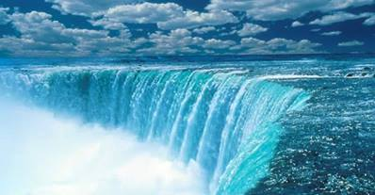

Slide 84
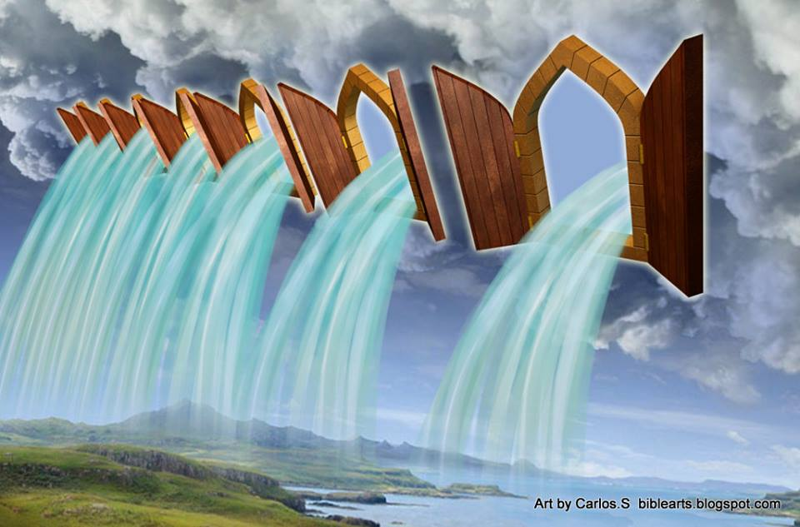

Slide 85
Governmental Structure of Church
House Church 7 house officers, elders, gate keepers
4 Visionary principles is outworked
Ministry to the church
Ruler
Teacher
3 AC
7 Gate keepers
In and out
Servant
3 God
Prophet
Giver
Exhorter
Love, safety, security, growth, transformation
Culture of Honour
Mercy
7 redemptive gifts

Slide 86
Vision Destiny 2014
7 elders or gatekeepers are responsible for outworking the visionary principles
So we have an environment where people can:
Live in and live out the manifest presence of God
Find and fulfil their destiny
Be free in accordance with their redemptive gifts and destiny
In the context of being an ARC
Heavenly and earthly resonance unity, harmony

Slide 87
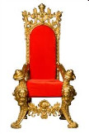
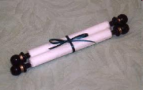
Kings
FREEDOM ARC
Lords
Lords
Lords
Lords
Lords
Lords
Lords
Good news
Health
Freedom
Harmony
Blessing
Media
Enterprise
Good to News Poor
Sight to Blind
Freedom to Captives
Free the Oppressed
Favourable Year Lord
Good to News Poor
Favourable Year Lord

Slide 88
Vision Destiny 2014
7 mountains spheres
Good news – Deb Parsons
Health Jan Olsson
Freedom Graham Murch
Harmony Alice Westcott
Blessing Jo Lane
Media Jeremy Westcott
Enterprise Nigel Harris

Slide 89
Vision Destiny 2014
Apostolic Council
Mike Parsons Nigel & Becky Harris
7 Gatekeepers eldership function
Deb Parsons, Jo Lane, Graham Murch, Jan Olsson, Derick Joubert, Dan Fuller, ?

Slide 90
Vision Destiny 2014
Council 12
Mike Parsons Nigel & Becky Harris
Deb Parsons, Jo Lane, Graham Murch,
Jan Olsson, Derick Joubert,
Alice & Jeremy Westcott, Jo Hill

Slide 91
Vision Destiny 2014
Sunday 23rd March
Calling solemn yet joyful assembly
Go on an adventure, journey and quest together

Slide 92
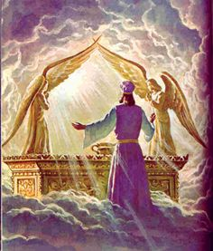

Slide 93
Vision Destiny 2014

Slide 94
Vision Destiny 2014
1 Cor 14:31 For you can all prophesy one by one, so that all may learn and all may be exhorted;
Everyone can prophesy
1 Cor 12:7 But to each one is given the manifestation of the Spirit for the common good. 10 to another miraculous powers, to another prophecy,
Some people have gift of prophecy

Slide 95
Vision Destiny 2014
Eph 4:11 And He gave some as apostles, and some as prophets, and some as evangelists, and some as pastors and teachers, 12 for the equipping of the saints for the work of service, to the building up of the body of Christ;
Some people will be call to the office of prophet

Slide 96
Vision Destiny 2014
Heb 5:14 But solid food is for the mature, who because of practice have their senses trained to discern good and evi
Faith level discernment Distinguishing or discerning spirits 1 Cor 12:10
Office of seer Eph 4:11-13

Slide 97
Vision Destiny 2014
Everyone can have their spiritual eyes and ears open and functioning
Heb 5:12 For though by this time you ought to be teachers, you have need again for someone to teach you the elementary principles of the oracles of God, and you have come to need milk and not solid food. 13 For everyone who partakes only of milk is not accustomed to the word of righteousness, for he is an infant. 14 But solid food is for the mature, who because of practice have their senses trained to discern good and evil.
Mature grow in this capacity through training and practice

Slide 98
Vision Destiny 2014
Eph 1:15 For this reason I too, having heard of the faith in the Lord Jesus which exists among you and your love for all the saints, 16 do not cease giving thanks for you, while making mention of you in my prayers; 17 that the God of our Lord Jesus Christ, the Father of glory, may give to you a spirit of wisdom and of revelation in the knowledge of Him. 18 I pray that the eyes of your heart may be enlightened, so that you will know what is the hope of His calling, what are the riches of the glory of His inheritance in the saints,
Eyes of heart opened

Slide 99
Vision Destiny 2014
2 Kings 6:15 Now when the attendant of the man of God had risen early and gone out, behold, an army with horses and chariots was circling the city. And his servant said to him, “Alas, my master! What shall we do?” 16 So he answered, “Do not fear, for those who are with us are more than those who are with them.” 17 Then Elisha prayed and said, “O Lord, I pray, open his eyes that he may see.” And the Lord opened the servant’s eyes and he saw; and behold, the mountain was full of horses and chariots of fire all around Elisha.
Pray for open spiritual eyes

Slide 100
Vision Destiny 2014
Rev 3:17 Because you say, “I am rich, and have become wealthy, and have need of nothing,” and you do not know that you are wretched and miserable and poor and blind and naked, 18 I advise you to buy from Me gold refined by fire so that you may become rich, and white garments so that you may clothe yourself, and that the shame of your nakedness will not be revealed; and eye salve to anoint your eyes so that you may see
Spiritual eyes opened

Slide 101
Vision Destiny 2014
Luke 4:18 18 “The Spirit of the Lord is upon Me, Because He anointed Me to preach the gospel to the poor. He has sent Me to proclaim release to the captives, And recovery of sight to the blind, To set free those who are oppressed,
Recovering sight to blind

Slide 102
Vision Destiny 2014
Matt 7:1 “Do not judge so that you will not be judged. 2 For in the way you judge, you will be judged; and [a]by your standard of measure, it will be measured to you. 3 Why do you look at the speck that is in your brother’s eye, but do not notice the log that is in your own eye? 4 Or how [b]can you say to your brother, ‘Let me take the speck out of your eye,’ and behold, the log is in your own eye? 5 You hypocrite, first take the log out of your own eye, and then you will see clearly to take the speck out of your brother’s eye.
See world through eyes of our heart

Slide 103
Vision Destiny 2014
1 John 2:9 The one who says he is in the Light and yet hates his brother is in the darkness until now. 10 The one who loves his brother abides in the Light and there is no cause for stumbling in him. 11 But the one who hates his brother is in the darkness and walks in the darkness, and does not know where he is going because the darkness has blinded his eyes.
Hate & unforgiveness blinds our spiritual sight

Slide 104
Vision Destiny 2014
Revelation ask God to show you pictures
Interpretation ask God to show you what it means
Application ask God to show you how to respond

Slide 105
Vision Destiny 2014
1 Chron 29:29 Now the acts of King David, from first to last, are written in the chronicles of Samuel the seer, in the chronicles of Nathan the prophet and in the chronicles of Gad the seer,
Seers & Prophets Same gift calling receive revelation differently
Seers operate in dreams, visions pictures - see
Prophets operate in a flow of words - hear

Slide 106
Vision Destiny 2014
Unseen realm
2 Cor 4:18 So we fix our eyes not on what is seen, but on what is unseen, since what is seen is temporary, but what is unseen is eternal.
Seen physical realm – unseen spiritual realm around us
Eternal heavenly realms – real realm

Slide 107
Vision Destiny 2014
Rev 1-3 physical body looking at a vision into the unseen realm with spiritual eyes
Rev 4:1-2 spirit leaves body engages the realm of heaven
Legal access through Jesus the door John 10:7 So Jesus said to them again, “Truly, truly, I say to you, I am the door of the sheep.
Illegal access John 10:“Truly, truly, I say to you, he who does not enter by the door into the fold of the sheep, but climbs up some other way, he is a thief and a robber.

Slide 108
Vision Destiny 2014
Gift of distinguishing of spirits
Judgement and discernment
Anakrino ability to distinguish
1 Cor 2:14 But a natural man does not accept the things of the Spirit of God, for they are foolishness to him; and he cannot understand them, because they are spiritually appraised.

Slide 109
Vision Destiny 2014
Dokimazo to test or prove
Luke 12:56 You hypocrites! You know how to analyze the appearance of the earth and the sky, but why do you not analyze this present time?
1 John 4:1 test the spirits
1 Thes 5:21 judge prophecies

Slide 110
Vision Destiny 2014
Krino condemn
Matt 7: “Do not judge so that you will not be judged. 2 For in the way you judge, you will be judged; and by your standard of measure, it will be measured to you.
John 7:24 Do not judge according to appearance, but judge with righteous judgment.”

Slide 111
Vision Destiny 2014
Working of Holy Spirit
Working of human spirit
Working of the heavenly spiritual beings
Working of the demonic spiritual beings

Slide 112
Vision Destiny 2014
Not the gift of criticism
Not the gift of suspicion
Not the gift of manipulation
Not the gift of condemnation

Slide 113
Vision Destiny 2014
Agreement with bible truth
Outward fruit matt 7:15-16 gal 5:22-23
Anointing guides to the truth 1 john 2:20, 26-27
Peace as our guide or umpire col 3:15
Ways and nature of God psa 103:2-7

Slide 115
Vision Destiny 2014
John 4:10 Jesus answered and said to her, “If you knew the gift of God, and who it is who says to you, ‘Give Me a drink,’ you would have asked Him, and He would have given you living water.” 11 She *said to Him, “Sir, You have nothing to draw with and the well is deep; where then do You get that living water? 12 You are not greater than our father Jacob, are You, who gave us the well…

Slide 116
Vision Destiny 2014
John 4:13 Jesus answered and said to her, “Everyone who drinks of this water will thirst again; 14 but whoever drinks of the water that I will give him shall never thirst; but the water that I will give him will become in him a well of water springing up to eternal life.”

Slide 117
Vision Destiny 2014
John 7:37 Now on the last day, the great day of the feast, Jesus stood and cried out, saying, “If anyone is thirsty, let him come to Me and drink. 38 He who believes in Me, as the Scripture said, ‘From his innermost being will flow rivers of living water.’” 39 But this He spoke of the Spirit, whom those who believed in Him were to receive; for the Spirit was not yet given, because Jesus was not yet glorified.

Slide 118
Vision Destiny 2014
My encounters with Jacob as one of the cloud of witnesses, men in white linen, spirit of righteous men made perfect
Heb 12:Therefore, since we have so great a cloud of witnesses surrounding us,
Act 1:10 And as they were gazing intently into the sky while He was going, behold, two men in white clothing stood beside them. 11 They also said, “Men of Galilee, why do you stand looking into the sky? This Jesus, who has been taken up from you into heaven, will come in just the same way as you have watched Him go into heaven.”

Slide 119
Vision Destiny 2014
Heb 12:18 For you have not come to a mountain that can be touched and to a blazing fire, and to darkness and gloom and whirlwind, .. 22 But you have come to Mount Zion and to the city of the living God, the heavenly Jerusalem, and to myriads of angels, 23 to the general assembly and church of the firstborn who are enrolled in heaven, and to God, the Judge of all, and to the spirits of the righteous made perfect, 24 and to Jesus, the mediator of a new covenant,

Slide 120
Vision Destiny 2014
Gen 28:12 He had a dream, and behold, a ladder was set on the earth with its top reaching to heaven; and behold, the angels of God were ascending and descending on it. 13 And behold, the Lord stood above it and said, “I am the Lord, the God of your father Abraham and the God of Isaac; the land on which you lie, I will give it to you and to your descendants. 14 Your descendants will also be like the dust of the earth,

Slide 121
Vision Destiny 2014
Gen 28:16 Then Jacob awoke from his sleep and said, “Surely the Lord is in this place, and I did not know it.” 17 He was afraid and said, “How awesome is this place! This is none other than the house of God, and this is the gate of heaven.”
John 14:20 In that day you will know that I am in My Father, and you in Me, and I in you. 23 Jesus answered and said to him, “If anyone loves Me, he will keep My word; and My Father will love him, and We will come to him and make Our abode with him.

Slide 122
Vision Destiny 2014
Luke 17:21 … the kingdom of God is within you [in your hearts] and among you [surrounding you].
Rev 3:20 Behold, I stand at the door and knock; if anyone hears My voice and opens the door, I will come in to him and will dine with him, and he with Me. 21 He who overcomes, I will grant to him to sit down with Me on My throne, as I also overcame and sat down with My Father on His throne

Slide 123
Vision Destiny 2014
Rev 4:1 After these things I looked, and behold, a door standing open in heaven, and the first voice which I had heard, like the sound of a trumpet speaking with me, said, “Come up here, and I will show you what must take place after these things.”

Slide 124
Vision Destiny 2014

Slide 128
Vision Destiny 2014

Slide 129
Vision Destiny 2014

