Slide 2
Review 2014
4 Guiding Visionary principles
Apostolic Resource Centre - big picture mandate – Joshua Generation
Living in and living out the manifest presence of God
Helping people find and fulfil their destinies
5 Free to be statements

Slide 3
Review 2014
Free to know God
Free to see who God destined us to be
Free to be who God created us to be
Free to do what God has prepared for us to do
Free to go where God has destined us to go

Slide 4
Review 2014
Sons of Issachar
1 Cron 12:32 Of the sons of Issachar, men who understood the times, with knowledge of what Israel should do
1 Chron 7:5 Their relatives among all the families of Issachar were mighty men of valour
Our calling is to be forerunners

Slide 5
Prophetic Timetable
Acts 2 Wine, Fire, Wind
Early Rain – Latter Rain
Former Glory – Latter Glory
LAST DAY
FINAL HARVEST
Heb 12:27 SHAKING OF WORLD SYSTEMS
A G E
T O
C O M E
WIND
Gen 41 HARVEST OF LABOURERS
ISA 2:2
1 Peter 4:17 JUDGMENT OF GOD’S HOUSEHOLD
FIRE
Matt 13 GATHERING & REMOVING STUMBLING BLOCKS Releasing Joshua Generation
Fatherhood, Sonship, Royal Identity A CALL TO INTIMACY Habitation of God Song Solomon 8:6
WINE
DAY OF RESURRECTION & JUDGMENT

Slide 6
Review 2014
2010 2011 2012 2013 2014
Eagle Lion Ox Man Eagle
2010 books prophetic revelation opened heavenly realms opened
2011 Kingly Destiny scroll revealed
2012 Transformation
2013 Man - Priestly - alignment agreement between heaven & earth
2014 Eagle - Apostolic blueprint government

Slide 7
Review 2014
What did God say last year 2013?
What has God said this year 2014?
What has God said for next year 2015?
Where are we prophetically now?
What does God want us to do in 2015?
Where does God want us to go in 2015?

Slide 8
Review 2014
As a church and wider apostolic ministry we are called to be a Joshua Generation
We are called to receive our kingdom inheritance
We are called to raise up and equip the next harvesting generation in the supernatural ways of their kingdom inheritance

Slide 9
Review 2014
Mike Bryant’s vision in 2013 is significant in light of previous words
God is about to do a new thing
Old rotting fruit on the tree must fall before a new book & season can begin
Need to identify the old rotting fruit and remove it
Need to open the black book

Slide 10
Review 2014
I am going to shake the tree violently to move you into this new season where the new book will be opened and new chapters and new pages will be revealed and initiated.
Transition is a tough time the old stops working before the new is fully established
Tension

Slide 11
Vision Destiny 2014
Stepping on to my throne l saw an angel come with a scroll. Scroll was calling for a solemn assembly, proclaiming new season.
Angel brought the black book I opened the book the golden pages contained both strategy & wisdom.
1st page - Apostolic Blueprint
2nd Page - 7 mountains & thrones
3rd page Access to wisdom where paths meet

Slide 12
Review 2014
Prepare house for glory, rewire the house – church & our lives
Are we a shadow or reflection of God on earth so He can fully occupy us?
We are responsible for the revelation we have been given
Are we aligned to that revelation?
Are we acting like forerunners?

Slide 13
Bench of 3
Father Son Spirit
North Gate Man Priestly
East Gate Lion Kingly
Heavenlies
Earth
West Gate Eagle Apostolic
South Gate Ox Prophetic
Bench of 3
Spirit Soul Body
Church, City, Region, Nation

Slide 14
Review 2014
Raise up a Bench of 7
Raise up rulers in the heavenlies to occupy and rule from your 7 mountains.
Establish the ministries that will enable fast tracking.
Seek wisdom in the place where the paths meet on the heights and wisdom will be your guide on this journey.

Slide 15
Review 2014
Bench of 3 or Beit Din or Apostolic Council
Provide apostolic strategic direction and government
Engages heaven and brings apostolic blueprints
Judicial authority to administer with righteousness and justice

Slide 16
Review 2014
Bench of 7 responsible for outworking the visionary principles
7 Mountains governmental spheres
Council of 12 – overall government

Slide 17
Review 2014
Freedom is to be a Sandhurst or WestPoint to raise up officers for the next generation, those capable of leading into battle.
Officers who understand and outwork strategy and battle plans. You must be able to fast track people. l have given you all the tools of ministry and revelation you need to quickly get people on the right track.

Slide 18
Review 2014
Apostolic Resource Centre (vision not building)
Realigning the parts of the apostolic vision (FT, FSP, FSE, FC, FC)
Serving a bigger vision removing the barriers of individual identities
Government formed and empowered to strategically lead the vision
Approved, Commissioned, Financed

Slide 19
Review 2014
Freedom Communities formed
Realigning of ministries to form Freedom Community Alliance
FSP & FC in a process of unifying as FCA
Forming Freedom Apostolic Ministries to providing strategic direction

Slide 20
Review 2014
New ways of ministry - experiential
New ways of teaching - experiential
New ways of prayer - experiential
New ways of interceding - experiential
New more effective ways of kingdom administration
New ways of partnering with the angelic realm – ministering servants

Slide 21
Review 2014
The new ways we are looking to embrace are to enable each of us to be the person God created us to be and fulfil our destiny.
We will be looking to encourage everyone to search their hearts
To ask God who am I, what am I called to and where do I fit

Slide 22
Review 2014
Rick Joyner – One of the greatest yokes of bondage enslaving the human race is called “the tyranny of the familiar.” It is the universal human temptation to cling to the familiar, regardless of how bad or painful it may be, and to resist change regardless of how promising it may be.

Slide 23
Review 2014
God would rather have you an amateur in the new thing than a professional in the old thing!! - David Wagner

Slide 24
Review 2014
Culture of honour
Within an apostolic framework we respect, value and honour each person
Each persons spiritual and redemptive gift, calling, destiny etc is honoured
Commitment to love, openness and honesty
Freedom to be real and permission to go for it

Slide 25
Review 2014
I went to my mountain and the throne was mobile and it went off up to the hall of revelation like a training centre.
I was encouraged by Wisdom to enrol in the courses that will bring me revelation of position from each of the 7 spirits in their official duties and to engage certain men in white linen who are my governors assigned to my mantle.

Slide 26
Review 2014
I am going to release the 7 spirits and your assigned councillors to greater measure to those who will position themselves and take the responsible seats of government.
Look for the colours and frequencies that will begin to speak to you more clearly.

Slide 27
7 spirits of God
SPIRIT OF COUNSEL
SPIRIT OF
UNDERSTANDING
SPIRIT OF MIGHT
Prepares us for Position
Authorizes us for Position
Reveals us for Position
SPIRIT
OF
WISDOM
SPIRIT OF KNOWLEDGE
Empowers us for Position
Equips us for Position
SPIRIT OF THE
LORD
SPIRIT OF THE FEAR OF THE LORD
Mandates us for Position
Brings us into Accountability For Position

Slide 28
Review 2014
Son Prophesy a new season call it forth declare it from the heights. Proclaim it blow the trumpet herald its coming.
The opening of a new book, new chapters and new pages.
A new level of government and a new fresh expression of kingdom.

Slide 29
Review 2014
l saw the 4 living creatures standing in the E S W N of the room each had a trumpet and a standard they were here to herald a new season. In the centre was Urandial the church angel carrying standard of 4 faces and fire was coming off him releasing fresh passion for the new season.

Slide 30
Review 2014
The I saw the 4 creatures move around the room creating like a vortex of colour, sound & energy that opened heavens.
In a new dimension and I saw new angels assigned. I saw the 7 spirits, l saw the cloud of witnesses with mantles coats of different colours.

Slide 31
Review 2014
l saw it in the spiritual realm and I saw it also as a prophetic act using the flags and leaders who have to be in agreement and unity.
Winds of change an Angel was assigned to administer this process
A new dimension for a new season.

Slide 32
Review 2014
Angelic memo - 4 angels
TRANSFORMATION
FIRE - Refining fire
WIND windows of change
SHAKING – sound of many waters
2 fiery scrolls
Harvest & Joshua generation

Slide 33
Review 2014
Son release the sound of heaven blow trumpet, herald the new season, sound the alarm, muster the troops Let the sound reverberate resonate and draw people.
Son let the Lion release His roar let the eagle soar let the ox snort and the man cry out.

Slide 34
Review 2014
Son hear My heart and focus on the main thing. It is time to end the old fruit that season of the old things has ended both good old things and bad old things.
The blueprints must be clearly established as the foundations and maps to direct you in the seasons ahead.

Slide 35
Legend
3G = Heavenly Bench
Father, Son, Holy Spirit
3 = Bench of 3
= Bench of 7
---- = 4 Apostolic visionary principles
----- = 7 redemptive gifts
----- = 4 ministry areas
= 7 mountains
= Church
= ARC
Council of 12 ARC 3 + 7 mountains + 2
FT = Freedom Trust
FCA = Freedom Community Alliance
FSE = Freedom Social Enterprises
S = Spiritual Social Supernatural
H = Health Holistic Hope
A = Accommodation Administration
L = Lifestyle Learning Liberty Love
O = Occupation Opportunities
M = Mentoring Mediation Ministry Media
FT
Good News
Media
S
7
Ruler
Health
M
Teacher
Servant
Bench 3
3 G
H
Enterprise
Prophet
Giver
O
Exhorter
Freedom
FSE
Mercy
A
Blessing
L
FCA
Harmony

Slide 36
Review 2014
Proclaim and herald a new day, a new season and new depths, new heights and new doors and new chapters will be opened and become accessible.
You have a year of preparation before the release of the hunter and gathering angels will be fully authorised. Make everything ready and be expectant with fear and trembling.

Slide 37
Review 2014
Government is the key to successfully rewiring the house and preparing it for glory. You must be one heart, one mind and be of one purpose for the full mandates to be released and for the full dimensions of your heavenly and earthy authority to be unveiled.

Slide 38
Review 2014
The government must be in place and the council must be functioning effectively, ruling the house and taking charge of the courts.
I have told you to prepare the house for glory all you have done up to now is to lay new foundations.
Now you must build and have the blueprint revealed and on display on earth as it is in heaven.

Slide 39
Review 2014
11 December 2013 Son the focus for you this year is to take the 3 and 7 and 12 into year heart and nurture them raise them up to Lordship and kingship. Help them embrace their right as Sons to rule so they will build the house for glory.

Slide 40
Review 2014
I will release the scrolls and the mandates necessary to rule effectively and establish the ministries that are destined to be released from the mountains. They must be willing to step up to their thrones and take the responsibility for the authority I am willing to release to them.

Slide 41
Review 2014
Call people to be drawn to the vision and they will be strategically released to you.
You must have the mountains occupied and then power, people and fresh resources will be released.

Slide 42
Review 2014
I am calling for lords to come forth to step out and take their responsible positions. l will release the scrolls for the mountains of church arc, area and region as you take position in the realm of the kingdom of heaven.

Slide 43
Review 2014
Good news
Freedom
Health
Harmony
Blessing
Media
Enterprise

Slide 44
Review 2014
I am raising up those who are hearing the sound in all its colours, shapes, symbols, numbers and formulas.

Slide 45
Review 2014
It is in heaven that this new order of Melchizedec will be recognised and its full governmental authority released. Nameless faceless ones on earth will be granted access to the judicial systems and protocols of heaven and will be recognised by the heavenly hosts.

Slide 46
Review 2014
The realms of My kingdom will become more clear and will overshadow your gatherings. Be sensitive to their appearing look carefully for the signs, colours and frequencies of their coming. They will tutor the surrendered to the deeper dimensions of the Kingdom.

Slide 47
Lion
King
YOD
Winds of Change
Transformation
Man Priest
HEI
Ox
Prophet
HEI
Eagle
Apostle
VAV
Refiners Fire
Sound of many waters

Slide 48
Review 2014
If you pursue Wisdom faithfully and diligently her rewards will be great. Access to the ancient paths, ancient doors and to the ancient knowledge will be released.
The portals will be opened and travel in time and space will have an important part to play in establishing the ARC places of refuge that will be needed for the time ahead.

Slide 49
Review 2014
31st December 2013
Before the court of war l present the scroll for a strategy for 2014.
Blow the trumpet herald the new season. Call forth destiny from My people. It is their destiny to engage with the deeper levels of revelation knowledge that is open to them.

Slide 50
Review 2013
I went to the garden of God and was directed to look at a golden mountain
I went to the top of that mountain and met Metatron chief angel of the angelic order Chayoth – living creatures
He gave me a golden key to open up the realms of heaven to those who are truly hungry and seeking

Slide 51
Review 2014
You must use the golden key to lead people into the realms of heaven until they are able to engage with wisdom where the paths meet and the doors will be opened.
There is a process to follow a strategy to reveal. Having established authority 3-7-12 and removed the rotten fruit.

Slide 52
Review 2014
1. Present the vision unveil the full picture.
2. Develop the 2 pathways
3. Establish the equipping track
4. Unveil the 4 chambers, garden, dance floor, soaking room, culminating in the marriage under the huppah covering of the sound of heaven.

Slide 53
Review 2014
5. Engage the new sounds and frequencies that I am releasing from heaven. The restoration Sounds of the key of David in the tabernacle of David.
6. Engage 7 spirits of God and the 12 Counsellors
7. Align yourselves with the 4 faces of God and the living Creatures to create the vacuum that will draw heaven to earth.
Sealed Lion ox eagle approved for action

Slide 54
Review 2014
Scroll of destiny I saw the world as a globe I saw the establishing of bends of 3 over the globe and the globe began to spin clockwise and then stop and spin anticlockwise and I saw arrows begin to fly from the globe and land here.

Slide 55
Review 2014
Engaging God on the heavenly pathways of relationship and responsibility manual
June recruit for alpha test group
200 people launched in August
2 modules
20 new mentoring groups
Recruit for beta groups next year
New leaders in transition support group

Slide 56
Review 2013
Supernatural mentoring with 18 groups in Europe and USA and Canada
Mentoring a group of ex-students who have started a church plant
YOUTUBE channel 200 to 1347 subscribers
25 to 250+ Mentoring videos 115,774 views 1,770,000 minutes of viewing time

Slide 57
Review 2014
Google plus 500 to 1000+ followers
Facebook page 1344 friends
Increase Blog views 46733 to 271,079
Increase in website views for church and Resources site

Slide 58
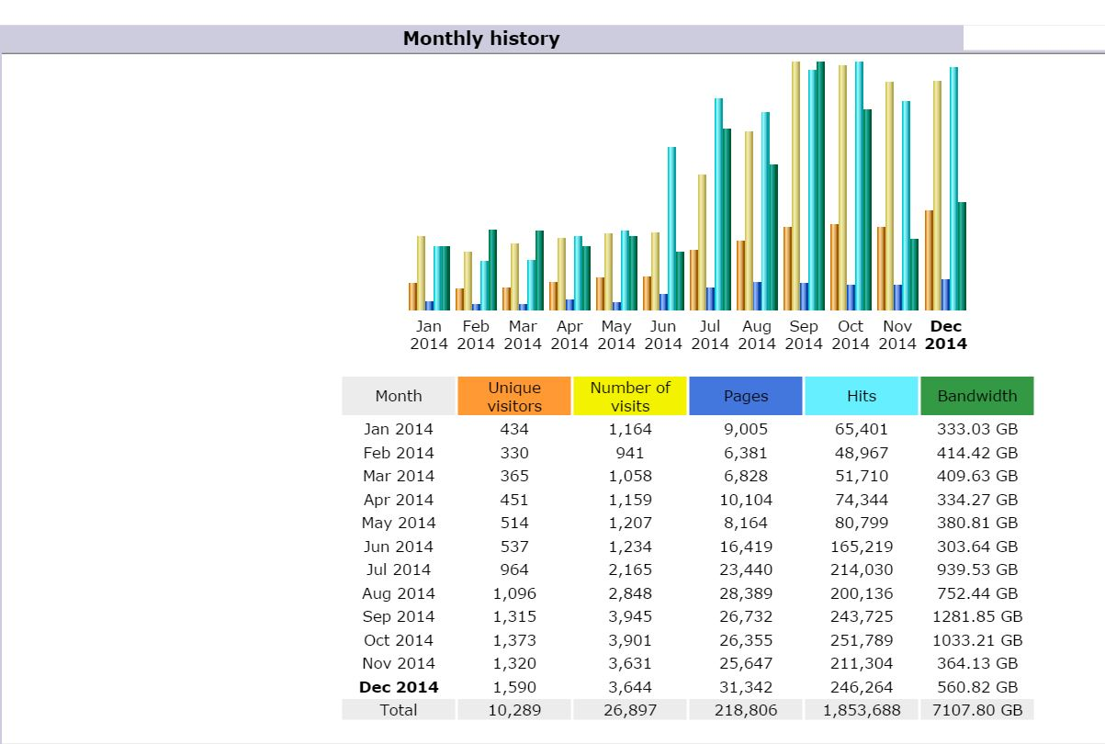

Slide 59
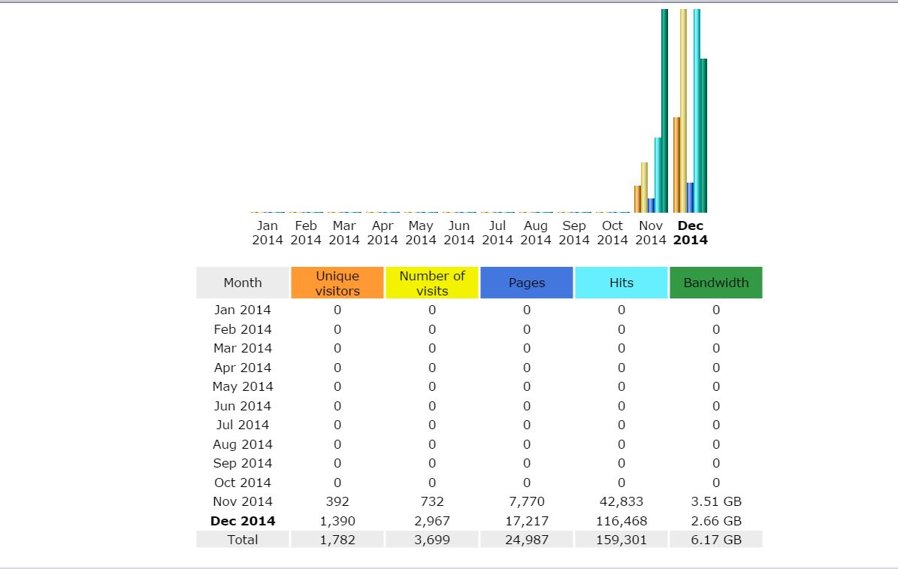
January, 2014 | 3,318 100.00% | 1,507 100.00% | 5,111 100.00% | 23.1 MB 100.00%
Total | 3,318 | 1,507 | 5,111 | 23.1 MB
October, 2014 | 4,635 | 1,908 | 6,501 | 31.6 MB
Total | 4,635 | 1,908 | 6,501 | 31.6 MB

Slide 60
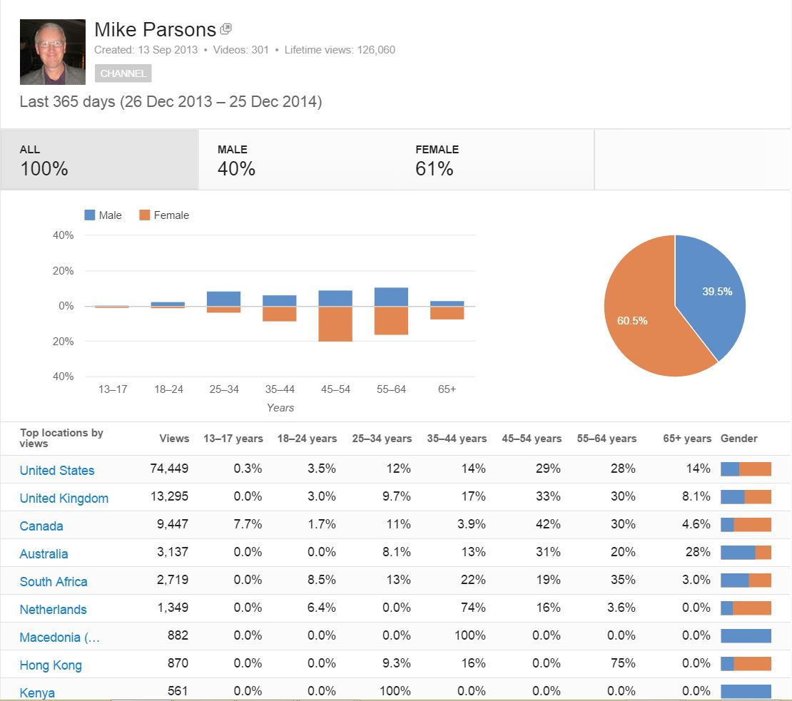

Slide 61
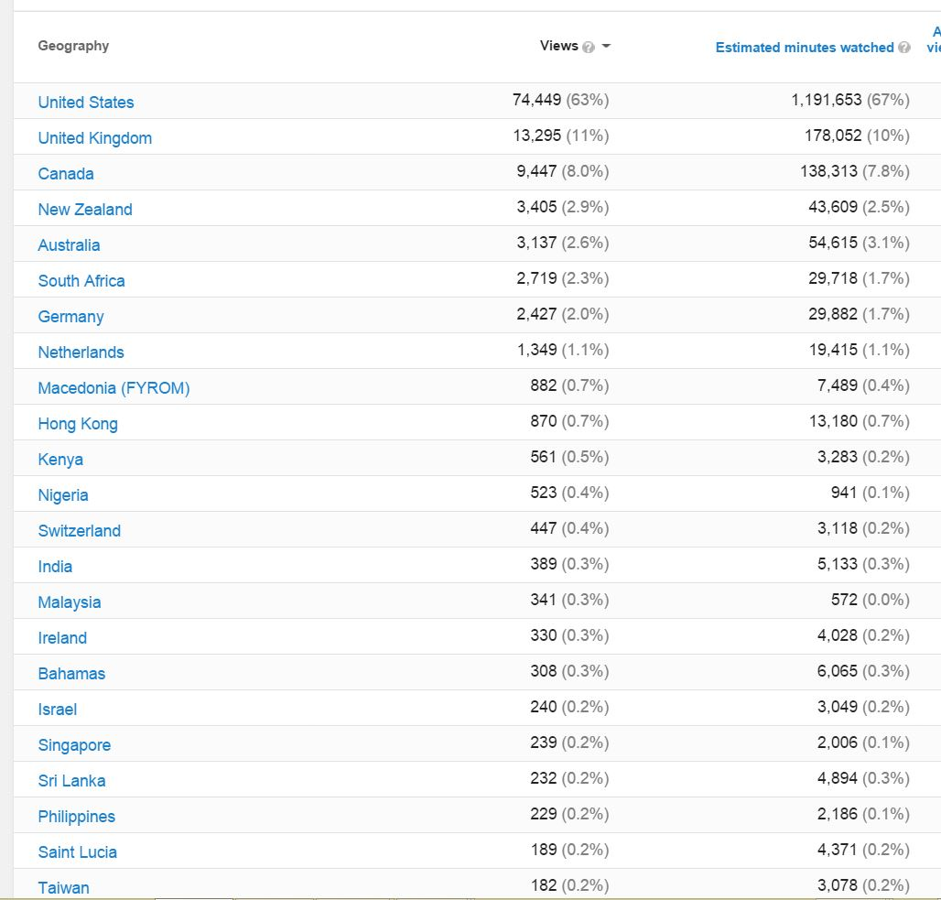

Slide 62
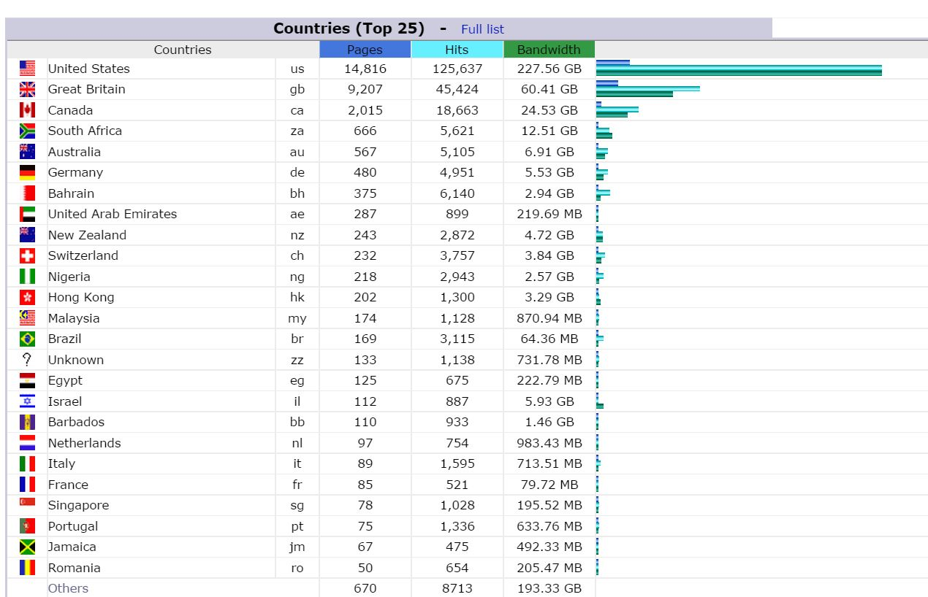

Slide 63
Review 2014
Review this year in your
What has God said and what has He done
What is God saying and what is He calling you to in 2015
Be ready for change to let go of the old and embrace the new

Slide 64
Review 2014
Embrace the new sound of heaven and resonate with it
Come into alignment with heaven
HOPE is the ability to hear the music of tomorrow.
FAITH is the courage to dance to it today.
End of the old & beginning of new year
Old things to let go of & new things to embrace

Slide 65
Review 2014
If you are holding on to something that doesn't belong to you and was never intended for your life, then you need to......LET IT GO!!!
If you are holding on to past hurts and pains..... LET IT GO!!!
if you are still affected by disappointment or discouragement.....LET IT GO!!!
If you are still affected by being rejected, unsupported, under-valued or ignored LET IT GO!!!
If people have made you feel insignificant, unaccepted or unappreciated... LET IT GO!!!

Slide 66
Review 2014
If you are still demotivated by your past failures or others bad treatment of you...... LET IT GO!!!
If your past is still negatively affecting your present and clouding your future..... LET IT GO!!!
If you are demotivated by unfulfilled dreams, vision or expectations.... LET IT GO!!!
If you are involved in a wrong relationship or an addiction..... LET IT GO!!!

Slide 67
Review 2014
If you are holding on to a job that no longer meets your needs or talents…. LET IT GO!!!
If you're stuck in the past and God is trying to take you to a new level in Him...... LET IT GO!!!
If you are struggling with the healing of a broken relationship....... LET IT GO!!!
If you keep trying to help someone who won't even try to help themselves..... LET IT GO!!!

Slide 68
Review 2014
If someone can't treat you right, love you back, and see your worth.....LET IT GO!!!
If someone has angered you ........LET IT GO!!!
If you are holding on to some thoughts of evil and revenge...... LET IT GO!!!
If you have a bad attitude.......LET IT GO!!!
If you keep judging others to make yourself feel better...... LET IT GO!!!

Slide 69
Review 2014
Your sinful nature .........LET IT GO!!!
Your iniquitous patterns .........LET IT GO!!!
Your negative blood-line influences .........LET IT GO!!!
Your genetic seed-line records .........LET IT GO!!!

Slide 70
Review 2014
Your slave identity .........LET IT GO!!!
Your slavery mindset .........LET IT GO!!!
Your old religious mindsets .........LET IT GO!!!
Your old earthly methods .........LET IT GO!!!
Your own cynicism, scepticism, criticism judgmentalism .........LET IT

Slide 71
Review 2014
If you're feeling depressed and stressed .........LET IT GO!!!
If there is a particular situation that you are so used to handling yourself and God is saying "take your hands off of it," then you need to...... LET IT GO!!!
Let the past be the past. Forget the former things. GOD is doing a new thing for 2014!!!
LET IT GO!!!
"The Battle is the Lord's!"

Slide 72
Destiny 2015
Your identity in God … GRAB HOLD OF IT!!!
Your destiny in God…. GRAB HOLD OF IT!!!
Who you are in Christ…. GRAB HOLD OF IT!!!
The plan and purpose for your life….GRAB HOLD OF IT!!!
Your inheritance in God….. GRAB HOLD OF IT!!!

Slide 73
Destiny 2015
Your spiritual gifts…….. GRAB HOLD OF IT!!!
The Fruit of the Spirit…… GRAB HOLD OF IT!!!
Your blessing….. GRAB HOLD OF IT!!!
Your forgiveness….. GRAB HOLD OF IT!!!
Your healing….. GRAB HOLD OF IT!!!
Your peace….. GRAB HOLD OF IT!!!

Slide 74
Destiny 2015
Your joy….. GRAB HOLD OF IT!!!
Your access to God….. GRAB HOLD OF IT!!!
Your debt cancellation….. GRAB HOLD OF IT!!!
Your financial blessing….. GRAB HOLD OF IT!!!

Slide 75
Destiny 2015
Your breakthrough in God….. GRAB HOLD OF IT!!!
Your relationship with God….. GRAB HOLD OF IT!!!
Your intimacy with God…… GRAB HOLD OF IT!!!
Your anointing with the Holy Spirit…. GRAB HOLD OF IT!!!
God's love for you…... GRAB HOLD OF IT!!!

Slide 76
Destiny 2015
Your heavenly encounters…... GRAB HOLD OF IT!!!
Your heavenly mountain thrones…... GRAB HOLD OF IT!!!
Your kingdom authority….. GRAB HOLD OF IT!!!
Your access into heavenly courts….. GRAB HOLD OF IT!!!

Slide 77
Destiny 2015
Your identity as Lords….. GRAB HOLD OF IT!!!
Your identity as kings….. GRAB HOLD OF IT!!!
Your identity as sons….. GRAB HOLD OF IT!!!
The choice to hold on or let go is yours
The choice to embrace the new is yours

Slide 78
Review 2014
The Eliminate List
There are some things that we just need to eliminate. Don’t take them into next year. Here’s a few in random order of what we can all drop:
Grudges
Anger
Toxic habits
Clutter
Negative thoughts
People who drag you down
Limiting language

Slide 79
Review 2014
Bitterness
Extra weight
Unrealistic expectations
Self righteousness
Meanness
Rudeness
Partially hydrogenated anything
Hatred
Swearing

Slide 80
Review 2014
Excuses
Distractions
Blind spots
Frivolous spending
Busywork
Being cheap
Drags
Texting while driving
Lateness

Slide 81
Review 2014
Limiting beliefs
Road rage
Time wasters
Doing it all alone
Too much screen time
Laziness
Jealousy
Stress

Slide 82
Review 2014
Old clothes
Gossip
Debt
Correcting others
Perfectionism
Self-sabotage
Roadblocks
Procrastination
“Um” and other filler words

Slide 83
Review 2014
Junk food
Worry
Sense of entitlement
Thinking the worst about people
High blood pressure
Empty and false promises
Seeking the approval of others
Some money in an envelope and send it to your favourite charity.

