Slide 1
Review 2013
What did God say last year?
What has God said this year?
What has God said for next year?
Where are we prophetically now?
What does God want us to do in 2014?
Where does God want us to go in 2014?

Slide 2
Review 2013
Sons of Issachar
1 Cron 12:32 Of the sons of Issachar, men who understood the times, with knowledge of what Israel should do
1 Chron 7:5 Their relatives among all the families of Issachar were mighty men of valour
Our calling is to be forerunners

Slide 3
Prophetic Timetable
Acts 2 Wine, Fire, Wind
Early Rain – Greater Latter Rain
Former Glory – Greater Latter Glory
LAST DAY
FINAL
HARVEST
Heb 12:27 SHAKING OF WORLD SYSTEMS
A
G
E
T
O
C
O
M
E
WIND
Gen 41 HARVEST OF LABOURERS
ISA 2:2
1 Peter 4:17 JUDGMENT OF GOD’S HOUSEHOLD
FIRE
Matt 13 GATHERING & REMOVING STUMBLING BLOCKS
Releasing Joshua Generation
Fatherhood, Sonship, Royal Identity A CALL TO INTIMACY Habitation of God
Song Solomon 8:6
WINE
DAY OF RESURRECTION
& JUDGMENT

Slide 4
Review 2013
2010 Eagle - Apostolic - books prophetic revelation opened heavenly realms opened
2011 Lion - Kingly - destiny scroll revealed
2012 Ox – Prophetic - transformation
2013 Man - Priestly - alignment agreement between heaven & earth

Slide 5
Review 2013
2013 = man - priestly function
Establish heavenly governmental pattern on earth
Earthly agreement for the heavenly apostolic blueprints
Purpose - On earth as it is in heaven
Inheritance - Forerunners a Joshua generation

Slide 6
Review 2013
Isa 43:18 “Do not call to mind the former things, Or ponder things of the past. 19 “Behold, I will do something new, Now it will spring forth; Will you not be aware of it, I will even make a roadway in the wilderness, Rivers in the desert.
Isa 42:9 “Behold, the former things have come to pass, Now I declare new things; Before they spring forth I proclaim them to you.”

Slide 7
Review 2013
It is time, it is time for a change in season, the old season will continue but a new season with be layered over it.
Time of transition to let go of the old to embrace the new

Slide 8
Review 2013
You have been invited to know the real Me so that you can be forerunners of the glory presence.
You will see angels on assignments amongst you and the cloud of witnesses will descend and start to appear.

Slide 9
Review 2013
Your regional authority will spread out and new government will be formed.
I am going to give you access to higher courts and higher thrones.

Slide 10
Review 2013
You must take your places, the old orders have to die so you can succeed and be enthroned at new and higher levels of power and authority.

Slide 11
Review 2013
New places in the realms of heaven will be open to you if you persevere through the fiery pillar of judgment.
Let go of the old to embrace the new.
New – New – New – New.
New for old. New for old, New for old, New for old.

Slide 12
Review 2013
Year to align heaven and earth
Year to replace the old with new
3 of apostolic heavenly authority must find agreement on earth with the forth to open the windows heaven or everlasting doors
Year of attack by the political and religious spirit
Jesus warned of the leaven Herod & Pharisees

Slide 13
Review 2013
Year of challenge to the old mindsets
Year challenges our old paradigms world views
Year where old mindsets and views have been exposed
Year of tension as we transition from the old to new
Year where pastoral old form of earthly church government opposed & resisted the apostolic new heavenly order

Slide 14
Review 2013
Masks of old identity coverings – being closed, hidden, secret - challenged
New levels openness, honesty, reality
New level honour, respect, commitment required
Joshua there was a time of consecration – choice presented
2.5 tribes decided to stay in the old wilderness ways

Slide 15
Review 2013
2010 August heavenly visions
Vision - valley - mountains – 3.5 years
Jan 2012 given 3 years to prepare and be ready for the future shaking
June 21st over half way balance tipped and shifted – heavenly sound released
2014 is a key year we can’t afford to be distracted by old battles

Slide 16
Review 2013
Prepare house for glory, rewire the house – church & our lives
Are we a shadow or reflection of God on earth so He can fully occupy us?
We are responsible for the revelation we have been given
Are we aligned to that revelation?
Are we acting like forerunners?

Slide 17
Review 2013
Examine our hearts for the old
What are the old blockages?
What are the old hindrances?
Is there are anything we have done wrong?
Is there any disobedience or procrastination?

Slide 18
Review 2013
A time for removal of limitations and ceilings.
God is going to deliver us from thinking processes that limit the future.
Now is a time to arise and shine – dawning of a new day.

Slide 19
Review 2013
New for Old - Insurance policy replaces old broken items with new current valued items
Grace, anointing, power, life leaves the old slowly but surely
New government for Old
Replaced old Eldership and leadership team with new Bench of 3 and 7 housekeepers, Council of 12

Slide 20
Review 2013
Old earthy for new heavenly
Old revelation for new revelation
Old mindsets for new mindsets
Old methods of teaching for new
Old earthly methodologies for new heavenly strategies
Old levels of relationship for new

Slide 21
Review 2013
Old worldview for a new paradigm
Old book for new book
Old season for new season
Old for New
You must be willing to let go of the old to embrace the new
Choice - You can stay with the Moses generation in wilderness as many did

Slide 22
Review 2013
Apostolic Resource Centre (vision not building)
Realigning the parts of the apostolic vision (FT, FSP, FSE, FC, FC)
Serving a bigger vision removing the barriers of individual identities
Government formed and empowered to strategically lead the vision
Approved, Commissioned, Financed

Slide 23
Review 2013
FSP & Church back into alignment
Freedom Communities formed
Realigning of ministries to form Freedom Alliance
Apostolic Council providing strategic direction
FSP & FC in a process of unifying
Release God’s vision & purposes

Slide 25
Review 2013
Scroll given in an encounter in the angelic court in heaven, planted it as a seed in my garden Silver trumpets grew from the tree
Num 10:2 Make yourself two trumpets of silver, of hammered work you shall make them; and you shall use them for summoning the congregation and for breaking camp

Slide 26
Review 2013
8 July 2013 It is time to facilitate the identification and removal of the masks that hinder and stop true identity being revealed.
You have 18 months to become a culture of honour. This will expand your space and give the room for all the gifts to function.
Judgment is coming be ready, be prepared to face the judgment seat.
Identity and raise up the Lords that will rule the 7 mountain thrones of their destinies and the Freedom mandates.

Slide 27
Review 2013
It is time for responsibility and authority to be released but only to those who wear no masks and have dealt with false humility and are willing to be recognised in the destinies that God has ordained.
Insecurity, fear, control, contempt familiarity exist deal with them

Slide 28
Review 2013
Jezebel deception must be unmasked and honesty and openness must be take its place.
There must be a time of exposure, bringing everything into the light so that the eyes of the Lord will release the all consuming fire.

Slide 29
Review 2013
To he honoured everyone must be willing to be recognised in the gift, office, rank or division they are called to operate in.
I have called you to be officers in the army that I am preparing.

Slide 30
Review 2013
The gatekeepers must be ready to take their places to be lifted up as heads and be true gateways of heaven to earth.
It is time to take your places of responsibility in the heavens and manifest the rule of God.

Slide 31
Review 2013
1 August 2013
Accessed Tree of life in heaven via the river of life
Eat fruit causes feelings of freedom and expansion
It felt like I had wings like a butterfly and I could draw sweet nectar from the plants. It was sweet going into my stomach.

Slide 32
Review 2013
Feed on the sweet revelation that is being released as the books are being opened.
You have read only the first chapter of the first book so there is so much more that will expand your capacity and your wisdom and your understanding of the knowledge of Me that is being released.

Slide 33
Review 2013
Pursue this path this is your portion of destiny and birthright.
This will be true delight to you as you expand your capacity to breath from heavens atmosphere of glory.
Breathe deeply expand your lungs to the maximum.

Slide 34
Review 2013
The ancient pathway will lead to ancient knowledge long forgotten but ready to be restored.
Stand on the sapphire floor and receive the knowledge of trade and of covenant exchange.
My books are your plants probe deeply to extract the ancient truths. 12 fruits, 12 stones, 12 gates, 12 foundations.

Slide 35
Review 2013
Be more diligent and vigilant to apply and live what you already know. Live in and from heaven
The deeper more ancient knowledge will become available to those who approach the ancient of days with passion and desire.

Slide 36
Review 2013
Mike Bryant Prophetic Vision Sunday 25th August 2013
I just had a glorious time in heaven where saw some stuff going on. God told me the time is now and He showed me a red book. An angel was standing with a red book in his hand and he was showing me the end of this book and he said that the end of a season is coming really soon.

Slide 37
Review 2013
The red book was not that fat but it was coming to an end. Then he showed me a black book that had gold pages and new season is about to start. He started to show me the wealth of heaven and the chariots of heaven and what is for the future.

Slide 38
Review 2013
He showed me that there was going to be expansion and that God was so desiring other people to be on board in this place with this vision and the things that Mike has been speaking about. God was showing me that many haven’t come to the calling they haven’t take it up and some are going to miss it..

Slide 39
Review 2013
He showed me, I don’t want to say a sea of people but He showed me thousands of people that were covered with like a flag that was on top of them like in some countries that put a big flag over a procession of people. God was showing me that it was the knowledge and revelation and intensity of the word that God has been releasing in this place.

Slide 40
Review 2013
God was showing me that there is an angel’s hand on the book and God wanted many people to open the book but many had not been in a place to be able to open this book with its gold pages.
Before this black book I saw a tree and there was no fruit on the tree except one really bad piece of fruit that was about to drop off. When that fruit drops off which is self that book is going to open.

Slide 41
Review 2013
God is about to do a new thing because of the steadfast blood.
Significant in light of previous words from Mike Bryant
Need to open the black book
Need to identify the bad old fruit that needs to be removed before new season can be released

Slide 42
Review 2013
I went to my throne and was calling forth people to rise up and take possession of their thrones.
When l saw the new black book. I saw a new page it was gold edged with pearls and was ornately inscribed in the corners and elaborately decorated.
It had new season inscribed along the top edge and ketubah under the chuppah.
You are invited to participate in the wedding of Freedom Church and the Lord.

Slide 43
Vision Destiny 2014
Court of Kings take the orb of authority and make a new decree that will establish a new season.
I decree in the court the law of fatherhood and sonship. l call forth the spirit that turns the hearts of the children back to their Father.
I call forth a new dimension in intimacy and relationship in sonship.
I call forth the alignment in the spirit with the 4 faces of God.
I call forth a new dimension in revelation of ministry in alignment.

Slide 44
Vision Destiny 2014
King, Prophet, Apostle, Priest - Praise Prophetic Prayer Pastoral.
I decree a new foundational government be established through resonating with the sound frequency of heaven that is calling for restoration.
I decree new kingdom government and a new season where Lords rise up and take their heavenly positions and responsibility to establish the new.

Slide 45
Vision Destiny 2014
Sealed with Lion Ox Eagle seal of 3
Agreement by man the forth corner to open the everlasting door for blessing to be released.
Court of Chancellors to a bench reviewing process before authorisation took place and court of scribes it was put into record room and displayed posted.

Slide 46
Review 2013
I saw the page in the black book edged with pearls again then I saw the Law of Fatherhood and sonship was added to the book.
I saw the spirit of the Lord come stand in the room holding up the scales of justice in his hand and smiling.

Slide 47
Review 2013
I went to the garden of God and was directed to look at a golden mountain
I went to the top of that mountain and met Metatron chief angel of the angelic order Chayoth – living creatures
He gave me a golden key to open up the realms of heaven to those who are truly hungry and seeking

Slide 48
Review 2013
I resisted this for a few months
Implications for the a wider vision of being an Apostolic Resource
God really twisted my arm to be proactive and not just reactive
I shared with the Preparing for Destiny private forum of 17 people
God started to open the doors

Slide 49
Review 2013
Preparing for Destiny forum gone from 17 to 112 members
Asked by 5 people to personally mentor them
Started a Google + account 500 followers
Discovered Google hangouts
October posted a YouTube video of my journey to see in the spirit – 1000+ views

Slide 50
Review 2013
Supernatural mentoring with 10 groups in Europe and USA and Canada
Mentoring a group of ex-students to start a church plant and helping another church in transitioning into new revelation
YOUTUBE channel has 200+ subscribers
23 Mentoring videos 7500+ views 109,053 minutes or 1817 hours viewing time

Slide 51
Review 2013
Website views have increased 10x
5x increase website resources sold
Free downloads increased 50 x
New Freedom Apostolic Resources website
Blog Sons of Issachar

Slide 52
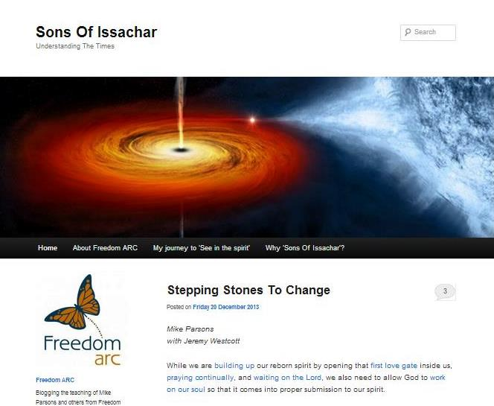
freedomarc.wordpress.com

Slide 53
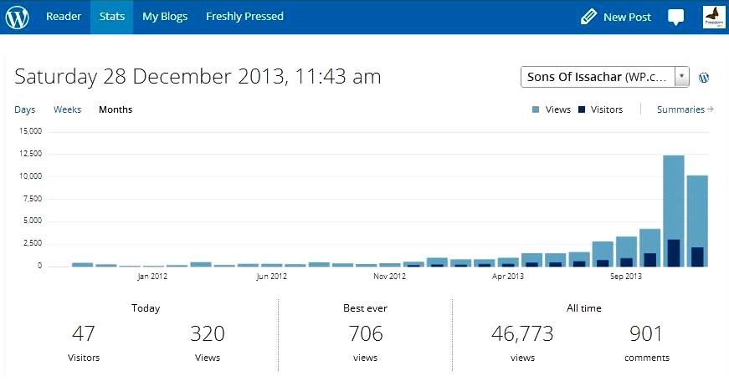
freedomarc.wordpress.com

Slide 54
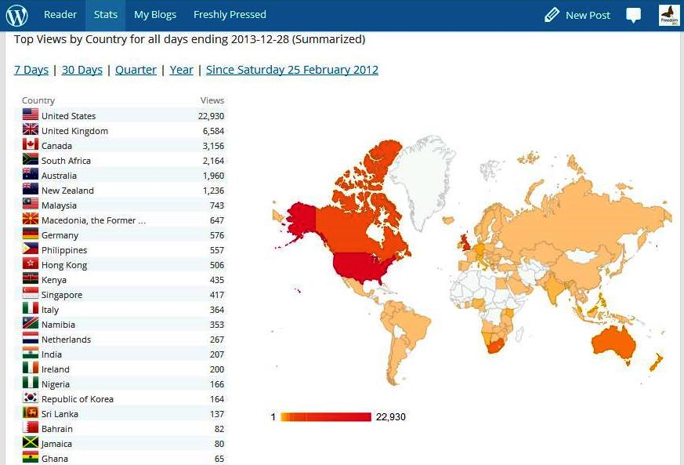
freedomarc.wordpress.com

Slide 55
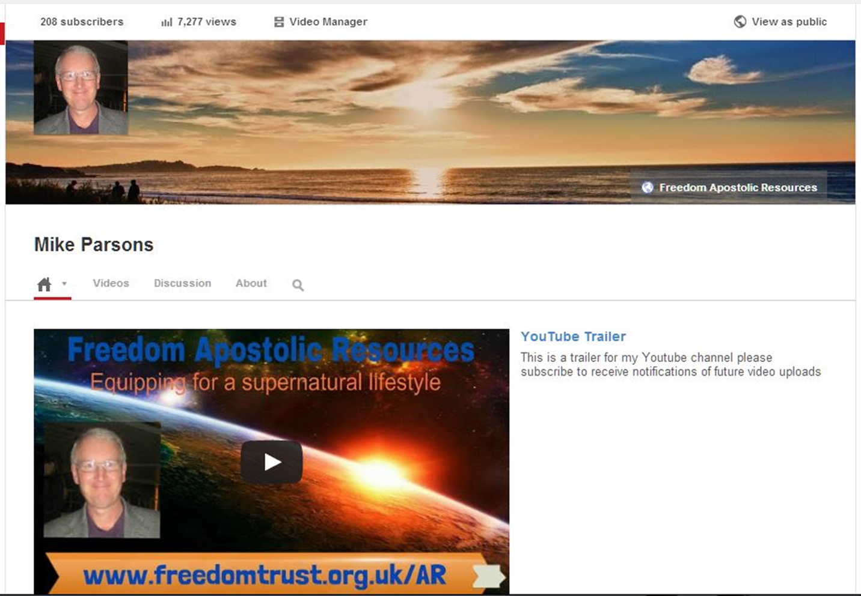
YouTube channel www.youtube.com/user/MikeParsonsFreedomAR

Slide 56


Slide 57
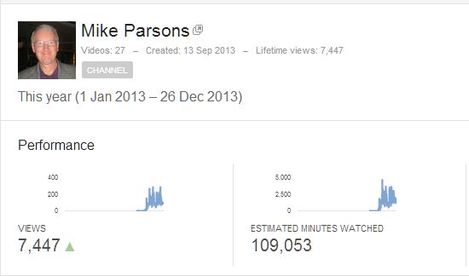
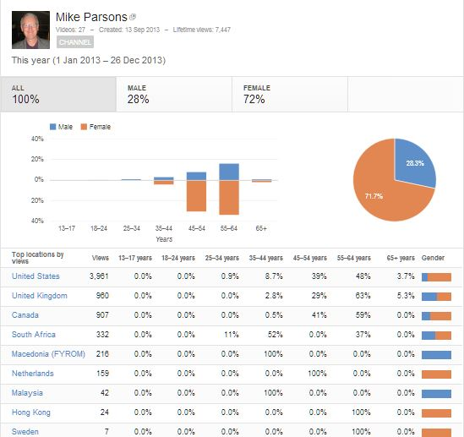

Slide 58
Review 2013
There is huge hunger around the world
Is there hunger here?
Matt 13:57 And they took offense at Him. But Jesus said to them, “A prophet is not without honour except in his hometown and in his own household.” 58 And He did not do many miracles there because of their unbelief.
Familiarity breeds contempt
Honour the message that God is entrusting us with
Don’t miss out on what God is planning

Slide 59
Review 2013
Jesus warned about the leaven of Herod & Pharisees
Political spirit & Religious spirit
Attacks new revelation - prophetic
Political manoeuvring, currying favour, factions, divisions, enmity, strife, gossip
Marked by - Scepticism, Cynicism, Criticism, Judgmentalism

Slide 60
Review 2013
Great resistance to change to let go of the old to embrace the new
Hard work overcoming the inertia that wants to maintain the old
There is old fruit on the tree that Mike Bryant prophesied that still needs to be removed
God is going to violently shake the tree if we don’t remove it

Slide 61
Review 2013
We have seen the Joshua Generation groups grow in heavenly encounters and experiences of God
Obstacles and spiritual dynamics to overcome along the way
Openness, honesty and honour is a key to spiritual growth and maturity

Slide 62
Review 2013
Journey from slavery to sonship
Our inheritance identity, redemptive gifts and destiny
Sound of heaven has been tuned into
4 faces of God revealed
Name of God revealed
Major shift in worship

Slide 63
Review 2013
Journey of Israel from Egypt through the wilderness to promise land
We are going to cross over into a new season
Old provision and lifestyle of the wilderness has to cease
Do you want your full inheritance as a son of God?

Slide 64
Review 2013
Review this year
Present what God has said and where He is calling us to go in 2014
Give everyone a choice as to whether to continue the journey with us
If you choose to continue you must be in AGREEMENT with the new

Slide 65
Review 2013
Embrace the new sound of heaven and resonate with it
Come into alignment with heaven
HOPE is the ability to hear the music of tomorrow.
FAITH is the courage to dance to it today.
End of the old & beginning of new year
Old things to let go of & new things to embrace

Slide 66
Review 2013
If you are holding on to something that doesn't belong to you and was never intended for your life, then you need to......LET IT GO!!!
If you are holding on to past hurts and pains.....
LET IT GO!!!
if you are still affected by disappointment or discouragement.....LET IT GO!!!
If you are still affected by being rejected, unsupported, under-valued or ignored LET IT GO!!!
If people have made you feel insignificant, unaccepted or unappreciated... LET IT GO!!!

Slide 67
Review 2013
If you are still demotivated by your past failures or others bad treatment of you...... LET IT GO!!!
If your past is still negatively affecting your present and clouding your future.....
LET IT GO!!!
If you are demotivated by unfulfilled dreams, vision or expectations.... LET IT GO!!!
If you are involved in a wrong relationship or an addiction..... LET IT GO!!!

Slide 68
Review 2013
If you are holding on to a job that no longer meets your needs or talents…. LET IT GO!!!
If you're stuck in the past and God is trying to take you to a new level in Him...... LET IT GO!!!
If you are struggling with the healing of a broken relationship....... LET IT GO!!!
If you keep trying to help someone who won't even try to help themselves..... LET IT GO!!!

Slide 69
Review 2013
If someone can't treat you right, love you back, and see your worth.....LET IT GO!!!
If someone has angered you ........LET IT GO!!!
If you are holding on to some thoughts of evil and revenge...... LET IT GO!!!
If you have a bad attitude.......LET IT GO!!!
If you keep judging others to make yourself feel better...... LET IT GO!!!

Slide 70
Review 2013
Your sinful nature .........LET IT GO!!!
Your iniquitous patterns .........LET IT GO!!!
Your negative blood-line influences .........LET IT GO!!!
Your genetic seed-line records .........LET IT GO!!!

Slide 71
Review 2013
Your slave identity .........LET IT GO!!!
Your slavery mindset .........LET IT GO!!!
Your old religious mindsets .........LET IT GO!!!
Your old earthly methods .........LET IT GO!!!
Your own cynicism, scepticism, criticism judgmentalism .........LET IT

Slide 72
Review 2013
If you're feeling depressed and stressed .........LET IT GO!!!
If there is a particular situation that you are so used to handling yourself and God is saying "take your hands off of it," then you need to...... LET IT GO!!!
Let the past be the past. Forget the former things. GOD is doing a new thing for 2014!!!
LET IT GO!!!
"The Battle is the Lord's!"

Slide 73
Destiny 2014
Your identity in God … GRAB HOLD OF IT!!!
Your destiny in God…. GRAB HOLD OF IT!!!
Who you are in Christ…. GRAB HOLD OF IT!!!
The plan and purpose for your life….GRAB HOLD OF IT!!!
Your inheritance in God….. GRAB HOLD OF IT!!!

Slide 74
Destiny 2014
Your spiritual gifts…….. GRAB HOLD OF IT!!!
The Fruit of the Spirit…… GRAB HOLD OF IT!!!
Your blessing….. GRAB HOLD OF IT!!!
Your forgiveness….. GRAB HOLD OF IT!!!
Your healing….. GRAB HOLD OF IT!!!
Your peace….. GRAB HOLD OF IT!!!

Slide 75
Destiny 2014
Your joy….. GRAB HOLD OF IT!!!
Your access to God….. GRAB HOLD OF IT!!!
Your debt cancellation….. GRAB HOLD OF IT!!!
Your financial blessing….. GRAB HOLD OF IT!!!

Slide 76
Destiny 2014
Your breakthrough in God….. GRAB HOLD OF IT!!!
Your relationship with God….. GRAB HOLD OF IT!!!
Your intimacy with God…… GRAB HOLD OF IT!!!
Your anointing with the Holy Spirit…. GRAB HOLD OF IT!!!
God's love for you…... GRAB HOLD OF IT!!!

Slide 77
Review 2013
Your heavenly encounters…... GRAB HOLD OF IT!!!
Your heavenly mountain thrones…... GRAB HOLD OF IT!!!
Your kingdom authority….. GRAB HOLD OF IT!!!
Your access into heavenly courts….. GRAB HOLD OF IT!!!

Slide 78
Destiny 2014
Your identity as Lords….. GRAB HOLD OF IT!!!
Your identity as kings….. GRAB HOLD OF IT!!!
Your identity as sons….. GRAB HOLD OF IT!!!
The choice to hold on or let go is yours
The choice to embrace the new is yours

