Slide 1
Base Camp
We are going on a journey or an adventure together – follow map
Journey of discovering how to engage the spiritual realms
Discovering the realms within us, around us and the heavenly realms
There are 2 main pathways that we are going to follow

Slide 2
Base Camp
Pathway of relationship that leads to deeper intimacy with God
Flowing from inside out – from heaven to our gateways of spirit, soul, body to the world around us
Pathway of responsibility that leads to greater kingdom rulership
Flowing from outside in from earth to heaven as living sacrifices to rule.

Slide 3
Pathway of Relationship
Flow from heaven inside out
Plant Seeds of Testimony
Enlarge Spirit Flowing
Experience River of life
Tongues Development
Matt 13
Matt 11
Cultivate good soil
Yoked to Jesus
Ps 23
Opening gateways
Rev 3:20
Preparation Spirit Building
Garden of Heart
Opening First Love Gate
Deal with stones, weeds hardness
Jesus is Lord
Invite Jesus to walk through
Experience God’s Presence
Meditation Thoughts Of God Visualization
Cultivate & Tend

Slide 4
Tongues 3 ways
Meditation Word Flow God’s thoughts
JOURNEY MAPS
Base Camp
Spirit Building
Eyes of Spirit Activation
Eyes of heart Activating Imagination

Slide 5
Tongues Word
Tongues 3 ways
Tongues
Vision
Be still
Psa 46:10
Relax
Hearing God’s voice
Journaling
Tongues Development
Meditation Word Flow God’s thoughts
Base Camp
Spirit Building
Eyes of Spirit Activation
Eyes of heart Activating Imagination
Black Veil
Spirit perception
3 levels of spirit realm
Picture Objects
Picture Word
Picture Doorways

Slide 6
Be still
Psa 46:10
Relax
Hearing God’s voice
Journaling
Further Info 1
Meditation Word Flow of God’s thoughts
Further Info 2

Slide 7
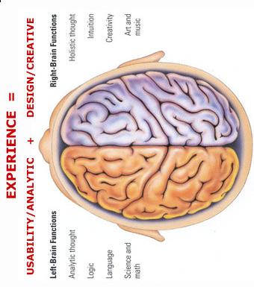
MIND
Hippocampus is a shredding machine for irrelevant information 100 billion instructions /sec
Trauma forms instant neural pathways
Or forms pathways around the memories to block them
Experiences are forgotten if they are not used Use it or lose it
Natural
H I P P O C A M P U S
SUBCONSCIOUS MIND
C ON SC I E N C E
I M A G I N A T I O N
M E M O R Y
B A NK S
R E P E T I T I O N
V A L U E
V A L U E
Write
Review
Revisit
Words Thoughts Meditations Imagination Doors Encounters
See
Smell
Hear
Taste
Touch
Synapses Close & Form Neural Pathways
Links to Memories
Meditate
H E A R T
Anchor Doors Meditation Words
Repetition
Spiritual
TONGUES
We all see spiritual realms most have no reference points or anchor so all info gets shredded
Use visions, dreams, Imagination, meditation, words
Words become doorways to spiritual experiences Words become anchors of experiences to keep doors open

Slide 8
Base Camp Spirit Building 4
Heb 5:14 But solid food is for the mature, who because of practice have their senses trained to discern good and evil.
Training Training Training
Practice Practice Practice
Mature to discern

Slide 9
Base Camp Spirit Building 4
Psa 46:10 Let be and be still, and know that I am God
Psa 46:10 Cease striving, Let be and be still and know that I am God;
Isa 40:31 But those who wait on the Lord shall change and renew their strength and power;
Active listening

Slide 10
Base Camp Spirit Building 4
Heb 4:12 For the word of God is living and active and powerful
Meditate on it in 2D to experience it in 3D. A picture paints a 1000 words
Write, Review & revisit - value
Some experiences of heaven not in word (greater works of Jesus)
Use word to plumb line experience to the principles of God’s nature & character
Word then becomes a starting point

Slide 11
Base Camp Spirit Building 4
John 10:27 My sheep hear My voice, and I know them, and they follow Me
Hearing God’s voice through His word is the beginning of engaging in living real time conversations with Him

Slide 12
Base Camp Spirit Building 4
Joshua 1:8 This book of the law shall not depart from your mouth, but you shall meditate on it day and night, so that you may be careful to do according to all that is written in it; for then you will make your way prosperous, and then you will have success.

Slide 13
Base Camp Spirit Building 4
God wants our attention.
Yes, we can relate to God in the busyness of life, but it is important for us to give Him quality time too.
When we meditate, we repeatedly bring the things God has said into the forefront of our thinking.
Psa 103:2 Bless the Lord, O my soul, And forget none of His benefits;

Slide 14
Base Camp Spirit Building 4
Psalm 63:6 When I remember You on my bed, I meditate on You in the night watches,
Psalm 77:11 I shall remember the deeds of the LORD; Surely I will remember Your wonders of old.
Psalm 143:5 I remember the days of old; I meditate on all Your doings; I muse on the work of Your hands.

Slide 15
Base Camp Spirit Building 4
What we repeat gets stored in our heart, in our subconscious mind; and what is in our subconscious triggers our conscious mind:
Prov 23:7 As a man thinks in his heart so is he
Luke 6:45 Out of the abundance of his heart, his mouth speaks

Slide 16
Base Camp Spirit Building 4
7 Steps to Meditation – God centred
Lord cleanse & prepare my heart
Lord give me a teachable attitude
Lord I surrender my senses to You
Lord open the eyes of my heart
Lord I present my abilities to reason & imagine to You to fill & flow through
Lord I focus my attention on what you show me
Lord thank you for what you have revealed to me

Slide 17
Base Camp Spirit Building 4
LORD, CLEANSE ME BY YOUR BLOOD:
Since receiving divine revelation is at the heart of biblical meditation, you prepare yourself to receive from the Holy Spirit by repenting and being cleansed
You need to be obedient to previous revelations from God (Matt. 7:6), and confess any sin in your life, so you are not cut off from ongoing revelation (Is. 59:1,2; I Jn. 1:9).

Slide 18
Base Camp Spirit Building 4
LORD, GRANT ME A TEACHABLE ATTITUDE:
Revelation is given to those who maintain an attitude of humility, and it is withheld from the proud and the arrogant.
So keep an open, humble attitude before God, allowing Him the freedom to shed greater light on any ideas you currently hold and to alter them as He sees fit (Jas. 4:6; 2 Pet. 1:19).

Slide 19
Base Camp Spirit Building 4
LORD, I WILL NOT USE MY FACULTIES MYSELF:
Jn. 5:19,20,30 You choose to do nothing of your own initiative but only what you hear and see by the Spirit
You do not have a mind to use, but a mind to present to God so He can use it and fill it with anointed reason and divine vision (Prov. 3:5-7; Rom. 12:1-2).
If you use your mind yourself, it can be a dead work (Heb. 6:1-2).

Slide 20
Base Camp Spirit Building 4
LORD, I PRAY THAT THE EYES OF MY HEART MIGHT BE ENLIGHTENED:
Slow down as you read, mulling the text over and over in your heart and mind, constantly asking God to give you a spirit of wisdom and revelation in the knowledge of Him (Eph. 1:17,18; Ps. 119:18).

Slide 21
Base Camp Spirit Building 4
LORD, I PRESENT THE ABILITIES TO REASON AND TO IMAGINE TO YOU TO FILL AND FLOW THROUGH BY YOUR SPIRIT:
Meditation involves presenting your faculties to God for Him to fill and use.
These include your left-brain reasoning capacities as well as your right-brain visual capacities.

Slide 22
Base Camp Spirit Building 4
John 7:37-39 Look for the river of God (i.e. Holy Spirit flow to guide and fill both brain hemispheres, granting you anointed reasoning and dreams and vision
2 Kings 3:15 But now bring me a minstrel.” And it came about, when the minstrel played, that the hand of the Lord came upon him.
Music can assist you, as can muttering, speaking, and writing as you go through the discovery process

Slide 23
Base Camp Spirit Building 4
LORD, SHOW ME THE SOLUTION TO THE PROBLEM I AM FACING:
Focused attention brings additional energies of concentration of heart and mind, which help release revelation.
For example, note the difference between a ray of sunlight hitting a piece of paper, and sunlight going through a magnifying glass to hit a piece of paper.

Slide 24
Base Camp Spirit Building 4
The focused energy creates a ray so concentrated that the paper bursts into flames.
Matt. 5:6 “Blessed are those who hunger and thirst for righteousness, for they shall be satisfied.
When you have a hunger to master a new understanding and discipline, that hungry and searching heart will cause you to see things you would not normally see

Slide 25
Base Camp Spirit Building 4
THANK YOU, LORD, FOR WHAT YOU HAVE SHOWN ME:
Realizing that the revelation came from the indwelling Holy Spirit, give all the glory to God for what has been revealed (Eph. 3:21).
An attitude of gratitude not taking things for granted.

Slide 26
Base Camp Spirit Building 4
Physical calm Heb 4:9-11
Focused attention Heb 12:1-2
Letting be Phil 4:6-7
Receptivity John 15:4-5
Spontaneous Flow John 7:37-38
Journal Hab 2:1-2

Slide 27
Base Camp Spirit Building 4
Hab 2:1 I will stand on my guard post And station myself on the rampart; And I will keep watch to see what He will speak to me.. 2 Then the LORD answered me and said "Record the vision
Recognise God’s voice as spontaneous thoughts in your mind
Quieten yourself so you can hear
Look for vision
Write down the flow of your thoughts

Slide 28
Base Camp Spirit Building 4
Key 1: God’s voice in your heart often sounds like a flow of spontaneous thoughts.
Habakkuk knew the sound of God speaking to him (Hab. 2:2). Elijah described it as a still, small voice (I Kings 19:12).
Listen for an inner audible voice,
Usually, God’s voice comes as spontaneous thoughts, visions, feelings, or impressions

Slide 29
Base Camp Spirit Building 4
Key 2: Become still so you can sense God’s flow of thoughts and emotions within.
Habakkuk said, “I will stand on my guard post...” (Hab. 2:1). Habakkuk knew that to hear God’s quiet, inner, spontaneous thoughts, he had to first go to a quiet place and still his own thoughts and emotions.
Psalm 46:10 encourages us to be still, and know that He is God.

Slide 30
Base Camp Spirit Building 4
There is a deep inner knowing (spontaneous flow) in our spirits that each of us can experience when we quiet our flesh and our minds.
If we are not still, we will sense only our own thoughts.
If thoughts come of things I have forgotten to do, Write them down and dismiss them.

Slide 31
Base Camp Spirit Building 4
If thoughts of guilt or unworthiness come ( tactic of enemy)
Repent thoroughly, receive forgiveness, putting on His robe of righteousness, seeing yourself as spotless before God (Is. 61:10; Col 1:22

Slide 32
Base Camp Spirit Building 4
Matt 11:28 Come to Me, all you who labour and are heavy-laden and overburdened, and I will cause you to rest. [I will ease and relieve and refresh your souls.]
1 Peter 5:7 Casting the whole of your care [all your anxieties, all your worries, all your concerns, once and for all] on Him, for He cares for you affectionately and cares about you watchfully.

Slide 33
Base Camp Spirit Building 4
To receive the pure word of God, it is a key that our hearts are properly focused on the source of the intuitive flow.
If I fix my eyes upon Jesus, the intuitive flow comes from Jesus.
If I fix my gaze upon some desire of my heart, the intuitive flow comes out of that desire.

Slide 34
Base Camp Spirit Building 4
Fix your gaze upon Jesus (Heb12:2), becoming quiet in His presence and sharing with Him what is on your heart.
Spontaneous thoughts will begin to flow from the throne of God to you, and you will actually be conversing with the God

Slide 35
Base Camp Spirit Building 4
Key 4 Journaling, the writing out of your questions and God’s answers, brings great freedom in hearing God’s voice.
God told Habakkuk to record the vision (Hab. 2:2). This was not an isolated command.
The bible records many examples of individual’s conversations with God’s and His replies (e.g. the Psalms, many of the prophets, Revelation).

Slide 36
Base Camp Spirit Building 4
Two-way journaling,” is a catalyst for clearly discerning God’s inner, spontaneous flow,
As you practice you will become able to write in faith for long periods of time, simply believing it is God.

Slide 37
Base Camp Spirit Building 4
What we have received from God must be tested.
However, testing involves doubt and doubt blocks divine communication, so it is best not to test while I am trying to receive.
We can receive in faith, knowing that when the flow has ended we can test and examine it carefully, making sure that it does not conflict up with the bible

Slide 38
Base Camp Spirit Building 4
Journaling is a biblical concept
Don’t let doubt hinder you
God is present and is speaking to His children.
Heb 4:10 For the one who has entered His rest has himself also rested from his works, as God did from His.
Relax. when we cease striving and enter His rest, God is free to flow

Slide 39
Base Camp Spirit Building 4
Sit back comfortably, take out your pen paper, smile, and turn your attention toward the Lord in praise and worship, seeking His face.
After you write your question to Him, become still, fixing your gaze on Jesus You will suddenly have a very good thought.
Don’t doubt it; simply write it down. Later, as you read your journaling, you will be blessed to discover that you are indeed dialoguing with God

Slide 40
Base Camp Spirit Building 4
Knowing God through the Bible is a vital foundation to hearing His voice in your heart,
Solid commitment to knowing and obeying the Scriptures.
It is also very important for your growth and safety that you be related to solid, spiritual counsellors
All major directional moves that come through journaling should be confirmed by your counsellors before you act upon them.

Slide 41
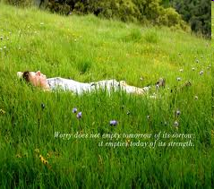

Slide 42
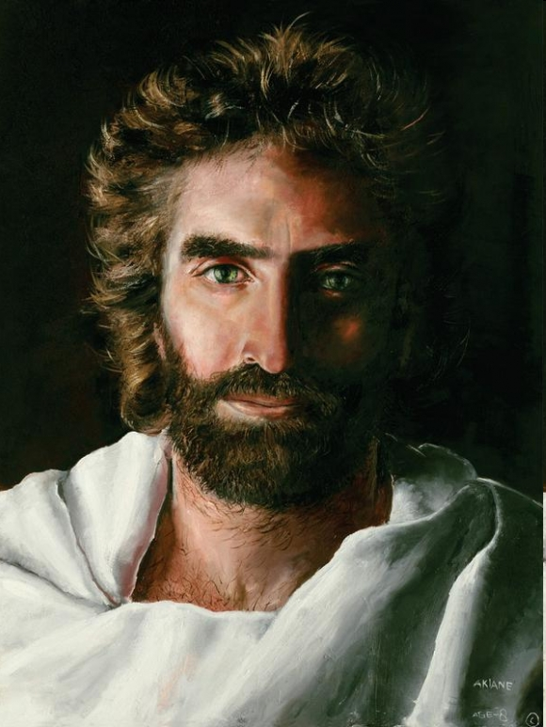

Slide 43
Base Camp Spirit Building 4
Pray in tongues 1 mins Out loud or within
Pray in tongues 5 mins Still mind, focus on Jesus Psa 23 relax lie in green pasture
Ask Jesus the question how do you feel about me?
Listen to the thoughts and write them down

Slide 45
Base Camp Spirit Building 4
Picture Jesus kneeling before you
Off load all your burdens to Jesus Share you heart with Him
Feel him lift off the weight from your shoulders
Talk to Him Listen to Him

