Slide 1
Journey Preparation 5
We are going on a journey or an adventure together
There are 2 main pathways that we are going to follow
Pathway of relationship that leads to deeper intimacy with God
Pathway of responsibility leads to greater kingdom rulership

Slide 2
Journey Preparation 5
2 Cor 4:18 So we fix our eyes not on what is seen, but on what is unseen, since what is seen is temporary, but what is unseen is eternal.
Seer and prophetic gifts the distinguishing or discerning spirits
This can be imparted as a seed but needs to be cultivated
We need to engage the angelic beings who our sent to guard and guide us
We to walk by faith

Slide 3
Journey Preparation 5
Basic Truths
You are a spirit You have a soul You live in a body
Your spirit makes you God conscious and you can engage God who is spirit
Your soul ( heart or subconscious mind) makes you self conscious and aware
Your body or earth suit makes you world conscious and aware

Slide 4
Journey Preparation 5
Basic preparation for the journey.
The language of the spirit how God communicates with us and how we communicate with Him
Journey map
Base camp - Spirit building exercises

Slide 5
Journey Preparation 4
You have the ability and capacity to hear God's voice and see what He is doing.
You have physical senses ears and eyes etc.
You have soul senses - consciousness Conscience, Imagination, Reason - ears eyes voice
Your spirit also has senses eyes, ears, thoughts etc.

Slide 6
Journey Preparation 5
How do we see in the spiritual realm?
How does God communicate with us?
How do we hear God’s voice?
How do we see what God is doing?
Frequency, Vibrations, Resonance
Light & Sound

Slide 7
Journey Preparation 5
Everything seen and unseen is energy vibrating at specific frequencies
Spiritual realms
Known universe
Our bodies, each organ
DNA has it’s own song
Our thoughts and emotions

Slide 8
Journey Preparation 5
Key is to understand how to receive and interpret those vibrations
Resonance brings revelation and transformation
Our consciousness our thoughts and emotions have frequency and therefore abilities that we need to learn how to use
Words, colour and music have frequency

Slide 9
Journey Preparation 5
Your body is designed to be a receiver of data, information both from the physical and spiritual realms
Your body is an amplifier of frequency & vibrations wavelengths of electromagnetic energy
Everything is interpreted in the brain as electrical signals transmitted by neurons synapses etc.

Slide 10
Journey Preparation 5
Physical sound and light
Soul’s thoughts and imagination
Spiritual thoughts, revelation & intuition
3 neurological areas in our bodies that send and receive information
Physical brain – conscious thought
Heart – subconscious mind or soul
Gut – inner most being

Slide 11
Journey Preparation 5
You can receive information from the physical world
Your own consciousness
Your spirit your true self
The unseen realm
The eternal heavenly realm.

Slide 12
Journey Preparation 5
We just have tune our receivers to pick up the right frequencies by training and practice
Hebrews 5:14 But solid food is for the mature, who because of practice have their senses trained to discern good and evil.
Practice requires exercise, repetition that produces greater strength, abilities and skill with use.

Slide 13
Journey Preparation 5
Natural eyes – light reflected from an object is focused through the lens to form an upside down image on the retina that goes along the optic nerve as electrical signals and is interpreted by our brains
We have learnt to be spatially aware of the physical world

Slide 14
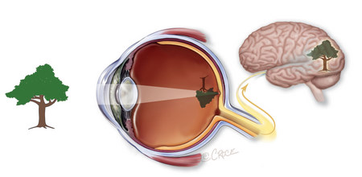
Journey Preparation 5

Slide 15
Journey Preparation 5
Natural ear receive pressure waves from air that vibrate the ear drum and that is passed by bones in fluid to be interpreted by the brain
We have learnt to interpret those pressure waves as sound and language

Slide 16
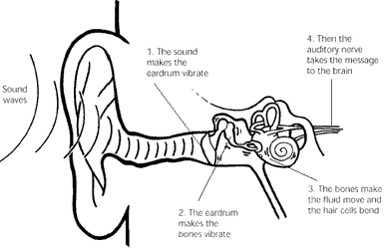
Journey Preparation 5

Slide 17
Journey Preparation 5
Our consciousness is a series of electrical impulses in our synapses passing along neural pathways that brain interprets as thoughts
We have learnt to interpret those signals

Slide 18
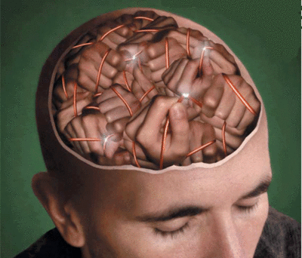
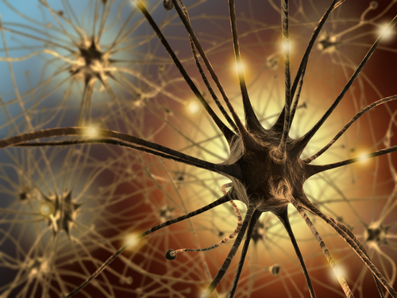
Journey Preparation 5

Slide 19
Journey Preparation 5
Eyes of our hearts – imagination forms directly in our mind on a screen
Eyes of our spirit – seeing in our spirit but is often translated & interpreted by our brain
Heb 5:14 train our senses to discern with practice.

Slide 20
Journey Preparation 5
God said – God saw
Connection between light and sound
Key in understanding how to hear God’s voice and see what God is doing
How do our natural and spiritual senses work together so we can hear, see and know God?
Passive or active receiver
Learn how to be an active receiver

Slide 21
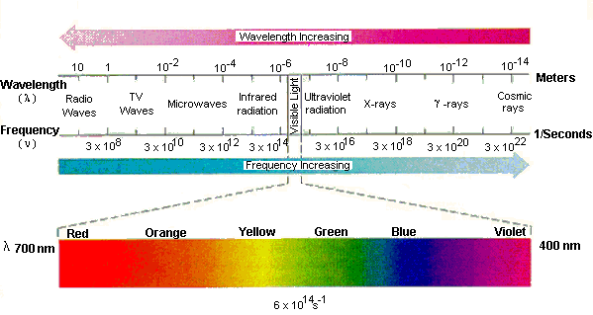
Journey Preparation 5

Slide 22
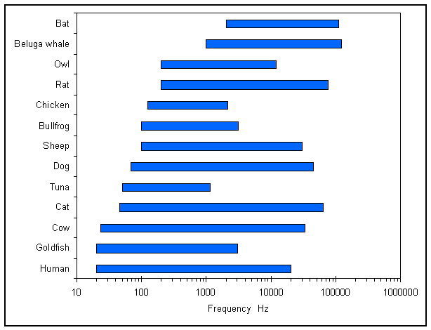
Journey Preparation 5

Slide 23
Journey Preparation 5
The ear and eyes have the abilities to hear and see range of wavelengths from Hz sound to nm light
The spirit is capable of discerning wavelengths that are not delectable by our natural ears and eyes.
Spirit is able to interpret and describe what it perceives

Slide 24
Journey Preparation 5
Natural eyes, Eyes of your heart, Eyes of your spirit
Signals are passed to the brain so we are able to understand and distinguish between spirits
See and hear and engage in other realms or dimensions
Both within our souls and spirits and in the external dimensions around us

Slide 25
Journey Preparation 5
Gen 2:7 Then the Lord God formed man of dust from the ground, and breathed into his nostrils the breath of life; and man became a living being.
Your spirit is a real dimensional place that represents the real you
TARDIS bigger on the inside and can grow and expand
Your soul is also a real dimensional place that you can engage God in

Slide 26
Journey Preparation 5
Our whole body vibrates at a frequency.
Our body is made up of 68% water & our brain is 80% water.
Water has the capacity to transmit vibrations e.g. sound frequencies 4x faster than air
We receive vibrational frequencies both within and from without

Slide 27
Journey Preparation 5
The ear is continually vibrating and is sensitive to changes in frequency it is connected to nearly every organ of the body via audio nerves.
Our whole body is like a detector and amplifier of frequency.
Our spirit can become sensitive to what God is saying and to seeing what God and the enemy is doing in the dimensions around us.

Slide 28
Journey Preparation 5
Room is filled with signals, sound and light frequencies that cannot be heard or seen by our natural eyes and ears
Our spirit & Soul can tune into to see, hear, feel what our body can’t
Our brain interprets the signals and decodes them so we can experience

Slide 29
Journey Preparation 5
Feel or sense the atmosphere
Cut the atmosphere with a knife
Feel cold chill shivers in certain places
Feel peace in certain places
Involuntary untrained senses
We can train those senses to “see” what our natural eyes can’t

Slide 30
Journey Preparation 5
Train our spirits to be able to discern and engage those frequencies
Spiritual radar and sonar where my spirit can send out a ping or wave frequency and then pick up the response as wave or frequencies that our body amplifies and sends to brain via the ear
William Branham determine disease by the vibrations in touch of someone's hand

Slide 31
Journey Preparation 5
Seeing & Hearing encompasses all the senses Hebrew – experience encounter
See with eyes connected to any sensation.
Eyes, ears, tongue, nose, skin also senses mental or spiritual perception.
Alpha brain waves slower and more spiritually sensitive
Eyes closed brain starts to see on our imagination screen

Slide 32
Journey Preparation 5
Hebrews 11:3 By faith we understand that the worlds were prepared by the word of God, so that what is seen was not made out of things which are visible.
God created and holds everything together by His consciousness – thoughts words and observation
Meditation and imagination are the doorways to experiencing true reality

Slide 33
Journey Preparation 5
1 Corinthians 2:16 For who has known the mind of the Lord , that he will instruct Him? But we have the mind of Christ.
Eph 1:18 I pray that the eyes of your heart may be enlightened (opened), so that you will know
Eyes of our heart is our imagination

Slide 34
Journey Preparation 5
“Imagination is more important than knowledge. For knowledge is limited to all we now know and understand, while imagination embraces the entire world, and all there ever will be to know and understand.”
Albert Einstein

Slide 35
Journey Preparation 5
“The intuitive mind is a sacred gift and the rational mind is a faithful servant. We have created a society that honours the servant and has forgotten the gift.”
Albert Einstein

Slide 36
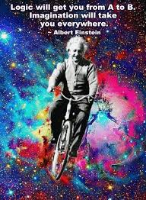

Slide 37
Journey Preparation 5
Einstein said Imagination was greater than knowledge.
Imagination is the gateway of possibility.
The beginning of substance.
The DNA of creative power.
It is the window of the soul to unseen possibilities.

Slide 38
Journey Preparation 5
The catalyst for growth.
The defining characteristic of a child like heart.
We must learn to release the power of being made in the image of God
We must learn to activate the creative power of our imaginations
When your memories are greater than your dreams you're already dying.

Slide 39
Journey Preparation 5
God communicates through spontaneous flow through the spirit
Spirit sensations are received as a spontaneous flow to soul/heart
When we relax, more blood flows to the right hemisphere; thus, a relaxed person can more readily access right-brain functions.
When we seek God, divine revelation flows through the soul from the spirit to our conscious understanding

Slide 40
Journey Preparation 5
God’s language
Flow of thoughts, pictures, words, impressions, perception
Received and interpreted in our brains
On the screen of our imagination

Slide 41
Journey Preparation 5
Visions is an example spirit to brain communication pictures on the imagination
Small Still Voice is another example of frequency heard as thoughts in the mind.
Intuition is another example from emotions
Seeing is tuning in to a spiritual frequency and communicating to brain so we have understanding.
Heb 5: 14 practice to train our senses by repetition meditation.

Slide 42
Journey Preparation 5
Tongues is another example spirit to brain, heart, gut communication
Language of the spirit
Your spiritual language how you speak to God – tongues
Language of men or angels
Gift of the Spirit
Key exercise for building up our spirit

Slide 43
Journey Preparation 5
Revelation ask God to show you pictures
Interpretation ask God to show you what it means
Application ask God to show you how to respond

Slide 44
Journey Preparation 5
Think of an object – door, garden
Close your eyes and picture the object
Think of Jesus and ask him for a picture or vision he wants to give you
Ask Him to reveal what it means
Ask Him to show you how to respond

Slide 45
Journey Preparation 5
Revelation ask God to show you pictures
Interpretation ask God to show you what it means
Application ask God to show you how to respond
Anyone not speaking in tongues ask ministry team to pray for you today to activate that gift

Slide 46
Journey Preparation 5
Activate our journey
Invite God into our spirit
Opening the door and sense His presence feel the river of life flow out
Feel the warmth and love of His presence
Feel Him, sense Him
Your spirit has a throne invite Him to sit on it as your Lord

Slide 47
Journey Preparation 5
Your spirit has doorways to your soul
Invite through a doorway to your heart
Your heart is like a garden sit and talk with Him
See the river of life flowing into your garden

Slide 48
Journey Preparation 5
All matter has frequency, which is best described as an electric current or vibrational energy.
Familiar examples are light and sound waves.
Everything including our bodies, thoughts and emotions

Slide 49
Journey Preparation 5
Sound & colour have an affect on the natural and spiritual dimensions
Healing frequencies in music
Fragrant oils with healing properties

Slide 50
Journey Preparation 5
A substance with a higher frequency can raise a lower frequency due to the principle of entrainment - the tendency for two oscillating bodies to lock into phase so that they vibrate in harmony.
This principle is key to understanding the effect essential oils can have on our personal electromagnetic frequency.

Slide 51
Journey Preparation 5
The human body vibrating within its normal vibratory range between 62 and 68 MHz is considered in a state of health.
Energy disturbances in the subtle bodies will actually precede the appearance of disease and illness in the physical body.

Slide 52
Journey Preparation 5
The normally harmonious coherent frequencies of the body easily go out of “tune” when a person experiences physical or emotional stress.
When the human frequency range drops below the norm of 62 megahertz, this is when abnormal processes can begin to develop.

Slide 53
Journey Preparation 5
Properly “retuning” the body to its original frequency brings it into balance and restores its natural harmonic resonance – illness either doesn’t manifest or is resolved.
The universe is out of sync, tune or balance with the spiritual or quantum realm that holds it together vibrationally

Slide 54
Journey Preparation 5
Human cells can start to change (mutate) when their frequency drops below 62MHz.
58 MHz is the frequency of your body when you have a cold or the flu.
When candida is present within your body, you vibrate at a frequency of 55MHz.
52 MHz is the frequency of a body with Epstein-Barr virus present.
42 MHz is the frequency of a body wherein cancer can appear.
When the death process begins - the frequency has been measured at 20 MHz.

Slide 55
Journey Preparation 5

Slide 56
Journey Preparation 5

Slide 57
Journey Preparation 5
Remember that light itself is frequency. A lack of light, i.e. darkness, has no frequency.
Sound is frequency. That is why the power of life and death is in the tongue (Pro18:21).
Words of truth (light- high frequency) can promote healing, while words of lies (darkness- low frequency) will produce death.
God Himself spoke the universe into existence- His words are words of LIFE!

Slide 58
Journey Preparation 5
SPIRIT, SOUL, & BODY
We as individuals must be healed in all three areas of body, mind, and spirit.
If one eats healthy, yet has unhealthy attitudes or experiences grief/depression, their overall health suffers (Pro14:30; 17:22; 18:14).
Negativity will lower our frequency, causing us to be susceptible to sickness. On the other hand, there are many “spiritual” people who are still sick, because they do not eat healthy.

Slide 59
Journey Preparation 5
ESSENTIAL OILS
The power of frequency is one reason why essential oils have tremendous healing capabilities. Because they are the highly concentrated life-force of the plant, they have high frequencies. When applied to the human body (either internally or externally), they will raise the body’s entire frequency, therefore promoting healing and restoration.

Slide 60
Journey Preparation 5
THE POWER OF MUSIC
David played his harp for King Saul when he was tormented by evil spirits. His music was restorative- it was pure worship of God, and it raised the frequency of the atmosphere. This is why the evil spirits had to flee. They could not stand the higher frequency of the pure music- Praise and worship music are very effective in spiritual warfare and healing.

Slide 61
Journey Preparation 5
We have all experienced the effects of different frequencies in music?
How some music soothes our souls and brings peace, while some music just “feels wrong”?
It is the spirit/frequency of the music that we are experiencing, and it will affect us either good or bad.

Slide 62
Journey Preparation 5
MATCHING FREQUENCY
An opera singer, hitting a certain high note, can make glass shatter. What happens is that the sound of her voice is matching the frequency of the glass, but her voice eventually overpowers the glass. The glass molecules can no longer hold together and so they break apart and shatter.

Slide 63
Journey Preparation 5
MATCHING FREQUENCY
An opera singer, hitting a certain high note, can make glass shatter. What happens is that the sound of her voice is matching the frequency of the glass, but her voice eventually overpowers the glass. The glass molecules can no longer hold together and so they break apart and shatter.
This concept could explain how the walls of Jericho came down. Israel silently marched around Jericho for six days, probably coming into the same frequency as the wall. When they let out their loud shout, it overpowered the wall’s frequency and caused it to crash. This may also explain the seemingly strange instruction God gave to His people about not mixing wool and linen. Both of these fibers are reported to have the same high frequency. When a woman put on a wool jacket over her linen shirt, the frequency of both fabrics immediately dropped to zero. Wearing fabric of zero frequency so close to our bodies certainly will not offer protection and may actually be harmful. God knew what he was talking about!

Slide 64
Journey Preparation 5
This may also explain the seemingly strange instruction God gave to His people about not mixing wool and linen. Both of these fibres are reported to have the same high frequency. When a woman put on a wool jacket over her linen shirt, the frequency of both fabrics immediately dropped to zero.
Wearing fabric of zero frequency so close to our bodies certainly will not offer protection and may actually be harmful.
God knew what he was talking about!

Slide 65
Journey Preparation 5
We believe that the spirit realm is an extremely high frequency (or at least, the kingdom of LIGHT is, as opposed to the kingdom of darkness), and we believe this is why the holy anointing oil mixture detailed in Exodus chapter 30 was used only for the priests. It was probably an extremely high frequency blend which prepared the priests to come before God, who is Spirit, and naturally, would have the highest frequency of all!
It is probably why, when Moses spent time with God, his skin began to radiate- light is frequency!

Slide 66
Journey Preparation 5
Negative food choices or exposure to toxic chemicals lower our frequency. God created us to be in harmony and balance with ourselves and with the rest of His creation.
All areas of our life must be properly nourished and taken care of.
We need to envelop our bodies, minds, and spirits in high frequencies by living healthy and by focusing our minds on the truths of God’s Word (Pro3:7-8).

Slide 67
Journey Preparation 5

Slide 68
Journey Preparation 5
In Genesis chapter six, we learn that men had become so wicked that every intent of their hearts were bent towards evil. These evil thoughts, words, and actions of mankind also corrupted the earth itself.
“The earth also was corrupt before God, and the earth was filled with violence. So God looked upon the earth, and indeed it was corrupt; for all flesh had corrupted their way on the earth.”
Genesis 6:11-12
The evil deeds of the population had so lowered the frequency of the earth that the earth itself began to corrupt. Some believe this is part of the reason the fountains of the deep broke open and chaos ensued. The earth simply could not hold together any longer. It was producing the fruits of violence and corruption that had been planted by men.

Slide 69
Journey Preparation 5
How do we hear the voice of God?
How do we recognise the voice of God?
God is a spirit being who transcends time and space
Eph 4:6 one God and Father of all who is over all and through all and in all.
God is not everything and everything is not God
Develop a lifestyle of the supernatural

Slide 70
Journey Preparation 5
1 Kings 19:12 ..a still, small voice. 13 Elijah heard the voice - inside
Num 12:6 He said, Hear now My words: If there is a prophet among you, I, the LORD, shall make Myself known to him in a vision I shall speak with him in a dream
Made in the image of God
Creative abilities
Made to receive

Slide 71
Journey Preparation 5
1 Cor 2:10 For to us God revealed them through the Spirit; for the Spirit searches all things, even the depths of God. 11 For who among men knows the thoughts of a man except the spirit of the man which is in him? Even so the thoughts of God no one knows except the Spirit of God.

Slide 72
Journey Preparation 5
1 Cor 2:12 Now we have received, not the spirit of the world, but the Spirit who is from God, so that we may know the things freely given to us by God, 13 which things we also speak, not in words taught by human wisdom, but in those taught by the Spirit, combining spiritual thoughts with spiritual words.

Slide 73
Journey Preparation 5
1 Cor 14:1 Pursue love, yet desire earnestly spiritual gifts, but especially that you may prophesy. 2 For one who speaks in a tongue does not speak to men but to God; for no one understands, but in his spirit he speaks mysteries. 4 One who speaks in a tongue edifies himself; 18 I thank God, I speak in tongues more than you all;

Slide 74
Journey Preparation 5
Heb 5:14 But solid food is for the mature, who because of practice have their senses trained to discern good and evil
Faith level discernment
Distinguishing or discerning spirits 1 Cor 12:10
Office of seer Eph 4:11-13

Slide 75
Journey Preparation 5
Everyone can have their spiritual eyes and ears open and functioning
Heb 5:12 For though by this time you ought to be teachers, you have need again for someone to teach you the elementary principles of the oracles of God, and you have come to need milk and not solid food. 13 For everyone who partakes only of milk is not accustomed to the word of righteousness, for he is an infant. 14 But solid food is for the mature, who because of practice have their senses trained to discern good and evil.
Mature grow in this capacity through training and practice

Slide 76
Journey Preparation 5
Even thoughts and feelings have a vibratory quality that forms a measurable frequency. A negative mental state can lower a person's frequency by 10-12 MHz.
Likewise, a substance or influencing factor - such as thoughts, emotions, and frequency devices - in our internal and external environments can also serve to raise our frequencies. For example, a positive mental attitude, prayer or meditation can raise it by 10-15 MHz.

Slide 77
Journey Preparation 5
THIS STONE SHALL BE A WITNESS
“And [Joshua] took a large stone, and set it up there under the oak that was by the sanctuary of YHVH. And Joshua said to all the people, ‘Behold this stone shall be a witness to us, for it has heard all the words of YHVH which He spoke to us. It shall therefore be a witness to you, lest you deny your God.’”
Joshua 24:26-27
Joshua said that the stone was a witness- it literally “heard” all the words spoken. It absorbed the frequency/sound of the words of God and of the children of Israel. I believe it is playing back what was spoken that day on a frequency that we are unable to physically hear with our ears. We know that objects can record sound. It’s the same concept as being able to record music on a cassette or disc, and being able to play it back.
Gives new meaning to the phrase, “If walls could talk”!

Slide 78
Journey Preparation 5

Slide 79
Pathway of Relationship
Psalms 46:4 There is a river whose streams make glad the city of God, The holy dwelling places of the Most High.5 God is in the midst of her, she will not be moved; God will help her when morning dawns. 6 The nations made an uproar, the kingdoms tottered; He raised His voice, the earth melted. 7 The Lord of hosts is with us; The God of Jacob is our stronghold.

Slide 80
Pathway of Relationship
Psalms 46:10-11“Be still cease striving and know that I am God; I will be exalted among the nations, I will be exalted in the earth." The Lord of hosts is with us; The God of Jacob is our stronghold. Selah

