Slide 1
Journey Preparation 4
We are going on a journey or an adventure together
There are 2 main pathways that we are going to follow
Pathway of relationship that leads to deeper intimacy with God
Pathway of responsibility leads to greater kingdom rulership

Slide 2
Journey Preparation 4
Rick Joyner - “Torch and the Sword”-
“The body of Christ is about to go through a metamorphosis. It has been like a caterpillar crawling along the ground, but is about to emerge into a glorious butterfly which soars above the earth. The church that is about to arise will be more at home in the heavenly realm than the earthly.”

Slide 3
Journey Preparation 4
“There is a door standing open in heaven, and there is an invitation for us to go through it. Those who answer this call will be caught up into the Spirit, with the result that they will always be seeing the One who sits on the throne. This is the ultimate purpose of all, true prophetic revelation- seeing the glorious, risen Christ and the authority He now has over all.”

Slide 4
Journey Preparation 4
“This is not a fantasy. True Christianity is the greatest adventure that anyone can ever have on this earth. True church life, the way it was intended to be, is a supernatural experience. It is life from another realm beyond this earth that brings true life to the earth.”

Slide 5
Journey Preparation 4
Revelation is always progressing! What I believe today is not what I believed even 3 years ago! We must be open to fresh revelations that may wreck our old religious mindsets. God expects us to walk in the light we are given!

Slide 6
Journey Preparation 4
2 Cor 4:18 So we fix our eyes not on what is seen, but on what is unseen, since what is seen is temporary, but what is unseen is eternal.
Seer and prophetic gifts - distinguishing or discerning spirits that can be imparted as a seed but needs to be cultivated
We need to engage the angelic beings who are sent to guard and guide us
We need to walk by faith

Slide 7
Journey Preparation 4
Heb 11:6 And without faith it is impossible to please Him, for he who comes to God must believe that He is and that He is a rewarder of those who seek Him.

Slide 8
Journey Preparation 4
Basic preparation for the journey.
Faith
Basic truths
The language of the spirit
Base camp - Spirit building

Slide 9
Journey Preparation 4
You are a spirit You have a soul You live in a body
Your spirit makes you God conscious and you can engage God who is spirit and spiritual dimensions
Your soul ( heart or subconscious mind) makes you self conscious and aware
Your body or earth suit makes you world conscious and aware

Slide 10
Journey Preparation 4
1 Thes 5:23 Now may the God of peace Himself sanctify you entirely; and may your spirit and soul and body be preserved complete, without blame at the coming of our Lord Jesus Christ.
Gen 1:26 Then God said, “Let Us make man in Our image, according to Our likeness;
You are made in the image of God with creative ability and power

Slide 11
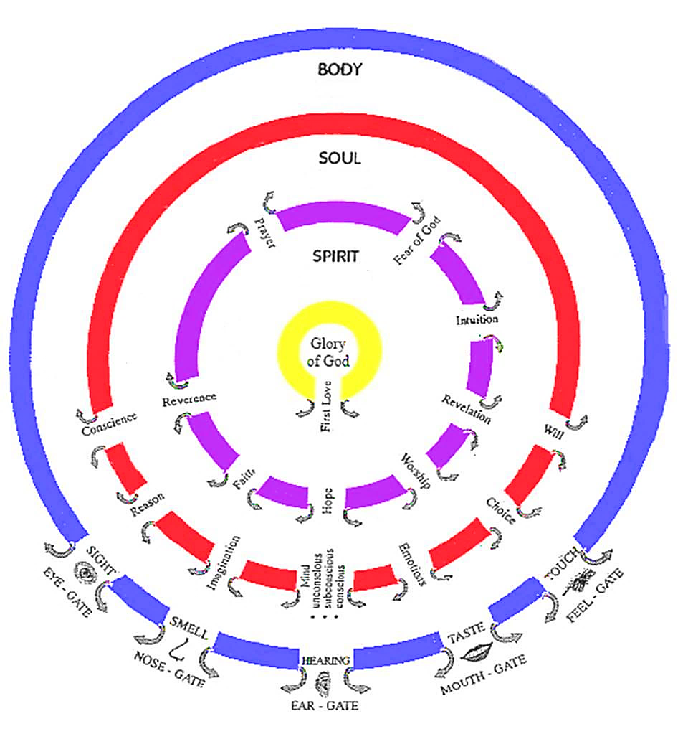

Slide 12
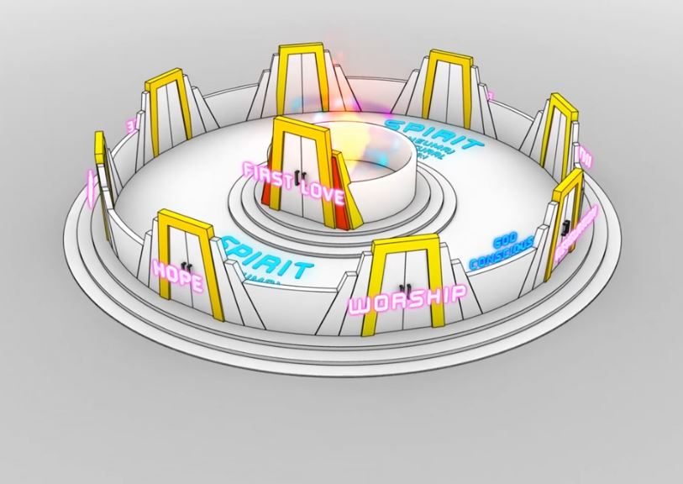

Slide 13
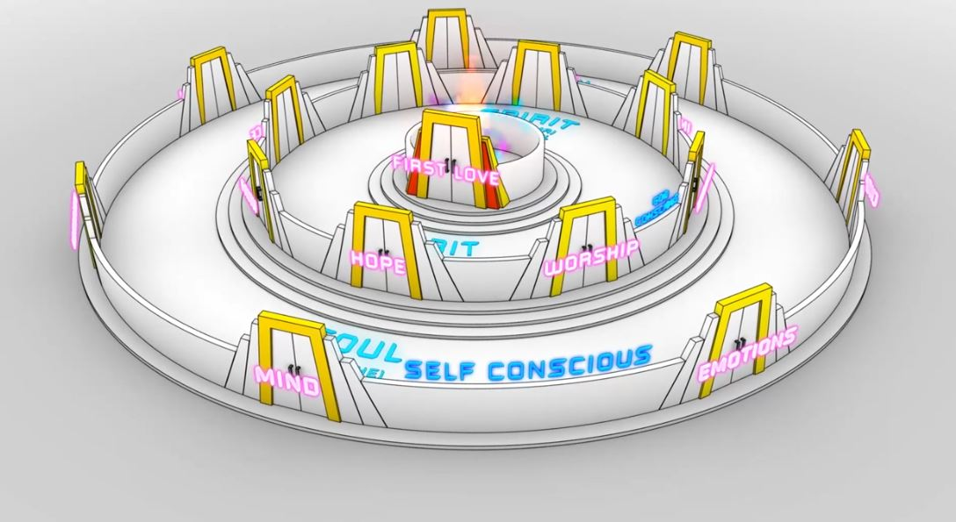

Slide 14
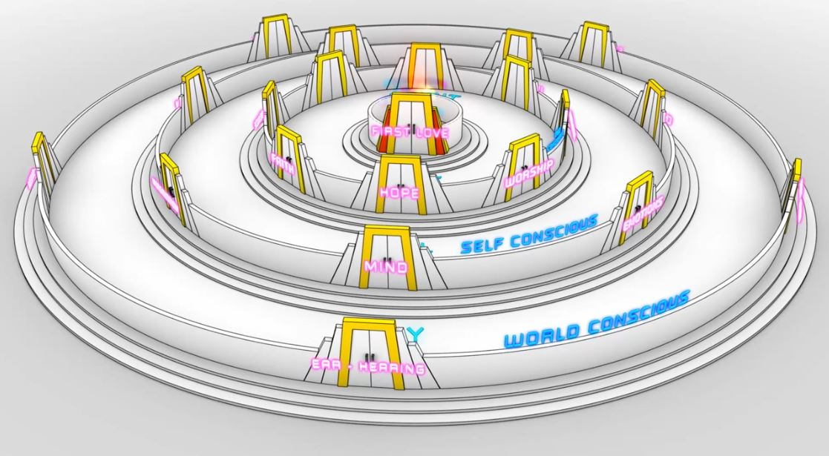

Slide 15
Journey Preparation 4
There is the eternal world
There is the physical world
There is the unseen world
You have access to all dimensions through your spirit soul and body
Your spirit and soul also have a dimensional form

Slide 16
Journey Preparation 4
You are a house of God therefore God lives in you
Gen 28:12, 17 And he dreamed that there was a ladder set up on the earth, and the top of it reached to heaven; and the angels of God were ascending and descending on it! He was afraid and said, How to be feared and reverenced is this place! This is none other than the house of God, and this is the gateway to heaven

Slide 17
Journey Preparation 4
John 14:20, 23 In that day you will know that I am in My Father, and you in Me, and I in you. Jesus answered and said to him, "If anyone loves Me, he will keep My word; and My Father will love him, and We will come to him and make Our abode (home) with him.
Now you are a house of God

Slide 18
Journey Preparation 4
1 Corinthians 3:16 Do you not know that you are a temple of God and that the Spirit of God dwells in you?
1 Corinthians 6:19 Or do you not know that your body is a temple of the Holy Spirit who is in you, whom you have from God, and that you are not your own?

Slide 19
Journey Preparation 4
Luke 17:21 Nor will people say, Look! Here it is! or, See, it is there! For behold, the kingdom of God is within you, in your hearts and among you, surrounding you.
Spirit realm is connected to you because heaven or God's kingdom is in you
Therefore you have access to God the heavenly spiritual realm and God has access to you.
You are a gate of that spiritual heavenly realm and a God Channel

Slide 20
Journey Preparation 4
John 1:51 And He said to him, "Truly, truly, I say to you, you will see the heavens opened and the angels of God ascending and descending on the Son of Man.“
You live under an open heaven with an invitation to interact with the spiritual realm both eternal heavenly and unseen angelic

Slide 21
Journey Preparation 4
Matthew 3:16-17 After being baptized, Jesus came up immediately from the water; and behold, the heavens were opened, and he saw the Spirit of God descending as a dove and lighting on Him, and behold, a voice out of the heavens said, "This is My beloved Son, in whom I am well-pleased."

Slide 22
Journey Preparation 4
Revelation 3:20 Behold, I stand at the door and knock; if anyone hears My voice and opens the door, I will come in to him and will dine with him, and he with Me.
You must give a daily invitation to fill you and flow through you
This is the access point to the Pathway of relationship

Slide 23
Journey Preparation 4
Revelation 4:1-2 After these things I looked, and behold, a door standing open in heaven, and the first voice which I had heard, like the sound of a trumpet speaking with me, said, "Come up here, and I will show you what must take place after these things."
You have to accept the invitation
This begins the pathway of responsibility

Slide 24
Journey Preparation 4
Revelation 3:18 I advise you to buy from Me gold refined by fire so that you may become rich, and white garments so that you may clothe yourself, and that the shame of your nakedness will not be revealed; and eye salve to anoint your eyes so that you may see.
Jesus is your source and supply for this journey but you must draw from Him

Slide 25
Journey Preparation 4
John 1:1 In the beginning was the Word, and the Word was with God, and the Word was God.
Heb 4:12 For the word of God is living and active
Jesus is the Word of God
He will be your guide, doorway and anchor on this journey.

Slide 26
Journey Preparation 4
John 14:16-17 I will ask the Father, and He will give you another Helper, that He may be with you forever; that is the Spirit of truth, whom the world cannot receive, because it does not see Him or know Him, but you know Him because He abides with you and will be in you.
The Holy spirit is also your helper on this journey to guide you to truth or reality

Slide 27
Journey Preparation 4
John 16:13-14 But when He, the Spirit of truth, comes, He will guide you into all the truth; for He will not speak on His own initiative, but whatever He hears, He will speak; and He will disclose to you what is to come. He will glorify Me, for He will take of Mine and will disclose it to you.

Slide 28
Journey Preparation 4
You can hear God's voice and receive God's thoughts and see or perceive what He is doing
John 10:27 My sheep hear My voice, and I know them, and they follow Me;
Vital truth to believe by faith and experience daily

Slide 29
Journey Preparation 4
John 10:1-4 "Truly, truly, I say to you, he who does not enter by the door into the fold of the sheep, but climbs up some other way, he is a thief and a robber. But he who enters by the door is a shepherd of the sheep. To him the doorkeeper opens, and the sheep hear his voice, and he calls his own sheep by name and leads them out. When he puts forth all his own, he goes ahead of them, and the sheep follow him because they know his voice.

Slide 30
Journey Preparation 4
John 10:9 I am the door; if anyone enters through Me, he will be saved, and will go in and out and find pasture.
We have access to the spiritual unseen and eternal heavenly realms
Jesus is the door we can follow Him in and out

Slide 31
Journey Preparation 4
Ephesians 1:3, Blessed be the God and Father of our Lord Jesus Christ, who has blessed us with every spiritual blessing in the heavenly places in Christ,
Ephesians 2:6 and raised us up with Him, and seated us with Him in the heavenly places in Christ Jesus,

Slide 32
Journey Preparation 4
You are a gateway of heaven on earth
The kingdom of God is in you
It flows from heaven inside your spirit through your soul and body
You have authority to create and control the spiritual atmosphere around your life

Slide 33
Journey Preparation 4
John 4:14 but whoever drinks of the water that I will give him shall never thirst; but the water that I will give him will become in him a well of water springing up to eternal life.”
John 7:38 He who believes in Me, as the Scripture said, ‘From his innermost being will flow rivers of living water.’”

Slide 34
Journey Preparation 4
Ephesians 1:18 I pray that the eyes of your heart may be opened, enlightened, so that you will know what is the hope of His calling, what are the riches of the glory of His inheritance in the saints,

Slide 35
Journey Preparation 4
3 engagements exercises
Open your spiritual eyes engage your imagination
God is going to send His Spirit around you and speak from heaven to your spirit
Father is going to come into the unseen realm around you so you can engage Him
You can go through the open door to meet Jesus in the heavenly realms

Slide 43
Journey Preparation 4
Close your natural eyes relax, open your spiritual eyes, engage your imagination
Start thinking about the doorway of heaven open over you now
Start thinking about God standing in the open door
Start allowing your imagination to picture these truths

Slide 44
Journey Preparation 4
Matthew 3:16-17 After being baptized, Jesus came up immediately from the water; and behold, the heavens were opened, and he saw the Spirit of God descending as a dove and lighting on Him, and behold, a voice out of the heavens said, "This is My beloved Son, in whom I am well-pleased.“
Feel His Spirit rest on you now

Slide 47
Journey Preparation 4
You are under an open heaven
I declare you are my beloved son and I am well pleased with you
I call you My children & I am your Father, you are mine and I am yours
I legitimise you as my child
I call forth your spiritual destiny

Slide 48
Journey Preparation 4
I call your spirit to attention
Listen with your spirit to the words that I your heavenly Father have for you
The Spirit of your Father gives witness to your spirit that you are My son

Slide 49
Journey Preparation 4
I bless your spirit with the spirit of sonship and the mindset of sonship
I bless you with a deep heart identity as My very own child, securely loved in My family

Slide 50
Journey Preparation 4
I bless you with the settled assurance that I have a future and hope for you and I have written your days in My book with love for your best interest and My ultimate glory
I bless you with the deep knowledge that I know what you need and I have all the resources of the universe to meet that need

Slide 51
Journey Preparation 4
Listen with your spirit to My words for you
My Spirit testifies to your spirit that you are My child
I bless you with the ears to hear the testimony of the Spirit of the Lord, the Spirit of knowledge, wisdom & understanding, the Spirit of counsel, power and fear of the Lord

Slide 52
Journey Preparation 4
I bless you with being tuned into Me with eyes for seeing, ears for hearing and a mind for understanding according to the Spirit
I bless you with being led by the fullness of My Spirit of truth to see things as I see them in the heavenly realms

Slide 53
Journey Preparation 4
I bless you with the deep knowledge that you are an heir with your brother Jesus to all of My treasuries
I bless you with the confidence that you lack for nothing that you need, spiritually, emotionally, mentally, physically & practically

Slide 54
Journey Preparation 4
I bless you with the sure understanding that I want you to have My blessings and My glory to possess your birthright
I bless you with the desire to press forward to see the glory that I am revealing

Slide 55
Journey Preparation 4
I bless you with a heart that does not rebel or shrink back from the opportunities I put before you daily
I bless you with a hunger for the manifestation of My glory day by day in you and through your life

Slide 56
Journey Preparation 4
I declare that you are no longer a slave, orphan or victim
I declare that you are mine and I am yours
I am your inheritance & you are My inheritance

Slide 57
Journey Preparation 4
I declare that I am your Father & you are My son & I give you access to your heavenly home
I give you access to the river & tree of life in your heavenly home
I call you to be a gateway of heaven on the earth
You are my child and I call you to be displayed as a mature son on the earth

Slide 59
Journey Preparation 4
Prodigal exercise
Father God is standing before you but you have a huge weight chained around your neck and can’t look at Him
Guilt, shame sin in your past, hurt & unforgiveness, responsibility heaviness
Surrender it to Father allow him to break the chain feel lightness
Look up and see the Father waiting arms open love in His eyes

Slide 60
Journey Preparation 4
Come to Him
Feel His loving embrace
Feel the ring of sonship He puts on your finger
Feel the clean robes He puts on you
Enjoy the joy & celebration of His heart
Feel His acceptance & restoring love
Feel His affirmation

Slide 62
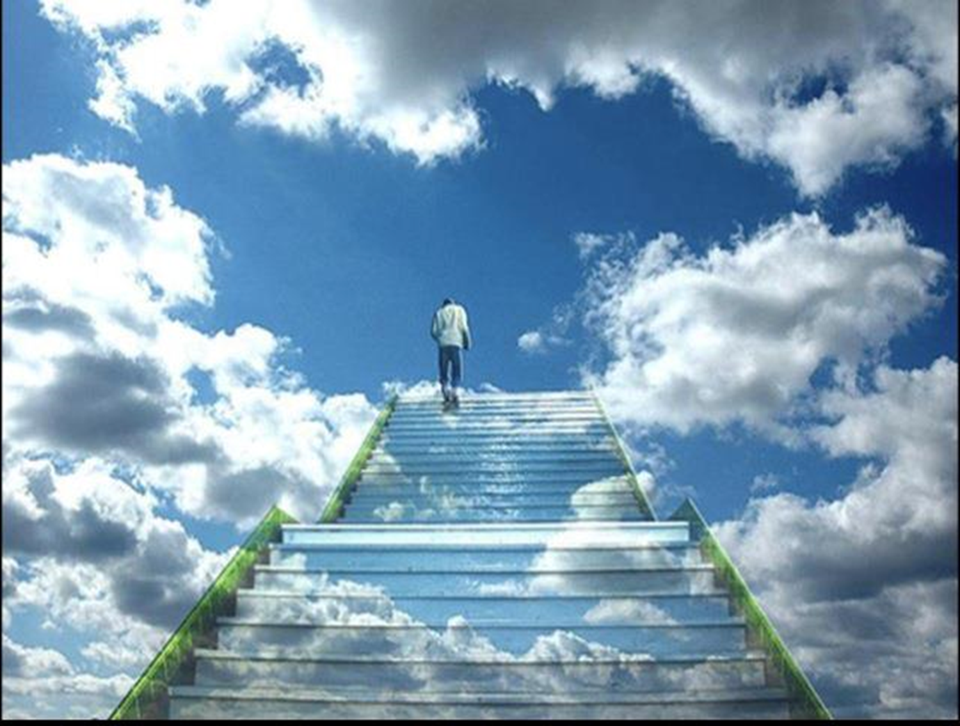

Slide 63
Journey Preparation 4
Revelation 4:1-2 After these things I looked, and behold, a door standing open in heaven, and the first voice which I had heard, like the sound of a trumpet speaking with me, said, "Come up here, and I will show you what must take place after these things."
Accept the invitation to come

Slide 65
Journey Preparation 4

Slide 66
Journey Preparation 4
1 Corinthians 2:16 For who has known the mind of the Lord , that he will instruct Him ? But we have the mind of Christ.
“Imagination is more important than knowledge. For knowledge is limited to all we now know and understand, while imagination embraces the entire world, and all there ever will be to know and understand.” -Albert Einstein

Slide 67
Journey Preparation 4
How Jesus made framed world hold together
John 1:1-4 In the beginning was the Word, and the Word was with God, and the Word was God. He was in the beginning with God. All things came into being through Him, and apart from Him nothing came into being that has come into being. In Him was life, and the life was the Light of men.

Slide 68
Journey Preparation 4
Hebrews 1:2-3 in these last days has spoken to us in His Son, whom He appointed heir of all things, through whom also He made the world. And He is the radiance of His glory and the exact representation of His nature, and upholds all things by the word of His power. When He had made purification of sins, He sat down at the right hand of the Majesty on high,

Slide 69
Journey Preparation 4
Hebrews 11:3 By faith we understand that the worlds were prepared by the word of God, so that what is seen was not made out of things which are visible.
Meditation and imagination are the doorways to experiencing true reality

Slide 70
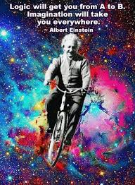

Slide 71
Journey Preparation 4
“The intuitive mind is a sacred gift and the rational mind is a faithful servant. We have created a society that honours the servant and has forgotten the gift.” Albert Einstein

Slide 72
Journey Preparation 4
Gen 2:7 Then the Lord God formed man of dust from the ground, and breathed into his nostrils the breath of life; and man became a living being.
Your spirit is a real dimensional place that represents the real you
TARDIS bigger on the inside and can grow and expand
Your soul is also a real dimensional place that you can engage God in

Slide 73
Journey Preparation 4
Activate our journey
Invite God into our spirit
Opening the door and senses His presence feel the river of life flow out
Feel the warmth and love of His presence
Feel Him, sense Him
Your spirit has a throne invite Him to sit on it as your Lord

Slide 74
Journey Preparation 4
Your spirit has doorways to your soul
Invite through a doorway to your heart
Your heart is like a garden sit and talk with Him
See the river of life flowing into your garden

Slide 75
Journey Preparation 4
Einstein said Imagination was greater than Knowledge. Imagination is the gateway of possibility.
The beginning of substance.
The DNA of creative power.
It is the window of the soul to unseen possibilities.

Slide 76
Journey Preparation 4
The catalyst for growth.
The defining characteristic of a child like heart.
When your memories are greater than your dreams you're already dying.

Slide 77
Journey Preparation 4
Revelation ask God to show you pictures
Interpretation ask God to show you what it means
Application ask God to show you how to respond

Slide 78
Vision Destiny 2014
Rev 1-3 physical body looking at a vision into the unseen realm with spiritual eyes
Rev 4:1-2 spirit leaves body engages the realm of heaven
Legal access through Jesus the door John 10:7 So Jesus said to them again, “Truly, truly, I say to you, I am the door of the sheep.
Illegal access John 10:“Truly, truly, I say to you, he who does not enter by the door into the fold of the sheep, but climbs up some other way, he is a thief and a robber.

Slide 79
Vision Destiny 2014
Working of Holy Spirit
Working of human spirit
Working of the heavenly spiritual beings
Working of the demonic spiritual beings

Slide 80
Journey Preparation 4
Hunger and thirst
John 7:37
Matt 5:
Rev 3:

Slide 81
Journey Preparation 4
Pursuit is the evidence of desire
Love God with all

Slide 82
Journey Preparation 4
Agreement with bible truth
Outward fruit matt 7:15-16 gal 5:22-23
Anointing guides to the truth 1 john 2:20, 26-27
Peace as our guide or umpire col 3:15
Ways and nature of God psa 103:2-7

Slide 83
Journey Preparation 4
Meditation
Josh 1:8
Focus on good things
Prov 23:7
Psa 19:14
Phil 4:8
Psa 104:34

Slide 84
Journey Preparation 4
Meditate on the word
2 Tim 3:16-17
Josh 1:8
Meditate on prophetic
1 Tim 4:14-15
Meditate on God
Psa 63:6

Slide 85
Journey Preparation 4
Names of God reveal his character nature
El-shaddai – the almighty Gen 17:1-2
Jehovah-Jireh Lord our provider Gen22:14
Jehovah-Rapha healer
Jehovah-Tsisqenu righteousness
Jehovah-Nissi banner
Jehovah-shalom peace
Jehovah-shammah is there

Slide 86
Journey Preparation 4
Jehovah-sabaoth Lord of hosts
Meditate on God’s acts –testimony
Rev 19:10
Heb 13:8
Psa 77:10-12
Psa 143:5

Slide 87
Journey Preparation 4
Imagination – eyes of your heart
Eph 1:18
Matt 5:27-28
Imagination is as valid as reality
Creative part of our soul
Job 33:14-16

Slide 88
Journey Preparation 4
Experience word through the interactive experience through imagination
Heb 4:12
Alive and active and engagable
John 6:63 spirit and life
John 17:17 truth = reality
Enter into reality in the word

Slide 89
Journey Preparation 4
New season joy
Isa 61:3 To grant those who mourn in Zion, Giving them a garland instead of ashes, The oil of gladness instead of mourning, The mantle of praise instead of a spirit of fainting. So they will be called oaks of righteousness, The planting of the Lord, that He may be glorified.

Slide 90
Journey Preparation 4
Psalms 46:4 There is a river whose streams make glad the city of God, The holy dwelling places of the Most High.
Psa 45:6 Your throne, O God, is forever and ever; A sceptre of uprightness is the sceptre of Your kingdom. 7 You have loved righteousness and hated wickedness; Therefore God, Your God, has anointed You With the oil of joy above Your fellows.

Slide 91
Journey Preparation 4
Gen 2:10 Now a river flowed out of Eden to water the garden; and from there it divided and became four rivers.
Rev 22:1 Then he showed me a river of the water of life, clear as crystal, coming from the throne of God and of the Lamb,

Slide 92
Vision Destiny 2014
Rev 4:1 After these things I looked, and behold, a door standing open in heaven, and the first voice which I had heard, like the sound of a trumpet speaking with me, said, “Come up here, and I will show you what must take place after these things.”

Slide 94
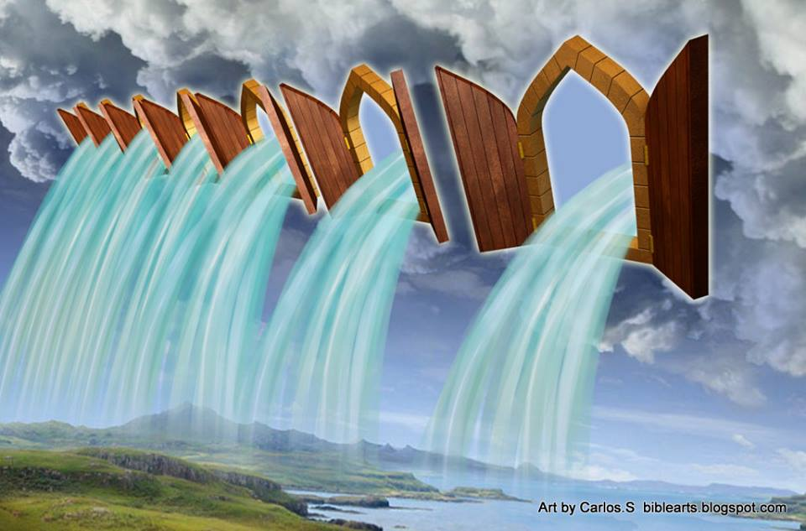

Slide 95
Journey Preparation 4
4 things that will block your sight
veils, scales, demonic devices and devils
Journaling
Habakkuk 2:2 Then the Lord answered me and said: Write the vision and make it plain on tablets, that he may run who reads it.

Slide 96
Journey Preparation 4
Lead me in you truth, and teach me; for you are the God of my salvation ; on you do I wait all the day. (Psalm 25: 5)

Slide 97
Journey Preparation 4
Imagination has gotten a bad rap from the church world. Any time you hear about it you seem to get the warnings from people who want to tell you how “new age” people use the imagination , or how the Bible says we are to cast down imaginations, while conveniently forgetting to quote the rest of the verse. Imagination is a gift from God. Adam had to use his imagination to name all the animals in the garden. One can use the imagination for good or for evil. The imagination just needs to be sanctified so that it fulfils God’s purpose.

Slide 98
Journey Preparation 4
One of the major hang-ups I had with this word was that from childhood on I was taught that imagined meant “not real” or “pretend.” Just your imagination was always a phrase to dismiss imagination as not real or not important. So when I began to be taught from men of God that the imagination was a very powerful key or doorway into the spirit, I had a lot of hurdles to jump over. How could pretending something be the same as it really happening? I don’t want to pretend to see angels. I want to really see them!

Slide 99
Journey Preparation 4
Use your imagination in every part of your Christian walk.
Use it in prayer, and in worship.
Use it while waiting on the Lord, or when praying for the sick .
Practice using your imagination by putting yourself into biblical scenes or imagine the visions that John or Ezekiel describe as if they are happening to you.
What will happen is that you will find yourself being “pulled” into these visionary experiences. The doorway is your imagination.

Slide 100
Journey Preparation 4
But I say unto you, that whosoever looketh on a woman to lust after her hath committed adultery with her already in his heart. (Matthew 5: 28)
Imagination is reality to the Lord.

Slide 101
Journey Preparation 4
Feeding your Spirit It is the spirit that quickeneth; The flesh profiteth nothing; The words that I speak unto you, they are spirit and they are life. (John 6: 63) There are the things that should be more obvious, like prayer and Bible study. And other things like church attendance and fellowship as well. These things are a given for Christian life in general, as well as for opening your spiritual eyes. In my own journey, there were several other things that I considered very significant in causing my eyes to open. I’m going to start with perhaps one of the most important things. Testimonies In an atmosphere of testimonies of God’s greatness, anything can happen. Bill Johnson of Bethel Church in Redding, CA, says that the root word of testimony means “to do again.” Testimonies will inspire you to believe for the things you desire. God is no respecter of persons, what He does for another He will do for you. Fellowship with people who love Testimonies

Slide 102
Journey Preparation 4
Fasting

Slide 103
Journey Preparation 4

Slide 104
Journey Preparation 4

Slide 105
Journey Preparation 4
Language of the spirit
Flow of thoughts, pictures, words, impressions, perception
Received and interpreted in our brains
On the screen of our imagination

Slide 106
Journey Preparation 2
Everyone can have their spiritual eyes and ears open and functioning
Heb 5:12 For though by this time you ought to be teachers, you have need again for someone to teach you the elementary principles of the oracles of God, and you have come to need milk and not solid food. 13 For everyone who partakes only of milk is not accustomed to the word of righteousness, for he is an infant. 14 But solid food is for the mature, who because of practice have their senses trained to discern good and evil.
Mature grow in this capacity through training and practice

Slide 107
Pathway of Relationship
Psalms 46:1-3 God is our refuge and strength, A very present help in trouble. Therefore we will not fear, though the earth should change And though the mountains slip into the heart of the sea; Though its waters roar and foam, Though the mountains quake at its swelling pride. Selah.

Slide 108
Pathway of Relationship
Psalms 46:4 There is a river whose streams make glad the city of God, The holy dwelling places of the Most High.5 God is in the midst of her, she will not be moved; God will help her when morning dawns. 6 The nations made an uproar, the kingdoms tottered; He raised His voice, the earth melted. 7 The Lord of hosts is with us; The God of Jacob is our stronghold.

Slide 109
Pathway of Relationship
Psalms 46:10-11“Be still cease striving and know that I am God; I will be exalted among the nations, I will be exalted in the earth." The Lord of hosts is with us; The God of Jacob is our stronghold. Selah

Slide 110
Pathway of Relationship
1 Cor 14:31 For you can all prophesy one by one, so that all may learn and all may be exhorted;
Everyone can prophesy
1 Cor 12:7 But to each one is given the manifestation of the Spirit for the common good. 10 to another miraculous powers, to another prophecy,
Some people have gift of prophecy

Slide 111
Pathway of Relationship
Eph 4:11 And He gave some as apostles, and some as prophets, and some as evangelists, and some as pastors and teachers, 12 for the equipping of the saints for the work of service, to the building up of the body of Christ;
Some people will be call to the office of prophet

Slide 112
Pathway of Relationship
Heb 5:14 But solid food is for the mature, who because of practice have their senses trained to discern good and evil
Faith level discernment Distinguishing or discerning spirits 1 Cor 12:10
Office of seer Eph 4:11-13

Slide 113
Pathway of Relationship
Everyone can have their spiritual eyes and ears open and functioning
Heb 5:12 For though by this time you ought to be teachers, you have need again for someone to teach you the elementary principles of the oracles of God, and you have come to need milk and not solid food. 13 For everyone who partakes only of milk is not accustomed to the word of righteousness, for he is an infant. 14 But solid food is for the mature, who because of practice have their senses trained to discern good and evil.
Mature grow in this capacity through training and practice

Slide 114
Pathway of Relationship
Eph 1:15 For this reason I too, having heard of the faith in the Lord Jesus which exists among you and your love for all the saints, 16 do not cease giving thanks for you, while making mention of you in my prayers; 17 that the God of our Lord Jesus Christ, the Father of glory, may give to you a spirit of wisdom and of revelation in the knowledge of Him. 18 I pray that the eyes of your heart may be enlightened, so that you will know what is the hope of His calling, what are the riches of the glory of His inheritance in the saints,
Eyes of heart opened

Slide 115
Pathway of Relationship
2 Kings 6:15 Now when the attendant of the man of God had risen early and gone out, behold, an army with horses and chariots was circling the city. And his servant said to him, “Alas, my master! What shall we do?” 16 So he answered, “Do not fear, for those who are with us are more than those who are with them.” 17 Then Elisha prayed and said, “O Lord, I pray, open his eyes that he may see.” And the Lord opened the servant’s eyes and he saw; and behold, the mountain was full of horses and chariots of fire all around Elisha.
Pray for open spiritual eyes

Slide 116
Pathway of Relationship
Rev 3:17 Because you say, “I am rich, and have become wealthy, and have need of nothing,” and you do not know that you are wretched and miserable and poor and blind and naked, 18 I advise you to buy from Me gold refined by fire so that you may become rich, and white garments so that you may clothe yourself, and that the shame of your nakedness will not be revealed; and eye salve to anoint your eyes so that you may see
Spiritual eyes opened

Slide 117
Pathway of Relationship
Luke 4:18 18 “The Spirit of the Lord is upon Me, Because He anointed Me to preach the gospel to the poor. He has sent Me to proclaim release to the captives, And recovery of sight to the blind, To set free those who are oppressed,
Recovering sight to blind

Slide 118
Pathway of Relationship
Matt 7:1 “Do not judge so that you will not be judged. 2 For in the way you judge, you will be judged; and [a]by your standard of measure, it will be measured to you. 3 Why do you look at the speck that is in your brother’s eye, but do not notice the log that is in your own eye? 4 Or how [b]can you say to your brother, ‘Let me take the speck out of your eye,’ and behold, the log is in your own eye? 5 You hypocrite, first take the log out of your own eye, and then you will see clearly to take the speck out of your brother’s eye.
See world through eyes of our heart

Slide 119
Vision Destiny 2014
1 John 2:9 The one who says he is in the Light and yet hates his brother is in the darkness until now. 10 The one who loves his brother abides in the Light and there is no cause for stumbling in him. 11 But the one who hates his brother is in the darkness and walks in the darkness, and does not know where he is going because the darkness has blinded his eyes.
Hate & unforgiveness blinds our spiritual sight

Slide 120
Vision Destiny 2014
1 Chron 29:29 Now the acts of King David, from first to last, are written in the chronicles of Samuel the seer, in the chronicles of Nathan the prophet and in the chronicles of Gad the seer,
Seers & Prophets Same gift calling receive revelation differently
Seers operate in dreams, visions pictures - see
Prophets operate in a flow of words - hear

Slide 121
Vision Destiny 2014
Unseen realm
2 Cor 4:18 So we fix our eyes not on what is seen, but on what is unseen, since what is seen is temporary, but what is unseen is eternal.
Seen physical realm – unseen spiritual realm around us
Eternal heavenly realms – real realm

Slide 122
Vision Destiny 2014
Gift of distinguishing of spirits
Judgement and discernment
Anakrino ability to distinguish
1 Cor 2:14 But a natural man does not accept the things of the Spirit of God, for they are foolishness to him; and he cannot understand them, because they are spiritually appraised.

Slide 123
Vision Destiny 2014
Dokimazo to test or prove
Luke 12:56 You hypocrites! You know how to analyze the appearance of the earth and the sky, but why do you not analyze this present time?
1 John 4:1 test the spirits
1 Thes 5:21 judge prophecies

Slide 124
Vision Destiny 2014
Krino condemn
Matt 7: “Do not judge so that you will not be judged. 2 For in the way you judge, you will be judged; and by your standard of measure, it will be measured to you.
John 7:24 Do not judge according to appearance, but judge with righteous judgment.”

Slide 125
Vision Destiny 2014
Not the gift of criticism
Not the gift of suspicion
Not the gift of manipulation
Not the gift of condemnation

Slide 126
Vision Destiny 2014
Agreement with bible truth
Outward fruit matt 7:15-16 gal 5:22-23
Anointing guides to the truth 1 john 2:20, 26-27
Peace as our guide or umpire col 3:15
Ways and nature of God psa 103:2-7

Slide 128
Vision Destiny 2014
John 4:10 Jesus answered and said to her, “If you knew the gift of God, and who it is who says to you, ‘Give Me a drink,’ you would have asked Him, and He would have given you living water.” 11 She *said to Him, “Sir, You have nothing to draw with and the well is deep; where then do You get that living water? 12 You are not greater than our father Jacob, are You, who gave us the well…

Slide 129
Vision Destiny 2014
John 4:13 Jesus answered and said to her, “Everyone who drinks of this water will thirst again; 14 but whoever drinks of the water that I will give him shall never thirst; but the water that I will give him will become in him a well of water springing up to eternal life.”

Slide 130
Vision Destiny 2014
John 7:37 Now on the last day, the great day of the feast, Jesus stood and cried out, saying, “If anyone is thirsty, let him come to Me and drink. 38 He who believes in Me, as the Scripture said, ‘From his innermost being will flow rivers of living water.’” 39 But this He spoke of the Spirit, whom those who believed in Him were to receive; for the Spirit was not yet given, because Jesus was not yet glorified.

Slide 131
Vision Destiny 2014
My encounters with Jacob as one of the cloud of witnesses, men in white linen, spirit of righteous men made perfect
Heb 12:Therefore, since we have so great a cloud of witnesses surrounding us,
Act 1:10 And as they were gazing intently into the sky while He was going, behold, two men in white clothing stood beside them. 11 They also said, “Men of Galilee, why do you stand looking into the sky? This Jesus, who has been taken up from you into heaven, will come in just the same way as you have watched Him go into heaven.”

Slide 132
Vision Destiny 2014
Heb 12:18 For you have not come to a mountain that can be touched and to a blazing fire, and to darkness and gloom and whirlwind, .. 22 But you have come to Mount Zion and to the city of the living God, the heavenly Jerusalem, and to myriads of angels, 23 to the general assembly and church of the firstborn who are enrolled in heaven, and to God, the Judge of all, and to the spirits of the righteous made perfect, 24 and to Jesus, the mediator of a new covenant,

Slide 133
Vision Destiny 2014
Gen 28:12 He had a dream, and behold, a ladder was set on the earth with its top reaching to heaven; and behold, the angels of God were ascending and descending on it. 13 And behold, the Lord stood above it and said, “I am the Lord, the God of your father Abraham and the God of Isaac; the land on which you lie, I will give it to you and to your descendants. 14 Your descendants will also be like the dust of the earth,

Slide 134
Vision Destiny 2014
Gen 28:16 Then Jacob awoke from his sleep and said, “Surely the Lord is in this place, and I did not know it.” 17 He was afraid and said, “How awesome is this place! This is none other than the house of God, and this is the gate of heaven.”
John 14:20 In that day you will know that I am in My Father, and you in Me, and I in you. 23 Jesus answered and said to him, “If anyone loves Me, he will keep My word; and My Father will love him, and We will come to him and make Our abode with him.

Slide 135
Vision Destiny 2014
Luke 17:21 … the kingdom of God is within you [in your hearts] and among you [surrounding you].
Rev 3:20 Behold, I stand at the door and knock; if anyone hears My voice and opens the door, I will come in to him and will dine with him, and he with Me. 21 He who overcomes, I will grant to him to sit down with Me on My throne, as I also overcame and sat down with My Father on His throne

Slide 136
Vision Destiny 2014
Rev 4:1 After these things I looked, and behold, a door standing open in heaven, and the first voice which I had heard, like the sound of a trumpet speaking with me, said, “Come up here, and I will show you what must take place after these things.”

Slide 140
Vision Destiny 2014

Slide 141
Vision Destiny 2014
l saw the 4 living creatures standing in the E S W N of the room each had a trumpet and a standard they were here to herald a new season. In the centre was Urandial the church angel carrying standard of 4 faces and fire was coming off him releasing fresh passion for the new season.

Slide 142
Vision Destiny 2014
The I saw the 4 creatures move around the room creating like a vortex of colour, sound & energy that opened heavens.
In a new dimension and I saw new angels assigned. I saw the 7 spirits, l saw the cloud of witnesses with mantles coats of different colours.

Slide 143
Vision Destiny 2014
l saw it in the spiritual realm and I saw it also as a prophetic act using the flags and leaders who have to be in agreement and unity.
Wind of change an Angel was assigned to administer this process
A new dimension for a new season.

Slide 144
Vision Destiny 2014
Engaging by faith walk by faith
2 Cor 5:7
Faith leads to experience
Mark 11:

Slide 145
Vision Destiny 2014

Slide 146
Vision Destiny 2014
Doors of faith
Salvation
Eph 2:8
Healing
1 Peter 2:24
Abiding
Col 3:1-3

Slide 147
Vision Destiny 2014
Insight
1 Cor 2:6
Joy
Psa 16:11
Authority
Eph 2:6

Slide 148
Vision Destiny 2014
Word is living and active and waiting for you to experience
Angels, Heaven, visions, trances, dreams, manifest presence of God are available to us through faith
Use faith as a doorway to experience
Heb 4:2

Slide 149
Vision Destiny 2014
Increase faith
Luke 17:5
Fasting
Matt 17:21
James 4:8
Praying in the spirit
Jude 1:20

Slide 150
Vision Destiny 2014
Hearing the prophetic word
Rom 10:17
Eph 6:17
Fellowship with faith filled people
Rom 1:12
Prov 27:17

Slide 151
Vision Destiny 2014
Faith confidence
Com – fidere with faith

Slide 152
Vision Destiny 2014
Meditation
Josh 1:8
Focus on good things
Prov 23:7
Psa 19:14
Phil 4:8
Psa 104:34

Slide 153
Vision Destiny 2014
Meditate on the word
2 Tim 3:16-17
Josh 1:8
Meditate on prophetic
1 Tim 4:14-15
Meditate on God
Psa 63:6

Slide 154
Vision Destiny 2014
Names of God reveal his character nature
El-shaddai – the almighty Gen 17:1-2
Jehovah-Jireh Lord our provider Gen22:14
Jehovah-Rapha healer
Jehovah-Tsisqenu righteousness
Jehovah-Nissi banner
Jehovah-shalom peace
Jehovah-shammah is there

Slide 155
Vision Destiny 2014
Jehovah-sabaoth Lord of hosts
Meditate on God’s acts –testimony
Rev 19:10
Heb 13:8
Psa 77:10-12
Psa 143:5

Slide 156
Vision Destiny 2014
Imagination – eyes of your heart
Eph 1:18
Matt 5:27-28
Imagination is as valid as reality
Creative part of our soul
Job 33:14-16

Slide 157
Vision Destiny 2014
Experience word through the interactive experience through imagination
Heb 4:12
Alive and active and engagable
John 6:63 spirit and life
John 17:17 truth = reality
Enter into reality in the word

Slide 158
Vision Destiny 2014
No need to fear deception
Luke 11:11-13
When pursuing the word through our imagination God is able to protect us

Slide 159
Vision Destiny 2014
Spirit
Human spirit
Holy spirit
Spirit realm
John 4:24 spirit and truth or reality
John 16:13 guide into reality
1 John 5:6 Spirit is reality

Slide 160
Vision Destiny 2014

Slide 161
Vision Destiny 2014
David’s tent – 3 seers
Amos 9:11
Acts15:15-18

Slide 162
Vision Destiny 2014

Slide 163
Vision Destiny 2014

Slide 167
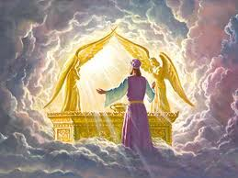

Slide 168
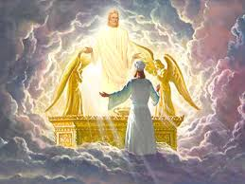

Slide 171
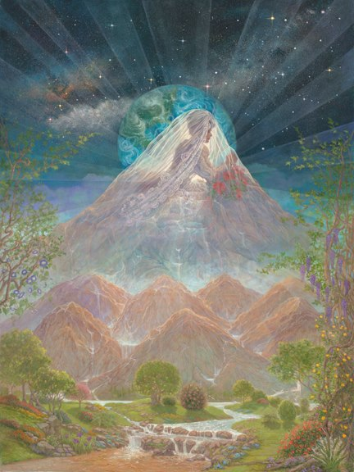

Slide 172
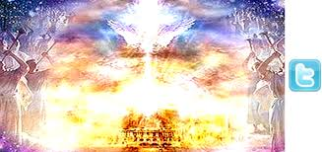

Slide 173
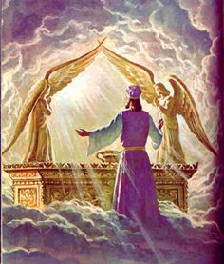

Slide 174
Pathway of Relationship
New season joy
Isa 61:3 To grant those who mourn in Zion, Giving them a garland instead of ashes, The oil of gladness instead of mourning, The mantle of praise instead of a spirit of fainting. So they will be called oaks of righteousness, The planting of the Lord, that He may be glorified.

Slide 175
Pathway of Relationship
Psalms 46:4 There is a river whose streams make glad the city of God, The holy dwelling places of the Most High.
Psa 45:6 Your throne, O God, is forever and ever; A sceptre of uprightness is the sceptre of Your kingdom. 7 You have loved righteousness and hated wickedness; Therefore God, Your God, has anointed You With the oil of joy above Your fellows.

Slide 176
Pathway of Relationship
Gen 2:10 Now a river flowed out of Eden to water the garden; and from there it divided and became four rivers.
Rev 22:1 Then he showed me a river of the water of life, clear as crystal, coming from the throne of God and of the Lamb,

