Slide 1
Journey Preparation 3
We are going on a journey an adventure together
There are 2 main pathways that we are going to follow
Pathway of relationship that leads to deeper intimacy with God
Pathway of responsibility leads to greater kingdom rulership

Slide 2
Journey Preparation 3
2 Cor 4:18 So we fix our eyes not on what is seen, but on what is unseen, since what is seen is temporary, but what is unseen is eternal.
Prophetic gifts & Seer gift of distinguishing or discerning spirits
This can be imparted as a seed but needs to be cultivated in our lives
We need to engage angelic beings who are sent to guard and guide us

Slide 3
Journey Preparation 3
What do we need to know for the this journey?
Faith
Basic truths
The language of the Spirit
Base camp spirit training

Slide 4
Journey Preparation 3
Faith
Heb 11:1 Now faith is the assurance, substance or evidence of things hoped for, the conviction of things not seen.
Expectations for this journey
What do you believe?
What do you expect?

Slide 5
Journey Preparation 3
Heb 11:1 Now faith is the assurance (the confirmation, the title deed) of the things [we] hope for, being the proof of things [we] do not see and the conviction of their reality [faith perceiving as real fact what is not yet revealed to the physical senses].

Slide 6
Journey Preparation 3
Heb 11:3 By faith we understand that the worlds were prepared by the word of God, so that what is seen was not made out of things which are visible.

Slide 7
Journey Preparation 3
What are our expectations of our journeys?
God will respond to our hopes or expectations
Faith engages our expectations
Your consciousness has the creative power to frame your world

Slide 8
Journey Preparation 3
Matthew 9:29 Then He touched their eyes, saying, "It shall be done to you according to your faith.“
What do you believe will done?
For you?
In you?
Through you?
Around you?

Slide 9
Journey Preparation 3
Mark 11:22-24 And Jesus answered saying to them, "Have God like faith. Truly I say to you, whoever says to this mountain, 'Be taken up and cast into the sea,' and does not doubt in his heart, but believes that what he says is going to happen, it will be granted him.

Slide 10
Journey Preparation 3
Matt 11:24 Therefore I say to you, all things for which you pray and ask, believe that you have received them, and they will be granted you.
If you don’t think you can you can’t
If you don’t think you can hear and see God you probably won’t
If you don’t think you can step into heaven you probably won’t

Slide 11
Journey Preparation 3
Matt 6:9 “Pray, then, in this way: ‘Our Father who is in heaven, Hallowed be Your name. 10 ‘Your kingdom come. Your will be done, On earth as it is in heaven.
Eph 1:3 Blessed be the God and Father of our Lord Jesus Christ, who has blessed us with every spiritual blessing in the heavenly places in Christ,
Faith engages the heavenly realms first and that manifests the unseen in the physical realm

Slide 12
Journey Preparation 3
We are going to engage the unseen or invisible realm from which everything exists
We are going to learn how to manifest the unseen
2 Corinthians 5:7 for we walk by faith, not by sight

Slide 13
Journey Preparation 3
2 Corinthians 4:13 having the same spirit of faith, according to what is written, "I believed, therefore I spoke ," we also believe, therefore we also speak
We can frame our world from what we can imagine, believe and speak

Slide 14
Journey Preparation 3
Faith leads to experience
Faith opens doors
Eph 2:8 For by grace you have been saved through faith; and that not of yourselves, it is the gift of God;
Door of Salvation – healing, provision, protection, deliverance, wholeness

Slide 15
Journey Preparation 3
1 Cor 2:9 “Things which eye has not seen and ear has not heard, And which have not entered the heart of man, All that God has prepared for those who love Him.” 10 For to us God revealed them through the Spirit; 12 Now we have received, not the spirit of the world, but the Spirit who is from God, so that we may know the things freely given to us by God

Slide 16
Journey Preparation 3
1 Cor 2:14 But a natural man does not accept the things of the Spirit of God, for they are foolishness to him; and he cannot understand them, because they are spiritually appraised.
We need a living spirit to engage spiritual things legitimately

Slide 17
Journey Preparation 3
Heb 4:12 For the word of God is living and active
John 1:1 In the beginning was the Word, and the Word was with God, and the Word was God.
Word of God both logos written and rhema spoken is living active powerful and is a person Jesus
Jesus will be your reference, guide, doorway and anchor on this journey.

Slide 18
Journey Preparation 3
Word is living and active and waiting for you to experience it
Salvation, healing, blessings, promises, angels, heaven, visions, trances, dreams, the manifest presence of God etc. are available to us through faith

Slide 19
Journey Preparation 3
John 21:25 And there are also many other things which Jesus did, which if they were written in detail, I suppose that even the world itself would not contain the books that would be written.
Word of God is our foundation and starting point, guide, doorway and anchor
Not everything about God and the heavenly realms is in the written word

Slide 20
Journey Preparation 3
Use faith as a doorway to experience
Heb 4:2 For indeed we have had good news preached to us, just as they also; but the word they heard did not profit them, because it was not united by faith in those who heard.

Slide 21
Journey Preparation 3
Heb 4:2 We received the same promises as those people in the wilderness, but the promises didn’t do them a bit of good because they didn’t receive the promises with faith. If we believe, though, we’ll experience that state of resting. But not if we don’t have faith.

Slide 22
Journey Preparation 3
Luke 17:5 The apostles said to the Lord, “Increase our faith!”
How can we increase our faith?
James 4:8 Draw near to God and He will draw near to you
Praying in the spirit – gift of tongues
Jude 1:20 But you, beloved, building yourselves up on your most holy faith, praying in the Holy Spirit

Slide 23
Journey Preparation 3
Rom 10:17 So faith comes from hearing, and hearing by the word of Christ.
Hearing the prophetic and living word
Eph 6:17 And take the sword of the Spirit, which is the word of God.
Rom 1:12 that is, that I may be encouraged together with you while among you, each of us by the other’s faith, both yours and mine.
Fellowship with faith filled people

Slide 24
Journey Preparation 3
We have not been this way before therefore we need to have confidence that God will lead and direct us
Faith = confidence
Comfidere means with faith
Who is our confidence in?

Slide 25
Journey Preparation 3
Luke 11:11 Now suppose one of you fathers is asked by his son for a fish; he will not give him a snake instead of a fish, will he? 12 Or if he is asked for an egg, he will not give him a scorpion, will he? 13 If you then, being evil, know how to give good gifts to your children, how much more will your heavenly Father give the Holy Spirit to those who ask Him?”

Slide 26
Journey Preparation 3
Enemies of faith on our journey
Familiar spirits, Fear, Doubt, Unbelief, Insecurity, Pride, Scepticism, Legalism
Friends tutors on our faith journey -spirit of Lord, knowledge, wisdom, council, understanding, might, Fear of God

Slide 27
Journey Preparation 3
There are 2 pathways you can follow in life
Tree of the knowledge of good and evil
Tree of life
We all start out on the first
We will you stay there?

Slide 28
Journey Preparation 3
We all have an opportunity to change paths
The first pathway leads to eternal separation from God - HELL
The second pathway leads to eternal life with God - relationship
Which one do you want to be on?

Slide 29
Journey Preparation 3
To join this journey you have to have a living active spirit that is connected to the source of life in the spiritual realm
You have to have a relationship with the guide
You have to know God through Jesus
He is the only way to legitimately engage spiritual dimensions

Slide 30
Journey Preparation 3
For the unbeliever the human spirit is in darkness
Once God has come to dwell inside our spirit, the Spirit of Man is renewed and made light with the presence of God.
The renewing process starts from within and penetrates outwards.
This begins with being born again of the Spirit

Slide 31
Journey Preparation 3
John 3:3 Jesus answered and said to him, “Truly, truly, I say to you, unless one is born again he cannot see the kingdom of God.”
John 3:16 “For God so loved the world, that He gave His only begotten Son, that whoever believes in Him shall not perish, but have eternal life.

Slide 32
Journey Preparation 3
Know the truth or reality
John 14:6 Jesus said to him, “I am the way, and the truth, and the life; no one comes to the Father but through Me.
Matrix discover the real world or continue to live in deception
Join the journey come into reality take the red pill so the veil blindness is removed.

Slide 33
Journey Preparation 3
Choice between a red pill and a blue pill.
The blue pill would allow you to remain in the fabricated reality of the Matrix, therefore living the "illusion of ignorance“
The red pill would lead you to escape from the Matrix and into the real world, therefore living the "truth of reality"

Slide 34
Journey Preparation 3
This is your last chance. After this, there is no turning back. You take the blue pill – the story ends, you wake up in your bed and believe whatever you want to believe. You take the red pill – you stay in Wonderland, and I show you how deep the rabbit hole goes. Remember, all I'm offering is the truth – nothing more.
Discover the real world or continue to live in deception the choice is yours

Slide 35
Journey Preparation
2 Cor 4:3 And even if our gospel is veiled, it is veiled to those who are perishing, 4 in whose case the god of this world has blinded the minds of the unbelieving so that they might not see the light of the gospel of the glory of Christ, who is the image of God.
Do you want the veil of blindness removed?
Do you want to discover the real world or continue to live in deception?

Slide 36
Journey Preparation
How do I start this journey and a get a relationship with God?
Make a decision to follow Him as a disciple
Surrender your life to Him
Change direction and paths
Change your destination
Transfer from the kingdom in darkness to the kingdom of light
By faith choose to follow Jesus

Slide 37
Journey Preparation 3
Come Follow Me
He made the implications clear with some unambiguous statements
Count the cost before you set out
Don’t start out and look back

Slide 38
Journey Preparation 3
Deny yourself
Leave everything behind
Give up your rights to everything
Let your love for Me make your love of everything else seem like hate in comparison

Slide 39
Journey Preparation 3
Our Spirit is given life by God’s Spirit the breath of life
Our spirit receives God’s light and becomes light
Our eyes are opened to the light of truth
Drink living water and receive a fountain
Our spirit becomes a house for God’s presence

Slide 40
Journey Preparation 3
Analogies or illustrations of how you can encounter God in reality as person
Drinking Living water
Engaging the light.
Opening the door to your life
Returning to the Father

Slide 41
Journey Preparation 3
John 4:10 Jesus answered and said to her, “If you knew the gift of God, and who it is who says to you, ‘Give Me a drink,’ you would have asked Him, and He would have given you living water.” 13 Jesus answered and said to her, “Everyone who drinks of this water will thirst again; 14 but whoever drinks of the water that I will give him shall never thirst; but the water that I will give him will become in him a well of water springing up to eternal life.”

Slide 42
Journey Preparation 3
2 Cor 4:6 For God, who said, “Light shall shine out of darkness,” is the One who has shone in our hearts to give the Light of the knowledge of the glory of God in the face of Christ.

Slide 43
Journey Preparation 3
Rev 3:20 Behold, I stand at the door and knock; if anyone hears My voice and opens the door, I will come in to him and will dine with him, and he with Me.

Slide 44
Journey Preparation 3
Luke 15:20 So he got up and came to his father. But while he was still a long way off, his father saw him and felt compassion for him, and ran and embraced him and kissed him. 21 And the son said to him, ‘Father, I have sinned against heaven and in your sight; I am no longer worthy to be called your son.’

Slide 45
Journey Preparation 3
Luke 15:22 But the father said to his servants, ‘Quickly bring out the best robe and put it on him, and put a ring on his hand and sandals on his feet; 23 and bring the fattened calf, kill it, and let us eat and celebrate; 24 for this son of mine was dead and has come to life again; he was lost and has been found.’ And they began to celebrate.

Slide 47
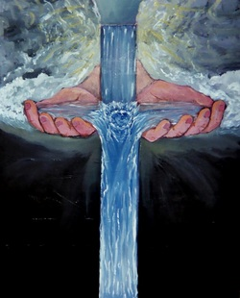

Slide 50
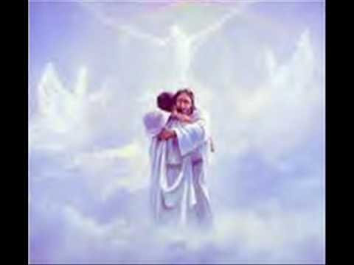

Slide 51
Journey Preparation 3
Make a choice to follow Jesus
Start to picture drinking living water as you drink your spirit becomes alive and a fountain of God’s Spirit forms within your spirit
Feel the source of life come into your spirit
Feel the bubbling life giving forgiveness wash away your past cleansing you

Slide 52
Journey Preparation 3
Make a choice to follow Jesus
Light floods your spirit opening your eyes to the truth - your spirit comes out of darkness and becomes light
Feel the truth of who you are adopted into His family
Feel His love revealing how special you are to Him

Slide 53
Journey Preparation 3
Make a choice to follow Jesus
Picture your life as a door Jesus is knocking open that door and let Him into to bring life to your spirit and make a home in you
Feel His love, acceptance, forgiveness
Feel His joy and peace fill you
Feel His presence in your spirit

Slide 54
Journey Preparation 3
Picture yourself coming to God in dirty clothes
You come carrying all the burdens and weight of your past life
See God welcome you with open arms with love in His eyes
You have to drop all that you are carrying
Feel His embrace of acceptance and love
His gives you new clothes and a ring of sonship

Slide 55
Journey Preparation 3
Receive forgiveness for all your past
Receive cleansing from all your past
Receive a new identity as a child of God
Receive adoption into a new family
Receive love, acceptance, affirmation
Receive a destiny and purpose

Slide 58
Journey Preparation

Slide 61
Journey Preparation

Slide 62
Journey Preparation
2 Corinthians 4:18 while we look not at the things which are seen, but at the things which are not seen; for the things which are seen are temporal, but the things which are not seen are eternal.
2 Corinthians 4:3-4 And even if our gospel is veiled, it is veiled to those who are perishing, in whose case the god of this world has blinded the minds of the unbelieving so that they might not see the light of the gospel of the glory of Christ, who is the image of God

Slide 63
Journey Preparation

Slide 64
Pathway of Relationship
Basic Truths
You are a spirit You have a soul You live in a body
Your spirit makes you God Conscious and you can engage God who is spirit
You soul ( heart or Subconscious mind) makes you self conscious and aware
Your body or earth suit makes you world Conscious
There is the eternal world there is the physical world and there is the unseen world
You are a house of God God lives in you John 14:23 Gen 281 Corinthians 3:16 Do you not know that you are a temple of God and that the Spirit of God dwells in you?1 Corinthians 6:19 Or do you not know that your body is a temple of the Holy Spirit who is in you, whom you have from God, and that you are not your own?Spirt realm is connected to you heaven or God's kingdom is in you Luke 17:21

Slide 65
Journey Preparation
Basic Truths
You are a spirit You have a soul You live in a body
Your spirit makes you God Conscious and you can engage God who is spirit
You soul ( heart or Subconscious mind) makes you self conscious and aware
Your body or earth suit makes you world Conscious
There is the eternal world there is the physical world and there is the unseen world

Slide 66
Journey Preparation
The Centre of Our Being - the residing place of the promise of God, centred inside our spirit.
The Human Spirit
The Human Soul
The Human Body

Slide 67
Journey Preparation
You are a house of God therefore God lives in you
John 14:23
Gen 28:12, 17 And he dreamed that there was a ladder set up on the earth, and the top of it reached to heaven; and the angels of God were ascending and descending on it! He was afraid and said, How to be feared and reverenced is this place! This is none other than the house of God, and this is the gateway to heaven

Slide 68
Journey Preparation
You are a house of God God lives in you
John 14:20, 23 In that day you will know that I am in My Father, and you in Me, and I in you. Jesus answered and said to him, "If anyone loves Me, he will keep My word; and My Father will love him, and We will come to him and make Our abode with him.

Slide 69
Journey Preparation
You are a house of God God lives in you
Gen 28:12, 17 And he dreamed that there was a ladder set up on the earth, and the top of it reached to heaven; and the angels of God were ascending and descending on it! He was afraid and said, How to be feared and reverenced is this place! This is none other than the house of God, and this is the gateway to heaven

Slide 70
Journey Preparation
1 Corinthians 3:16 Do you not know that you are a temple of God and that the Spirit of God dwells in you?
1 Corinthians 6:19 Or do you not know that your body is a temple of the Holy Spirit who is in you, whom you have from God, and that you are not your own?

Slide 71
Journey Preparation
Luke 17:21 Nor will people say, Look! Here [it is]! or, See, [it is] there! For behold, the kingdom of God is within you [in your hearts] and among you [surrounding you].
Spirit realm is connected to you because heaven or God's kingdom is in you
Therefore you have access to God heavenly spiritual realm and God has access to you. You are a gate of the spiritual realm heaven and God Channel

Slide 72
Journey Preparation
You live under an open heaven with an invitation to interact with the spiritual realm both eternal heavenly and unseen angelic
John 1:51 And He said to him, "Truly, truly, I say to you, you will see the heavens opened and the angels of God ascending and descending on the Son of Man.“
Matthew 3:16-17 After being baptized, Jesus came up immediately from the water; and behold, the heavens were opened, and he saw the Spirit of God descending as a dove and lighting on Him, and behold, a voice out of the heavens said, "This is My beloved Son, in whom I am well-pleased."

Slide 73
Journey Preparation
Revelation 3:20 Behold, I stand at the door and knock; if anyone hears My voice and opens the door, I will come in to him and will dine with him, and he with Me.
Revelation 4:1-2 After these things I looked, and behold, a door standing open in heaven, and the first voice which I had heard, like the sound of a trumpet speaking with me, said, "Come up here, and I will show you what must take place after these things." Immediately I was in the Spirit; and behold, a throne was standing in heaven, and One sitting on the throne.
You must give an invitation
You have to accept an invitation

Slide 74
Journey Preparation
Revelation 3:18 I advise you to buy from Me gold refined by fire so that you may become rich, and white garments so that you may clothe yourself, and that the shame of your nakedness will not be revealed; and eye salve to anoint your eyes so that you may see.
Jesus is your Source and supply for this journey but you must draw from Him

Slide 75
Journey Preparation
You have the ability and capacity to hear God's voice and see what He is doing.
You have physical Senses ears and eyes voice
You have Soul Senses Consciousness Conscience Imagination reason - ears eyes voice
You spirit has Senses eyes ears thoughts etc

Slide 76
Journey Preparation
Your body designed to be a receiver of data information both from the physical and spiritual realms
Your body is an amplifier of frequency vibrations wavelengths of electromagnetic energy
Everything is interpreted both physical sound light soul thoughts imagination and spiritual thoughts revelation intuition in the Conscious physical brain which receives information as electrical signals transmitted by neurons synapses etc.

Slide 77
Pathway of Relationship
You can receive information from physical world your own consciousness and the spiritual realm of your true self the unseen realm and eternal heavenly realm.
You just have tune our receivers to pick up the right frequencies by training and practice
Hebrews 5:14 But solid food is for the mature, who because of practice have their senses trained to discern good and evil.
Exercise repetition produces greater strength abilities skill with use.

Slide 78
Journey Preparation
Word of God both logos written and Rhema spoken is living active powerful and a person Jesus
He will be your guide, doorway and anchor on this journey.
Heb 4:12 12 For the word of God is living and active
John 1:1 In the beginning was the Word, and the Word was with God, and the Word was God.

Slide 79
Journey Preparation
The Holy spirit is also your helper on this journey guide to truth or reality
John 14:16-17 I will ask the Father, and He will give you another Helper, that He may be with you forever; that is the Spirit of truth, whom the world cannot receive, because it does not see Him or know Him, but you know Him because He abides with you and will be in you.
John 15:26 "When the Helper comes, whom I will send to you from the Father, that is the Spirit of truth who proceeds from the Father, He will testify about Me,
John 16:13-14 But when He, the Spirit of truth, comes, He will guide you into all the truth; for He will not speak on His own initiative, but whatever He hears, He will speak; and He will disclose to you what is to come. He will glorify Me, for He will take of Mine and will disclose it to you.

Slide 80
Journey Preparation
You can hear God's Voice and receive God's thoughts and see or perceive what He is doing
John 10:1-2 "Truly, truly, I say to you, he who does not enter by the door into the fold of the sheep, but climbs up some other way, he is a thief and a robber. But he who enters by the door is a shepherd of the sheep. John 10:3 To him the doorkeeper opens, and the sheep hear his voice, and he calls his own sheep by name and leads them out.
John 10:27 My sheep hear My voice, and I know them, and they follow Me;

Slide 81
Journey Preparation
John 10:4 When he puts forth all his own, he goes ahead of them, and the sheep follow him because they know his voice.
John 10:9 I am the door; if anyone enters through Me, he will be saved, and will go in and out and find pasture.
Access to the spiritual unseen and eternal heavenly realms
Jesus is the door we can follow Him in

Slide 82
Journey Preparation
Ephesians 1:3, Blessed be the God and Father of our Lord Jesus Christ, who has blessed us with every spiritual blessing in the heavenly places in Christ,
Ephesians 2:6 and raised us up with Him, and seated us with Him in the heavenly places in Christ Jesus,

Slide 83
Journey Preparation
Ephesians 1:11 also we have obtained an inheritance, having been predestined according to His purpose who works all things after the counsel of His will,
Ephesians 1:18 I pray that the eyes of your heart may be enlightened, so that you will know what is the hope of His calling, what are the riches of the glory of His inheritance in the saints,

Slide 84
Journey Preparation
1 Corinthians 2:16 For who has known the mind of the Lord , that he will instruct Him ? But we have the mind of Christ.
“Imagination is more important than knowledge. For knowledge is limited to all we now know and understand, while imagination embraces the entire world, and all there ever will be to know and understand.” -Albert Einstein

Slide 85
Journey Preparation
How Jesus made framed world hold together
John 1:1-4 In the beginning was the Word, and the Word was with God, and the Word was God. He was in the beginning with God. All things came into being through Him, and apart from Him nothing came into being that has come into being. In Him was life, and the life was the Light of men.

Slide 86
Journey Preparation
Hebrews 1:2-3 in these last days has spoken to us in His Son, whom He appointed heir of all things, through whom also He made the world. And He is the radiance of His glory and the exact representation of His nature, and upholds all things by the word of His power. When He had made purification of sins, He sat down at the right hand of the Majesty on high,

Slide 87
Journey Preparation
Hebrews 11:3 By faith we understand that the worlds were prepared by the word of God, so that what is seen was not made out of things which are visible.
Meditation is the doorway to experiencing true reality

Slide 88
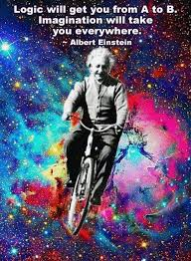

Slide 89
Journey Preparation
“The intuitive mind is a sacred gift and the rational mind is a faithful servant. We have created a society that honours the servant and has forgotten the gift.” Albert Einstein

Slide 90
Journey Preparation
Language of the spirit
Flow of thoughts, pictures, words, impressions, perception
Received and interpreted in our brains
On the screen of our imagination

Slide 91
Journey Preparation

Slide 92
Pathway of Relationship

Slide 93
Pathway of Relationship
Psalms 46:1-3 God is our refuge and strength, A very present help in trouble. Therefore we will not fear, though the earth should change And though the mountains slip into the heart of the sea; Though its waters roar and foam, Though the mountains quake at its swelling pride. Selah.

Slide 94
Pathway of Relationship
Psalms 46:4 There is a river whose streams make glad the city of God, The holy dwelling places of the Most High.5 God is in the midst of her, she will not be moved; God will help her when morning dawns. 6 The nations made an uproar, the kingdoms tottered; He raised His voice, the earth melted. 7 The Lord of hosts is with us; The God of Jacob is our stronghold.

Slide 95
Pathway of Relationship
Psalms 46:10-11“Be still cease striving and know that I am God; I will be exalted among the nations, I will be exalted in the earth." The Lord of hosts is with us; The God of Jacob is our stronghold. Selah

Slide 96
Pathway of Relationship
1 Cor 14:31 For you can all prophesy one by one, so that all may learn and all may be exhorted;
Everyone can prophesy
1 Cor 12:7 But to each one is given the manifestation of the Spirit for the common good. 10 to another miraculous powers, to another prophecy,
Some people have gift of prophecy

Slide 97
Pathway of Relationship
Eph 4:11 And He gave some as apostles, and some as prophets, and some as evangelists, and some as pastors and teachers, 12 for the equipping of the saints for the work of service, to the building up of the body of Christ;
Some people will be call to the office of prophet

Slide 98
Pathway of Relationship
Heb 5:14 But solid food is for the mature, who because of practice have their senses trained to discern good and evil
Faith level discernment Distinguishing or discerning spirits 1 Cor 12:10
Office of seer Eph 4:11-13

Slide 99
Pathway of Relationship
Everyone can have their spiritual eyes and ears open and functioning
Heb 5:12 For though by this time you ought to be teachers, you have need again for someone to teach you the elementary principles of the oracles of God, and you have come to need milk and not solid food. 13 For everyone who partakes only of milk is not accustomed to the word of righteousness, for he is an infant. 14 But solid food is for the mature, who because of practice have their senses trained to discern good and evil.
Mature grow in this capacity through training and practice

Slide 100
Pathway of Relationship
Eph 1:15 For this reason I too, having heard of the faith in the Lord Jesus which exists among you and your love for all the saints, 16 do not cease giving thanks for you, while making mention of you in my prayers; 17 that the God of our Lord Jesus Christ, the Father of glory, may give to you a spirit of wisdom and of revelation in the knowledge of Him. 18 I pray that the eyes of your heart may be enlightened, so that you will know what is the hope of His calling, what are the riches of the glory of His inheritance in the saints,
Eyes of heart opened

Slide 101
Pathway of Relationship
2 Kings 6:15 Now when the attendant of the man of God had risen early and gone out, behold, an army with horses and chariots was circling the city. And his servant said to him, “Alas, my master! What shall we do?” 16 So he answered, “Do not fear, for those who are with us are more than those who are with them.” 17 Then Elisha prayed and said, “O Lord, I pray, open his eyes that he may see.” And the Lord opened the servant’s eyes and he saw; and behold, the mountain was full of horses and chariots of fire all around Elisha.
Pray for open spiritual eyes

Slide 102
Pathway of Relationship
Rev 3:17 Because you say, “I am rich, and have become wealthy, and have need of nothing,” and you do not know that you are wretched and miserable and poor and blind and naked, 18 I advise you to buy from Me gold refined by fire so that you may become rich, and white garments so that you may clothe yourself, and that the shame of your nakedness will not be revealed; and eye salve to anoint your eyes so that you may see
Spiritual eyes opened

Slide 103
Pathway of Relationship
Luke 4:18 18 “The Spirit of the Lord is upon Me, Because He anointed Me to preach the gospel to the poor. He has sent Me to proclaim release to the captives, And recovery of sight to the blind, To set free those who are oppressed,
Recovering sight to blind

Slide 104
Pathway of Relationship
Matt 7:1 “Do not judge so that you will not be judged. 2 For in the way you judge, you will be judged; and [a]by your standard of measure, it will be measured to you. 3 Why do you look at the speck that is in your brother’s eye, but do not notice the log that is in your own eye? 4 Or how [b]can you say to your brother, ‘Let me take the speck out of your eye,’ and behold, the log is in your own eye? 5 You hypocrite, first take the log out of your own eye, and then you will see clearly to take the speck out of your brother’s eye.
See world through eyes of our heart

Slide 105
Vision Destiny 2014
1 John 2:9 The one who says he is in the Light and yet hates his brother is in the darkness until now. 10 The one who loves his brother abides in the Light and there is no cause for stumbling in him. 11 But the one who hates his brother is in the darkness and walks in the darkness, and does not know where he is going because the darkness has blinded his eyes.
Hate & unforgiveness blinds our spiritual sight

Slide 106
Vision Destiny 2014
Revelation ask God to show you pictures
Interpretation ask God to show you what it means
Application ask God to show you how to respond

Slide 107
Vision Destiny 2014
1 Chron 29:29 Now the acts of King David, from first to last, are written in the chronicles of Samuel the seer, in the chronicles of Nathan the prophet and in the chronicles of Gad the seer,
Seers & Prophets Same gift calling receive revelation differently
Seers operate in dreams, visions pictures - see
Prophets operate in a flow of words - hear

Slide 108
Vision Destiny 2014
Unseen realm
2 Cor 4:18 So we fix our eyes not on what is seen, but on what is unseen, since what is seen is temporary, but what is unseen is eternal.
Seen physical realm – unseen spiritual realm around us
Eternal heavenly realms – real realm

Slide 109
Vision Destiny 2014
Rev 1-3 physical body looking at a vision into the unseen realm with spiritual eyes
Rev 4:1-2 spirit leaves body engages the realm of heaven
Legal access through Jesus the door John 10:7 So Jesus said to them again, “Truly, truly, I say to you, I am the door of the sheep.
Illegal access John 10:“Truly, truly, I say to you, he who does not enter by the door into the fold of the sheep, but climbs up some other way, he is a thief and a robber.

Slide 110
Vision Destiny 2014
Gift of distinguishing of spirits
Judgement and discernment
Anakrino ability to distinguish
1 Cor 2:14 But a natural man does not accept the things of the Spirit of God, for they are foolishness to him; and he cannot understand them, because they are spiritually appraised.

Slide 111
Vision Destiny 2014
Dokimazo to test or prove
Luke 12:56 You hypocrites! You know how to analyze the appearance of the earth and the sky, but why do you not analyze this present time?
1 John 4:1 test the spirits
1 Thes 5:21 judge prophecies

Slide 112
Vision Destiny 2014
Krino condemn
Matt 7: “Do not judge so that you will not be judged. 2 For in the way you judge, you will be judged; and by your standard of measure, it will be measured to you.
John 7:24 Do not judge according to appearance, but judge with righteous judgment.”

Slide 113
Vision Destiny 2014
Working of Holy Spirit
Working of human spirit
Working of the heavenly spiritual beings
Working of the demonic spiritual beings

Slide 114
Vision Destiny 2014
Not the gift of criticism
Not the gift of suspicion
Not the gift of manipulation
Not the gift of condemnation

Slide 115
Vision Destiny 2014
Agreement with bible truth
Outward fruit matt 7:15-16 gal 5:22-23
Anointing guides to the truth 1 john 2:20, 26-27
Peace as our guide or umpire col 3:15
Ways and nature of God psa 103:2-7

Slide 117
Vision Destiny 2014
John 4:10 Jesus answered and said to her, “If you knew the gift of God, and who it is who says to you, ‘Give Me a drink,’ you would have asked Him, and He would have given you living water.” 11 She *said to Him, “Sir, You have nothing to draw with and the well is deep; where then do You get that living water? 12 You are not greater than our father Jacob, are You, who gave us the well…

Slide 118
Vision Destiny 2014
John 4:13 Jesus answered and said to her, “Everyone who drinks of this water will thirst again; 14 but whoever drinks of the water that I will give him shall never thirst; but the water that I will give him will become in him a well of water springing up to eternal life.”

Slide 119
Vision Destiny 2014
John 7:37 Now on the last day, the great day of the feast, Jesus stood and cried out, saying, “If anyone is thirsty, let him come to Me and drink. 38 He who believes in Me, as the Scripture said, ‘From his innermost being will flow rivers of living water.’” 39 But this He spoke of the Spirit, whom those who believed in Him were to receive; for the Spirit was not yet given, because Jesus was not yet glorified.

Slide 120
Vision Destiny 2014
My encounters with Jacob as one of the cloud of witnesses, men in white linen, spirit of righteous men made perfect
Heb 12:Therefore, since we have so great a cloud of witnesses surrounding us,
Act 1:10 And as they were gazing intently into the sky while He was going, behold, two men in white clothing stood beside them. 11 They also said, “Men of Galilee, why do you stand looking into the sky? This Jesus, who has been taken up from you into heaven, will come in just the same way as you have watched Him go into heaven.”

Slide 121
Vision Destiny 2014
Heb 12:18 For you have not come to a mountain that can be touched and to a blazing fire, and to darkness and gloom and whirlwind, .. 22 But you have come to Mount Zion and to the city of the living God, the heavenly Jerusalem, and to myriads of angels, 23 to the general assembly and church of the firstborn who are enrolled in heaven, and to God, the Judge of all, and to the spirits of the righteous made perfect, 24 and to Jesus, the mediator of a new covenant,

Slide 122
Vision Destiny 2014
Gen 28:12 He had a dream, and behold, a ladder was set on the earth with its top reaching to heaven; and behold, the angels of God were ascending and descending on it. 13 And behold, the Lord stood above it and said, “I am the Lord, the God of your father Abraham and the God of Isaac; the land on which you lie, I will give it to you and to your descendants. 14 Your descendants will also be like the dust of the earth,

Slide 123
Vision Destiny 2014
Gen 28:16 Then Jacob awoke from his sleep and said, “Surely the Lord is in this place, and I did not know it.” 17 He was afraid and said, “How awesome is this place! This is none other than the house of God, and this is the gate of heaven.”
John 14:20 In that day you will know that I am in My Father, and you in Me, and I in you. 23 Jesus answered and said to him, “If anyone loves Me, he will keep My word; and My Father will love him, and We will come to him and make Our abode with him.

Slide 124
Vision Destiny 2014
Luke 17:21 … the kingdom of God is within you [in your hearts] and among you [surrounding you].
Rev 3:20 Behold, I stand at the door and knock; if anyone hears My voice and opens the door, I will come in to him and will dine with him, and he with Me. 21 He who overcomes, I will grant to him to sit down with Me on My throne, as I also overcame and sat down with My Father on His throne

Slide 125
Vision Destiny 2014
Rev 4:1 After these things I looked, and behold, a door standing open in heaven, and the first voice which I had heard, like the sound of a trumpet speaking with me, said, “Come up here, and I will show you what must take place after these things.”

Slide 127
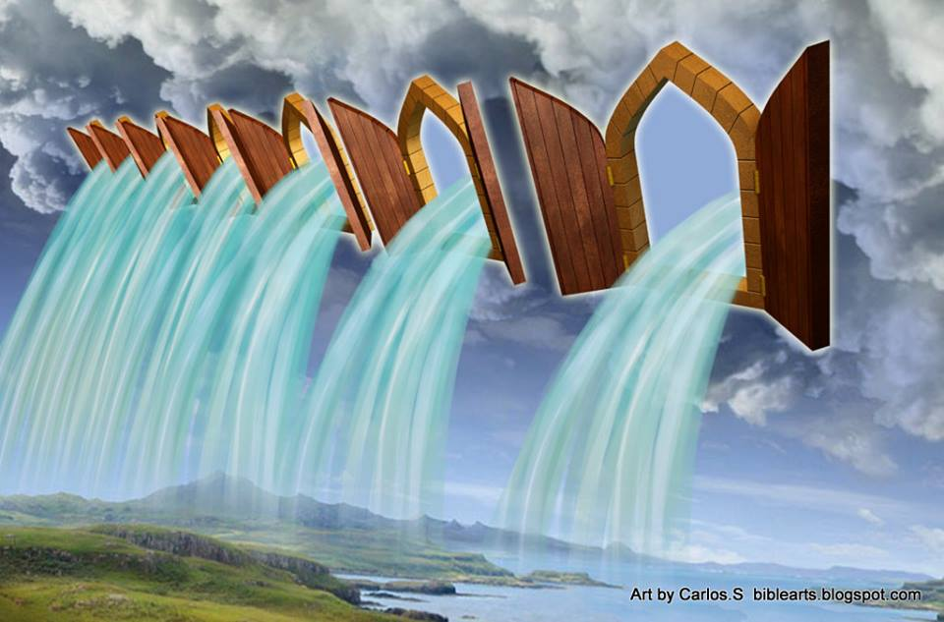

Slide 129
Vision Destiny 2014

Slide 130
Vision Destiny 2014
l saw the 4 living creatures standing in the E S W N of the room each had a trumpet and a standard they were here to herald a new season. In the centre was Urandial the church angel carrying standard of 4 faces and fire was coming off him releasing fresh passion for the new season.

Slide 131
Vision Destiny 2014
The I saw the 4 creatures move around the room creating like a vortex of colour, sound & energy that opened heavens.
In a new dimension and I saw new angels assigned. I saw the 7 spirits, l saw the cloud of witnesses with mantles coats of different colours.

Slide 132
Vision Destiny 2014
l saw it in the spiritual realm and I saw it also as a prophetic act using the flags and leaders who have to be in agreement and unity.
Wind of change an Angel was assigned to administer this process
A new dimension for a new season.

Slide 133
Vision Destiny 2014
Engaging by faith walk by faith
2 Cor 5:7
Faith leads to experience
Mark 11:

Slide 134
Vision Destiny 2014

Slide 135
Vision Destiny 2014
Doors of faith
Salvation
Eph 2:8
Healing
1 Peter 2:24
Abiding
Col 3:1-3

Slide 136
Vision Destiny 2014
Insight
1 Cor 2:6
Joy
Psa 16:11
Authority
Eph 2:6

Slide 137
Vision Destiny 2014
Word is living and active and waiting for you to experience
Angels, Heaven, visions, trances, dreams, manifest presence of God are available to us through faith
Use faith as a doorway to experience
Heb 4:2

Slide 138
Vision Destiny 2014
Increase faith
Luke 17:5
Fasting
Matt 17:21
James 4:8
Praying in the spirit
Jude 1:20

Slide 139
Vision Destiny 2014
Hearing the prophetic word
Rom 10:17
Eph 6:17
Fellowship with faith filled people
Rom 1:12
Prov 27:17

Slide 140
Vision Destiny 2014
Faith confidence
Com – fidere with faith

Slide 141
Vision Destiny 2014
Meditation
Josh 1:8
Focus on good things
Prov 23:7
Psa 19:14
Phil 4:8
Psa 104:34

Slide 142
Vision Destiny 2014
Meditate on the word
2 Tim 3:16-17
Josh 1:8
Meditate on prophetic
1 Tim 4:14-15
Meditate on God
Psa 63:6

Slide 143
Vision Destiny 2014
Names of God reveal his character nature
El-shaddai – the almighty Gen 17:1-2
Jehovah-Jireh Lord our provider Gen22:14
Jehovah-Rapha healer
Jehovah-Tsisqenu righteousness
Jehovah-Nissi banner
Jehovah-shalom peace
Jehovah-shammah is there

Slide 144
Vision Destiny 2014
Jehovah-sabaoth Lord of hosts
Meditate on God’s acts –testimony
Rev 19:10
Heb 13:8
Psa 77:10-12
Psa 143:5

Slide 145
Vision Destiny 2014
Imagination – eyes of your heart
Eph 1:18
Matt 5:27-28
Imagination is as valid as reality
Creative part of our soul
Job 33:14-16

Slide 146
Vision Destiny 2014
Experience word through the interactive experience through imagination
Heb 4:12
Alive and active and engagable
John 6:63 spirit and life
John 17:17 truth = reality
Enter into reality in the word

Slide 147
Vision Destiny 2014
No need to fear deception
Luke 11:11-13
When pursuing the word through our imagination God is able to protect us

Slide 148
Vision Destiny 2014
Spirit
Human spirit
Holy spirit
Spirit realm
John 4:24 spirit and truth or reality
John 16:13 guide into reality
1 John 5:6 Spirit is reality

Slide 149
Vision Destiny 2014

Slide 150
Vision Destiny 2014
David’s tent – 3 seers
Amos 9:11
Acts15:15-18

Slide 151
Vision Destiny 2014

Slide 152
Vision Destiny 2014

Slide 156
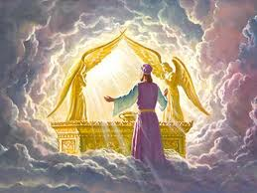

Slide 157
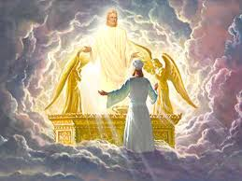

Slide 160
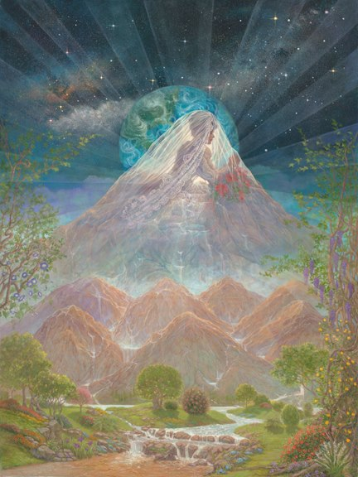

Slide 161
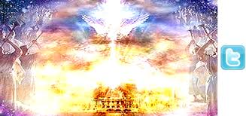

Slide 162
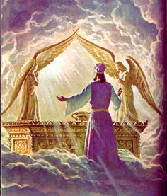

Slide 163
Pathway of Relationship
New season joy
Isa 61:3 To grant those who mourn in Zion, Giving them a garland instead of ashes, The oil of gladness instead of mourning, The mantle of praise instead of a spirit of fainting. So they will be called oaks of righteousness, The planting of the Lord, that He may be glorified.

Slide 164
Pathway of Relationship
Psalms 46:4 There is a river whose streams make glad the city of God, The holy dwelling places of the Most High.
Psa 45:6 Your throne, O God, is forever and ever; A sceptre of uprightness is the sceptre of Your kingdom. 7 You have loved righteousness and hated wickedness; Therefore God, Your God, has anointed You With the oil of joy above Your fellows.

Slide 165
Pathway of Relationship
Gen 2:10 Now a river flowed out of Eden to water the garden; and from there it divided and became four rivers.
Rev 22:1 Then he showed me a river of the water of life, clear as crystal, coming from the throne of God and of the Lamb,

