Slide 1
Journey Preparation 6
Hearing God’s voice, visions etc.
Seeing in the spirit
Spirit travel, heavenly encounters
Seem easy as I describe them but…
Long Journey of discovery
Forerunner to open the door for others
Persevere & press in

Slide 2
Journey Preparation 6
Methodist & Brethren background
Strong Fear of public speaking or even reading out loud
No baptism in water
No baptism in Spirit
No real heritage
Destiny from God calling me

Slide 3
Journey Preparation 6
Always believed in God went to Sunday School
Aged 12 September 1970 personal commitment didn’t feel anything
Fire insurance – no doubts believed
Inquisitive interest in the bible
No experience or real emotions

Slide 4
Journey Preparation 6
Journey of increasing intimacy
Journey of increasing experiential encounters
Journey from the left to the right side of the brain
Journey from earth to heaven
Journey many stepping stones

Slide 5
Journey Preparation 6
Books – God’s way to get through to me
Normal Christian life – sin victory, soul
The Cross & Sanctification – Holy Spirit
9 o’clock in the morning 1983 gifts
3 year pursuit - Baptism Holy Spirit 1986
Experience – love & revival
Tongues, key emotions - worship

Slide 6
Journey Preparation 6
I am free and love to praise God
Lift my hands, dance, kneel, lie
Not always case
I have had to get over myself realise it is not about me but God
Fear man, embarrassment
Knock the British stuffing out of me

Slide 7
Journey Preparation 6
Revival pursuit
Privileged to be involved in 6 distinct out-pouring's of the Holy Spirit
1993 Cornwall
1994 Devon - Toronto
1995 Brazil – gold fillings teeth
1996 Brownsville Pensacola Florida
2008 Devon - Lakeland
2011 Devon Kingdom Explosion

Slide 8
Journey Preparation 6
18 years biochemistry background
Logical analytical
Left brained non creative
Word based
Hunger & desire for biblical reality
I still hadn’t found what I was looking for

Slide 9
Journey Preparation 6
1990 egg sandwich vision - power
1993-5 visionary experiences & encounters mountain
2002 Living word - filling cabinet -meditation – thoughts of God - Journal
2006 Faithworks conference – visual meditation
ROC 2008 - Healing anointing, addictions increase in signs & wonders Catch the Fire
September 2008 first heavenly encounter

Slide 10
Journey Preparation 6
River of fire with a throne above it
9 steps - fire stones I saw at sub-atomic level
Risers were swirling with grace & faith
Stepped on it I became one – love, joy, peace etc.
I saw the throne & the feet of God
I saw thrones going off into the distance
Looking for my throne, saw only a few occupied
Found my name & sat down next to God

Slide 11
Journey Preparation 6
Saw an oval screen vision of our dimension
High definition 3D multi coloured
Reverse image in dull grey
I saw a portal open & God’s glory poured out
I was taken down to see 3 demonic creatures
I saw that they blocked off the flow of glory and the portal closed
I had an experience but I could not repeat it
Continue to meditate – became hungry more

Slide 12
Journey Preparation 6
June 2010 prophesy Mike Bryant
A change is coming and you cannot stop it, so be strong in My Spirit and the things I have shown you.
Prepare for the future and know that the harvest you long for is near.
Ascend to where I am, where you are seated. A door will open for you.
Prepare for the future ask of Me and I will show you.
Envelope – read every day for 7 weeks

Slide 13
Journey Preparation 6
June 2010 Torquay conference heart
August 2010 40 day fast - revelation word - 21 nights burning fire
Day 19 trance - Come up here!!
Ian Clayton
87 heavenly encounters & visions
Mostly first person face to face encounters
Visions – Visitations - Habitation

Slide 14
Journey Preparation 6
Quantum physics lesson – Heb 11:3
I saw how the spiritual & physical dimensions interact & are connected through a quantum realm
Zero point energy, Light creative & created
God revealed string theory – grace as the vibrating power of the voice of creation that remains in everything - Eph 4:6 over all, through all & in all
Different dimensions – heavens, earth & under the earth, kingdom within me
God revealed the importance of frequency, resonance, harmony

Slide 15
Journey Preparation 6
I saw creation spoken into existence
I visited another solar system
I saw the first creation before satan's fall
I saw when there was no absence of light
I experienced the harmony of the senses of heaven
Everything has colour, frequency, sound, fragrance, emotions, mathematics formula

Slide 16
Journey Preparation 6

Slide 17
Journey Preparation 6

Slide 18
Journey Preparation 6

Slide 19
Journey Preparation 6
I saw Jesus kneeling before me
Child like faith – angel book of life
Face to face encounters with Jesus & Holy Spirit
Asked me what I wanted to know & then answered my questions
Showed me miracles & how He did them
Jesus taught about me the seat of rest & government of kingdom – Matt 11:28-30

Slide 20
Journey Preparation 6
Met Jesus – friend, brother, lion, lamb, King, bible Jesus, Jesus on the cross
Met Holy Spirit – always moving, creative, fun, almost mischievous
Father wound
Betrayal wounds
Met Father – in many forms & places
Intimacy at a new level

Slide 21
Journey Preparation 6
Father wound healing
- 100 to 0 but +++ 100
Sonship +++
How does God Father Me?
Relationship intimacy – talks reveals His heart -
Love languages liberty to be me

Slide 22
Journey Preparation 6
Heaven multiverse – personal individual
Rivers – life, grace, fire, glory Waterfalls, pools, gardens
God dwells on a mountain – Ezek 28
Throne room, Mantle room, Book room, Treasury room, War room, Judgment seat, Wine room, Record room,
Mountains Thrones – for individuals & churches corresponding to destiny & authority
Tabernacle – altar of incense, mercy seat arc

Slide 23
Journey Preparation 6
On earth as it is in heaven - spiritual came first
Heaven is the pattern for our Lives & church
Garden – overlap heaven earth where the river of life flowed out of Eden to man’s garden & then flowed out to the world
Eden is in heaven with the river of life flowing into man’s spirit
River of life is in us needs to flow to the garden in our hearts
Our heart needs cultivating by intimate relationship to then flow out to the world

Slide 24
Journey Preparation 6
I encountered Father, Jesus & Holy Spirit in my garden in my heart
Real encounters
I had revelation of being a habitation of God, Gen 28, John 14 - Jacob
Rev 3:20 'Behold, I stand at the door and knock; if anyone hears My voice and opens the door, I will come in to him and will dine with him, and he with Me.

Slide 25
Journey Preparation 6
Gateways of spirit, soul, body - me
Gate first love
Invite God daily into my spirit & heart
Flow life from inside out – fragmented parts, - wholeness
Transformed from the inside out
Open up my life by allowing God access to all of me
Process of change from intimacy love

Slide 26
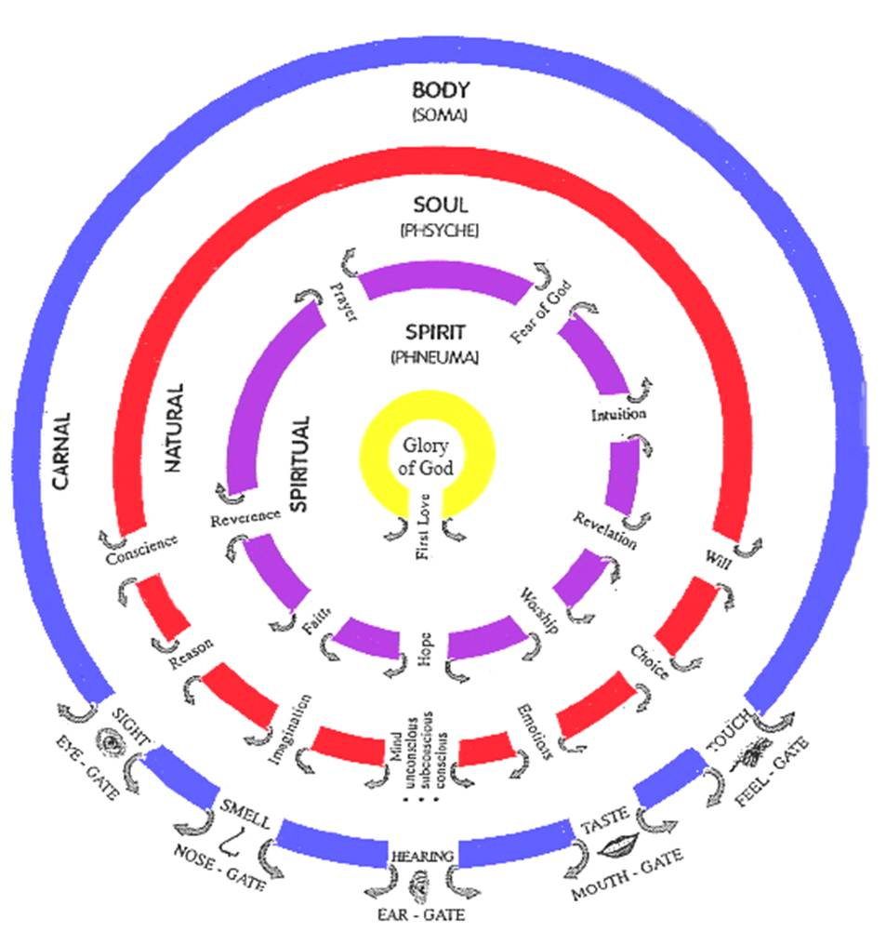

Slide 27
Journey Preparation 6
I saw my scroll of destiny - eternity
I encountered the Judgment Seat where I saw my life scroll, front & back
I met the Father in His garden
To be at total rest, peace & unity
I heard the sound of creation calling me into harmony
Black hole bflat – calling to sons of God

Slide 28
Journey Preparation 6
Met angels my 2 personal & many others
Met 2 church angels know their names
Gathering angels
Seraphim – burning ones
Cashmalim – shining ones
Breakthrough angel

Slide 29
Journey Preparation 6
See angelic portals, hear angelic sounds, smell angelic fragrances
Met the 7 spirits of God
Met men in white linen – cloud witnesses - Melchizedek, Adam, Jacob, Enoch
Met my grandchildren in the children's play ground, trained by angels

Slide 30
Journey Preparation 6
Taught to present myself daily as a living sacrifice at the altar in heavenly tabernacle
Taught to daily engage the Arc – to resonate with the will of God, come into harmony with the heart of God & to take up rod of authority YHVH
Revelation of the structure of heavens
Discovered where I had been

Slide 31
Journey Preparation 6
Taught how to engage the heavenly courts been in 10 different courts
Wisdom’s height Proverbs 8 doors, gates, paths
Taught how to establish a law as a king
Taught how to access court of upright, chancellors, angels, war
Taught how to engage kingdom protocol – heavens & atmosphere of the earth
Taught how to get daily mandates authorisations
Administer from mountain throne– open the everlasting doors

Slide 32
Journey Preparation 6
I have had daily encounters with God both within & in the heavenly realms
Write - Review - Revisit
Word & my written Testimony becomes a doorway & anchor
Some encounters are totally involuntary
Most encounters are now deliberate
I can engage heaven by faith based on past testimony

Slide 33
Journey Preparation 6
Psa 18:11 He made darkness His hiding place, His canopy around Him, Darkness of waters, thick clouds of the skies.12 From the brightness before Him passed His thick clouds,
Psa 97:2 Clouds and thick darkness surround Him; Righteousness and justice are the foundation of His throne.
4 months Be still, wait, rest, wait expectantly

Slide 34
Journey Preparation 6
Anyone can learn how to engage God within & in the heavenlies
It takes desire – discipline – delight
Relationship deepens to experience personal intimacy with God’s presence
Practice

Slide 35
Journey Preparation 6
Heb 5:14 But solid food is for the mature, who because of practice have their senses trained to discern good and evil.
Train our senses to see from the inside outside
Glory of God can flow from inside out

Slide 36
Journey Preparation 6
Trained my senses
Meditate in word flow of God’s thoughts
Meditate opening the eyes of my heart - Imagination
Open the eyes of my spirit
Flow thoughts, pictures, words, impressions, visions – Discern Perceive

Slide 37
Journey Preparation 6
My spirit can communicate to me what it sees - sonar
More like discern or perceive the spiritual realm
Not interested in the demonic side
Just what God is doing

Slide 38
Journey Preparation 6
Journey
Books
Word – thoughts
Visions – imagination
Impression – Spiritual eyes
Discerning to see with my spirit

Slide 39
Journey Preparation 6
I have discovered that there are 2 main pathways of entrance into heavenlies
Relationship - Intimacy with the presence and person of God
Garden heart & garden of God via the river of life – gate first love
Rulership – yielding as living sacrifices to the kingdom purposes of God, thrones, courts, mountain of God

Slide 40
Journey Preparation 6
Can't rule in righteousness without coming from a place of rest and relationship - knowing Him as Father - So we can know Him as Lord & King.
Priest before we are a king
Love before service
Serve from a relationship not for one

Slide 41
Journey Preparation 6
Encountering God is not just an end in itself but it leads on to worshipping or serving Him
John 5:19 Truly, truly, I say to you, the Son can do nothing of Himself, unless it is something He sees the Father doing; for whatever the Father does, these things the Son also does in like manner.
John 14:10 Do you not believe that I am in the Father, and the Father is in Me? The words that I say to you I do not speak on My own initiative, but the Father abiding in Me does His works.

Slide 42
Journey Preparation 6
Many small steps of obedience
Trust His guidance and direction
Struggle resist
Last year proactive reach out
Now Mentoring groups around world
God said He would opened doors
I had to choose to step through

Slide 43
Journey Preparation 6
Where are you on your journey?
Not started yet – follow him
Do you desire more are you hungry & thirsty for more?
It will take discipline, perseverance
Delight of intimacy is waiting for each of us
Will you pursue God & your destiny
Jesus is here in this room

Slide 44
Journey Preparation 6

Slide 45
Journey Preparation 6
Close your eyes relax
Think about Jesus standing in front of you
Picture that with your imagination – REAL
What do you want to say to Him?
What is He saying to You?
Surrender your life to Him at a deeper level
Open your heart and your deepest emotions hurts, fears desires, anxieties
Let Him touch you heal you love you

Slide 46
Journey Preparation 6

Slide 48
Heb 12:1-2 Therefore, since we have so great a cloud of witnesses surrounding us, let us also lay aside every encumbrance and the sin which so easily entangles us, and let us run with endurance the race that is set before us, 2 fixing our eyes on Jesus, the author and perfecter of faith
Matt 11:28 “Come to Me, all who are weary and heavy-laden, and I will give you rest. 29 Take My yoke upon you and learn from Me, for I am gentle and humble in heart, and you will find rest for your souls.
John 7:37 Jesus stood and cried out, saying, “If anyone is thirsty, let him come to Me and drink. 38 He who believes in Me, as the Scripture said, ‘From his innermost being will flow rivers of living water.’
Heb 4:16 Therefore let us draw near with confidence to the throne of grace, so that we may receive mercy and find grace to help in time of need.

