Slide 1
Deep Calls to Deep
Freedom Apostolic Resources
www.freedomtrust.org.uk/AR
www.freedomarc.wordpress.com
mike@freedomarc.org

Slide 2
Deep Calls to Deep
My mandate or authorisation
Establish agreement between heaven and earth
Open everlasting doors for a manifestation of Gods' glory
Engagement with the 4 faces of God

Slide 3
Deep Calls to Deep
“If you live cautiously, your friends will call you wise. You just won’t move many mountains.” – Bill Johnson
Engage new revelation of ancient paths

Slide 4
Deep Calls to Deep
Yoked to Jesus
He sets the direction
We go where He goes
We may not know where that is just like Abraham – engage heavenly city
We have to be prepared to leave the old behind to follow the cloud

Slide 5
Deep Calls to Deep
Psa 42:7 Deep calls to deep at the sound of Your waterfalls;
What is the sound?
Where is the waterfall?
What is the deep?
Rev 1:15 His voice was like the sound of many waters.

Slide 6
Deep Calls to Deep
1 Cor 2:9 but just as it is written, “Things which eye has not seen and ear has not heard, And which have not entered the heart of man, All that God has prepared for those who love Him.” 10 For to us God revealed them through the Spirit; for the Spirit searches all things, even the depths of God.

Slide 7
Deep Calls to Deep
1 Cor 2:11 For who among men knows the thoughts of a man except the spirit of the man which is in him? Even so the thoughts of God no one knows except the Spirit of God. 12 Now we have received, not the spirit of the world, but the Spirit who is from God, so that we may know the things freely given to us by God,

Slide 8
Deep Calls to Deep
This sound, has a vibration, a frequency, a symbol and a formula it has colour and fragrance and is being released from heaven
This sound is drawing people to their heavenly home into new heavenly alignments into new levels of heavenly authority

Slide 10
Deep Calls to Deep
Cultivate, brood, incubate - Desire
To see as it WAS in the beginning to manifest that into the IS to transform the what WILL be
Works & will of God to the ways and heart of God
Call to sonship

Slide 11
Deep Calls to Deep
Invitation to come deeper into Him
3 levels intimacy
Deeper baptism into the Father, Son and Spirit

Slide 12
Deep Calls to Deep
Deeper into the river of life to engage the Spirit – source of life
Deeper into the Fire stones to engage Jesus
Deeper into the Fathers Heart

Slide 13
Deep Calls to Deep
Rom 8:19 For the anxious longing of the creation waits eagerly for the revealing of the sons of God. 21 that the creation itself also will be set free from its slavery to corruption into the freedom of the glory of the children of God.

Slide 14
Deep Calls to Deep
Acts 17:28 for in Him we live and move and exist, (have our being)
In Him
In Christ
In the Holy Spirit
In the Father

Slide 15
Deep Calls to Deep
Eph 3:17 so that Christ may dwell in your hearts through faith; and that you, being rooted and grounded in love, 18 may be able to comprehend with all the saints what is the breadth and length and height and depth, 20 Now to Him who is able to do far more abundantly beyond all that we ask or think, according to the power that works within us,

Slide 16
Deep Calls to Deep
Height up and down in and out of heaven and under the earth
To and fro on the earth
Back and forwards in time

Slide 17
Heaven
Up
Backwards
Reflection of heaven on earth
To
Fro
Forwards
Down
Under Earth

Slide 18
Deep Calls to Deep
Help form 3 new Benches of 3
New pattern of heavenly government on earth
Help lay the foundations of 3 new Ekklesia
Henry first fruits

Slide 19
Bench of 3
Father Son Spirit
North Gate Man Priestly
East Gate Lion Kingly
Heavenlies
Earth
West Gate Eagle Apostolic
South Gate Ox Prophetic
Bench of 3
Spirit Soul Body
Church, City, Region, Nation

Slide 20
New alignment with 4 faces of God symbol, sound, frequency and shape of heaven
Heaven
Priestly
Kingly
Reflection of heaven on earth
Apostolic
Prophetic
Earth

Slide 21
Deep Calls to Deep
Establishing ARC’s, Habitations of God, gardens of God, cities of refuge, embassies of heaven on earth
Living in the overlap of heaven and earth
Living under the higher spiritual authority and laws of heaven

Slide 22
Deep Calls to Deep

Slide 23
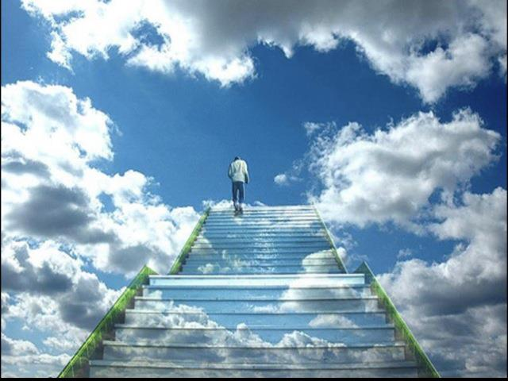

Slide 24
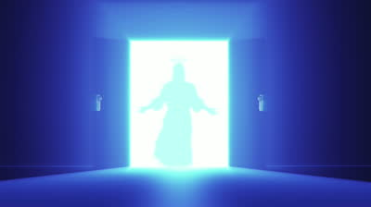

Slide 25
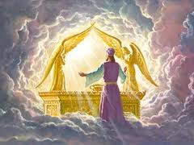

Slide 26
Deep Calls to Deep

Slide 27
Deep Calls to Deep
We look into the manifest presence and glory of God
We see the will and purpose of God for our lives
We resonate or align ourselves to His will
Our hearts desires draw us towards His will and our destiny
We receive our mandate to rule

Slide 28
Deep Calls to Deep
We begin to frame our world from the mandate we receive
We become the representation of the 4 faces of God on earth
We act as kings and priests
We speak prophetically and administer apostolically

Slide 29
Deep Calls to Deep
When we engage the ark/arc
Focus fix our eyes on and begin to meditate
Yod Hei Vav Hei think, speak, sing the names of God Lion Ox Eagle Man.
Take your place to look into the manifest presence of God as the arc forms between wings of the cherubim.

Slide 30
Deep Calls to Deep
Focus on the - will of God for today
Father reveal your will for me today
Father my desire is to come into agreement, resonate and be in harmony with your will today.
My food is to do your will Father. I choose to take that manna into my heart as my source of supply for this day.
Father l open my heart to you. Please write your desires on my heart

Slide 31
Deep Calls to Deep
Father unveil the revelation of my destiny that the desires of my heart will draw me towards, so l will see your purposes around me
Father I Surrender my day to align my will Your will.
I bring this ..... to You now give me specific revelation of anything I need to know.

Slide 32
Deep Calls to Deep
Focus on being in Him, in His name in His authority, seeing from His perspective
Yod Hei Shin Vav Hei see yourself in Him.
Father I choose to step into You, to look out at my day and my circumstances from Your heavenly perspective.
I look out through the Lions' eyes (ox, eagle man) to see things and administer things from the kingly, prophetic, apostolic and priestly function.

Slide 33
Deep Calls to Deep
Cultivating desire in my heart
Brood, incubate it
Father I bring my mountain (personal, church, a person, etc) that which l carry within my heart to You. Show me Your perspective.
Carry in our to have authority

Slide 34
Deep Calls to Deep
l look back into what was Your desire in eternity.
l look back to where there was no sin, show me what l look like and feel like?
Let me see, hear, feel and perceive the vast some of Your thoughts about me.
Do this for each thing you carry in your heart

Slide 35
Deep Calls to Deep
Reveal Your desires for me. Reveal what is written on my scroll for today.
Father I look at what was to manifest that into what it is today to transform what will be
What does my life .... my mountain ..... my 7 mountains. ... church .... group …? look like before in the beginning.

Slide 36
Deep Calls to Deep
Father I choose to receive the revelation of Your heart, Your thoughts into my spirit. As deep calls to deep.
I choose to brood over my life .... my mountain ..... freedom mountain. ... Freedom church .... ? to incubate it in my heart. That my desires will become fulfilled as a tree of life to me.
Show me what does it looks like, feels like to manifest this today?

Slide 37
Deep Calls to Deep
I look into the end from the beginning what does the journey look like? Reveal it so I can declare and call it forth.
What does the next year etc. look like from seeing your eternal purpose
My desire is to manifest Your desires in, through and around my life today.

Slide 38
Deep Calls to Deep
Receiving a daily mandate
I open my heart to receive Your mandate for today
Show me what You are doing today.
Show me what I am authorised to do today.
I receive that mandate and take it into my heart I value it cherish it and surrender to it.

Slide 39
Deep Calls to Deep
Administrating your mandate
I take Aarons rod the sceptre of my authority and l step onto my mountain throne, my position of authority and kingdom government to administrate my mandate today.
l choose to frame my day in accordance with Your will and purpose.
I declare blessing and favour around me today. I send out my angels to go before me to prepare and align kingdom connections in accordance with my mandate. Etc. Etc.

Slide 40
Deep Calls to Deep
Freedom Apostolic Resources
www.freedomtrust.org.uk/AR
www.freedomarc.wordpress.com
mike@freedomarc.org

