Slide 1
Base Camp 2
We are going on a journey or an adventure together - systematic way
Journey of discovering how to engage the spiritual realms
Discovering the realms within us, around us and the heavenly realms
There are 2 main pathways that we are going to follow

Slide 2
Base Camp 2
Pathway of relationship that leads to deeper intimacy with God
Flowing from inside out - heaven to our gateways of spirit, soul, body to the world around us
Pathway of responsibility that leads to greater kingdom rulership
Flowing from outside in from earth to heaven as living sacrifices to rule.

Slide 3
Base Camp 2
Base camp – Journey Map
Pathway of relationship
Door of first love
Garden of our heart
Door back into Eden the garden of God in the realm of heaven
River of life, tree of life, waterfalls, throne of grace, judgement seat

Slide 4
Base Camp 2
Pathway of Responsibility
The state or fact of having a duty to deal with something or of having control over something or someone.
authority, control, power, leadership, management, influence

Slide 5
Base Camp 2
Responsibility
The state or fact of being accountable or to blame for something.
Accountable, blame, fault, guilt, culpability

Slide 6
Base Camp 2
Gen 1:28 God blessed them; and God said to them, “Be fruitful and multiply, and fill the earth, and subdue it; and rule over … it
That would have been just the start – whole creation awaits

Slide 7
Base Camp 2
Rom 8:16 The Spirit Himself testifies with our spirit that we are children of God, 17 and if children, heirs also, heirs of God and fellow (joint) heirs with Christ, if indeed we suffer with Him so that we may also be glorified with Him.

Slide 8
Base Camp 2
Rom 8:19 For the anxious longing of the creation waits eagerly for the revealing of the sons of God. 21 that the creation itself also will be set free from its slavery to corruption into the freedom of the glory of the children of God

Slide 9
Base Camp 2
Responsible to rule the created universe
Physical created realm
Spiritual unseen created realm
Are we willing to take that responsibility and be accountable as sons of God?

Slide 10
Base Camp 2
Psalm 24:7 Lift up your heads, O gates, And be lifted up, O ancient doors, That the King of glory may come in!
You are to be lifted up to higher levels of authority to become gates of heaven and administer everlasting doors

Slide 11
Base Camp 2
Zech 3: 7 “Thus says the Lord of hosts, ‘If you will walk in My ways and if you will perform My service, then you will also govern My house and also have charge of My courts, and I will grant you free access among these who are standing here.

Slide 12
Base Camp 2
Follow the map to engage this pathway
Learn the protocols of kingdom rulership
So it becomes each of our pathways
We take our responsibility as Lords, Kings, Sons

Slide 13
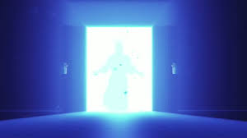
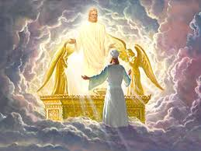
WAY
TRUTH
LIFE
CROSS
THOUGHTS & INTENTIONS
MOTIVES
BONE & MARROW DNA
SOUL/SPIRIT
SKINS
LIVING SACRIFICES
LAVER
LIGHT
ALTAR
Pattern of the true tabernacle
Pathway of Responsibility

Slide 14
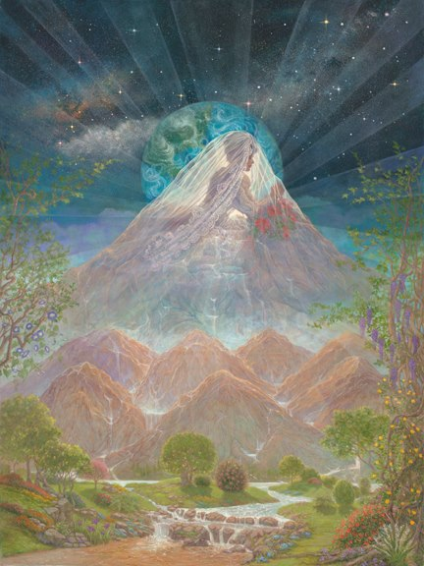
KINGDOM OF GOD
COURT ACCUSATION
COURT OF WAR/STRATEGY
COURT OF ANGELS
RULING LORDSHIP
WAY
TRUTH
CROSS
EVERLASTING DOORS

Slide 15
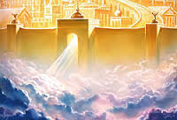
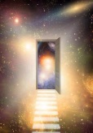
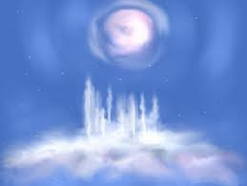
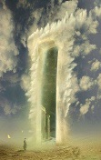
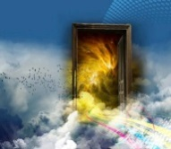
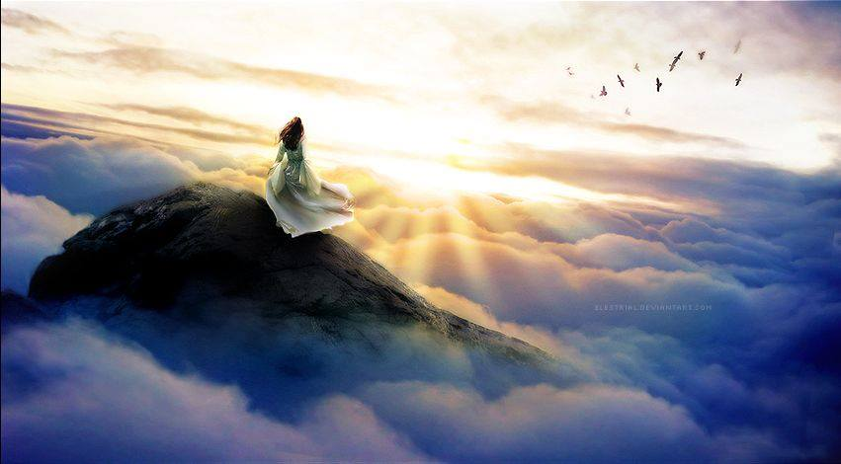
KINGDOM OF HEAVEN
Stars
TRUTH
LIFE
WISDOMS HEIGHTS
Under Earth
Atmosphere
Earth
COURT OF CHANCELLORS
COURT OF SCRIBES
RULING KINGSHIP

Slide 16
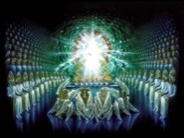
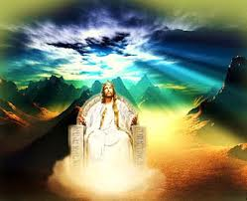
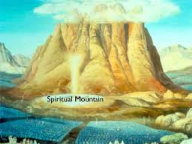
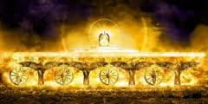
HEAVEN Mountain or House of God
LIFE
COURT OF KINGS
COURT OF COUNCILS
COURT OF THE UPRIGHT
Throne Room
RULING SONS
Temple
Fire Stones
River of Life
River of Fire
Holy of Holies

Slide 17
HEAVEN Mountain or House of God
LIFE
RULING SONS
TRAINING HALL 7 SPIRITS of GOD
Trading Floors
12 Chancellors Houses
Treasury Room - Mantle Room - Scroll Room - Affairs of Nations Room - Weapons Room - Culture Room - Discovery Room - Commissioning Room - Law Room - Precepts Room - Ordinance Room - Statutes Room
Book Room
Wine Room
Oil Room
Dialogue Room
Wardrobe Room
Class Rooms
Quest Room
Body Parts Room
Record Room
Infinite Resources Room

Slide 18
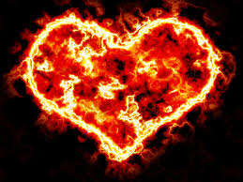
Heaven of Heavens
Perfection
Eternity
Dark Cloud Person of God
COURT OF JUDGES
COURT OF THE LORD
COURT OF 70

Slide 19
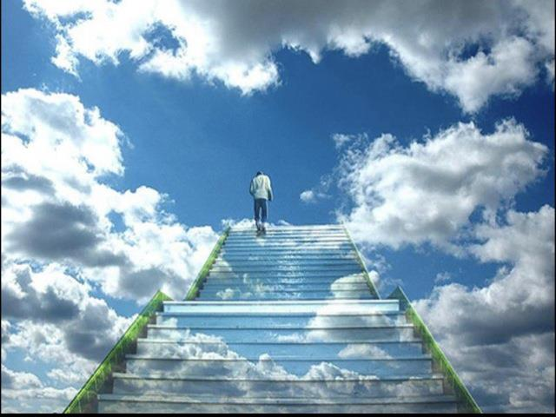
Pathway of Responsibility
Come up here
Rev 4:1

Slide 21
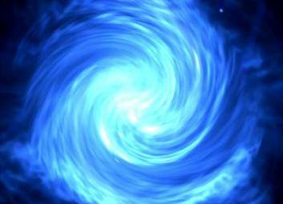

Slide 22
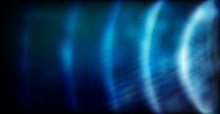

Slide 23
Base Camp 2
Stepping into heavenly realms your spirit is free from earthly constraints physical laws etc. - multiversed
Let your mind and heart go to rise above this earthly realm.
Breathe in the atmosphere of heaven it is not oxygen that sustains you there but love joy peace - glory

Slide 24
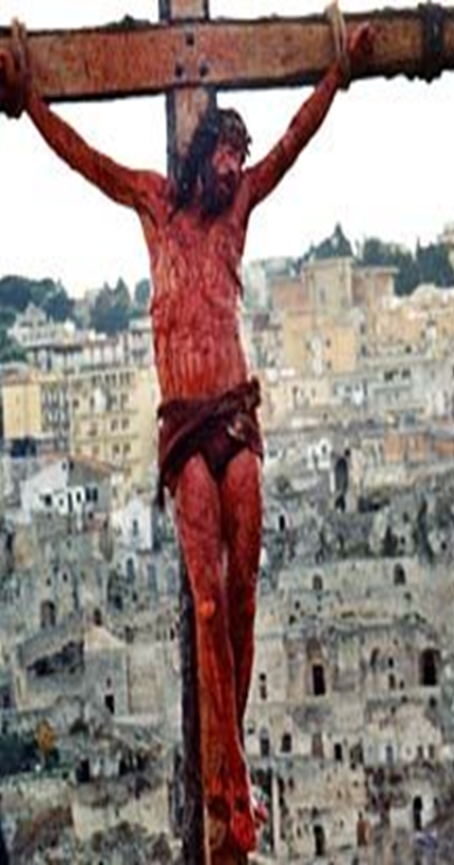
1 Cor 5:21 He made Him who knew no sin to be sin on our behalf, so that we might become the righteousness of God in Him.

Slide 25
Base Camp 2
1 Cor 5:21 He made Him who knew no sin to be sin on our behalf, so that we might become the righteousness of God in Him.
Gal 2:20 I have been crucified with Christ; and it is no longer I who live, but Christ lives in me; and the life which I now live in the flesh I live by faith in the Son of God, who loved me and gave Himself up for me.
Engage the Fathers great love for us

Slide 26
Pathway of Responsibility
Come up here
Rev 4:1

Slide 28
Base Camp 2
Breathe deeply let your capacity increase as Love flows as you enter into a deeper level of peace wholeness and rest.
Let heavens joy fill you and sense your strength and supernatural abilities increase.
Just stepping in and stepping out practice acclimatising. Let the freedom of heavens expansiveness expand the realm of your possibilities.

Slide 29
The Covenant Exchange at the Cross
OLD LIFE
DEATH
SIN & SICKNESS
BONDAGE TO SIN
OLD NATURE
GUILTY
CONDEMNED
SINFUL
JUDGMENT
SLAVES TO SIN
NEW LIFE
LIFE
FORGIVENESS & HEALTH
FREEDOM FROM SIN
NEW NATURE
INNOCENT
AQUITTED
RIGHTEOUS
JUSTIFICATION
SLAVES OF RIGHTEOUSNESS
1 Cor 5:21 He made Him who knew no sin to be sin on our behalf, so that we might become the righteousness of God in Him.

