Slide 1
Base Camp 1
We are going on a journey or an adventure together
Journey of discovering the spiritual realms
Discovering the realms within us, around us and the heavenly realms
There are 2 main pathways that we are going to follow

Slide 2
Base Camp 1
Pathway of relationship that leads to deeper intimacy with God
Flowing from inside out - heaven to our gateways of spirit, soul, body to the world around us
Pathway of responsibility that leads to greater kingdom rulership
Flowing from outside in from earth to heaven as living sacrifices to rule.

Slide 3
Base Camp 1
Basic preparation for the journey.
Faith
Basic truths
The language of the spirit
Base camp – Journey Map

Slide 4
Base Camp
Spirit Building
Tongues Development
Meditation Word Flow God’s thoughts
Spirit Building
Activations
Eyes of Spirit Activation
Eyes of heart Activating Imagination
JOURNEY MAP

Slide 5
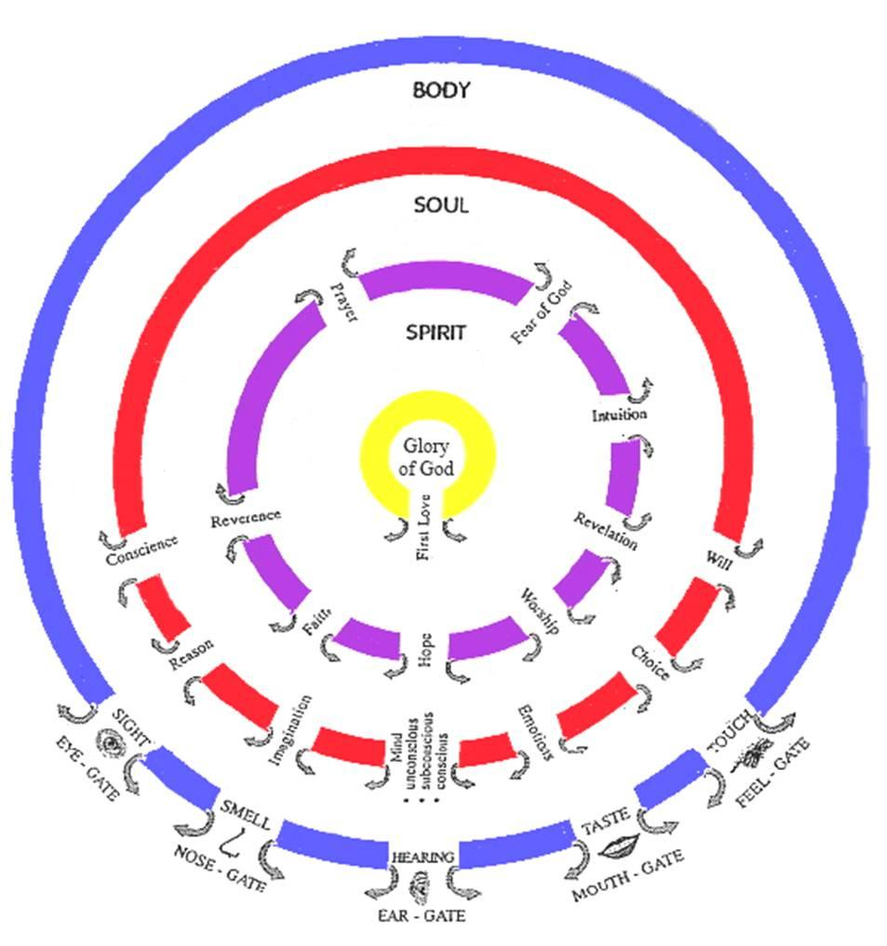

Slide 6
Base Camp
Journey Preparation
Unseen Realms
Heavenly Realms
River of Life
River of Life
Pathway of Relationship

Slide 7
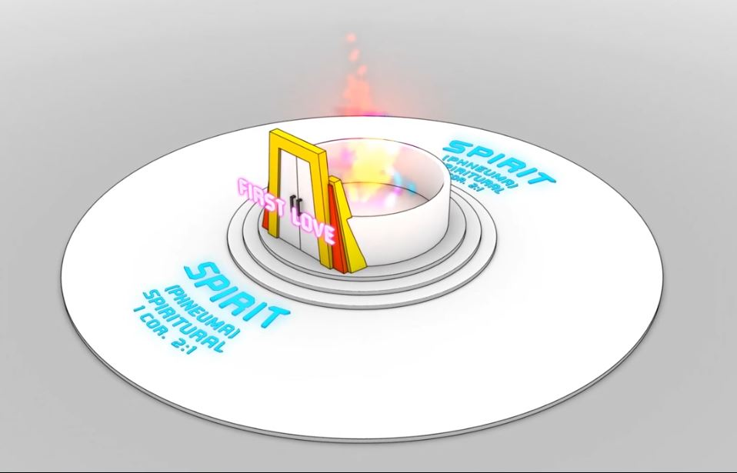
Living Water
John 4 & John 7
Gateway first love
Rev 3:20
Gateway first love
Rev 3:20
River of Life
River of Life

Slide 8
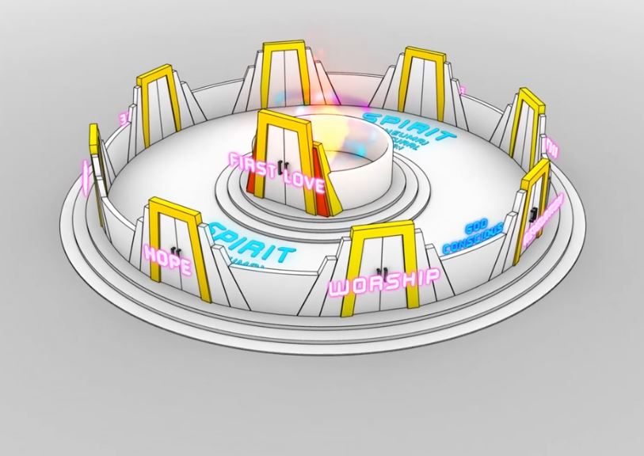
Living Water
John 4 & John 7
Gateway first love
Rev 3:20
River of Life
River of Life
River of Life
River of Life
River of Life

Slide 9
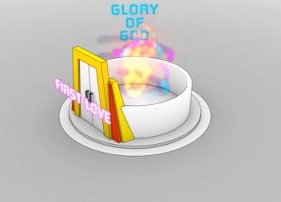
SPIRIT
River of Life
River of Life

Slide 10
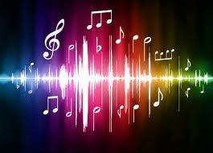
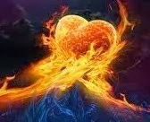
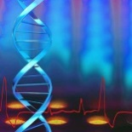
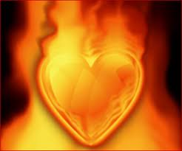
Familiar spirits
Soul
Familiar spirits
Spirit
Guilt Shame
Fear of God
Conscience
Soaking room
Reverence
Memories
Imagination
Bridal Chamber
Dance Floor
Prayer
Mindsets
Reason
Faith
River of Life
Choice
Worship
Lies
Mind
Garden of our Heart
Hope
Hurts
Emotions
Revelation
Will
Doubts Fears
Intuition
Pathway of Relationship

Slide 11
World
Body
Soul
Spiritual Atmosphere
Personal Atmosphere
Realm of Holy spirit
Conscience
Sight
Imagination
Reason
Hearing
River of Life
Smell
Choice
Mind
Taste
Emotions
Touch
Will
Angelic & Demonic
Personal angels
Pathway of Relationship

Slide 12
SPIRIT
Come up here
Rev 4:1
Heaven
River of Life
River of Life
Pathway of Relationship

Slide 13
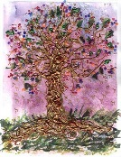
Eden
Tree of Life
Throne of Grace
Judgement Seat
Father’s Garden
Waterfalls
Pools of revelation
River of Life
Bridge
Waterfall
Pathway of Relationship

Slide 14
Living Water
John 4
Gateway first love
Rev 3:20
Gateway first love
Rev 3:20
River of Life
River of Life

