Slide 1
Deep Calls to Deep
Deep Calls to Deep
Freedom Apostolic Resources
www.freedomtrust.org.uk/AR
www.freedomarc.wordpress.com
mike@freedomarc.org

Slide 2
Deep Calls to Deep
God is raising up a new order in the kingdom
Order of Melchizedec – no genealogy
Transition from the Moses generation into the Joshua generation
Joshua generation will be forerunners in possessing their inheritance out of relationship, intimacy, identity

Slide 3
Deep Calls to Deep
The pathway of responsibility is about taking responsibility as LORDS, KINGS, SONS for the spheres of authority (mountains) that are assigned to us in our eternal destiny scroll
Kingdom is about government, rule, dominion justice in righteousness & love
Gen 1:28 fill, subdue, rule mandate

Slide 4
Deep Calls to Deep
Rom 8:19 For the anxious longing of the creation waits eagerly for the revealing of the sons of God. 21 that the creation itself also will be set free from its slavery to corruption into the freedom of the glory of the children of God.

Slide 5
Bench of 3
Father Son Spirit
North Gate Man Priestly
East Gate Lion Kingly
Heavenlies
Earth
West Gate Eagle Apostolic
South Gate Ox Prophetic
Bench of 3
Spirit Soul Body
Church, City, Region, Nation

Slide 6
Deep Calls to Deep
Following the pathway of responsibility begins with presenting ourselves daily as a living sacrifice
Surrender of our agendas
Step in by faith so our spirit’s engage the heavenly realms
To engage His agenda for His purposes for His glory

Slide 7
Deep Calls to Deep
Rom 12:1 Therefore I urge you, brethren, by the mercies of God, to present your bodies a living and holy sacrifice, acceptable to God, which is your spiritual service of worship. ² And do not be conformed to this world, but be transformed by the renewing of your mind, so that you may prove what the will of God is, that which is good and acceptable and perfect.

Slide 8
Deep Calls to Deep
Sacrificial lamb was prepared
Ex 29:16 And you shall kill the ram 17 And you shall cut the ram in pieces and wash its entrails and legs and put them with its pieces and its head,
Slit its throat (dead) drained blood
Chopped off its head
Skinned it
Split it open down to bone
Washed it’s inner organs
Cut off its legs

Slide 9
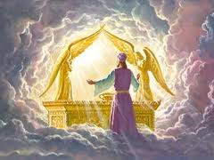

Slide 10
North
Man
Priest
HEI
Tabernacle
Holy of Holies
Arc of God
West
Eagle
Apostle
VAV
East
Lion
King
YOD
South
Ox
Prophet
HEI

Slide 11
Deep Calls to Deep
Zech 3:6 And the angel of the LORD admonished Joshua, saying, 7 “Thus says the LORD of hosts, ‘If you will walk in My ways and if you will perform My laws, then you will also govern My house and also have charge of My courts, and I will grant you free access among these who are standing here.

Slide 12
Deep Calls to Deep
Jesus is Lord
Training
You
Trials Tribulations
Abdicate
Friend
Relationship
Steward
Resources Responsibility
Seat of Rest
Government
Seat of Rest
Government
Servant
Works of God
Ways of God
Jesus is King
God is Father
I am a Son
I am Lord
I am King
Holy Spirit
Jesus
Father
Seat of Rest
Government
Seat of Rest
Government
Seat of Rest
Government
Rule House
Administer Principles of Kingdom
Judge Courts
Access to Stand

Slide 13
Deep Calls to Deep
Eph 1:3 Blessed be the God and Father of our Lord Jesus Christ, who has blessed us with every spiritual blessing in the heavenlies in Christ
Eph 2:6 and raised us up with Him, and seated us with Him in the heavenlies in Christ Jesus,

Slide 14
Deep Calls to Deep
Psa 24:7 Lift up your heads, O you gates! And be lifted up, you everlasting doors! And the King of glory shall come in 8 Who is this King of glory? The LORD strong and mighty,
Heads represents authority
Gates represents access points
Everlasting doors heaven touches earth

Slide 15
Deep Calls to Deep
Psa 89:14 Righteousness and justice are the foundation of Your throne; mercy and loving-kindness and truth go before Your face.
Psa 45:6 Your throne, O God, is forever and ever; the sceptre of righteousness is the sceptre of Your kingdom.

Slide 16
Heavenly Realms
Earth Sphere
Rulers Principalities & powers
Atmosphere Earth
Everlasting Doors

Slide 17
Deep Calls to Deep
Zech 3:1 Then he showed me Joshua the high priest standing before the angel of the LORD, and Satan standing at his right hand to accuse him. 2 The LORD said to Satan, “The LORD rebuke you, Satan!.. 3 Now Joshua was clothed with filthy garments and standing before the angel. 4 He spoke and said to those who were standing before him, saying, “Remove the filthy garments from him.” Again he said to him, “See, I have taken your iniquity away from you and will clothe you with festal robes.”

Slide 18
Deep Calls to Deep
Job 1:6 Now there was a day when the sons (the angels) of God came to present themselves before the Lord, and Satan (the adversary and accuser) also came among them.
Psa 82:1 GOD STANDS in the assembly [of the representatives] of God; in the midst of the magistrates or judges He gives judgment [as] among the gods.

Slide 19
Deep Calls to Deep
Psa 82:1 God takes His place in His divine council, in the midst of the gods he holds judgment
Ps 89:7 A God greatly feared and revered in the council of the holy (angelic) ones, and to be feared and worshipfully revered above all those who are round about Him?
Jer 23:18 “But who has stood in the council of the LORD, That he should see and hear His word?

Slide 20
Deep Calls to Deep
Jesus - Peter – Satan has desired to sift you how did he know?
Luke 22:31 “Simon, Simon, behold, Satan has demanded permission to sift you like wheat; 32 but I have prayed for you, that your faith may not fail
Jesus was living in dual realms
Satan is a legalist

Slide 21
Deep Calls to Deep
Close your eyes relax
Activate our imaginations open the eyes of our spirit
Open your first love gate
Engage the river of life in Eden the garden of God

Slide 22
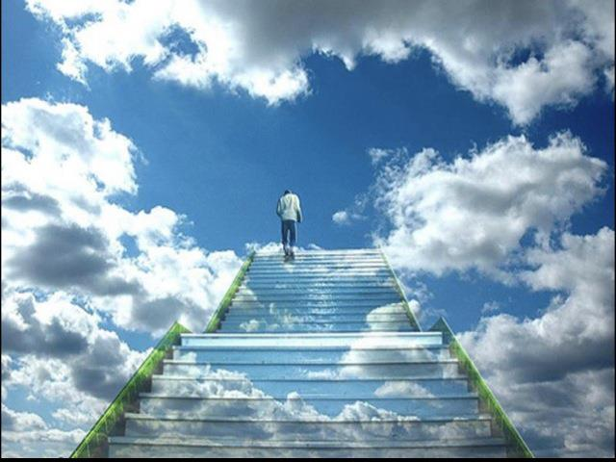

Slide 23
Deep Calls to Deep
Deep Calls to Deep
Freedom Apostolic Resources
www.freedomtrust.org.uk/AR
www.freedomarc.wordpress.com
mike@freedomarc.org

