Slide 1
Deep Calls to Deep
Freedom Apostolic Resources
www.freedomtrust.org.uk/AR
www.freedomarc.wordpress.com
mike@freedomarc.org

Slide 2
Deep Calls to Deep
Zech 3:6 And the angel of the LORD admonished Joshua, saying, 7 “Thus says the LORD of hosts, ‘If you will walk in My ways and if you will perform My laws, then you will also govern My house and also have charge of My courts, and I will grant you free access among these who are standing here.

Slide 3
Deep Calls to Deep
Zech 3:1 Then he showed me Joshua the high priest standing before the angel of the LORD, and Satan standing at his right hand to accuse him. 2 The LORD said to Satan, “The LORD rebuke you, Satan!.. 3 Now Joshua was clothed with filthy garments and standing before the angel. 4 He spoke and said to those who were standing before him, saying, “Remove the filthy garments from him.” Again he said to him, “See, I have taken your iniquity away from you and will clothe you with festal robes.”

Slide 4
Deep Calls to Deep
Job 1:6 Now there was a day when the sons (the angels) of God came to present themselves before the Lord, and Satan (the adversary and accuser) also came among them.
Psa 82:1 GOD STANDS in the assembly [of the representatives] of God; in the midst of the magistrates or judges He gives judgment [as] among the gods.

Slide 5
Deep Calls to Deep
Psa 82:1 God takes His place in His divine council, in the midst of the gods he holds judgment
Ps 89:7 A God greatly feared and revered in the council of the holy (angelic) ones, and to be feared and worshipfully revered above all those who are round about Him?
Jer 23:18 “But who has stood in the council of the LORD, That he should see and hear His word?

Slide 6
Deep Calls to Deep
Luke 22:31 “Simon, Simon, behold, Satan has demanded permission to sift you like wheat; 32 but I have prayed for you, that your faith may not fail
Jesus - Peter – Satan has desired to sift you how did he know?
Jesus was living in dual realms
Satan is a legalist

Slide 7
Deep Calls to Deep
7 levels of courts like family court, magistrates, county, crown, high, appeal, house of lords
Kingdom of God - Accusation courts - deal with Blockages, Restrictions , Accusations etc. Court of angels, court of war
Kingdom of Heaven - Chancellors court and Court of scribes
Heaven – Court of kings, Court of the Upright and the Court of the Councils of Father
Heaven of heavens – Galactic Council etc

Slide 9
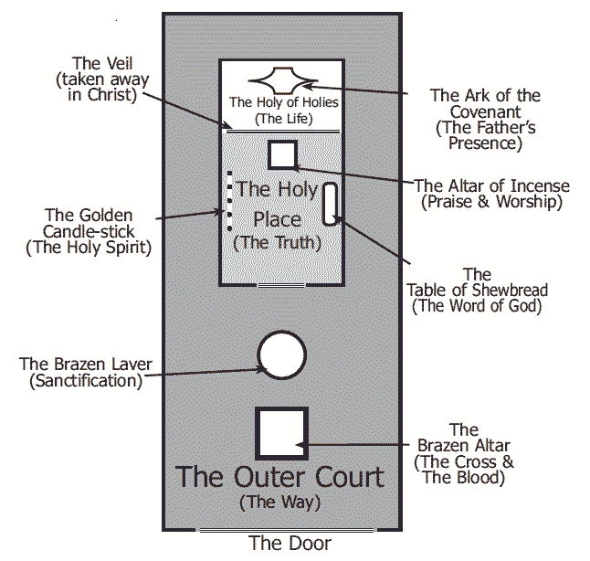
Heaven of Heavens
Free Access to stand in God’s presence
Son
Zechariah 3:7
Heaven
Charge of My Courts
Holy of Holies ---------------------
Veil -Life
King
Kingdom of Heaven
Govern or Rule My House
Inner Court ---------------------
Veil -Truth
Lord/King
Kingdom of God
Perform My service
Keep My laws (charge)
Outer Court ---------------------
Veil -Way- Cross
Lord
Servant – Steward - Friend
Kingdom of Earth
Walk in His ways

Slide 10
Place of His Presence
Eternity
Place of His Government
Perfection
Heaven of Heavens
Place of His Domain
2 Cherubim
Fiery Sword
Realm of His Abode
Heaven
Holy Holies
Holy Place
Inner Court
Outer Court
Kingdom of Heaven
Realm of His Domain
Walk in the light
LIGHT
Kingdom of God
Realm of His Government
See the light
LIGHT & DARK
Kingdom of Earth
Realm of His Presence
Time & Space
Born in darkness

Slide 11
Created Light Light/Darkness
Kingdom of God
Perform My service - Keep My laws (charge)
Court of War
(Strategy/Council For War)
Mobile Court Accusations & papers
Court of Angels
Authorizations/Mandates Actioned
Lord
Locality
Prophetic
Business
Healing
Leadership
Invention
?
Spiritual opposition, block, hinder & usurp authority - Battleground
Family
Workplace
Area
Church
Gifting
Ministry
?
Outer Court
Laver
Altar - Cross
Everlasting Door
Everlasting Door
Everlasting Door
Everlasting Door
Everlasting Door
Everlasting Door
Everlasting Door
Veil - Way

Slide 12
Bench of 7
7 Spirits of God
Kingdom of Heaven
Creative Light
Judge or Rule My House
Spirit of Might
Court of Chancellors
Administration of Protocols
From all Judicial Systems
Court of the Scribes
(Records of You and Your Maturity)
Spirit of Understanding
Spirit of Wisdom
Spirit of Knowledge
Altar of Incense
Spirit of Council
Menorah
Table - Bread
Spirit of the fear of the Lord
Inner Court
Holy of Place
Spirit of Lord
Veil - Truth

Slide 13
Heaven
Creative Light Light
Bench of 3
Throne of God
Judge My Courts
CHAYOTH
OFANIM
ER’ELIM
METATRON
CHASHMALIM
Creatures
RAZIEL
SERAPHIM
Spheres
TZAPHKIEL
MALACHIM
Mighty ones
TZADKIEL
ELOHIM
Shining ones
GABRIEL
B’NAI-ELOHIM
Burning ones
URIEL
CHERUBIM
Messengers
Judges
HANIEL
ISHIM
Sons of God
MICHAEL
RAPHAEL
Covering ones
SANDELPHON
Warring ones
Holy of Holies Mercy Seat
Zion
Judgment Seat of Christ
River of Life
Garden of God
Rooms
Tree of Life
Court of Kings (Sons who have their Mountain)
(Legislative Decrees)
Court Councils of the Fathers (Mature sons)
Court of the Upright
(Men in White Linen)
Veil -Life

Slide 14
Heaven of Heavens
Access to stand
Court of the Lord
Ya Sod 1
Council of God
Court of Judges
Kingdom Government 3 Judicial Decrees
Court of 70 Galactic Council 2 Legislative for First nations

Slide 15
Deep Calls to Deep
Responsibility – Government
1 Peter 2:9 But you are A CHOSEN RACE, A royal PRIESTHOOD
Priestly function intimacy – engaging the deep things of God
Responsibility as Lords, Kings, Sons

Slide 16
Deep Calls to Deep
Identification – authority spheres
Family, Workplace, Destiny, Calling
Church, Locality, Region, Nation
Authority to manifest the kingdom on earth
Authority to change the atmosphere and environment in your sphere
Authority to destroy the works of the devil
Authority to subdue and exercise dominion
Training process in humility

Slide 17
Deep Calls to Deep
Prov 8:1 Does not wisdom call, And understanding lift up her voice? 2 On top of the heights beside the way, Where the paths meet, she takes her stand; 3 Beside the gates, at the opening to the city, At the entrance of the doors, she cries out:

Slide 18
Deep Calls to Deep
Prov 8:15 “By me kings reign, And rulers decree justice. 16 “By me princes rule, and nobles, All who judge rightly. 17 “I love those who love me; And those who diligently seek me will find me.

Slide 19
Wisdom’s Heights
City Zion Heaven
Door
Stars
Training Hall
Heights
Door
Atmosphere
Engage Wisdom Prov 8
Door Under the Earth
Prov 8:15“By me kings reign, And rulers decree justice. 16 “By me princes rule, and nobles,
All who judge rightly.
Court of Kings
Door
Earth
WAY

Slide 20
Pathway of Responsibility
Decree New laws
Authorize New laws
New laws Entered into Statutes
Make Laws Mountain KOH
Court of Kings
Court of Chancellors
Court of Scribes
Court of War
Court of Angels
Court of Upright
Administer Laws Mountain KOG
Strategies
Angelic Assignments
Council of Reference

Slide 21
Deep Calls to Deep
What do you do from your mountain?
How do you rule?
What is it to administer the kingdom?
Release from your spirit that which you receive around the arc of His presence from desire and mandate

Slide 22
Deep Calls to Deep
Keys of kingdom – lock & unlock
Declarations from a place of authority
Bind to God’s will (kingdom)
Loose from restrictions hindering God’s will (kingdom)
Call things that be not from the realm in heavenlies that they are
Release forgiveness

Slide 23
Deep Calls to Deep
Mandates, court orders authorisation
Prophetic declarations
Rom 4:17 .. calls into being that which does not exist.
Rom 4:17 .. speaks of the non-existent things that [He has foretold and promised] as if they [already] existed.

Slide 24
Deep Calls to Deep
Remove stumbling blocks & obstacles
Prepare the way for heaven to invade earth
Declarations or proclamations
Faith statements of God’s will
Assign angels – clear atmosphere earth, prepare the way

Slide 25
Deep Calls to Deep
Keys of Kingdom
Forgiveness
John 20:23 If you forgive the sins of any, their sins have been forgiven them; if you retain the sins of any, they have been retained.”

Slide 26
Deep Calls to Deep
Sin gives power to the enemy to cause a veil of darkness - blindness
2 Cor 4:4 in whose case the god of this world has blinded the minds of the unbelieving so that they might not see the light of the gospel of the glory of Christ, who is the image of God.

Slide 27
Deep Calls to Deep
John 12:40 He has blinded their eyes and he hardened their heart, so that they would not see with their eyes and perceive with their heart, and be converted and I heal them.”
Our declarations of forgiveness temporarily removes blindness caused by sin

Slide 28
Deep Calls to Deep
Can I bind someone against their will?
Isn’t it manipulation & control?
You can only bind someone to the will of God for theirs lives e.g. salvation, destiny not our will e.g. they will give us money or marry us etc.

Slide 29
Deep Calls to Deep
Understand biblical authority symbolism – Mountains, Thrones
Crowns, Mantles or cloaks, Sceptres
Swords, spears, arrows, Orbs, Keys, Seals, staffs
Use these symbols to rule effectively
Remember you level of rule will be determined by your level of transformation

Slide 30
Deep Calls to Deep
I sit on the throne of my authority on the mountain of … e.g. family
By faith or in the spirit
I put on my mantle and crown
I take my sceptre as a lord and I declare, I call forth, I bind, I loose, I forgive etc.
Expect a flow of revelation

Slide 31
Deep Calls to Deep
Go to the court of accusation in heavens
By faith or in the spirit
God is on His throne
Jesus is our advocate
Satan or fallen angels are our accusers
Receive robes of righteousness automatically Zech 3:1-5

Slide 32
Deep Calls to Deep
Demand to hear the accusation
The devil or sometimes other fallen creature can be summoned they can’t lie
This may come as thoughts in your mind
As a vision on the screen of your imagination
As a clear impression
Don’t argue

Slide 33
Deep Calls to Deep
Agree with the judgment against you
Receive God’s judgment – righteous
Releases that judgment upon all your accusers present and absent
Be open to receive directions, judicial mandates, declarations
Be motivated at all times by love
You may need to go the throne
You may need to do something practical

Slide 34
Deep Calls to Deep
False accusations made by people
No smoke without fire be prepared to humble ourselves
No truth in accusation – forgive and release the person and bless them
Testimonies
School, Jobs, Finances, Business, Church, Projects

Slide 35
Deep Calls to Deep
Familiar spirits – whisperers
Go to mobile court
Demand your accuser
Accept weakness and be judged
Release God’s judgment
Get mandated to be separated
Repeat process

Slide 36
Deep Calls to Deep
False accusations from people
Forgive and release them
Bless them
If you can’t honestly bless them you can’t truly have forgiven them!

Slide 37
Deep Calls to Deep
Personal example
Father I step into the place of responsibility in the governmental courts of heaven
I accept responsibility firstly as a priest of my own life. I take the covering of the word of God and I place it over my head as a covering of your love.
Father I have sinned (confess - secret hidden struggles) I accept responsibility for this area for giving access and expressing sin

Slide 38
Deep Calls to Deep
Today I stand and take responsibility, I have sinned
Every demonic spirit associated with this area of my life who accuses me I agree with quickly
I agree with my adversary and say I have sinned
I ask you to judge me according to the covering of your love for my life

Slide 39
Deep Calls to Deep
Judge this in me to destroy the yoke and power of this sin
I ask for divorce papers from its influence
I confess that I am divorced from this influence in my life
I ask you to judge it in me according to the papers

Slide 40
Deep Calls to Deep
Separate it from me and judge it so I do not operate by default in my brain and thought patterns or in my desires birthed out of brokenness
I judge my life according to the testimony of your covering.
I release this covering over all who stand here and release judgment over everything that is associated with that area of my life

Slide 41
Deep Calls to Deep
Release judgment according to the testimony in my life because I am now free from its power.
I take the papers in my heart and mountain and step back into the earthly realm.
I administer justice into the world around me and into every circumstance of my life & arena of influence affected by this issue of enslavement body, soul & spirit
I am judged divorced from heaven in Jesus name

Slide 42
Deep Calls to Deep
Know our identity as kings and priests
Know our authority as sons
Know our calling our sphere of influence
Activate our imaginations open the eyes of our spirit
Practice stepping in & out
Access our thrones & courts by faith

Slide 43
Deep Calls to Deep
Close your eyes relax
Activate our imaginations open the eyes of our spirit
Engage the arc to get a mandate to engage wisdom

Slide 44
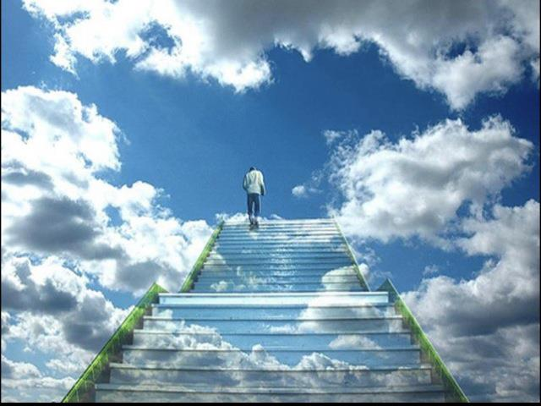

Slide 45
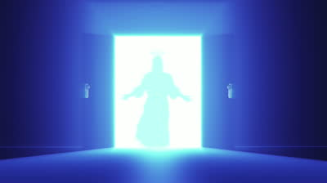

Slide 46
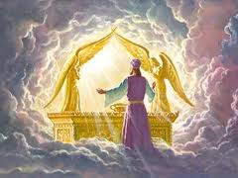

Slide 47
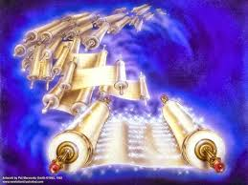

Slide 48
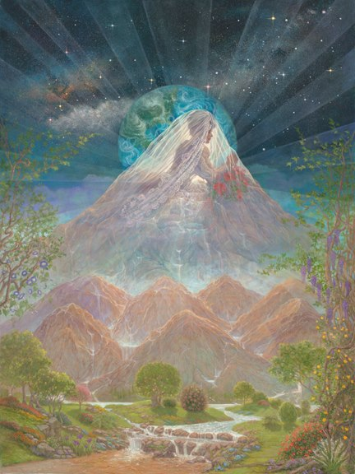

Slide 49
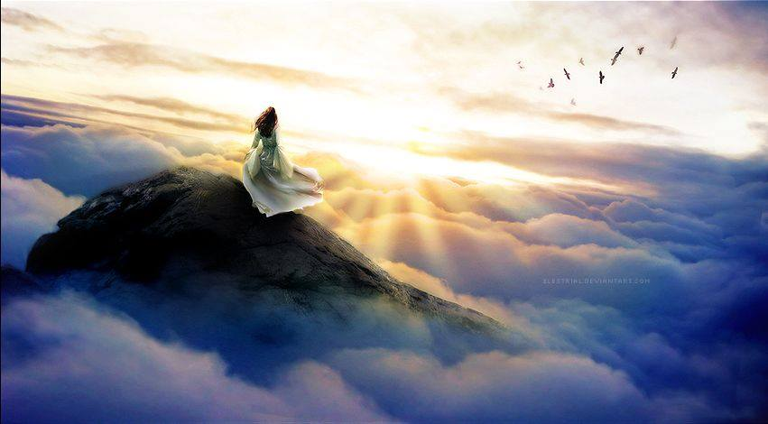
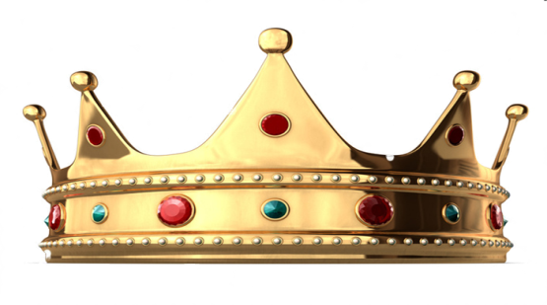

Slide 50
Deep Calls to Deep
Deep Calls to Deep
Freedom Apostolic Resources
www.freedomtrust.org.uk/AR
www.freedomarc.wordpress.com
mike@freedomarc.org

