Slide 1
Deep Calls to Deep
Freedom Apostolic Resources
www.freedomtrust.org.uk/AR
www.freedomarc.wordpress.com
mike@freedomarc.org

Slide 2
Bench of 3
Father Son Spirit
Heavenlies
Earth
Bench of 3
Spirit Soul Body

Slide 3
Deep Calls to Deep
Rom 8:19 For the anxious longing of the creation waits eagerly for the revealing of the sons of God. 21 that the creation itself also will be set free from its slavery to corruption into the freedom of the glory of the children of God.

Slide 4
Deep Calls to Deep
God is raising up a new order in the kingdom
Order of Melchizedec – no genealogy
Transition from the Moses generation into the Joshua generation
Joshua generation were forerunners who mentored the next generation into their inheritance

Slide 5
Deep Calls to Deep
Following the pathway of responsibility begins with presenting ourselves daily as a living sacrifice
Step in by faith for your spirit to engage the heavenly realms
Surrender to transformation by denying self to transform the soul
Transfiguration of the flesh into the image of God

Slide 6
Deep Calls to Deep
Romans 12:1-2 Therefore I urge you, brethren, by the mercies of God, to present your bodies a living and holy sacrifice, acceptable to God, which is your spiritual service of worship. 2 And do not be conformed to this world, but be transformed by the renewing of your mind, so that you may prove what the will of God is, that which is good and acceptable and perfect.

Slide 7
Deep Calls to Deep
Sacrificial lamb was prepared
Ex 29:16 And you shall kill the ram 17 And you shall cut the ram in pieces and wash its entrails and legs and put them with its pieces and its head,
Slit its throat (dead) drained blood
Skinned it
Split it open down to bone
Washed it’s inner organs
Chopped off its head
Cut off its legs

Slide 8
Deep Calls to Deep
By faith enter into the Holy Place in the heavenly tabernacle in surrender to our High Priest Jesus who prepares sacrifice
Throat cut & drained the blood
Deny yourself take up cross and follow
Luke 9:23 And He was saying to them all, “If anyone wishes to come after Me, he must deny himself, and take up his cross daily and follow Me. 24 For whoever wishes to save his life will lose it, but whoever loses his life for My sake, he is the one who will save it.

Slide 9
Deep Calls to Deep
Heb 4:12 For the Word that God speaks is alive and full of power [making it active, operative, energizing, and effective]; it is sharper than any two-edged sword, penetrating to the dividing line of the breath of life (soul) and [the immortal] spirit, and of joints and marrow [of the deepest parts of our nature], exposing and sifting and analysing and judging the very thoughts and purposes of the heart.

Slide 10
Deep Calls to Deep
Nature - DNA programming
Nurture - environmental programming
Trauma - experiential programming
Soul tries to draw from the outside in
Soul in control blocks the flow of the spirit
Dethronement of soul, self, the old life is a key to encountering heaven

Slide 11
Deep Calls to Deep
Stripped off your skin totally naked and transparent your flesh exposed before Him.
No self-righteousness
No defence or coping mechanism
Matt 6:33 But seek first His kingdom and His righteousness, and all these things will be added to you.

Slide 12
Deep Calls to Deep
Your body is split open down to your back bone revealing the marrow
Open for God to reveal your inward parts, emotions, heart (subconscious),
Your spirit needs to be separated from your soul ties
The thoughts and motives are revealed

Slide 13
Deep Calls to Deep
Psa 139:23 Search me thoroughly , O God, and know my heart; Try me and know my anxious thoughts; 24 And see if there be any hurtful way in me, And lead me in the everlasting way.

Slide 14
Deep Calls to Deep
Head chopped off - our choices & decision making surrendered.
You become connected to the Head and He can place His government on your shoulders Isa 9:6 the yoke of Jesus Matt 11:29
Luke 22:42 yet not My will, but Yours be done.”
John 4:34 “My food is to do the will of Him who sent Me and to accomplish His work.

Slide 15
Deep Calls to Deep
Your legs chopped off symbolic of a surrendered walk - obedient walk
You now walk by faith not sight – Gal 2:20
Not my will but yours be done
Only do what you see the Father doing
Father abiding in you does His works

Slide 16
Deep Calls to Deep
Blood of Jesus is always on the mercy seat covering the ark
You come to make intercessory connection at the mercy seat - cherubim
Your spirit must resonate and harmonise with the contents of the ark
Expect God to reveal His will, word, heart and release His authority
The level of authority is proportional to level of holiness

Slide 17
Deep Calls to Deep

Slide 18
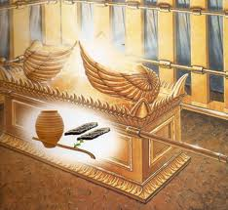
Deep Calls to Deep
Manna
Aaron’s Rod
Tablets

Slide 19
Deep Calls to Deep
Manna Bread of life is the will of God
John 4:32 But He said to them, “I have food to eat that you do not know about.”
John 4:34 Jesus said to them, “My food is to do the will of Him who sent Me and to accomplish His work.
John 6:27 Do not work for the food which perishes, but for the food which endures to eternal life,

Slide 20
Deep Calls to Deep
Tablets - Word of God His heart is written on our hearts/spirits.
Jer 31:33 I will put My law within them and on their heart I will write it; and I will be their God, and they shall be My people.
John 5:19 See what the Father is doing
Jod Hei Vav Hei

Slide 21
Deep Calls to Deep
Aaron’s rod God’s authority, anointing and power
Matt 6:10 Your kingdom come. Your will be done, On earth as it is in heaven.
Administer kingdom government
Mountain thrones

Slide 22
North
Man
Priest
HEI
Tabernacle
Holy of Holies
Arc of God
West
Eagle
Apostle
VAV
East
Lion
King
YOD
South
Ox
Prophet
HEI

Slide 23
Deep Calls to Deep
When we engage the ark/arc
Focus fix our eyes on and begin to meditate
Yod Hei Vav Hei think, speak, sing the names of God Lion Ox Eagle Man.
Take your place to look into the manifest presence of God as the arc forms between wings of the cherubim.

Slide 24
Deep Calls to Deep
Focus on the - will of God for today
Father reveal your will for me today
Father my desire is to come into agreement, resonate and be in harmony with your will today.
My food is to do your will Father. I choose to take that manna into my heart as my source of supply for this day.
Father l open my heart to you. Please write your desires on my heart

Slide 25
Deep Calls to Deep
Father unveil the revelation of my destiny that the desires of my heart will draw me towards, so l will see your purposes around me
Father I Surrender my day to align my will Your will.
I bring this ..... to You now give me specific revelation of anything I need to know.

Slide 26
Deep Calls to Deep
Focus on being in Him, in His name in His authority, seeing from His perspective
Yod Hei Shin Vav Hei see yourself in Him.
Father I choose to step into You, to look out at my day and my circumstances from Your heavenly perspective.
I look out through the Lions' eyes (ox, eagle man) to see things and administer things from the kingly, prophetic, apostolic and priestly function.

Slide 27
Deep Calls to Deep
Cultivating desire in my heart
Brood, incubate it
Father I bring my mountain (personal, church, a person, etc) that which l carry within my heart to You. Show me Your perspective.
Carry in our to have authority

Slide 28
Deep Calls to Deep
l look back into what was Your desire in eternity.
l look back to where there was no sin, show me what l look like and feel like?
Let me see, hear, feel and perceive the vast some of Your thoughts about me.
Do this for each thing you carry in your heart

Slide 29
Deep Calls to Deep
Reveal Your desires for me. Reveal what is written on my scroll for today.
Father I look at what was to manifest that into what it is today to transform what will be
What does my life .... my mountain ..... my 7 mountains. ... church .... group …? look like before in the beginning.

Slide 30
Deep Calls to Deep
Father I choose to receive the revelation of Your heart, Your thoughts into my spirit. As deep calls to deep.
I choose to brood over my life .... my mountain ..... freedom mountain. ... Freedom church .... ? to incubate it in my heart. That my desires will become fulfilled as a tree of life to me.
Show me what does it looks like, feels like to manifest this today?

Slide 31
Deep Calls to Deep
I look into the end from the beginning what does the journey look like? Reveal it so I can declare and call it forth.
What does the next year etc. look like from seeing your eternal purpose
My desire is to manifest Your desires in, through and around my life today.

Slide 32
Deep Calls to Deep
Receiving a daily mandate
I open my heart to receive Your mandate for today
Show me what You are doing today.
Show me what I am authorised to do today.
I receive that mandate and take it into my heart I value it cherish it and surrender to it.

Slide 33
Deep Calls to Deep
Administrating your mandate
I take Aarons rod the sceptre of my authority and l step onto my mountain throne, my position of authority and kingdom government to administrate my mandate today.
l choose to frame my day in accordance with Your will and purpose.
I declare blessing and favour around me today. I send out my angels to go before me to prepare and align kingdom connections in accordance with my mandate. Etc. Etc.

Slide 34
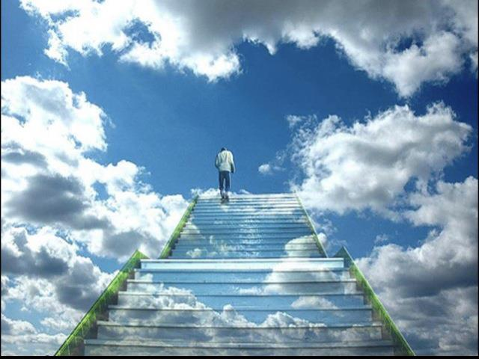

Slide 35
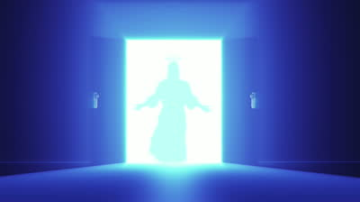

Slide 36
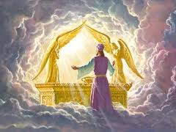

Slide 37
Deep Calls to Deep
Freedom Apostolic Resources
www.freedomtrust.org.uk/AR
www.freedomarc.wordpress.com
mike@freedomarc.org

