Slide 1
Deep Calls to Deep
Freedom Apostolic Resources
www.freedomtrust.org.uk/AR
www.freedomarc.wordpress.com
mike@freedomarc.org

Slide 2
Deep Calls to Deep
What are the new things?
New governmental structure patterned after heaven
Both for the corporate and the individual
Body, Soul and Spirit in wholeness connected to heaven flowing from inside out
New revelations and understanding of how to expand kingdom, subdue and rule

Slide 3
Deep Calls to Deep
New ways of ministry - experiential
New ways of teaching - experiential
New ways of prayer - experiential
New ways of interceding - experiential
New more effective ways of kingdom administration
New ways of partnering with the angelic realm – ministering servants

Slide 4
Deep Calls to Deep
New ways are about maturity
Moses did miracles, parted red sea, food just appeared, clothes never wore out, pillar cloud & fire - children
Joshua - people miracles, parted Jordan, Jericho fall, sow & reap
Jesus disciples – multiply food, do miracles, produce provision etc.

Slide 5
Deep Calls to Deep
New ways of being salt and light
New ways of being agents of change in history, society and culture
Are we influenced or influencers?
New ways to bring transformation to our communities
Establishing all things in heaven first so they can be manifested on earth

Slide 6
Deep Calls to Deep
Compare the old and new
Prayer from earth asking for God's help from heaven - God hears us from a distance.
Isaiah 64:1 Oh, that You would rend the heavens and come down,
Isaiah 64:4 For from days of old they have not heard or perceived by ear, Nor has the eye seen a God besides You, Who acts in behalf of the one who waits for Him.

Slide 7
Deep Calls to Deep
God has come down and He has rent the heavens
He has gone back up into heavens and opened up the veil for us to come.
Rev 4:1 After these things I looked, and behold, a door standing open in heaven, and the first voice which I had heard, like the sound of a trumpet speaking with me, said, “Come up here, and I will show you what must take place after these things.”

Slide 8
Deep Calls to Deep
Old - access to holy places and holy things of God is limited to only some special people – mediator priest
New access open to all of us
Old way of seeking God’s help pray from earth and hope He hears you
New way come to meet Him face to face

Slide 9
Deep Calls to Deep
Heb 4:14 Therefore, since we have a great high priest who has passed through the heavens, Jesus the Son of God..16 Therefore let us draw near with confidence to the throne of grace, so that we may receive mercy and find grace to help in time of need.

Slide 10
Deep Calls to Deep
Old ways like the wilderness expecting God to do it for us from heaven
New ways God has given us responsibility to be coheirs, partners in heaven operating as lords, kings and sons.
Your Kingdom come on earth as it is in heaven old way thinking God administers from His throne we just obey here
New way thinking we are given thrones to administer from in heaven.

Slide 11
Deep Calls to Deep
Old ways like being children where the parent does many things for and on behalf of the child
But there comes a time when children become responsible adults
God is withdrawing His support for old
As this happens if we don't embrace the new the old will slowly stop being effective.

Slide 12
Deep Calls to Deep
God wants us to grow up to become mature
He is starting to withdraw from doing everything for us to enable us to become adults
He wants to manifest His mature sons on the earth
To fulfil their destinies

Slide 13
Deep Calls to Deep
Why can’t I keep the old ways?
2.5 tribes did but there is no record of them and no evidence that the old ways continued to work for them
We can all desire the simplicity of childhood with few responsibilities
We are called to grow up we can’t just keep drinking milk if we want to be true sons

Slide 14
Deep Calls to Deep
There is coming another sound of a mighty rushing wind that will be a sound that is on a higher frequency.
This sound will be like when I hovered and vibrated over the matter and space and caused cohesion to take place.

Slide 15
Deep Calls to Deep
This sound will be vibrating at a frequency that will shake the very particles of your beings.
You will be shaken from the central core of your physical and spiritual structure and you will be transformed by this new and infinitely more powerful Pentecost.

Slide 16
Deep Calls to Deep
There will be a new order of being established restored to My original specification. Living beings containing the very essence of I am will take transformational order.
Creation itself will be shaken violently as I come closer and the spiritual and the natural orders once again overlap.

Slide 17
Deep Calls to Deep
I am releasing the sound frequency that is calling deep to deep and many are being drawn into position being made ready for the great vibrational wind that is coming.
For the new order to be established the old order must fall away and die. Those who cling to the old will die along with it just as Moses and his disobedient faithless generation died in the wilderness.

Slide 18
Deep Calls to Deep
Son I am giving this warning again because many are not heeding My wooing.
I am releasing the harbingers I will remove the stumbling blocks and obstacles.
Lawlessness will be removed from My kingdom there is no room for discord.

Slide 19
Deep Calls to Deep
You must prepare and be ready as the sound of the mighty rushing wind that will shake the created order will destroy as well as transform. The frequency of the created order itself will be changed by the power of My voice.
Use this warning to shake people out of their complacency and call for a heavenly and earthy alignment.

Slide 20
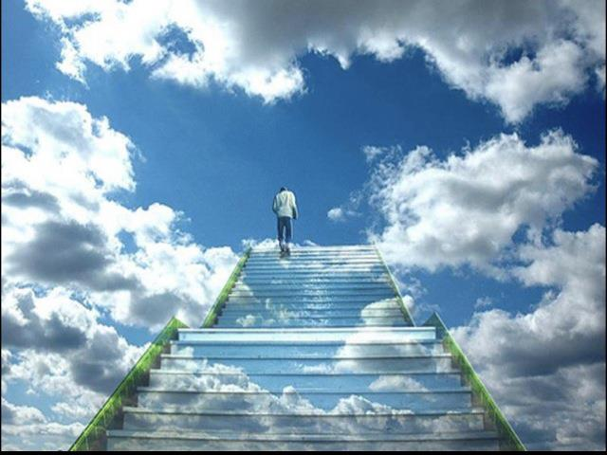

Slide 21
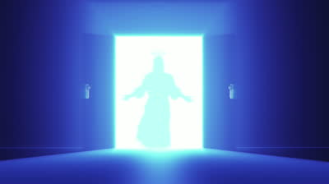

Slide 22
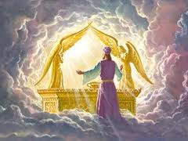

Slide 23
Deep Calls to Deep
Freedom Apostolic Resources
www.freedomtrust.org.uk/AR
www.freedomarc.wordpress.com
mike@freedomarc.org

