Slide 1
Base Camp Introduction
Welcome to Base Camp
Now we begin the spirit building exercises that will activate our senses to engage the God and the realms of the spirit
Remember it is a journey not a race so rushing through the material will not be beneficial

Slide 2
Base Camp Introduction
Remember that these training our spirit exercises are like the scaffolding used to erect a house. It is only needed during the building process
Once you have built the house then you have to live in it.
Practicing these basic exercises should continue until they are part of your lifestyle

Slide 3
Base Camp Introduction
Work through the 7 spirit sessions in order
Don’t progress to the next session until the last is functioning in your life
Each session builds on the last and uses progressive revelation to activated the different senses
Tongues to build your spiritual muscles in the mediation process

Slide 4
Base Camp Introduction
Tuning your thoughts to hear the voice of God in intimacy by meditating
Using the word of God as a doorway through meditation
Opening the eyes of our hearts to engaging the word of God and the realms of heaven
Opening the eyes of our spirit to see into the realms of the spirit

Slide 5
Base Camp Introduction
Remember the key to engagement and activation is practice, practice, practice
Heb 5:14 But solid food is for the mature, who because of practice have their senses trained to discern good and evil.
Don’t give up and don’t get discouraged
If I can take the journey from the left side to the right side of the brain then anyone can

Slide 6
Base Camp Introduction
This is now about seeking after spiritual experiences but after intimate relationship with Father Son and Holy Spirit
Keep Knocking and the door will be opened to you
Keep asking and you be given the answers
Keep seeking and you will find the desires of your heart

Slide 7
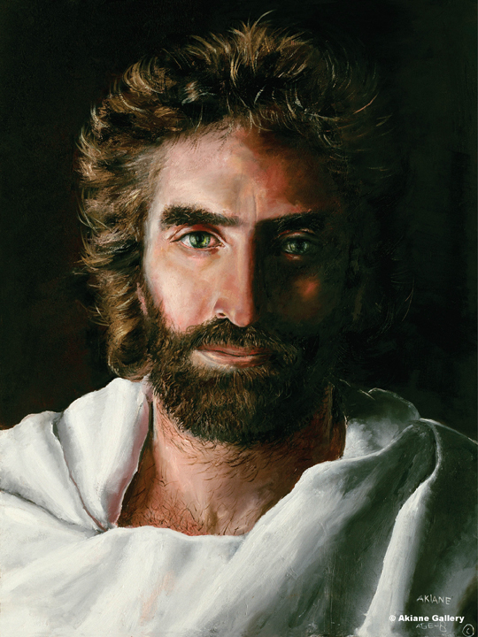
Heb 12:1 Keep your fixed on Jesus who is the author and completer of our faith

